Slide 1
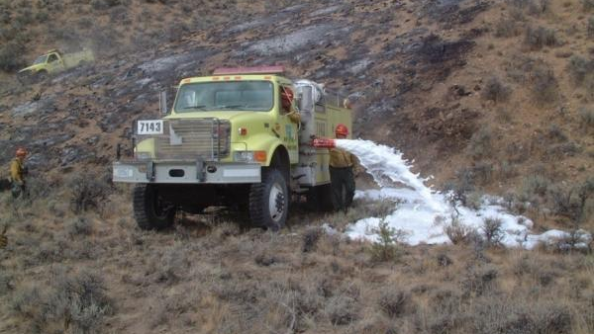
Water Handling Operations
Unit 4C - Foam and Foam Proportioning Equipment
1

Slide 2
Objectives
Discuss why foam is more effective than plain water when performing wildland fire suppression operations.
Discuss foam safety, including guidelines for handling foam products.
Identify and discuss the advantages and disadvantages of manual foam proportioning methods used when performing wildland fire suppression operations.
2

Slide 3
Objectives
Identify various operational components of the FoamPro® 1600/1601 and Waterous Aquis 1.5.
Demonstrate the ability to set up, run, have foam solution pumped to a nozzle person, and shut down a foam proportioner.
Discuss basic maintenance, winterization, and troubleshooting methods for foam systems.
3

Slide 4
Foam Types
Class A – used on ordinary combustibles such as wood, vegetation, paper, cloth, etc. Concentrate ratio to water is typically 0.1-1 percent
Class B – used exclusively on burning liquids such as gas, oil, acetone, and propane
Notes:
The water in the foam is doing the work. Foam layer insulates the fuel from heat and water can be absorbed reducing chance of reignition

Slide 5
Reasons to use foam
Makes water “wetter” (more effective)
Reduces evaporation/improves absorption
Adheres to surfaces for pre-treating fuels and structures
Improves water conservation and usage, especially during mop-up.
Use as holding feature during ignition operations
Restricts oxygen. Reduces fuel temperature to below ignition point.
5

Slide 6
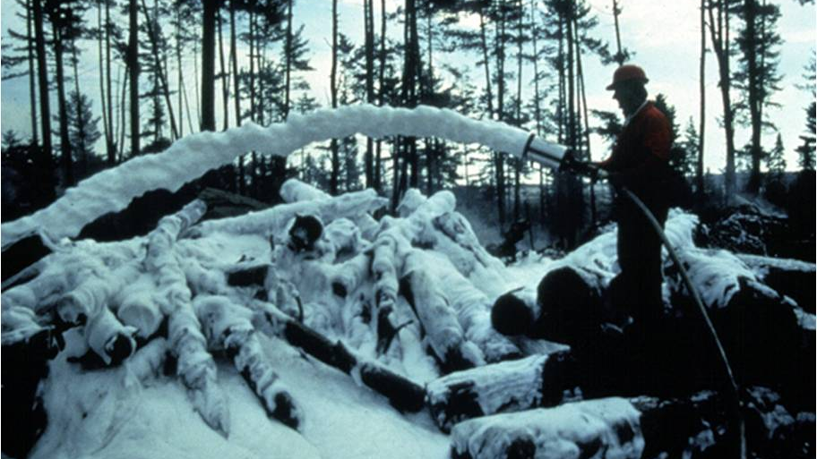
Example of foam use
Notes:
Choose the appropriate application ratio of concentrate:water based on the fire conditions/fuel type.

Slide 7
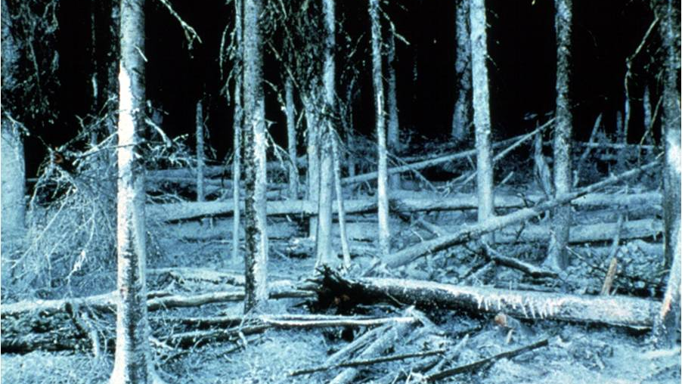
Example of foam use

Slide 8
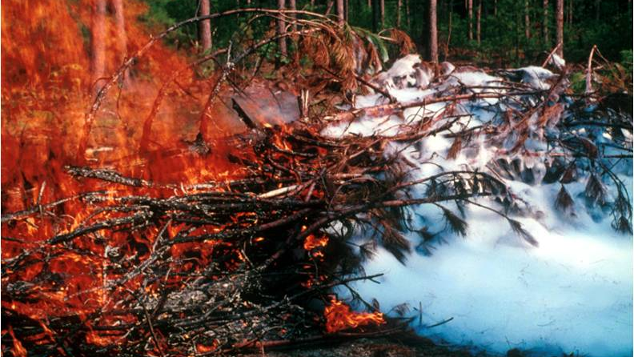
Example of foam use

Slide 9
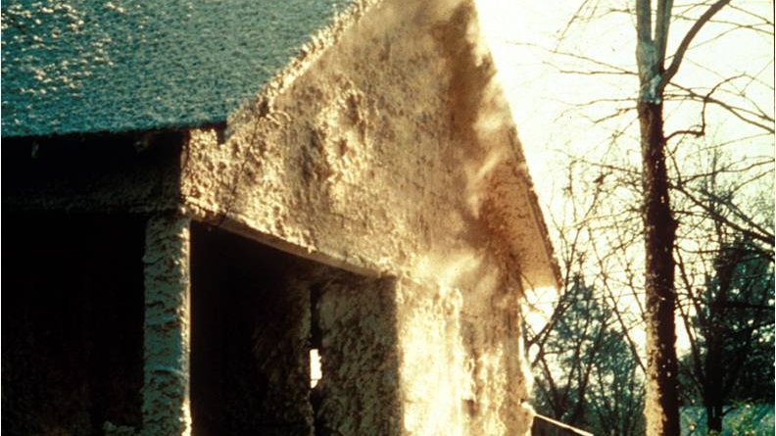
Example of foam use

Slide 10
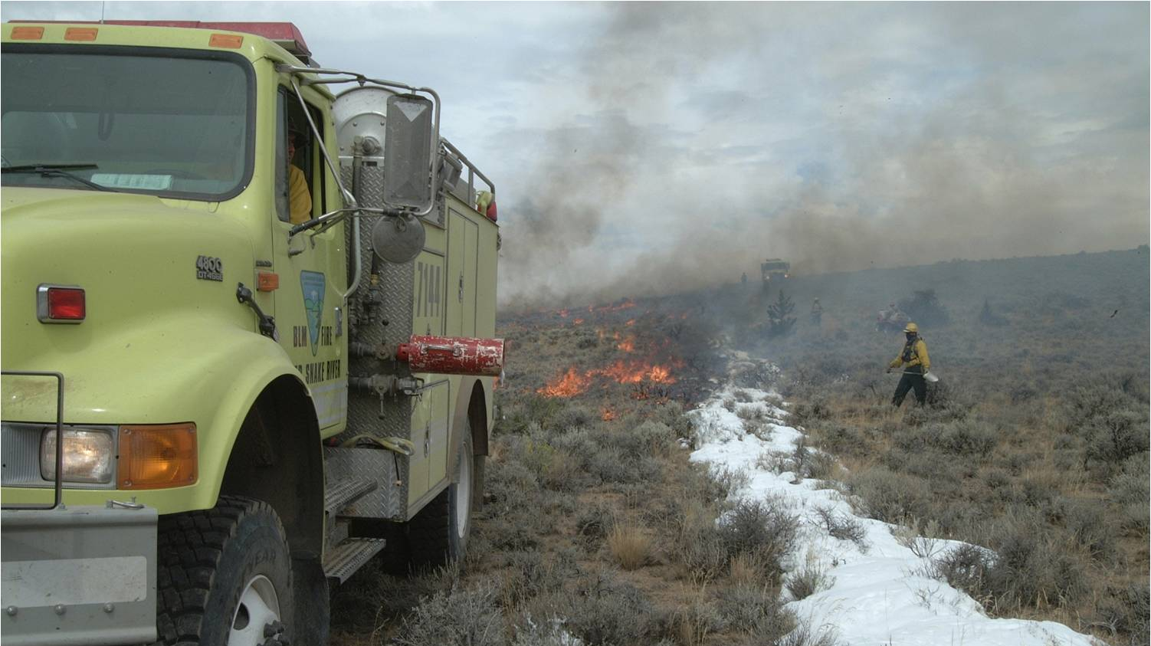
Example of foam use

Slide 11
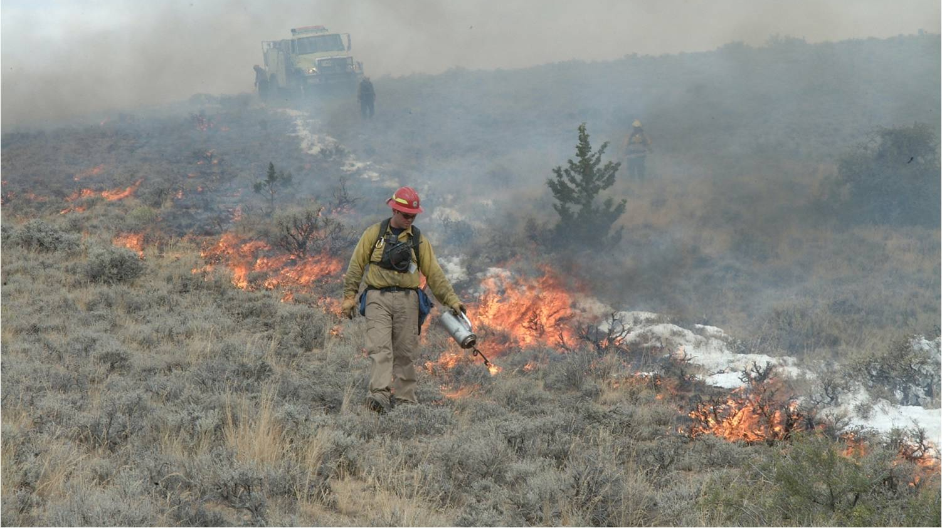
Example of foam use

Slide 12
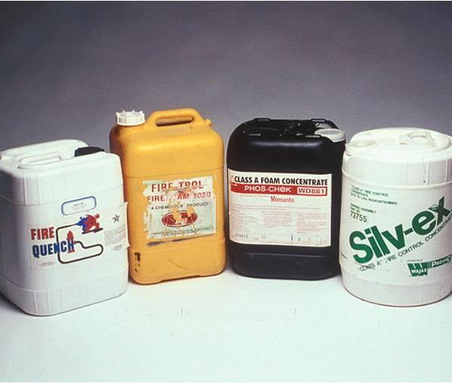
To Mix or Not to Mix....
THAT Is the question!
12

Slide 13
Safety Concerns
Skin and eye irritant
Dries out skin, boots, gloves, etc.
Caution when using in sensitive areas and waterways
13

Slide 14
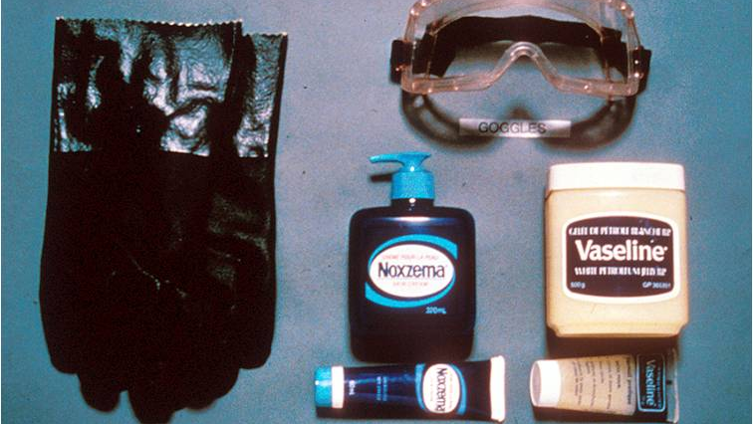
Safety equipment
14

Slide 15
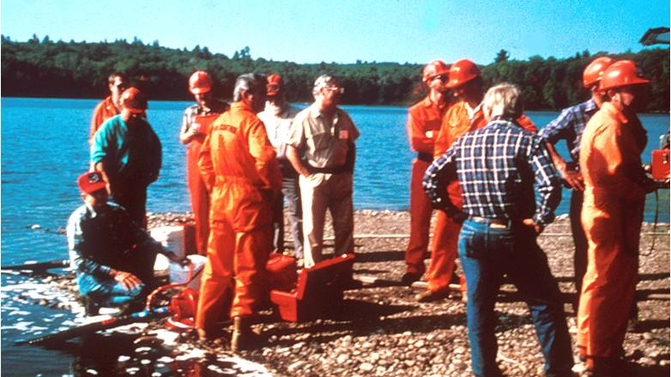
Think safety!
15
Notes:
Whats wrong? Lacking PPE, water contamination

Slide 16
Batch Mixing
16

Slide 17
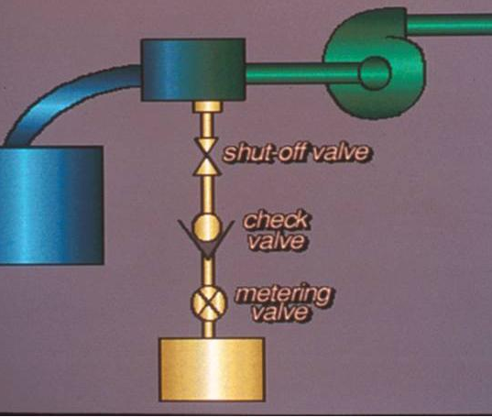
Suction-Side Proportioners
17

Slide 18
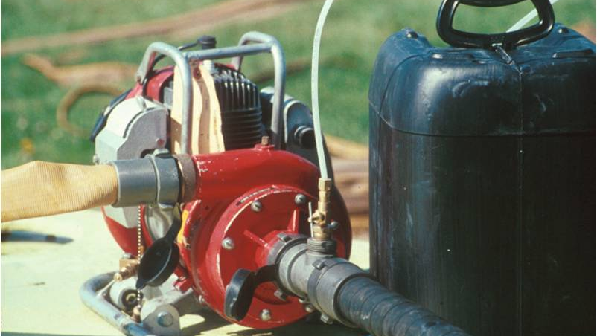
Suction-Side proportioners
18

Slide 19
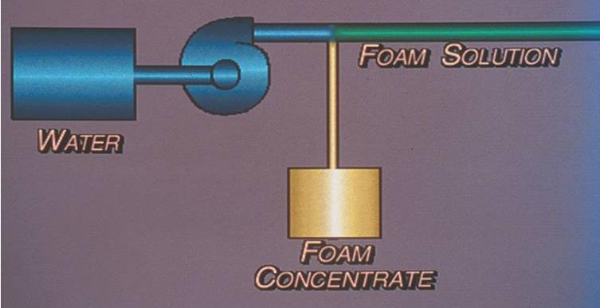
Foam Proportioners
19

Slide 20
Manual Foam Proportioners
Operators manually adjust the device to maintain a constant mix ratio when water flow and pressure changes.
Cannot maintain constant mix ratio over various flow and pressure rates
Caution with plumbing configuration to not "foam the tank"
20

Slide 21
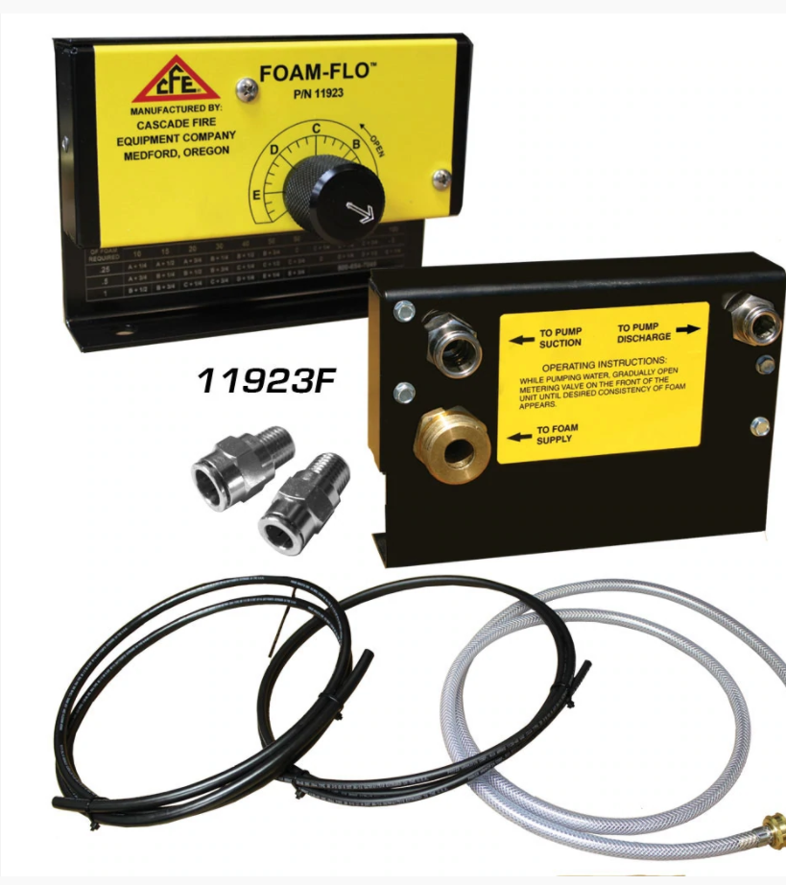
Cascade Foam Flo
Simple and effective.
Uses standard fittings and is unpowered.
Caution: Foam can get into the tank if valving is not correctly installed or if internal check ball malfunctions.
21

Slide 22
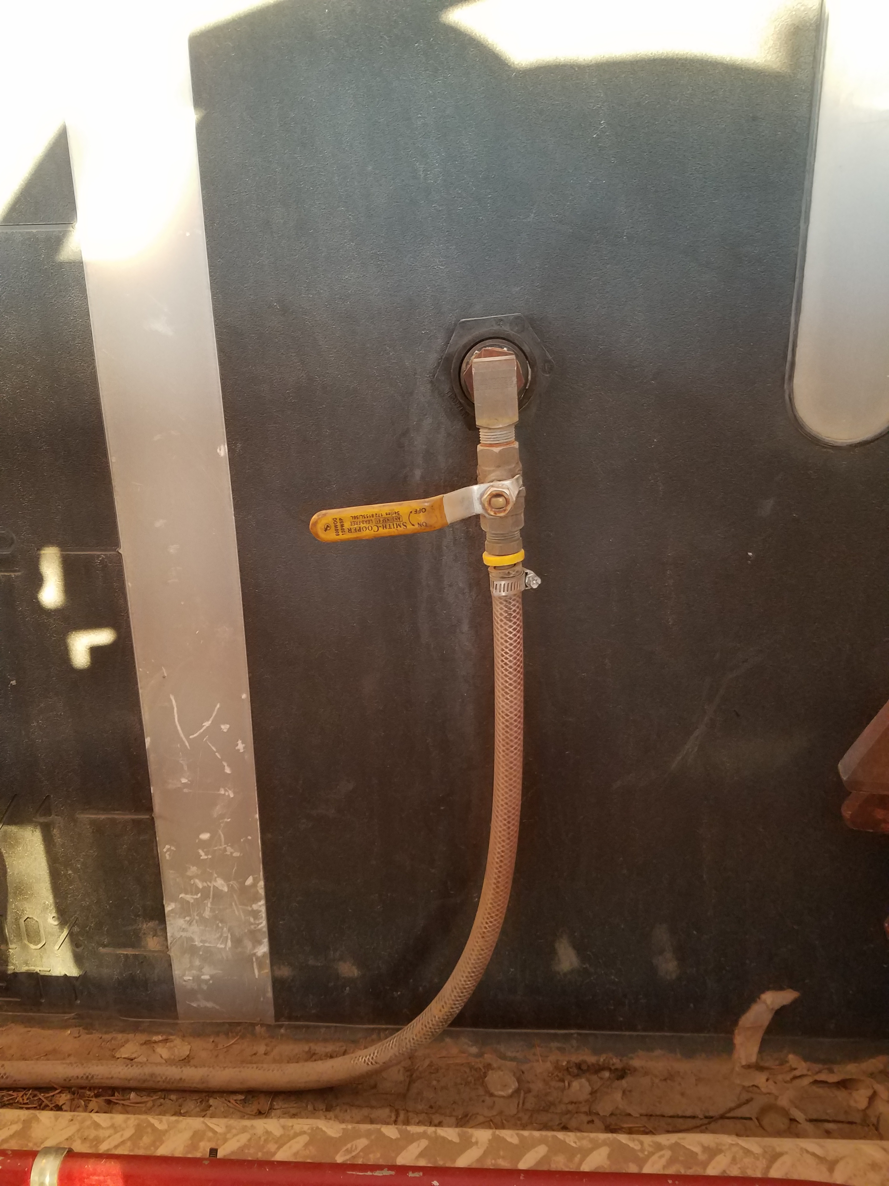
Foam On/off valve at tank
22
Notes:
On/Off valve to foam tank. Must be opened to flow foam.

Slide 23
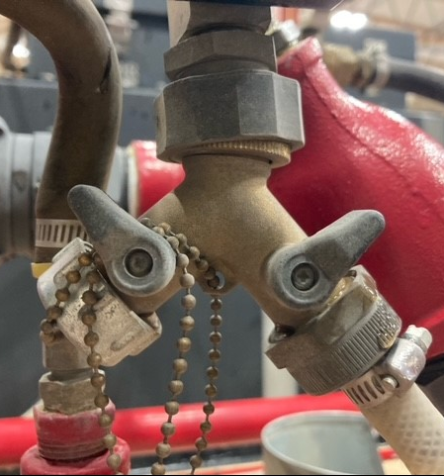
Foam Proportioner inlet Valve -Off Position
Notes:
This photo is input from the foam tank to foam proportioner. This valve must also be in the open position to flow foam.

Slide 24
Model 52 Foam-flo
Water is Pushed Into the Unit From the Pump Side (LEFT SIDE)
Flows Across the Proportioner Valve and Pulls Concentrate Into a Mixture of Water and Concentrate.
Exits in Solution Above the Overboard Discharge Valve #3 (Right Side).
Notes:
Most BIA M-52's discharge into a single Overboard Pipe. If this pipe is plumbed to part of the system that can uptake water into the pump head (common on BIA Model 52's) and the Recirculation Valve is open (#17), you will pump foam into the tank. This is a common issue and can lead to all sorts of problems. One of the discharge valves needs to be cracked open in order prevent foam from going the into the water tank. Review the foam valving on all BIA M-52's and correct as needed. View is top of Foam Pro.

Slide 25
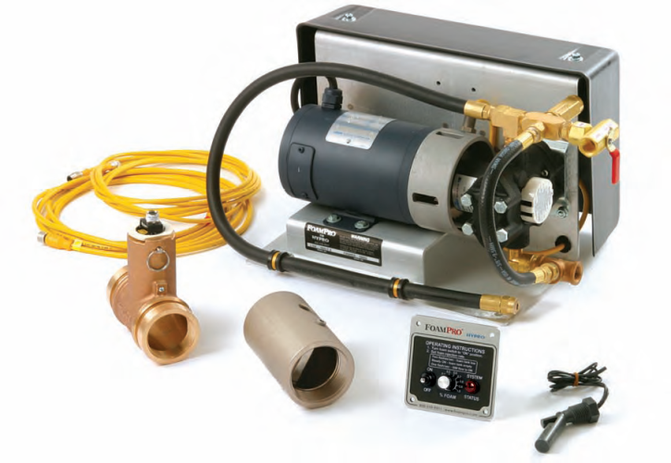
Automatic Foam Proportioner
The automatic foam proportioner makes an adjustment on its own to maintain a constant mix ratio when water flow and pressure changes.
FoamPro® 1601
Waterous Aquis™ 1.5

Slide 26
Foam Proportioner
Manual proportion and automatic
Works on discharge side of pump
Class A foam only
Requires water flow and electrical current
No restrictions due to hose length or number of nozzles
No loss of pressure or flow
Accurate at all flow ranges
Resupply foam without interruption
26

Slide 27
Operating the Foam Proportioner Major Components
Operator control module
Motor driver box/module
Paddlewheel flowmeter
Foam pump and electric motor
Calibrate/Inject valve
Inline strainer
27

Slide 28
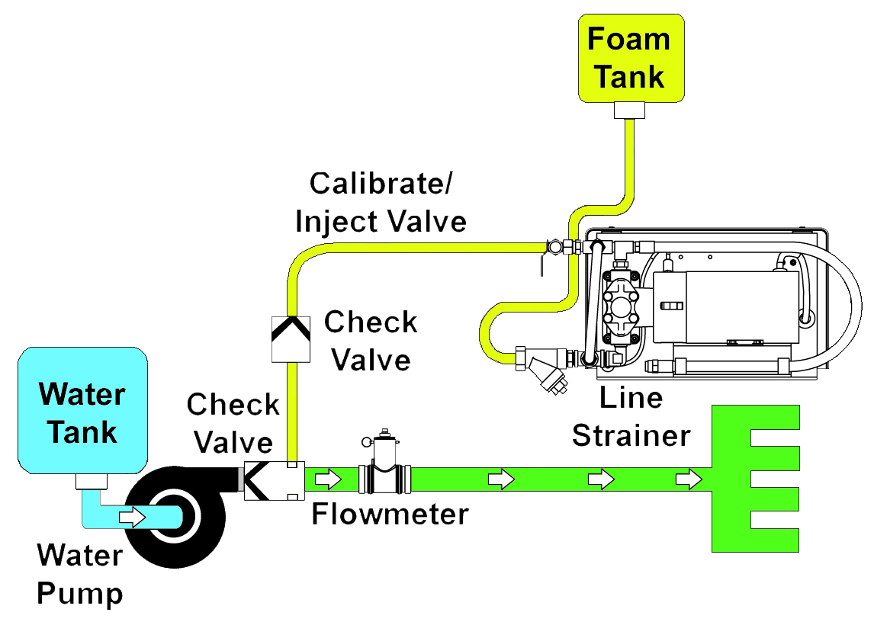
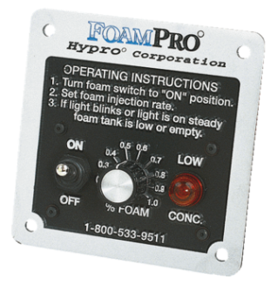
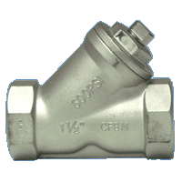
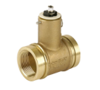
Foam Proportioner
s
28

Slide 29
Operator Control Module Panel Mounted
Operating instructions
On/Off switch
Injection rate control
Adjustable from 0.1%-1.0%
Low concentrate (“LOW CONC.”) light
29

Slide 30
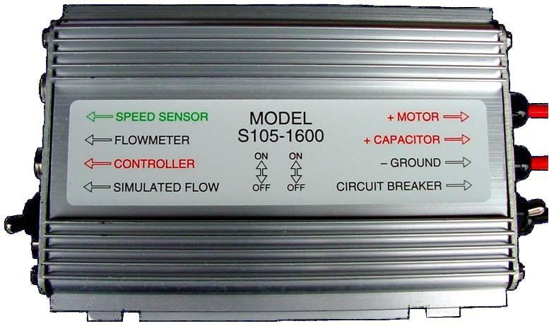
Motor Driver Box/Module Normal Operation
Simulated flow switch “Down” for normal operation
Circuit breaker switch “Up” for normal operation

Slide 31
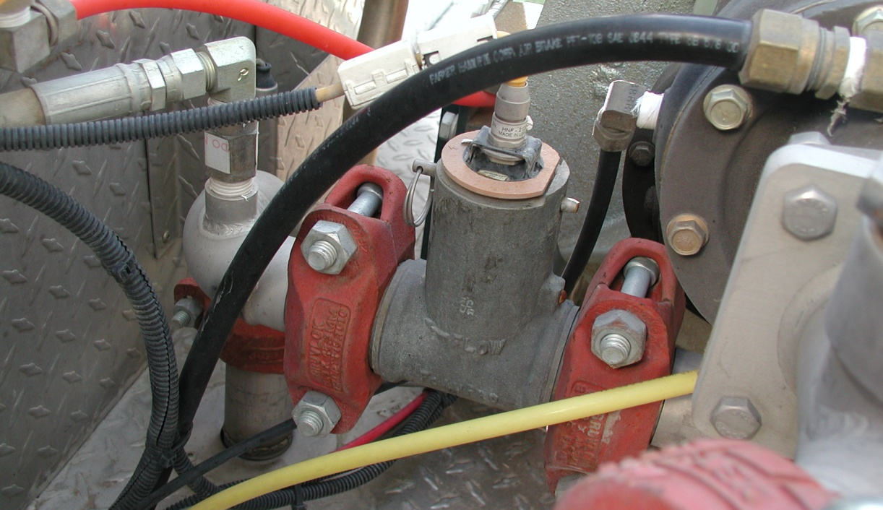
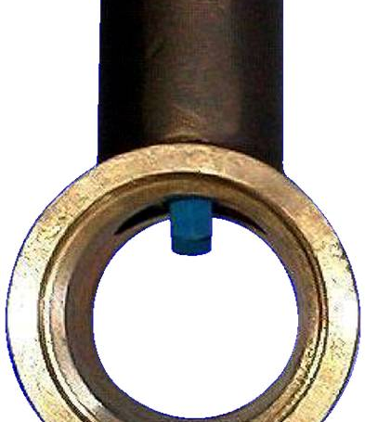
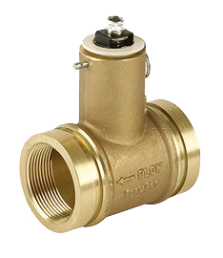
Paddlewheel Flowmeter
31

Slide 32
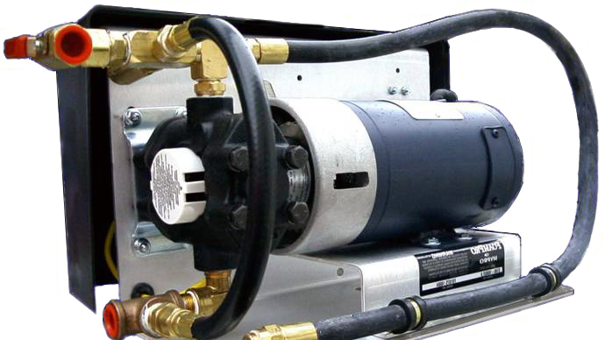
Foam Pump and Electric Motor
32

Slide 33
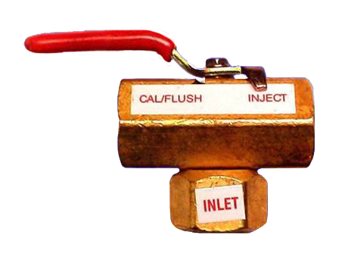
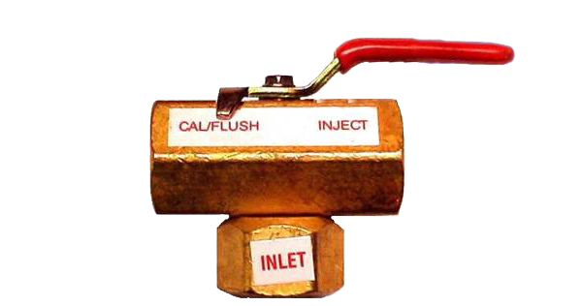
Calibrate/Inject Valve
33

Slide 34
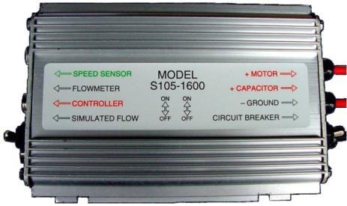
Purging Air
Enter “Simulated Flow”
Switch to “Up” position
Preprogrammed for 100 GPM
Valve to “Cal/Flush”
Turn panel switch “On”
Run pump until concentrate flows from dump line
34

Slide 35
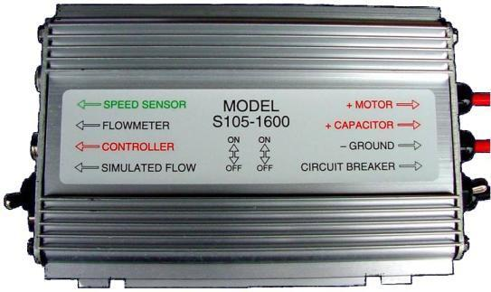
Purging Air Continued
Turn control panel to “Off” position
Return valve to “Inject”
Exit “Simulated Flow” by returning switch to “Down” position

Slide 36
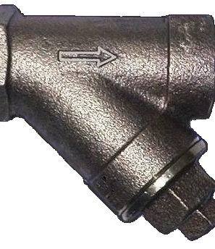
Inline Strainer
36

Slide 37
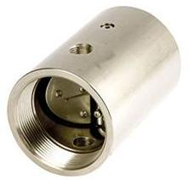
Foam Injection Check Valve and Injection Port
37

Slide 38
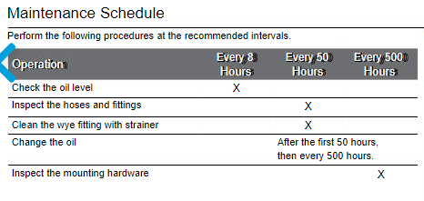
Maintenance
Follow manufacturer recommendations for service intervals.
Waterous Aquis 1.5
6.1 oz., SAE30, non-detergent
FoamPro 1601
Grease every 50 hours

Slide 39
CaL/Flush (Simulated Flow)
Check flow rates.
Flush system.
Purge air/prime system.
39
Notes:
Steps to Prime the Foam Proportioner
1. Make sure that the motor driver box toggle switches are set correctly. (FoamPro® 1601 only; otherwise, skip to step 2.)
“Simulated Flow” switch is in the “Up” position.
“Circuit Breaker” switch is in the “Up” position.
2. Set the Foam Percentage” switch to “1%.”
3. Place a container to collect the output that will be coming from the foam pump through the outflow foam concentrate line.
4. Turn the “Calibrate/Inject” valve to the “Cal/Flush” position.
5. Turn the “Controller Module” switch to the “On” position
Foam concentrate should start flowing into the container. When it is flowing at a steady rate (about 20 seconds), the foam pump is primed and ready for operation.
6. Turn the “Controller Module” switch to the “Off” position.

Slide 40
Winterization
Drain tank.
Drain lines.
Clean inline "Y" strainer.
Flush with clean water.
Flush with recreational vehicle antifreeze.
When in doubt, follow the manual.
40

Slide 41
Troubleshooting
Is there foam?
Is there enough water flowing?
Check valves
Paddlewheels
Correct settings on proportioner/control module
Manufacturer’s manual for workflows/common issues
41

Slide 42
Objectives
Discuss why foam is more effective than plain water when performing wildland fire suppression operations.
Discuss foam safety, including guidelines for handling foam products.
Identify and discuss the advantages and disadvantages of manual foam proportioning methods used when performing wildland fire suppression operations.
42

Slide 43
Objectives
Identify various operational components of the FoamPro® 1600/1601 and Waterous Aquis 1.5.
Demonstrate the ability to set up, run, have foam solution pumped to a nozzle person, and shut down a foam proportioner.
Discuss basic maintenance, winterization, and troubleshooting methods for foam systems.
43

