Slide 1
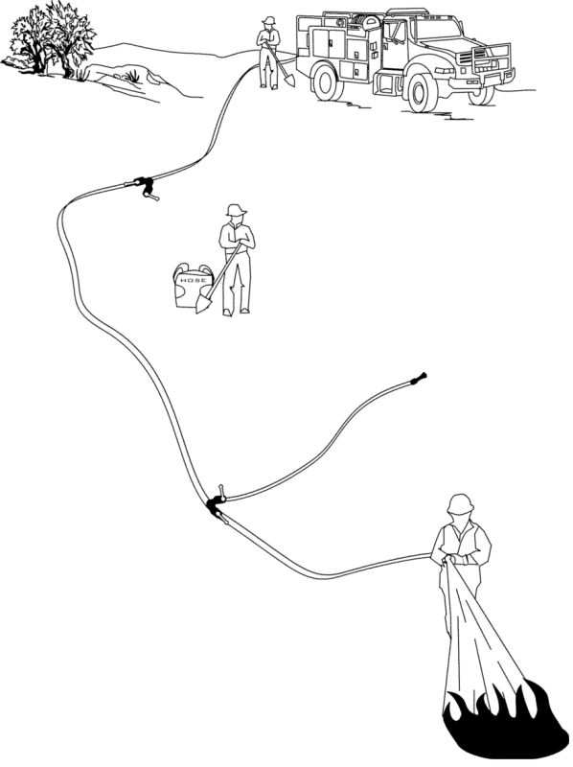

Water Handling Operations
Unit 4B – Water Sources and Pumping Operations
1

Slide 2

Objectives
Identify water sources used in engine refill operations.
Define aquatic invasive species.
Discuss actions an ENOP can perform to help reduce/eliminate the spread of aquatic invasive species.
Identify potential problems that occur when interfacing with a municipal apparatus.
Demonstrate the use and hazards of hydrants during refill operations.

Slide 3
Objectives
Describe the differences between parallel, stage, and series pumping.
Describe the differences between a simple and progressive hose lay.
List the advantages and disadvantages of hose deployment methods.
Locate and describe the function of valves in the fire engine plumbing system.
3

Slide 4
Water Sources for Engine Refill
Operations
4

Slide 5
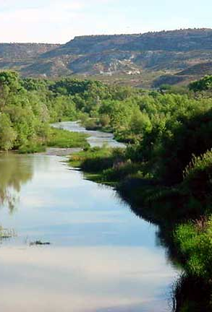
Natural Water Sources
Streams
Ponds
Lakes
Springs
Other
5

Slide 6
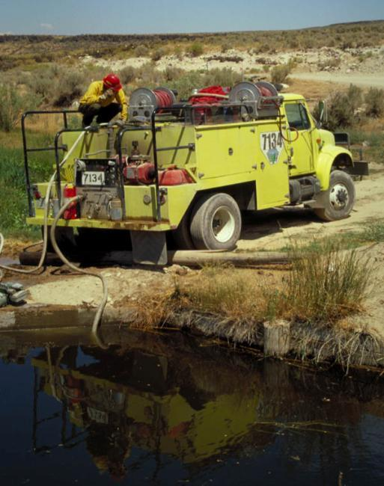
Considerations
Limit environmental impacts
Adequate water supply (flow)
Good ingress and egress
Owner permission for private water source
Communicate location to others
Flush tank and plumbing after use
6

Slide 7
Dam Building
Locate
Locate dams in areas narrow enough to dam easily.
Use
Use rocks, logs, or plastic to build a dam.
Tear down
Tear down the dam after use.
7

Slide 8
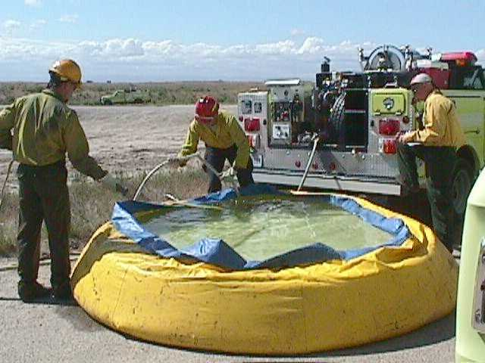
Portable Tank Setup
Locate in an area where the water can drain on the downhill side without causing access problems.
Locate on relatively smooth, flat ground.
Communicate location to others.
8

Slide 9
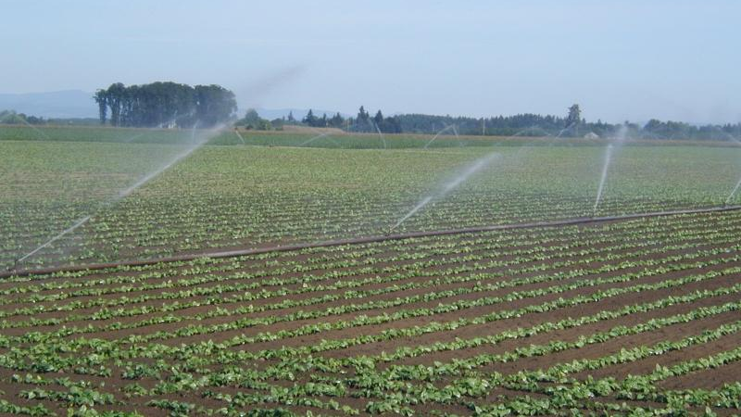
Agricultural Sources
9

Slide 10
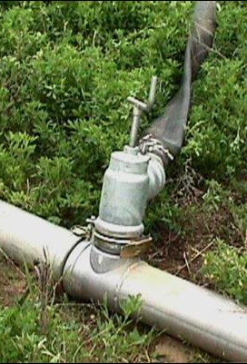
Irrigation Risers
Obtain owner permission.
Consult with owner regarding line and pump.
Use riser adapter and fill hose.
Open with caution.
Communicate location to others.
10

Slide 11
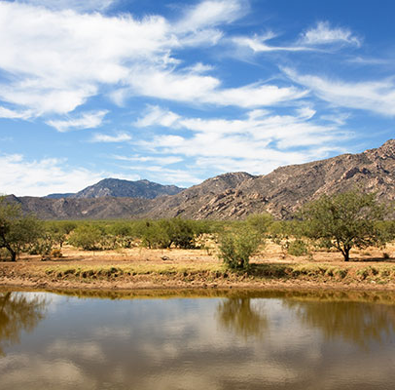
Stock Ponds
Limit environmental impacts.
Obtain owner permission.
Adequate water supply.
Good ingress and egress.
Communicate location to others.
Pond refilled after use, if required.
11

Slide 12
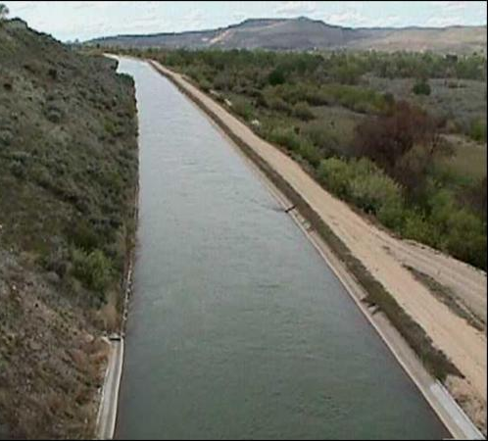
Canals
Obtain owner permission before use.
Inspect site for safe access (cut banks, soft or loose banks can cause engine rollovers).
Communicate location to others.

Slide 13
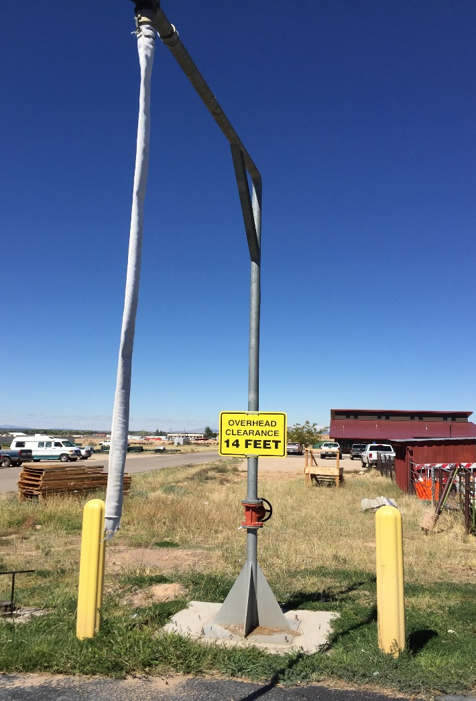
StandPipes
Obtain owner permission.
Ensure fill hose is long enough to be placed in tank.
  Use an air gap as backflow prevention.
Employ a two-person operation when necessary.
Open with caution.
Communicate location to others.
13

Slide 14
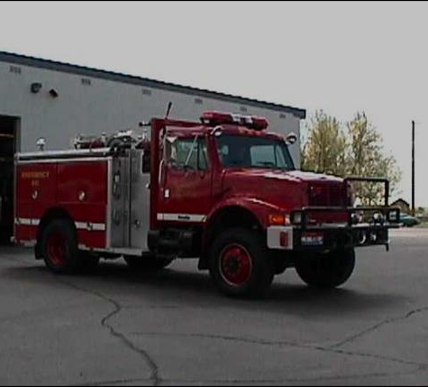
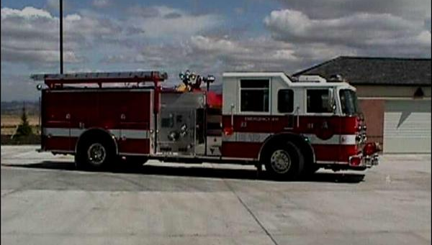
Municipal Apparatus
14

Slide 15
Considerations
Municipal apparatus deal primarily with large volume pumps.
Thread types vary from department to department. Carefully inspect all connections before using.
When filling through the direct fill (Dri-Fill) valve, do not exceed 50 PSI.
15

Slide 16
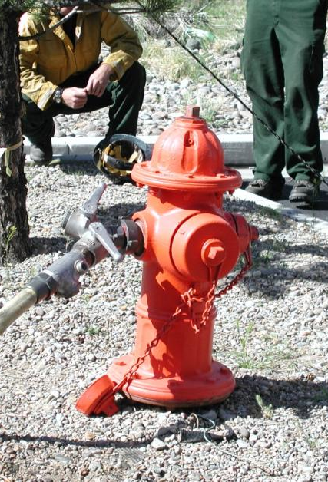
Fire Hydrants
16

Slide 17
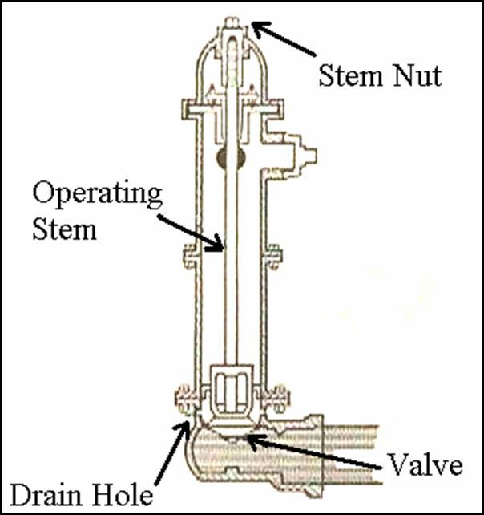
Dry Barrel Fire Hydrant
Most common.
Used in areas subject to freezing.
Drain when not in use.
Single on/off system.
Stem nut must be opened all the way.
17

Slide 18
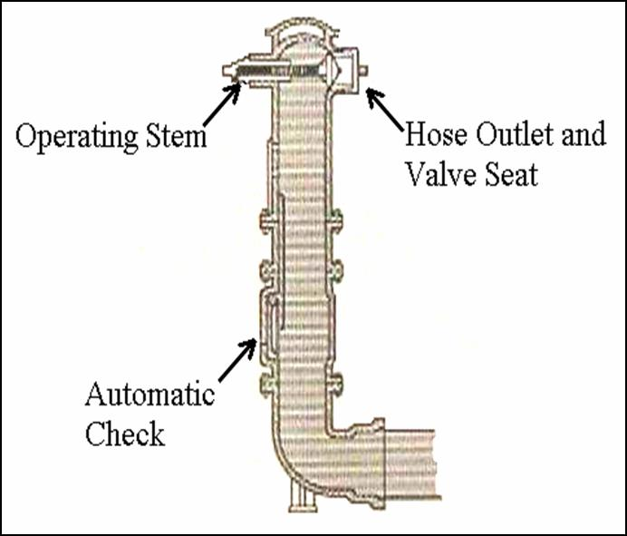
Wet Barrel Fire Hydrant
Used in areas not subject to freezing.
Always charged.
Individual hookup.
18

Slide 19
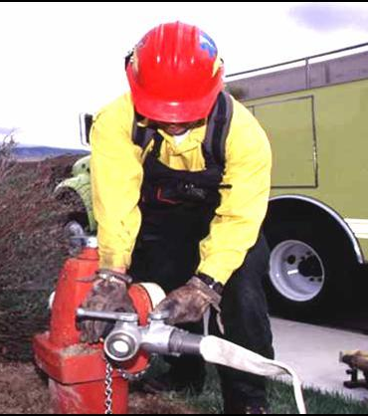
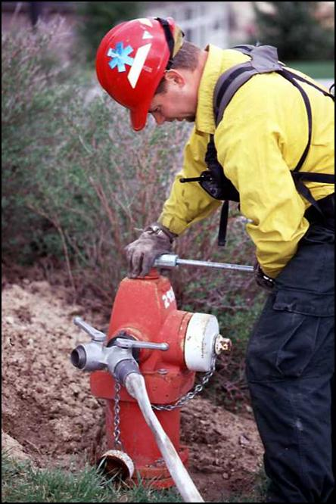
Proper Use and Hazards Associated with Hydrant Use
19

Slide 20
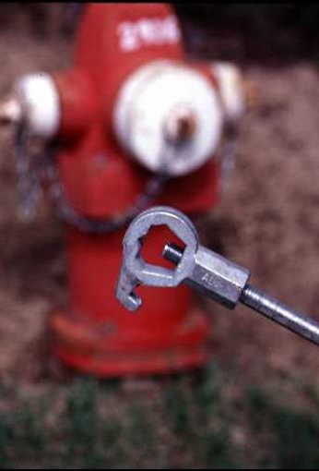
Hydrant Hookup
The five-sided hydrant wrench is the only wrench that should be used on hydrants.
20

Slide 21
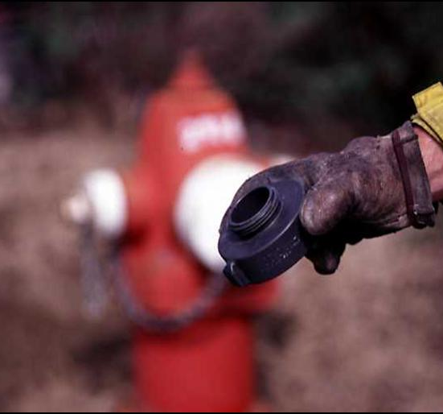
Hydrant Hookup
Always use the correct thread adapters and reducers.
21

Slide 22
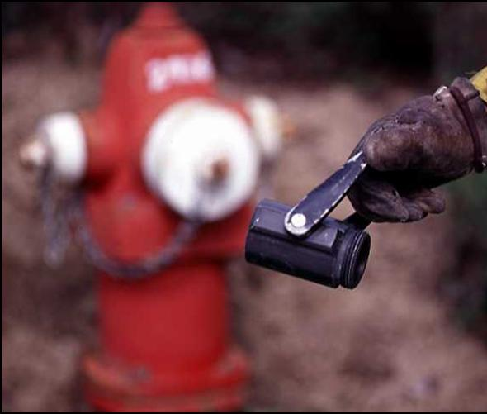
Hydrant Hookup
While the hydrant is in the off position, install appropriate fittings to control hydrant flow.
22

Slide 23
Hydrant Use
Open and close hydrant and valves slowly to avoid water hammer.
Bleed off any air, rust, or debris before attaching hose.
23

Slide 24

Hydrant Use
Open hydrant completely.
  Never control hydrant flow with the stem nut!
24

Slide 25
Improper Hydrant Use
Contamination of water supply
Damage to underground water supply lines
Injury to the operator
Damage to the engine attachments, fill controls, backflow prevention devices, or hose
25

Slide 26
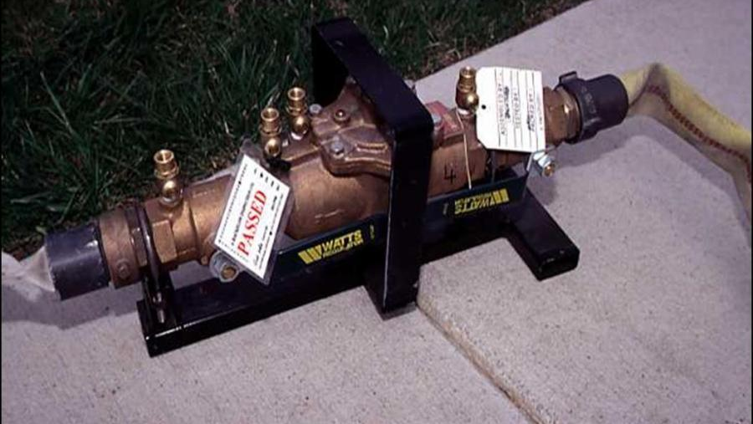
Backflow Prevention Devices
26

Slide 27

Why backflow prevention devices Required?
Answer:
To prevent contamination of the drinking water supply!
27

Slide 28
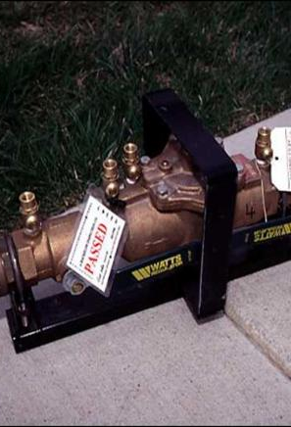
Backflow Prevention Device Components
Two check valves
Differential pressure relief valve
Four properly located test cocks
Two isolation valves
28

Slide 29
Backflow Prevention Devices
Use of
Place between the hydrant and the engine tank.
Know the local protocol regarding hydrant use.
Certify and test device annually.
Use the air gap method to refill if you do not have a backflow prevention device.
29

Slide 30
Air Gap Method
An air gap assembly is a permanently attached pipe with a hose connection.
Requirements:
  Air gap distance is required to be two times the inside diameter of the pipe.
  If no air gap assembly or backflow prevention device assembly is available, use the manual air gap method.
30

Slide 31
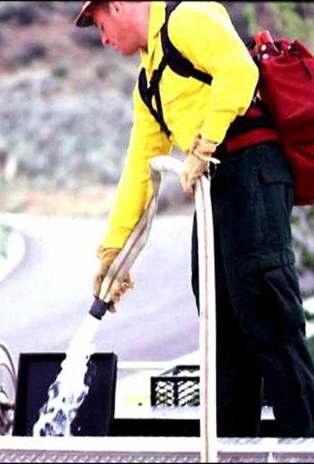
Manual Air Gap Method
Person holds the fill hose.
Never insert the fill hose into the tank.
Always maintain the air gap.
31

Slide 32
Aquatic Invasive Species
(AIS)
32

Slide 33
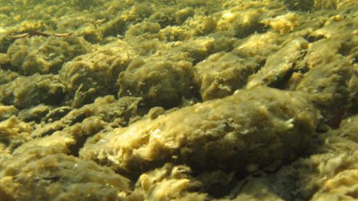
Aquatic Invasive Species (AIS)
“Aquatic invasive species” are alien (non-native) aquatic plants and animals whose introduction into an ecosystem causes, or is likely to cause, economic or environmental harm or harm to human health.
33

Slide 34

Invasive Aquatic Plants
Invasive aquatic plants are non-native plants that have adapted to living in, on, or next to water, and that can grow either submerged or partially submerged in water.
34

Slide 35
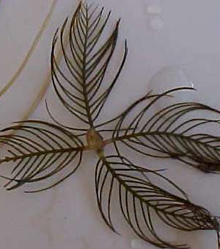
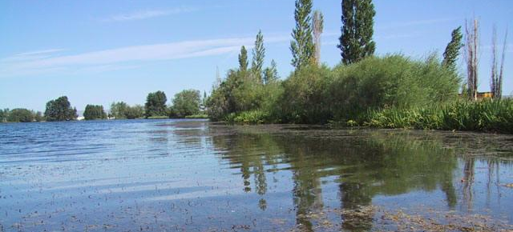
Eurasian Milfoil
35

Slide 36
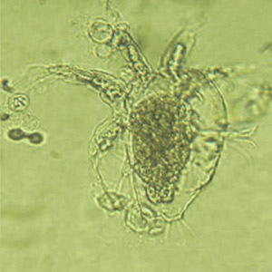
Chytrid Fungus
Microscopic
Mainly affects amphibians
36

Slide 37
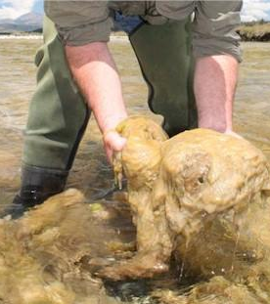
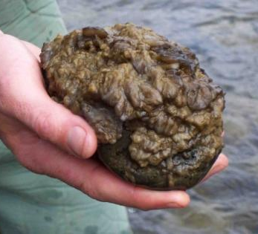
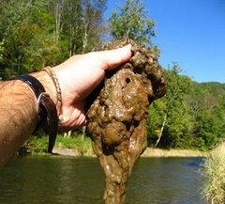
Didymo (Rock Snot)
37

Slide 38

Invasive Aquatic Animals
Invasive aquatic animals are non-native animals that require a watery habitat but do not necessarily have to live entirely in water.
38

Slide 39
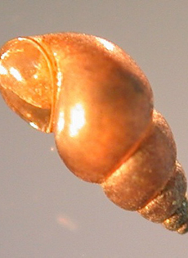
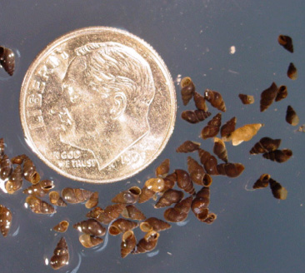
New Zealand Mudsnails
39

Slide 40
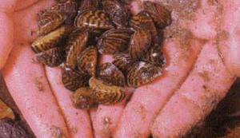
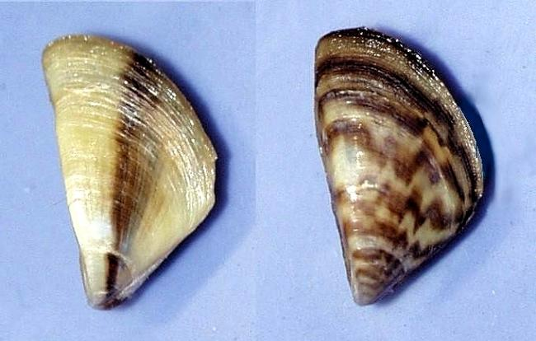
Zebra Mussels
40

Slide 41
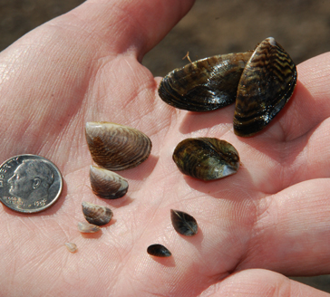
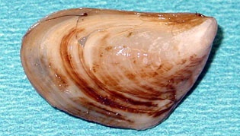
Quagga Mussels
41

Slide 42
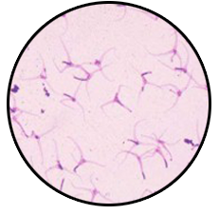


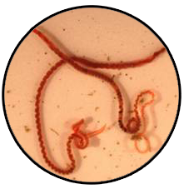
Whirling Disease Parasite
42

Slide 43
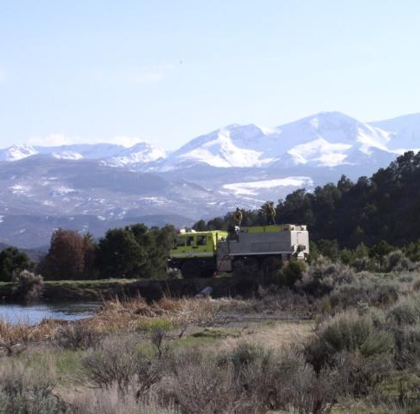
AIS Policy Direction
AIS is an emerging issue with no clear national policy direction for fire operations.
ENOPs are encouraged to:
  Self educate – review AIS in the IRPG.
  Ask questions of geographic area specialists.
  Follow local SOPs.
43

Slide 44
Standard Operating Procedures
Understand and follow the SOPs for AIS in your area.
Brief out-of-area engine crews working with you about AIS problems in your area.
When working outside your local area, learn and understand the SOPs for AIS in that area.
Treat every body of water as if AIS is present!

Slide 45
Cleaning and Sanitizing Equipment
Screening Methods
May be impractical
Chemical Use
Mix ratio
Cleaning solution disposal
Consult the Safety Data Sheet (SDS)
45

Slide 46
Common Sense Mitigation Measures for AIS Prevention
Always assume that AIS could be present in any body of water.
When possible, avoid driving through bodies of water.
Avoid dumping water directly from one waterway into another.
Avoid drafting water from multiple sources during a single operational period unless equipment is sanitized between sources.
Avoid sucking organic and bottom material when drafting.
Clean out and sanitize the plumbing strainers.
46

Slide 47
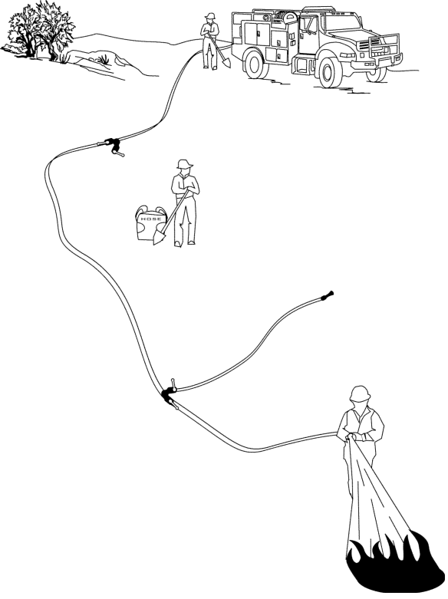
Pumping
Operations
47

Slide 48
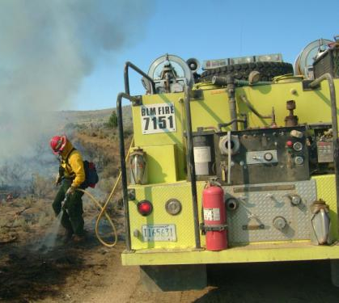
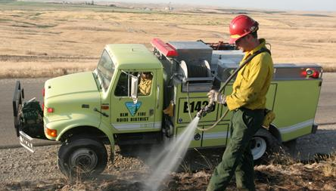
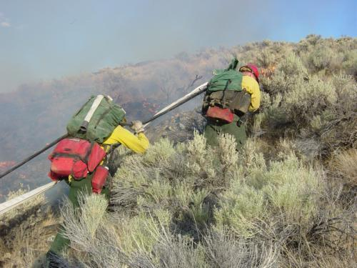
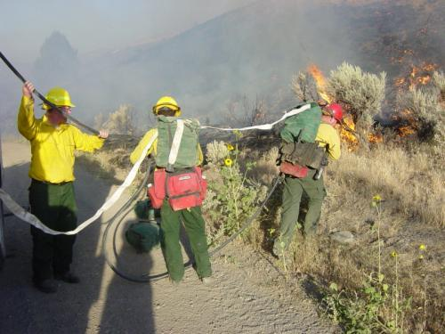
Water Delivery
48

Slide 49
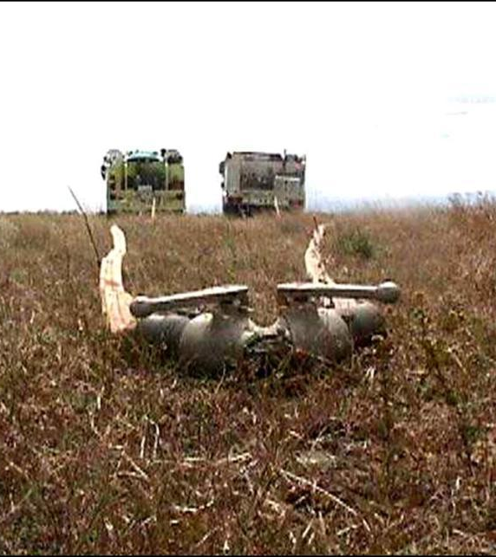
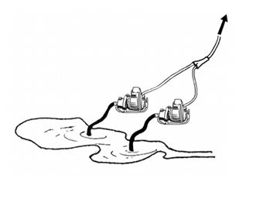
Parallel Pumping
49
Notes:
More than 1 pump delivering water into hoselay. Pumps should have equal capacities pressure and flow. If a pump fails system will operate at reduced capacity.

Slide 50
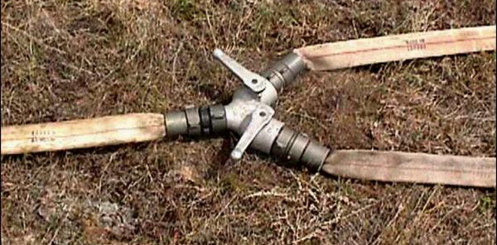
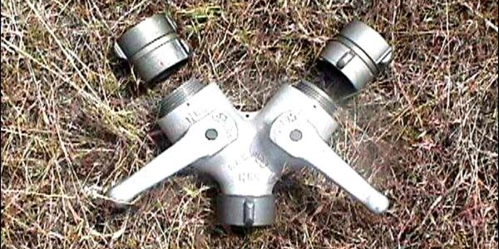
Parallel Pumping
A Siamese fitting is used to connect the two water supplies.
Water is pumped independently from each engine into a single hose lay coming off the Siamese fitting.
  The hydraulic effect is increased volume.
50
Notes:
Drawback is that it increases amount of hose and appliances. Main advantage is reduce friction loss ( ¼ friction loss of a single line) due to reduced flow

Slide 51
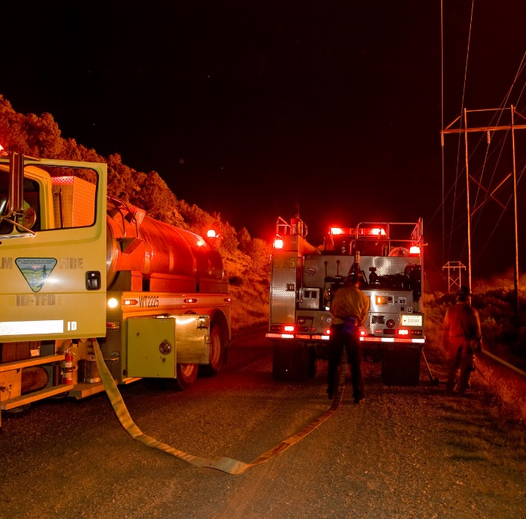
Stage Pumping
Two engines operate independently of one another.
Water pumped from one engine/ pump into another holding tank.
  The hydraulic effect is equal to the ability of each pump. System provides more stable water supply and less interruption if pump needs to be shut down
51

Slide 52
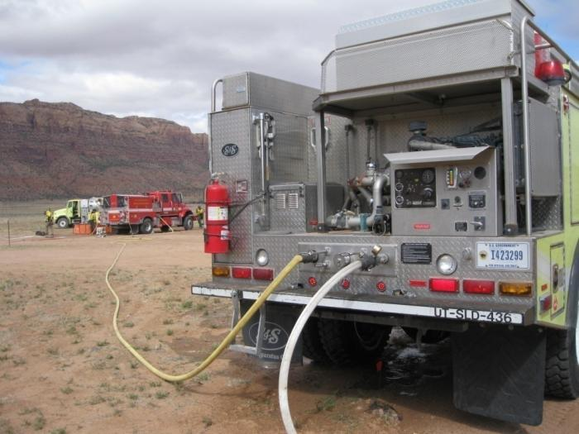
Series Pumping
Two or more pumps are directly connected in series.
Place the pump with the highest output closest to the source.
  The hydraulic effect is to increase the pressure.
52
Notes:
If 1st pump fails system fails. Does not increase flow. Used to overcome elevation rise or long hose lays

Slide 53
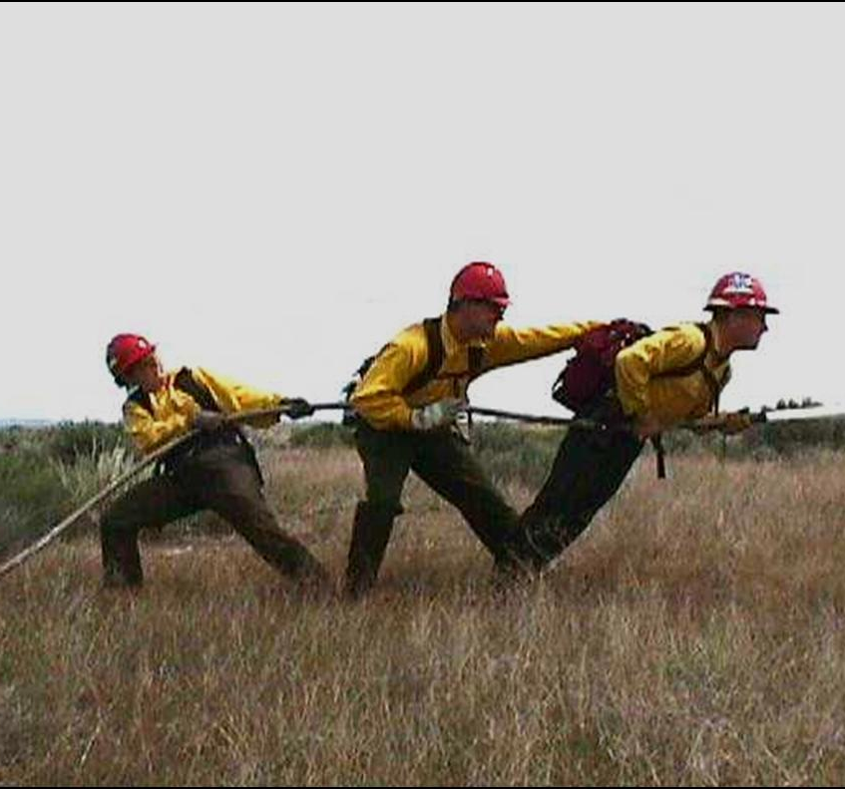
Hose Lays
53

Slide 54

Simple Hose Lay
Comes straight off the pump and goes directly to the nozzle with no appliances in between hose connections.
54
Notes:
Often used for small fire, quick set up, plan to add laterals to make it a progressive if conditions warrant

Slide 55

Progressive Hose Lay
Comes from the pump source to the fire via a series of laterals w/ nozzles coming off different appliances. Used to direct attack at several points. Effective for mop up stages.
55
Notes:
Designed for speed and safety on hot fast-running fire where mobile attack is not possible or effective.

Slide 56



Hose Deployment
Attack Methods
56
Notes:
Direct attack, downhill line construction, anchor points, plan for supplies and pump performance (project fire activity/location/water use)

Slide 57

Rolled Hose
Advantages:
Disadvantages:
Easy to store and transport.
Comes from the supply cache single rolled.
Hard to deploy uphill or through brush or slash
Takes both hands to unroll

Slide 58



Hose Packs
Forester hose packsack
Gasner
Used for quick deployment of predetermined lengths of hose.
Specific to needs of geographic area.
58

Slide 59

Hose Packs
Advantages:
Disadvantages:
Easy to deploy
Fittings attached
Ease to store and transport
Takes skills and time to package
Requires extra training time

Slide 60
Mobile Attack
Live Reel Use
Placement of hoses for mobile attack:
  Lead hose usually knocks down the fire, and the trail hose catches any remaining threat to the line.
Speed of line construction:
  Dependent upon number/type of resource, fuel type, and terrain.
60
Notes:
Hose placement/use may differ between fires based on fuel type, engine capabilities, personnel, available resources (water).

Slide 61
Mobile Attack
From the Black
Entails positioning the engine and personnel in the black and directing the water stream towards the green.
  Used when terrain, obstacles and fuel type allow.
Hazards:
  Residual heat from the flaming fire front
  Burning debris under the engine
  Burned brush stobs (may puncture tires)
61

Slide 62
Mobile Attack
From the Green
Entails positioning the engine and personnel in the unburned fuel on the fire perimeter and directing the water stream towards the black.
Hazards:
  Unburned fuel between you and the fire
  Rocks or holes hidden by fuels

Slide 63

Engine Placement
Stationary Pumping
Adhere to LCES during all fire operations.
Keep in mind ingress and egress during pumping operations.
  Back in vehicle for quick egress.
  Chock vehicle.
Look Up, Look Down, Look Around
63

Slide 64



Engine Protection Lines
64

Slide 65
Engine Protection Lines
Know the location of engine protection lines.
Leave a quick connect hose in place to protect the engine at all times.
Engine protection line should be 1½” hose with same size nozzle and shut-off valve.
Leave a supply of water in tank (at least 10% of pumpable capacity) for engine protection.
Line needs to be deployed quickly and cover all sides of the engine.
65
Notes:
10% is chapter 14 of Redbook Firefighting Equipment – in type 6 engine may need more water depending on fuel conditions

Slide 66

Communications
Radio
PA system
Headset
Hand signals
Others?
66

Slide 67

Fire Engine Plumbing
67
Notes:
#1 - TANK TO PUMP - Flows water from the tank to the pump. #2 - PUMP TO TANK - Flows water from the pump to the tank. #3 - OVERBOARD DISCHARGE - Flows water from the pump to the main discharge lines. #4 - HOSE REEL - Flows water from the pump to the hose reel(s). #5 - AUXILIARY DISCHARGE - Flows water from the pump to an engine protection discharge. #6 - PRIMER - With the priming unit, allows the centrifugal pump to be primed. #7 - ADJUSTABLE PRESSURE RELIEF - Relieves excess pressure, preventing pump damage. #8 - OVERBOARD SUCTION - Flows water from an external source to pump. #9 - 40 GALLON RESERVE - Flows reserve 40 gallons to the pump. #10 - IN-TANK SHUT-OFF - Shuts off water in the tank to the pump. #11 - PUMP & PLUMBING DRAIN - Drains water from the pump and plumbing. #12 - PUMP COOLANT CLEAN-OUT - Flushes debris from plumbing. #13 - GRAVITY TANK DRAIN - Drains water tank. #14 – FOAM BYPASS – Water routed around foam unit (Clean water discharge). #15 - PUMP TRANSFER - Switches the pump to either parallel or series operation #16 - ENGINE COOLER - Circulates cool water from engine. #17 - PUMP BYPASS - Circulates water from the pump back to the tank for pump cooling. #18 - LOW VOLUME GRAVITY - Gravity discharge for backpack fill. #19 – CLEAN WATER DISCHARGE – 1.5” overboard discharge plumbed prior to the foam injection. #20 – FEEDER VALVE – For clean water discharge and #2 valve.

Slide 68

Tank-to-pump Valve #1
68

Slide 69

M-52 Tank to Pump valve #1
Valve

Slide 70



Pump-to-Tank Valve #2
70

Slide 71



M-52 Pump to Tank #2
To Activate Pump to Tank...
Close #13
Open #2
Ensure (on some models) Foam is Shut, or Foam Will Enter Tank
Valve

Slide 72




Pump-to-Discharge Valve #3
Hosereel #4
72

Slide 73

M-52 Pump To Discharge #4
Valve

Slide 74


Engine Protection Valve #5
74

Slide 75


M-52 Engine Protection line #5
This Is Not Present On All M-52's. Due to This Reason....
It is HIGHLY Suggested The Drivers Side Overboard Discharge Be Designated As The #5 and fitted with a "Flaked" 25ft Hoses.
This Allows The ENOP to Use a Protection Line Near The Pump Panel and Driver Door.
If the Drivers Side #3 is Required, A Gated Y Allows Both Hoses to Be Available.

Slide 76



Primer #6 valve
76

Slide 77

M-52 Primer

Slide 78


Bypass/
Recirculation
Valve #17
78

Slide 79


Bypass/Recirculation Valve
79

Slide 80

M-52 Bypass/Recirculation #17
Valve
Line to Panel for Pressure Gauge
Bypass Return Line

Slide 81



Overboard Draft #8
81

Slide 82

M-52 Overboard Draft #8
Draft

Slide 83



Strainer
83

Slide 84


M-52 Strainer
Located In Tank
Is a Standard Foot Valve
Significantly Decreases Pump Capabilities
Is Used to Prevent Invasive Species Contamination

Slide 85


Gravity Drain/Direct (Dri-Fill) #13
85

Slide 86

The M-52 Exhaust Primer
Some Older M-52's Have An Exhaust Primer. This is a Very Useful System, EXCEPT.....
They Get Lost or Stolen, Leaving a Vertical Muffler Open to The Atmosphere.
If it Rains, and an Exhaust Valve is Open, A Cylinder Head Will Fill With Water.
Once The Pump Engine is Rotated (Starting) the Pump Will Hyro-Lock
Remove Spark Plugs and Cycle to Clear.

Slide 87


REPAIR OR ORDER A NEW EXHAUST

Slide 88

Common Components
88
Notes:
Valve configurations

Slide 89

Pump-to-Fire

Slide 90

Draft-to-Tank

Slide 91

Draft-to-fire

Slide 92
Objectives
Identify water sources used in engine refill operations.
Define aquatic invasive species.
Discuss actions an ENOP can perform to help reduce/eliminate the spread of aquatic invasive species.
Identify potential problems that occur when interfacing with a municipal apparatus.
Demonstrate the use and hazards of hydrants during refill operations.

Slide 93
Objectives
Describe the differences between parallel, stage, and series pumping.
Describe the differences between a simple and progressive hose lay.
List the advantages and disadvantages of hose deployment methods.
Locate and describe the function of valves in the fire engine plumbing system.
93

