Slide 1
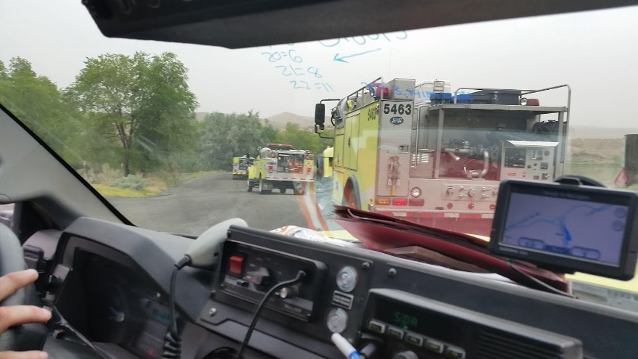
Fire Engine Driving Operations
Unit 3B - Basic Driving Skills
1

Slide 2
Objectives
Describe and demonstrate the driver walk-around before moving a fire engine.
Describe the STOP procedure and how it relates to the driver when operating a fire engine.
Identify danger zones around fire engines and describe actions that can be performed to reduce risk in these areas.
2

Slide 3
Objectives
Describe and demonstrate the start-up and shifting procedures an ENOP must perform when operating fire engines.
Identify hazardous driving situations and describe actions that can be performed to reduce risk.
Demonstrate on an established course fire engine handling and maneuvering capabilities.

Slide 4
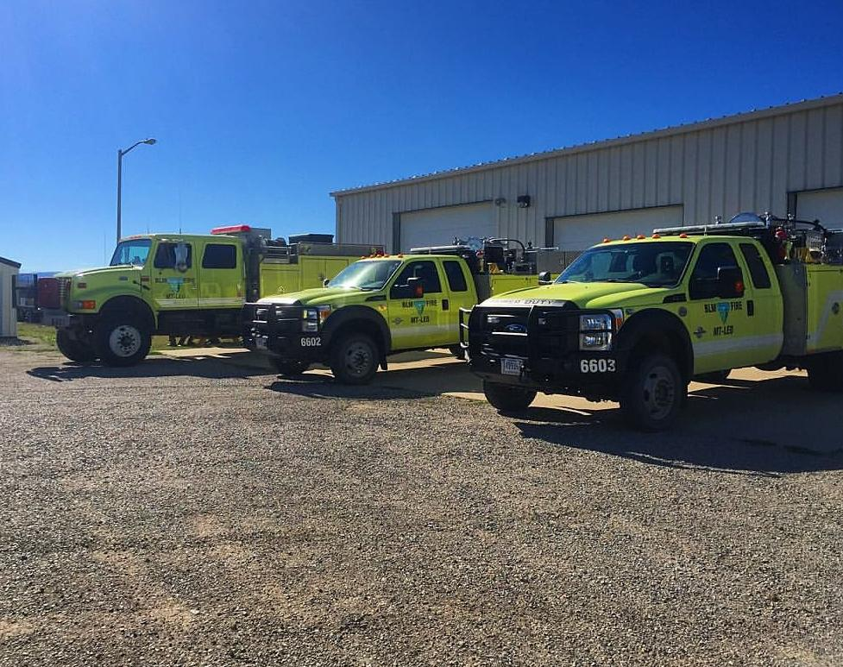
Preparing to Drive a Fire Engine
4

Slide 5
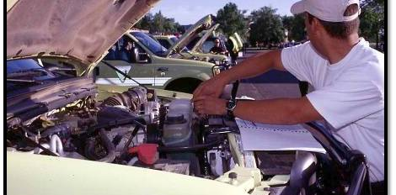
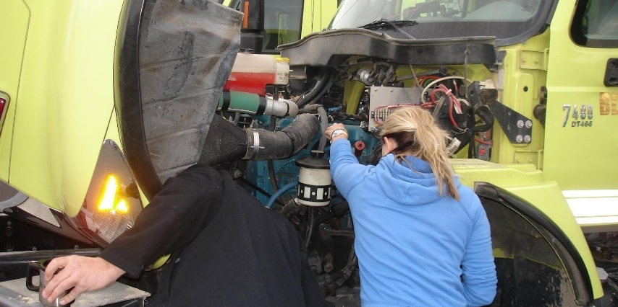
Pre-trip Inspection (Preventative Maintenance Check)
Performed daily during fire season
Documented in the FEMPR
Different from the driver walk-around
5
Notes:
PM checks were covered in Unit 1B

Slide 6
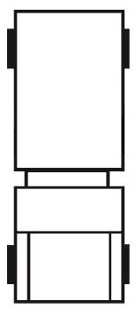
Driver Walk-Around
Passenger Side Rear
Driver Side Rear
Cab
Passenger Side Front
Driver Side Front
6

Slide 7
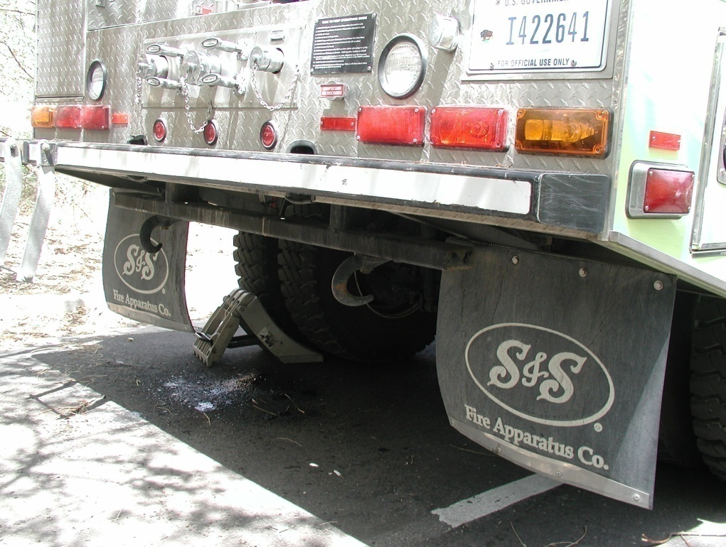
Walk-Around Watch Outs
Rocks in the way of tires
Holes, berms, ditches, etc.
Large stobbs or downed trees
Chock blocks secured and in place
Gear or equipment around or under vehicle
7

Slide 8
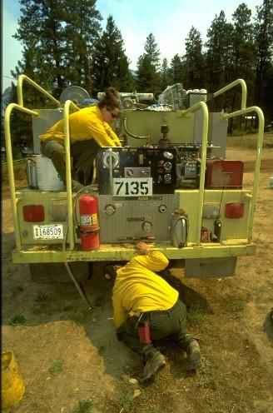
More Walk-Around Watch Outs
Vehicles parked behind the engine
Personnel relaxing or sleeping around engine
Body damage while away from the engine
Cabinets latched and equipment secured
Side and overhead clearance in and near the path your vehicle will travel
8

Slide 9
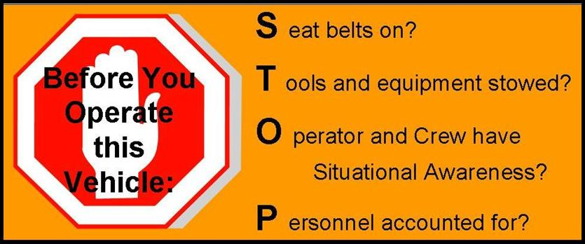
STOP Procedure
9
Notes:
Complete STOP procedure prior to moving vehicle

Slide 10
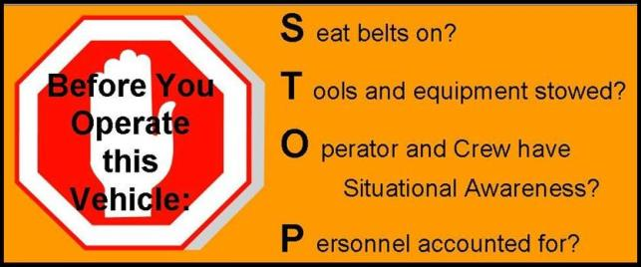
“S”
Seat belts on?
Seat belts must be available and used in Bureau motor vehicles.
The driver is responsible for asking passengers if they are wearing their seat belts and ensuring they are worn at all times.
10

Slide 11
“T”
Tools and equipment stowed?
Ensure all tools and equipment are secured in cabinets or approved storage areas before moving the engine.
11

Slide 12
“O”
Operator (driver) and crew has situational awareness.
Determine if the engine is clear of hazards.
Never back up an engine without checking behind the vehicle.
Utilize spotters whenever possible.
12

Slide 13
“P”
Personnel accounted for?
Ensure all personnel are account for and their locations are known.
Communicate your intentions to all personnel before moving the vehicle.
13

Slide 14
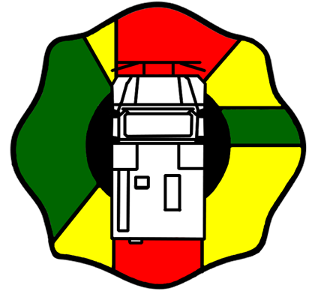
Engine Danger Zones
14

Slide 15
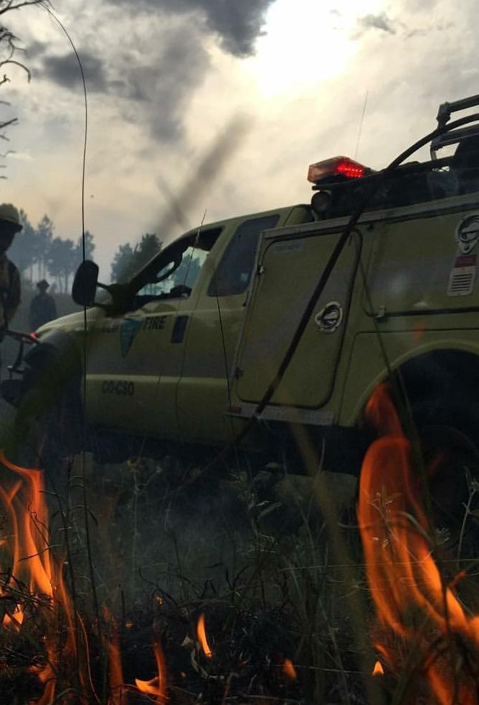
Engine Danger Zones
When working in close proximity of a moving engine, there is an increased risk for an accident to occur.
Given the size of our engines and the environment we work in, operator “blind spots” or danger zones exist.
15

Slide 16
Engine Danger Zones
Whenever possible, operate in the green zones.
Offer visual contact with the operator.
Yellow zones are areas of limited visibility and mirror-use areas.
Notify the driver when you are in these areas.
16

Slide 17
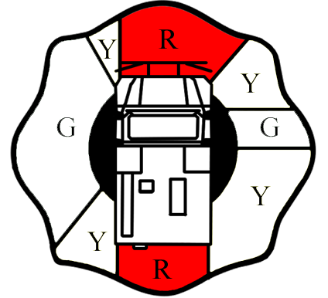
Engine Danger Zones
Never work in red zones when vehicle is moving.
Notify operator prior to entering red zones.
Stay out of red zone where the operator has no visual.
17

Slide 18
Engine Danger Zones
The red area in front of the engine extends 10 feet out from the front bumper.
You must have visual contact with the driver when working in front of the vehicle beyond the 10-foot range.
18

Slide 19
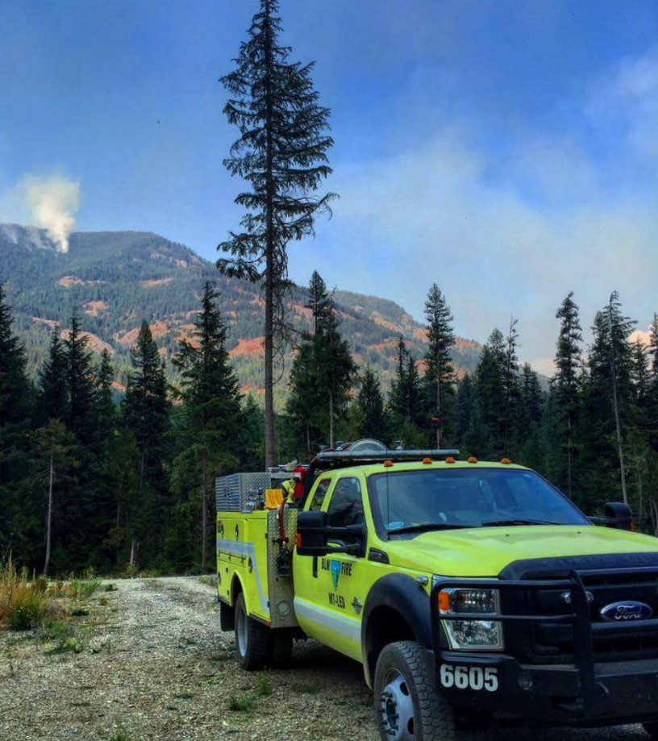
Engine Spotter Usage
There are always blind spots around the engine.
Always use a spotter when another person is available.
If alone, get out and do a visual yourself.
19

Slide 20
When to Use a Spotter
Backing up
Off-road pioneering
Hazardous conditions exist
Low vehicle clearances exist
Narrow/confined driving spaces exist
20
Notes:
Technology has improved the visibility and awareness for drivers, but it is still recommended to utilize spotters when available. Base your decisions on current and anticipated driving conditions.

Slide 21
Spotter Techniques
Spotters should have a clear line of sight to the driver. Spotter position should be:
Forward movement: Outside the forward red zone on the driver side windshield
Backing movement: Outside the rear red zone on the driver side mirror
Spotters and drivers should agree upon a common set of hand signals.
21

Slide 22
Spotter Techniques
Spotters and drivers need to communicate on the planned action.
Spotter distance from the engine will depend on various situations at the time of the maneuver; however, visual contact between the spotter and the driver shall not be compromised.
If the driver loses sight of the spotter, the driver should stop immediately and determine the spotter’s location.
22

Slide 23
Mirror and Seat Adjustment
23

Slide 24
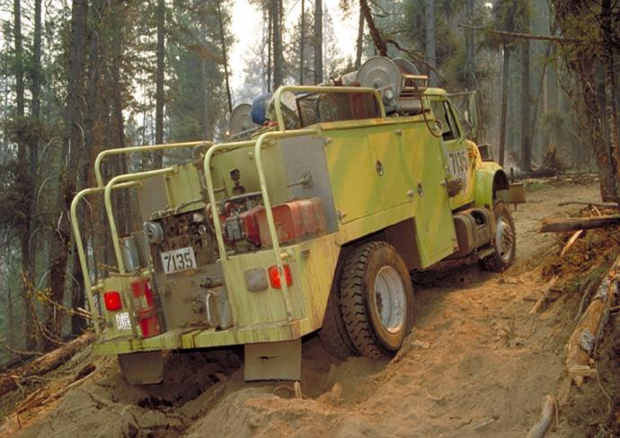
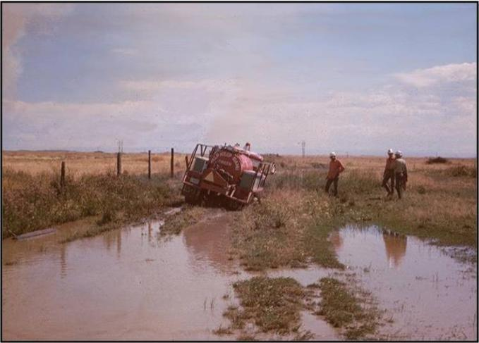
Mud and Sand Areas
24

Slide 25
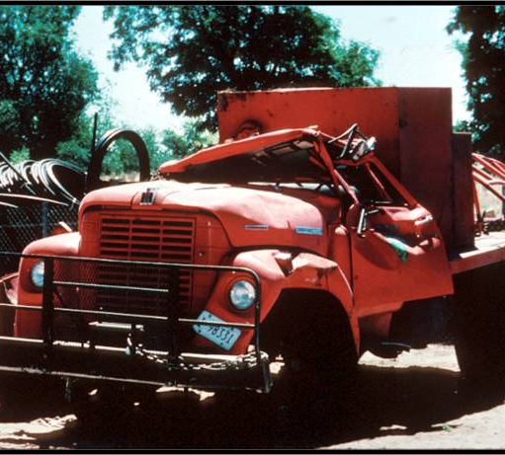
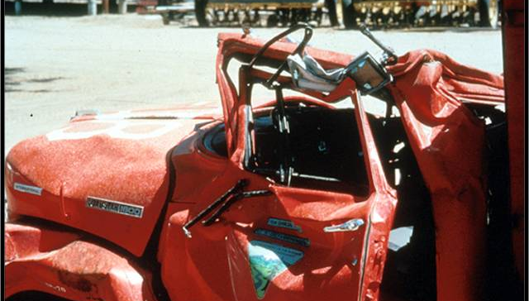
Side Hills
25

Slide 26
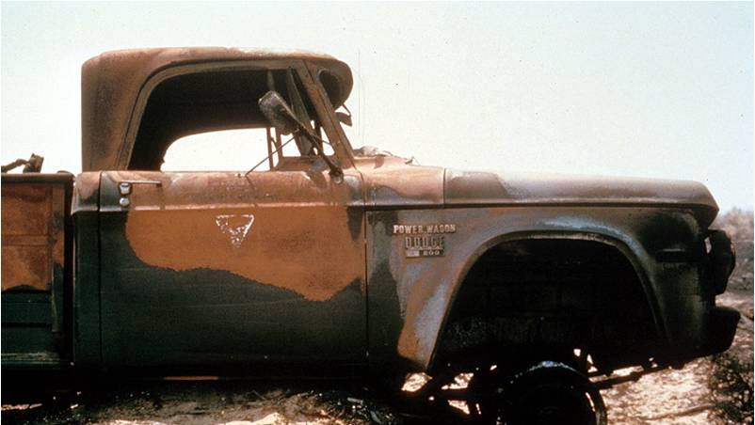
Gullies/Ditches
26

Slide 27
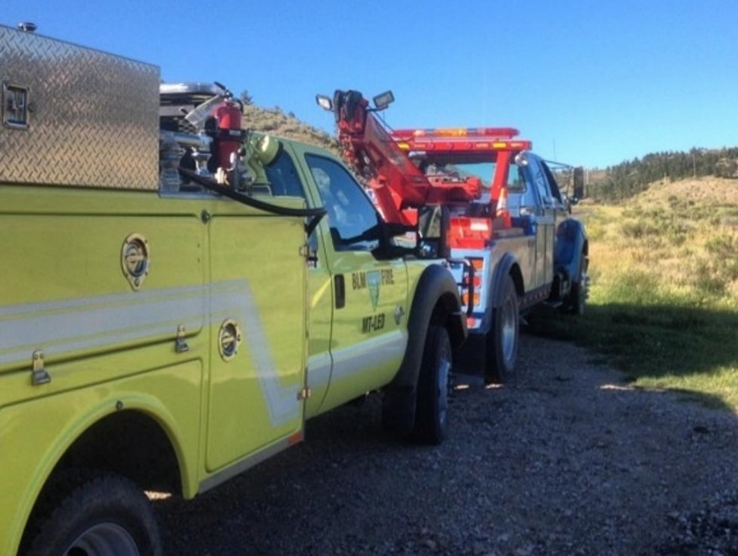
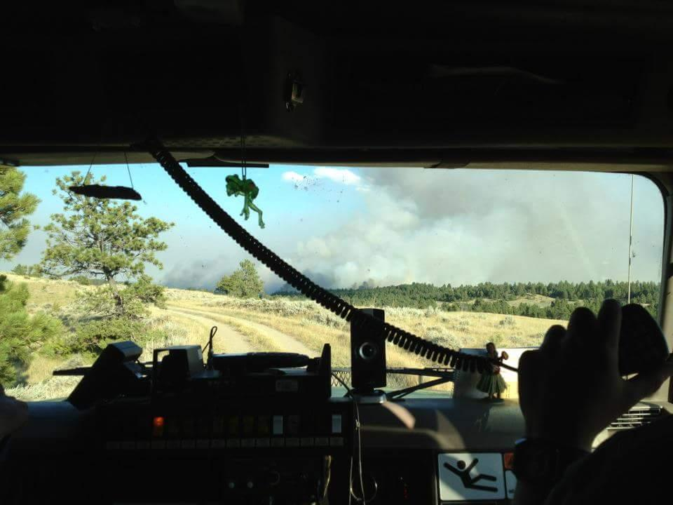
Vehicle Operations and Recovery
27

Slide 28
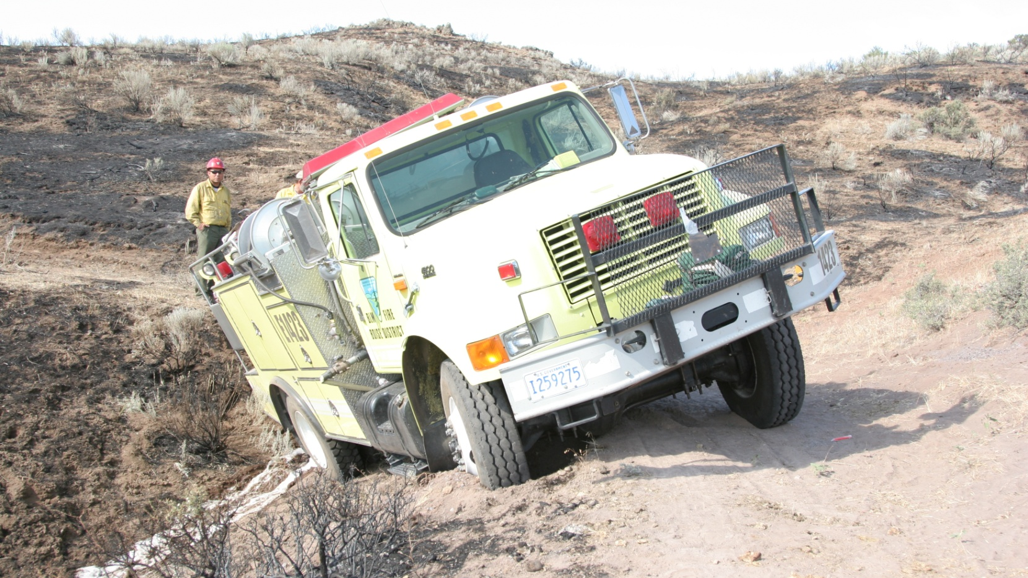
Vehicle Recovery
28

Slide 29
When Recovering a Stuck Vehicle
Every situation is different, and you need to assess each one differently. Survey each situation and really analyze the problem before you try to remove a stuck vehicle. And be aware that you may have to change your mind in the middle of an extraction. If you realize you didn’t assess the entire situation or that circumstances changed, stop what you’re doing and keep your people and equipment safe.

Slide 30
Assess the stuck Equipment
Is the location of the stuck vehicle safe and secure to work in?
Do you know or understand what you are doing?
Will you cause more damage if you do it yourself?
You don’t know the rated capacities for the towing equipment — straps, clevises, chains, and so on?
IF UNSURE, STOP AND CALL A PROFESSIONAL.

Slide 31
Items to Consider When Recovering a Vehicle
Always us the properly rated Recovery Strap.
Attach the Recovery strap to the proper tow points.
Every Fire Engine has two tow points on the front a back.
Never attach to suspension components or Axles.
Trailer hitch ball is not designed as an anchor point.
Secure the extraction area from nonessential personal.

Slide 32
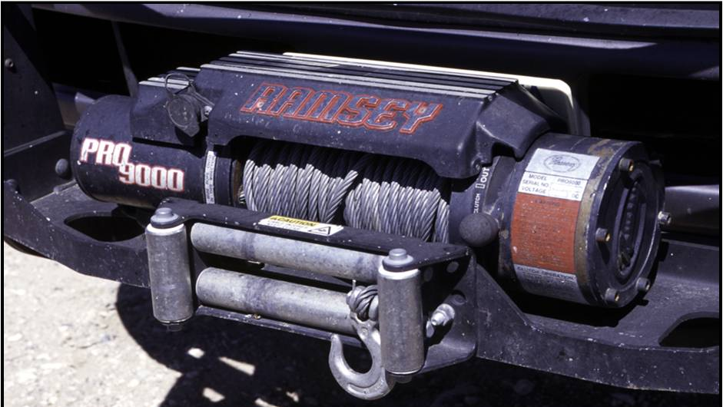
Winch Use
32

Slide 33
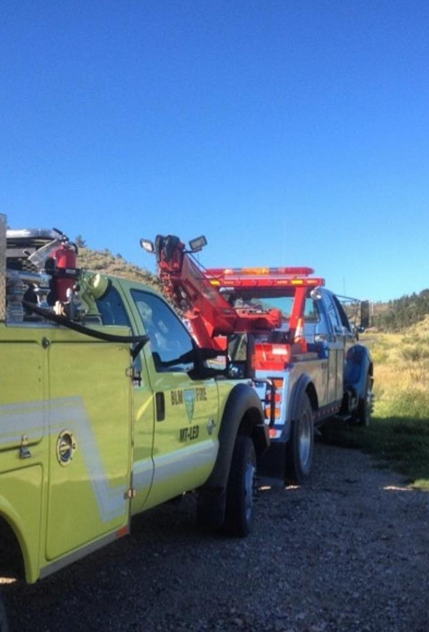
Towing and Being Towed
33

Slide 34
Towing Fees and WCF
Towing or damage from failure to follow the manufacturer’s towing guidelines may not be charged to the WCF, unless the vehicle became disabled due to a component failure that is authorized to be repaired with WCF funds.

Slide 35
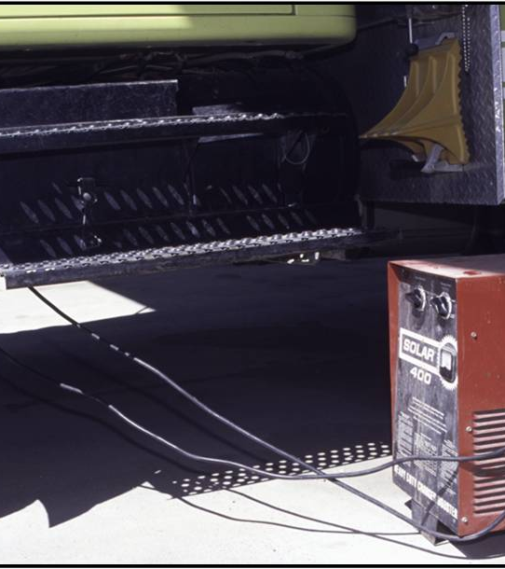
Jump Starting
Refer to the FEMPR.
Turn off ignitions.
Connect red (positive) on dead battery to positive on good battery.
Connect black (negative) on good battery and to solid ground on the other vehicle.
Do not touch cables.
Start good battery and run idle then try to start dead vehicle.
Run for 30 minutes if it starts.
35
Notes:
Remember to remove radio fuses if applicable to the vehicle before jump starting as failure can lead to radio damage.

Slide 36
Portable Battery Jump Starter
Works on Model 52 engines
Inexpensive.
Easily Stored.
Does Not Need a Second (Jumper) Vehicle.

Slide 37
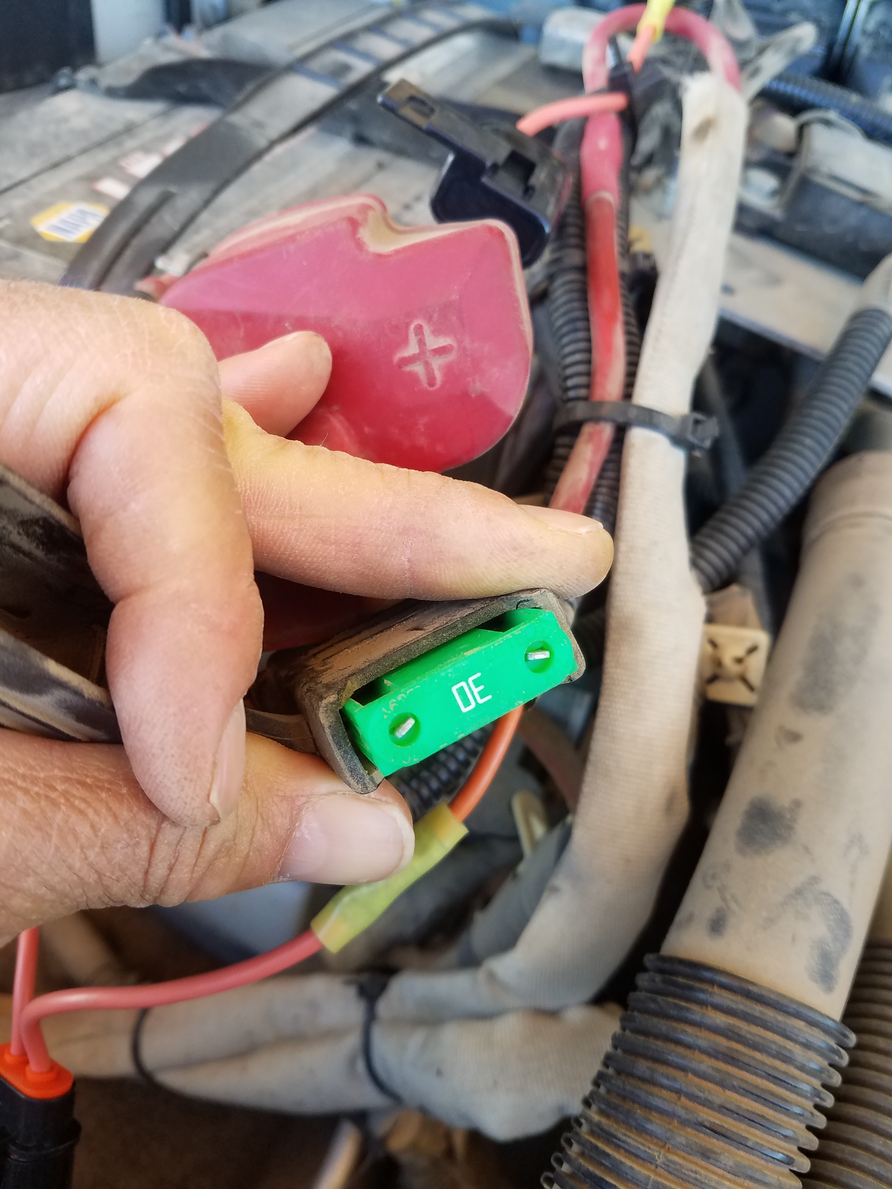
BIA M-52 Remove Radio Fuse
Most M-52 Radios are Fused at the Battery.
Remove Fuse Before Jump Starting.
Failure Will Lead to Serious Radio Damage for the KNG M-Series Radios.
B/K (Old Style) are Less Vulnerable But Can Still Become Damaged.

Slide 38
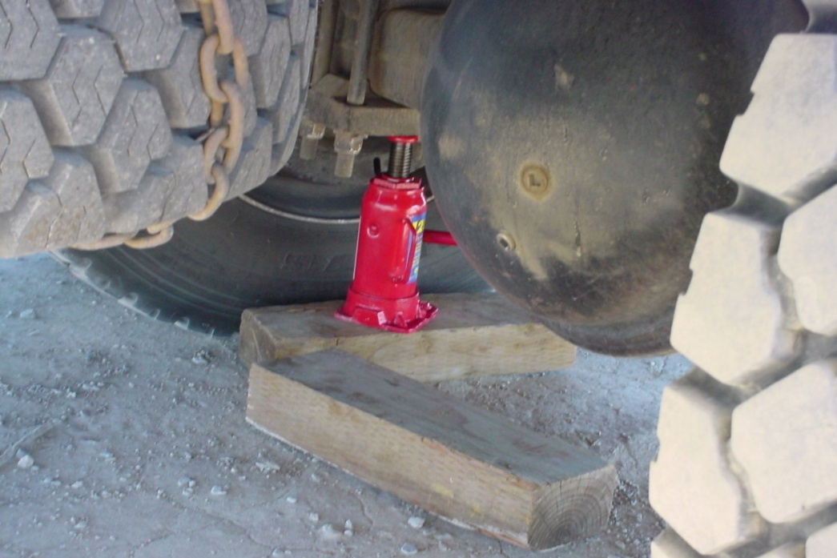
Tire Changing and Jacking
Ensure the jack has the proper tonnage rating for the vehicle.
Torque to the manufacturer’s specifications.
Check torque at 50 miles and 500 miles after tire/rim installation.
38
Notes:
ENOPs need to ensure they have all the materials needed to change tire in field. Pneumatic jacks work well if vehicle can supply pressurized air.

Slide 39
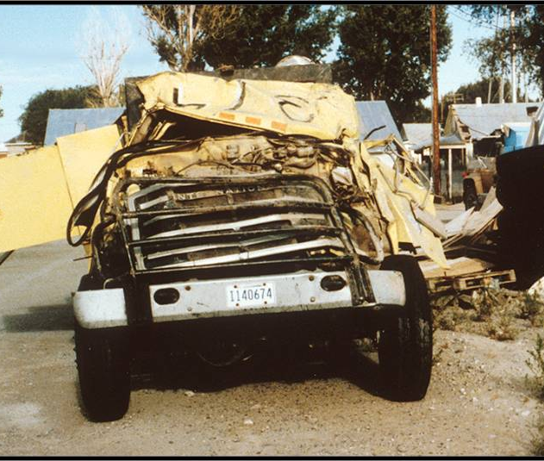
Driving Safety
The crew depends on you!
39

Slide 40
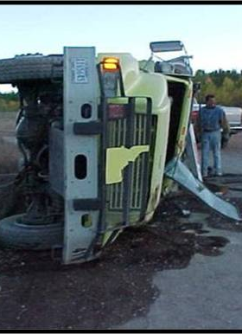
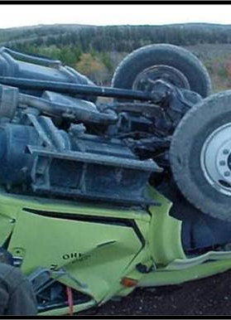
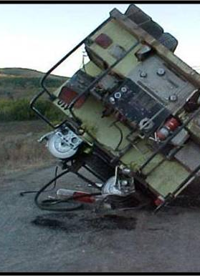
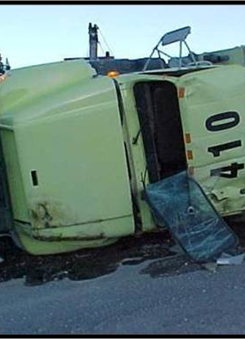
Follow Safe Driving Practices
40

Slide 41
Following Other Vehicles
41

Slide 42
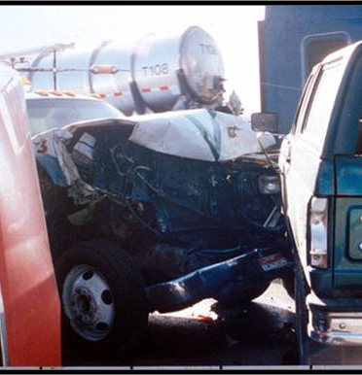
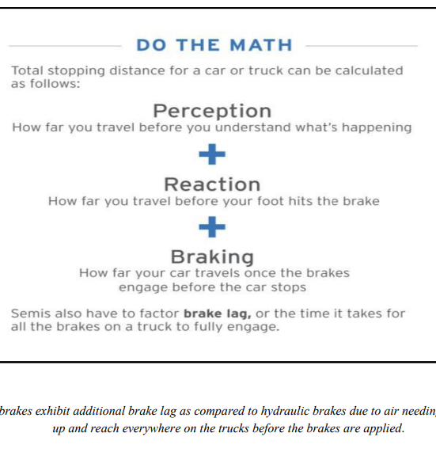
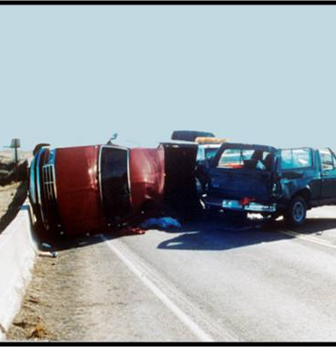
Braking/Stopping Distance
42

Slide 43
Blown Tire Technique
The goal in any rapid loss of tire pressure or “blowout” is to keep the vehicle balanced and controllable. Do not panic. Any over-reaction by the driver—including slamming on the brakes or abruptly removing your foot from the accelerator—can result in a loss of vehicle control.
What you should not do:
Do not step on the brake.
Do not abruptly release your foot from the brake pedal.
What you should do:
Accelerate slightly or keep steady pressure on the accelerator pedal.
Gently correct the steering as necessary to stabilize your vehicle and regain control. Look where you want the vehicle to go and steer in that direction.
Once your vehicle has stabilized, slowly remove your foot from the accelerator pedal allowing the vehicle to slow on its own.

Slide 44
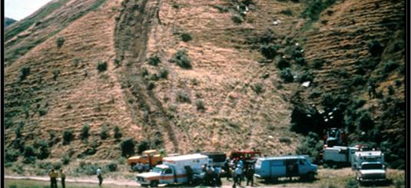
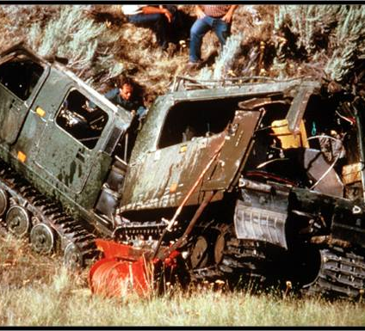
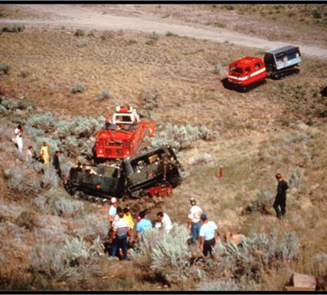
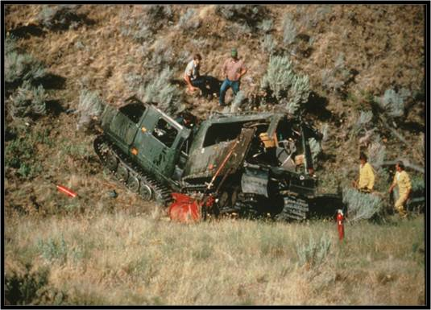
Off-Road Driving
44

Slide 45
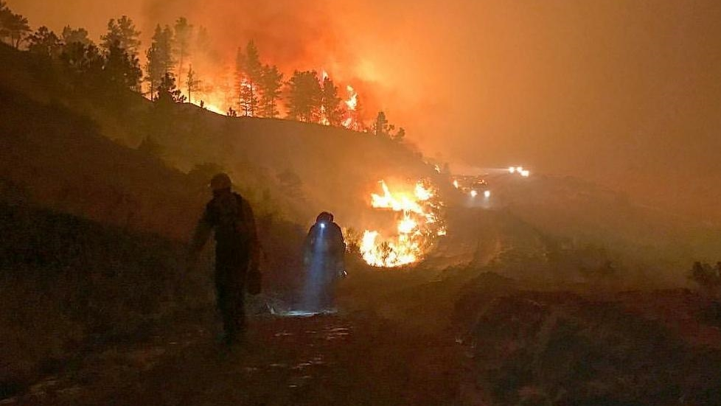
Night Driving
45

Slide 46
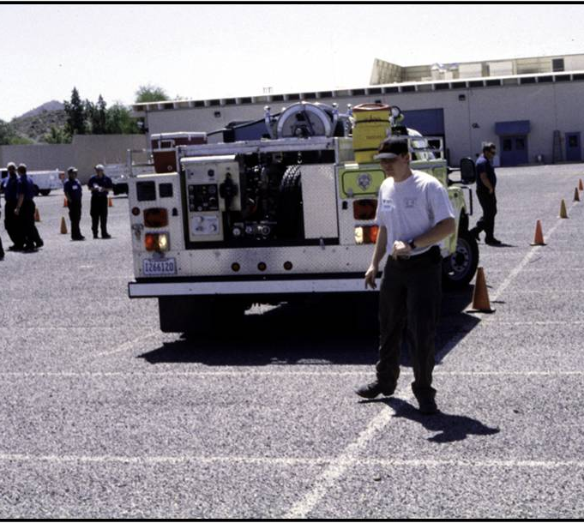
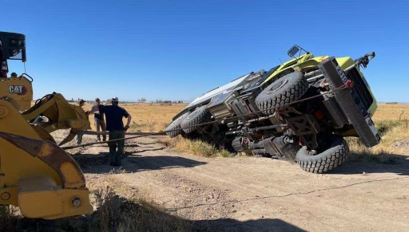
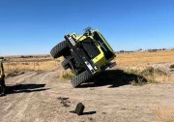
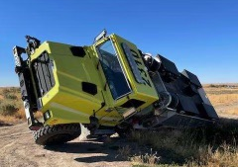
Backing
46

Slide 47
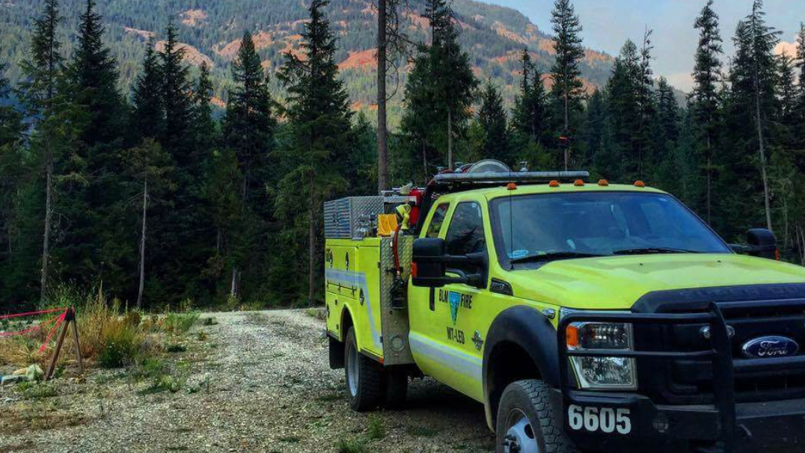
Ingress and Egress
47

Slide 48
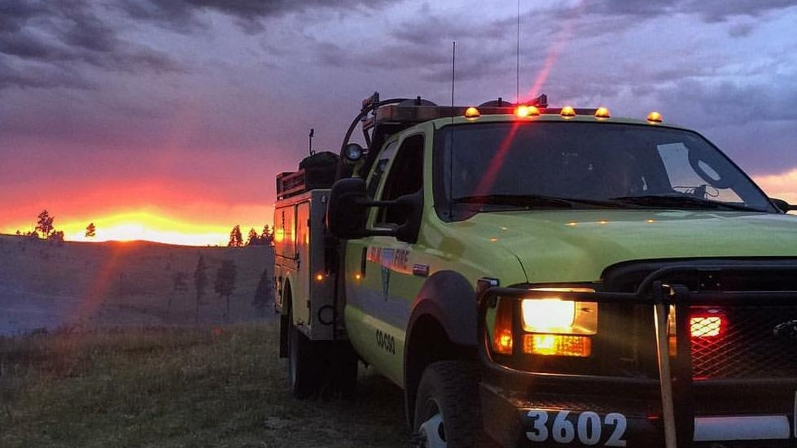
Parking
48

Slide 49
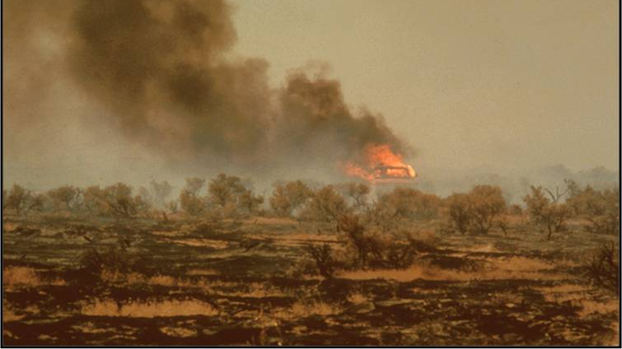
Engine Placement
49

Slide 50
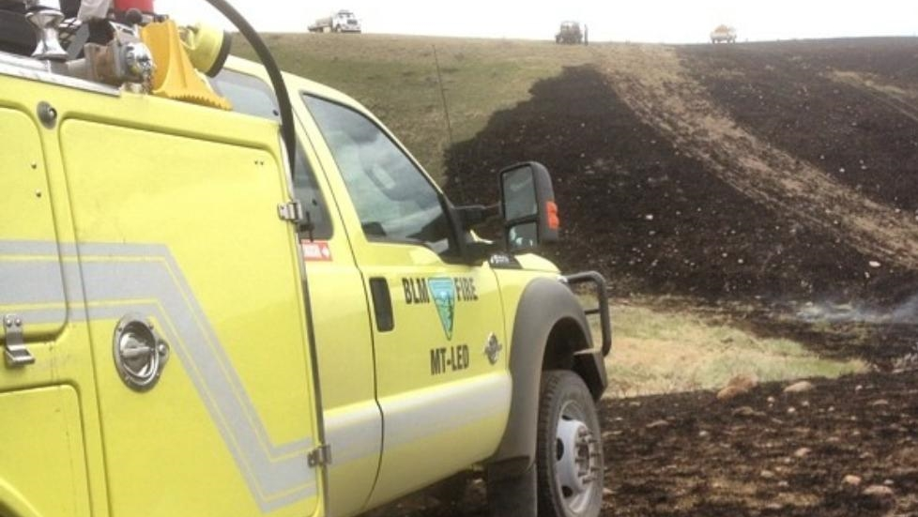
The Black
50

Slide 51
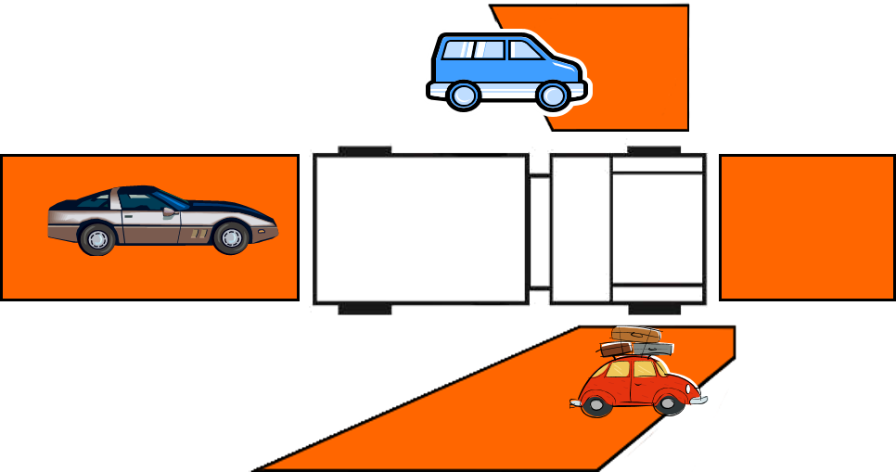
Blind Spots
51

Slide 52
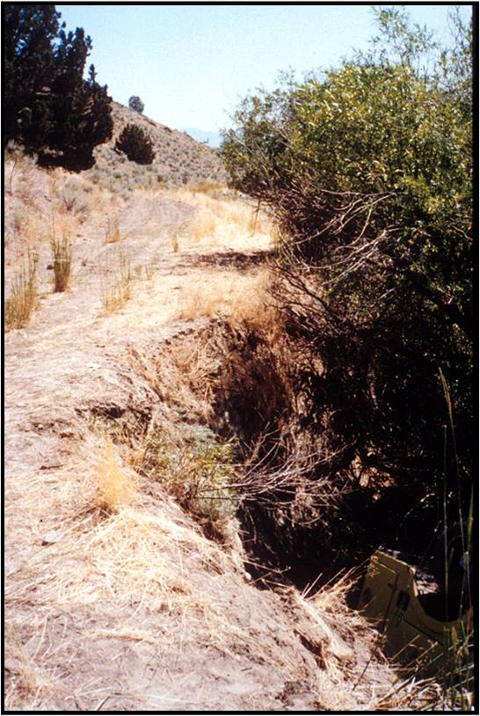
Hazards
Pay attention to your surroundings!
What hazards do you see in this picture?
52

Slide 53
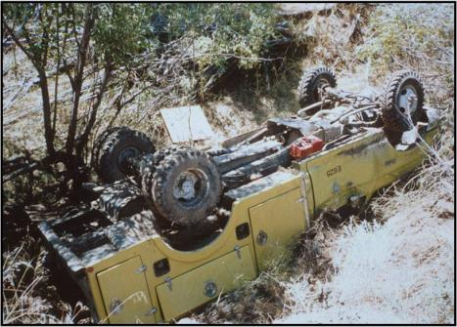
What was in the picture . . .
Creek undercut the road bank
Narrow passageway
Various terrain and fuel types
Rolled engine!

Slide 54
Rock Piles/Outcroppings
54

Slide 55
Various Terrain and Fuel Type Changes
55

Slide 56
Aircraft
56

Slide 57
Wild and Domesticated Animals
57

Slide 58
Poor Weather Conditions
58

Slide 59
Wildland-Urban Interface
59

Slide 60
Staying Alert
60

Slide 61
Post Off-Road Inspection
61

Slide 62
Driving Reminders
62

Slide 63
Driving Reminders
More time can be made up by getting out of the station quickly than by speeding en route. Abide by DOT and local unit driving policies
Keep your vehicle in top condition. Inspect it regularly.
63

Slide 64
Driving Reminders
Never let distractions interfere with your driving.
Good drivers drive smoothly and with control, not recklessly or erratically.
A heavier piece of equipment will not stop as easily as a passenger car.
64

Slide 65
Accidents do not “just happen”
65

Slide 66
Objectives
Describe and demonstrate the driver walk-around before moving a fire engine.
Describe the STOP procedure and how it relates to the driver when operating a fire engine.
Identify danger zones around fire engines and describe actions that can be performed to reduce risk in these areas.

Slide 67
Objectives
Describe and demonstrate the start-up and shifting procedures an ENOP must perform when operating fire engines.
Identify hazardous driving situations and describe actions that can be performed to reduce risk.
Demonstrate on an established course fire engine handling and maneuvering capabilities.

Slide 68
Cone Course Exercise
68

