Slide 1
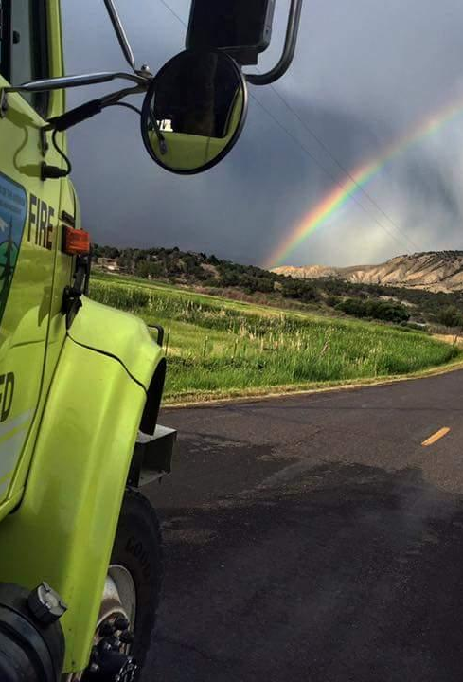
Fire Engine Driving Operations
Unit 3A – Driving Policy and Procedures
1

Slide 2
Objectives
Discuss agency policies and regulations related to driving fire engines.
Discuss and interpret duty-day limitations.
Identify the components of a risk assessment (RA).
2

Slide 3
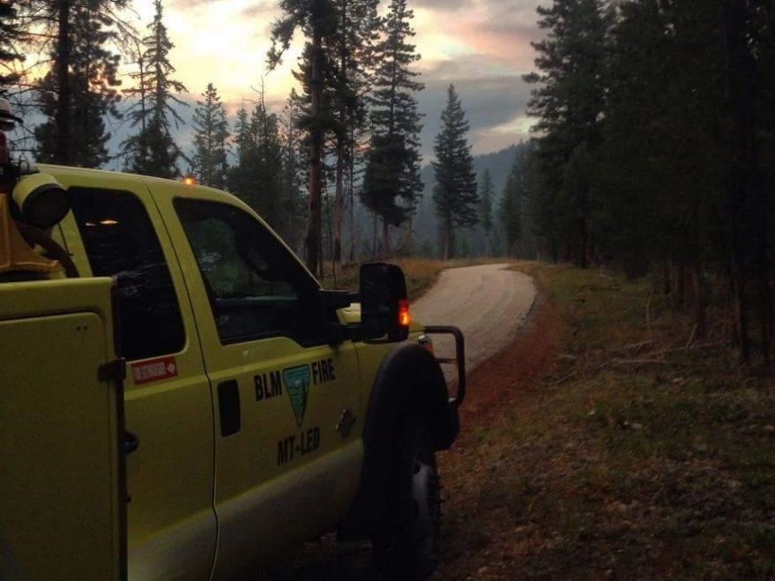
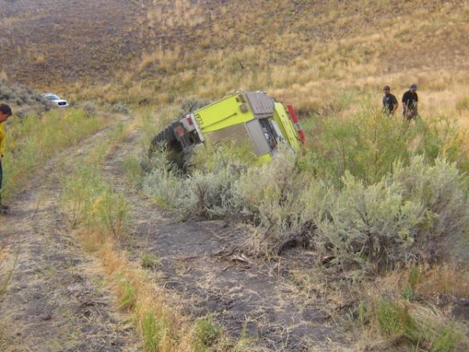
Agency Policies and Regulations
3
Notes:
Policies are set in place because of what has happened before. For safety.

Slide 4
Drug-Free Work Place
Executive Order 12564
Fit For Duty
Interagency Standards for Fire and Fire Aviation Operations
4
Notes:
Fit For Duty

Slide 5
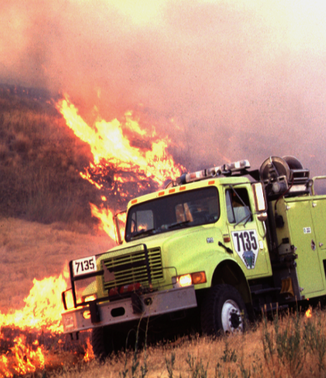
Fire Vehicle Operation Standards
5

Slide 6
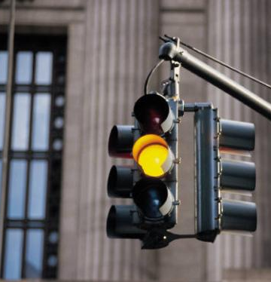
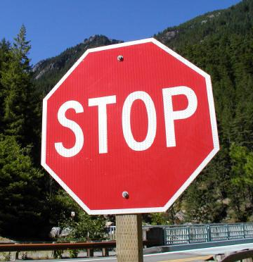
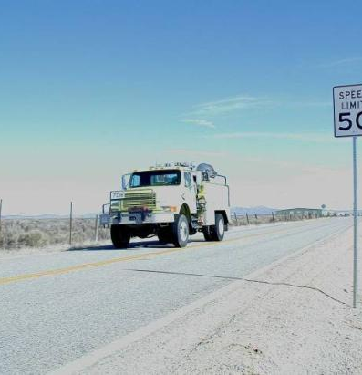
State Traffic Regulations
6

Slide 7
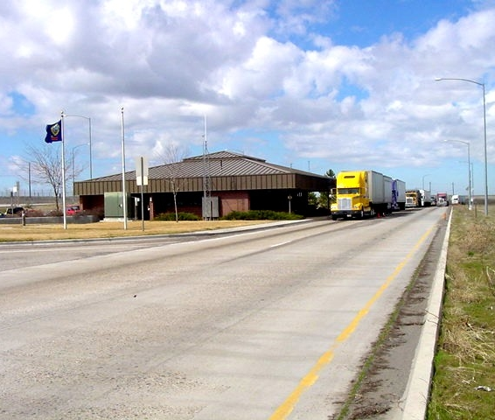
State Traffic Regulations
7
Notes:
Follow all DOT policies enacted for each state – signs, speed limits, etc.

Slide 8
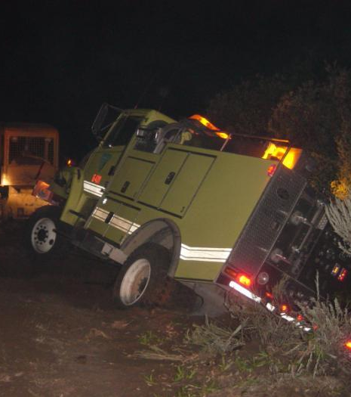
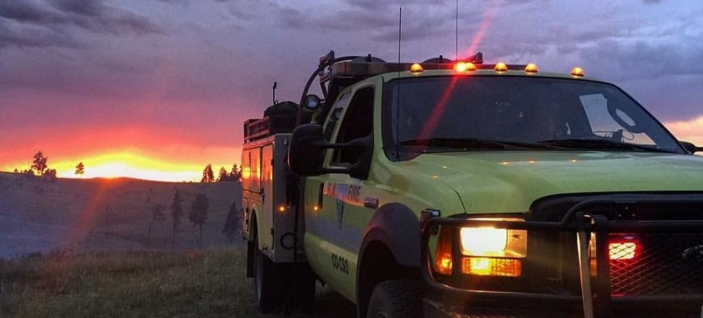
Lights
8
Notes:
Red Lights and Sirens Policy may differ from unit to unit. Ensure you know your units policy and the policy for requirements when off unit. RLS is a separate training

Slide 9
General Driving Policy
Valid state driver’s license
Government Motor Vehicle Operator’s Identification Card (BLM & BIA policies)
Defensive driver training
BL-300/RT-301
Seat belts
Physical Fitness Inquiry for Motor Vehicle Operators (BLM policy)
9
Notes:
Government Motor Vehicle Operator’s Identification Card:
BLM – BLM Form 1112-11, Motor Vehicle/Special Equipment Authorization
BIA – GSA Form 3607, Motor Vehicle Operator’s License and Driving Record (annually)

Slide 10
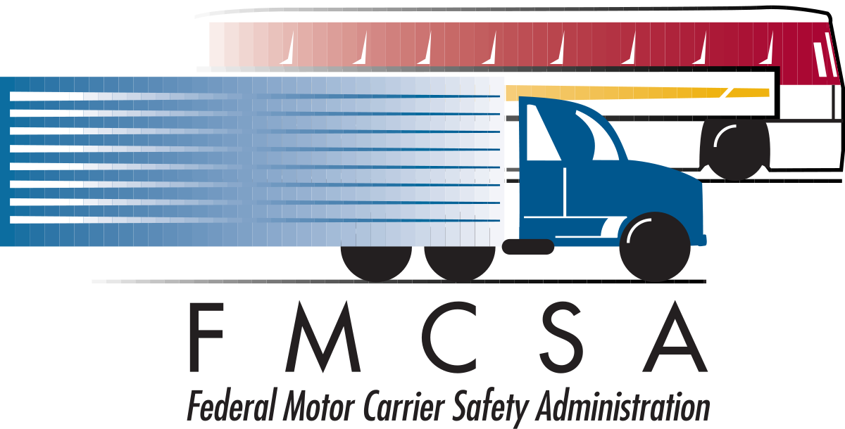
Driving Limitations
CDL for ENOPs operating vehicles in excess of 26,000 GVW/Entry Level Driver Training (ELDT)
DOT exemptions for wildland fire
10
Notes:
Share ELDT information with class _ Entry Level Driver Training Requirements

Slide 11
Incident Operations Driving
No driver will drive more than 10 hours (behind the wheel) within any duty day.
Multiple drivers in a single vehicle may drive up to the duty-day limitation provided no driver exceeds the individual driving (behind the wheel) time limitation of 10 hours.
Driving hours are from 0500-2200 hours.
To manage fatigue, every effort should be made to avoid off-unit (excluding IA response) mobilization and demobilization travel between 2200-0500 hours.
11
Notes:
25 IAM Chapter 4 is the official BIA driving policy, updated in April 2020. This sets the duty day limitations for one driver at 8 hours. This is also in the 2022 Red Book.

Slide 12
Incident Operations Driving
A driver shall drive only if he/she has had at least eight (8) consecutive hours off duty before beginning a shift. Exception to the minimum off-duty hour requirement is allowed when essential to:
Accomplish immediate and critical suppression objectives.
Address immediate and critical firefighter or public safety issues.
12

Slide 13
Work/Rest Guidelines
Documentation is required for shifts in excess of 16 hours.
Minimum 2:1 work-to-rest ratio (for every two hours of work or travel, provide one hour of sleep and/or rest)
13

Slide 14
Work/Rest Driving Scenarios
14

Slide 15
Scenario 1
You (the ENOP with a CDL) and a module member (non-CDL driver) are traveling to another state in a Type 4 engine. The trip length is estimated at 26 hours.
How many days will it take to reach your destination?
15

Slide 16
Scenario 1 - Answer
Three days
“No driver will drive more than 10 hours (behind the wheel) within any duty day.”
The non-CDL driver is not allowed to drive the engine.
16

Slide 17
Scenario 2
You (the ENOP with a CDL) and a module member (non-CDL driver) are traveling to another state in a Type 6 engine. The trip length is estimated at 26 hours.
How many days will it take to reach your destination?
17

Slide 18
Scenario 2 - Answer
Two days
“Multiple drivers in a single vehicle may drive up to the duty-day limitation provided no driver exceeds the individual driving (behind the wheel) time limitation of 10 hours.”
The non-CDL driver is allowed to drive the engine, but both drivers are subject to the 16-hour duty day.
18

Slide 19
Scenario 3
While on assignment on a 200,000-acre fire and working 12-hour shifts, the division group supervisor asks your crew to work an extra 8-hour shift to monitor the line.
Is this something your crew can do?
19

Slide 20
Scenario 3 - Answer
No. This will exceed the 2:1 work-to-rest ratio.
However, the Incident Commander could write a justification authorizing the action.

Slide 21
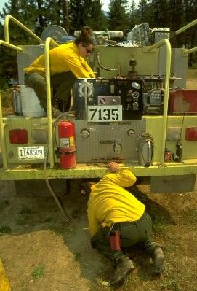
Driver Walk-around
A driver walk-around will be done every time the engine is moved.
Notes:
Differs from a full morning PM check as you are not completing full inspection. Ensuring everything is secured and no hazards exist that will impede vehicle operation. Covered in later unit in depth

Slide 22
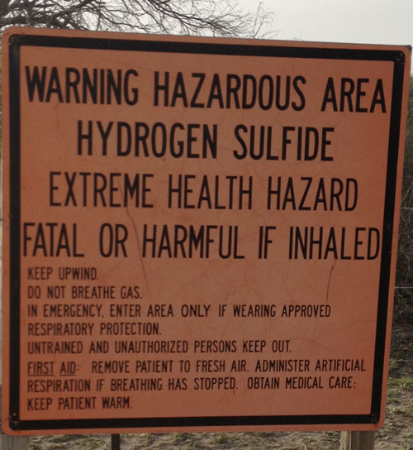
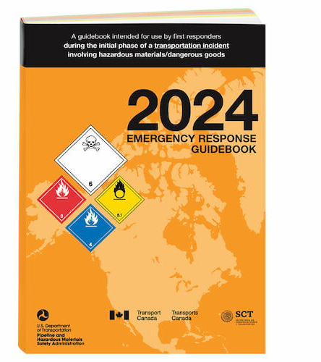
Hazardous Materials

Slide 23
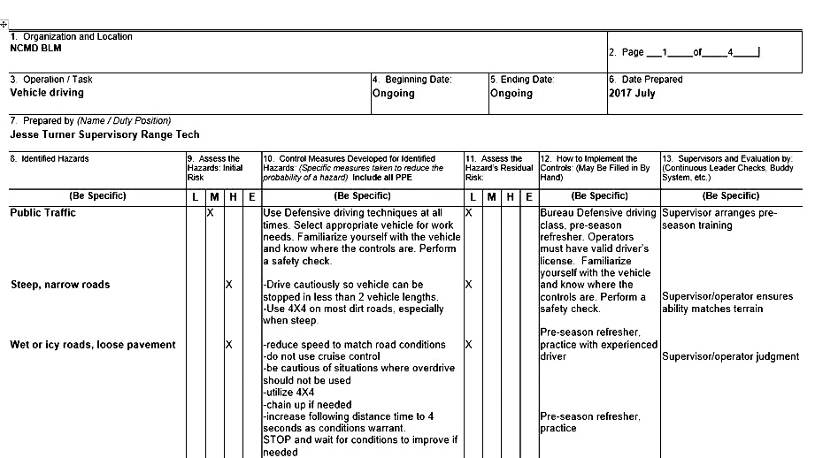
Safety and the Risk Assessment

Slide 24
What is a Risk Assessment?
A risk assessment (RA) is a technique that focuses on job tasks as a way to identify hazards before they occur. It focuses on the relationship between the worker, the task, the tools, and the work environment. Ideally, after you identify uncontrolled hazards, you will take steps to eliminate or reduce them to an acceptable risk level.

Slide 25
Why Complete a Risk assessment?
A completed RA is required for:
Jobs or work practices that have potential hazards.
New, non-routine, or hazardous tasks to be performed where potential hazards exist.
Jobs that may require the employee to use non‑standard personal protective equipment (PPE).
Changes in equipment, work environment, conditions, policies, or materials.
Interagency Standards for Fire and Fire Aviation Operations

Slide 26
Why do a Risk Assessment? (Continued)
Supervisors and appropriate line managers must ensure that established JHAs are reviewed and signed prior to any non-routine task or at the beginning of the fire season.
BUREAU OF LAND MANAGEMENT
A risk assessment (in lieu of JHA) must be completed for all non-suppression work practices/projects that have potential hazards.”
Interagency Standards for Fire and Fire Aviation Operations
BUREAU OF INDIAN AFFAIRS
A completed JHA/RA is required for jobs or work practices that have potential hazards.
Interagency Standards for Fire and Fire Aviation Operations

Slide 27
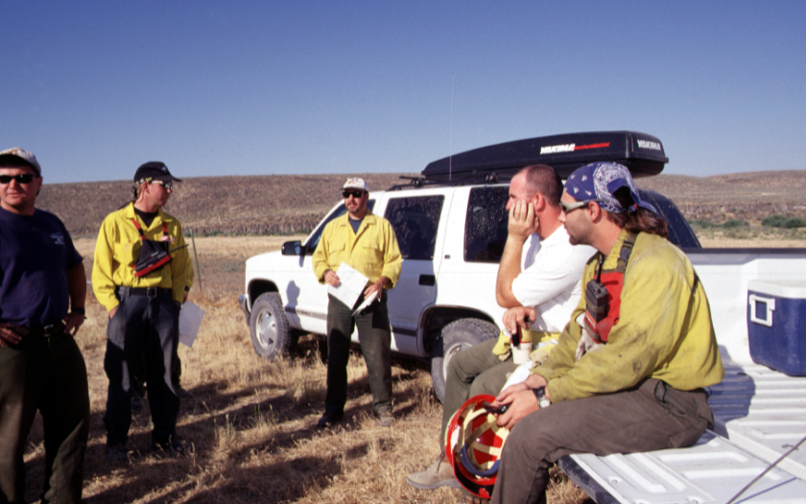
Tailgate Safety Session
Notes:
BLM/BIA utilizes tailgate safety sessions as a component of discussing the risk assessment and identifying mitigations for hazards. Can be done at any time but mostly completed when performing tasks outside routine parameters

Slide 28
Objectives
Discuss agency policies and regulations related to driving fire engines.
Discuss and interpret duty-day limitations.
Identify the components of a risk assessment (RA).
28

