Slide 1
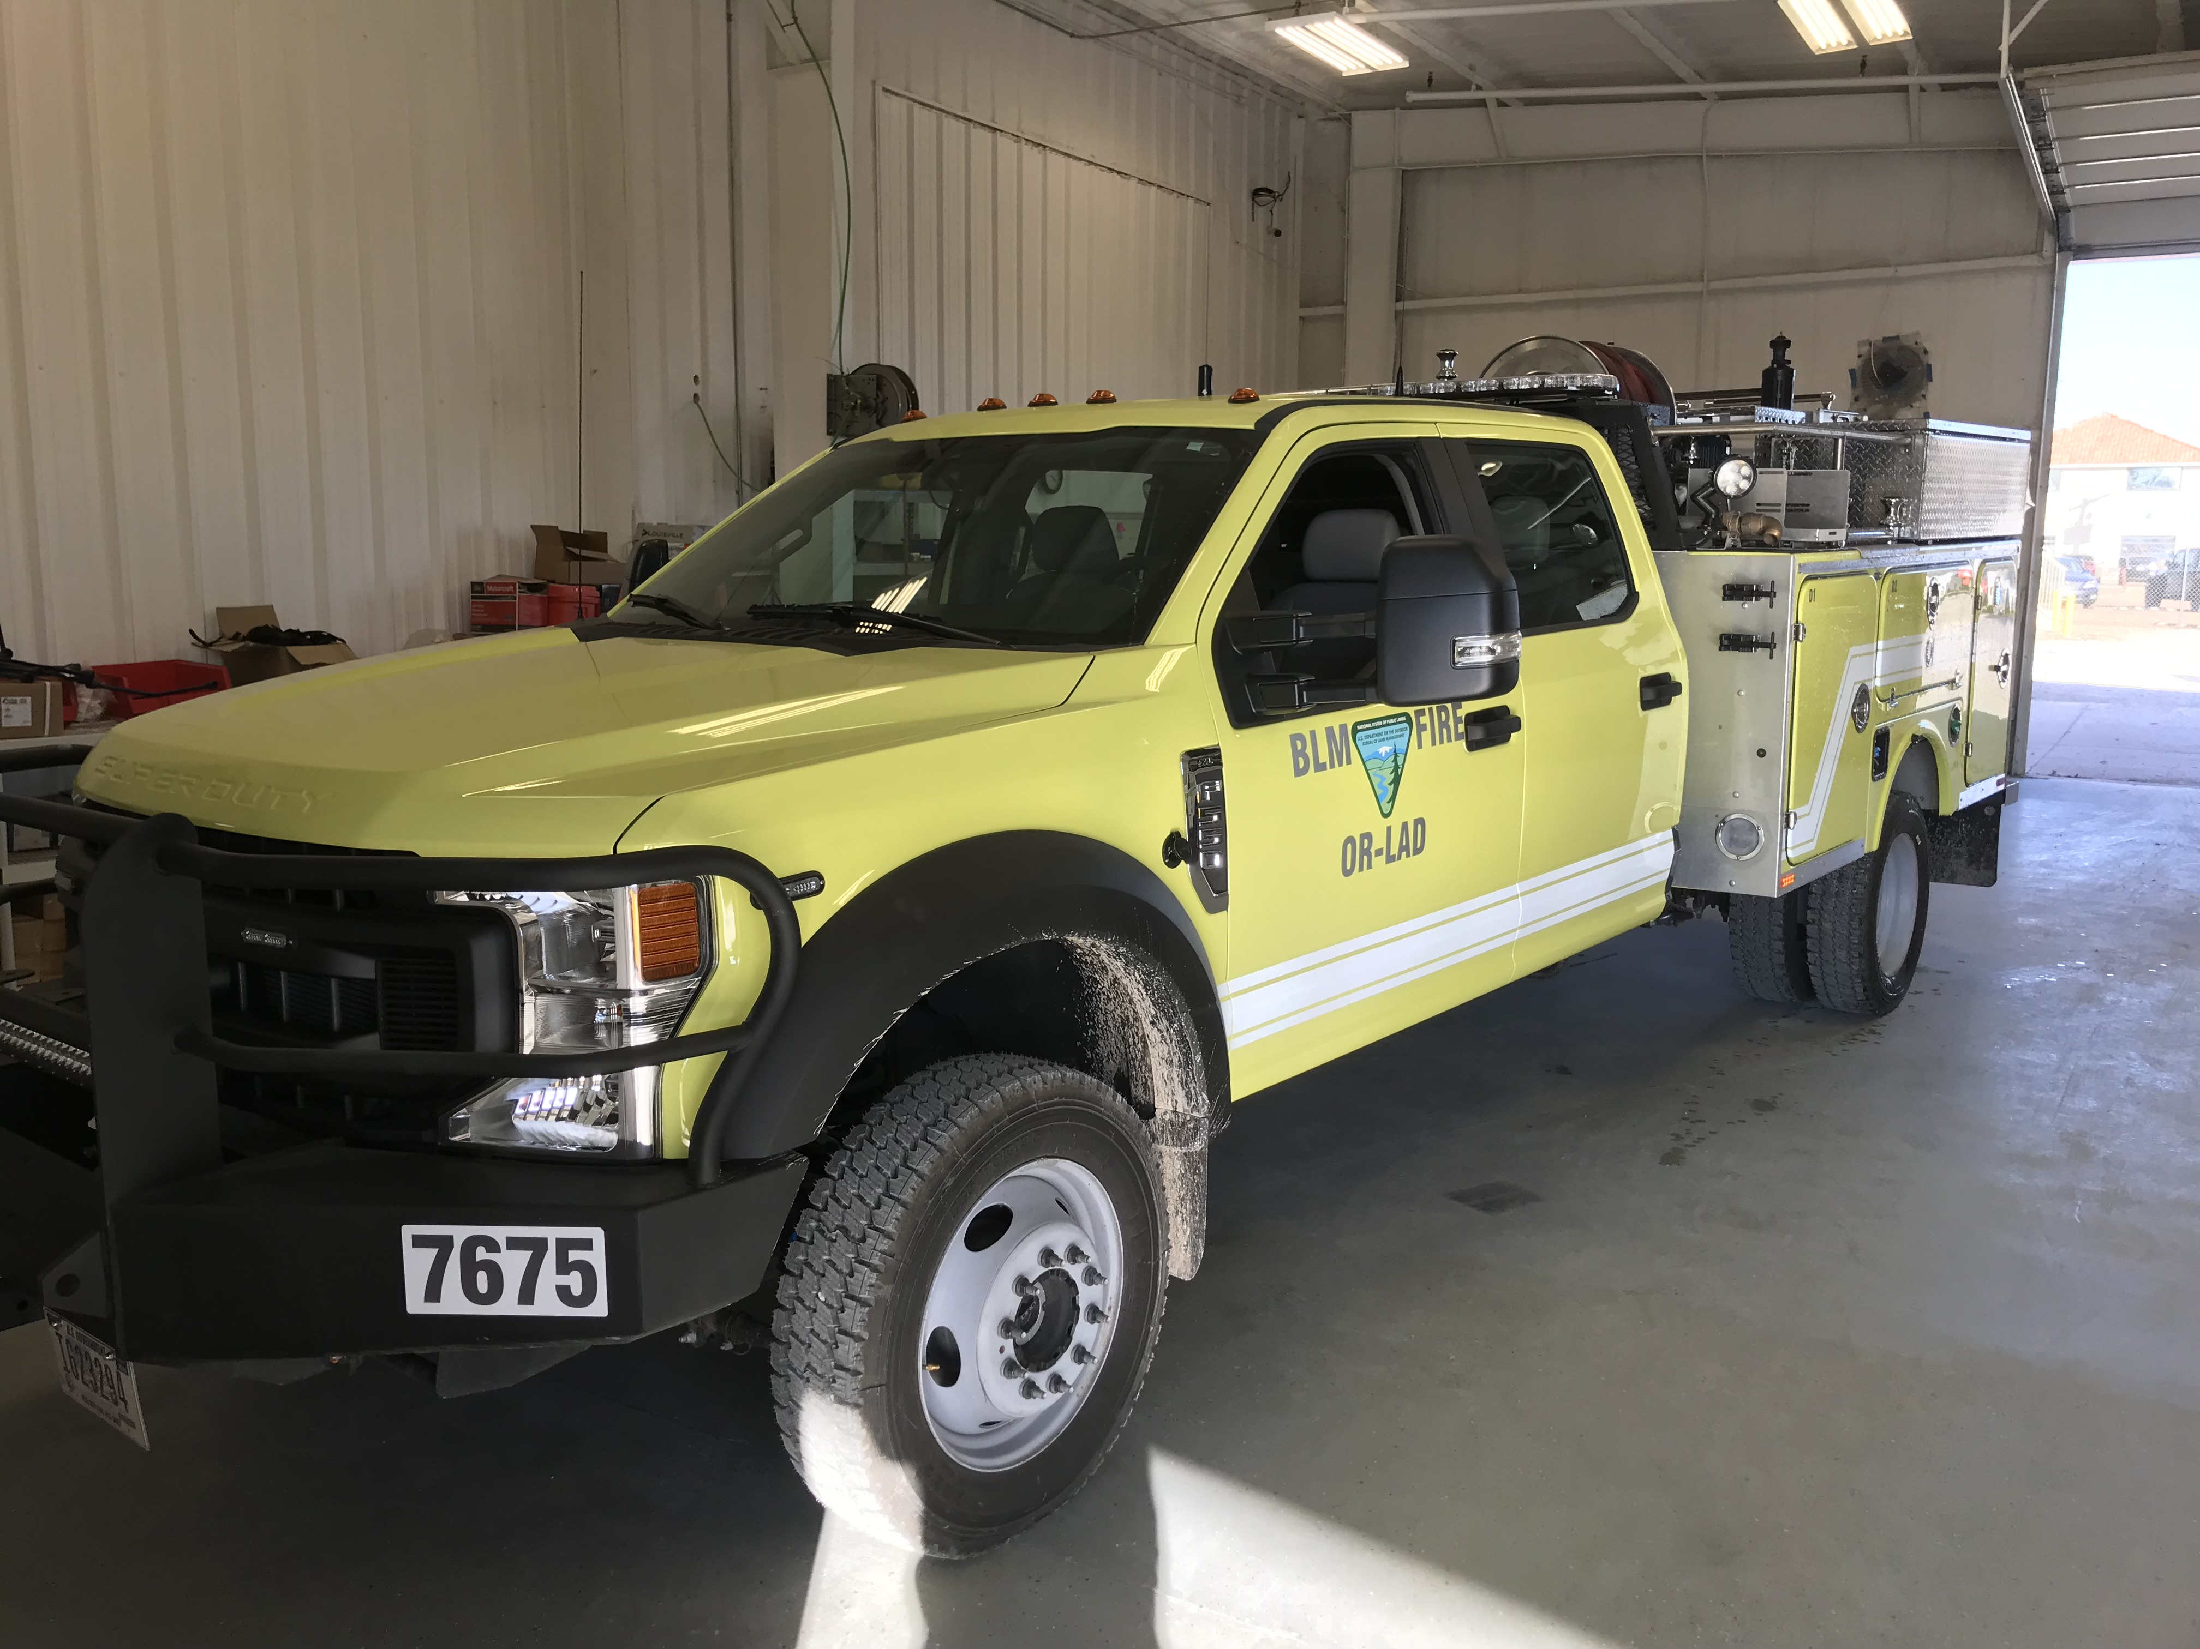
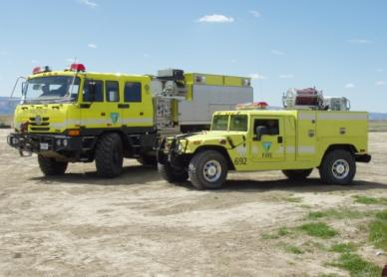
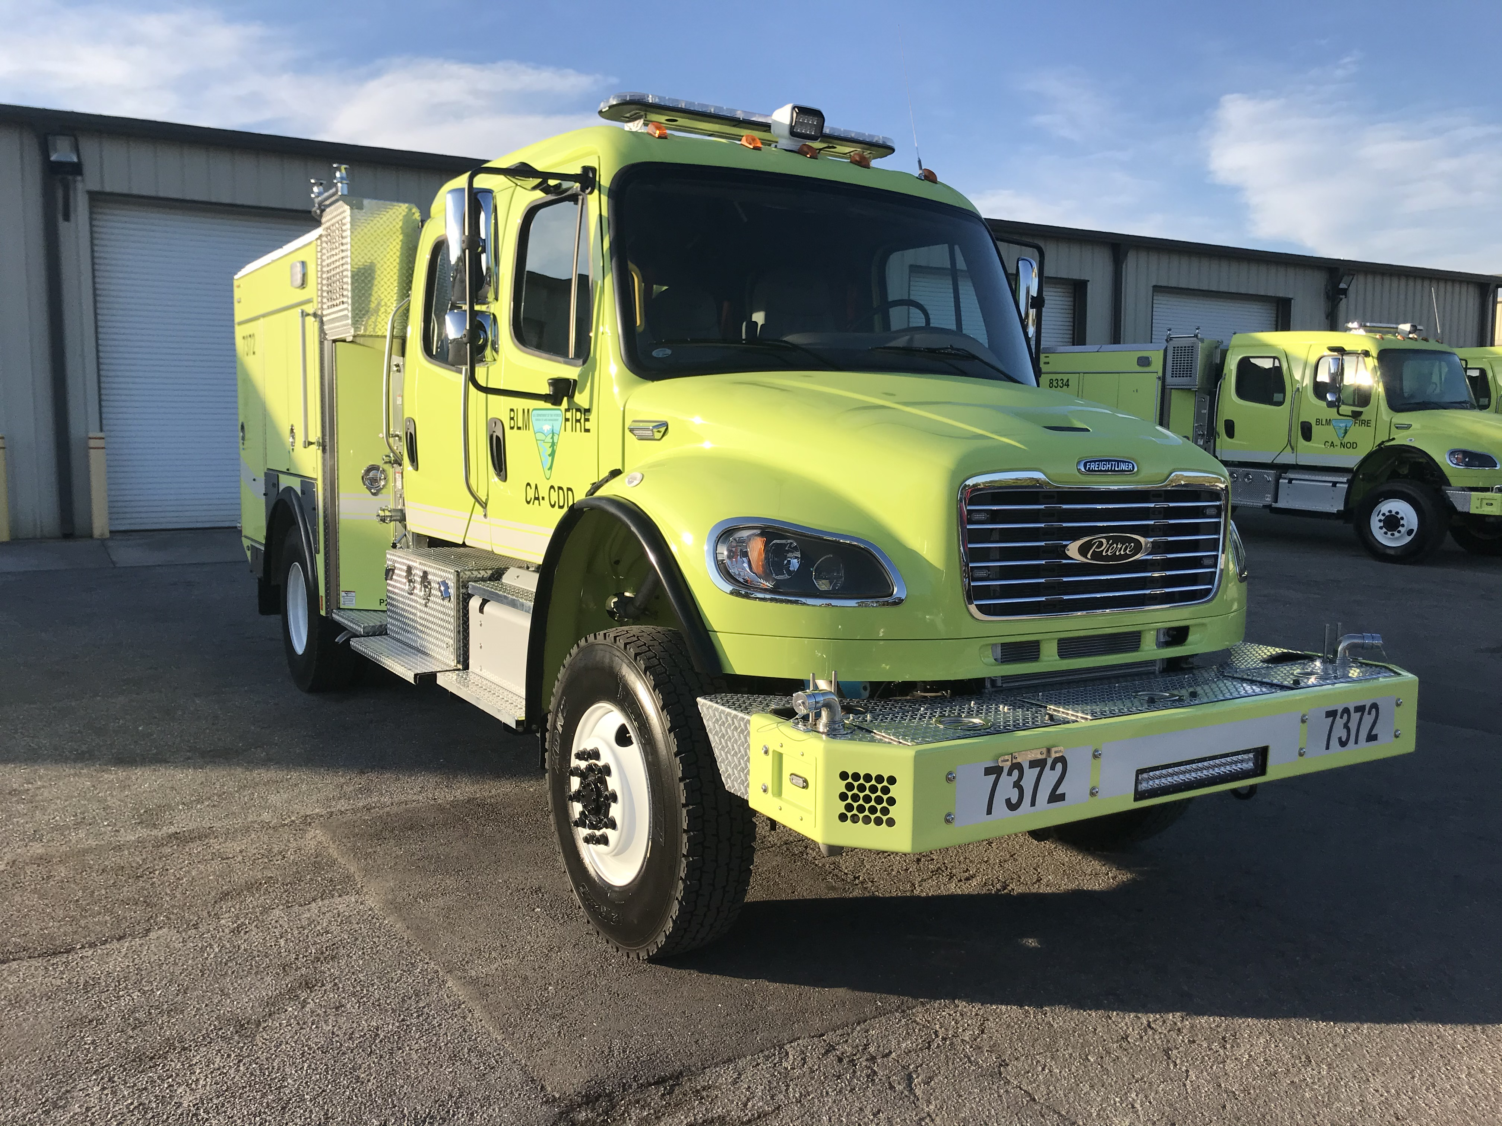
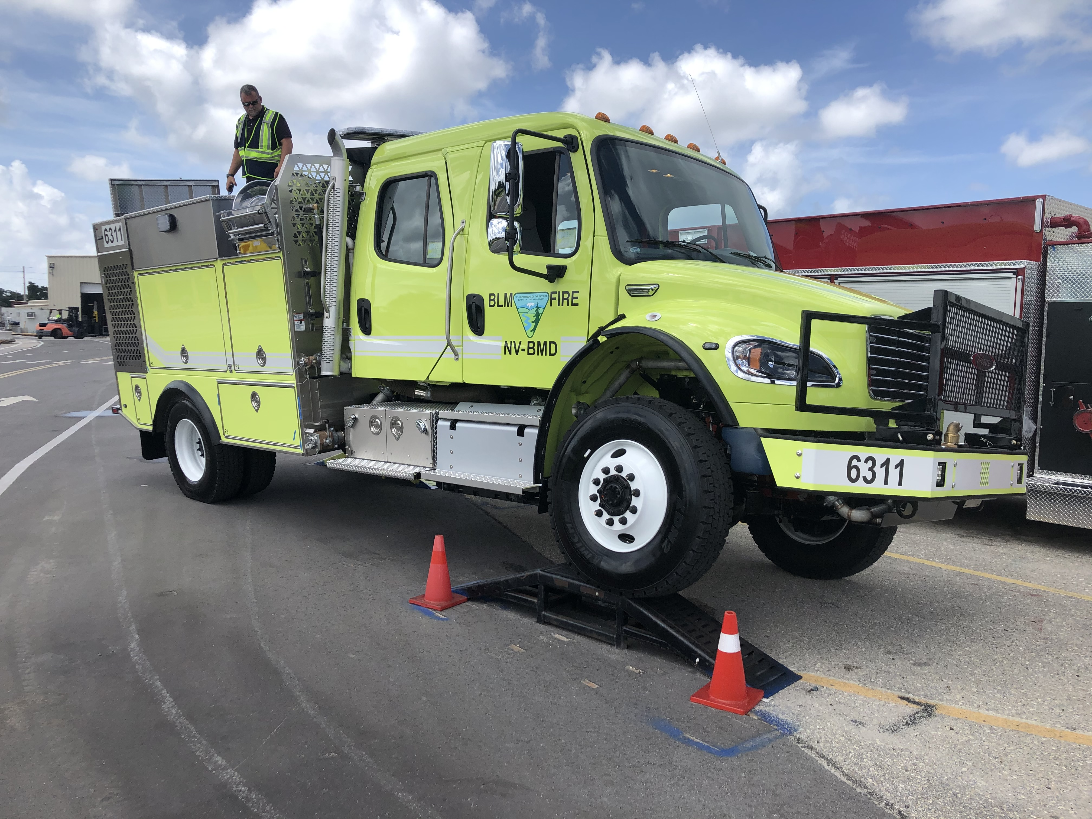
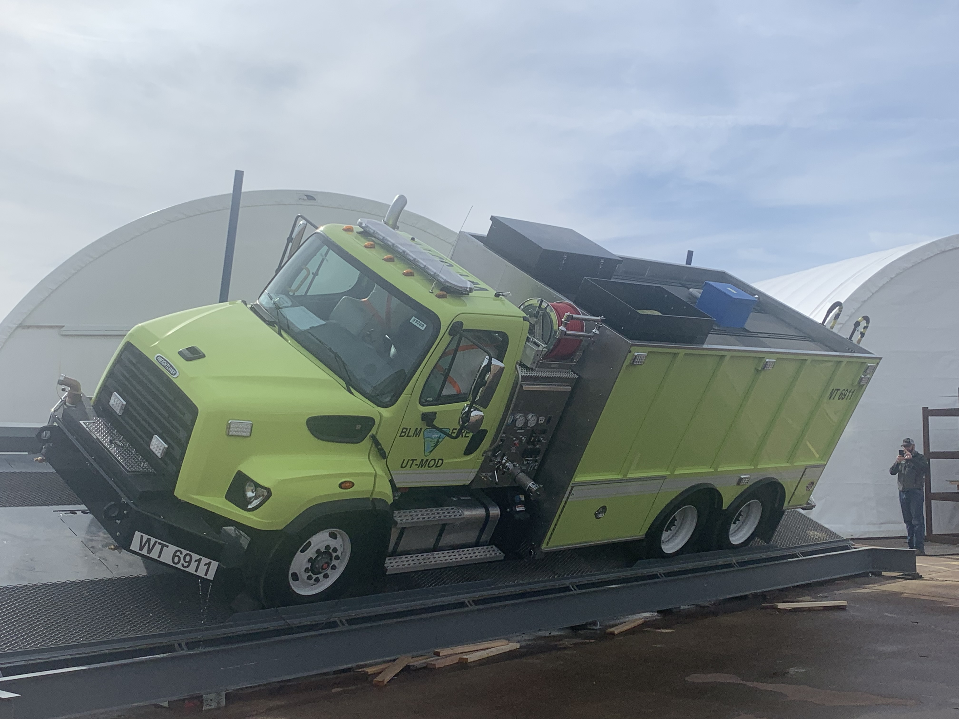
FLEET MANAGEMENT
UNIT 2
1

Slide 2
Objectives
Accurately identify expenditures that can be charged to the Working Capital Fund (WCF).
Discuss the ENOP’s fleet charge card responsibilities.
Explain the concepts of gross vehicle weight rating (GVWR), gross axle weight rating (GAWR), gross vehicle weight (GVW), and the ENOP’s role in maintaining proper GVW.
Identify items that are included in the vehicle use (log) book.
2

Slide 3
Objectives
Demonstrate the ability to complete and reconcile the “Utilization Record” (USDI/BLM Form 1520-042).
Explain the procedure an ENOP should follow when involved in a motor vehicle accident.
Explain fire engine warranty repairs and recall procedures.
3

Slide 4
Introduction to the Working Capital Fund
4
Notes:
The BLM WCF is managed by the BLM Fleet Manager at the National Operations Center, Denver. Replacement of fire vehicles that have reached the end of their service life and certain maintenance expenditures are managed through the WCF. Vehicle replacement and maintenance is accomplished with funds that are paid into the WCF over the life of the vehicle. The WCF collects funds through Fixed Ownership Rates (FOR) and Use Rates.

Slide 5
Fixed Ownership Rates (FOR)
Monthly hours- or miles-based fees that are assessed through the Automated Fleet Management System (AFMS) for each fire vehicle in service.
Assessed on a per-hour basis (BLM standard)
Accumulate over the life of a vehicle
Used to replace each vehicle at the end of its life cycle
Charged to the benefiting activity
Adjusted annually at a minimum (reflect changes in replacement costs for inflation and/or changes to benefitting activity)
5
Notes:
Revenues from FORs and expenditures for capitalized assets

Slide 6
Use Rates
Charged monthly based on a per-hour or per-mile basis for vehicle operating costs.
Independent of the FOR rates
Adjusted annually
May vary from year to year
Notes:
Revenues from use rates and expenditures for operating expenses.
Use rates are independent of the FOR rates and are adjusted annually to reflect all WCF costs associated with the administration, delivery, maintenance, and repair of vehicles in each vehicle class.
Use rates may vary from year to year, particularly in those vehicle classes which have low number of vehicles.

Slide 7
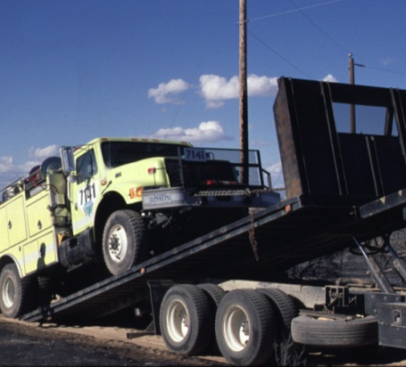
Use Rate Costs
Fuel
Repair/normal wear and tear on engine components
Tow charges resulting from mechanical breakdowns
Preventative maintenance
Overhead
7

Slide 8
Items WCF Covers
Normal wear and tear associated with use the vehicle was designed to perform.
Tires
Windshield wipers
Brakes
Shocks
Paint
Upholstery
Pumps
Lights
Scheduled/required maintenance and inspections
To service, replace and inspect fire vehicle components that were part of the initial vehicle build and options, as delivered to the BLM.
Mechanical failure unrelated to benefiting activity if there is no negligence or misuse associated with the damage.
Fire operations
Project work

Slide 9
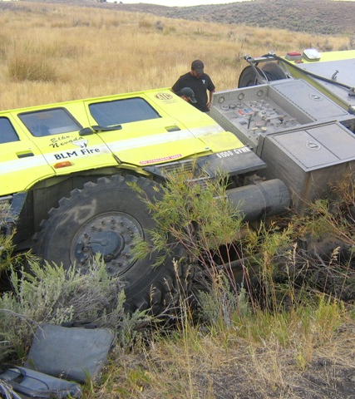
Items WCF Does Not Cover
Accident damage or repairs due to benefitting activity actions such as fire operations or other project work
Mechanical/component failure due to neglect or misuse
Towing charges related to accidents or getting stuck
Locally required vehicle modifications/ add-ons/accessories
Light bars
Tools
Radios
Winches
9

Slide 10
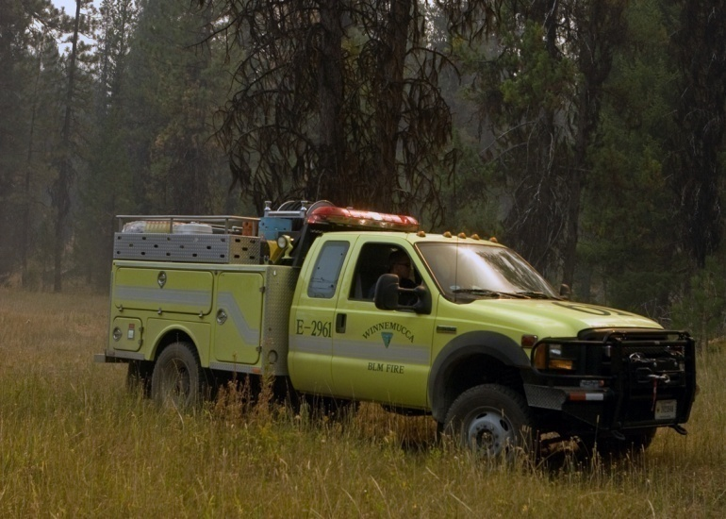
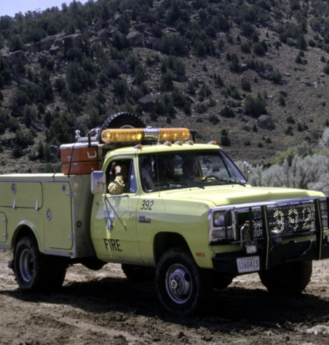
WCF Life Cycle
Predetermined period that vehicles of a given class are expected to be in service before they can be replaced.
Determined through evaluation of the historical amount of use and general durability for vehicles of that class.
10

Slide 11
The WCF account
11

Slide 12
WCF Repair Process
$0-$2500 – Maintenance/Repair charges are processed through local fleet manager on vehicle CC
$2500-$10000 – Charges must be approved by NFEP manager or delegate (1520-063 form)additional documentation may be required (maintenance documentation package including FEMPR, oil sampling results, annual inspections, multiple quotes)
$10000-$15000 – PR needs to be completed w/ PR vocer sheet – approved by WCF Funds Approver / NFEP manager
$15000 + - PR process with NOC approval
Visit NFEP Equipment Policy / Resources SharePoint for additional information and access to the 600 class vehicle repair flowchart
https://doimspp.sharepoint.com/sites/blm-fa/fire-operations/SitePages/NFEP-Policy-Resources.aspx?web=1

Slide 13
Fund Code Exercise Student Workbook pP. 59-60
13
Notes:
Complete scenarios 1-9, pp. 59-60 in the Student Workbook and page 18 in the Facilitator’s Guide.

Slide 14
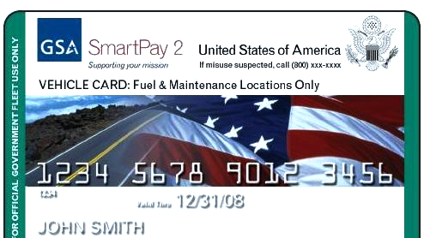
Fleet Charge Card
14

Slide 15
Fleet Charge Card Basics
Purchases restricted to the vehicle or piece of equipment to which the card is assigned.
Fuel costs for unleaded, non-premium fuel or fuel alternative
Emergency towing
Approved preventative maintenance (e.g., oil changes)
Approved repairs
Tolls
Parking
Note spending limits
Avoid abuse of limitations on authorized purchases.
Ensure vendor accepts the card prior to purchase.
Record purchases on the Utilization Record.
Safeguard the card.
Immediately notify the local Fleet Manager of problems with the card.

Slide 16
BIA Fleet Card Use Requirements
A Signed Requisition is Required for Several types of Purchases.
Buy Indian Act Applies if Non-Emergency.
Model 52 Request or Repair if on a Fire.
Some items do NOT Require a Signed Requisition
See Following Slides.
Local Agency Policy May Supersede this information.
Notes:
Model 52 request form discussed in later slide

Slide 17
2022 BIA Fleet Charge Card Policy
When the Fleet, Heavy Equipment or Trailer charge card is obtained and activated, the charge card may be used to purchase:
• Fuel (Regular unleaded 86/87 octane);
• Services and maintenance and;
• Special vehicle adjustments (ex: window tint, interior alterations are authorized for EMERGENCY vehicles ONLY.
The use of the Purchase card is required for:
• Toll
• Speed pass
• Purchase of vehicle item NOT permanently affixed to the vehicle (Reference: DOI Fleet Card Policy Program).
https://www.bia.gov/guide/fire-vehicle-training-courses
Notes:
Follow link to BIA Wildland Fire Fleet Information for charge card policy/vehicle checklists/fleet service request, etc.

Slide 18
2022 BIA Fleet Charge Card Policy
Use of the Travel card is required for:
• Parking (while on TDY)
• Local travel (pay out-of-pocket) **
Items that do NOT require a requisition are:
• Fuel (except miscellaneous account; i.e., UTV fuel, burning etc.)
• Car wash (receipt identifying service performed)
• Oil change (receipt identifying service performed). IF other services are performed at the same time during an oil change, a requisition IS required.
*For more information see IA Fleet Charge Policy document dated Jan. 18, 2022:

Slide 19
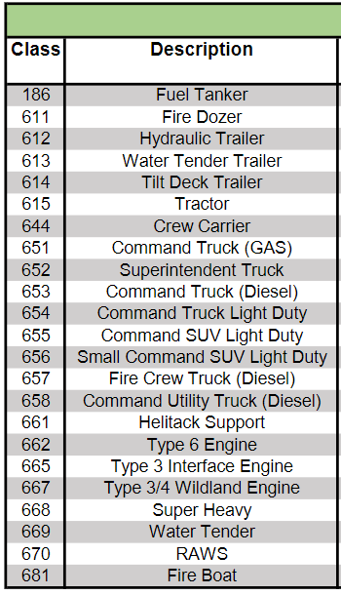
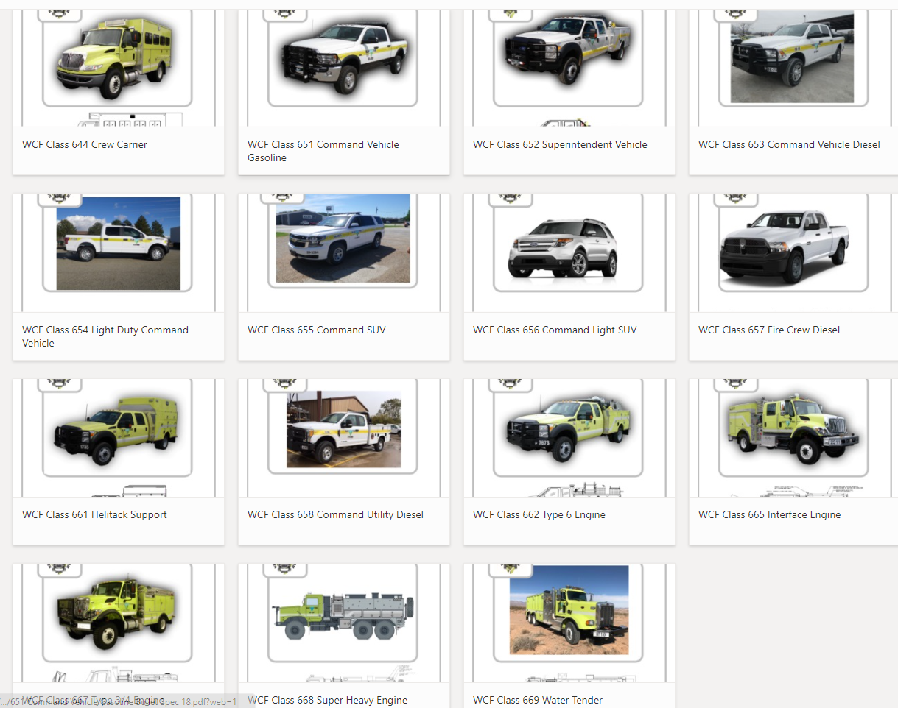
Equipment Classes
19

Slide 20
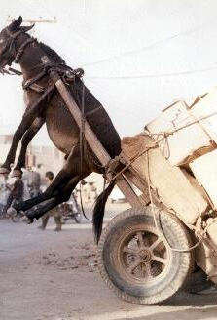
Gross Vehicle Weight (GVW)
20

Slide 21
What makes up the GVW?
GVW includes the total of
Vehicle weight
Fuel
Passengers
Water
Normal Unit Stocking (NUS or cargo and equipment)
21

Slide 22
ENOPs and the GVW
ENOPs are responsible for ensuring that the gross vehicle weight does not exceed maximum weight ratings.
Passengers are put at risk.
Poor handling on highways and off road may occur.
Mechanical break downs occur more often.
When vehicles exceed maximum weight ratings:
22

Slide 23
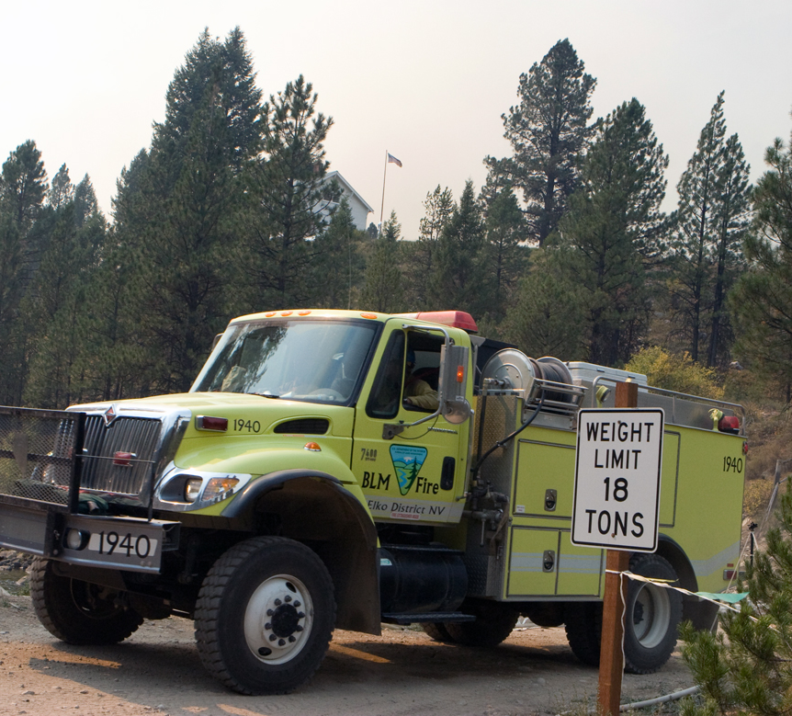
Weight-Restricted Bridges and Roads
ENOPs who know their vehicle’s GVW will know if they can travel on weight-restricted bridges and roads.
23

Slide 24
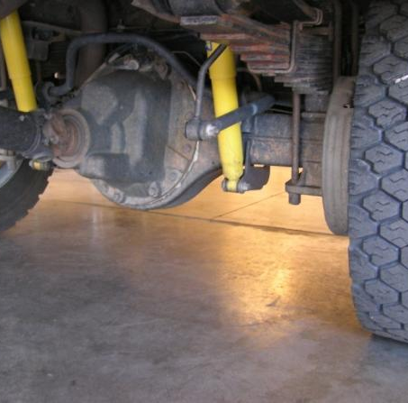
Chassis Manufacturer Weight Ratings
Gross Vehicle Weight Rating (GVWR)
The vehicle’s maximum load carrying capacity
Gross Axle Weight Rating (GAWR)
The maximum carrying capacity of an axle system as measured at the tire/ground interface
24

Slide 25
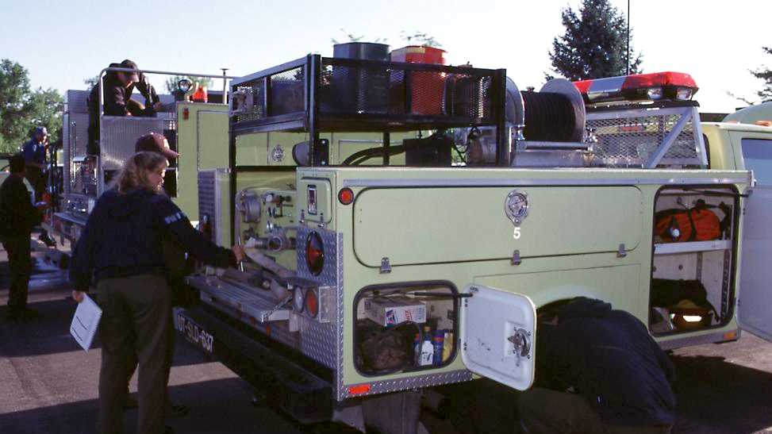
Does the GVW of this vehicle exceed GVWR?
900 pounds overweight
25

Slide 26
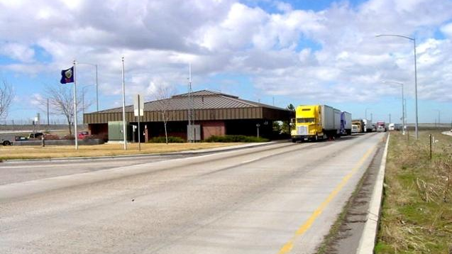
Weighing the Vehicle
Weigh the fully-loaded engine on a certified scale annually.
Allow 250 pounds for each person and their personal gear.
Keep the certified weight slip with the vehicle at all times.
26

Slide 27
Determining GVW
Weigh the front axle.
Is the weight less than the manufacturer’s front axle GAWR?
Weigh the rear axle.
Is the weight less than the manufacturer’s rear axle GAWR?
Add the front axle weight to the rear axle weight (this total weight is GVW).
Is the GVW less than the manufacturer’s GWVR?
27

Slide 28
RecordKeeping and Reporting
28

Slide 29
Reasons for Having Records
Avoid mechanical mishaps
Discover mechanical trends and assist with future fire engine design
Identify maintenance performed on incidents or during inspections
Identify maintenance issues charged to the WCF
Document when mechanical service was performed or needs to be performed
Facilitate information sharing
29

Slide 30
Improvement/Deficiency Reporting System (IDRS)
IDRS is used to collect improvement suggestions and deficiency reports for all BLM fire equipment.
NFEP personnel use the information to build a database to:
Document problems
Identify trends
Establish priorities for development and modification of new and existing equipment
30
Notes:
BIA is developing a Fire Equipment Deficiency, Major Repair or Improvement Reporting System. This is required for repairs over $1,000. The information reported will be used to help track deficiencies and make improvements to Bureau Wildland Fire Equipment.

Slide 31
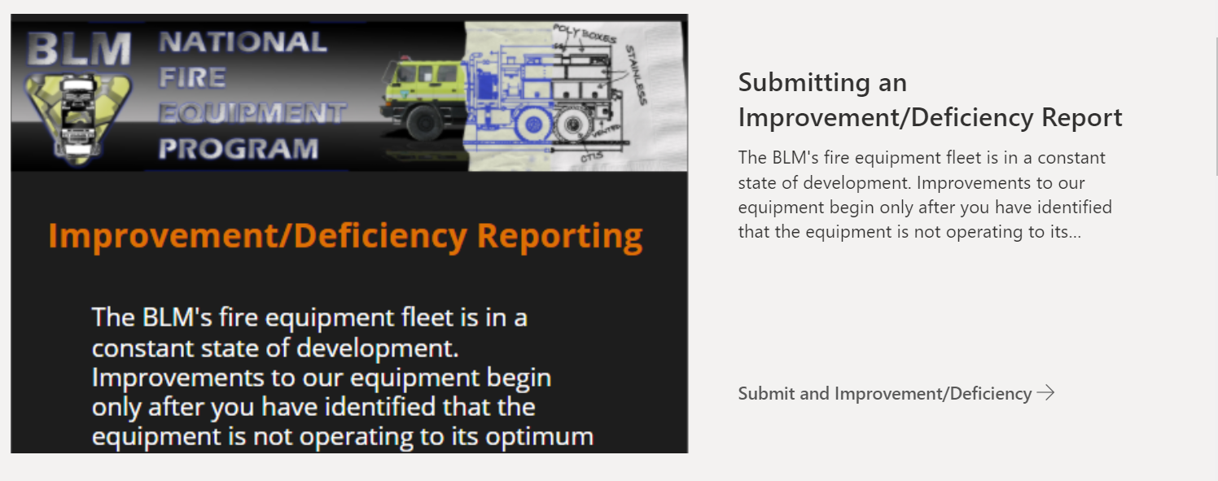
The IDRS Process
NFEP follows up on submissions.
Results are placed on the NFEP website.
Submit individual reports via the NFEP SharePoint.
https://doimspp.sharepoint.com/sites/blm-fa/fire-operations/SitePages/Improvement-and-Deficiency-Reports.aspx?web=1
Notes:
2023 – Made available to NPS, FWS, and BIA as well as BLM. Fleet leads from each agency are notified when IDR’s are submitted. Each agency is responsible for contacting submitter if warranted.

Slide 32
Vehicle Use (Log) Book
32

Slide 33
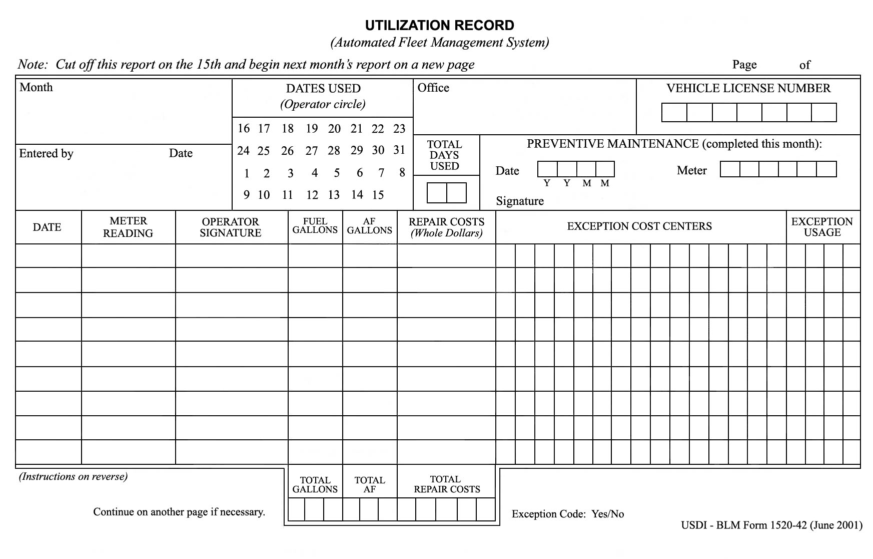
Utilization Record

Slide 34
BIA DI-120 (Jan-Dec)
Notes:
Ensure students have a DI-120 and complete exercises in SW pg 57-60 and FG pg 21

Slide 35
Utilization Record Exercise
35
Notes:
Students: Complete scenarios 1-4 on pp. 66-68 of the Student Workbook.
Instructors: Refer to Facilitator Guide, page 21, for conducting the exercise.

Slide 36
BIA DI-120 - Completed for Excercise
DI120_ENOP_exercise.xlsx
Notes:
Link to completed form for exercises and has additional examples in workbook. Open in New Window for BIA/BLM classes to compare both DI-120 and BLM Utilization sheet

Slide 37
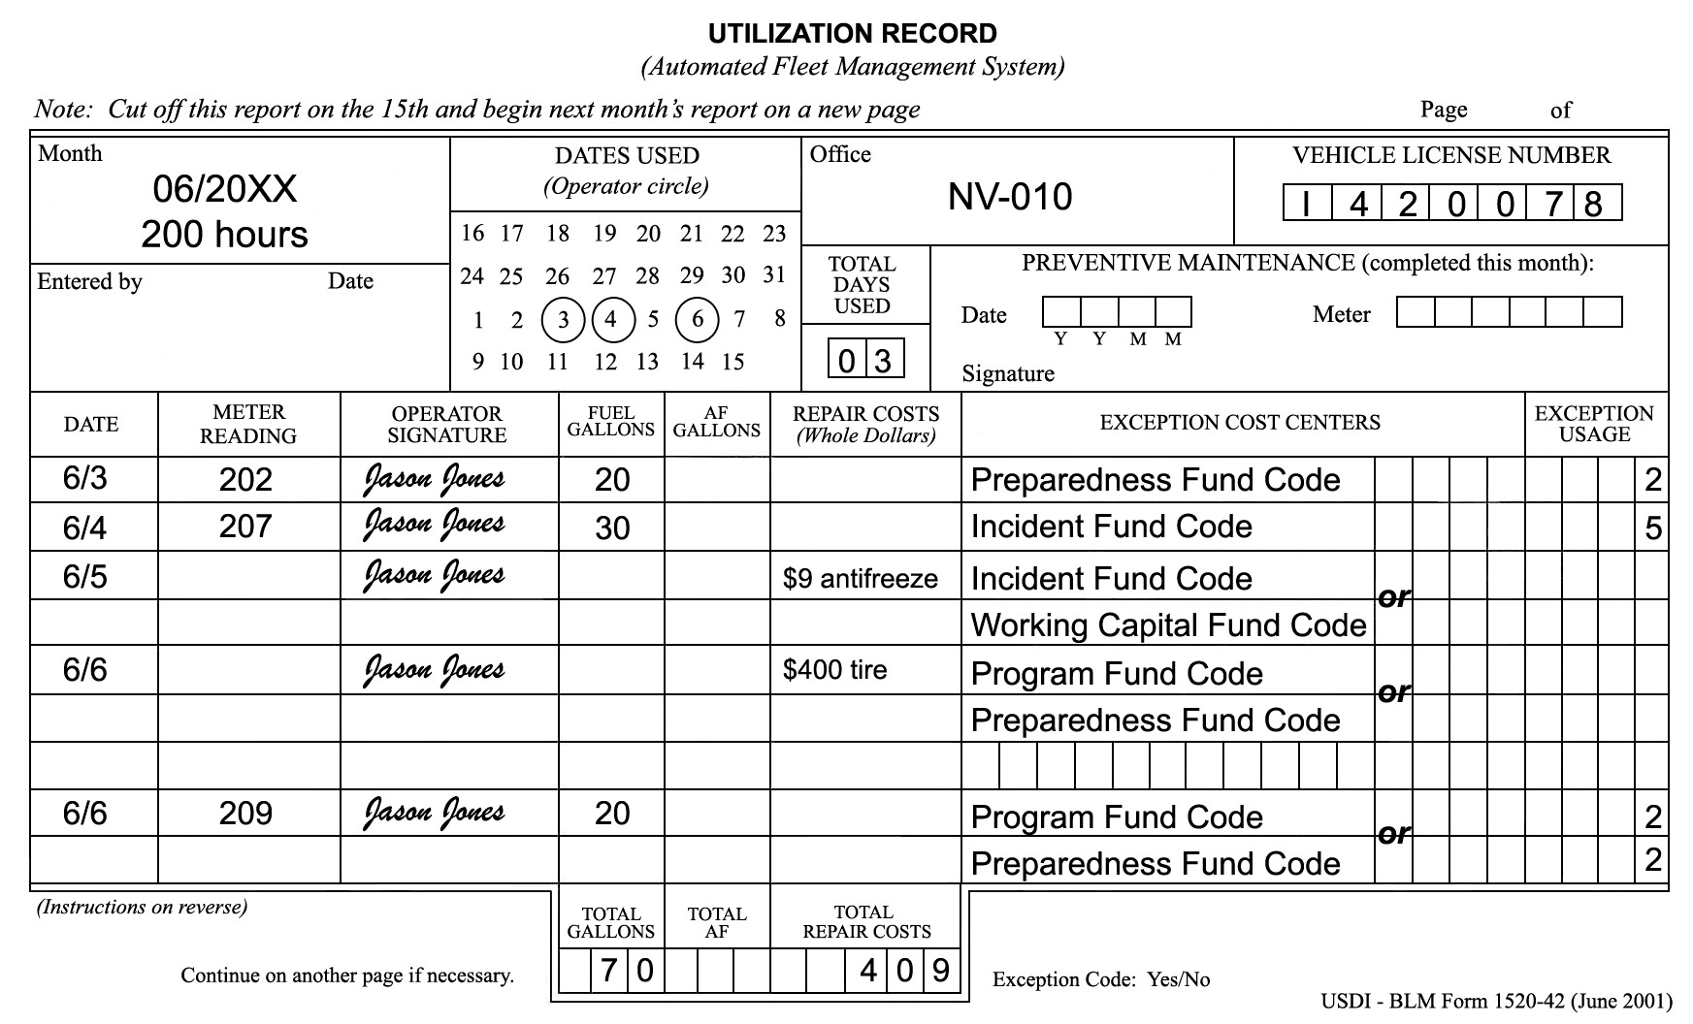
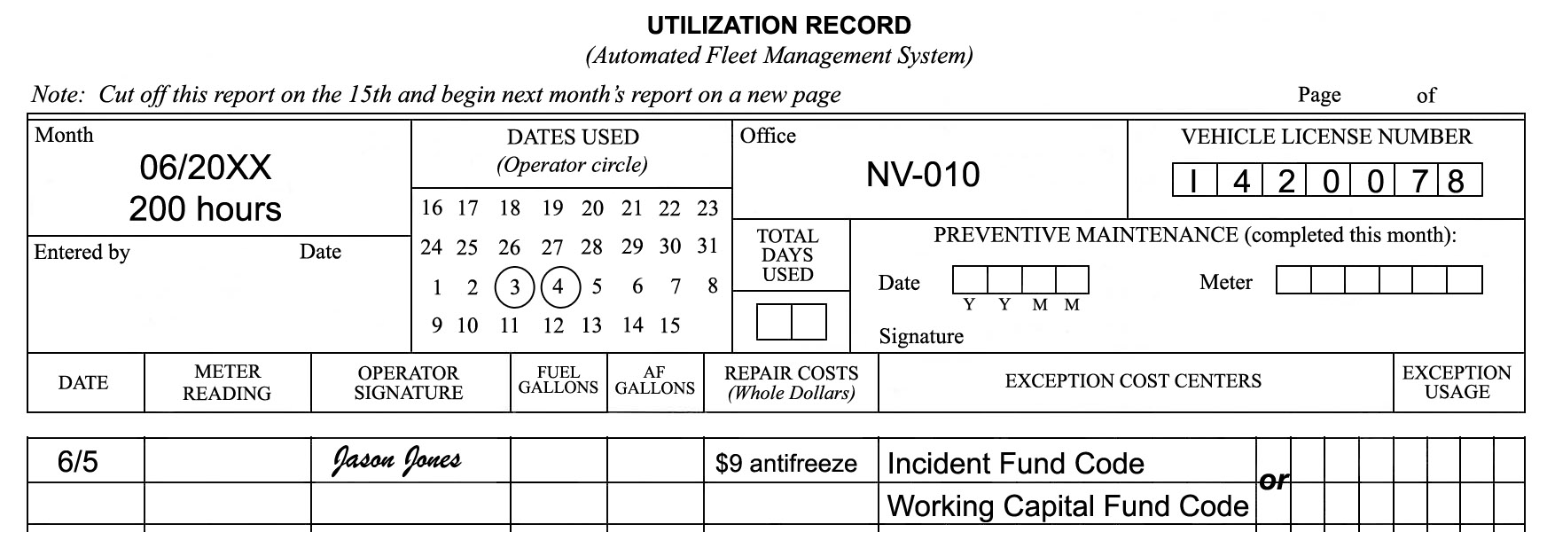
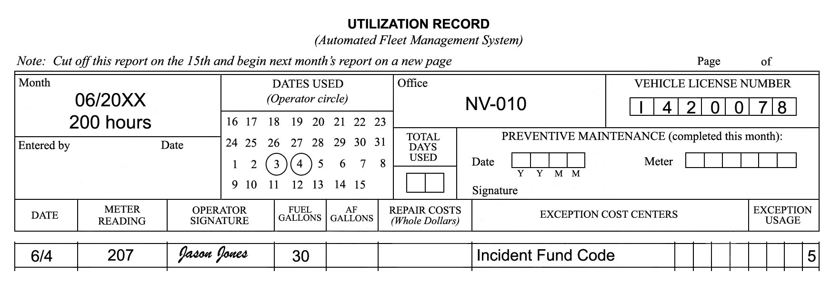
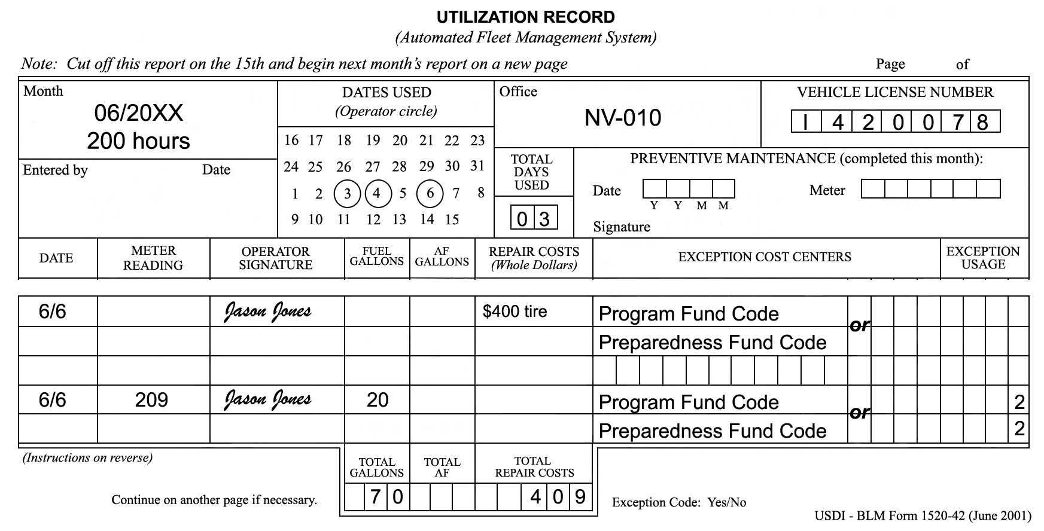
Utilization Record Completion

Slide 38
Engine Use Reporting
Standardized system to document and quantify important program accomplishments.
Necessary to ensure effective use of assets and to assist with critical planning decisions at local, state, and national levels.
Provides an accurate method of tracking daily statistics associated with each BLM wildland fire engine.
Redbook requirement to enter data monthly.
State FOG representative manages access.
38

Slide 39
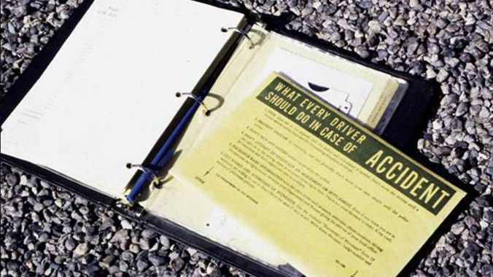
Accident Reporting Documents
39

Slide 40
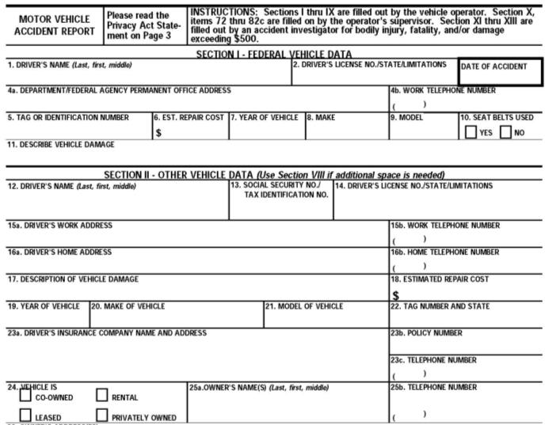
Exchange Basic Information (Standard Form 91)
Names
Addresses
Phone numbers
Driver license information
Vehicle registrations
Proof of insurance
40

Slide 41
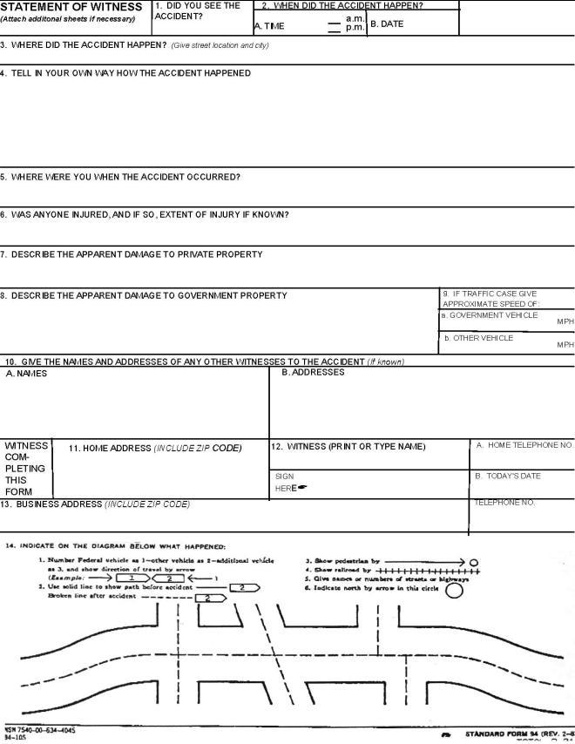
Statement of Witness
(Standard Form 94)
41

Slide 42
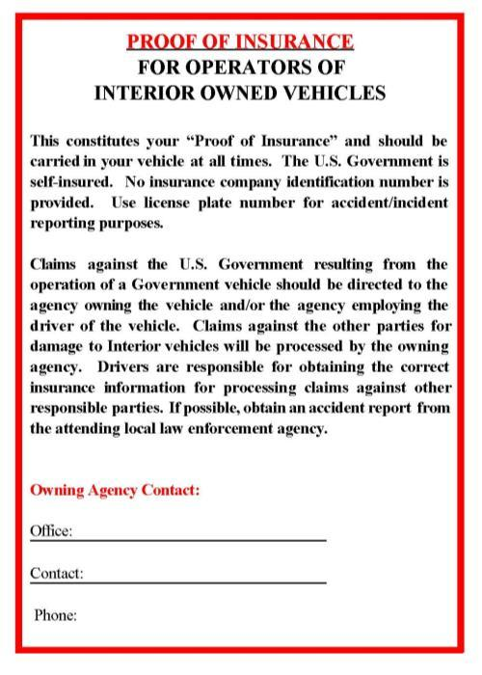
Proof of Insurance Form
Created as official documentation that the government is self-insured
Must be signed by the appropriate authorizing official and kept with the vehicle at all times
42

Slide 43
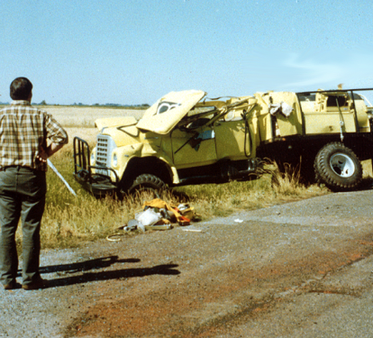
What To Do
Stop and give aid to the injured.
Notify the police and request an ambulance if needed.
Prevent danger to oncoming cars.
Try not to move your vehicle until police arrive.
43

Slide 44
Other Tasks To Do
Notify state, county, or municipal authorities, as required by law.
Complete the “Operator’s Report of Motor Vehicle Accident” (SF-91).
Notify your supervisor and Fleet Manager as quickly as possible.
Perform actions as required by local policy and procedures.
Notify the proper authorities before leaving the scene of the accident.
44

Slide 45
What Not To Do
Do not sign any papers or make any statement as to fault.
Do not attempt to negotiate an agreement or settlement.
45

Slide 46
Fire Engine Warranty Repairs and Recalls
46

Slide 47
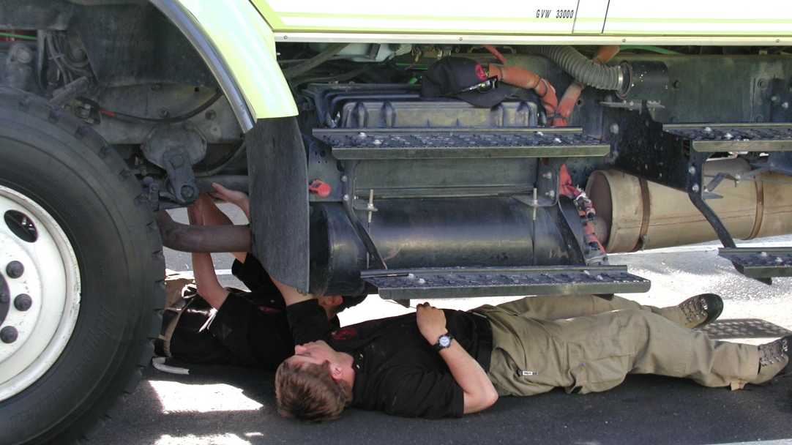
Warranty Repairs
Responsibility of ENOP to ensure warranty timeframes and parameters are known for all components (update FEMPR)
Recall/safety issues can be found on NFEP SharePoint
If issues arise while completing warranty claim contact NFEP
47

Slide 48
Recalls – Equipment Bulletins & Equipment Alerts
The purpose of an equipment bulletin (EB) or an equipment alert (EA) is to share accurate and timely information regarding potential equipment problems and/or needed repairs.
Equipment Bulletin
Equipment Alert
Intended to inform the equipment users of recommendations for repairs, potential hazards, or general information related to the overall maintenance, awareness, and safe operation of fire equipment
Time sensitive and addresses potentially serious hazards or risks.
The alert includes specific actions users must act upon

Slide 49
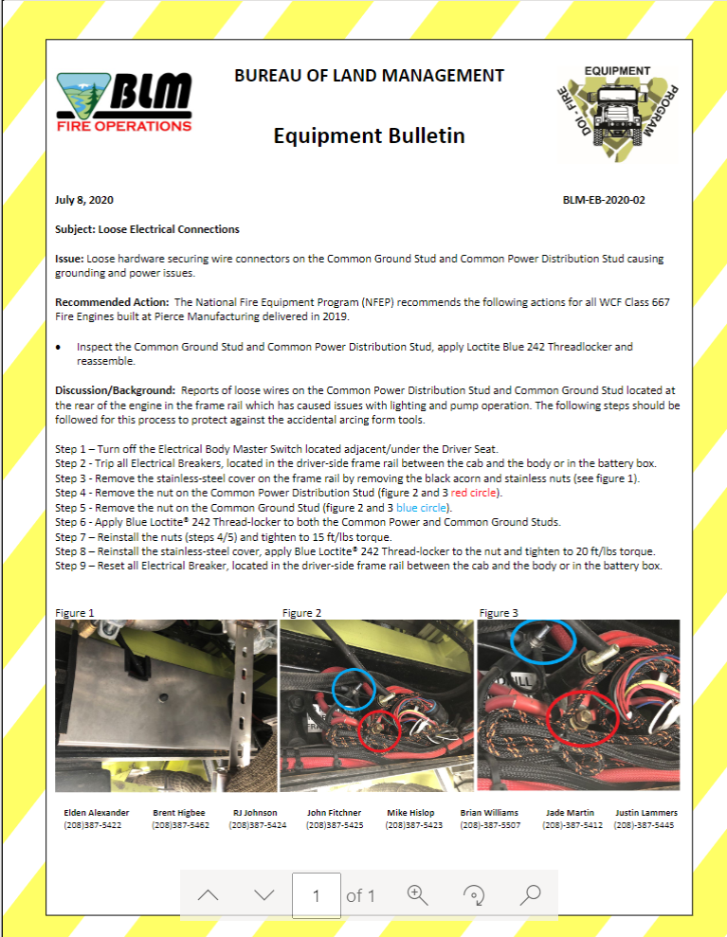
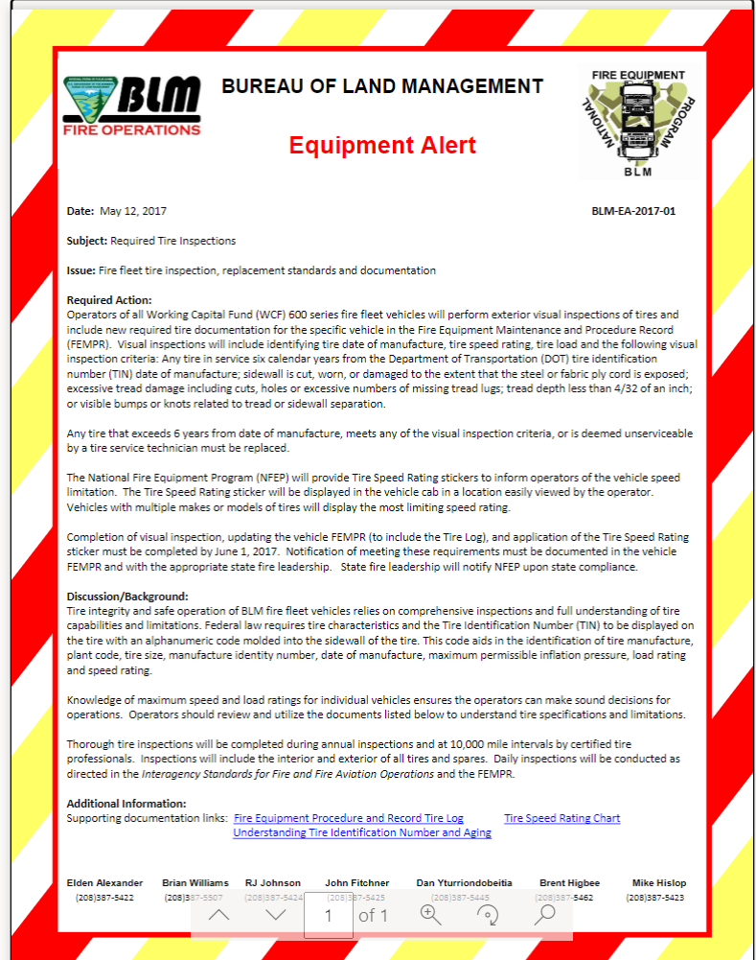
Viewing Bulletins and alerts
https://doimspp.sharepoint.com/sites/blm-fa/fire-operations/SitePages/Equipment-Alerts-Bulletins.aspx?web=1
49
Notes:
To view equipment alerts or recall notices, visit the BLM National Fire Equipment Program website. Additionally, a notification email will be sent to the states. Operators must follow the recommended or required actions. Contact NFEP for additional information or assistance.

Slide 50
BIA-Warranty Repairs
If a repair is under warranty, it can be handled at the dealership or any authorized Service Center.
Check with your FMO, AFMO or FOS.
Some programs have a Fire Engine Program Supervisor, this will be your point of contact for warranty repairs.
If you do not have this option, call your Regional Model 52 Center.

Slide 51
MODEL 52 Center
WHAT?? Is the Model 52 Center?
BIA Builds Engines "In House"
Regional Centers Order, Build, and Repair Type-6 and Type-4 Engines.
Engines are Essentially a Universal Build (they are all the same).
They Can Often Be Repaired with Basic Mechanical Skill and Common Tools....OR Order a Model 52 Repair Technician!
If You Do Not Have The Skills or Tools, Call and Ask Questions.
When in Doubt, Order a Tech!

Slide 52
For BIA- Local (Regional) Model 52 Center.
Fill Out the "Field Unit Request for Repairs"

Slide 53
M-52 Request Form
AFMO, FMO, or Designated Authority to approve the completed form and send it, by email, to the Center Manager.
You will Need a Charge Code aka-"Fire Code"
Otherwise, you're calling a mechanic and using the vehicle card, subject to BIA Fleet regulations.

Slide 54
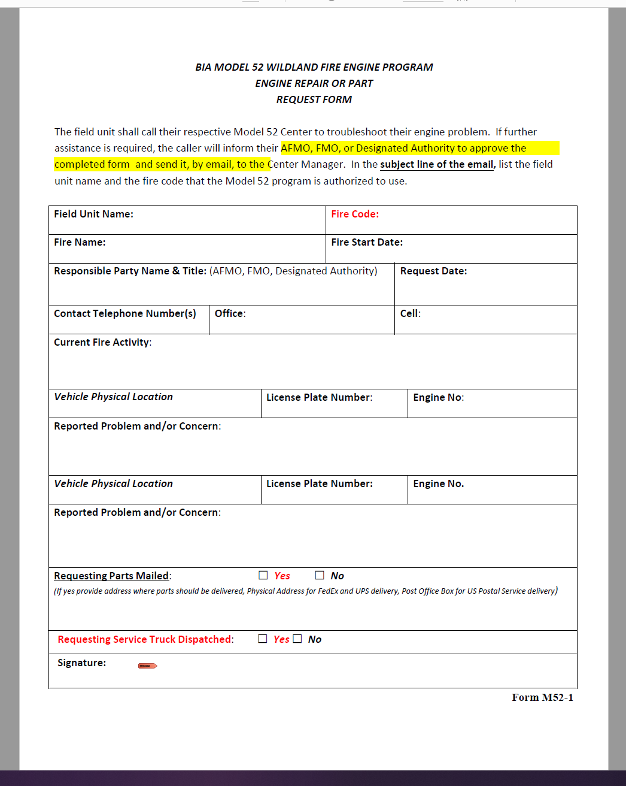
Form M52-1
Request Parts if you can fix it at the Unit.
EXAMPLES: Pump Head, Valves, Flex Tubes, Pump Panel Components.
It's all 12 Volt, so get your multi-meter out.
Most of the components are available at a hardware supply store.
MEASURE, with a measuring tape, take pictures with the tape showing measurements.

Slide 55
Objectives
Accurately identify expenditures that can be charged to the Working Capital Fund (WCF).
Discuss the ENOP’s fleet charge card responsibilities.
Explain the concepts of gross vehicle weight rating (GVWR), gross axle weight rating (GAWR), gross vehicle weight (GVW), and the ENOP’s role in maintaining proper GVW.
Identify items that are included in the vehicle use (log) book.
55

Slide 56
Objectives
Demonstrate the ability to complete and reconcile the “Utilization Record” (USDI/BLM Form 1520-042).
Explain the procedure an ENOP should follow when involved in a motor vehicle accident.
Explain fire engine warranty repairs and recall procedures.
56

