Slide 1
BL-300 Fire Vehicle Driver Orientation

Slide 2
Objectives
Discuss agency policies and regulations related to driving agency, rental, and NERV vehicles
Discuss State Traffic Regulations
Discuss and interpret duty-day limitations
Discuss STOP procedure
Discuss Diesel vs Gas vehicles
Discuss Wildland Fire Fleet Book contents

Slide 3
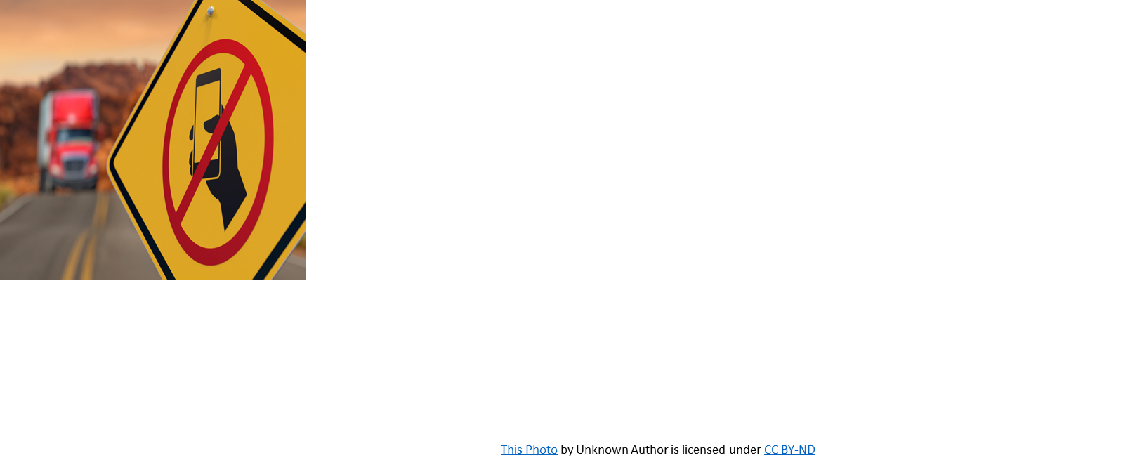
Bureau Policies
Bureau Policies
Drug-free Workplace
Vehicle Operation
Seat belts
Speed limits
No cell phone use while driving
No tobacco use in BIA vehicles
Driver’s license
Current state driver’s license
Commercial driver’s license (CDL) instruction permit
Commercial driver’s license (CDL)

Slide 4
Helpful Resources

Slide 5
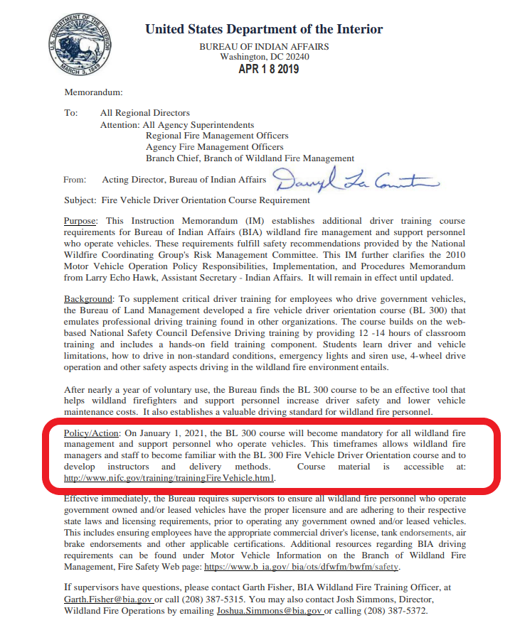
Helpful Resources

Slide 6
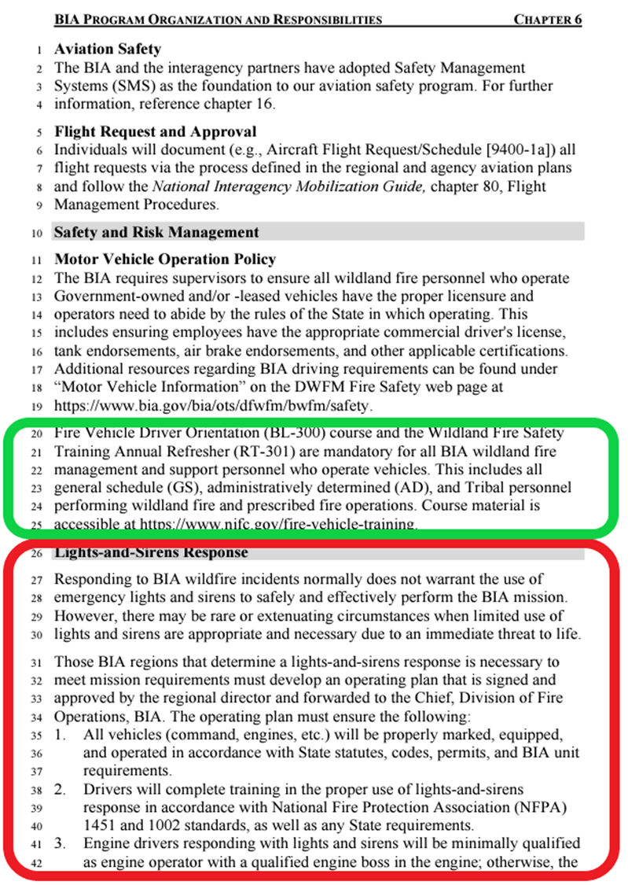
Helpful Resources
BL-300 and RT-301 are required annually.
ENGB and ENOP qualified personnel are required to complete RT-301 to maintain currency for those positions in IQCS.

Slide 7
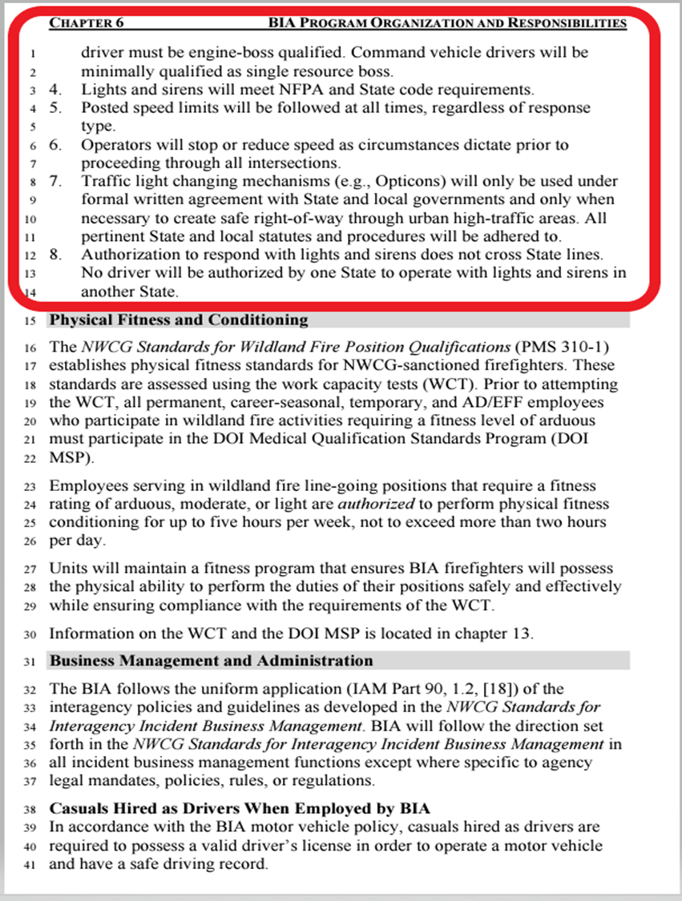
Helpful Resources

Slide 8
Incidental Operators are not required to complete Defensive Driving

Slide 9
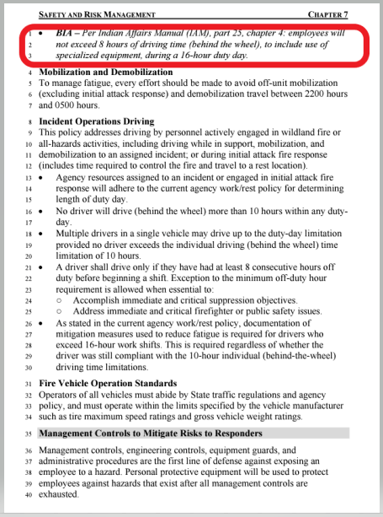
Driving Requirements
This applies to nonemergency driving
This applies to incident or “emergency” driving

Slide 10
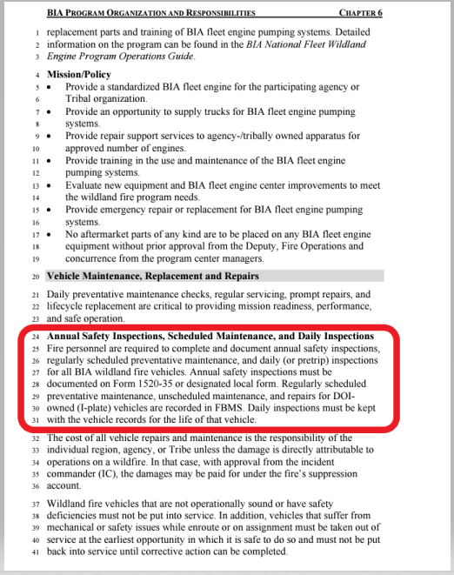
Driving Requirements

Slide 11
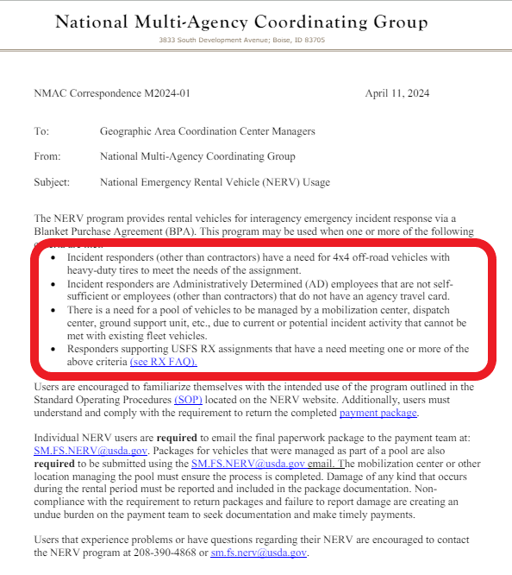
Driving Requirements

Slide 12
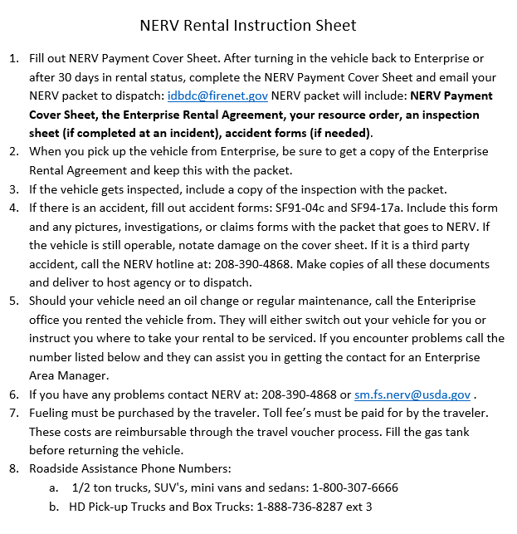
NERV Rental Instruction Sheet
ID-BDC Example

Slide 13
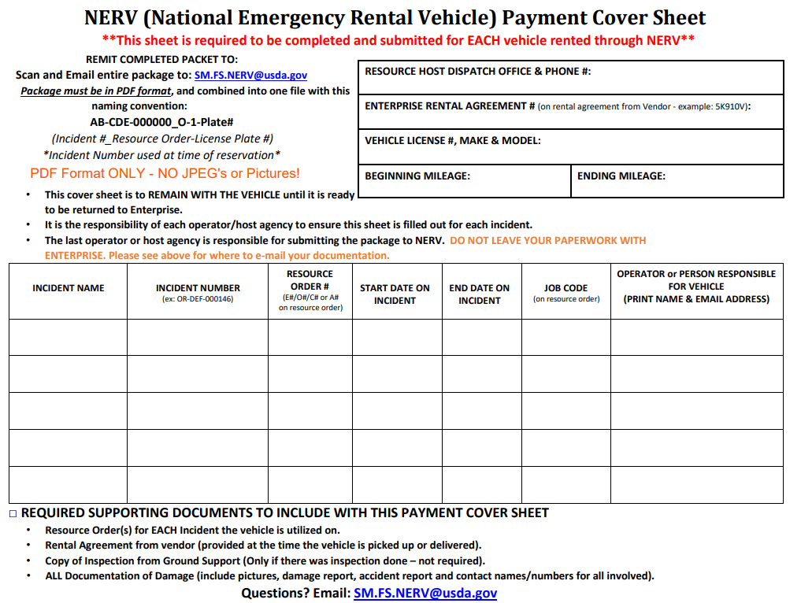
NERV Payment Cover Sheet

Slide 14
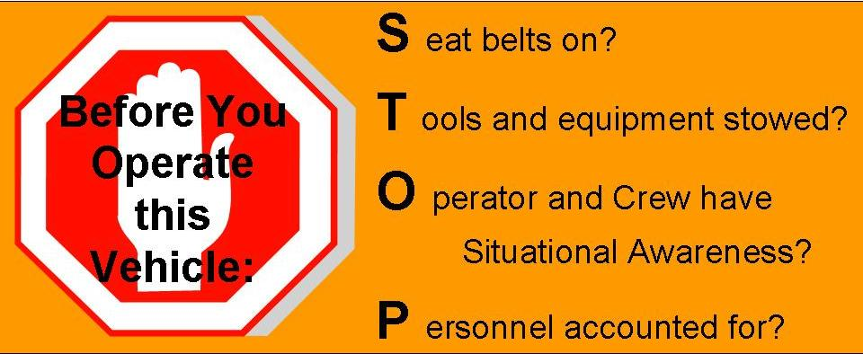
The S.T.O.P. Procedure

Slide 15
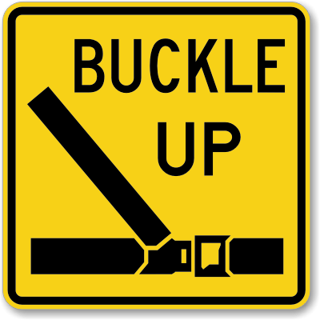
“S” – Seat Belts On?
“S” – Seat belts on?
Seat belts must be available and used in Bureau motor vehicles.
The driver is responsible for asking passengers if they are wearing their seat belts and ensuring that they are worn at all times.

Slide 16
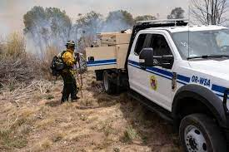
“T” – Tools and equipment Stowed?
Ensure all tools and equipment is secured in cabinets or approved storage areas before moving the vehicle.

Slide 17
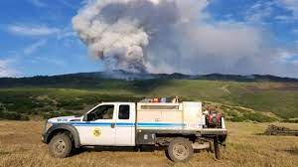
“P” – Personnel accounted for?
Ensure all personnel are accounted for and their locations are known.
Communicate your intentions to all personnel before moving the vehicle.

Slide 18
Driver Walk-Around
What are you looking for before moving the vehicle?
Rocks in the way of tires
Debris or rocks stuck in duals or elsewhere
Holes, berms, ditches, etc.
Large stumps or downed trees
Chock blocks secured and in place
Gear or equipment around or under vehicle

Slide 19
Driver Walk-Around
What are you looking for before moving the vehicle? (continued)
Vehicles parked near the vehicle
Personnel relaxing or sleeping around vehicle
Body damage that occurred while away from the vehicle
Cabinet doors closed
Side and overhead clearance in and near the path your vehicle will travel

Slide 20
Driver Walk-Around
Driver is responsible to complete a 360° visual inspection of the vehicle and surrounding area every time the vehicle is moved.
The walk-around begins as you approach the vehicle then continues in a clockwise or counter clockwise fashion.

Slide 21
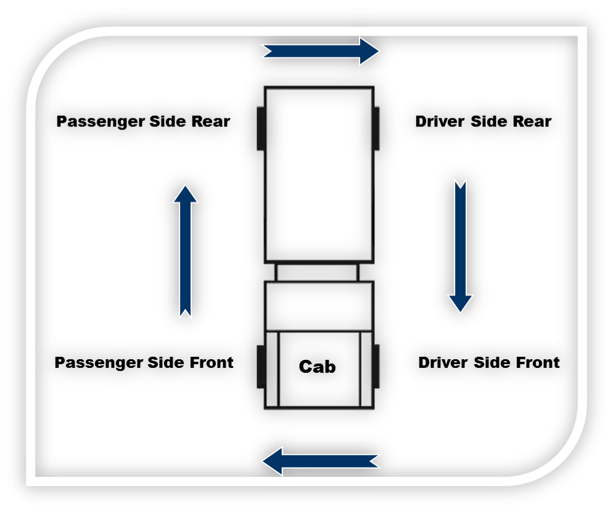
Driver Walk-Around
DRIVER WALK-AROUND

Slide 22
Vehicle Danger Zones
When working in close proximity of a moving vehicle, there is an increased risk for an accident to occur.
Given the design and size of our vehicles and the environment we work in, operator danger zones (blind spots) exist.

Slide 23
Green and Yellow Danger Zones
Whenever possible operate in the green areas.
- Usually offer visual contact with the operator.
Yellow areas are limited visibility and mirror use areas.
- Notify the driver when you are in these areas.

Slide 24
Red Danger Zones
Never work in red zones when vehicle is moving.
Notify operator prior to entering red zones.
Stay out of the red zone where the driver has no visual.

Slide 25
Red Danger Zones
The red area in front of the vehicle extends 10 feet out from the front bumper.
You must have visual contact with the driver when working in front of the vehicle beyond the 10-foot range.

Slide 26
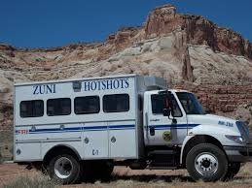
Using Spotters
There are always blind spots around the vehicle.
Always use a spotter to compensate for danger zones (blind spots) located in the driver’s field of vision.
If alone, get out and do a visual yourself.

Slide 27
Use spotters when…
Backing up
Performing off-road operations
Hazardous conditions exist
Low vehicle clearances exist
Narrow/confined driving spaces exist

Slide 28
Spotter Techniques
Spotter and driver need to communicate on the planned action.
- Where to park
- Distance from the shoulder
- Areas of travel
Spotter distance from vehicle varies; however, visual contact between spotter and driver shall not be compromised.
- If driver loses sight of the spotter, the driver should stop immediately and determine the spotter’s location.

Slide 29
SPOTTER TECHNIQUES
Spotter should have a clear line of sight to the driver. The spotter’s position should be located as follows:
- Forward movement: Outside the forward red zone on the driver side windshield
- Backing movement: Outside the rear red zone on the driver side mirror
Spotter and driver should understand a common set of hand signals.

Slide 30
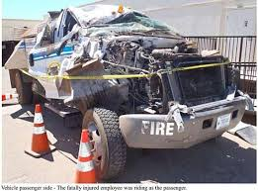
Situational Awareness (SA)

Slide 31
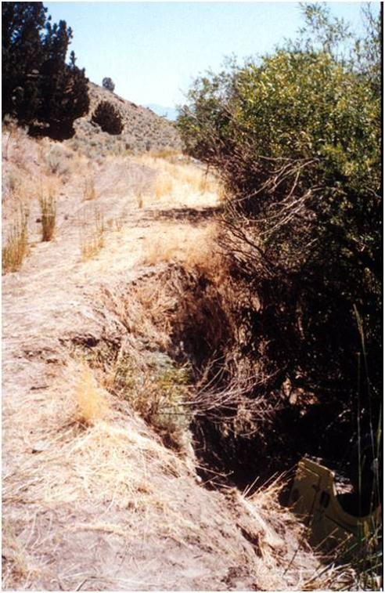
Pay Attention to the Surroundings
Pay attention to your immediate surroundings.
Road conditions and type
Road shoulders
Clearances
Ground cover and type
What is going on in this picture?

Slide 32
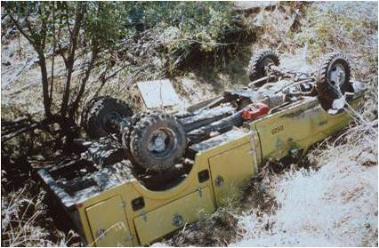
What could have been done to mitigate this hazard?

Slide 33
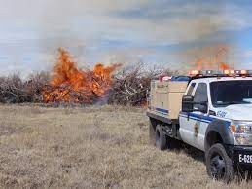
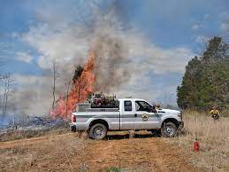
SITUATIONAL AWARENESS (SA)
SA is your perception of what is happening or has happened around the vehicle you are driving.
Lack of good situational awareness is the leading cause of vehicle-related accidents.

Slide 34
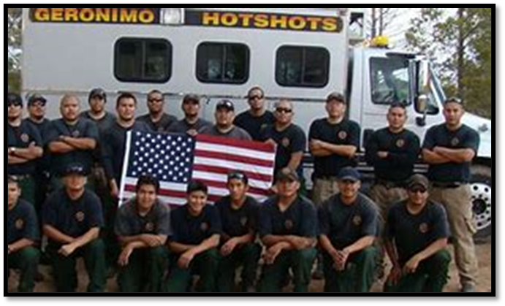
Situational Awareness Crew Safety
Know the location of your crewmembers and personnel at all times.
Never move a vehicle without ensuring all personnel are clear of the area.
Communicate with personnel on vehicle maneuvers before moving.
Honk your horn before moving the vehicle.

Slide 35
Situational Awareness Crew Safety
Understand vehicle danger zones.
- Keep personnel where the driver can see and communicate with them (green zones)
- Driver visibility is limited (yellow zones)
- Stay out of the blind spots and away from the tires (red zone and black areas)

Slide 36
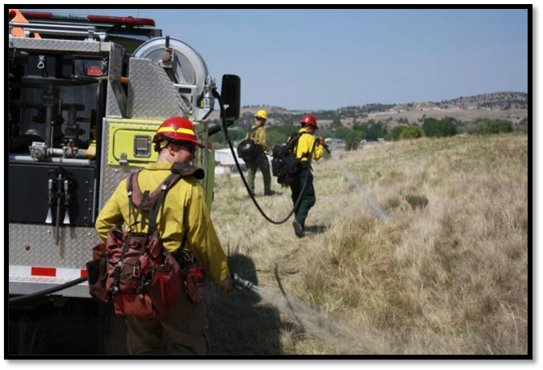
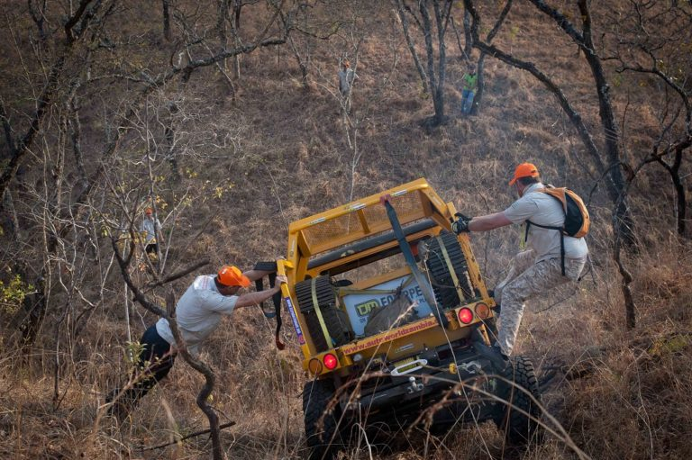
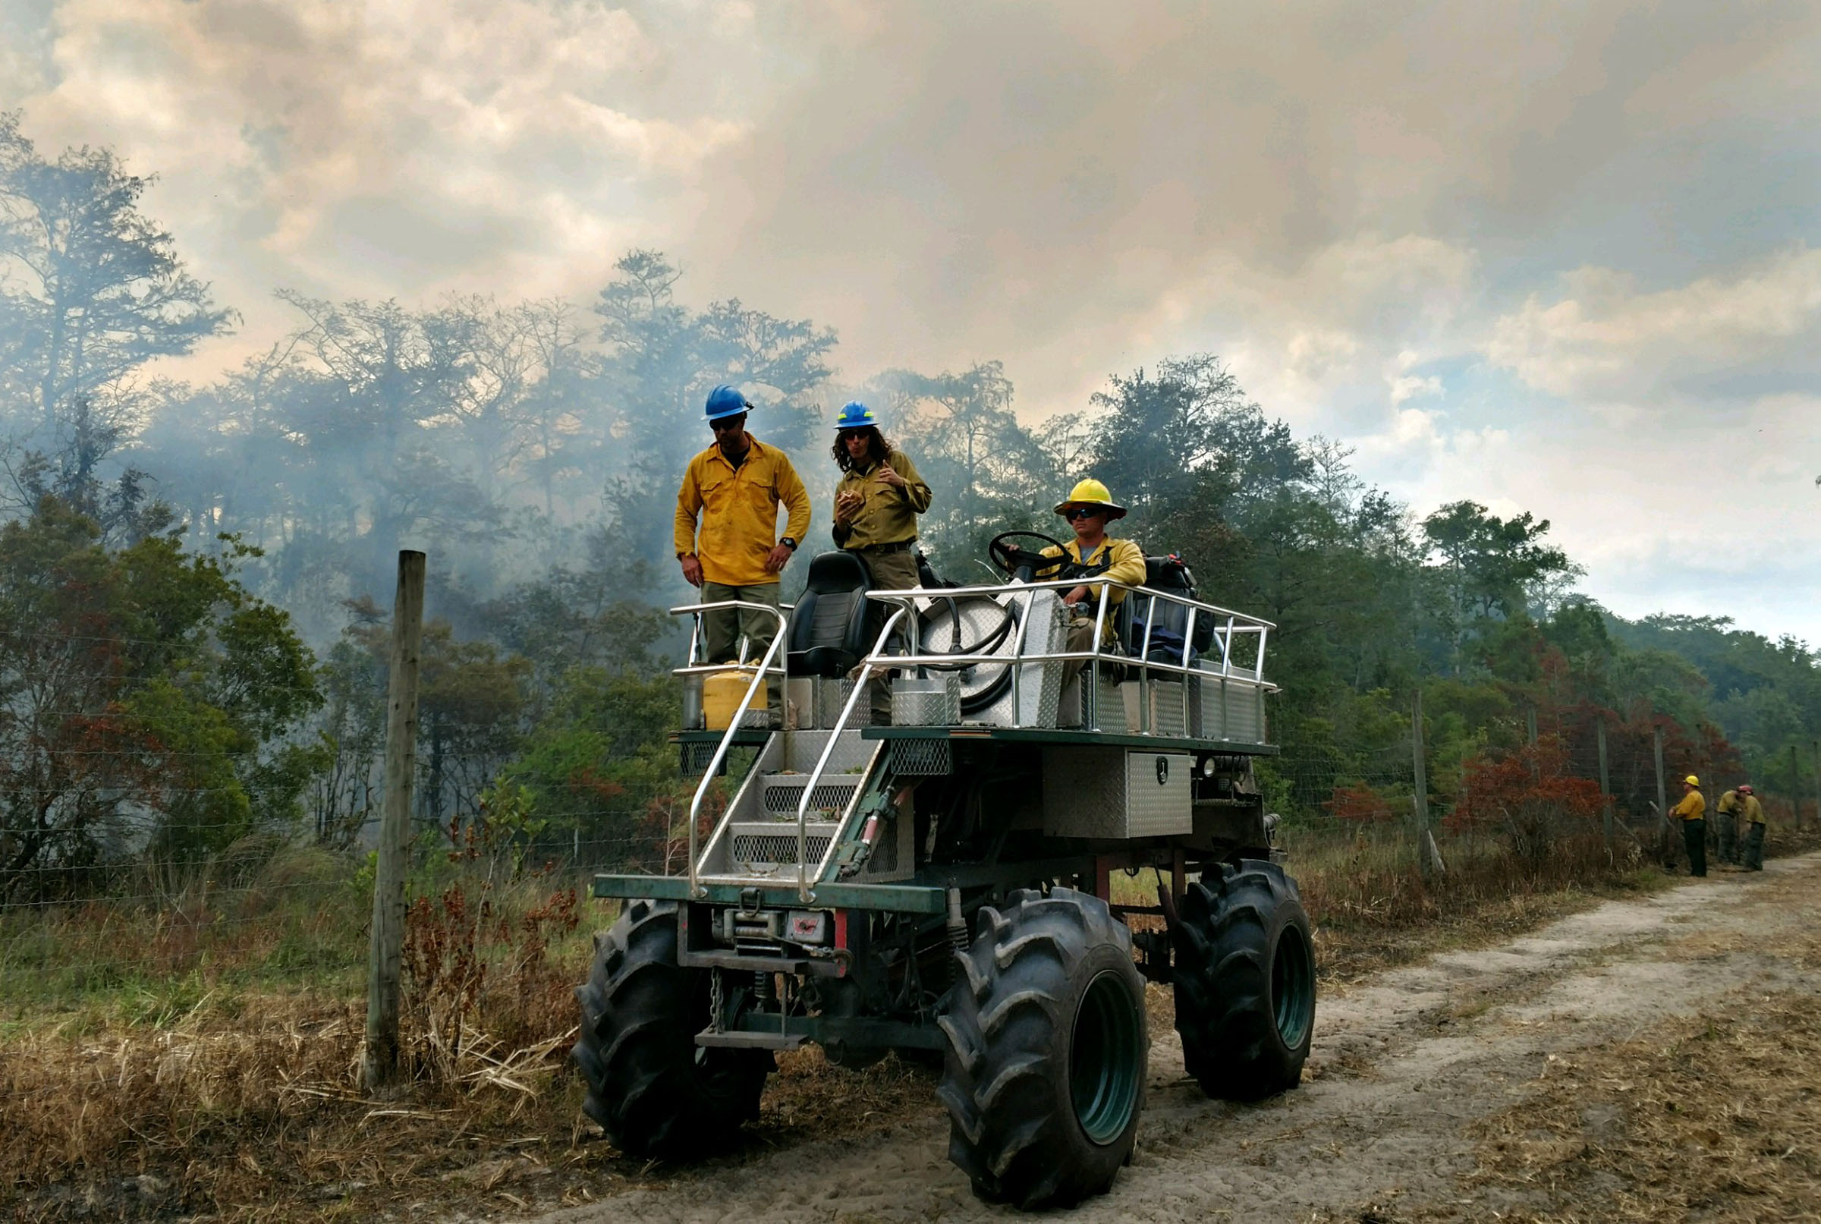
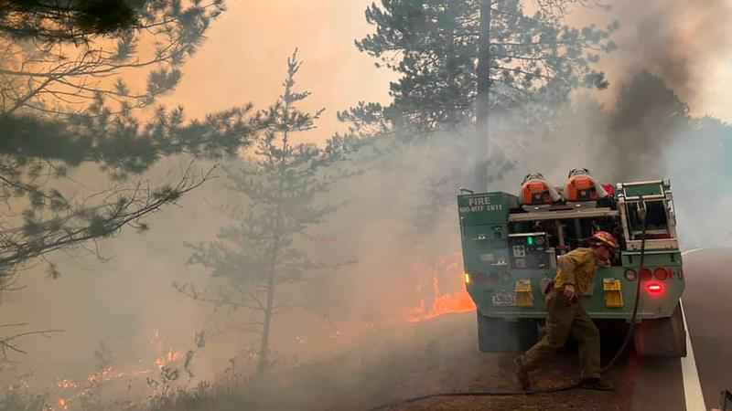
Situational Awareness
Situational Awareness
Identify any concerns you see in these pictures.

Slide 37
True or False
All trucks are diesel?

Slide 38
True or False
FALSE
Some think that all ¾ ton (Dodge 2500, Chevrolet 2500, Ford F-250) and above are all diesel motor and require diesel fuel and DEF. This is not true.

Slide 39
How Can I Tell Diesel vs Gas

Slide 40
Diesel Exhaust Fluid

Slide 41
Diesel Exhaust Fluid

Slide 42
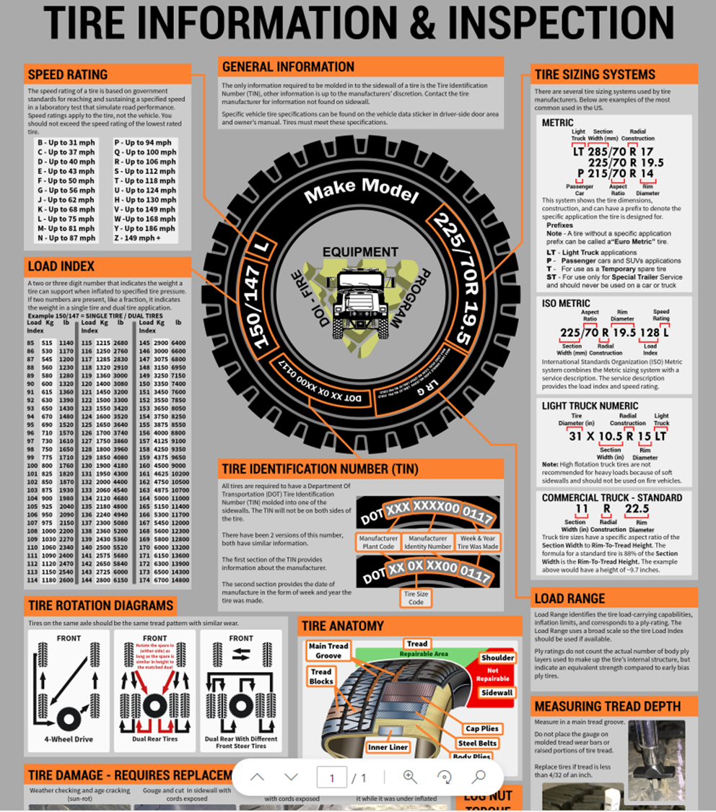
Tire Information & Inspection

Slide 43
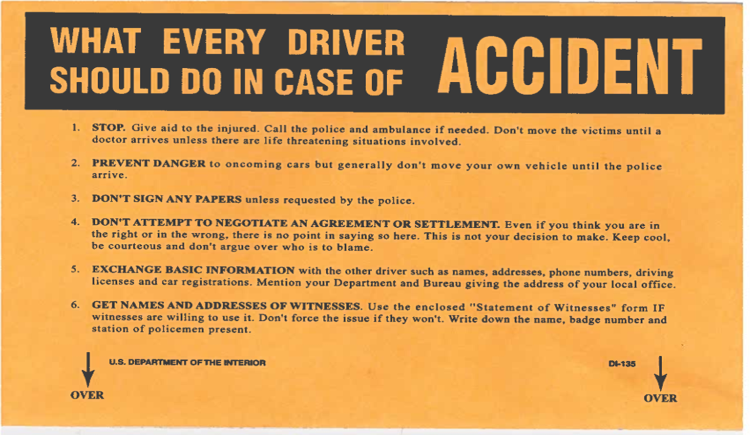
Wildland Fire Fleet book Contents These accident forms are available on the IA Fire Vehicle Training Courses webpage

Slide 44
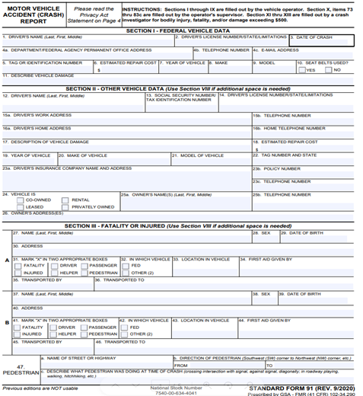
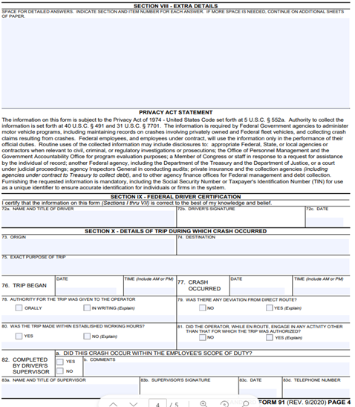
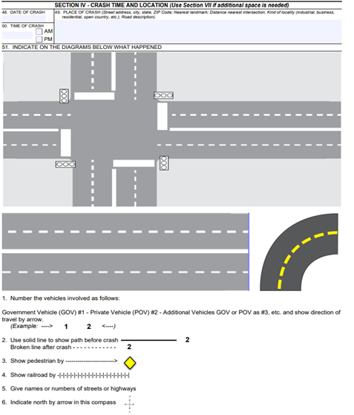
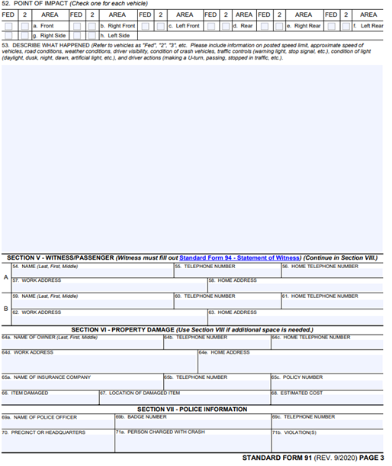
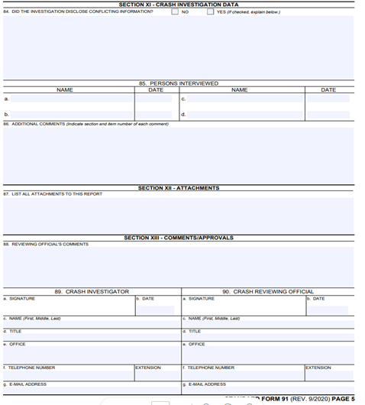
SF-91 Motor Vehicle Accident (CRASH) Report
SF-91
MOTOR VEHICLE ACCIDENT(CRASH)REPORT

Slide 45
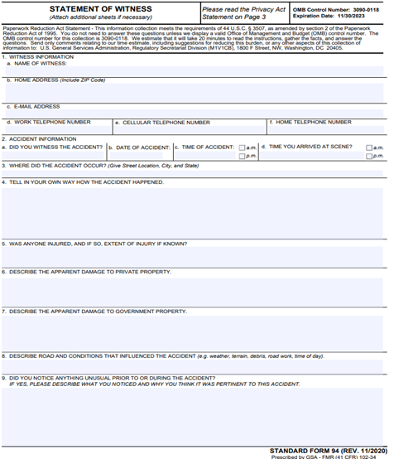
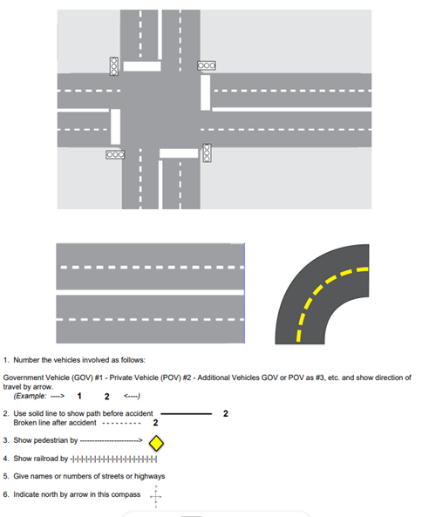
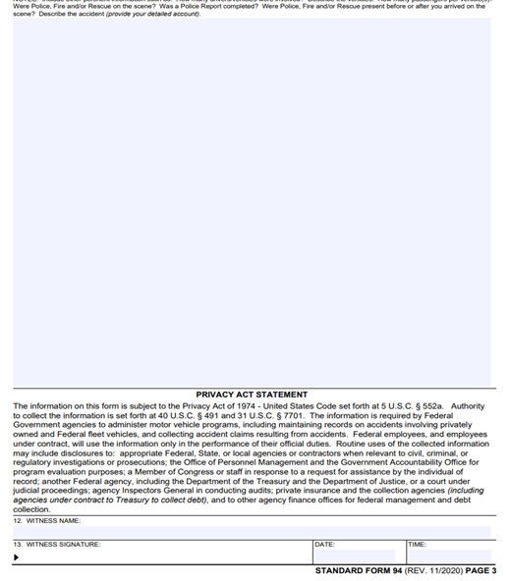
SF-94 Statement of Witness
SF-94 STATEMENT OF WITNESS

Slide 46
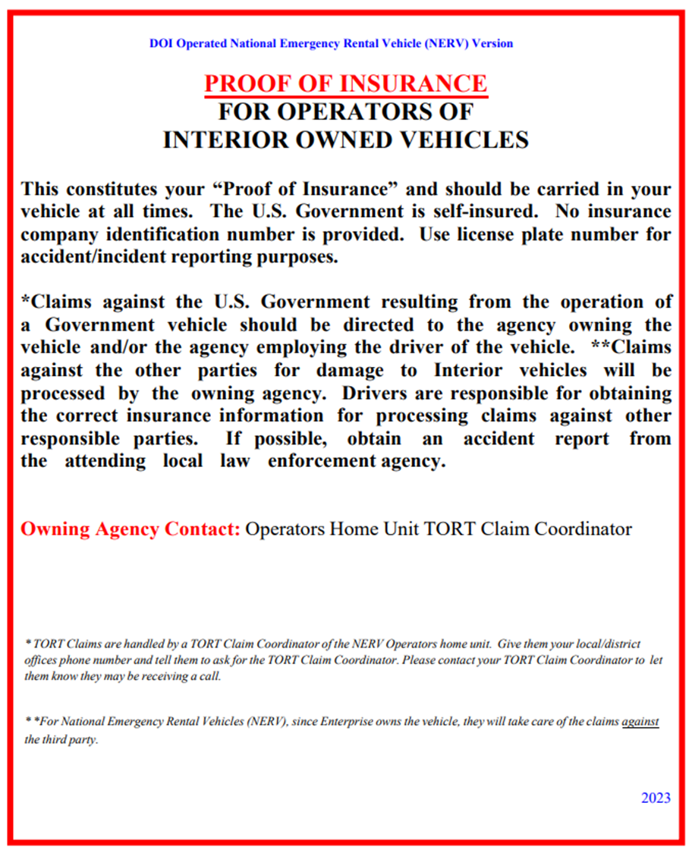
Proof of insurance for operators of interior owned vehicles

Slide 47
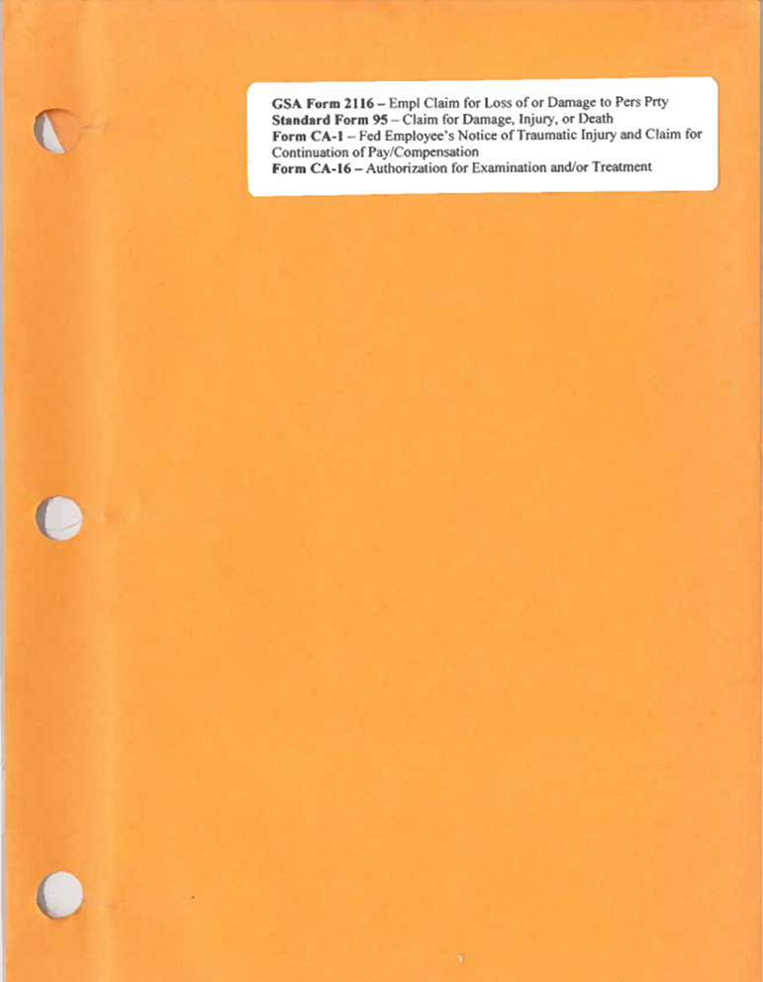
GSA Form 2116, Standard Form 95, Form CA-1, Form CA-16

Slide 48
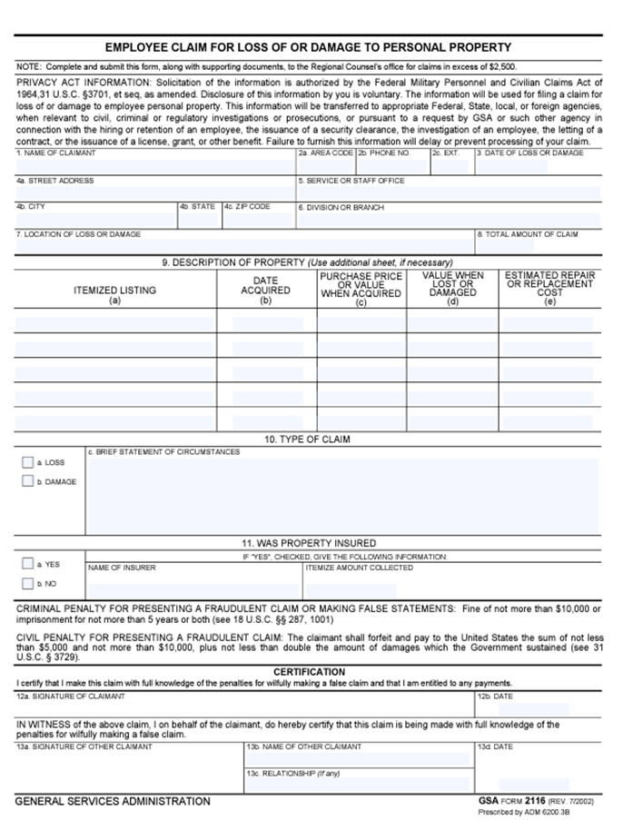
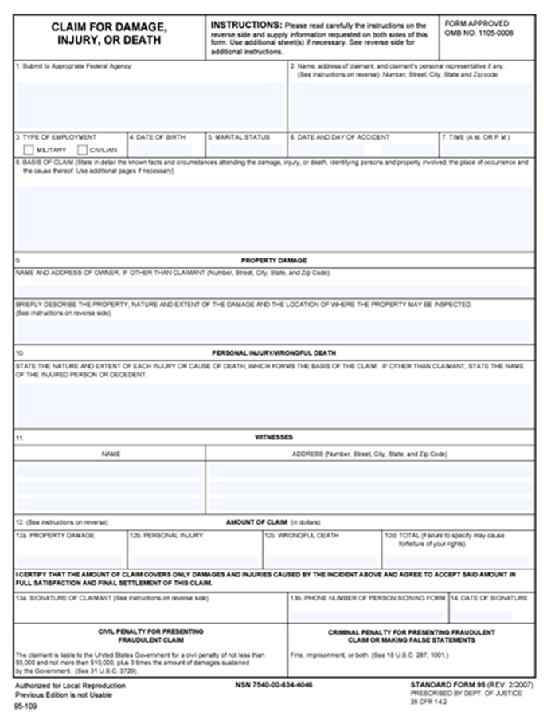
GSA-2116 and SF-95
GSA-2116 Employee Claim for Loss of or Damage to Personal Property
SF-95 Claim for Damage, Injury, or Death

Slide 49
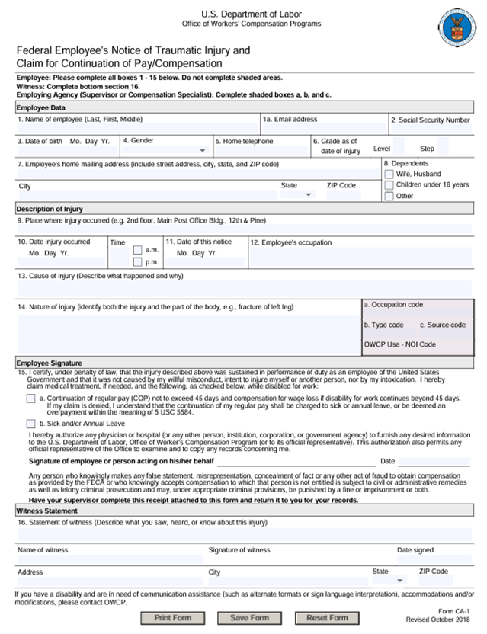
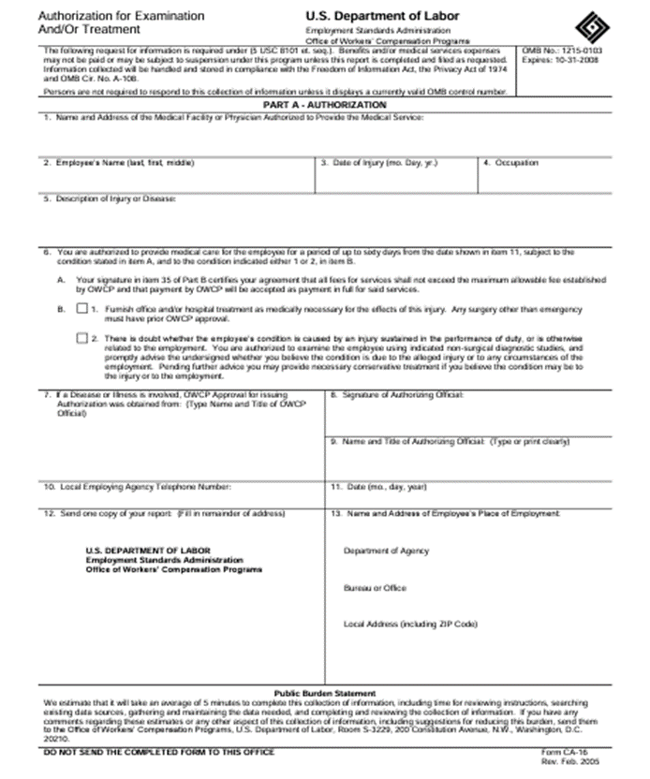
CA-1 and CA-16
CA-1 Notice of Traumatic Injury and Claim for Continuation of Pay/Comp

Slide 50
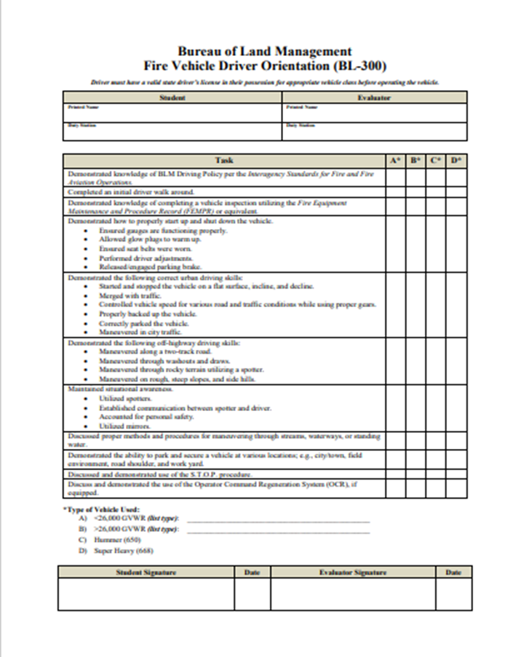
BL-300 Student Evaluation
BL-300 Student Evaluation

