Slide 1
Safeguarding Tribal Objects of Cultural Patrimony (STOP) Act Consultations Summer 2023

Slide 2
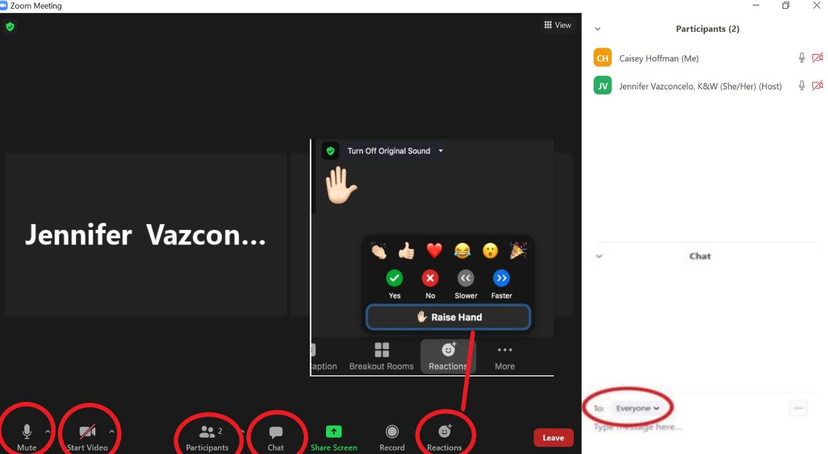
How to Use Zoom
Name, title, Tribe/Nation or organization

Slide 3
Participant Engagement
Participants should engage actively and respectfully.
Participants can mute/unmute themselves using the webinar function.
The facilitation team may mute/unmute participants as needed to manage audio quality.
Use the “raise hand” function in the participant tab to join in the discussion queue.
Please limit comments to 2-3 mins per person.
This meeting will not be recorded.

Slide 4
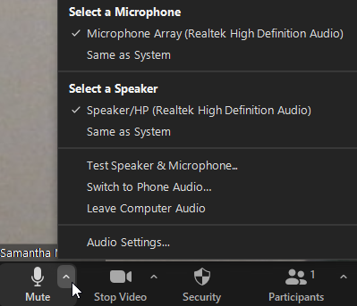
Zoom Webinar Features
If you have not connected your audio, click on the “Join Audio” at the bottom left of your screen.​
To switch to phone, click the arrow next to the microphone icon and select “Switch to Phone Audio”. ​
If you have joined by browser, please click “Audio Settings”
For technical support, please contact STAFF, XXX-XXX-XXXX

Slide 5
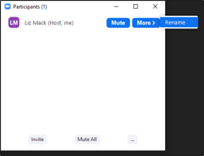
Zoom Webinar Features
Keep yourself on mute when not speaking. ​
Use video, if possible, to promote face to face communication. ​
If needed rename yourself in the participant panel.​
Find your raise hand function at the bottom of your screen

Slide 6
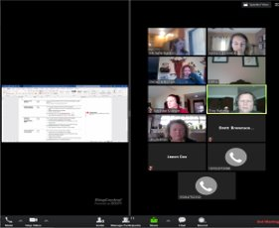
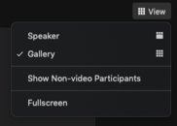
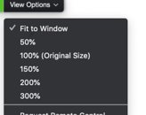
Zoom Webinar Features
Adjust view options

Slide 7
WELCOME
Bryan Newland
U.S. Assistant Secretary of the Interior for Indian Affairs
Joan Mooney
Principal Deputy, Assistant Secretary for Policy, Management and Budget
Rachel Brown
Senior Advisor, Assistant Secretary for Policy, Management and Budget

Slide 8
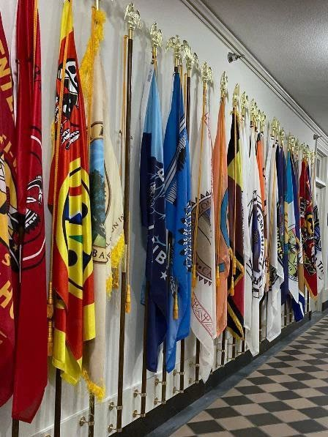
Consultation Overview
Overview of STOP Act
Consultation Timeline
Consultation Questions

Slide 9
STOP Act Overview
Signed into law on December 21, 2022, enrolled as Public Law 117-258.
Prevents the international export of cultural items prohibited from trafficking under the Native American Graves Protection and Repatriation Act (NAGPRA) and the Archeological Resources Protection Act (ARPA).
The law directs Interior, with State, Justice, and Homeland Security to:
Regulate export of tribal cultural items;
Facilitate voluntary repatriation of Native American human remains and cultural items from overseas back to the US; and
Operate a program (authorized up to $3 million annually) to issue export certificates and work in consultation with Tribes on the repatriations efforts under the Act, managing databases and workflows, collecting fees and fines, and coordinate interagency implementation.

Slide 10
Consultation Timeline
Consultation Invitation Letter sent on April 26, 2023
Consultation Sessions:
May 31, 2023 in Oklahoma City, OK
July 14, 2023 in Fairbanks, AK
July 27, 2023 Virtual consultation
August 8, 2023 Virtual Consultation
August 18, 2023 in Santa Fe, NM
Please send written comments by email to consultation@bia.gov by 11:59 ET by August 25, 2023

Slide 11
Questions for Consultation
The Department seeks your input on these questions:
Which Assistant Secretary, Bureau or Office should be responsible for the Stop Act program?
What types of interagency agreements would be helpful for the program and for Act implementation?
What should or should not be included in the draft regulations?

Slide 12
Questions?

Slide 13
Thank you
Please send written comments by email
to consultation@bia.gov
by 11:59 ET by August 25, 2023

