Slide 1
Bureau of Indian Affairs Office of Justice Services
Public Safety and Justice Budgetary Needs of Tribes Affected by Public Law 83-280

Slide 2
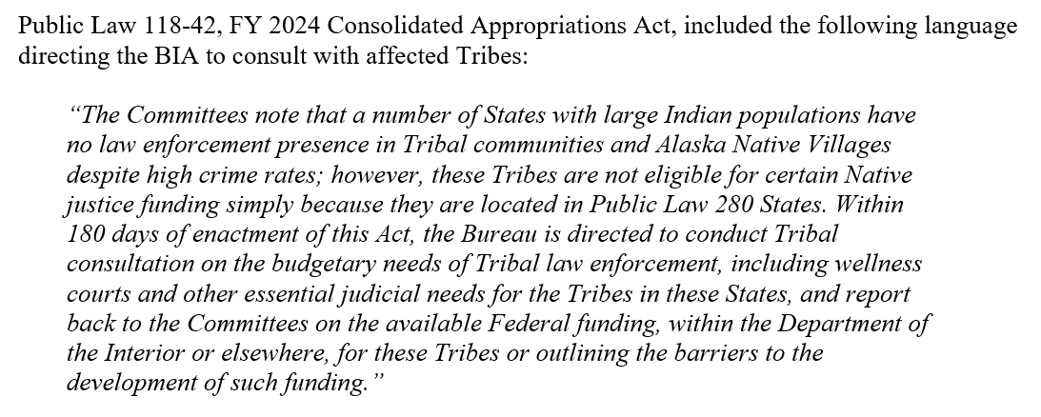
Bureau of Indian Affairs Office of Justice Services
Bureau of Indian Affairs - Office of Justice Services
2024 BIA PS&J Appropriation

Slide 3
Bureau of Indian Affairs Office of Justice Services
Bureau of Indian Affairs - Office of Justice Services
2021 TLOA Report - Summary
The BIA has prepared a Spending, Staffing, and Estimated Funding Costs for Public Safety and Justice Programs in Indian Country report for each annual appropriation since fiscal year 2010.
The latest report (for FY 2021 funding) estimates that an additional $3.1 billion and 25,655 public safety personnel are required to adequately serve Indian Country each year. PL-280 needs are included.
Notes:
The first page of the report summarizes the estimated public safety and justice program needs for Indian Country. Needs are estimated for Law Enforcement, Detention/Corrections, and Tribal Court programs.

Slide 4
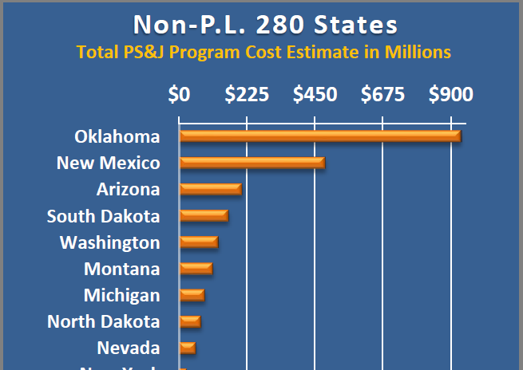
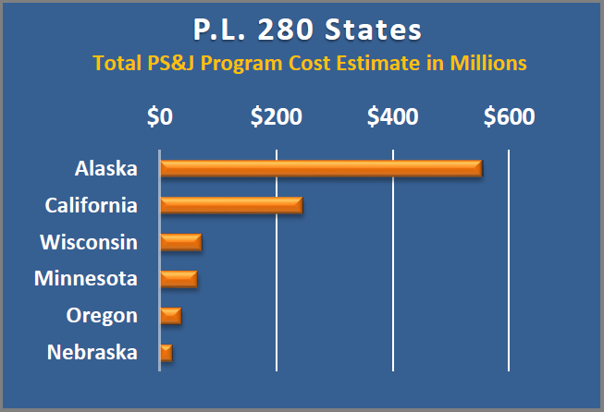
Bureau of Indian Affairs Office of Justice Services
Bureau of Indian Affairs - Office of Justice Services
2021 TLOA Report – Need Estimates
Because the need estimates for Law Enforcement programs and Tribal Courts are calculated from service population data, we can estimate needs for all 574 Federally recognized tribes (including those in P.L. 280 States).

Slide 5
Bureau of Indian Affairs Office of Justice Services
You may provide written comments to consultation@bia.gov by 11:59PM ET on August 14, 2024.
Open for Tribal leaders to speak

