Slide 1
Indian Arts & Crafts Act Consultations April - August 2023

Slide 2
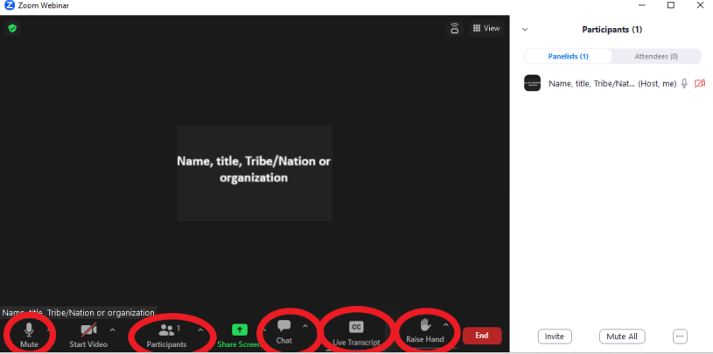
How to Use Zoom
Keep yourself on mute when not speaking. ​
Please rename yourself in the participant panel.​
This meeting is being recorded.
Find your raise hand and chat function at the bottom of your screen
For those joining via a toll-free number, please hit *9 to raise your virtual hand and *6 to mute and unmute yourself.
Closed captions can be accessed at the bottom of your screen

Slide 3
WELCOME
Bryan Newland
U.S. Assistant Secretary of the Interior for Indian Affairs
Kathryn Isom-Clause
Deputy Assistant Secretary for Indian Affairs
Joan Mooney
Principal Deputy, Assistant Secretary for Policy, Management and Budget
Samuel Kohn
Senior Counselor to the Assistant Secretary of Indian Affairs

Slide 4
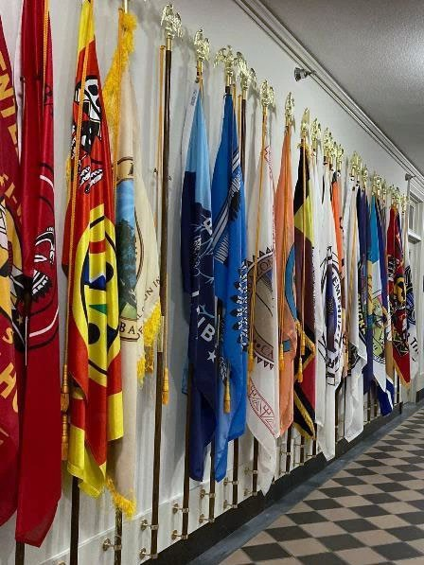
Consultation Overview
Background
Revision Timeline
Proposed Revisions
Consultation Questions

Slide 5
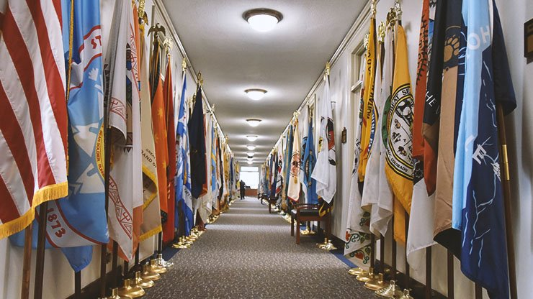
Background
Biden-Harris Plan
Current Regulations
Proposed New Regulations
Notes:
The Biden-Harris Plan for Tribal Nations included a directive to “employ the resources of the federal government to protect Native artisans” to expand economic and community development in Indian Country. DOI (via AS-IA and AS-PMB) is proposing to revise 25 C.F.R Chapter II, the regulations implementing the Indian Arts and Crafts Act.
The Indian Arts and Crafts Board (Board) enforces the Indian Arts and Crafts Act to protect truth in advertising for "Indian Products" a term of art under the current statute. "Indian Product" is currently limited to traditional Indian Art and Craft (such as beadwork, silversmithing, etc.) and is defined by exclusion: if any non-Indian works on or touches the item, it is no longer eligible to be advertised as an Indian Product. Much of Board’s current regulations have not been updated since the 1930s, and are generally not focused on modern media or promotion of Indian Art, as the Indian Art and Craft Act directs.
We are happy to come together with you today to offer this briefing on our proposal to revise the regulations implementing the Indian Arts and Crafts Act. At the risk of re-stating the obvious, our regulations remain in process within DOI, and are pre-decisional .

Slide 6
Regulatory Revision Timeline
Rollout in Spring 2023.
Consultation on discussion draft over Summer 2023.
Potential for NPRM as early as Fall 2023.
Notes:
We rolled our consultation draft out in early April 2023, and have consultation/listening sessions over the summer months. We’ll include listening sessions to ensure that we hear from Native Artists individually as well as our more common consultation process.
Depending on feedback, we’ll review our work and consider next steps, including a possible NPRM, this coming fall.

Slide 7
Revisions In Our Proposal
Expand the definition of “Indian Product” to include new media
Allow extremely limited non-Indian labor to work on "Indian Products"
Formalize the regulatory basis for the Source Directory of American Indian and Alaska Native Owned and Operated Arts and Crafts Businesses
Re-invigorate statutorily-required trademark.
Notes:
Our draft proposal will aim to modernize the IACA regulations by updating concepts and bringing a co-equal focus to promotional activities across four major points:
expanding the definition of “Indian Product” to include new media, such as TV/media, comics, podcasts, and certain artisanal food or drink and agricultural products, including both restaurants (Sioux Chef, Tocabe) and prepared foods like jerky (Tanka bars), wild rice, fry bread mix, teas, and craft beer;
allowing non-Indian labor to work on "Indian Products" in a very narrow situation, akin to our Buy Indian regs: when it’s a Tribally-led business that is 50% owned by an Indian or Indians or by an Indian Tribe; an Indian or Indians or Indian Tribe must receive at least 50% of earnings from the business, and management and daily operations of the business are controlled by one or more Indians. We also add a “Made in America” requirement. Our goal is include Tribal artists who use some manufacturing process (Tribal fashion designers) or require a team to create their art (like a film production crew for Reservation Dogs) in protections of the Act.
Cementing a regulatory basis for the Source Directory of American Indian and Alaska Native Owned and Operated Arts and Crafts Businesses, which is in use now;
Re-invigorating the Board’s trademark to identify “Indian Products.” Our hope is that this will ease enforcement, add a layer of protection for the Native Artists, and act similarly to USDA's Organic mark by allowing consumers to choose to purchase goods that support Indian Country.

Slide 8
Other Points on Revisions
Strive not to affect enforcement efforts
Do not encompass everything “Made in Indian Country”
Complimentary to ARTIST Act of 2023
Notes:
The proposed regulations strive not to impact enforcement efforts. The Board’s Law Enforcement team is doing great work to protect the viability of Indian Art and Craft work and, with their participation in our regulatory process, we strove not to affect their enforcement processes. We may seek feedback in consultation on whether additional enforcement tools would be helpful in this regulatory revision, but we do not anticipate making proposals.
Our proposed draft elevates artisanal and craft work from Indian Country, but does not encompass everything that is “Made in Indian Country”. Examples of craft products that are not explicitly included are raw agricultural ingredients (hay, barley, wheat, etc.) and certain craft beverages (kombucha, alcoholic spirits).
We’re happy there is attention being paid to this issue within SCIA, given the mid-March discussion draft bill called the Amendments to Respect Traditional Indigenous Skill and Talent Act (ARTIST Act) of 2023. We were especially pleased that there is no conflict between our proposed regulations and the discussion draft, although the discussion draft would expand statutory authority in a few ways that we cannot within regulations. [IF ASKED, THOSE ARE:]
(1) directs inclusion of Native Hawaiians in the regulations and a shift of terminology from “Indian Product” to “Native American product”;
(2) requires reporting to Congress on complaints received/pursued/declined, customs violations, and estimated lost revenue;
(3) directs a feasibility study on creating an online registration option for the Source Directory;
(4) proposes statutory forfeiture;
(5) creates a reward mechanism for information leading to arrest/conviction/forfeiture and directs regulations on that point;
(6) expands eligible plaintiffs in a cause of actions for misrepresentation to include Native American businesses and nonprofits;
(7) requires country of origin marking on all Native American-style jewelry from USA, Canada, or Mexico.

Slide 9
Consultation Questions
The Department seeks your input on these questions:
Do the revisions sufficiently account for the range of Indian art and crafts that Indian artists are presently creating?
Should Native Hawaiian Organizations be included in the definition of “Indian Tribe” for purposes of regulations implementing the Indian Arts and Crafts Act?
Would additional enforcement tools, such as administrative forfeiture, provide confidence to Indian artists?

Slide 10
More Information
Consultation webpage is https://www.bia.gov/service/tribal-consultations/indian-arts-and-crafts-board-25-cfr-chapter-ii
Dear Tribal Leader Letter
Summary of Proposed Changes
Schedule of Upcoming Sessions
Notes:
If you’re looking for more information, we’ve pulled everything together in one place on our BIA Consultations’ webpage. You’ll find there the text of the DTLL, a summary of proposed changes, and a schedule of upcoming consultations.

Slide 11
Comments?
Questions?
consultation@bia.gov

Slide 12
Thank you
Please send written comments by email
to consultation@bia.gov
by 11:59 ET by September 1, 2023

