Slide 1
Land and Water Conservation Fund Tribal Land Acquisition Tribal Consultation
Session 1 – September 26, 2023 (1-3p EST)
Session 2 - September 27, 2023 (1-3p EST)
Session 3 - September 28, 2023 (4-6p EST)

Slide 2
Agenda
Introductions
LWCF Overview
LWCF Tribal Land Acquisition
Proposed Criteria
Tribal Leader Comments & Questions
Closing

Slide 3
Introductions
Trina Locke, Acting Deputy Bureau Director - Office of Trust Services
Lorna Babby, Division Chief - Trust Land Consolidation
Tonya Almaraz, Tribal Relations Advisor - Trust Land Consolidation
Luree Livermont, Tribal Relations Advisor - Trust Land Consolidation

Slide 4
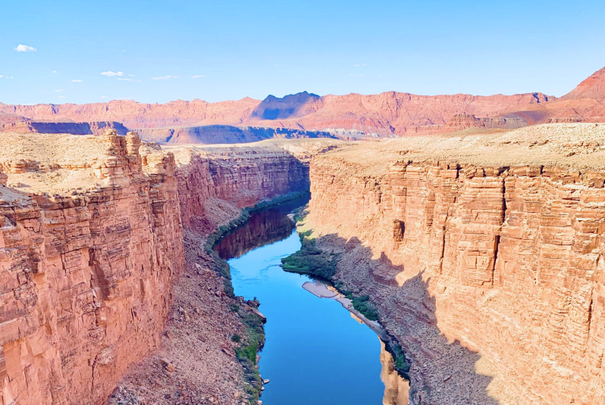
LWCF Overview
The Land and Water Conservation Fund (LWCF) was created in 1965 to help preserve, develop, and ensure access to outdoor recreation resources.
The Great American Outdoors Act of 2020 authorized $900 million annually in permanent funding for LWCF.

Slide 5
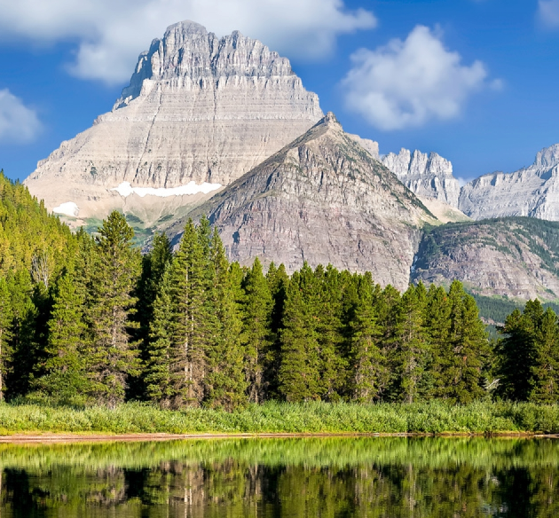
LWCF Overview
LWCF is available for 2 main purposes:
Federal acquisition of land and waters and interests therein;
Grants to states for recreational planning; acquiring recreational lands, waters, or related interests; and developing outdoor recreational facilities

Slide 6
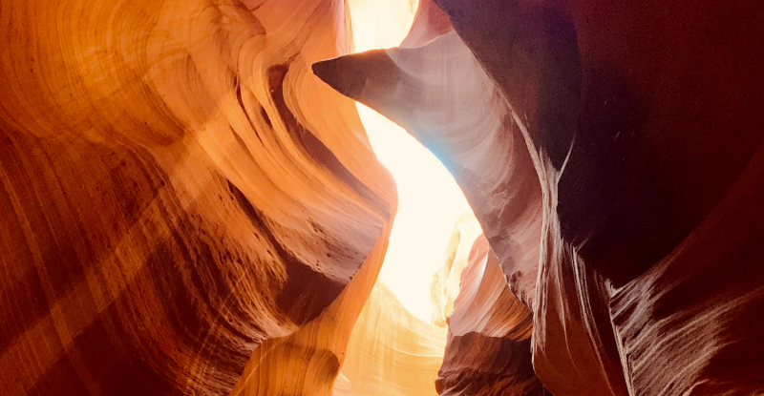
LWCF Overview
To date, LWCF funding for Federal land acquisition has been allocated to the following 4 land management agencies:
Bureau of Land Management
U.S. Fish and Wildlife Service
National Park Service
Forest Service

Slide 7
LWCF Tribal Land Acquisition
FY24: BIA has requested $12 million for the creation of a new Tribal LWCF land acquisition program

Slide 8
LWCF Tribal Land Acquisition
Funding is intended to support:
acquisition of lands, waters, and interests therein
for the purpose of protecting and conserving natural resource areas that may also be of cultural importance to Tribes and Alaska Natives, or have recreational benefits for Tribal communities and Alaska Native Villages

Slide 9
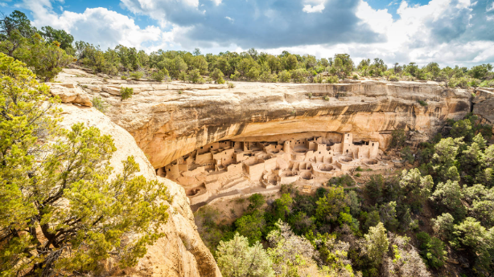
LWCF Tribal Land Acquisition
The LWCF Tribal land acquisition program aims to increase the amount of Tribal trust land for stewardship and other uses deemed beneficial by Tribes and Alaska Natives, consistent with purposes of the LWCF.

Slide 10
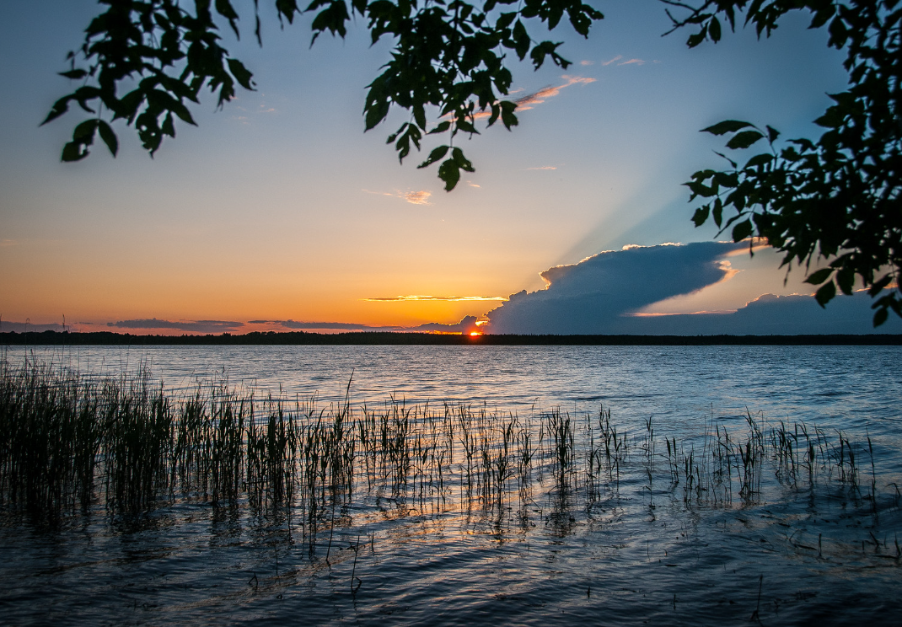
LWCF Tribal Land Acquisition
The BIA will develop its own process and criteria for allocating Tribal LWCF land acquisition funding in
a manner which:
advances the BIA’s mission and goals
maximizes opportunity to Tribes and Alaska Natives
meets statutory LWCF requirements

Slide 11
Statutory Criteria
Common Criteria Specified under the LWCF Act:
1. Significance of the acquisition;
2. Urgency of the acquisition;
3. Management efficiencies;
4. Management cost savings;
5. Geographic distribution;
6. Threats to the integrity of the land; and
7. Recreational value of the land.

Slide 12
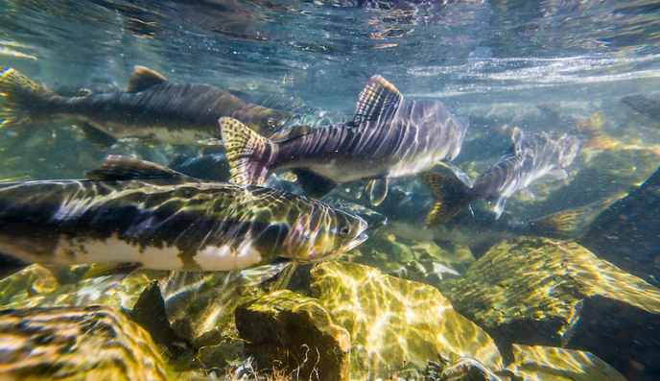
Proposed Criteria
Proposed Additional BIA Criteria for Tribal Land Acquisition:
1. Strengthens Tribal sovereignty and self-determination
2. Facilitates Tribal climate resilience
3. Related to “nature-based solutions” to climate issues
4. Conserves and/or restores habitat or species
5. Conserves natural landscapes
6. Benefits water quality and/or quantity
7. Connects ecosystems
8. Protects cultural/historic resources and sites by restoring access to ancestral lands
9. Supports traditional uses

Slide 13
Proposed Criteria
Proposed Additional BIA Criteria for Tribal Land Acquisition (Continued):
10. Enhances and improves recreational access and/or opportunities
11. Appraisal availability
12. Availability of willing seller
13. Addresses willing seller hardship/need to sell (financial or medical circumstances)
14. Cost-effectiveness
15. Operation & maintenance cost and savings
16. Local/community support
17. Outside contribution or assistance

Slide 14
LWCF Tribal Land Acquisition Questions for Feedback
Are the proposed BIA criteria for Tribal land acquisition appropriate?
What other criteria should BIA consider in allocating LWCF Tribal land acquisition funding?
Should there be a maximum funding amount available per Tribe?

Slide 15
Please submit comments or questions by 11:59 pm Eastern Time on Thursday, October 5, 2023 to: consultation@bia.gov
Written Comments

Slide 16
Additional Resources and Contacts
Background Information
https://www.bia.gov/sites/default/files/dup/tcinfo/bia_ots-dtlc_dtll-lwcf_tribal_land_acquisition_updated_7.28.23_dbia_signed_3.pdf
https://www.bia.gov/sites/default/files/dup/tcinfo/bia_dtll-lwcf_tribal_land_aquisition_enclosure_proposed_criteria_updated_7.28.23.pdf
https://www.bia.gov/service/tribal-consultations/tribal-land-acquisition-funded-through-land-and-water-consultation
Contacts for Questions
Division of Trust Land Consolidation, BIA
Lorna Babby, Division Chief: lorna.babby@bia.gov
Tonya Almaraz, Tribal Relations Advisor: tonya.almaraz@bia.gov
Luree Livermont, Tribal Relations Advisor: luree.livermont@bia.gov

Slide 17
THANK YOU!
www.indianaffairs.gov

