Slide 1
Trust Land Consolidation
Implementation Strategy
Tribal Consultation
Session 1 – July 16, 2024 (1-3p EST)
Session 2 - July 17, 2024 (1-3p EST)
Session 3 – July 18, 2024 (1-3p EST)

Slide 2
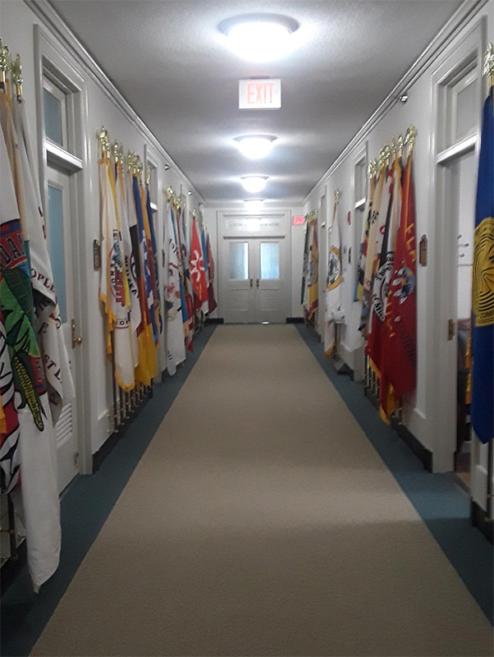
Welcome & Agenda
Welcome
Introduction
DTLC Overview
Proposed Strategy
Tribal Leader Comments & Questions
Closing

Slide 3

Introductions
Johnna Blackhair, Deputy Bureau Director - Office of Trust Services
Lorna Babby, Division Chief - Trust Land Consolidation
Tonya Almaraz, Tribal Relations Advisor - Trust Land Consolidation
Staci Shelton, Management Analyst - Trust Land Consolidation
Amber Green, Management Analyst - Trust Land Consolidation

Slide 4
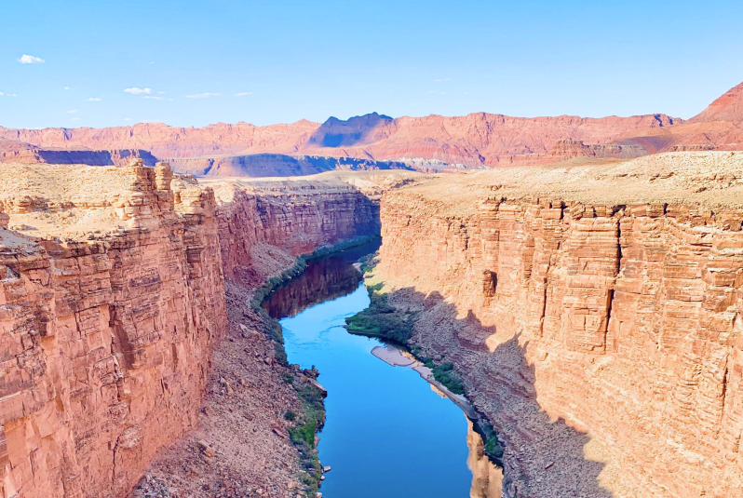
DTLC Overview
The Division of Trust Land Consolidation (DTLC) was created in the BIA Office of Trust Services (OTS) to build upon the success of the Land Buy-Back Program for Tribal Nations (Buy-Back Program).
DTLC assumed the lead for the Interior Department's fractional interest acquisition program after the Buy-Back Program ended.

Slide 5

DTLC Overview (Continued)
Consolidated Appropriations Act of 2022 (Public Law 117–103) authorized BIA to continue land consolidation efforts and provided an initial $7 million to be available until expended
Consolidated Appropriations Act, 2023 (Public Law 117-328) provided an additional $8 million
Consolidated Appropriations Act, 2024 (Public Law 118-42 ) provided an additional $4 million

Slide 6
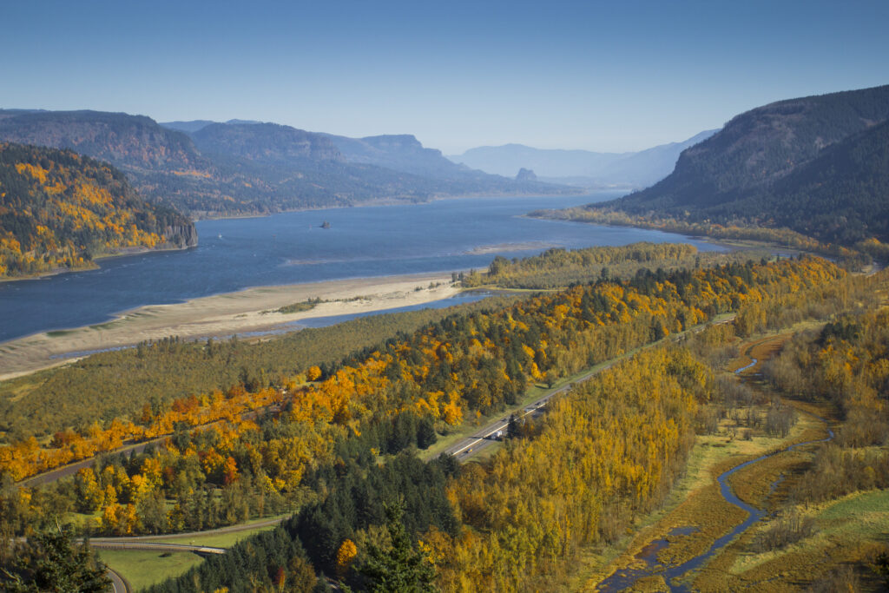
DTLC Overview (Continued)
Statutory Authorization
Indian Land Consolidation Act Amendments of 2000 (Public Law 106–462)
​
American Indian Probate Reform Act of 2004 (Public Law 108–374)

Slide 7

DTLC Overview (Continued)
Mission Statement
The mission of DTLC is to facilitate sound land management and administration, support Tribal sovereignty and self-determination, and promote economic opportunity in Indian Country by reducing Indian land fractionation.

Slide 8
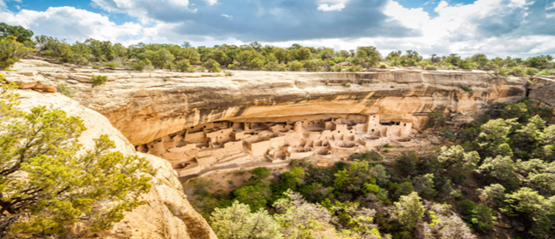
DTLC Overview (Continued)
Best Practices:
  Streamlined, standardized and automated processes and procedures
  Efficient and cost-effective appraisal methods
  Close coordination and collaboration with Tribes
Key decisions:
  The reservation locations at which to acquire fractional land interests;
  The tracts and/or interests to offer to purchase at each location; and
  The amount of funding to allocate for acquisition of fractional interests at each location.

Slide 9

DTLC Overview (Continued)
Initial Steps:
Tribal Listening Sessions - September 2022
Initial Implementation Plan
Pilot Implementations
Tribal Consultation on Proposed Strategy

Slide 10
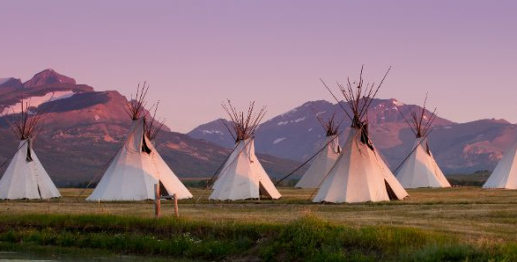
Proposed Strategy
Conduct the Trust Land Consolidation Program in a Manner That:
  Supports Tribal Sovereignty & Self-Determination (Strategic Goal 1)
  Minimizes Administrative Costs (Strategic Goal 2)
  Complements Existing Probate Rules (Strategic Goal 3)

Slide 11

Proposed Strategy (Continued)
  Strategic Goal 1: Consolidate fractionated land in a manner that enhances Tribal sovereignty and promotes Tribal self-determination.
    Objective 1.1: Meaningful Tribal Consultation on land consolidation strategy going forward.
    Objective 1.2: Close coordination and collaboration with participating Tribes.

Slide 12
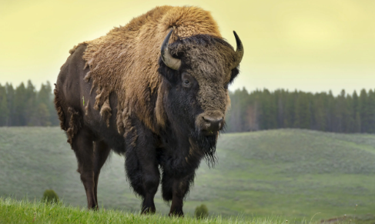
Proposed Strategy (Continued)
  Strategic Goal 2: Consolidate fractionated land in an efficient and effective manner that minimizes associated administrative costs.
    Objective 2.1: Utilize streamlined and improved land acquisition policies and procedures.
    Objective 2.2: Utilize efficient and cost-effective appraisal methods.
    Objective 2.3: Target cost-effective locations, tracts, and interests.

Slide 13

Proposed Strategy (Cont’d)
  Strategic Goal 3: Consolidate fractionated land in a manner that complements existing probate provisions aimed at slowing future fractionation.
    Objective 3.1: Target interests that are not subject to AIPRA’s “Single Heir Rule.”
    Objective 3.2: Target interests and tracts owned by willing sellers.
    Objective 3.3: Target tracts with large interests to gain.

Slide 14

Proposed Strategy (Cont’d)
  Proposed Strategy is intended to be:
    Flexible
    Subject to modification and refinement
    Updated as needed

Slide 15

Questions for Feedback
Are the proposed goals and objectives for Trust Land Consolidation appropriate?
What other factors should be considered in determining locations for implementation?
What other factors should be considered in determining tracts and interests for acquisition?

Slide 16

Please submit comments or questions by 11:59 pm Eastern Time on
Wednesday, September 18, 2024 to: consultation@bia.gov
Written Comments

Slide 17
Additional Resources and Contacts
Background Information
  BIA-OTS Division of Trust Land Consolidation is available on the web at: Division of Trust Land Consolidation | Indian Affairs (bia.gov)
Contacts for Questions - Division of Trust Land Consolidation, BIA
    Lorna Babby, Division Chief: lorna.babby@bia.gov
    Tonya Almaraz, Tribal Relations Advisor: tonya.almaraz@bia.gov

Slide 18
THANK
YOU!
www.indianaffairs.gov

