Slide 1
Tiwahe Consultation
Monday, September 12, 2022
Department of Interior
Office of the Assistant Secretary – Indian Affairs

Slide 2
Introduction
Tiwahe (“Family” in Lakota) is about possibility, symbolizing the interconnectedness of all living things and one’s personal responsibility to protect family, community, and the environment.
The Tiwahe Initiative empowers Tribes to create their own potential and provides freedom to design programs and integrate services with Tribal culture and tradition producing powerful outcomes beneficial to the Indian community and families living there.
Tiwahe is different primarily in that it centers the Tribes’ voices and choices, and it is based on their knowledge and understanding of their communities’ needs.

Slide 3
Tiwahe Components
Housing
Job Placement and Training
Social Services
Recidivism Reduction
ICWA
Tribal Courts

Slide 4
Tiwahe Funding 2015-2020

Slide 5
Tiwahe Pilot Sites
Association Village of Council Presidents
Laurinda Weston-O'Brien, Family Advocacy Coordinator
Fort Belknap Indian Community
Sarah Gone, J.D., Family Advocacy Coordinator
Pascua Yaqui Tribe
Erin Pazos, Acting Tiwahe Coordinator
Red Lake Nation
Robert “Charlie” Reynolds, Family Advocacy Coordinator
Spirit Lake Tribe
Carla Carmona, Tiwahe Coordinator
Ute Mountain Ute Tribe
Juanita Plentyholes, Tiwahe Coordinator

Slide 6
Site Characteristics
Funding Mechanisms:
Self Governance
AVCP
Red Lake
638
Ft. Belknap
Pascua Yaqui
Spirit Lake (transitioned to 638)
Ute Mountain
Direct Service
Spirit Lake (transitioned to 638)
Locations:
Alaska Region
Rocky Mountain Region
Southwestern Region
Western Region
Great Plains Region
Midwest Region

Slide 7
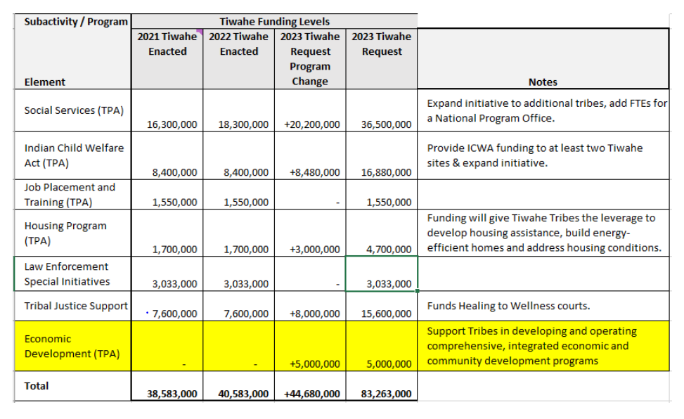
Proposed FY 2023 Funding

Slide 8
Site Selection Timeline (Tenative)
Sept. 12, 2022
Consultation
Oct. 12, 2022
Comment Period Closes
Oct. 31, 2022
Selection Framework Released
Nov. – Dec. 2022
Site Proposals Submitted
Jan. 2023
Site Selection Announced
Spring 2023
New Sites Onboarded

Slide 9
Additional Information
Tiwahe Congressional Report and Appendices
https://www.bia.gov/ois/tiwahe
Tiwahe Program Evaluation
https://www.fhi360.org/sites/default/files/media/documents/resource-tiwahe-family-community-tribal-services-report.pdf
Contact Information
Meghan Bishop, IPA Policy Specialist
Office of the Assistant Secretary – Indian Affairs
meghan.bishop@bia.gov

