Slide 1


Safeguard Tribal Objects of Patrimony (STOP) Act
Aloha mai!
Native Hawaiian Community Consultation
Notice of Proposed Rulemaking
STOP Act
November 25 and 26, 2024

Slide 2
STOP Act Overview
Ke kānāwai
Signed into law on December 21, 2022, enrolled as Public Law 117-258.
Seeks to prevent the illegal trafficking of human remains and cultural items protected under the Native American Graves Protection and Repatriation Act (NAGPRA) and the Archaeological Resources Protection Act (ARPA).
Directs the U.S. Departments of the Interior, State, Justice, and Homeland Security to:
  Regulate export of tribal cultural items;
  Facilitate voluntary return of tangible cultural heritage to Indian Tribes and Native Hawaiian organizations; and
  Operate a program (authorized up to $3 million annually) to issue export certificates and work in consultation with Indian Tribes and Native Hawaiian organizations on the repatriation efforts under the Act, manage databases and workflows, collect fees and fines, and coordinate interagency implementation.

Slide 3
STOP Act Overview
Definitions of “Native Hawaiian” and “Native Hawaiian organization”
Nā kānaka ʻōiwi
“Native Hawaiian” as defined in NAGPRA means “any individual who is a descendant of the aboriginal people who, prior to 1778, occupied and exercised sovereignty in the area that now constitutes the State of Hawaii.” 25 USC § 3001(10).
“Native Hawaiian organization” in NAGPRA means “any organization which-
serves and represents the interests of Native Hawaiians,
has as a primary and stated purpose the provision of services to Native Hawaiians, and
has expertise in Native Hawaiian Affairs, and
shall include the Office of Hawaiian Affairs and Hui Malama I Na Kupuna O Hawaiʻi Nei.”
25 USC § 3001(11).

Slide 4
Development of Draft Regulations
  DOI convened seven consultations from May 2023 to Sept 2023 to receive feedback about:
    Which Assistant Secretary, Bureau, or office within DOI should be responsible for the STOP Act Program;
    What types of interagency agreements would be helpful for the program and for Act implementation; and
    What should or should not be included in the draft regulations.
  DOI convened a working group of staff from DOI, DOJ, U.S. State, and Homeland Security to prepare draft regulatory language based on consultation feedback.
    That working group achieved a general consensus on the draft regulations.

Slide 5
Proposed Rule Being Consulted Upon
The proposed rule would implement the STOP Act by:
establishing an export certification system;
setting forth procedures for detention of items subject to the rule and repatriation of those items;
establishing a framework for voluntary return of items subject to the rule; and
establishing federal interagency and Native working groups.
Federal Register Notice of Proposed Rulemaking (STOP Act) - https://www.federalregister.gov/documents/2024/10/25/2024-24332/safeguard-tribal-objects-of-patrimony

Slide 6
Framing Questions
(to start the discussion)
He mau nīnau
Topic 1: Subpart B – Export Certification System
Do you have concerns/comments/suggestions about the process or associated timelines for reviewing and approving an Export Certification under Subpart B §1194.104(d) & §1194.104(e)?
Proposed process & timeline:
Review for completeness (up to 20 business days).
Notify applicant of deficiencies in application.
Determine application is complete.
Notify Tribe or NHO of complete application the following business day.
DOI receives application for export.
Notify Tribe or NHO of receipt.
Tribe or NHO has 9 business days to review application and supporting documents.

Slide 7
Framing Questions
Topic 2
He mau nīnau
Topic 2: Subpart E – Voluntary Return of Tangible Cultural Heritage
Do you have any suggestions/comments/concerns with the process outlined under Subpart E for the voluntary return of cultural items?
Excerpt:
  § 1194.402 When is consultation initiated?
  (a) An individual or organization that is seeking to voluntarily return tangible cultural heritage under this subpart must compile a simple itemized list and description of any tangible cultural heritage. . . .
Specifically, how do you think DOI, State, & Homeland Security should facilitate this voluntary return process?

Slide 8
Framing Questions
Topic 3
He mau nīnau
Topic 3: Subpart G –Native Working Group
Do you have comments/suggestions/concerns related to the proposed purpose, function, membership, or duties of the Native Working Group under Subpart G?
Excerpt:
  § 1194.602 What is the membership of the Native Working Group?
  (a) . . . composed of representatives of Indian Tribes and Native Hawaiian organizations with relevant expertise.
  (b) There are thirteen members . . . one representing Native Hawaiian organizations.
  (c) . . . appointed by the Secretary for an initial term of four years. A member may be reappointed for a term of two years.
  (d) Any Indian Tribe or Native Hawaiian organization may nominate a person from a particular BIA Region or Hawaiʻi for membership, even if that Indian Tribe or Native Hawaiian organization is not in that Region or in Hawaiʻi. The Office will recommend
  a list of candidates to the Secretary, in
  coordination with the Interagency Working
  Group convened under subpart F of this part.

Slide 9
Framing Questions
Topic 4
He mau nīnau
Topic 4: Export Certification Database and Protecting Confidential Information - §1194.107 of Subpart B
Do you have comments/suggestions/concerns about:
The information being made available to Tribes, Native Hawaiian organizations, and relevant Federal agencies through the database?
The proposed procedures for protecting information deemed culturally sensitive?
How DOI can better protect confidential information or what types of specific information should be protected?

Slide 10
Discussion Guidance
To allow our facilitation team to capture your comments and discussion
Ke ʻoluʻolu
Use the “raise hand” feature if you wish to speak.
Wait for our facilitator to call upon you to speak and come off mute.
Identify yourself and any organization you may be representing during this consultation.
Ask questions using the Q+A feature. Feel free to make comments in the chat.
Do not speak over one another.
Focus your comments and discussion on today's topic.
Help us identify other interested people and subject matter experts we should consult.

Slide 11
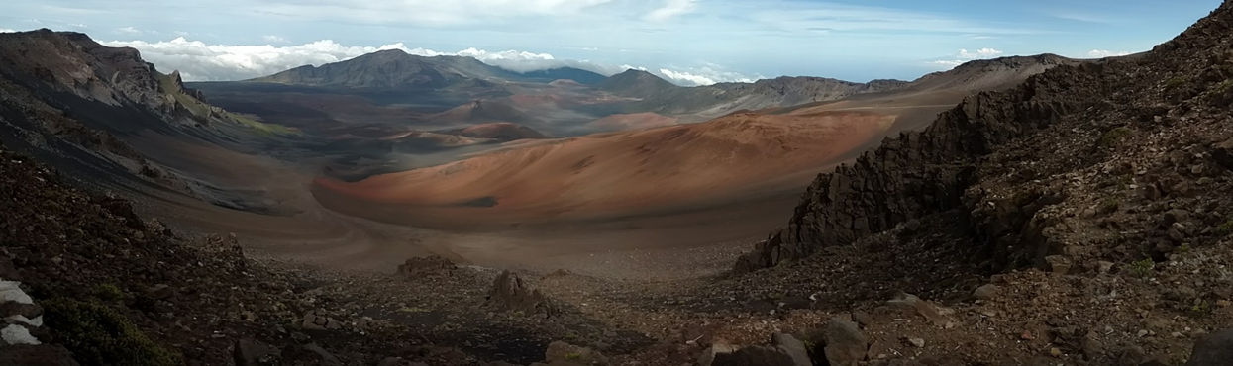
Mahalo nui loa!
Written Comments
Email to consultation@bia.gov by 6:59 pm HST on Tuesday, December 24, 2024.
Next Virtual Consultation - Tuesday, Nov. 26, 2024, at 5:00 pm HST.

