Slide 1
Tribal Consultation on Notice of Proposed Rulemaking
25 C.F.R. Part 293
Class III Tribal-State Gaming Compact Process
Office of the Assistant Secretary—Indian Affairs
January 2023

Slide 2
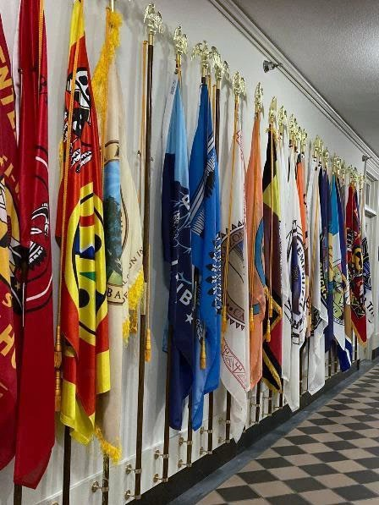
Consultation Schedule
Fri, Jan 13, 2023 1:00 PM - 4:00 PM Mountain (DST) (In-Person)
Thu, Jan 19, 2023 1:00 PM - 4:00 PM Eastern (Virtual)
Mon, Jan 30, 2023 2:00 PM - 5:00 PM Eastern (Virtual)
Written comments are due by 11:59 p.m. Eastern Time on Wednesday, March 1, 2023 to consultation@bia.gov

Slide 3
25 C.F.R. Part 293 Class III Tribal State Gaming Compact Process
The changes for the Notice of Proposed Rulemaking (NPRM) include the following:
Updated definitions of amendment, extension, gaming facility, and added definitions for gaming spaces, meaningful concession, and substantial economic benefit. See § 293.2.
Clarification of when ancillary agreements or documents are amendments which need to be submitted to the Secretary for approval. See §§ 293.4, 293.8, 293.21, and 293.28.
Clarification as to when the Tribe and State submit a gaming compact for review and what documents need to be included. See § 293.8.
Updated the provision on when the 45-day review period begins to require that the Office of Indian Gaming provides an email acknowledgement when a gaming compact is received and the date of the 45th day. See § 293.11.
Requires that after the 45-day review period, if no action is taken on a gaming compact, the Secretary will issue a letter informing the parties that the gaming compact or amendment has been approved by operation of law. See § 293.12.

Slide 4
25 C.F.R. Part 293 Class III Tribal State Gaming Compact Process
Clarifies that a Tribe may submit to the Department any agreement or document that a Tribe is concerned may amend its gaming compact for a determination within 60-days if it is an amendment requiring Secretarial review and approval under IGRA. See §§ 293.4, 293.21, and 293.28.
Provides that if any gaming compact or amendment requires that the Tribe adopt standards equivalent to State law or regulation, the parties must show that these mandated Tribal standards are both directly related to and necessary for, the licensing and regulation of the gaming activity. See § 293.22.
Provides different examples of factors that are and are not directly related to the operation of gaming activities. See § 293.23 – 293.24.
Includes a new provision that the Secretary must also consider whether the Tribe is the primary beneficiary of the gaming when analyzing whether the revenue share is lawful. See § 293.25.
Added a section allowing gaming compacts to include statewide remote wagering or internet gaming—similar to the justification in the Seminole letter. See § 293.29.
Added a section as to the effect on pending requests, final agency decisions already issued, and future requests. See § 293.30.
Please raise your hand if you would like to speak.
Please enter your question or comment in the Zoom chat box.

Slide 5
Next Steps…
Written comments are due by 11:59 p.m. Eastern Time on March 1, 2023 to consultation@bia.gov
Register for upcoming virtual consultations here: https://www.bia.gov/service/tribal-consultations/nprm-25-cfr-151-land-acquisitions-and-25-cfr-293-class-iii-tribal
If you have questions regarding this effort, please contact Oliver Whaley, Director, Office of Regulatory Affairs and Collaborative Action (RACA), Office of the Assistant Secretary -Indian Affairs, by telephone at (202) 738-6065, or email at RACA@bia.gov.

