Slide 1
Tribal Consultation on Notice of Proposed Rulemaking
25 C.F.R. Part 151
Land Acquisition
Office of the Assistant Secretary—Indian Affairs
January 2023

Slide 2
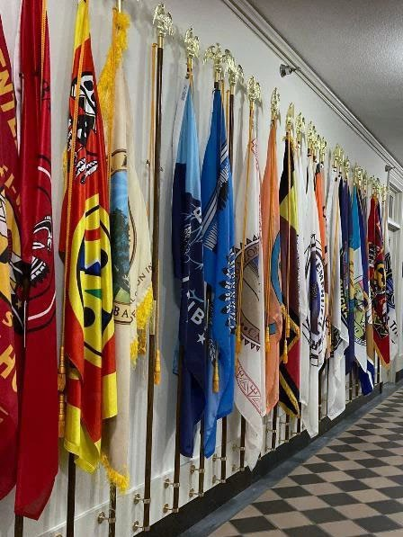
Consultation Schedule
Fri, Jan 13, 2023 9:00 AM - 12:00 PM Mountain (DST) (In-Person)
Thu, Jan 19, 2023 1:00 PM - 4:00 PM Eastern (Virtual)
Mon, Jan 30, 2023 2:00 PM - 5:00 PM Eastern (Virtual)
Written comments are due by 11:59 p.m. Eastern Time on Wednesday, March 1, 2023 to consultation@bia.gov

Slide 3
25 C.F.R. Part 151 - Land Acquisition
The NPRM proposes the following changes:
Codify standards that implement the 2009 decision in Carcieri v. Salazar to increase clarity and certainty in determining the Secretary’s authority to take land in trust for Tribes. See § 151.4.
Reduce processing time and uncertainty by identifying the documents needed for a complete application, after which the BIA will issue a decision within 120 days. See § 151.8.
Articulate a clear land acquisition policy to strengthen self-determination and sovereignty, ensure that every Tribe has protected homelands where its citizens can maintain their Tribal existence and way of life, and consolidate land ownership to strengthen Tribal governance over reservation lands and reduce checkerboarding. See § 151.3.
Establish clear criteria by requiring that great weight be given to establishing a Tribal land base or protecting Tribal homelands, protecting sacred sites or cultural resources and practices, establishing or maintaining conservation or environmental mitigation areas, consolidating land ownership, reducing checkerboarding, acquiring land lost through allotment, protecting treaty or subsistence rights, or facilitating Tribal self-determination, economic development, Indian housing. See §§ 151.9 – 12.

Slide 4
25 C.F.R. Part 151 - Land Acquisition
Increase efficiency by analyzing applications as either on-reservation, contiguous to a reservation, an initial acquisition for landless Tribes, or off-reservation, recognizing that each category requires specific criteria for an appropriate analysis. See §§ 151.9 – 12.
Establish clear criteria that presume on-reservation, contiguous, and initial acquisitions for landless Tribes will be approved and that Tribal communities will benefit from proposed acquisitions without regard to distance from their reservation. See §§ 151.9 – 10, 12.
Consider the concerns of state and local governments by notifying them and requesting comments on regulatory jurisdiction and real property taxes, except that no comments will be requested for on-reservation acquisitions because they are likely to have very few or no impacts on these governments. See §§ 15.10 – 12.
Reduce expense by clarifying when environmental studies and reports are to be updated, thus, eliminating the need for repeated updates. See § 151.15.
Please raise your hand if you would like to speak.
Please enter your question or comment in the Zoom chat box.

Slide 5
Next Steps…
Written comments are due by 11:59 p.m. Eastern Time on March 1, 2023, to consultation@bia.gov
Register for upcoming virtual consultations here: https://www.bia.gov/service/tribal-consultations/nprm-25-cfr-151-land-acquisitions-and-25-cfr-293-class-iii-tribal
If you have questions regarding this effort, please contact Maria Wiseman, Senior Policy Advisor for Climate and the Environment, at (202) 208-7227 or via email: maria.wiseman@bia.gov

