Slide 1
White House Council on Native American Affairs
Committee on Education
10 - Year National Plan on Native Language Revitalization Consultation
September 20, 2023

Slide 2
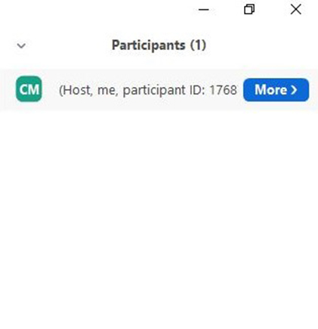
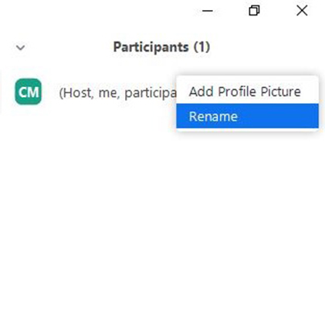
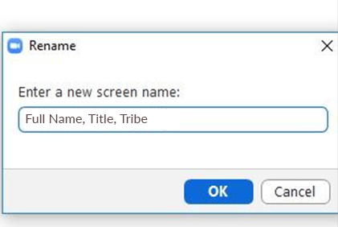
Add Your Full Name, Title, and Tribe
1
In the Participants list, click the More button by your name.
2
Select Rename from the drop-down menu.
3
Type your full name, title, tribe, then click OK.

Slide 3
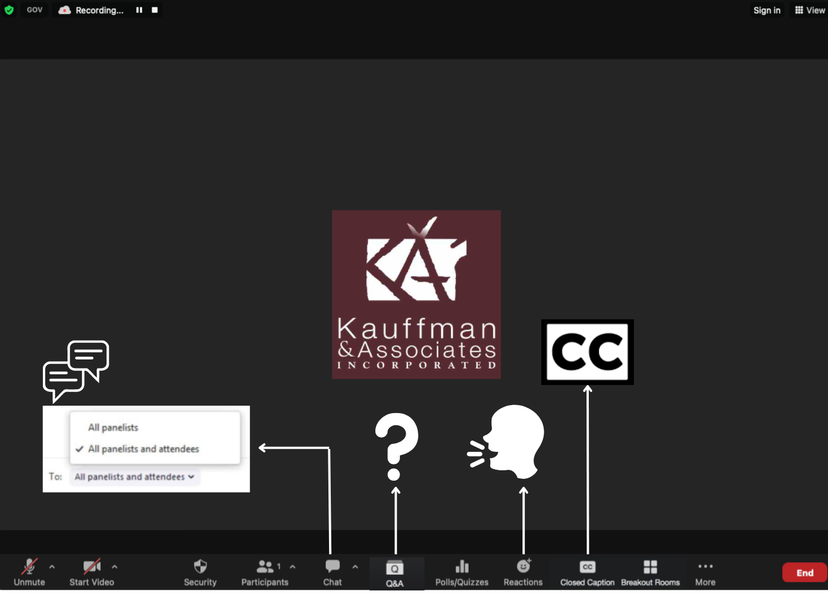
Technical Support
If you lose connectivity during the session, simply re-click your join link to re-access the webinar.
If you experience technical difficulties, send a note using the chat box on your bottom menu bar. We’ll assist you from there.

Slide 4
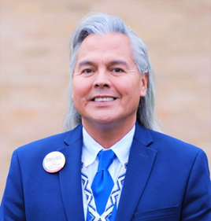
Welcome
Dr. Aaron Payment
BiiWaagajiig (Sault Ste. Marie Tribe of Chippewa)
Facilitator

Slide 5
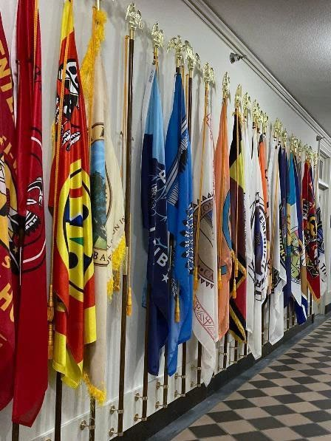
Agenda
Opening Remarks
Session 1: Vision
Session 2: Barriers/Challenges
Session 3: Support
Session 4: 10-Year National Plan
Closing Remarks

Slide 6
Open In a Good Way

Slide 7
Opening Remarks

Slide 8
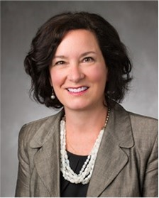
Opening Remarks
Patrice H. Kunesh
Commissioner, Administration for Native Americans, Department of Health and Human Services

Slide 9
White House Council on Native American Affairs, Committee on Education Leads
Naomi Miguel
Executive Director, WHI-NATCU, ED
Tony Dearman
Director, Bureau of Indian Education
Wizipan Garriott
Principal Deputy, Assistant Secretary- Indian Affairs, DOI
Tracy Goodluck
Senior Advisor to the Assistant Secretary-Indian Affairs, DOI

Slide 10
10-Year National Plan on Native Language Revitalization Roadmap
June 2022
Native Language Listening Sessions
September 2022
Initial consultation and planning framework published
June 2023
Draft Native Language Revitalization literature review
September 2023
10-Year National Plan on Native Language Revitalization consultations and community discussions.
Fiscal Year 2024
Implementation preparation
November 2023
Draft 10-Year National Plan on Native Language Revitalization
October 2021
Biden Administration signs Executive Order 14049

Slide 11
Framework Pillars for the 10-Year National Plan on Native Language Revitalization
Awareness
Recognition
Integration
Support
Create national awareness of the importance of Native languages to tribes and the country, the current crises of Native language loss, and the urgency for immediate action.
Formal policy recognition of the role the U.S. government played in erasing Native languages, the state of crises, and the need for federal resources and support for Native language revitalization.
Integrate Native language revitalization in mainstream society, including U.S. federal policies and outline the need for the creation of Native language revitalization ecosystems.
Identify funding, including federal and philanthropic, for Native language revitalization.

Slide 12
Consultation
How can the federal government work with Tribes, Native Hawaiian Organizations, Tribal and non-profit organizations, states, schools, higher education institutions, and the private sector to raise national awareness about the importance of Native languages for Tribes and the country?
What can the federal government do to create national awareness of the current crisis of Native language loss and establish a sense of urgency for immediate national action?
How important to a National Plan is a formal policy recognition of the historic role that the federal government played in Native language erasure?
How could the National Plan support the integration of Native language revitalization into mainstream society, e.g., school curriculum, immersive learning, early and adult education, federal and state policies, signage, etc.?
How could the National Plan stimulate and facilitate access to financial support for Native language revitalization (including federal, state, and philanthropic funding)?

Slide 13
Session 1: Tribes’ Vision for Native Language Revitalization

Slide 14
What is your Vision for Revitalization for Tribal Language for your Tribal Nation?

Slide 15
Session 2: Identified barriers or challenges for Native Language Revitalization

Slide 16
What challenges or barriers exist that inhibit your Tribal Nation for realizing your vision?

Slide 17
Session 3: Implementation needs for Native Language Revitalization

Slide 18
What does your Tribal Nation need to implement and sustain your Tribal Nation vision to revitalize your language?

Slide 19
Session 4: 10-Year National Plan for Native Language Revitalization

Slide 20
What does a comprehensive 10-year NA language revitalization plan look like? How can the federal government support it?

Slide 21
Summary
and Closing
Remarks

Slide 22
Upcoming Consultations
FOR: | DATES: | LOCATION and TIME: | TO JOIN WEBINAR:
Tribal Governments | Tuesday, September 26 | Virtual 3–5 p.m. ET | https://www.zoomgov.com/meeting/register/vJIsd-CgqzIuHHilDdpme8q8MY_JRs_EMcc
Tribal Governments | Thursday, September 28 | Virtual 2–4 p.m. ET | https://www.zoomgov.com/meeting/register/vJItfuipqDwuG5qtq9UKQ_slzY7lpcR4fa4
22

Slide 23
Thank you!

Slide 24
Slide left intentionally blank.

Slide 25
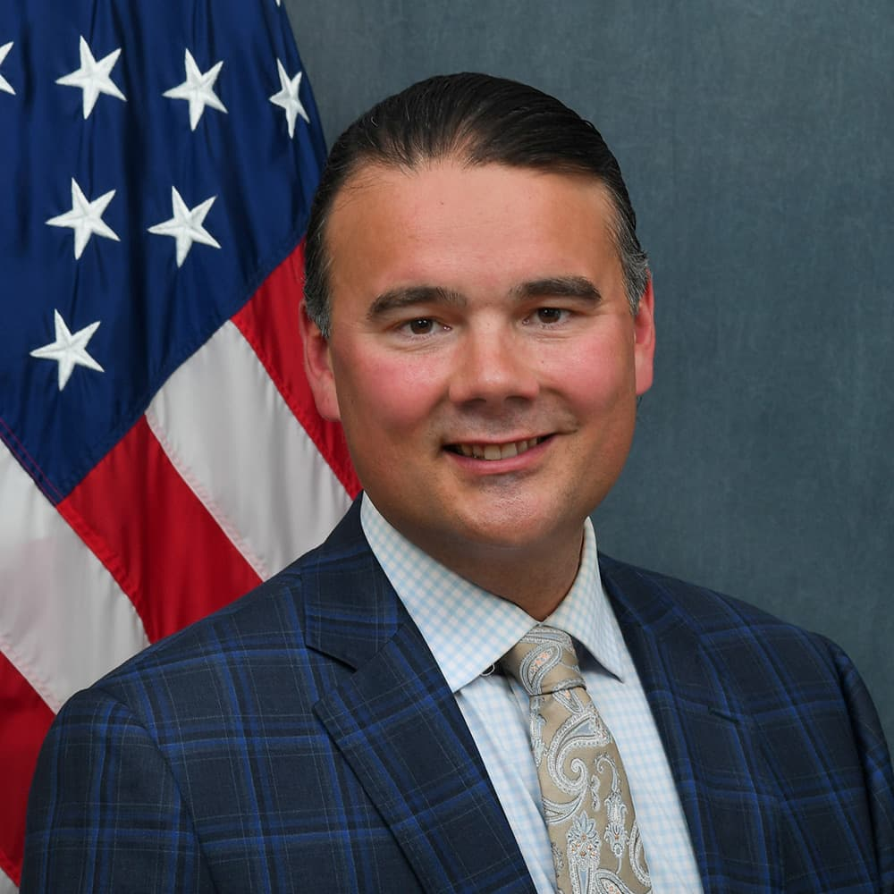
Indian Affairs leadership
Office of Assistant Secretary for Indian Affairs
Bryan Newland, Assistant Secretary for Indian Affairs
Bryan Newland is a citizen of the Bay Mills Indian Community (Ojibwe), where he recently completed his tenure as Tribal President. Prior to that, Bryan served as Chief Judge of the Bay Mills Tribal Court. From 2009 to 2012, he served as a Counselor and Policy Advisor to the Assistant Secretary of the Interior – Indian Affairs. He is a graduate of Michigan State University and the Michigan State University College of Law. Bryan enjoys hiking and kayaking the shores of Lake Superior and is a nature photography enthusiast.

Slide 26
Literature review at-a-glance
Native Language Revitalization Background
Federal Laws, Regulations, and Policies
Native Language Revitalization Efforts
Document and Preserve
Curriculum and Resource Development
Teacher Training and Post-secondary Initiatives
Policy Development and Political Advocacy
Language classes
Bilingual School
Immersion Practices
Native Language Revitalization Efforts

