Slide 1
ISDEAA 105(l) Facility Lease
Guidebook Overview
2023

Slide 2
105(l) Guidebook Overview
What is a Section 105(l) Lease?
Eligibility Requirements
Types of Compensation
How to Start the Process
Facility Lease Details
Lease Terms & Renewals
Lease Process Overview

Slide 3
Indian Self Determination and Education Assistance Act (ISDEAA)
Indian Self Determination and Education Assistance Act (ISDEAA)
The act requires the Secretaries of the Department of the Interior and the Department of Health and Human Services, upon request of a tribe or tribal organization, to enter into a facility lease agreement for certain facilities used for the provision of programs, functions, services, or activities (PFSAs) assumed under ISDEAA.
Programs, Functions, Services, or Activities (PFSAs)

Slide 4
What is a 105(l) Facility Lease?
They are not traditional leases.
They are facility cost agreements that compensate the Tribes for facility operational expenses associated with using the facility to administer (ISDEAA) contracted/compacted services.
They are a statutory requirement
Chapter 1
Notes:
Statutory requirements are those requirements established by law for specific acquisition positions.

Slide 5
The Tribe’s Considerations
Types of Compensation
Eligibility
Tribe must hold title to the facility; or
A leasehold interest in the facility; or
A trust interest in the facility
The facility must be occupied, and the PFSA must be in an approved ISDEAA Self-Determination contract, Self-Governance compact, Public Law 100-297 grant, or 477 program.
Fair Market Rental
Cost Elements listed in 25 CFR Section 900.70 (a) – (h) only
Combination of Fair Market Value and Cost Elements
* Costs included in compensation must be reasonable and not duplicative.
Chapters 1 and 3
Chapter 1
Notes:
The Tribe can prove interest in the facility with a quitclaim or warranty deed, trust title, or lease/rental agreement.

Slide 6
Fair Market Rental Analysis
  A full-service lease is typically defined as a lease with one all-inclusive rental rate that includes both the base lease rate and the operating expenses (property taxes, insurance, and common area maintenance) combined into one figure.
  A modified gross lease is a type of real estate rental agreement where the tenant pays base rent at the lease's inception. Still, it takes on a proportional share of some of the other costs associated with the property as well, such as property taxes, utilities, insurance, and maintenance.
  In a triple net lease, the tenant pays for building maintenance, property insurance, and property tax in addition to monthly rent.
Net- Rent + Taxes
Net-Net- Rent + Taxes + Insurance
Net-Net-Net- Rent + Taxes + Insurance + Operating Cost
Notes:
Very important to establish a method before hiring a subject matter expert. Appraiser/Realtor

Slide 7
How to Start the Process
  Contact us at ISDEAA105L@BIA.GOV
  There is no standard application
  The lease proposal should confirm the following:
  - The Tribe holds title to, a leasehold interest, or a trust interest in the facility
  - The Tribe is using the facility to administer an approved ISDEAA PFSA
  - List the PFSAs in each facility
  - The type of compensation the Tribe is seeking
  - The address for each facility
  - The contact information for the Tribal representative
Chapter 2

Slide 8
Facility Details
  Items to be included in the facility description:
  The name and address of the facility
  The date the facility was placed into service
  The Certificate of Occupancy, if available
  Recent photos of the facility’s interior and exterior
  A recent inspection report of the condition of the facility, if available
  Floor plan showing all the PFSAs, and any non-PFSAs, common areas, shared space, and a description if there are other tenants in the facility
Chapter 3

Slide 9
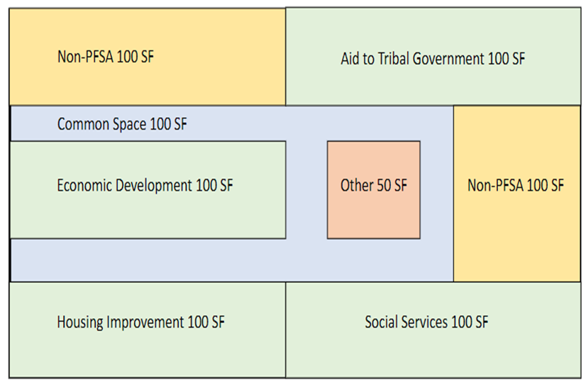
Lease Space Example

Slide 10
Facility Lease Details (Continued)
  Lease can only compensate for the space associated with ISDEAA PFSAs
  One lease per facility, even if multiple PFSAs operate in the same location
  A proposal may contain multiple facilities
  CFO Certification
  Tribal Resolution

Slide 11
Lease Process Overview
  Determine eligibility
  Determining the method of lease compensation
  Tribe submits proposal to ISDEAA105L@BIA.GOV
  IA to verify the funding agreement on which the lease is based
  Review of facility documentation
  Follow on (Technical Assistance) meetings as needed
  Review the draft lease
  Legal sufficiency review
  CFO Certification
  Tribal Resolution
  Final lease execution and funding
Proposal Chapters 1-2
Draft and Review Chapters 5-6
Approval and
Execution
Chapter 6

Slide 12
The Lease Terms and Renewals
The initial lease term for either a calendar year or fiscal year will be prorated to the approved proposal letter’s date of receipt.
The awarding official will incorporate the 105(l) lease agreement into the ISDEAA agreement or 297 grant
Lease Renewals:
Request 90 days before the expiration of the current lease
Are for a full calendar year or fiscal year
Terms may be renegotiated at renewal
Chapters 6 - 7

Slide 13
The Path Forward
  Contact us at ISDEAA105L@BIA.GOV
Published Guidebook https://www.bia.gov/as-ia/ofpsm/brpl/105lp
105(l) team will provide sample templates for required documents
The 105(l) team will provide technical assistance as needed
The 105(l) team will coordinate with IHS to ensure no overlaps

Slide 14
Thank You!
www.indianaffairs.gov

