Slide 1
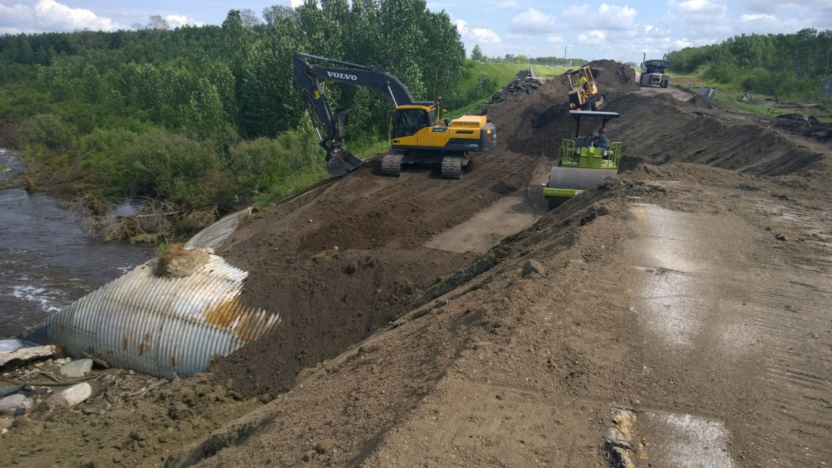
Tribal Emergency Preparedness: Construction Materials for Emergency Use
Lynne Carpenter
Geologist
U.S. Department of the Interior Assistant Secretary - Indian Affairs Office of Indian Energy and Economic Development Division of Energy and Mineral Development 13922 Denver West Parkway, Suite 200 Lakewood, CO 80401

Slide 2
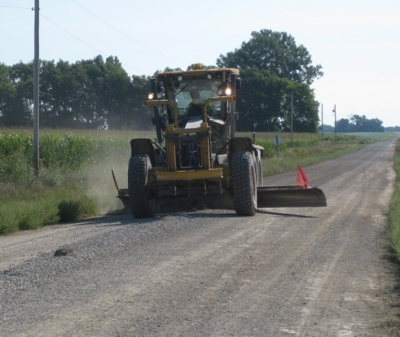
Tribal Construction Aggregate Internal Use
Second Title…

Slide 3
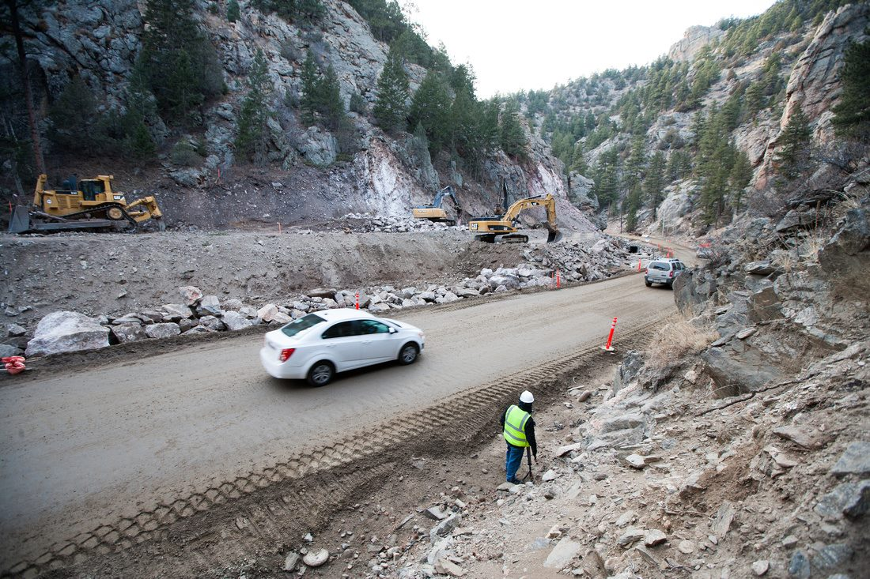
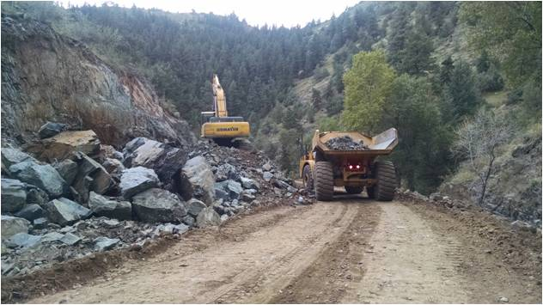
Construction Aggregate’s role in Emergency Preparedness
This talk is partly about one small, but important, aspect of emergency preparedness: the development and availability of the primary raw material required to mitigate, prepare, respond, and recover buildings, infrastructure, roads, bridges, and homes.
That raw material is Construction Aggregate

Slide 4
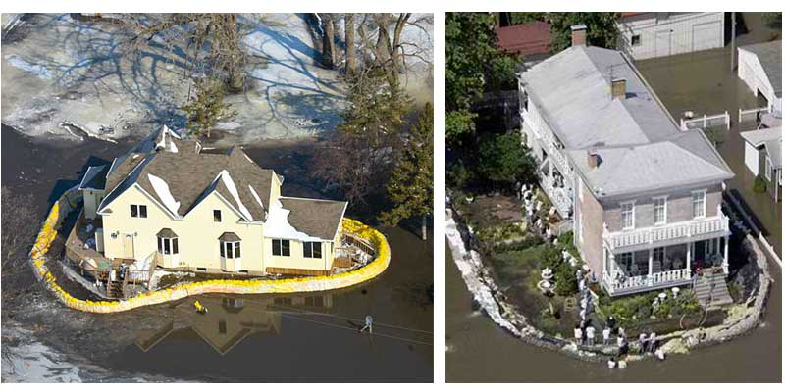
Types of Natural Hazards
Fires
Floods
Tornadoes
Severe Weather
Earthquakes
Landslides
Tsunamis
Volcanic Activity
Avalanches

Slide 5
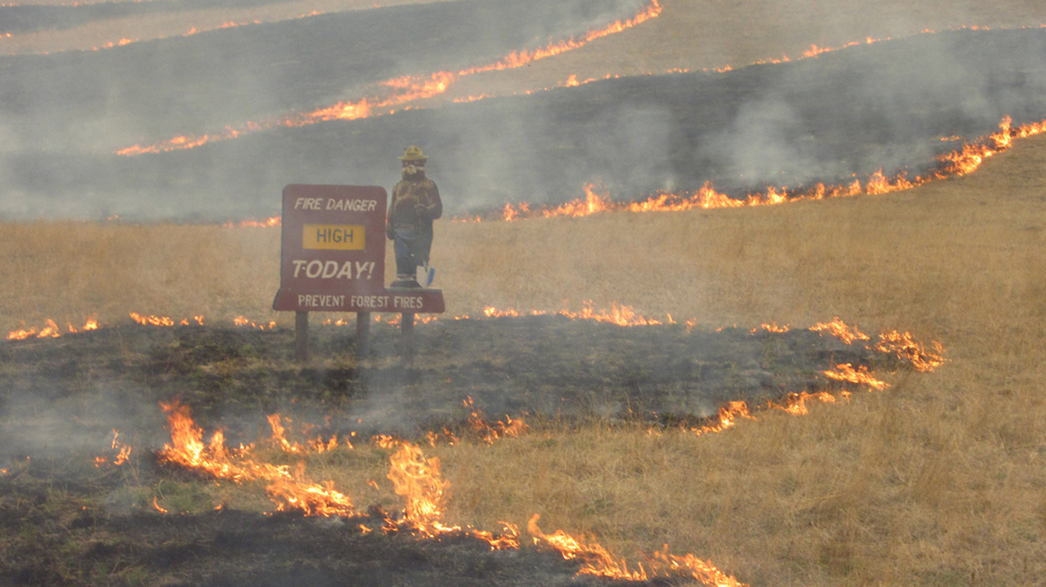
Fires

Slide 6
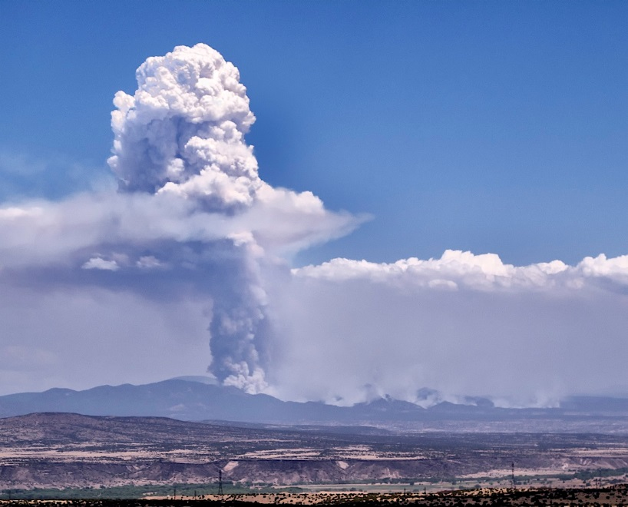
Las Conchas Fire, 2011, Valles Caldera, NM

Slide 7
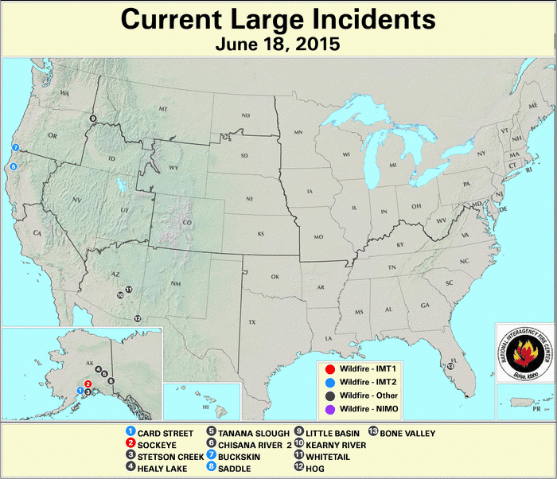
http://activefiremaps.fs.fed.us/

Slide 8
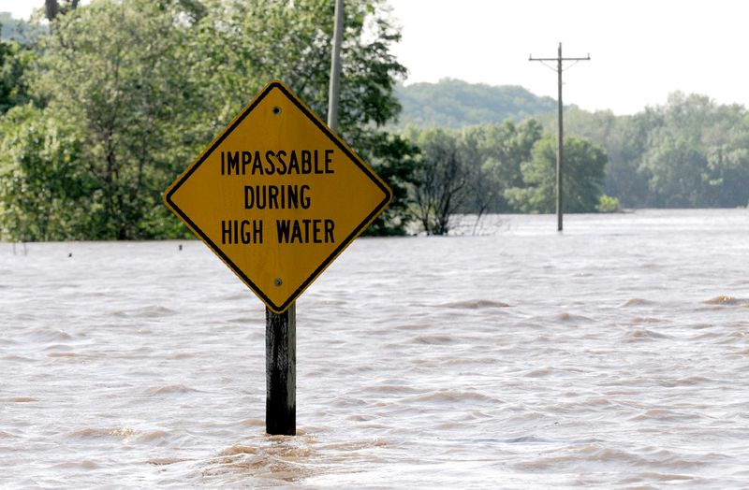
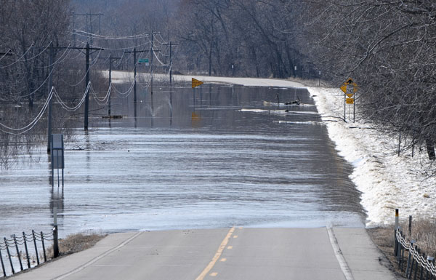
Floods
Mississippi River submerges Highway 19 near Henderson, MN

Slide 9
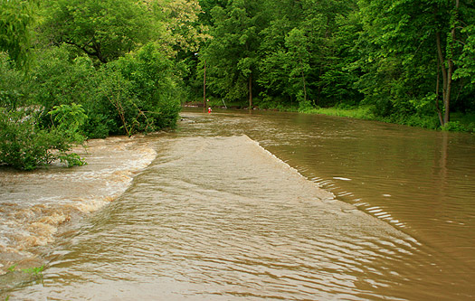
Flooding in Baraboo, WI, 2008

Slide 10
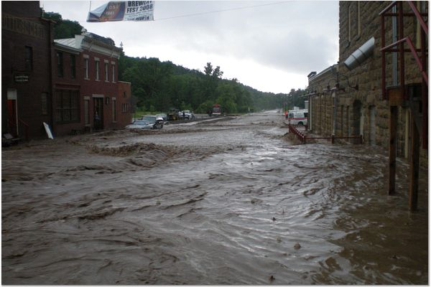
Flash flood in Potosi, WI , 2008

Slide 11
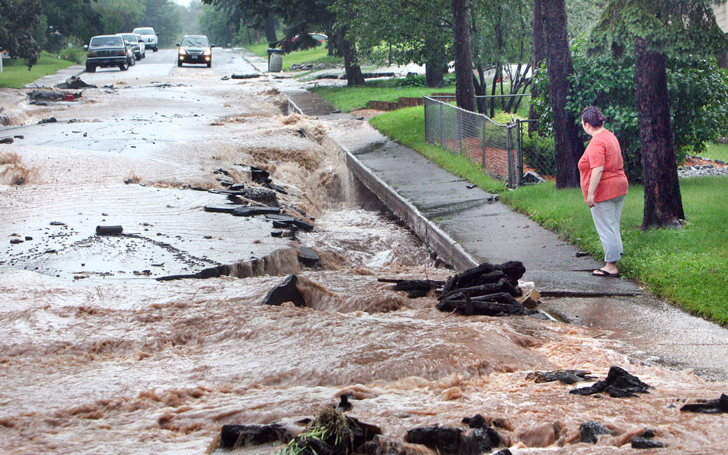
Flash flood in Duluth, MN 2012

Slide 12
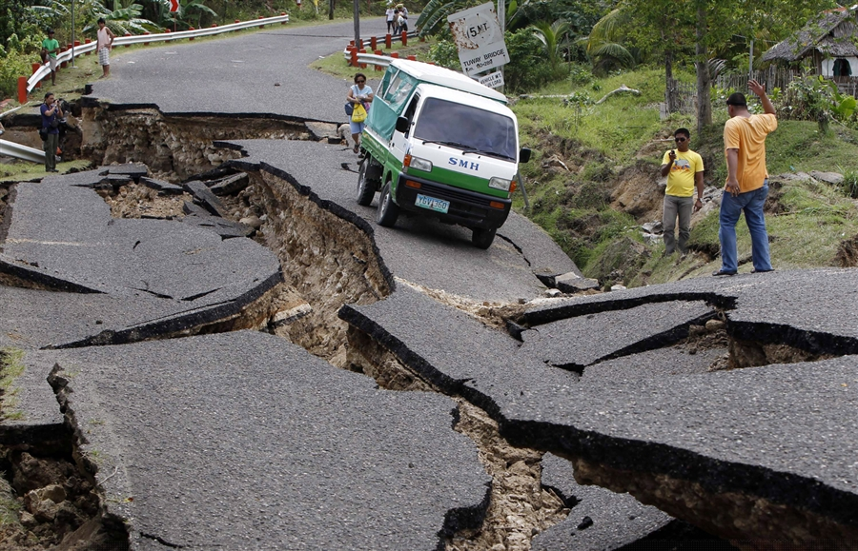
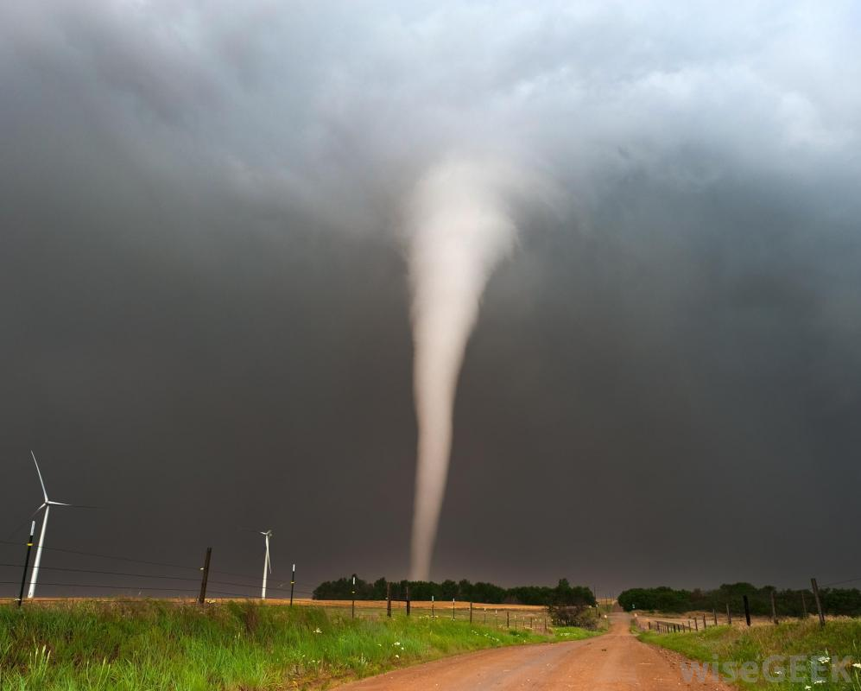
Tornadoes, Severe Weather, Earthquake, and Other Disasters

Slide 13
Emergency Response Plans

Slide 14
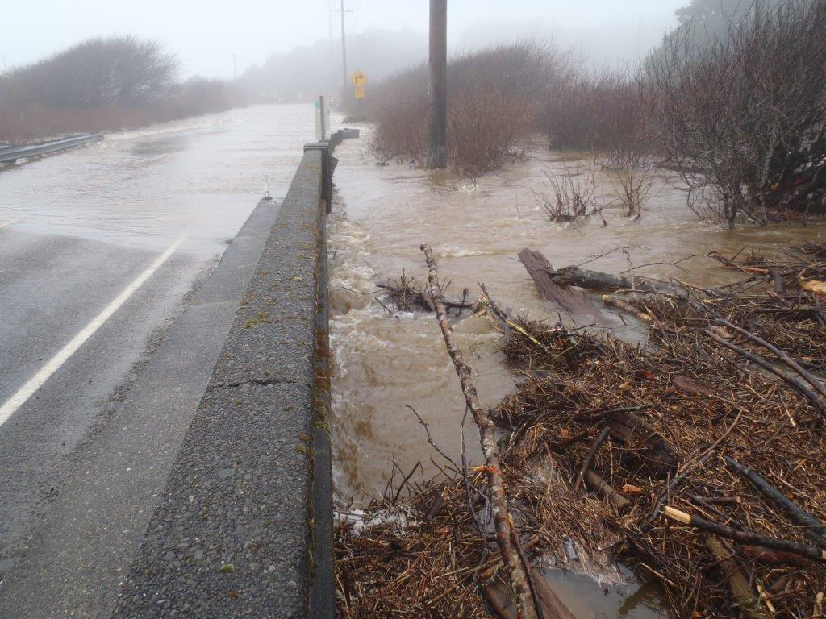
Emergency Response Plan Components:
How do Construction Aggregates fit into each of these components?
Mitigation
Preparedness
Response
Recovery
Quinault Indian Reservation, January 2015

Slide 15
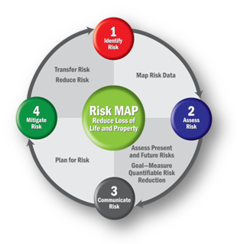
Emergency Preparedness
Mitigation
Preparedness
Response
Recovery
Mitigation
Identify Risk
Assess Risk
Communicate Risk
Mitigate Risk

Slide 16
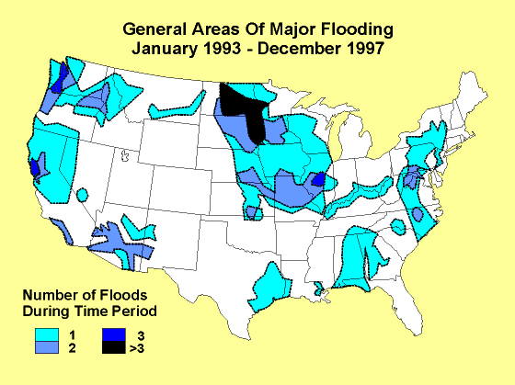
1. Identify Risk: Flood-Prone Areas

Slide 17
2. Assess Risk
Flood Maps, Historical problem areas, etc.
Lynne’s Parents House
Lynne’s House

Slide 18
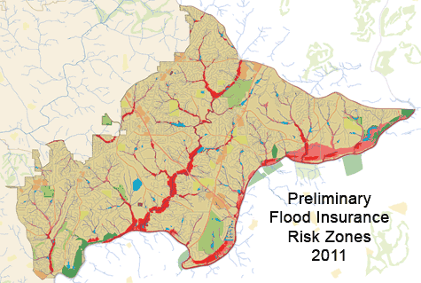
3. Communicate Risk
Community Meetings
Maps
Other methods include: signage, radio,
media advertisements, school,
religious services, etc.

Slide 19
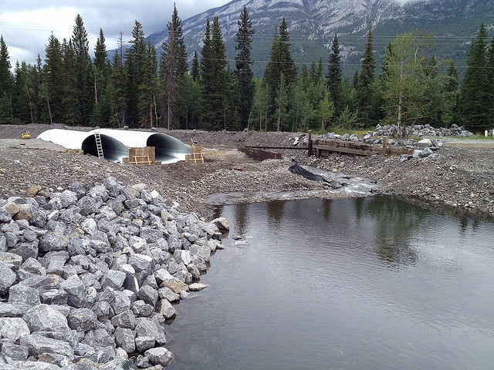
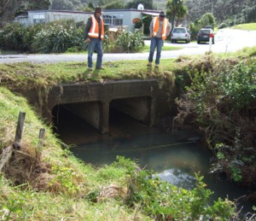
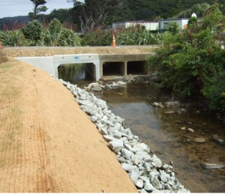
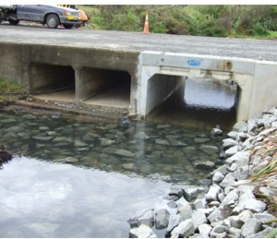
4. Mitigate Risk
Construction Aggregate
is used in almost every
type of natural disaster
risk mitigation
Rip Rap and other
Construction
Aggregate
Canada
Australia
Before construction
After construction
After construction

Slide 20
Mitigation
FEMA is updating flood hazard maps throughout the country: https://msc.fema.gov/portal
Free Floodplain Management Training is offered by the Minnesota Department of Natural Resources
The Rural Domestic Preparedness Consortium offers classes such as “Disaster Recovery – Rural Communities.” https://www.ruraltraining.org
Other States coordinate with FEMA and Homeland Security to provide free and low cost training for local community officials and citizens.

Slide 21
Emergency Preparedness
Mitigation
Preparedness
Response
Recovery

Slide 22
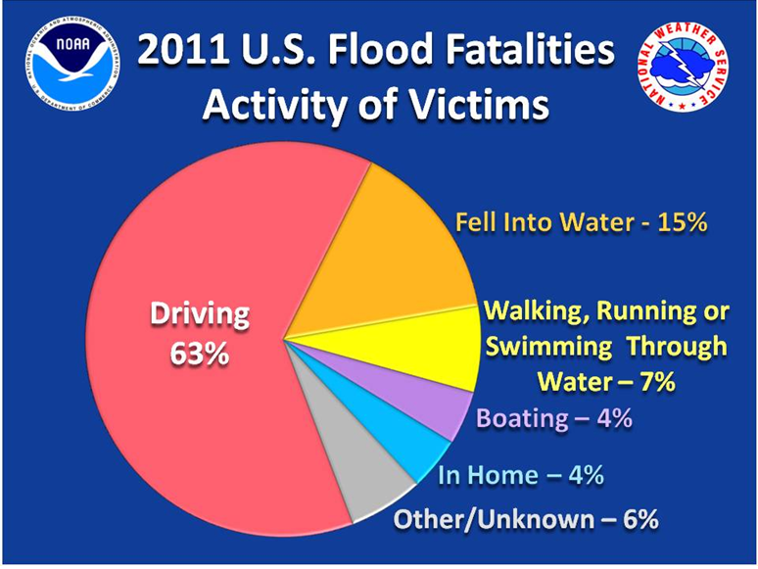

Slide 23
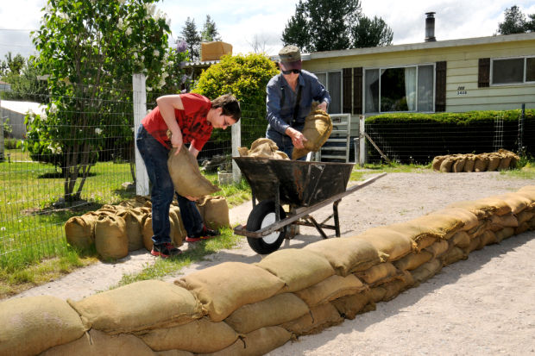
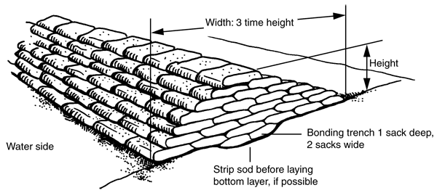
Role of Construction Aggregates in Tribal Flood Preparedness

Slide 24
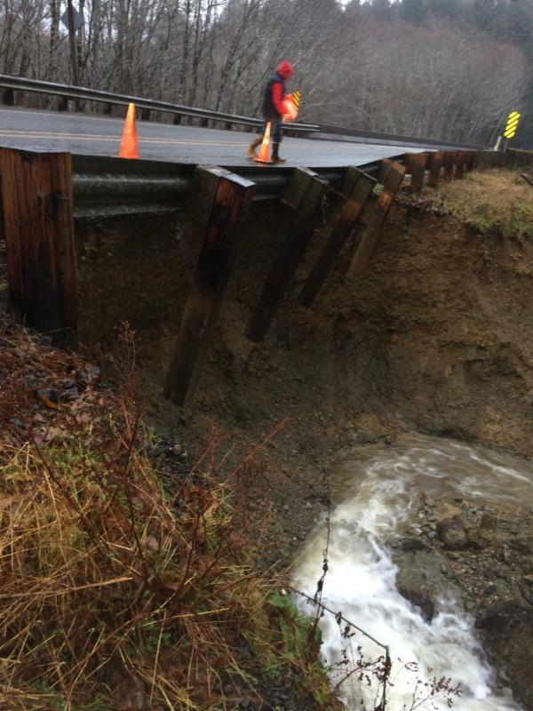
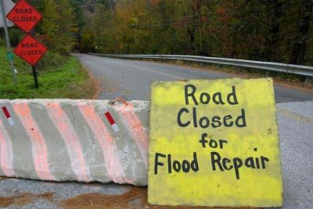
Emergency Preparedness
Mitigation
Preparedness
Response
Recovery

Slide 25
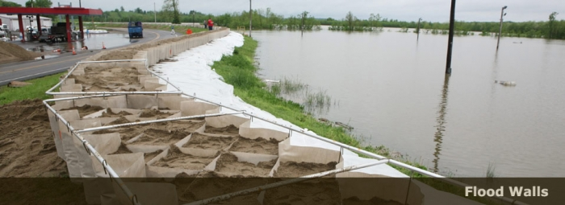
Role of Construction Aggregates in Tribal Flood Response

Slide 26
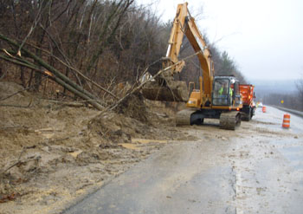
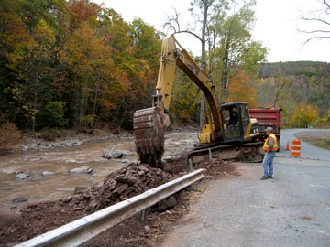
Emergency Preparedness
Mitigation
Preparedness
Response
Recovery

Slide 27
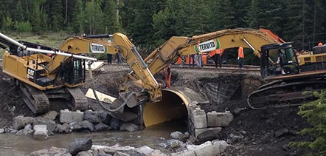
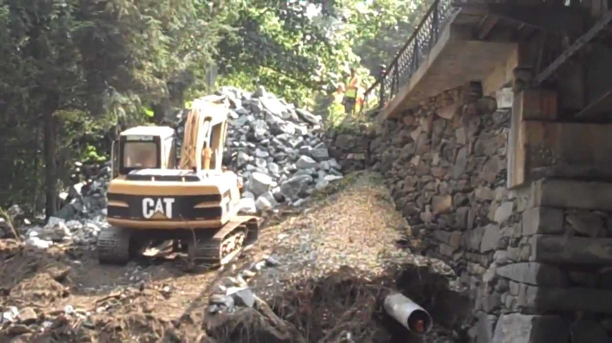
Role of Construction Aggregates in Tribal Flood Recovery

Slide 28
Tribal Emergency Preparedness
A Tribal Emergency Preparedness Plan is similar to other planning documents. It would include (along with planning related to first responder and other medical priorities, emergency team hierarchy, communications, evacuation routes, etc.):
How many miles of roads / buildings are at risk?
What sections of roads are in the 50 year floodplain? The 100 year floodplain? Cross waterways? Are near fault zones? Near burn areas? Near areas of high burn potential? Etc.
What are the repair / reinforcement priorities during an emergency?
Which roads, which buildings should be protected first?
Which areas will experience problems first during the various types of emergency (i.e. flood-prone streams, known fault zones, existing avalanche chutes)?
Are there any exacerbating factors?
Burn areas, flood prone areas, drought, vulnerable buildings, vulnerable populations, vulnerable access roads (only one road in/out), etc.
How much material and what quality of material would be needed?
For sandbags to protect vulnerable buildings or infrastructure?
For emergency repair of a road breach or damage?
For emergency berm or dike augmentation?

Slide 29
Tribal Internal Use of Construction Aggregate
How much does the Tribe use every year?
How much does the Tribe pay for the material? How much is the transportation cost?
How many miles of road are located on the Reservation?
Can the Tribe offset costs (or sell to the BIA) during road maintenance, repair, and construction?
Are their opportunities for the Tribe to sell off-reservation? Is the Tribe interested in commercial development?

Slide 30
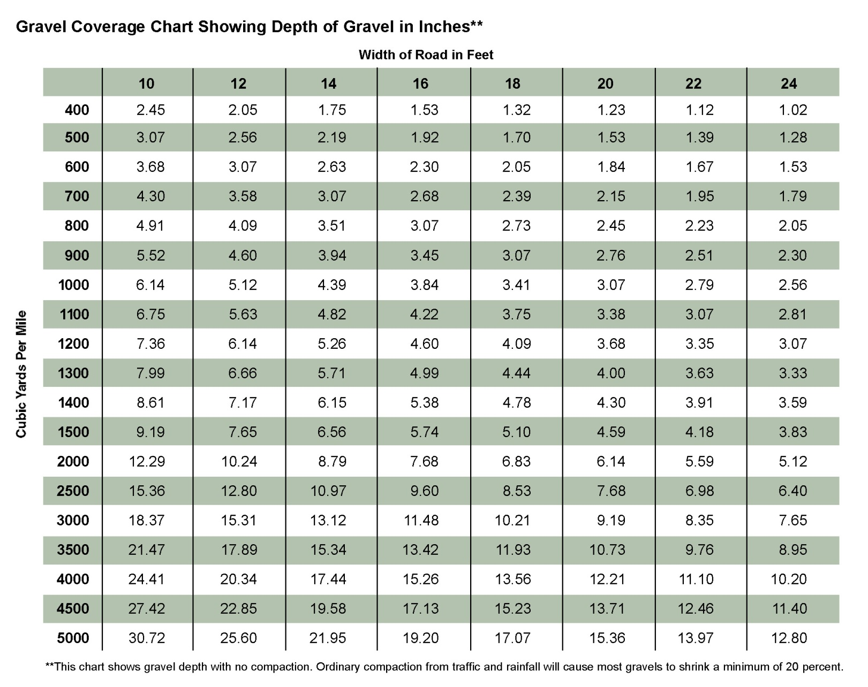
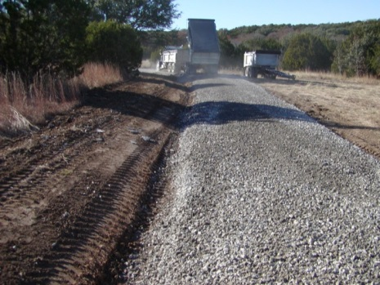
Tribal Internal Use of Construction Aggregate
Construction Aggregate
Chart is from Appendix C, Chart 1, of the “Gravel Roads Maintenance and Design Manual,” South Dakota LTAP and FWHA, 2000.

Slide 31
Evaluation of Tribal Construction Aggregate Needs
Volume: How much material does the Tribe use every year for routine road maintenance, repair, and construction? How much material does the Tribe estimate it will need for emergency preparedness?
Cost: Where does the Tribe acquire the material currently? How much does it cost per ton/cubic yard?
Location / Access: Where are the off-Reservation aggregate resources located? How much does it cost to transport the material? Can these resources be accessed in an emergency?
Tribal Resource: What is the quality of the Tribal resource, and how does it compare to the off-site materials? How much resource exists? How far is the site from the most densely populated location (or most flood-prone, or most vulnerable, etc.) on the Reservation? Is it mineable? How many jobs would be created? How much money could be off-set?
Future Needs: What kind of reclamation would be acceptable? Does the Tribe need/want: a new water storage facility? a new waste disposal location? additional wetlands?
Tribal Interest: Is the Tribe interested in developing own resources?

Slide 32
Tribal Construction Aggregate Development for Emergency Preparedness and Internal Use
Locating the Tribe’s construction aggregate resources.
How much and what quality are those resources?
Where are the resources geographically located in relation to the high-risk and high-priority roads and buildings?
Tribal selection of specific areas for resource development, taking into account resource location, resource quality and quantity, vulnerable areas, emergency priorities, etc.
Tribes permitting the selected areas (preferable via a mineral agreement or other permitting vehicle, which triggers NEPA compliance before, not during, the emergency).
Contract mine and stockpile or only break ground during emergency?
Stockpiles of known quality
If no mine, must use “pit run” material, unprocessed, of unknown quality

Slide 33
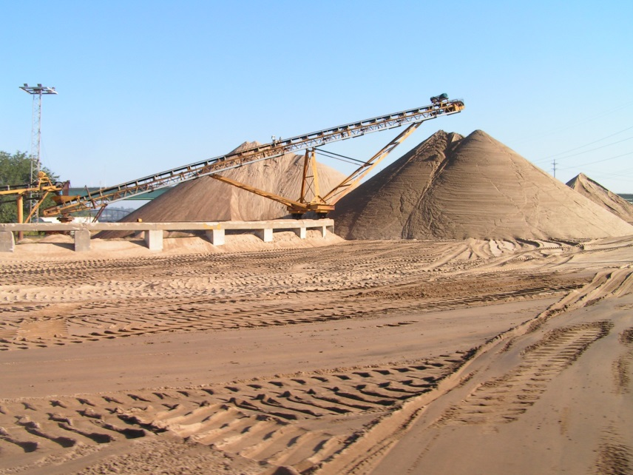
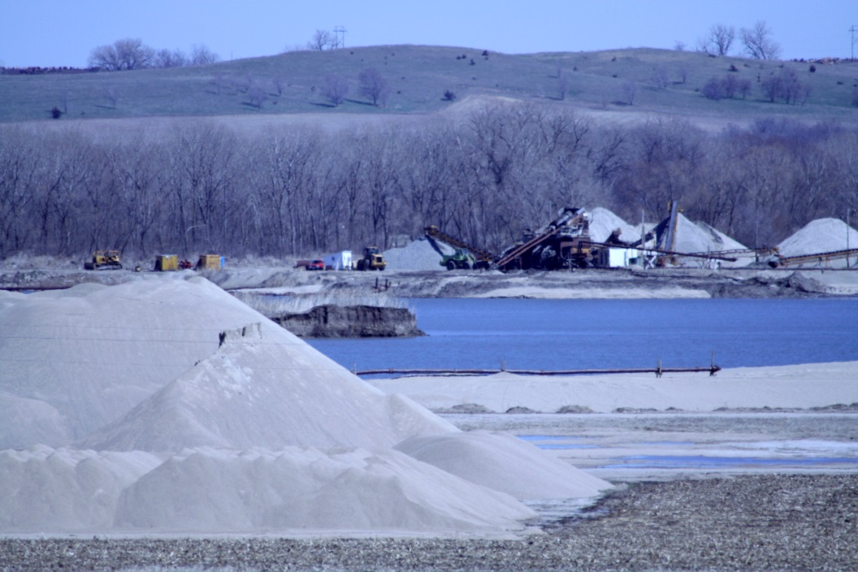
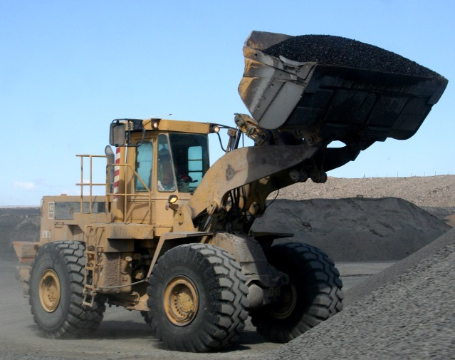
Where do Tribes get the Construction Aggregate?

Slide 34
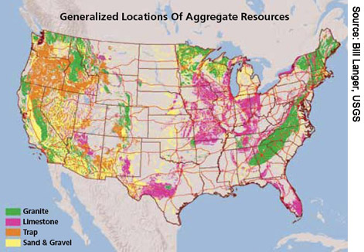
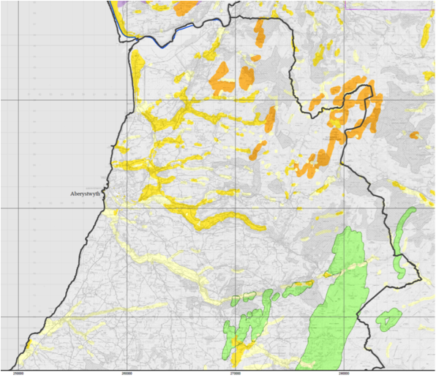
Resource Location: Geologic Mapping
First must determine where the resources are…

Slide 35
Resource Assessment
The Tribe must determine if the resource is of sufficient quality, quantity, and mineability to create a mining operation:
What is the quality (Does it meet the specifications required by the governing authority?)
Laboratory evaluation
Gradation
Durability
Deleterious materials
Particle shape and size
What is the mineability?
Location of resource geologically (too deep? Water table too high?)
Mineability (overburden? Thin-bedded?)
Processing cost? (Excess of fines? Too much sticky clay?)
What is the quantity?
Is there enough material to cover capital costs or to entice a business partner?

Slide 36
Tribal Decisions:
Tribe has located and defined their resources, and determined that they may be economic to develop.
If it is cheaper to generate your own construction aggregate than to purchase and transport aggregate off-reservation, then it makes economic sense to do so.
(Of course, economics is not the only consideration.)
Does Tribe want to develop Tribal construction aggregate resources for internal and/or emergency preparedness use?

Slide 37
Construction Aggregates
Tribal Resource development decisions are based on both measurable and non-measurable factors.
Non-measurable
Emergency Preparedness
Aesthetics
Cultural
Reclamation options (how do they mesh with cultural norms?)
Tribal job creation
Stronger sovereignty
Less dependence on outside sources / variable costs
Measurable
Emergency Preparedness mitigation or recovery off-set costs
Resource volume, location, longevity, and mineability
Need (tons / cubic yards)
Tribal job creation
Economics
Imported material costs
Mining costs (reclamation, bonding, capital costs, etc.)
Offsetting costs/savings (mining costs minus imported material costs)
Transportation costs/savings
Improved infrastructure savings

Slide 38
Permitting: Sand and Gravel Handbook
If the Tribe decides to pursue construction aggregate resource development, one of the main hurdles is permitting.
The Sand and Gravel Handbook is designed to assist Tribes and BIA staff (Especially realty officials) with the permitting process.
Sand and Gravel Handbook
Section 1 – Introduction
Section 2 – Process and Procedures Overview
Section 3 – General Authorities and Policies
Section 4 – Procedures
Section 5 – Attachments
Section 6 – Additional Information / Guidance

Slide 39
The Tri-partite Agreement (really should be “quad”-partite)
BIA:
Administers and approves the mineral lease (or permit)
BLM:
Administers and approves the mining plan of operations and reclamation plan
Performs production verifications (ensures that the amount the company said the mined is actually the amount they mined)
ONRR:
Performs audits to ensure that the amount paid is in agreement with the amount mined (see production verification above)
OST
Ensures that the money is transferred from the company to the Tribe

Slide 40
Funding for Resource Assessment
The Division of Energy and Mineral Development (DEMD) has two grants that can assist Tribes with collecting and analyzing data in order to make this decision:
The Energy and Mineral Development Program (EMDP) grant
The Tribal Energy Development Capacity Program (TEDC) grant
The EMDP and TEDC grants can assist the Tribes gather specific information about your Tribe’s aggregate development options.
The next round will probably be announced in late 2015 / early 2016.

Slide 41
Mining Options
Continuous / yearly mining, by the Tribe.
Tribe would bear all risk and capital costs. May be least expensive, but also incurs all the risk.
Continuous / yearly mining by an aggregate operator with a mineral agreement.
Tribe could set up specific requirements requiring ease / guarantee of use / purchase / material in lieu of royalties / jobs / etc., in the mineral agreement.
Tribe has guaranteed royalty and material, but won’t make / save as much as with a Tribally run operation. Significantly lower risk.
Turnkey aggregate producer every few years to produce sufficient material for the Tribe’s internal use for that time period.
Tribe only has to deal with mining every so many years (3, 5, 7, etc.).
Costs may be more or less than purchasing off-site. Needs evaluation.

Slide 42
Mining Options
All mining options should be weighed against the costs to procure specification gravel from off-reservation.
If the costs to purchase and transport off-Reservation are less, then it would be un-economic to mine Tribal resources.
Other considerations:
Tribal Jobs
History of purchases from off-reservation source:
Timeliness?
Quality assurance?
Transportation cost variability?
Aggregate cost variability?

Slide 43
How much would it cost to mine the deposit?
Common Economic Elements
Resource evaluation
Capital cost to develop
Operating costs
Gross income
Taxes
Cash flows from items 2-5
* NOTE: DEMD can assist Tribes with all of these items.

Slide 44
How much would it cost to mine the deposit?
Hypothetical costs for a 100,000 Ton Per Year Mine
Tribal Business $7.37
Taxed Company (Tribe receives royalty) $8.93
Major Assumptions
Tax rate of 7.3%
100,000 tons per year (TPY)
Processing Plant
Crushing Plant
Pit Production: 400 tons per day (TPD)
5 people
20 year project
No overburden
90% of tons Contractor
10% of tons Retail
Used equipment 70% of new
15% ROR Profit Margin
Two year ramp-up production
10% royalty for taxed company
12% G&A

Slide 45
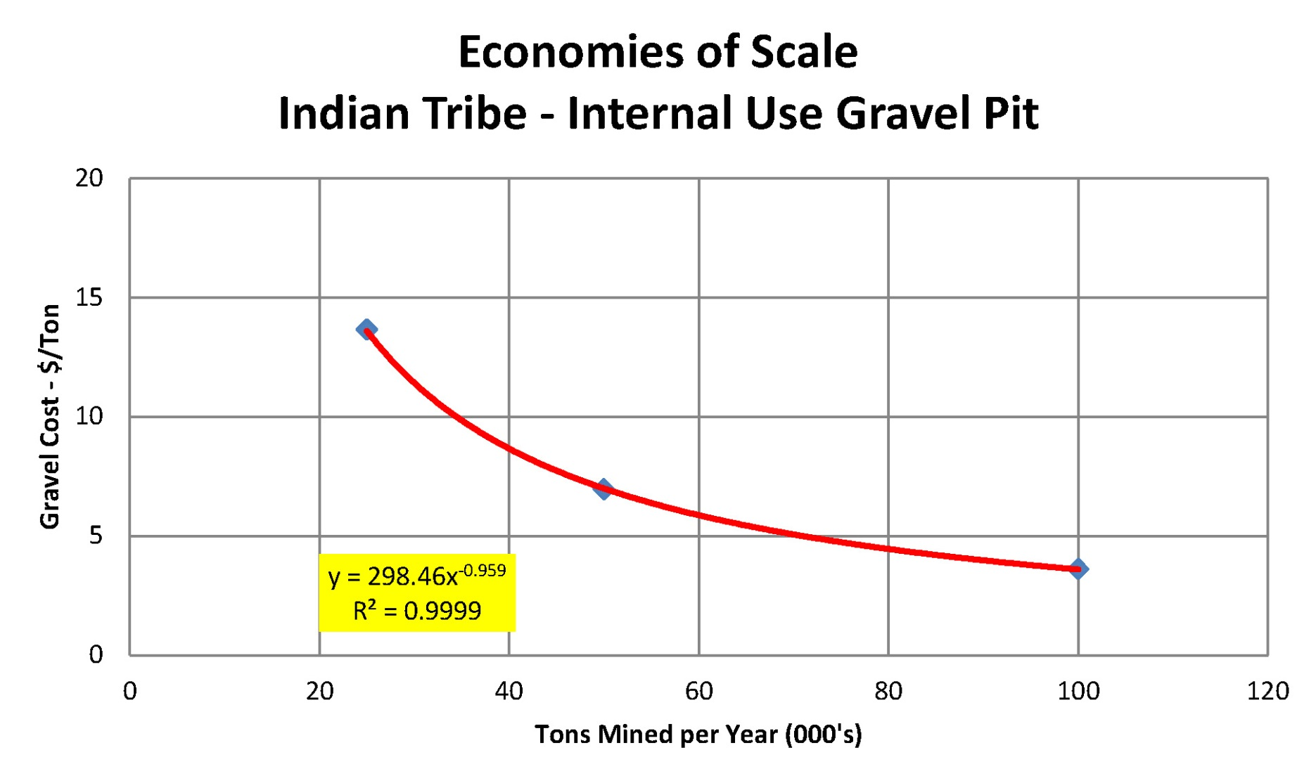
How much would it cost for a Tribe to mine the deposit?

Slide 46
Reclamation
Sand and gravel operations do not typically use special chemicals or other hazardous materials during mining or processing.
Environmental effects include increased dust, surface disturbance, changes of natural water flow across the surface, and other mitigatable disturbances.
Abandoned mines can be locations for dumping (debris, trash, people changing their oil, etc.) which has the potential to affect the subsurface water. If properly reclaimed, this risk is minimized.
Mines can be reclaimed in a variety of ways:

Slide 47
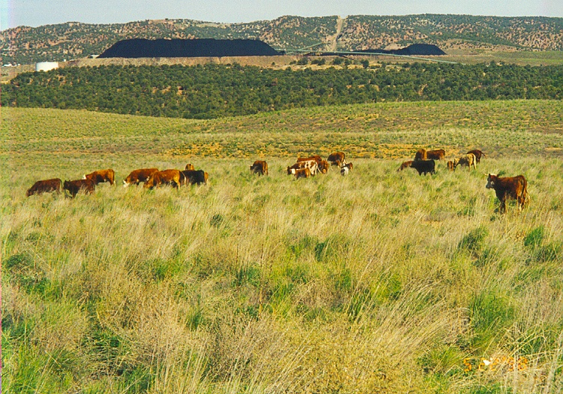
Poop and Stomp
Reclamation Options?
Contour as required (say 4:1)
Place and spread waste overburden
Place and spread topsoil
Use as feedlot for 1-2 years
Work topsoil layer with harrow
Seed and mulch

Slide 48
Restoration
Reclamation Options?
Quarry - Partial
Plant Site - Complete

Slide 49
Agricultural Use
Reclamation Options?
Apple Orchard
Christmas Tree Farm

Slide 50
Parks and Recreation Areas
Reclamation Options?
Before
After

Slide 51
Wildlife Habitat
Reclamation Options?
Former Gravel Pit
Former Gravel Pit

Slide 52
Residential Areas
Reclamation Options?
Former Quarry
Former Sand and Gravel Pit

Slide 53
Resorts
Reclamation Options?

Slide 54
Golf Courses
Reclamation Options?
Before
After

Slide 55
Office Parks
Reclamation Options?
Former Quarry
Former Sand and Gravel Pit

Slide 56
Raider Crater
Reclamation Options?
Sand and gravel pit in southern California being filled with inert debris consisting of waste material from other pits and waste construction concrete.
When complete, the area will be a high-end residential area.

Slide 57
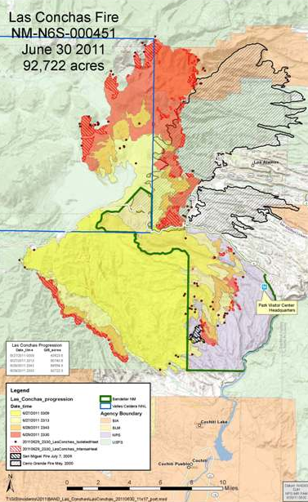
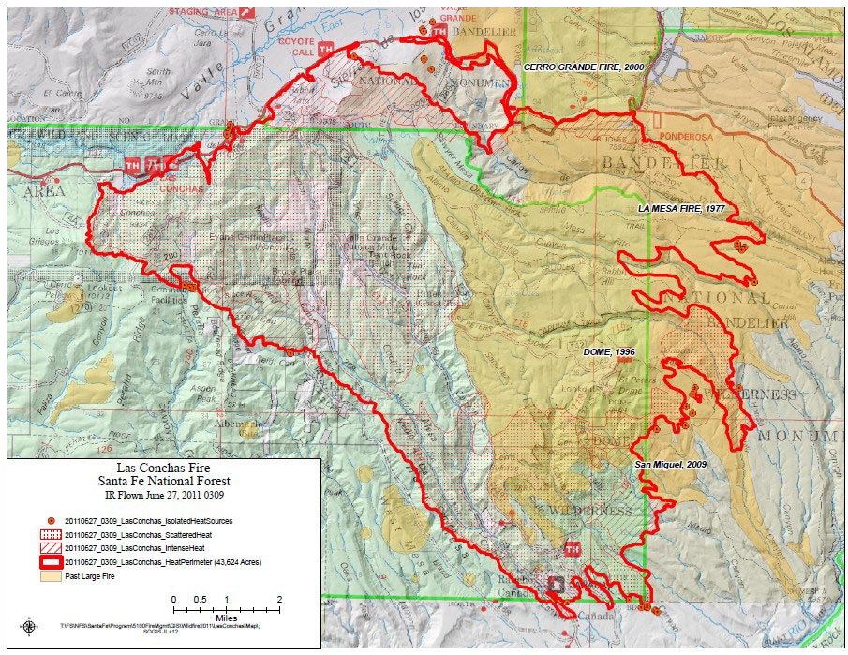
Case Study: Cochiti Pueblo

Slide 58
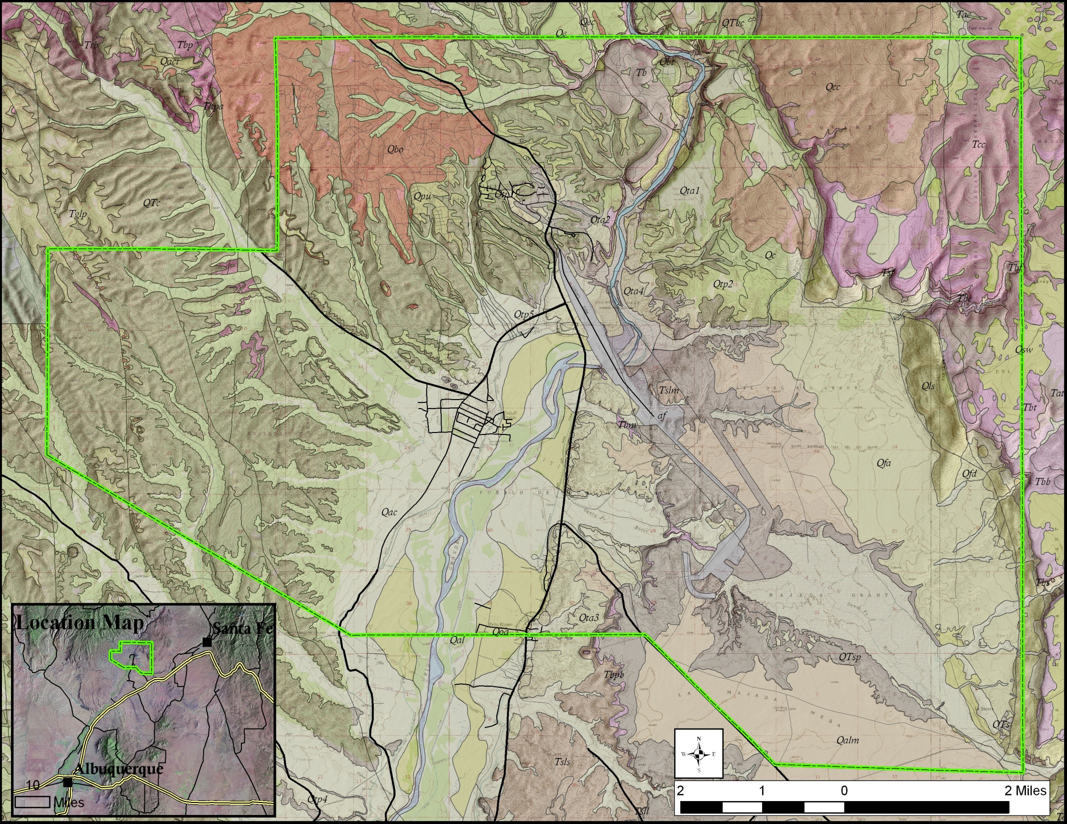
Cochiti Pueblo
Pueblo has two operations, one a (now-defunct) business lease, one a mineral lease specifically for emergencies realted to the Las Conchas fire and subsequent flooding

Slide 59
Cochiti Pueblo

Slide 60
Cochiti Pueblo

Slide 61
Cochiti Pueblo
Road to golf course
compromised for
more than three years
Deflection
berms
Historical Pueblo
and housing
development
Bridge on one
of two Pueblo
accesses
(pictures to come)

Slide 62
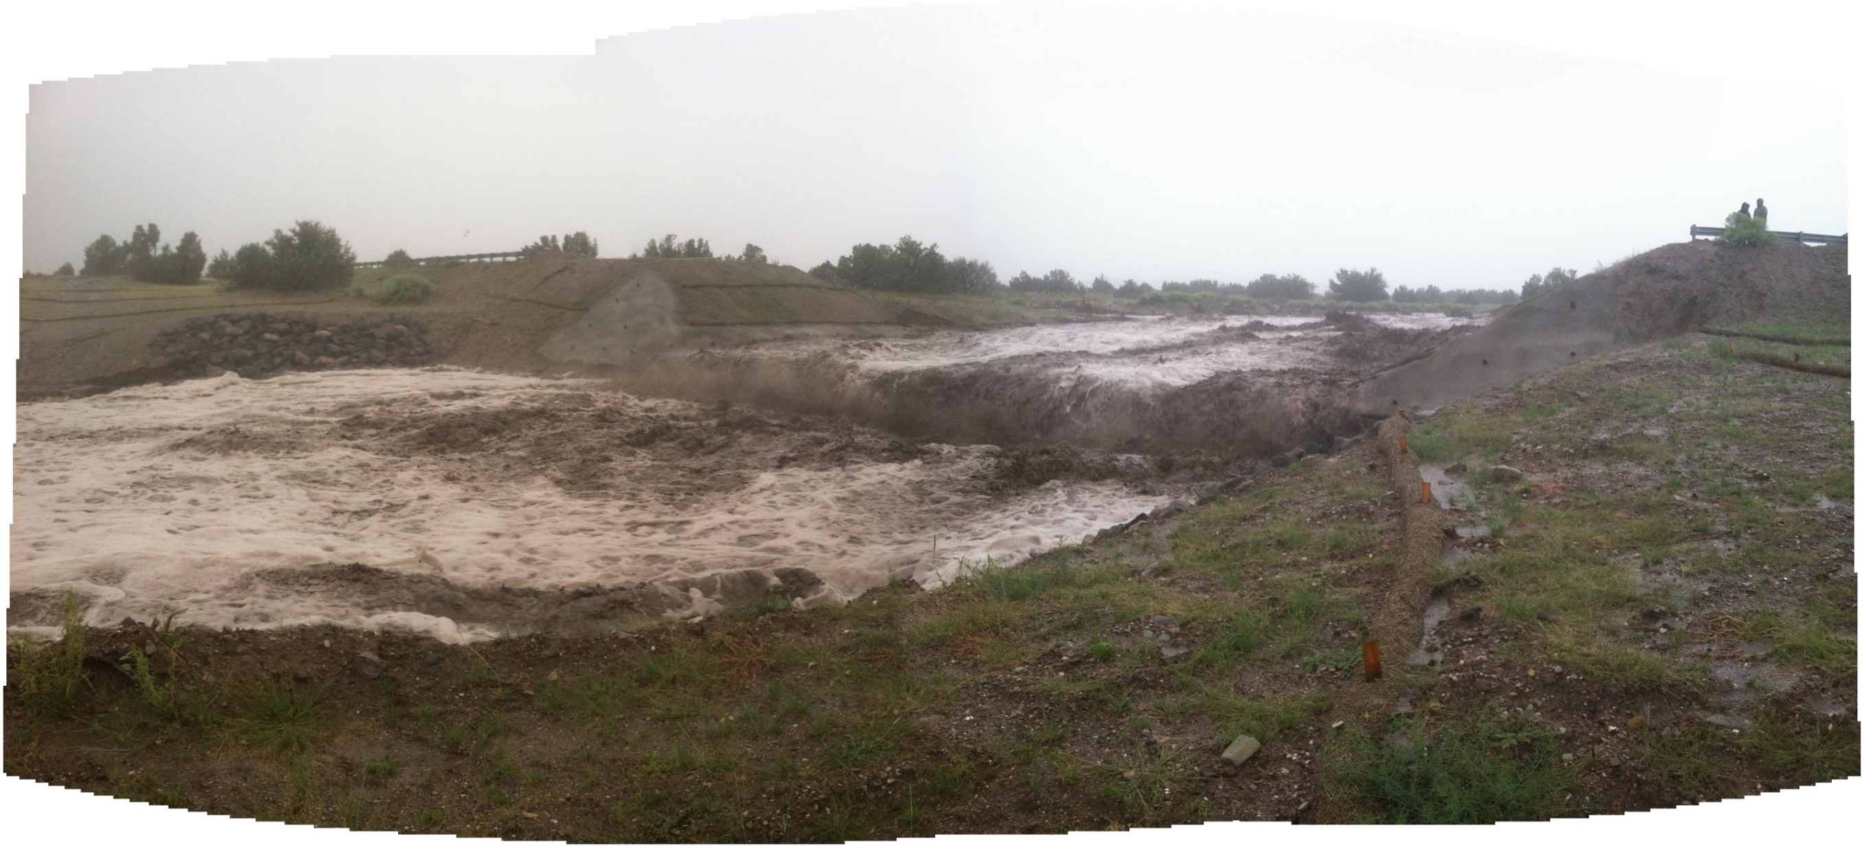
Cochiti Pueblo Impact from Las Conchas Fire
Pueblo de Cochiti, July 2014

Slide 63
Also consider transportation costs in this decision tree.

Slide 64
Summary
Tribes may be able to offset costs, employ Tribal members, prepare for emergencies, and strengthen sovereignty by developing their own aggregate resources.
DEMD can assist with the technical questions: Do you have the resource? What quality, quantity do you have? How much would it cost to mine? How do I permit the resource? How do I set up a mineral agreement? How do I evaluate the economics? And many more…
Notes:
Add in mission statement or short summary of what we do

Slide 65
Decision Flowchart
Questions?
Lynne Carpenter
Geologist
DIVISION OF ENERGY AND MINERAL DEVELOPMENT
Lakewood, Colorado
OFFICE:
720-407-0605
EMAIL: lynne.carpenter@bia.gov
Also consider transportation costs in this decision tree.

