Slide 1
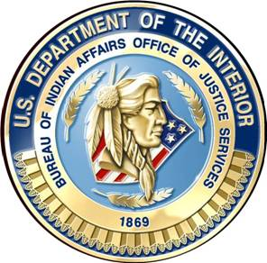
Bureau of Indian Affairs Office of Justice Services
Office of Tribal Justice Support

Slide 2
Tribal Justice Support
Associate Director-Tricia Tingle 202-208-5787
Deputy Associate Director, Criminal Law Specialist -Natasha Anderson
Deputy Associate Director, Diversion and Re-entry Tribal Justice Support-
Rodney Robinson
Civil Law Specialist - Katherine Scotta
National Coordinator for Court Reviews-Open

Slide 3
Tribal Justice Support
Budget Coordinator-Simone Toya
505-563-3763
Administrative Coordinator for Court Reviews-Savannah Joe
Law Enforcement Administrator- Wanda Brunson

Slide 4
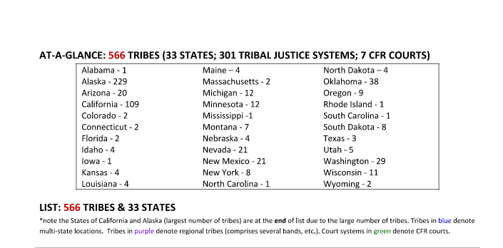
Active Tribal Justice Systems
TOTAL # of Tribes = 566
TOTAL # of TRIBAL COURTS = 314 (308 without some specialty courts)

Slide 5
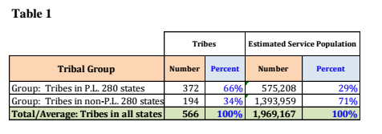
PL 280 Tribal Court Budget Findings

Slide 6
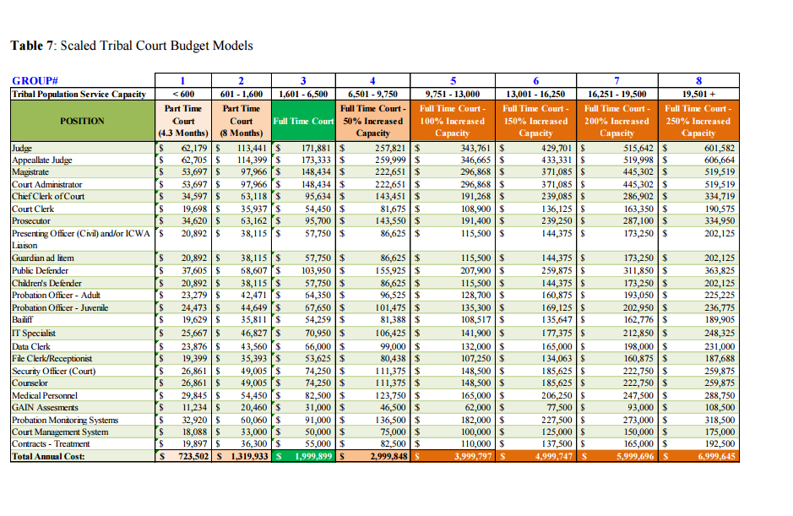

Slide 7
VAWA Training
VAWA Training- Each of the 5 VAWA Pilot Tribes will host a VAWA Training funded through the BIA, and specific appropriations for VAWA Training for Tribes.
Tulalip –September 2-4, 2015
Fort Peck-Late Fall 2015 or Early Spring 2016, in conjunction with the USAO
Sisseton-Wahpeton-Early Spring 2016

Slide 8
The 2015 Model Indian Juvenile Code
Sample juvenile code to assist tribal governments as a tool in creating or revising their juvenile codes.
25 years ago, the BIA contracted with the National Indian Justice Center to develop the first Code in 1988 after the passage Public Law 99-570, title IV, § 4221, which required the creation of a “Model Indian Juvenile Code” (25 U.S.C. 2454).
Tribal Law and Order Act of 2010, a Memorandum of Agreement between DOI, DOJ, and DHHS was developed to establish a framework for collaboration that results in the coordination of resources and programs. 25 U.S.C. 2454 and the Model Indian Juvenile Code.
.

Slide 9
Model Juvenile Code cont’d
Juveniles’ Rights; and Keeping Tribal Youth Out Of Jail And In The Community
The 2015 Model Juvenile Code is divided into three categories: 1) Delinquency;
2) Child in Need of Services;
and 3) Truancy.
The 2015 Model Juvenile Code focuses on several principles including, but not limited to:
Right to Counsel for Each Child Brought Into the Juvenile Justice System;
Right to Counsel for Parents;
Preference for Alternatives to Secure Detention; and
Numerous Opportunities to Divert Cases Out of Adversarial Process and into Traditional Forums as preferred by a particular Tribal Community.

Slide 10
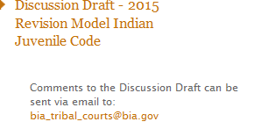
Model Code at BIA.Gov

Slide 11
Additional Components of TJS
Child Welfare Training designed for Social Workers and Tribal Court Personnel
Alaska Code Development
Tribal Court Advocacy Training
VAWA-Special AUSA training and PD training
Completed a total of 41 Tribal Court Assessments
One time year end funding

Slide 12
Reorganizational Chart
Billings
Aberdeen
Minneapolis
Portland
Nashville
Sacramento
Phoenix
Albuquerque
Muskogee

Slide 13
Contact Information
Tricia A. Tingle
Associate Director- Office of Tribal Justice Support
Tricia.Tingle@BIA.GOV
202-208-2675

