Slide 1
Acquisition Process
Bureau of Indian Affairs

Slide 2


Buy-Back Program Implementation
Valuation
Acquisition
Tribal Collaboration
Research
&
Outreach

Slide 3
Tract Eligibility
What makes a tract eligible for purchase?
  Has more than one owner
  Has at least one trust or restricted interest
  Recognized tribe exercises jurisdiction over the tract
  Tract must have current appraised values
  Tract must be mappable (i.e., legal description of a tract does not require further research)
  Tract must not be 100% owned by a combination of ineligible interests
What makes an interest eligible for purchase?
  Interest must be in a tract eligible for the Buy-Back Program
  Interest must be individually owned in trust or restricted status

Slide 4
Tract Ineligibility
What makes a tract ineligible for purchase?
  100% of interest in tract is ineligible for purchase as described below
  Identified as having an improvement without a lease or Tribal resolution
What makes an interest ineligible for purchase?
  Owned in fee status or by the tribe
  Subject to Life Estate or Joint Tenancy
  Interest is in probate proceedings
  Owned by a minor
  Owned by an individual unable to make decisions on their own behalf – under a legal disability (based on restricted status of landowner's IIM account)

Slide 5
Preparation for Implementation and Offers
    Realty Transactions
      Ensure all Acquisition and Disposal transactions are complete and recorded by the LTRO prior to an offer being generated
      Option to purchase (43 CFR 30.262)
      Gift Deeds
        If landowner wishes to gift deed land, they should be advised of the Land Buy-Back implementation schedule and that once the conveyance is approved, the grantee would receive the offer.
        If landowner is considering gift deeding, specifically to enable others to receive a purchase offer that includes that land, the conveyance must be complete well before the offer is generated.
        Will require close coordination between Tribe, Agency, LTRO and Acquisition Center.

Slide 6
Preparation Continued
    Joint Tenancy
      If landowner would like to receive a purchase offer that includes interest subject to Joint Tenancy, the JT must be relinquished well before the offer is generated.
      Will require close coordination between Tribe, Agency, LTRO and Acquisition Center.
    Life Estate
      If landowner would like to relinquish a Life Estate specifically to enable the remaindermen to receive a purchase offer that includes interest subject to that Life Estate, the LE must be relinquished well before the offer is generated.
      Ensure landowner understands that they will not receive an offer on those interests. Instead the remaindermen will receive the offer.
      Will require close coordination between Tribe, Agency, LTRO and Acquisition Center.

Slide 7
Acquisition Steps
Fair Market Values are uploaded to
Trust Asset Accounting Management System (TAAMS)
Criteria are applied to generate purchase offer set
Purchase offer packages are printed and mailed
Approval and payment acknowledgement is mailed to landowner
Willing sellers return purchase offer documents
Documents are scanned into TAAMS for processing
Electronic approval of purchase by BIA – Acquisition Center
Payment posted to landowner’s Individual Indian Money (IIM) account
Title automatically transfers to Tribe

Slide 8
Purchase Offer Package
  Cover Letter
  Instructions
  One-Page Deed
  Purchasable Interests Inventory
  Summary and Detail
  Landowner Tract Map(s)
  Self-Addressed, Postage Prepaid Return Envelope
Notes:
*MAPS- township level and includes tracts within township that landowners owns interest in

Slide 9
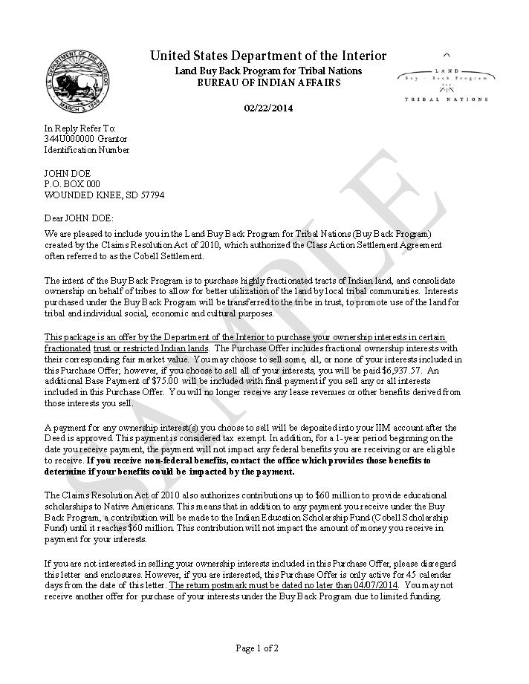
Purchase Offer Cover Letter – Page 1 of 2

Slide 10
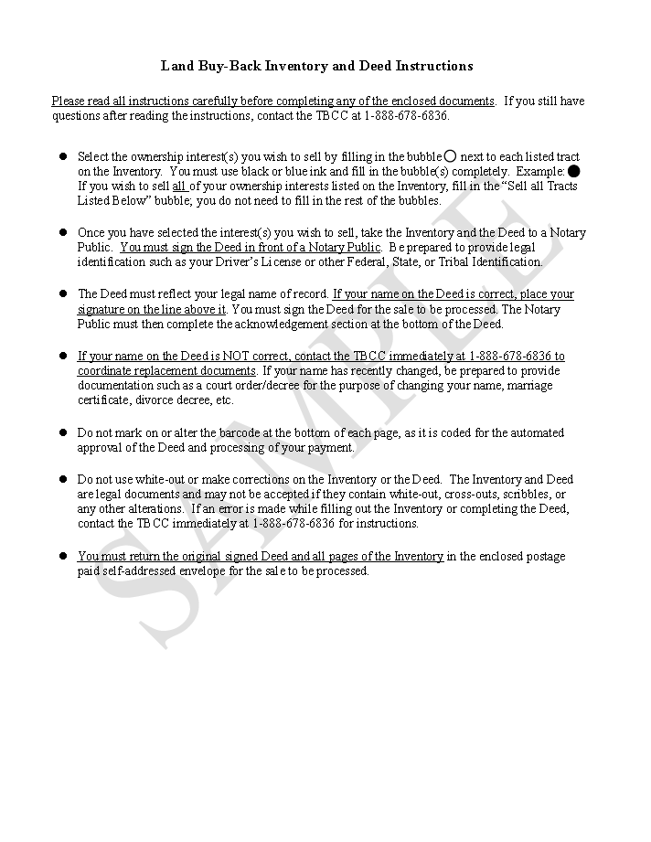
Instructions
Additional guidance on how to complete the deed and summary inventory is available on the Buy-Back Program website.
www.doi.gov/buybackprogram

Slide 11
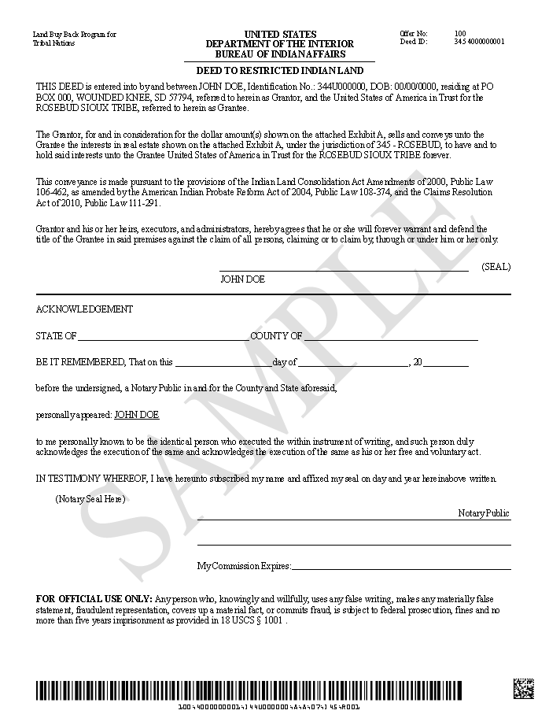
One-Page Deed
Deed signature requires notarization
Lessons Learned
Notary service is not always accessible to international and incarcerated landowners.
Federal - Oaths and Acknowledgments (18 U.S.C.)
International – U.S. Embassy or Apostille
State Specific Laws
Notes:
*Have revised deed to address common errors
*Provide sample deed with specific instructions at outreach events and online
*18 USC Part III, Ch 301, sec 4004
Wardens, superintendents, associate wardens and superintendents, chief clerks, and record clerks, take acknowledgments of officers, employees, and inmates
*Hague Convention – Apostilles

Slide 12
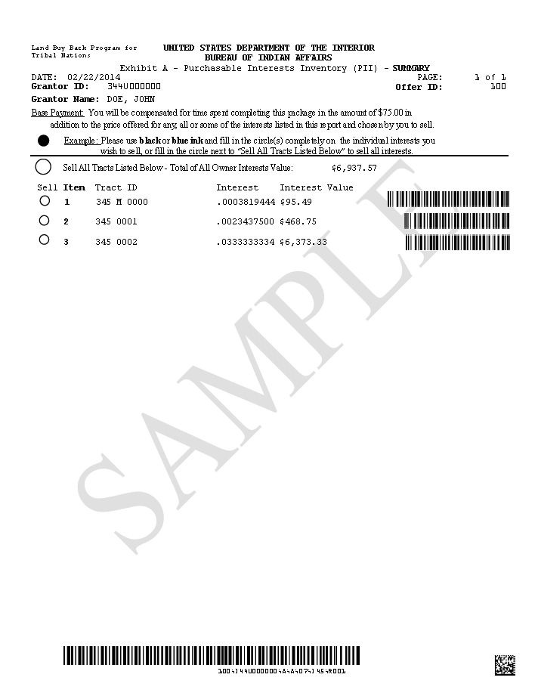
Purchasable Interest Inventory
Inventory Summary
(1 of 2 parts)
The Purchasable Interest Inventory is made of 2 parts. The Summary and the Detail parts are linked by the “Item” number.
May not include all landowner interest because some may not be eligible for purchase under the Buy-Back Program.

Slide 13
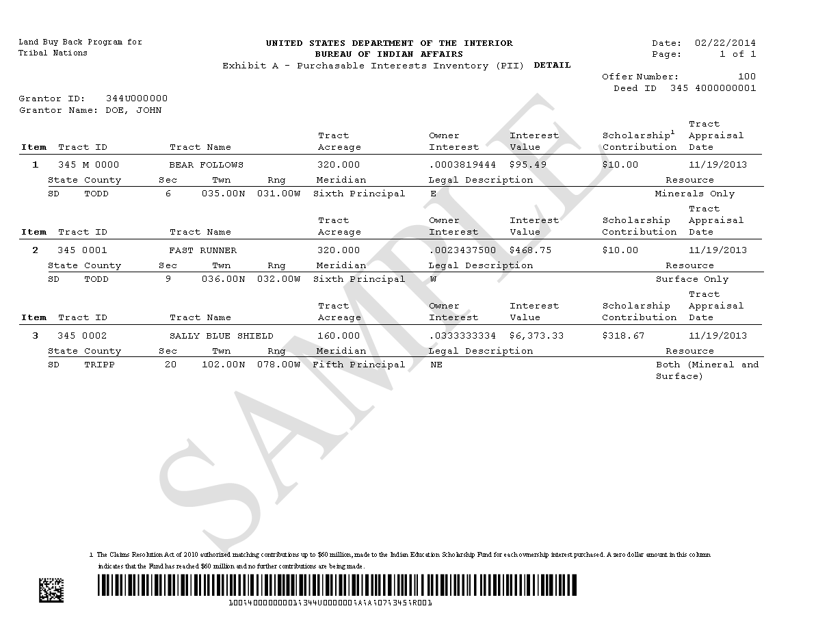
Purchasable Interest Inventory
Inventory Detail
(2 of 2 parts)

Slide 14
Cobell Scholarship Fund
Fund is administered by a non-governmental entity
Contributions are in addition to and do not impact land sale payments
Up to $60 million will be contributed to the Fund
Interest valued < $200
$10 contribution
Interest <> $200 and $500
$25 contribution
Interests valued > $500
contribution of 5% of the interest value

Slide 15
More Program Information
Buy-Back Program website with resources for both landowners and Tribes - Visit www.doi.gov/buybackprogram
  Sample purchase offer documents
  FAQs
  2014 Program Status Report
  Outreach materials
  Current offer schedule and return by dates
Trust Beneficiary Call Center (TBCC): 1-888-678-6836
  Monday – Friday 7:00 AM to 6:00 PM (Mountain Time)
  Saturday 8:00 AM to Noon (Mountain Time)

