Slide 1
The HEARTH Act
A General Overview of the HEARTH Act and BIA’s Review and Approval Process of Tribal Leasing Regulations
Presented by
Cynthia J. Morales, Realty Specialist
Hearth Act Coordinator & Liaison
The Bureau of Indian Affairs Office of Trust Services,
Division of Real Estate Services
June 23, 2015

Slide 2
THE HEARTH ACT
The Helping Expedite and Advance Responsible Tribal Home Ownership Act of 2012.
Signed into law July 30, 2012.
Amended the Indian Long-Term Leasing Act of 1955, 25 U.S.C. § 415, including § 415(h), Tribal Approval of Leases.

Slide 3
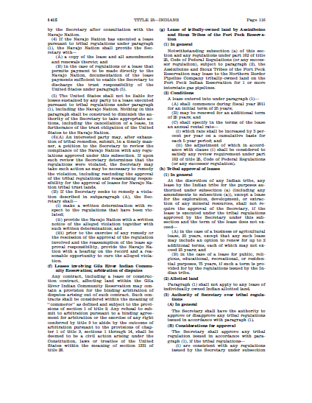
WHAT DOES THE HEARTH DO FOR TRIBES?
In support of tribal self-determination, the HEARTH Act provides a mechanism for Tribes to approve and manage leases of their trust lands
without review by the Bureau of Indian Affairs
or
approval by the Secretary of the Interior.

Slide 4
Prior to approval of the HEARTH Act, long term leases of Tribal Trust Land:
Required review by BIA for compliance with BIA’s leasing regulations found at 25 CFR Part 162.
And,
Required approval by the Secretary of the Interior (Secretary).

Slide 5
Since enactment of the HEARTH Act, a long term lease of Tribal Trust Land:
May be approved by tribes without BIA review or Secretarial approval.
If,
The lease has been executed under tribal leasing regulations (ordinances/codes).
and,
The tribal leasing regulations were reviewed by the BIA and approved by the Secretary prior to execution of the lease.

Slide 6
Tribal leasing regulations are eligible for Secretarial Approval if:
The tribe’s leasing regulations are consistent with the BIA’s regulations at 25 CFR Part 162 (the most recent version being effective January 4, 2013).
Tribal regulations must also provide for an environmental review process that includes:
Identification and evaluation of significant effects of the proposed lease on the environment;
A period for public notice and comment related to any significant impacts of the proposed lease on the environment;
The tribe’s response to relevant and substantive public comments on environmental impacts prior to tribal approval of the lease

Slide 7
Tribal Leasing Regulations Under the HEARTH Act:
May only authorize the following lease types and terms:
Business and agricultural leases: 25 years, but may include an option to renew for up to 2 additional terms, at no more than 25 years each (a total maximum lease term of 75 years).
Residential, public, religious, educational, or recreational leases: a term of 75 years.
Must only apply to tribal trust land.
Cannot apply to lands held in trust for individual Indian landowners
Cannot authorize leases for the exploration, development, or extraction, of any mineral resources.

Slide 8
There are three general steps in the review and approval process of tribal leasing regulations.
Tribal Government Drafts, Approves, and Submits its Leasing Regulations to the BIA’s Central Office
Final review within the offices of the Assistant Secretary – Indian Affairs and Secretarial approval.
Review by BIA Division of Real Estate Services and Office of the Solicitor

Slide 9
DRAFTING TRIBAL LEASING REGULATIONS
Consider Potential Benefits of Executing Leases Without BIA Review or Secretarial Approval:
The time to execute and approve leases upon tribal lands may be significantly reduced.
Timely execution of business, residential, and other leases can encourage investment and economic development in tribal communities.
Tribal regulations may include provisions that address issues in ways consistent with tribal practices (dispute resolution, trespass, land use for religious purposes, etc.).
Tribes can enact leasing regulations only for specific areas (i.e., business leasing), but leave other areas (i.e., residential or agricultural leases) subject to BIA review and Secretarial approval under 25 CFR Part 162.
However, each tribe should assess its own needs and determine if self-regulation of leasing activities under the HEARTH Act will benefit the tribe.

Slide 10
DRAFTING TRIBAL LEASING REGULATIONS
Utilize the Tools for Reference:
By referencing the following materials during the drafting process a tribe can minimize the likelihood that required revisions will be found during the BIA’s review process. Suggested materials include:
The Hearth Act, 25 U.S.C. § 415(h).
BIA’s leasing regulations, 25 CFR Part 162 (i.e., Subpart D Business Leases or other appropriate Subpart).
Central Office’s National Policy Memorandum (NPM-TRUS-29).
BIA’s checklist utilized in its review of tribal leasing regulations.
A sample of these materials follows and they are also provided on the BIA’s website dedicated to HEARTH Act matters:
http://www.indianaffairs.gov/WhoWeAre/BIA/OTS/HEARTH/index.htm

Slide 11
IA-BIA’s HEARTH ACT WEB PAGE
http://www.indianaffairs.gov/WhoWeAre/BIA/OTS/HEARTH/index.htm

Slide 12
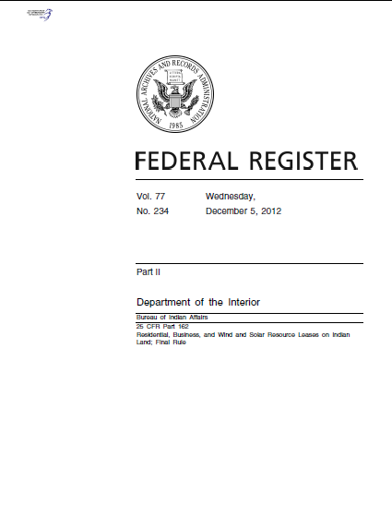
BIA’s LEASING REGULATIONS
The Final Rule, 25 CFR Part 162, Subpart D Business Leases, published in the Federal Register December 5, 2012 and effective January 4, 2013 can be found at:
http://www.gpo.gov/fdsys/pkg/FR-2012-12-05/pdf/2012-28926.pdf
or on the BIA’s website dedicated to the HEARTH Act:
http://www.indianaffairs.gov/WhoWeAre/BIA/OTS/HEARTH/index.htm

Slide 13
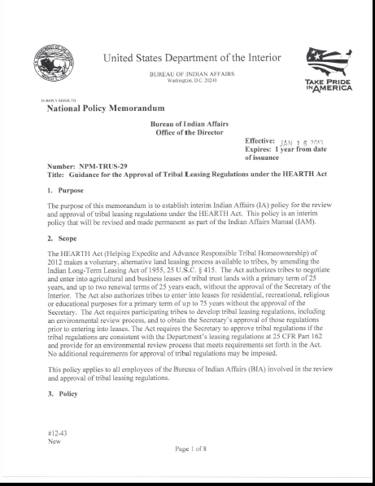
NATIONAL POLICY MEMORANDUM
Central Office’s National Policy Memorandum (NPM-TRUS-29) can be found with other guidance materials on the HEARTH website:
http://www.indianaffairs.gov/WhoWeAre/BIA/OTS/HEARTH/index.htm
Written for use by BIA employees, the NPM is currently being revised. However, it can still be valuable guidance to tribes in assessing whether their completed tribal regulations are “consistent with” 25 CFR 162, as required by the HEARTH Act.

Slide 14
THE BIA CHECKLIST
The BIA has prepared a modified version of its review checklist for use by tribes. This four-page “condensed” version can be found with other guidance materials on the HEARTH website:
http://www.indianaffairs.gov/WhoWeAre/BIA/OTS/HEARTH/index.htm
The full version used by the BIA is also posted on the website for informational purposes. However, it contains items specific only to the in-house processing at the BIA (signature process) that will likely not be useful to tribes.

Slide 15
SUBMITTING REGULATIONS FOR BIA REVIEW AND SECRETARIAL APPROVAL
Once the tribe drafts and approves its leasing regulations, they should be submitted to BIA’s Central Office in Washington, DC for BIA review and Secretarial approval.
The package submitted to the BIA should contain:
1) A cover letter that includes:
A request for review and approval of the regulations under the HEARTH Act;
Contact information for parties, with decision-making authority regarding the regulations (i.e., tribal officers, legal counsel);
Any special circumstances regarding submission of the regulations (an urgent need for approval; a unique provision included in the regulations, etc.).
2) The regulations, approved by the tribe and signed by the authorized tribal parties.
If the tribe submits an unsigned copy, it will be reviewed, but it will not be forwarded for approval until a fully executed regulation is received.
3) If applicable, a tribal resolution authorizing the regulation.

Slide 16
Please send the tribal leasing regulations with required tribal signatures, a cover letter requesting review and approval, and any applicable authorizing resolutions to:
Ms. Helen Riggs, Deputy Bureau Director
BIA-Office of Trust Services
1849 C Street, NW, MS 4620-MIB
Washington, D.C. 20240
Concurrently, please email a PDF and Word version of the submission to:
Cynthia Morales, Realty Specialist
HEARTH Act Coordinator and Liaison
E-mail: cynthia.morales@bia.gov

Slide 17
THE INITIAL BIA & SOLICITOR REVIEW:
When a tribal leasing regulations are received, they are forwarded to the BIA’s Division of Real Estate Services and to the Realty Specialist, HEARTH Act Coordinator and Liaison, where the BIA’s review process begins.
Tribal leasing regulations are reviewed in the order they are received, barring any special circumstances.
A copy of the tribal regulations is forwarded to the appropriate BIA Regional Office to provide an opportunity for comment (comment may also be provided at the Agency).
The regulations are concurrently reviewed by the BIA’s Realty Specialist-Hearth Act Coordinator and the Office of the Solicitor.
Utilizing the guidance materials referenced herein, the reviewers determine if the tribal regulations meet the criteria for Secretarial approval as required by the HEARTH Act.

Slide 18
THE REVIEWERS WILL VERIFY THE REGULATIONS ARE IN COMPLIANCE WITH THE HEARTH ACT, BY ASSESSING:
Consistency with the BIA’s leasing regulations at 25 CFR Part 162.
An environmental review process that:
Identifies and evaluates significant effects of the proposed lease on the environment;
Provides for a period for public notice and comment related to any significant impacts of the proposed lease on the environment,
Provides for the tribe’s response to relevant and substantive public comments on environmental impacts prior to tribal approval of a lease.
Lease terms;
Regulations only apply to tribal lands;
No application of regulation to lands held in trust for individual Indian landowners;
No authorization for the exploration, development, or extraction, of any mineral resources;
Reviewers consider additional details such as required definitions; specifics for identifying the land to be leased; whether prohibited provisions are included, etc.

Slide 19
FINALIZING THE INITIAL REVIEW:
When the BIA’s Realty Specialist-Hearth Act Coordinator and the Office of the Solicitor have completed their respective reviews, they meet to reach consensus upon any required or suggested modifications to the proposed regulations.
Absent any required or suggested modifications, the regulations are forwarded to the offices of the Assistant Secretary-Indian Affairs (AS-IA).
However, if modifications are recommended or required, Tribal representatives are contacted and the those modifications are discussed.
If needed, the document is referred back to the tribe for modification, otherwise, the document is moved forward for the AS-IA’s offices.

Slide 20
SECRETARIAL APPROVAL
When the final regulations are received at the AS-IA’s offices, they undergo a final round of review in preparation for approval.
Generally, the Assistant Secretary-Indian Affairs approves the regulations.
With approval of the tribe’s leasing regulations, no further BIA reviews or Secretarial approvals are necessary for leases executed under those tribal regulations.

Slide 21
PENDING AND APRPOVED REGULATIONS AS OF JUNE 19, 2015:
23 Leasing regulations from 20 tribes have received Secretarial approval.
(18 Business; 3 Residential; 1 Agricultural; 1 General)
12 Regulations are currently within the review and approval process.
(A total of 35 leasing regulations have been received from 32 tribes, which includes all of those approved and those within the review and approval process)

Slide 22
23 Approved Tribal Leasing Regulations (20 tribes)
Federated Indians of Graton Rancheria (Business) - Approved February 1, 2013
Pueblo of Sandia (Business) - Approved March 14, 2013
Pokagon Band of Potawatomi Indians (Residential) - Approved April 11, 2013
Ak-Chin Indian Community (Business) - Approved November 10, 2013
Santa Rosa Band of Cahuilla Indians (Business) - Approved November 10, 2013
Citizen Potawatomi Nation (Business) - Approved November 10, 2013
Ewiiaapaayp Band of Kumeyaay Indians (Business) - Approved December 10, 2013
Kaw Nation (Business) - Approved December 13, 2013
Jamestown S'Klallam Tribe (Business) - Approved April 4, 2014
Dry Creek Rancheria Band of Pomo Indians (Business) - Approved April 4, 2014
Wichita and Affiliated Tribes (Business) - Approved April 8, 2014
Mohegan Tribe of Indians of Connecticut (Business) - Approved April 8, 2014
Navajo Nation General Leasing Regulations - Approved May 16, 2014, under 25 U.S.C. 415(e)
Agua Caliente Band of Cahuilla Indians (Business) - Approved September 23, 2014
Seminole Tribe of Florida (Business & Residential Ordinances) - Approved January 8, 2015
Cowlitz Indian Tribe (Business) - Approved January 22, 2015
Oneida Indian Nation (Business) - Approved January 28, 2015
Ho-Chunk Nation (Business, Residential & Agricultural Ordinances) - Approved February 4, 2015
Absentee Shawnee Tribe of Oklahoma (Business) – Approved June 3, 2015
Rincon Band of Luiseno Indians (Business) – Approved June 4, 2015

Slide 23
The review of tribal leasing regulations is coordinated by the BIA Central Office, Division of Real Estate Services.
If you have questions, please contact Central Office’s HEARTH Act Coordinator, or your Regional or Local Realty Officer.
Cynthia Morales, Realty Specialist
HEARTH Act Coordinator and Liaison
(202) 768-4166
E-mail: cynthia.morales@bia.gov
Robin White, Associate Division Chief, Real Estate Services
1849 C Street, NW, MS 4642-MIB
Washington, D.C. 20240
Phone: 202.208.1110
E-mail: robin.white@bia.gov
Sharlene Round Face, Division Chief, Real Estate Services
1849 C Street, NW, MS 4642-MIB
Washington, D.C. 20240
Phone: 202.208.3615
E-mail: sharleneroundface@bia.gov

Slide 24
QUESTIONS, COMMENTS, & DISCUSSION

Slide 25
Thank you!
A General Overview of the BIA’s Review and Approval Process of Tribal Leasing Regulations
Please refer to our website for additional guidance materials provided in conjunction with the Bureau of Indian Affairs’ Information Series for the HEARTH Act.
http://www.indianaffairs.gov/WhoWeAre/BIA/OTS/HEARTH/index.htm

