Slide 1
FY 2017 Budget Formulation
Overview
Partners in Action
2015

Slide 2
Regional Representatives
Tribal Interior Budget Committee (TIBC)
Darrell Seki Sr.
  Chairman, Red Lake Band of Chippewa Indians
Jimmie Mitchell
  Director of Natural Resources, Little River Band of Ottawa Indians

Slide 3
Midwest Region
Budget Formulation Team
    Tribal Representative
      Dave Conner – Red Lake Band, Department of Natural Resources
    BIA Staff
      Patricia Olby – Superintendent Minnesota Agency

Slide 4
Midwest Region
Executive Direction
Diane Rosen Regional Director (612) 725-4595
Tammie Poitra Deputy Trust Services (612) 725-4503
Scott Sufficool Deputy Indian Services (612) 725-4510
Patricia Olby Superintendent, Minnesota Agency (218) 751-2011
Kim Bouchard Superintendent, Great Lakes Agency (715) 682-4527
Jason Oberly Superintendent, Michigan Agency (906) 632-6809

Slide 5
FY 2017 Budget Formulation Meeting
Midwest Region
Budget Meeting
Ramada, Bloomington MN
January 15, 2015

Slide 6
Objectives
Solicit Region-wide input for Regional Budget Initiatives
Consolidate input from all 35 Tribes
Develop one Regional Budget Formulation Package and submit by due date of
    February 13, 2015

Slide 7
FY 2017 Required Deliverables
Budget Funding Table
Budget Recommendations (top 10)
Budget Recommendations Narrative (+10%)
Regional Budget Initiatives (Top 10) & Narrative
Success Stories
New or Expiring Legislation
List of Budget Formulation Teams/POCs
Other Tribal Concerns
Evaluation

Slide 8
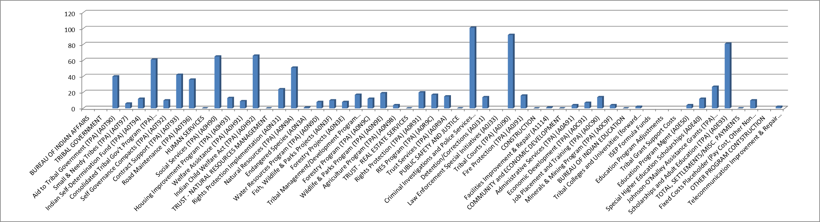
Results:
20 out of a total of 38 Tribes and Tribal Organizations…

Slide 9
FY 2017
Top 10 Budget Increases
Top 10 Budget Increases in Rank Order (1 given the most points)
Criminal Investigations and Police Services
Tribal Courts (TPA)
Scholarships & Adult Education (TPA)
ICWA (TPA)
Social Services(TPA)
CTGP (TPA) *
Natural Resources (TPA)
Contract Support (TPA) *
Aid to Tribal Government (TPA) *
Road Maintenance (TPA)
                *New this year

Slide 10
FY 2016 (Last Year) in review
Top 10 Budget Increases
Top 10 Budget Increases in Rank Order (1 given the most points)
1. Tribal Courts (TPA) A0J90
2. Criminal Investigation & Police Services A0J30
3. Scholarships & Adult Education (TPA) A0E93
4. Road Maintenance (TPA) A0T96
5. Social Services (TPA) A0H90
*6. ICWA (TPA) A0H92 (*tied)
*6. JOM (TPA) A0E90 (*tied) RED – Didn’t make FY 2017 Ranking
7. Natural Resources (TPA) A0N9A
8. Fire Protection (TPA) A0J91
9. Welfare Assistance (TPA) A0H91
----------------
10. Real Estate Services (TPA) A0R9C (Will not be part of the submission due to the tie of number 6., shown only for your information.)

Slide 11
Budget Recommendations
Budget Funding Table
Discuss and agree upon any budget changes/recommendations by budget line (activity/sub-activity) for a flat budget, level with the FY 2015 President’s Budget.
Discuss and agree upon budget recommendations by budget line (activity/sub-activity) at 10 percent increase from the FY 2015 President’s Budget.
Submit the top 10 budget increases in rank order and amounts (CO will tally all regions and rank with points system #1=10pts, #2=9 pts, #3=8pts, etc.)
Submit completed detail of changes worksheet.

Slide 12
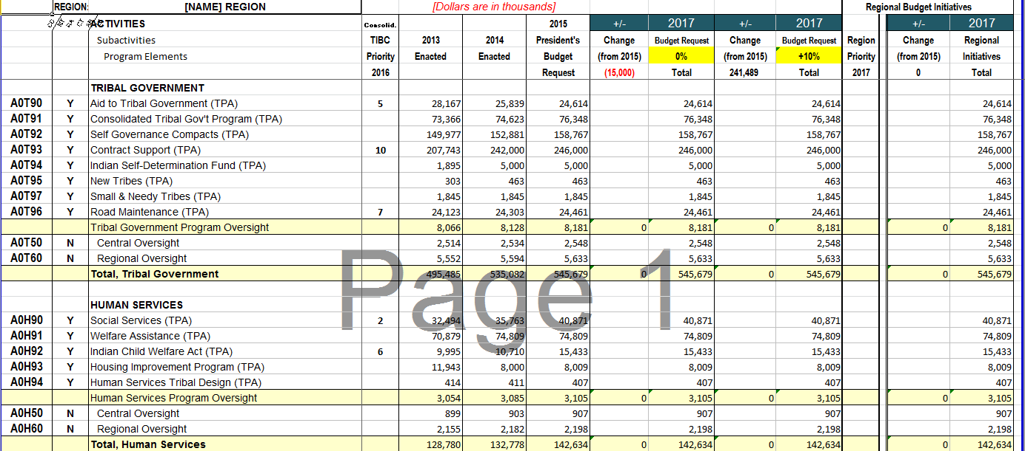
Attachment B – Budget Funding Table

Slide 13
WebEx Sessions
Budget Funding Table
Facilitated by Dave Conner
  February 3, 4 & 5.
4 hour calls
Review and completion of the Budget Funding Table, going line by line, determining where a 10% increase would go and how we would apply no change from the FY 2015 Presidents Budget Request.

Slide 14
Team Work
  Sub-Teams were established last year to gather information for the following program areas:
    Realty/Probate
    Social Services
    Law Enforcement/Tribal Courts
    Forestry
    Education
    Natural Resources Management

Slide 15
Team Leads
Natural Resources Management Team
 | Team Lead: | Mary Manydeeds Merven Cebrian | BIA Midwest Regional Hydrologist BIA Midwest Region Wildlife & Parks | 612-725-4539 612-725-4529 | mary.manydeeds@bia.gov Merven.Cebrian@bia.gov
Probate / Real Estate Services Team
 | Team Leads: | Roberta Larvingo Diane Baker | Regional Legal Administrative Spec. Regional Realty Officer | 612-725-4596 612-725-4586 | Roberta.Larvingo@bia.gov Diane.Baker@bia.gov
Forestry Team
 | Team Lead: | Matt Anderson | BIA Midwest Regional Forester | 312-725-4521 | matthew.anderson@bia.gov
Law Enforcment / Tribal Courts Team
 | Team Lead: | Jerin Falcon | Special Agenct in Charge, Office of Justice Svs | 952-851-5431 | Jerin.falcon@bia.gov
Social Services Team
 | Team Lead: | Valerie Vasquez-Braun | BIA Midwest Regional Social Worker | 612-725-4572 | valerie.vasquez@bia.gov
Education Team
 | Team Lead: | Rose-Marie Davis | Acting Assoc. Deputy Director BIE East | 952-851-5424 | rosemarie.davis@bie.edu

Slide 16
Sub-Team Final Products
  The Midwest Region submitted a narrative document for each program area listed in the Top 10 Ranking.
  Narratives for the Initiatives at a minimum described:
    Recommended initiatives with amounts allocated, i.e., why each increase is important;
    What makes this a good investment;
    How the funds could be spent in the allotted time period (one fiscal year); or describe the multi-year approach to get to the desired level.

Slide 17
Success Story / Testimony
Tribal testimony is presented during the National Budget Meeting in March. Regions are encouraged to submit one compelling budget related success story.
The success story should be budget related, e.g., testimony demonstrating a service not being provided because of insufficient funds, performance stories may also be submitted that demonstrate what can be achieved with a certain amount of funding, etc.
Written consent must be obtained from the individual and/or family to share a personal story.
Photos are encouraged.

Slide 18
New Legislation
Identify program areas by Sub-activities and Program Elements. List any new legislation with citation.

Slide 19
Other Tribal Concerns
  Regional Teams are encouraged to submit a list of concerns or suggestions on the budget formulation process, to be considered when the process is updated for future years.

Slide 20
Checklist
Budget Recommendations in Rank Order
Budget Funding Table – Will occur through WebEx – February 3, 4 &5. (Facilitator -Dave Conner )
Narrative of Programs Ranked 1-10 – Due February 5, 2015
Tribal Initiatives – Due February 5, 2015
Success Stories - Due February 5, 2015
New or Expiring Legislation – Due February 5, 2015
List of Budget Formulation Teams - Done!
Other Tribal Concerns – Due February 5, 2015
Evaluation Forms

Slide 21
Questions???

