Slide 1
Forestry Trespass Enforcement
Matthew Anderson, Midwest Regional Forester Partners In Action 2015 June 23-25, 2015, Ho Chunk Gaming—Wisconsin Dells, Baraboo, Wisconsin

Slide 2
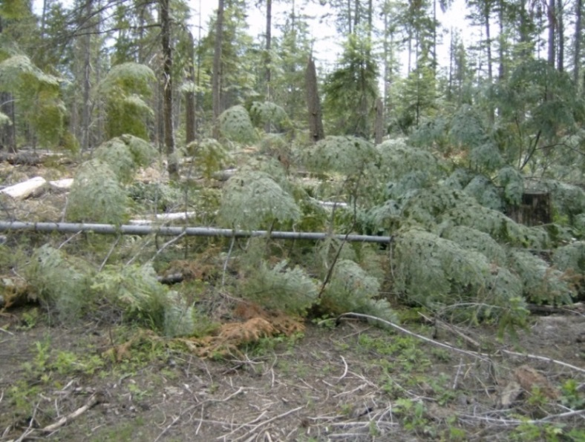
Objectives
Understand civil cases vs. criminal cases.
Understand the Enforcement process that follows completion of the Investigation process.
Understand the difference between Notification and Demand.
Understand the Administrative Decision and Appeals.
Understand Collection Procedures.

Slide 3
The Trespass Process
Detection—Discovery or recognition that an activity is trespass.
Investigation—Determination of the particulars of the incident: who, what, where, when, how, etc.
Enforcement—Applying civil or criminal procedures (or both) to meet the goals of the government or Tribe.

Slide 4
Civil Cases vs. Criminal Cases—53 IAM Chapter 7 sections 7.5 and 7.6
Civil Cases:
Requires proof of Indian ownership of the premises and commission of the acts by the trespasser.
Intent is to recover damages on behalf of the injured party.
Damages may be recovered from the trespasser or purchaser.
Independent of criminal action.
Civil prosecution is subject to applicable tribal, federal and state law as described in 25 CFR §163.29(a) (1) & (2).
Criminal Cases:
Requires proof beyond a reasonable standard of doubt.
Intent is to punish the wrongdoer.
Criminal prosecution is subject to applicable federal, tribal and state statutes and ordinances.
The criminal defendant can be apprehended in any state in which located and returned to the scene of the crime for prosecution.

Slide 5
BIA’s Trespass Enforcement Process
Consists of Three Phases
Notification
All interested parties are notified; not appealable.
Decision
Responsible parties are notified of their debt to the government; appealable.
Collection

Slide 6
Types of Trespass
Enforcement actions depend upon the circumstances of the trespass. Basically 4 possible scenarios.
Active trespass vs. Circumstantial trespass.
Active trespass means trespasser was caught in the act.
Circumstantial trespass identifies trespasser through available evidence and witnesses.
Seizure of stolen materials vs. no materials.

Slide 7
Trespass Scenarios
Active trespass, no seized materials.
Rare. If there are no trespass materials, what you’ve done is trespass prevention.
Active trespass, seized materials.
Most common type of trespass involving seized materials.
Circumstantial trespass, no seized materials.
Most common type.
Circumstantial trespass, seized materials.
Usually relies on eye witnesses.
Active trespasses have detection, investigation, and enforcement all happening at once. Circumstantial trespasses follow a more gradual process.

Slide 8
Process Overview
Overview of Enforcement Process
Stop the action (if applicable).
Seize trespass material(if applicable).
[Investigation]
Issue Notice of Trespass (Notification).
Issue Demand Letters (Decision and Collection).
If payment isn’t forthcoming, refer to Interior Business Center for debt collection.

Slide 9
Active Trespass
Active Trespass—Individual(s) caught in the act on Indian land.
Stop the action.
If you feel uncomfortable or threatened, call dispatch and Law Enforcement to address situation
Take possession of forest products (if applicable).
Issue Notice of Seizure or Poster of Seizure.
Appraise and sell perishable products if loss of value would occur.

Slide 10
Seizure of Trespass Materials
Seizure of Trespass Materials—Forest products removed from Indian land found on land not under Government supervision.
Provide a Notice of Potential Trespass to owner of land or party in possession of trespass property.
Example: Logs illegally harvested from Indian land and trucked to a sawmill.

Slide 11
Evidence of Trespass
Evidence of Trespass
May have to use circumstantial evidence to determine facts of trespass.
Available evidence must verify conclusion of trespass activity and connect accused person(s) to the action.
Different standard of proof for criminal cases vs. civil cases.

Slide 12
Trespass Reports
Type of trespass mostly impacts the Investigation phase.
Investigation results in a trespass report which is presented to the appropriate line officer for concurrence.
Trespass report will either identify that the trespasser is unknown, or identify one or more individuals as the trespasser.
Line Officer’s signature on the trespass report is concurrence with the findings of the report, including the culpability of any individuals named as trespasser.
If the Trespass Report identifies a trespasser, then Enforcement actions commence.

Slide 13
Notification
Notice of Trespass
Sent to all suspected trespassers.
Purpose is informational.
As no administrative action is made, Trespass Notices can’t be appealed.
Must be sent before any demand for payment is sent.

Slide 14
Trespass Notice
Notice of Trespass contents:
That a determination has been made that a trespass as occurred;
The basis for this determination;
An assessment of the damages, penalties, and costs;
The seizure of forest products, if applicable;
The disposition or removal of Indian forest products taken in trespass may result in civil and/or criminal action by the United States or tribe.
No action (in the legal sense) is taken under a Notice of Trespass. Purpose is to inform.

Slide 15
Decision and Demand
Demand Letter
Sent to all trespassers identified in the Trespass Report.
Demand Letter establishes an Administrative Action, namely the decision that the recipient owes a debt to the Government.
Demand Letter must therefore include information on how to appeal the Action.

Slide 16
Demand Letters
Demand Letter content guidelines:
Inform the trespasser of the consequences of his/her failure to cooperate;
Identify the basis for the indebtedness;
Identify applicable requirements for charging interest, penalties or administrative costs;
Give the name, address and phone number of a BIA contact person;
State the applicable requirements for reporting delinquent debts to commercial credit bureaus;
Specify the date by which the payment is to be made (date due) which should not be more than 30 days from the date of the initial notification;
Send “Certified Mail - Return Receipt Requested” or hand-delivered;
Contain appeal rights;
Include three copies of “Tender of Payment of Trespass Obligation”.

Slide 17
Trespass Enforcement
Demand Letter process
Demand Letter can be sent immediately after the Trespass Notice is issued.
If trespass case is Criminal rather than Civil, proceed under guidance of Solicitor’s Office and in cooperation with Law Enforcement.
Additional Demand Letters may sent but are not required. Guidance is to send three Demand Letters total.
Second and Third Demand Letters follow if response is not forthcoming. These do not contain appeal language because they are not establishing an administrative action, only referencing an action already taken.

Slide 18
Administrative Actions
First Demand Letter is formal notification of an Administrative Action.
Administrative Actions are appealable under 25 CFR Part 2.
Line Officer makes the determination to take the Administrative Action based on the content of the Trespass Report.
The Trespass Report should therefore be formatted to reflect concurrence of the Line Officer with the conclusion of the Trespass Report.
The Administrative Action is the determination that a debt to the Government exists on the part of the accused trespasser.

Slide 19
Responses from Trespassers
Demand Letter Responses
Four possibilities:
No response.
Non-appeal response.
Formal appeal. Must meet requirements of 25 CFR Part 2 and follow process described in the first Demand Letter. Responses not following the correct format may or may not be treated as appeals at the discretion of the Line Officer.
Payment.

Slide 20
Responding to Trespassers
After the Demand Letter
If decision is appealed, then follow procedures in 25 CFR Part 2 to respond to the appeal.
If no appeal is made or appeal is defective, then refer the debt to Interior Business Center for formal debt collection procedures.
If payment is made, initiate collection procedures in TAAMS.

Slide 21
Debt Collection Procedures
Debts referred to IBC are further referred to Treasury for collection. Actions can include garnishment of federal payments (e.g. income tax refunds), among other things.
Procedures for debt collection referral aren’t well-documented yet. Work with your Regional Office and Central Office to complete this step.

Slide 22
Prosecution
Prosecution:
Federal Prosecution
Department of Justice has in some areas set a dollar threshold, below which they will not take cases.
DoJ will aggregate multiple cases, so if the threshold isn’t met they’ll
Tribal Prosecution—Requires concurrent jurisdiction.

Slide 23
Concurrent Jurisdiction
Tribes can request acknowledgement of their concurrent jurisdiction.
This allows trespass cases to be prosecuted in Tribal Court.
Tribe addresses request to the Regional Director. Acknowledgement is granted by the Secretary of the Interior.
Request consists of two items.
Tribe must submit Tribal council resolution adopting 25 CFR 163.29.
Must notify the Regional Director that tribal court has ability to adjudicate forest trespass cases and that the Tribal court will enforce Indian Civil Rights Act
Secretary of the Interior will acknowledge receipt of these documents and notify the Tribe of this acknowledgement.

Slide 24
Trespass Enforcement
Questions?

