Slide 1
2017 Budget Formulation
Process and Results
Office of Budget and Performance Management
March 6, 2015

Slide 2
PROCESS
In September of 2014, OBPM launched the 2017 Formulation site.

Slide 3
PROCESS
A portion of that site contained the detailed instructions to help the regions fill out the forms OBPM requested.

Slide 4
PROCESS
Narratives sent to Central Office.
Analysis is ongoing, and will be released at a later date.

Slide 5
PROCESS
Here is an example of the information we collected.

Slide 6
RESULTS
Top 5 Priorities 2017 pts. 2016 rank
1. Scholarships and Adult Education 82 1
2. Aid to Tribal Governments 64 5
(ranked #1 five times)
3. Tribal Courts 64 3
4. Criminal Investigations 60 4
5. Social Services 56 2

Slide 7
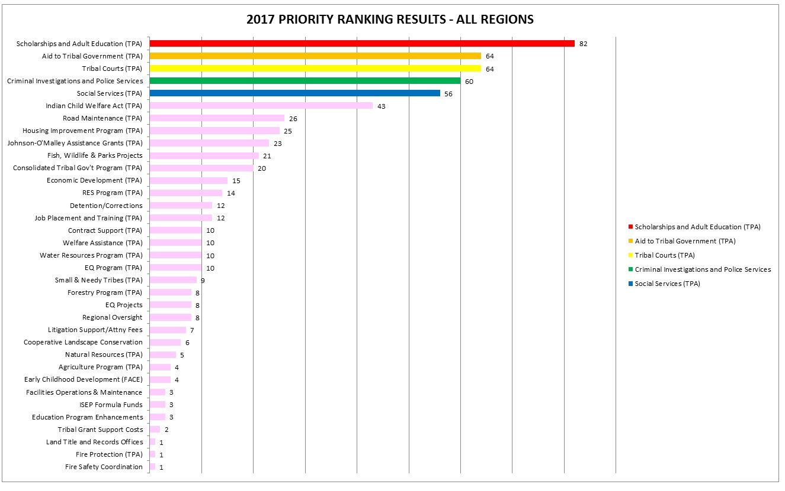

Slide 8
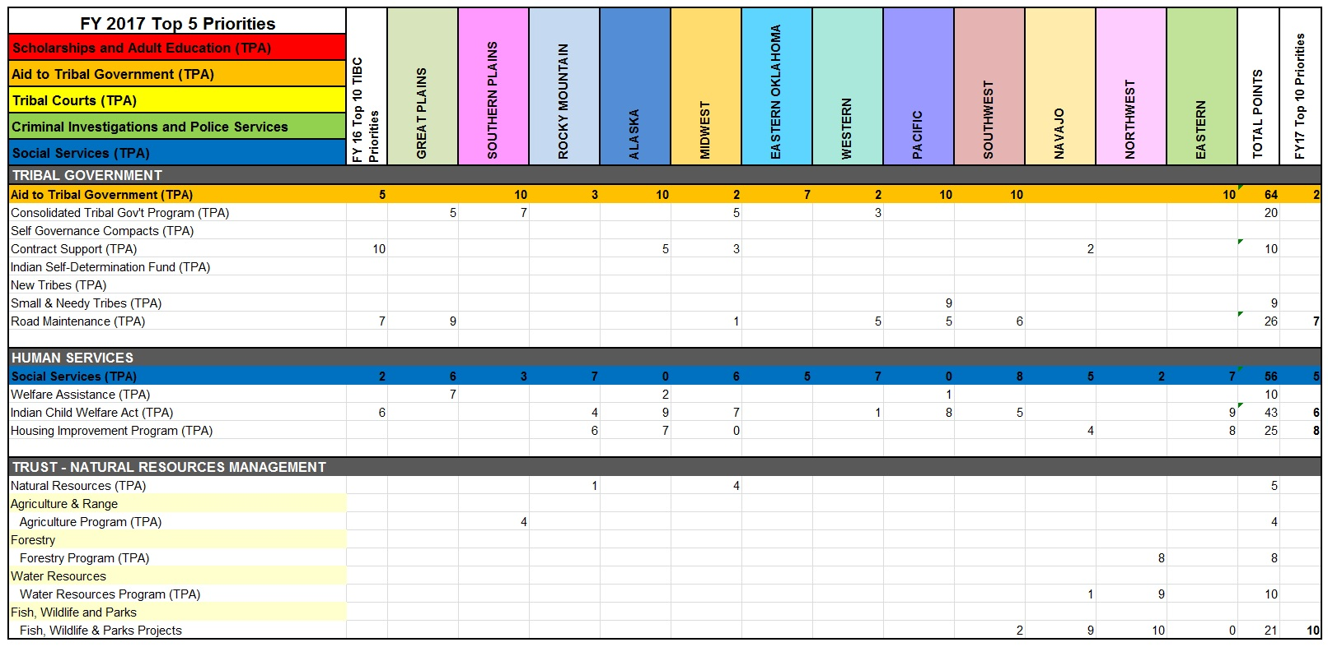

Slide 9
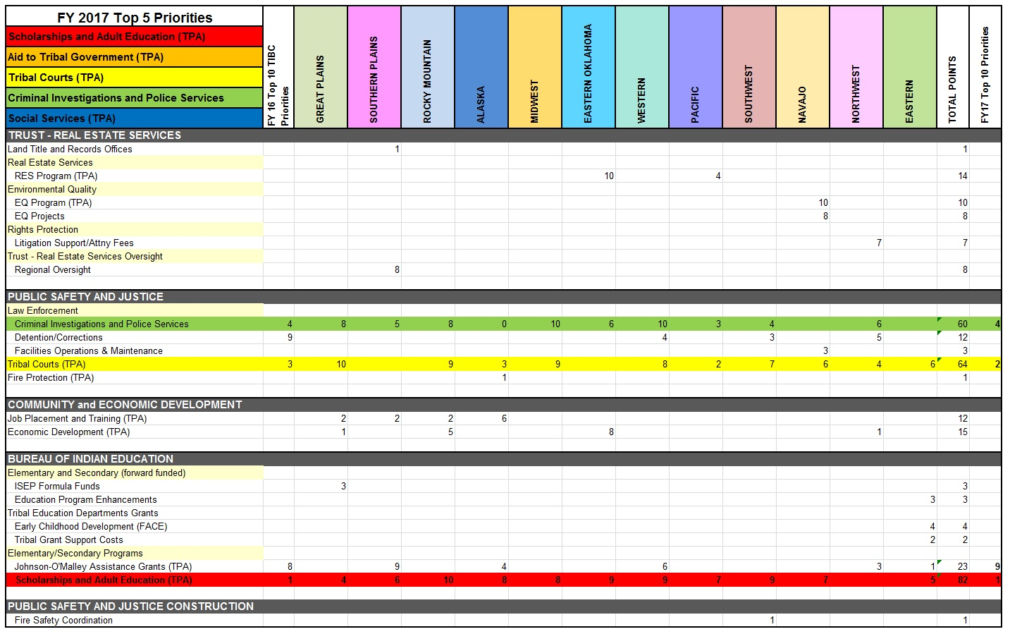

Slide 10
Timeline
Indian Affairs deals with multiple fiscal year budgets concurrently.

Slide 11
For more info:
Contact:
Roy Bohling
(202) 208 4808
leroy.bohling@bia.gov

