Slide 1
Fee to Trust
Robin White
Associate Chief
Office of Trust Services
Division of Real Estate Services
1849 C Street, NW, MS 4643-MIB
Washington, DC 20240
Ph: 202.208.1110
Robin.white@bia.gov

Slide 2
Fee to Trust 2017 Goal
BIA will assist Tribes and Tribal Members with placing 500K acres into trust
Since 2009, BIA has placed over 300K acres in trust status
BIA is working to
improve communications,
provide intra-agency cooperation, & enhance
fee to trust resources

Slide 3
Fee to Trust Resources
Fee to Trust Quick Reference Guide

Slide 4
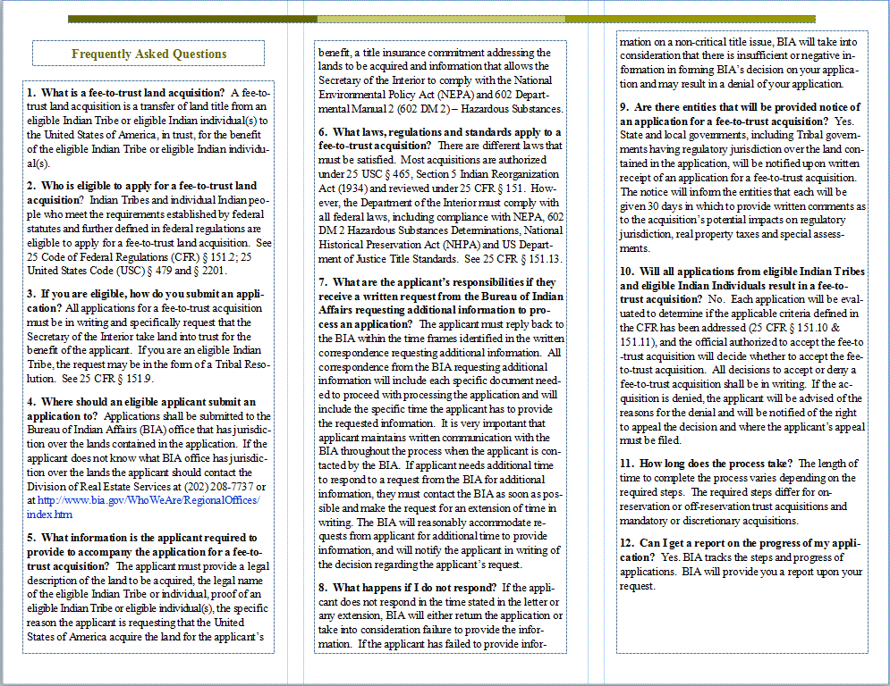
Fee to Trust Resources

Slide 5
Fee to Trust Resources
Brochures:
On Reservation Discretionary Acquisitions
Off Reservation Discretion Authority
Mandatory Acquisitions
Mandatory American
Indian Probate
Reform Act (AIPRA)

Slide 6
Fee to Trust Resources
Fee to Trust Handbook
Coming Soon!! Fee to Trust public website
Fee to Trust Roadshows:
DRES
SOL Office
Office of Indian
Gaming

Slide 7
Fee to Trust Road Shows
June – PIA, Wisconsin Dells
August – Southwest area
September – Eastern area
October - Southern Plains area

Slide 8
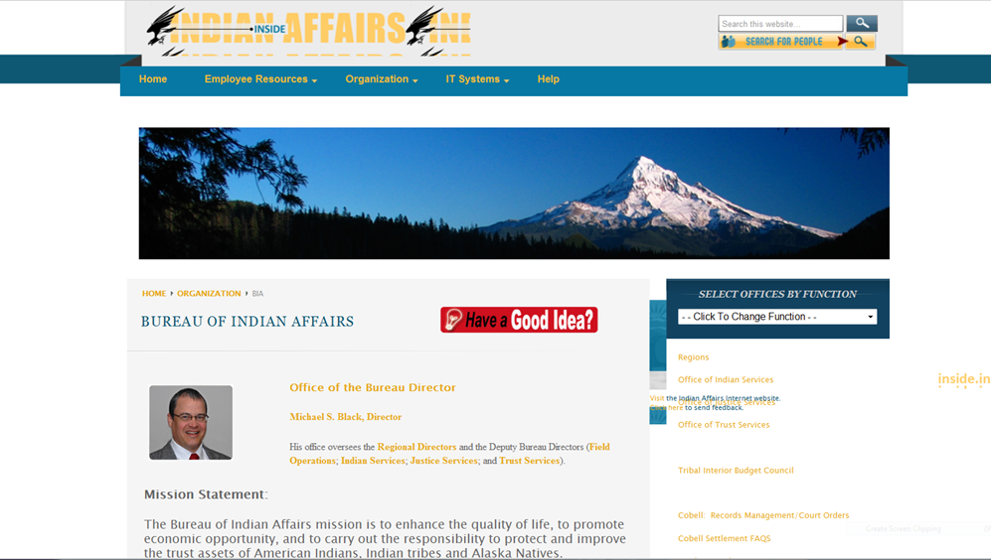
November 2017
“BIA DID IT—500K ACRES IN TRUST FOR INDIAN TRIBES!”

Slide 9
Thank You!

