Slide 1
Tribal Records Briefing 2015 Conferences Presented by Office of Trust Records

Slide 2
Agenda
Introduction:
This training is to provide information to Tribes on the preservation and management of tribal records
Tribal Records Management Options
Tribal Records Management Transfer Options
American Indian Records Repository
Tribal Research Options

Slide 3
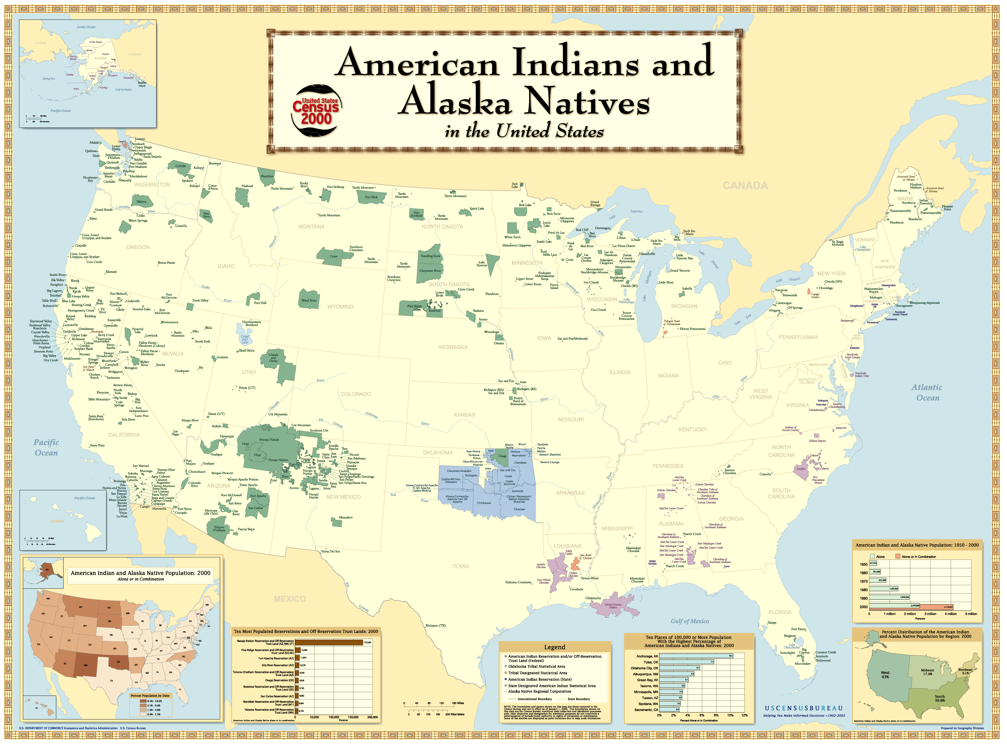
Office of Trust Records (OTR) established in 1999:
To develop and implement a program for the economical and efficient management of Indian fiduciary trust records
Directives: 1994 American Indian Trust Reform Act, the Federal Records Act and other statutes and regulations

Slide 4
What is Records Management?
A planned set of policies, procedures, and activities developed for the management of recorded information throughout the records lifecycle:
Records Lifecycle
creation and/or receipt of records
Office filing, retrieval and handling of records
storage of permanent inactive records of historical, financial and cultural value
destruction of temporary inactive records that are no longer needed
CREATION
MAINTENANCE AND USE
DISPOSITION
Notes:
We use the federal government’s definition of records management.
Any action or activity taken in regards to records.

Slide 5
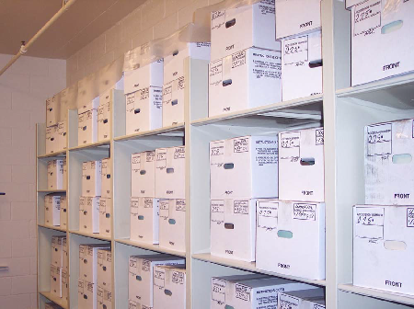
Importance of a Records Management Program
Preserves Historical Documents
Aids management in the decision-making process
Supports Litigation
Provides timely, complete and accurate information
Notes:
There are many benefits of a RM program.

Slide 6
Importance of a Records Management Program (Cont.)
Ensures legal and regulatory requirements for audits and assessments
Supports disaster recovery
Protects sensitive information
Protects rights
Conserves space, money and time
Notes:
And then there are potential problems of not having a RM program.

Slide 7
Definitions
Indian Fiduciary Trust Records (IFTR) also referred to as Trust Records. Trust records document the existence of particular lands, natural resources, monies, or other assets held in trust at a particular time by the federal government for an Indian tribe, Alaska native or individual Indian.
Examples of programs that create trust records are Real Estate, Natural Resources, Probate, Forestry, Appraisals, Field Operations (IIM) and Tribal Accounts.
General Trust Records: Does not meet the definition of a trust records but documents business activities related to program functions.
Examples of programs that create general trust records are Social Services, Tribal Court, Law Enforcement and Education.

Slide 8
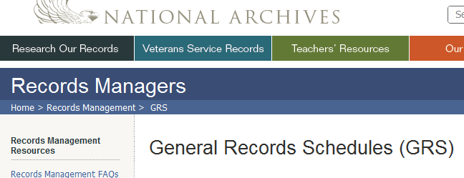
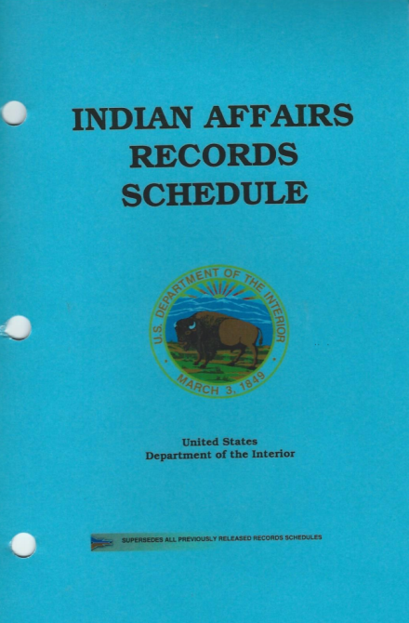
Definitions (c0nt.)
Record Schedules: Identifies records as temporary or permanent. Written guidance providing specific and mandatory instructions for what to do with records that are no longer needed for current business.
Schedules used by Indian Affairs:
General Records Schedule (GRS)
Administrative Support (i.e. travel, time and attendance)
Addresses Temporary records
Used by most Federal organizations
Indian Affairs Records Schedule
Supports Programs (i.e. Realty, Natural Resources,
Law Enforcement, Education, Social Services, etc.)
Addresses Permanent records
Used by Indian Affairs, and Office of the Special Trustee
Notes:
And then there are potential problems of not having a RM program.

Slide 9
Tribal Records Management Options for tribal Trust records
Option 1: The Tribe may use the Indian Affairs Records Management policy or revise it to fit Tribal needs.
Option 2: Tribes may create their own records management policy.

Slide 10
Option 1: Integrate Indian affairs RM Program
Roles and Responsibilities
Office of Trust Records:
Assist in developing and implementing a Records Management program
Provide training, as needed
Work with tribe to develop a memo of understanding/memorandum of agreement (MOU/MOA) for specific implementation of the Tribe’s Trust Records management program
Provide procedures to transfer Indian Fiduciary Trust Records (IFTR) to the American Indian Records Repository
Budget permitting, perform on-site records management assessment and evaluation to determine extent of technical assistance required
Tribe:
Designates a primary point of contact to develop, implement, and maintain a records management program.
Works with OTR to develop a memo of understanding/memorandum of agreement (MOU/MOA) for specific implementation of managing the Tribal Trust records program
Notes:
The first step in developing a RM program is to identify roles and responsibilities. OTR’s role, mainly the Regional Records Liaison will be the point of contact. We will assist in developing and implementing the Tribe’s RM program. In doing that, we will provide training if need be and help to transfer records to the AIRR.

Slide 11
OPTION 2: create a tribal RM Program
Steps to developing a Tribal Records Management program
Planning Stage:
staff and budget expense must be determined
create a work plan.
Legal Review and Acceptance: obtaining legal review and Tribal Resolution to accept new policy and procedures.
Deployment: Implementing the records management program.
Maintenance: Maintaining and updating the records management policies.
Execution of Work Plan: perform steps to develop a records management program.

Slide 12
OPTION 2: (Cont) Develop a tribal RM Program
Execution of a Work Plan
1) Determine who will be responsible - Appoint RM Staff
2) Identify Records - Conduct a Records Inventory and Classification
3) Develop Policies and Procedures - Create RM Forms
4) Develop Records Schedules - Disposition
5) Create a Recordkeeping System - Filing
6) Establish Records Storage
7) Create a Vital Records and Disaster Recovery Plan
8) Develop an RM Training Program
9) Develop a Records Audit/Assessment Program

Slide 13
Comparison of RM options
RM OPTION 1
Integrate Indian Affairs Record Management Program
RM OPTION 2
Create Tribal Records Management Program
Less work upfront
Less staff needed
Set of policies, procedures, record schedules, RM forms ready to be adapted to fit Tribal needs
Records storage is free at the American Indian Records Repository.
More work upfront
Full records staff needed
Time required to develop policies, procedures, record schedules, forms, etc.
High cost to rent or build records storage

Slide 14
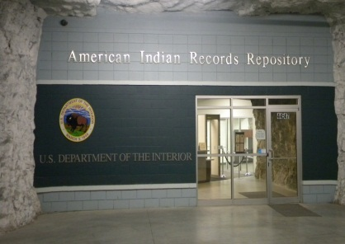
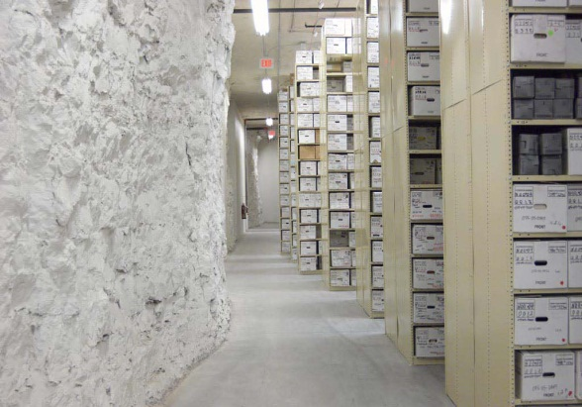
Transfer and storage options for inactive records
Where does your tribe store inactive records?
Has your Tribe considered sending records to the AIRR?
The following slides will show you 3 options to consider for storing and transferring your inactive records.

Slide 15
Transfer and storage options for inactive records
Option 1: Store Records at local Tribal Records Facility
Option 2: Compact/Contract Tribes Relinquish Records back to the BIA/OST/BIE
Option 3: Tribe/Consortium transfers records in accordance with Annual Funding Agreement

Slide 16
OPTION 1- Store records at local Tribal Records Facility
RECOMMENDATIONS:
Create (buy, build, rent) a tribal storage facility
Facility standards for federally funded programs are found in 36 C.F.R., Subpart B-Facility Standards. Tribes are encouraged to follow these same standards whether they have federally funded programs or not.
Building security
Clean, pest-free and climate controlled
Have access controls in place that addresses security and Personal Identifiable Information (PII)
Develop and implement indexing(system of locating records)/storage/transfer procedures
Tribal budget must be considered

Slide 17
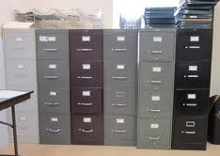
Option 1: Store records at local Tribal Records Facility
Recommended Transfer Procedures
Originating office arranges files in boxes by records series (basic unit for organizing and controlling your files).
Inventory (detailed listing of the volume, scope, and complexity of an organization's records) boxes for each separate transfer
Prepare transfer documentation and obtain approval
Transfer records to Tribal Records Storage Facility
Facility documents transfer receipt and assigns designated storage location (i.e. row, shelf)
Facility sends form to originating office acknowledging receipt and storage location

Slide 18
Option 2: Compact/Contract Tribe Relinquishes Records to BIA/OST/BIE
Agreement between Tribe/Consortium and BIA/OST/BIE
Tribe transfers legal custody of Indian Fiduciary Trust Records (Tribal Records) to BIA/OST/BIE if agreed to.
Indian Fiduciary Trust Records (Tribal records) become federal records
Records subject to FOIA and Privacy Act
Tribe/Consortium requests copies through BIA/OST/BIE
Shipment prepared according to IARMM (Policy)

Slide 19
Option 2: Compact/Contract Tribe
Relinquishes General Trust Records to BIA/OST/BIE
Policy exists for transferring only Indian Fiduciary Trust Records—not General Trust Records.
Effects of relinquishment: Tribe loses ownership of their records, the records become subject to FOIA/PA, and only copies of records are available to the Tribe.
General Trust Records
NO Policy

Slide 20
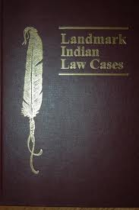
Option 3: Tribe/Consortium transfers trust records in accordance with Annual Funding Agreement
Annual Funding Agreement Language
Federal Register, Volume 70, Number 166, dated August 29, 2005
Department of Interior issued a Notice of Final Decision
Self-Determination and Self-Governance Funding Agreement language on Fiduciary Trust Records Management
Between the Secretary and the Tribe/Consortium
Notes:
The Department of Interior issued a Notice of Final Decision for self-determination and self-governance funding agreement.
This document spells out what the Secretary and Tribes are responsible for.

Slide 21
Option 3: Tribe/Consortium transfers records in accordance with Annual Funding Agreement
Annual Funding Agreement Language
Tribe/Consortium agrees to:
(a) Preserve, protect & manage all fiduciary trust records, created and/or maintained by the Tribes/Consortia during their management of trust programs in their Title IV agreement…
(b) Make available to the Secretary all fiduciary trust records…Access shall include visual inspection and at the expense of the Secretary, the production of copies (as agreed upon between the parties) and shall not include the removal of the records without tribal approval
(c) Store and permanently retain all inactive fiduciary trust records at the Tribe/ Consortium or allow such records to be removed and stored at the American Indian Records Repository (AIRR) at no cost to the Tribe/Consortium

Slide 22
Option 3: Tribe/Consortium transfers trust records in accordance with Annual Funding Agreement
Annual Funding Agreement Language
Secretary agrees to:
(a) Allow Tribe/Consortium to determine what records it creates to
implement the trust program
Except that the Tribe/Consortium must create and maintain the information required by statute and regulation
No additional recordkeeping requirements are required
Store all inactive fiduciary trust records at AIRR at no cost to the Tribe/Consortium when Tribe/Consortium no longer wishes to keep the records. These records stored at the AIRR shall not be treated as Federal records. Tribe/Consortium will retain legal custody and determine access to these records.
Create and manage a single tribal storage and retrieval system for all fiduciary trust records stored at the AIRR
Provide technical assistance for Tribes/Consortia in preserving, protecting, and managing their fiduciary trust records

Slide 23
Option 3: Tribe/Consortium transfers trust records in accordance with Annual Funding Agreement
Records stored at the AIRR remain legal custody of the Tribe
Tribal records are stored in a separate location from the BIA/OST records
Tribes must send written request (letter) along with Agreement to Director, OTR requesting inactive Indian Fiduciary Trust Records to be stored at AIRR.
Include the following:
Name of Tribe/Consortium Records Officer or POC
State whether Tribe/Consortia will use the Indian Affairs Record Schedules or their own Tribally developed schedules
Technical assistance from OTR

Slide 24
Which Records Storage Option should your tribe choose?
STORAGE OPTION 1
Tribal Storage Facility
STORAGE OPTION 2
Relinquish Ownership-Store at AIRR
STORAGE OPTION 3
Retain Ownership-
Store at AIRR
Tribe retains ownership
Tribe pays for storage costs
Tribe pays employee costs
Tribe transfers ownership to BIA/OST/BIE
Tribal Records become Federal Records
Subject to Freedom of Information (FOIA) and Privacy Act (PA)
No storage costs
No employee expense
Tribe retains ownership
No storage costs
No employee costs
Established RM Program needs to be in place
Not Subject to FOIA/PA

Slide 25
American Indian Records Repository (AIRR) Lenexa, Kansas
Opened July 1, 2004
Stores only Indian Records (BIA, BIE, OST, Tribes)
Approximately 275,000 cubic feet of Indian Records are currently stored at AIRR
Haskell Indian Nation University (HINU)
Haskell students are employed by AIRR
Records Management curriculum at Haskell University initiated in 2005
National Archives and Records Administration (NARA)
Agreement between AIRR and NARA provides NARA services in support of storing IA and OST records

Slide 26
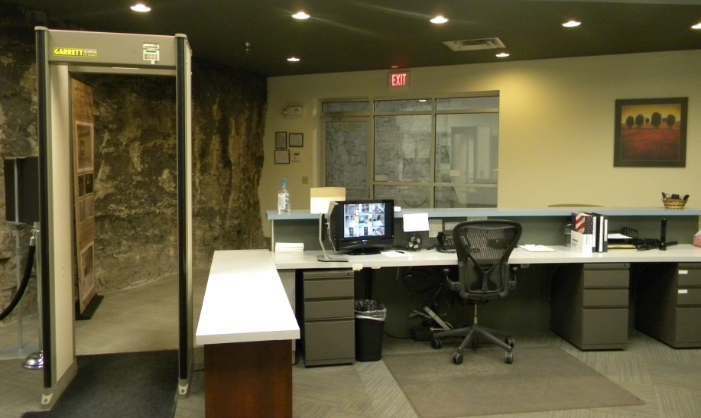

Slide 27
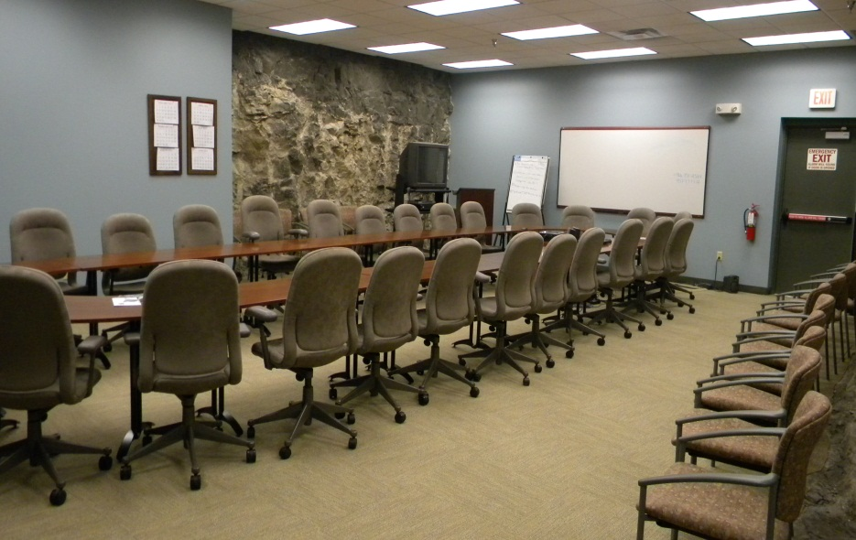
Notes:
-

Slide 28
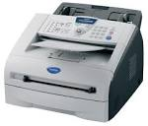
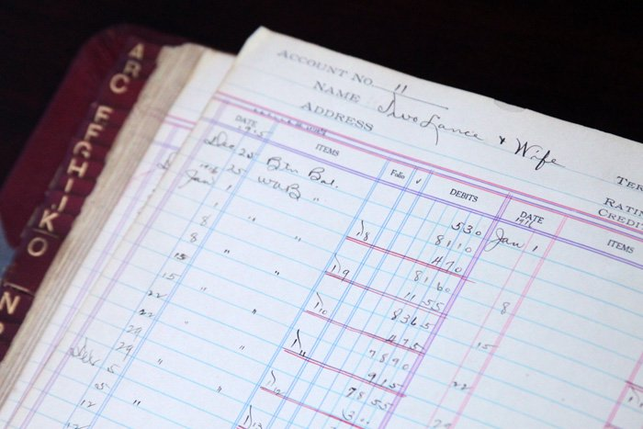
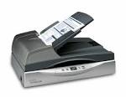
Researching your Records and Requesting Copies
Do you look for old documents?
The following slides provide options to consider for researching or retrieving copies of your records.

Slide 29
Research Requests under Option: 1
Option 1: When you choose to transfer records to tribal storage facility
Research request forms and procedures will need to be developed
Employee costs for manually retrieving and refiling information
Note: Response/retrieval time dependent on the organization of stored records

Slide 30
Research Requests under Option: 2
Option 2: Compact/Contract Tribe Relinquishes Records to BIA/OST/BIE (stored at AIRR)
BIA/OST/BIE requests records from AIRR on behalf of Tribe
Only copies of original documents are available
Response time to requestor with the requested information is approximately 2-3 days depending on the volume
BIA/OST/BIE provides to the tribe the requested information

Slide 31
Research Requests under Option 3:
Option 3: Tribe/Consortium transfers trust records in accordance with Annual Funding Agreement (stored at AIRR)
Tribal Point of Contact requests records as established in the Memorandum of Understanding (MOU).
Research Request is faxed to AIRR: (913) 956-2685
Tribal contact is notified on status of request within 24 hours of AIRR receipt
Response time is approximately 2-3 days, depending on the volume
Request to Withdraw the Records. If withdrawal of box(s) is requested in writing by an authorized individual, OTR DRMO will comply with the request and document the return of box(s) to the Tribe/Consortium.

Slide 32
Research request options
OPTION 1: Tribal
Research Request
(Tribal Storage)
OPTION 2:
Research Request (Relinquished Trust and General Trust Stored at AIRR)
OPTION 3:
Research Request (Tribe retains custody of records stored at AIRR)
Tribe stores locally, no Research Request necessary
Staff seek out files stored in local Tribal storage facility
No OTR involvement
Response/retrieval time dependent on organization of stored records
Tribal Point of Contact designated in MOU requests records by submitting written document.
If requested, originals will be sent
Response time is approximately 2-3 days
Tribe may withdraw the records.
Tribe pays cost to ship records back to tribe.
Tribal Point of Contact requests information to BIA/OST/BIE---- BIA/OST/BIE submits the research request to AIRR
Only copies of original documents are available
Response time is approximately 2-3 days

Slide 33
Question & answer session

Slide 34
Contact Information:
Kevin McNulty, Records Management Specialist
Office of Trust Records (OTR)
115 Fourth Avenue SE., Suite 500
Aberdeen, South Dakota 57401
Call: (605) 226-7421 Email: kevin_mcnulty@ost.doi.gov

