Slide 1
BIA History
Presented by: Patricia L. Olby

Slide 2
Background
1755 - The British Crown establishes an Indian Department.
1774 – A committee is established for Indian Affairs
1775 through 1783 – Revolutionary War
1786 – The Secretary of War assumes supervision of the Indian Affairs.
1789 – The United States creates the War Department because many Native American nations are still allied with the British and Spanish, Indian Affairs is moved to the newly developed War Department.

Slide 3
Background
1803 – Louisiana Purchase (7 present day states, plus portions of 8 present day states for 15 Million from the French.)
March 11, 1824 – The Office of the Indian Affairs is formed by War Secretary John C. Calhoun in the Department of War.
In 1849 Indian Affairs was transferred to the U.S. Department of the Interior. (The bureau was renamed as Bureau of Indian Affairs in 1947)
1853-1856 – The United States makes over 52 treaties with various Indian nations and it gains 174 million acres of land.
March 3, 1871 – Congress creates an act that disallows further treaty negotiations with tribes. Past treaties are still honored, but new agreements will be in the form of executive orders or congressional acts.

Slide 4
The Marshall Trilogy 1823-1832
The Marshall Trilogy is a set of three Supreme Court decisions in the early nineteenth century affirming the legal and political standing of Indian nations.
Johnson v. M’Intosh (1823)
Cherokee Nation v. Georgia (1831)
Worcester v. Georgia (1832)

Slide 5
Significant Historical Events
Dawes Act or
General Allotment Act of 1887
Burke Act 1906
Meriam Report of 1928
Indian Reorganization Act 1934

Slide 6
The Dawes Act or
General Allotment Act of 1887
Henry Lauren Dawes

Slide 7
Purposes of the Act
In the Report of the Secretary of the Interior of 1886, Senator Dawes said he wanted the government to:
“…put [the Indian] on his own land, furnish him with a little habitation, with a plow, and a rake, and show him how to go to work to use them .... The only way [to civilize the Indian] is to lead him out into the sunshine, and tell him what the sunshine is for, and what the rain comes for, and when to put his seed in the ground.”

Slide 8
The Dawes Act or General Allotment Act of 1887
Marker for an allotment established under the 1887 Dawes Act, near Pine Ridge, S.D.

Slide 9
The Burke Act of 1906
“..the Secretary of the Interior may, in his discretion, and he is hereby authorized, whenever he shall be satisfied that any Indian allottee is competent and capable of managing his or her affairs at any time to cause to be issued to such allottee a patent in fee simple, and thereafter all restrictions as to sale, encumbrance, or taxation of said land shall be removed.”

Slide 11
Results of Allotment
severe reduction in the quantity of Indian landholdings
from 138 million acres in 1887 to 48 million acres in 1934
division of allotments among the many heirs of original allottees
Inherited shares are often less than one-hundredth of a single allotment

Slide 12
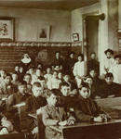
Meriam Report
1883 - St. Mary's Boarding School, on the Chippewa
[Bad River] Indian Reservation, Odanah, Wis.
The mission closed in 1969.

Slide 13
Meriam Report

Slide 14
Indian Reorganization Act of 1934
Enacted in response to the Meriam Report (1928) which described an array of Indian social and economic hardships – including failure of the allotment system
Repeal of the General Allotment Act of 1887 and halt to any further allotments
Any non-allotted surplus lands became available to tribes organized under the IRA
Trust period on Indian allotments was extended indefinitely
Taxation on allotments was eliminated

Slide 15
Indian Reorganization Act
Secretary of the Interior Harold L. Ickes hands the first constitution issued under the Indian Reorganization Act to delegates of the Confederated Tribes of the Flathead Indian Reservation (Montana), 1935. (LIBRARY OF CONGRESS, PRINTS AND PHOTOGRAPHS DIVISION)

Slide 16
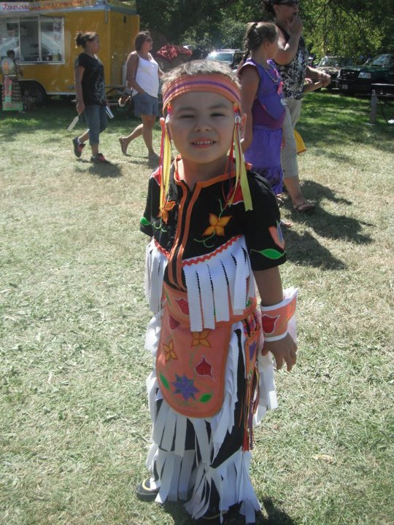
A New Government
Indian Preference
Self-Determination
Self Governance
Trust Reform

Slide 17
Missions of Interior Organizations with Trust Responsibilities
BIA: to enhance the quality of life, to promote economic opportunity, and to carry out the responsibility to protect and improve the trust assets of American Indians, Indian tribes and Alaska Natives.
OST: to perform our fiduciary trust responsibilities to American Indian tribes, individual Indians, and Alaska Natives by incorporating a beneficiary focus and beneficiary participation while providing effective, competent stewardship and management of trust assets.

Slide 18
Missions of Interior Organizations with Trust Responsibilities
OAS: To provide our clients with quality appraisal services in accordance with professional and federal appraisal standards and ensure that our appraisal services are independent, reliable and credible for sound business decisions made by or on behalf of trust beneficiaries.

Slide 19
The Indian Trust
The Indian trust represents the largest land trust in the U.S. and encompasses approximately 56 million acres of land.
Interior manages more than 100,000 leases on these lands.
Funds from leasing, use permits, land sales, and interest totaling approximately $300 million per year, are collected for about 323,000 open IIM accounts.
Approximately $500 million is collected each year in 1,450 tribal accounts for over 250 tribes.

Slide 20
Sources of Revenue
Includes a variety of encumbrances.
Road or Utility Rights-of-Way generate revenue that is usually a one time payment unless otherwise specified within the Right-of-Way document.
Timber Sales revenue generates multiple payments that are identified within the timber sale contract.
Residential, business, agricultural and recreational leases are another source of revenue.

Slide 21
Indian Land Consolidation Act (ILCA) 1983
Intended to limit fractionation by consolidating Tribal lands through sales and exchanges
Largely dependent on Tribes to implement – very few Tribes initiated any actions under the statute
Only two (2) Tribal Probate Codes approved to date (5 other tribal probate codes established under separate special statutes)
Self-executing “2% Rule” which was held unconstitutional by U.S. Supreme Court in Irving (1987) and Youpee (1997)

Slide 22
ILCA – 2000 Amendments
Purported to establish sweeping inheritance restrictions
Narrow definition of “Indian”
Restricted inheritance for non-Indians (life estate)
Restricted inheritance rights for collateral heirs
Significant objects raised by Tribes and Indian landowners with respect to inheritance restrictions
Secretary never certified the provisions – probate amendments never became effective
Indian Land Consolidation Project (Pilot) – Federal funds used to “buyback” highly fractionated interests on behalf of Tribes

Slide 23
The American Indian Probate Reform Act 2004
Establish a Federal Indian Probate Code
Effective Date for most provisions will be May, 2006
Replaces State Probate Codes
Tribes may develop their own probate codes
Limit Fractionation
Prevent Loss of Trust Land
Promote Land Consolidation
Allow Owner Management

Slide 24
Cobell Settlement
The Cobell settlement was approved by Congress on November 30, 2010 (Claims Resolution Act of 2010) and signed by President Obama on December 8, 2010. The $3.4 billion Cobell Settlement includes a $1.9 billion Trust Land Consolidation Fund and $1.5 billion in direct payments to class members.

Slide 25
Cobell Settlement
Eligibility determinations and payments are made exclusively by Garden City Group, and they can be reached at www.IndianTrust.com or 1-800-961-6109.
To update addresses or identify “Whereabouts Unknown” Individual Indian Money (IIM) accounts, please contact Garden City Group. Garden City Group will work with OST to update your information.
For more information, please visit the Department of the Interior Cobell website at http://www.doi.gov/cobell.

Slide 26
Land Buy-Back Program for Tribal Nations
The Secretary of the Interior established the Land Buy-Back Program for Tribal Nations (Buy-Back Program) to implement the land consolidation provisions of the Cobell Settlement Agreement. The Settlement provided for a $1.9 billion Trust Land Consolidation Fund (Fund) to consolidate fractional land interests across Indian Country.
There are approximately 150 unique reservations that have fractional interests. The Buy-Back Program allows interested individual owners to receive payments for voluntarily selling their land. All interests sold are restored to tribes, which helps to keep Indian lands in trust for tribal communities.

Slide 27
For additional information regarding the Bureau of Indian Affairs visit www.bia.gov
Questions?

