Slide 1
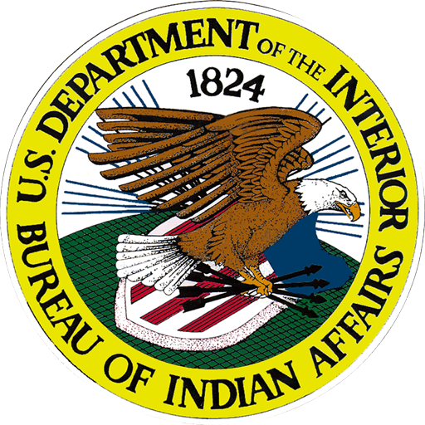
BIA Today
An Organizational Overview:
Mike Smith,
Deputy Bureau Director - Field Operations

Slide 2
Purpose
Provide an overview of the BIA organization, the work it does, and where it fits within the Department of Interior (DOI)

Slide 3
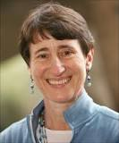

Department of the Interior
Secretary Sally Jewell

Slide 4
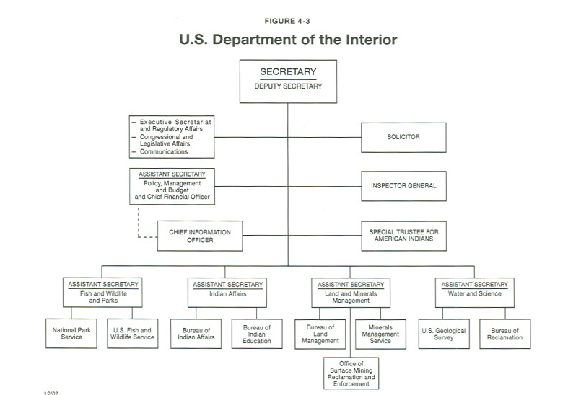

Slide 5
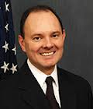
Indian Affairs
Kevin Washburn
Assistant Secretary

Slide 6
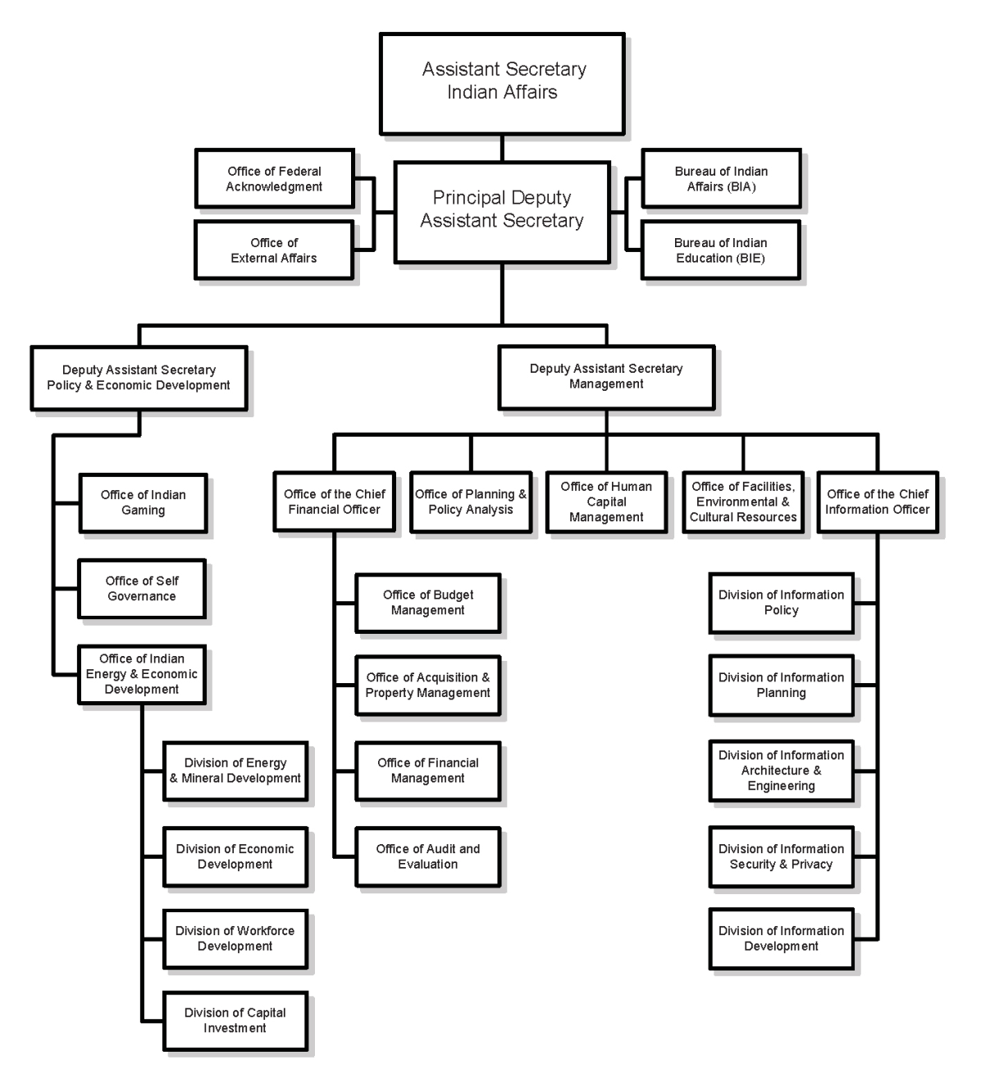
Assistant Secretary Indian Affairs

Slide 7
BIA Mission
To enhance the quality of life, to promote economic opportunity, and to carry out the responsibility to protect and improve the trust assets of American Indians, Indian tribes and Alaska Natives
This will be accomplished through the delivery of quality services and maintaining Nation-to-Nation relationships within the spirit of Indian self-determination

Slide 8
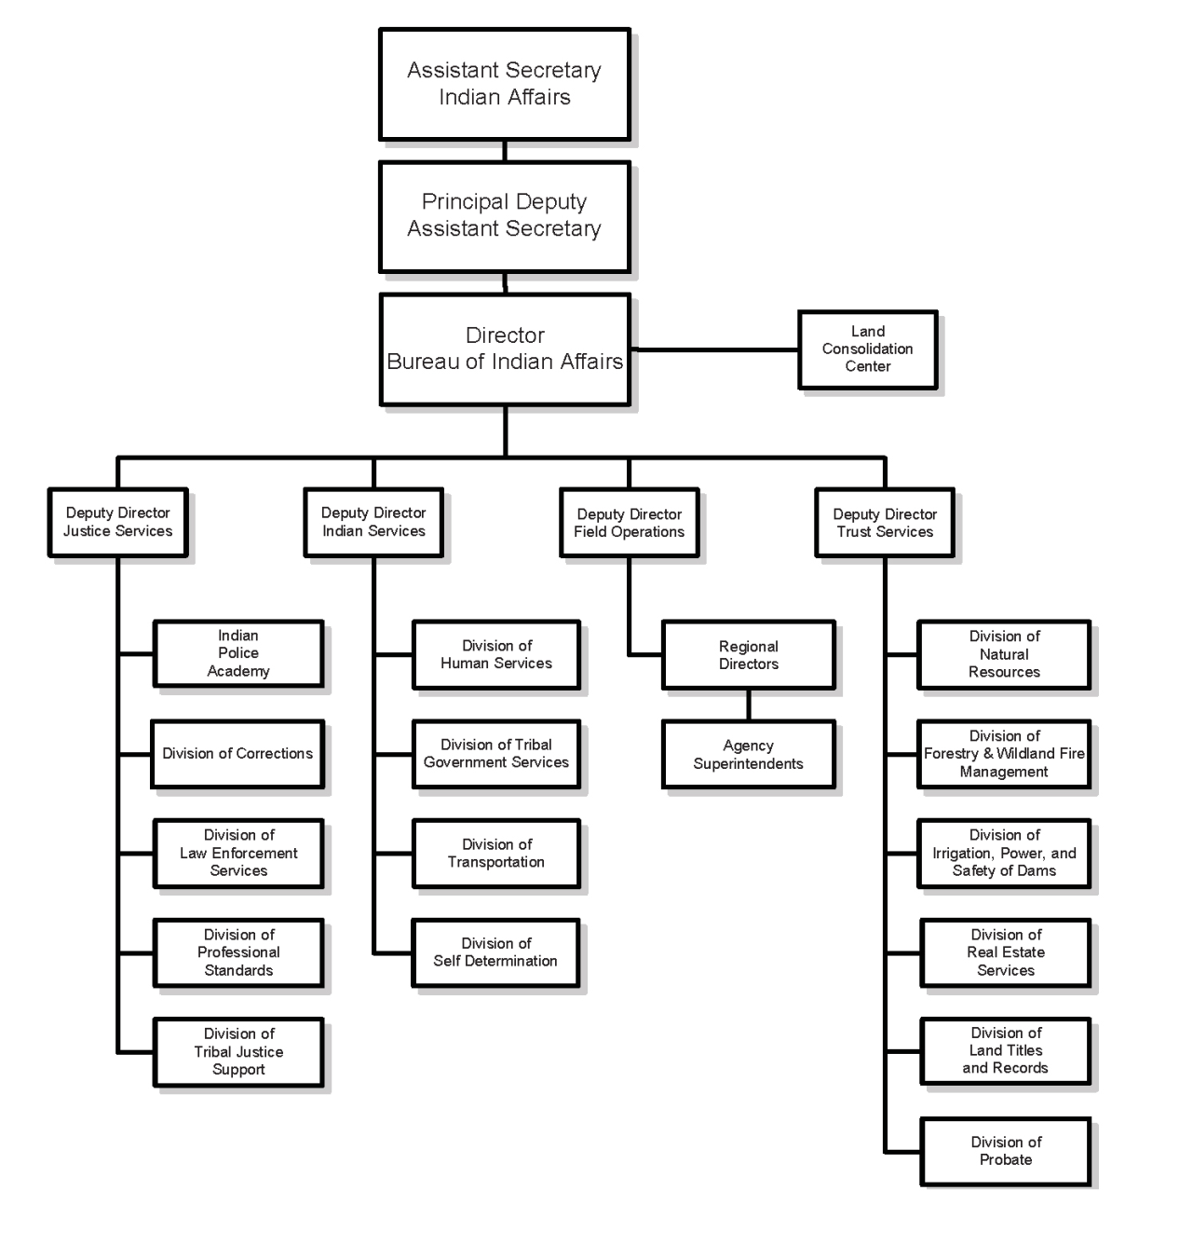
BIA

Slide 9
National Field
12 Regional Offices
85 Agencies
266 Duty locations
10,000 Employees

Slide 10
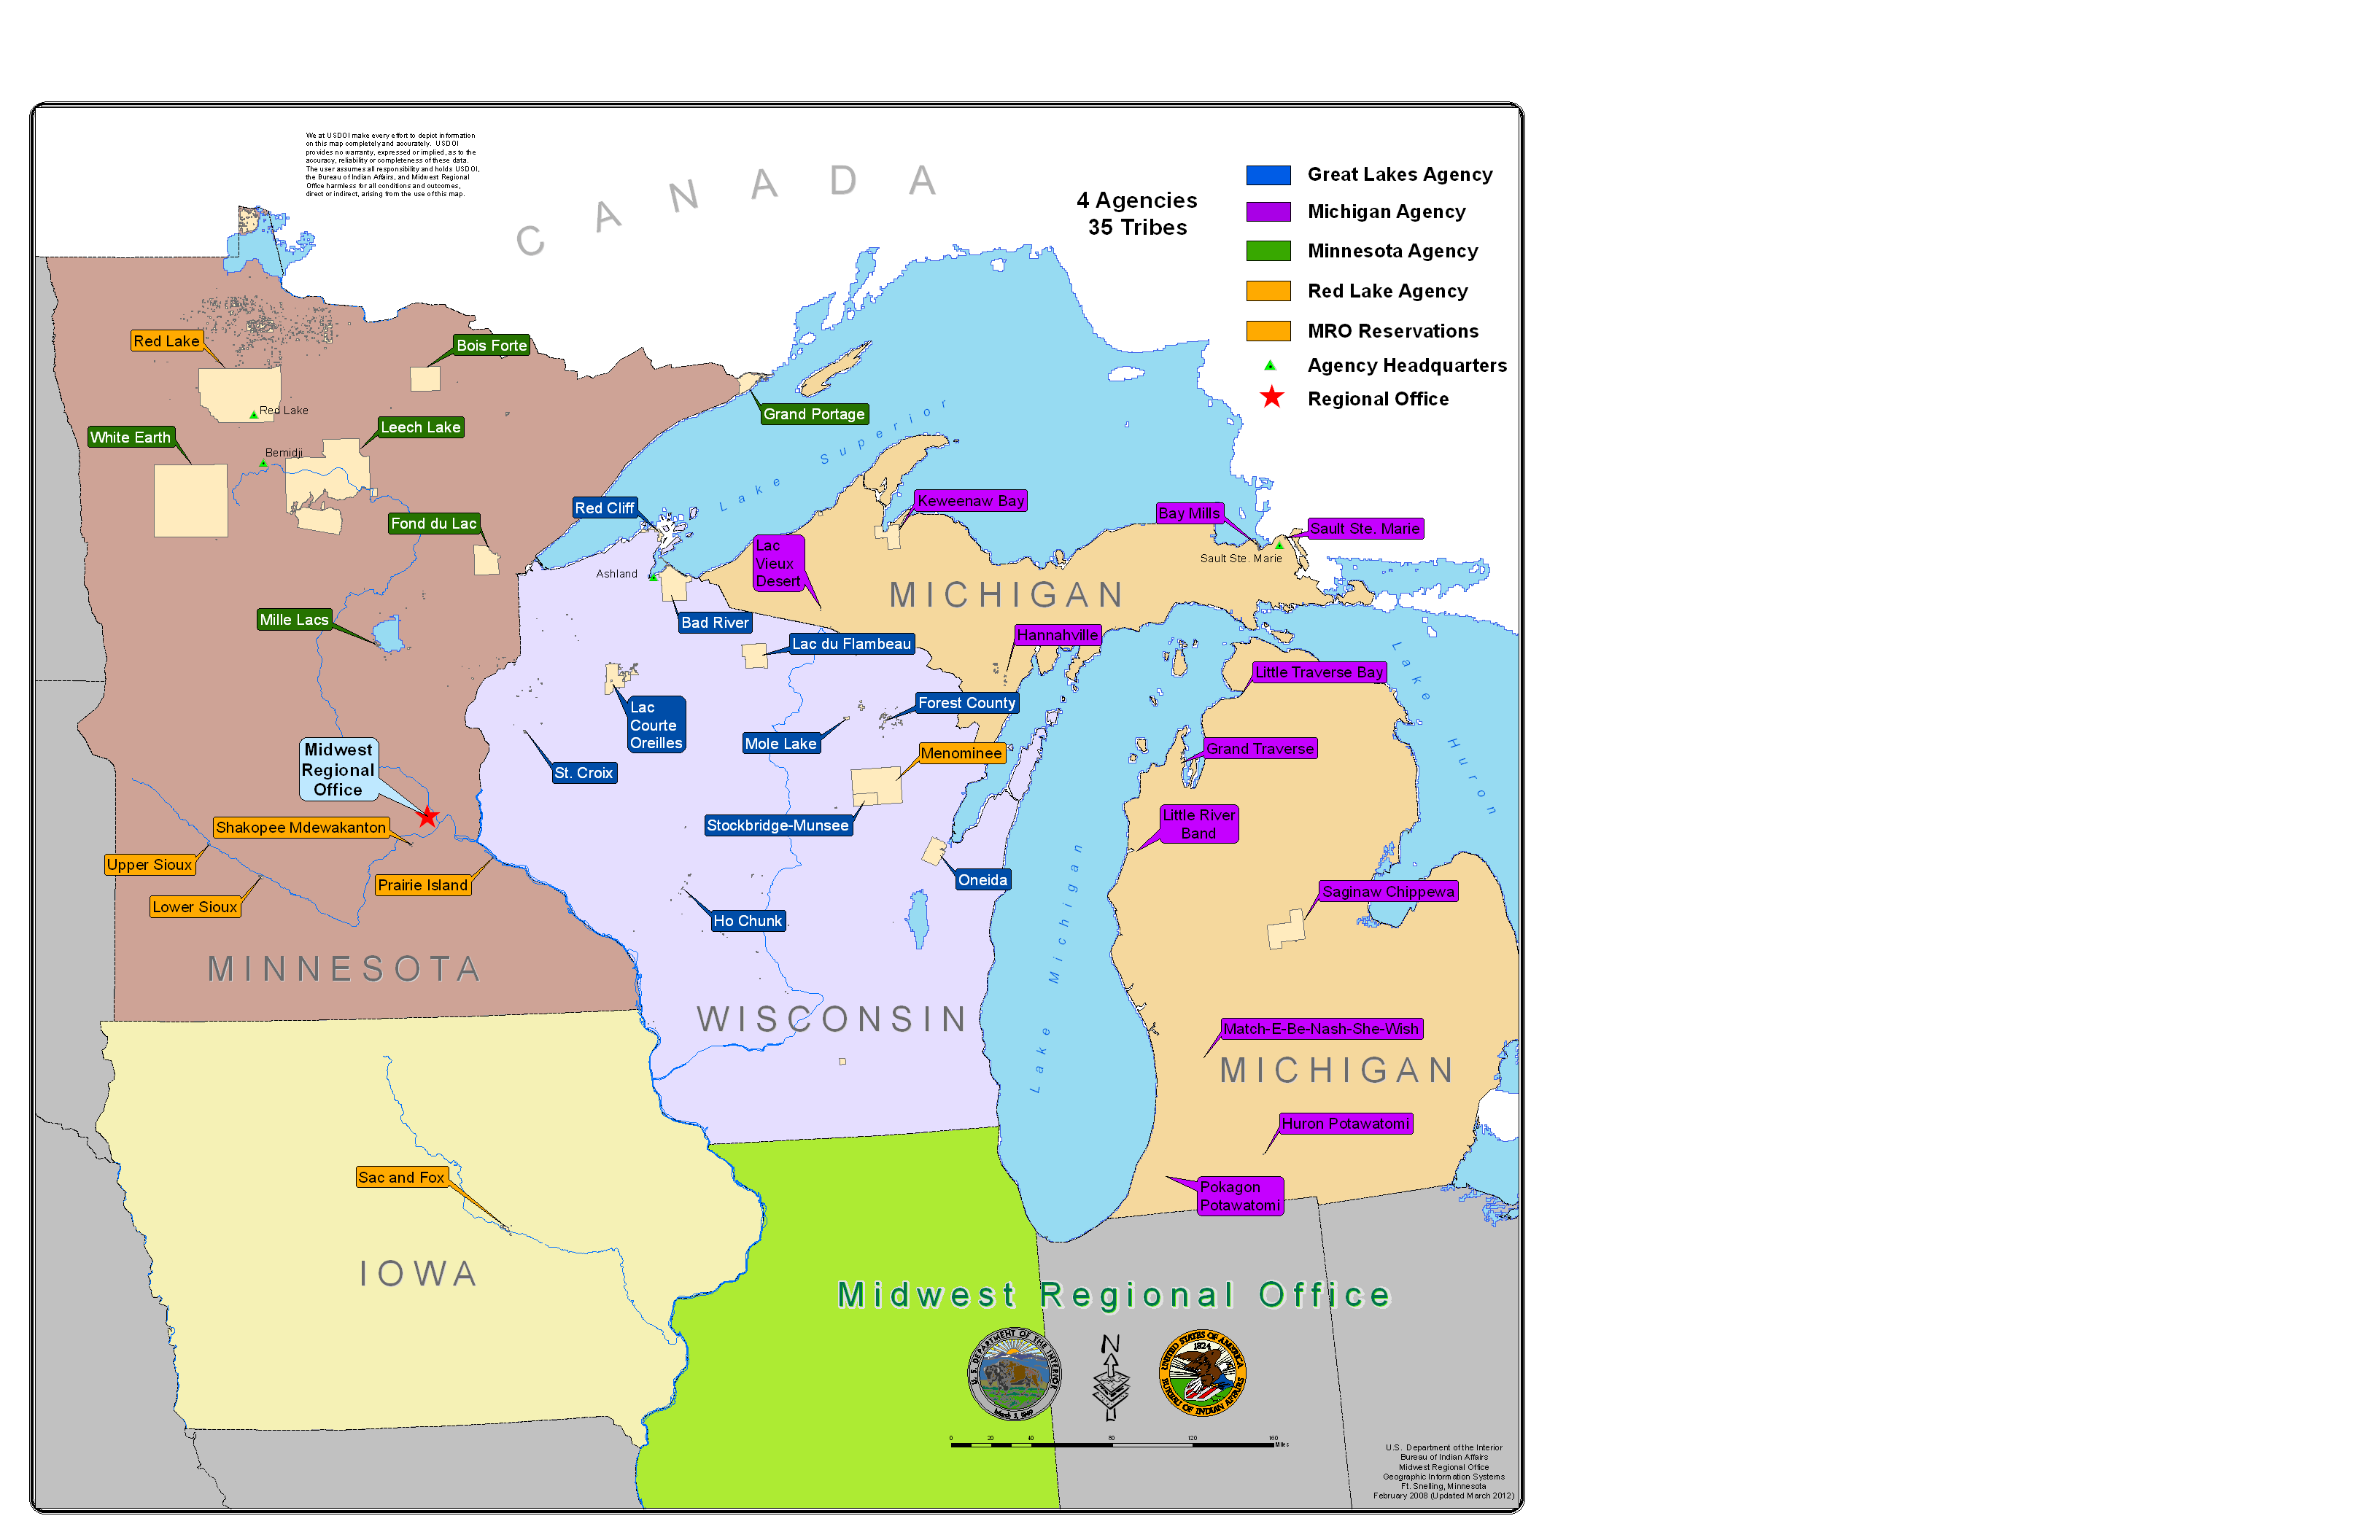
Tribes
The Midwest Region serves 35 Tribes in :
  Minnesota
  Michigan
  Iowa
  Wisconsin
  Indiana

Slide 11
Natural Resources
Midwest Region
(all Indian land including treaty and ceded areas)
Total Acres 62 Million
Forest Acres 41 Million
Lakes Acres 2.2 Million
Wetlands Acres 4.8 Million
Stream Miles 15,396

Slide 12
Regional Office
Regional Director
Minnesota
Agency
Deputy Regional Director, Trust Services
Deputy Regional Director, Indian Services
Branch of Tribal Operations
Branch of Roads
Branch of Social Services
Branch of Self Determination
Division of Fee to Trust
Branch of Forestry
Branch of Wildlife and Parks
Branch of Water & Safety of Dams
Branch of Real Estate Services
Branch of Probate & Estate Services
Trust Coordinator
(Lockbox)
Environmental Services
Michigan Agency
Great Lakes Agency

Slide 13
Office Justice Services
67 tribally-operated detention programs
24 detention programs facilities
191 law enforcement agencies:
- 42 agencies (BIA)
- 149 agencies (contracted / compacted)
288 tribal justice systems and BIA courts

Slide 14
Indian Services
Provide national guidance and policy to regions and tribes.
Programs and services for 566 federally recognized American Indian tribes and Alaska Natives villages serving 1.7 million people

Slide 15
Office Special Trustee
Indian trusts produce over $600 million per annum in revenue
$500 million was collected for 1,450 tribal accounts for over 300 tribes
128,000 individual Indian allotments and 3.6 million fractionated interests
86% of IIM accounts receive $10 or less per annum

Slide 16
Bureau Indian Education
Education services for 46,000 Indian students
Students from 63 reservations
184 day schools, boarding schools, and dormitories
23 state education line officers
Two post-secondary schools

