Slide 1
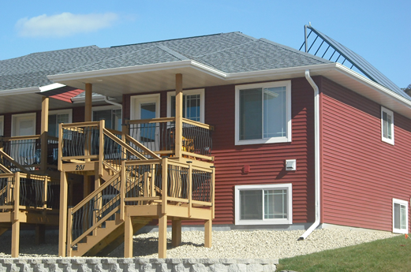
Rural Development

Slide 2
USDA Rural Development
Mission:
To increase economic opportunity and improve the quality of life for all rural Americans.
Vision:
A rural America that is a healthy, safe and prosperous place in which to live and work.
Committed to the future of rural communities.

Slide 3
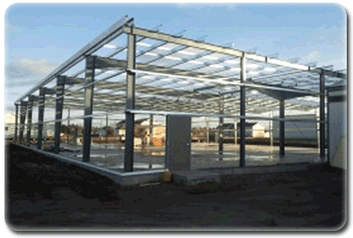
Business & Cooperative Programs
Supports the creation and expansion of businesses and cooperatives in rural areas.
Oneida Tribe of Indians of Wisconsin – Oneida, WI (VAPG)
Mountain Spring Hotel – Suring, WI (REAP)
Allesnik, LLC & Pointe Precision, Inc. – Plover, WI (B&I Loan)

Slide 4
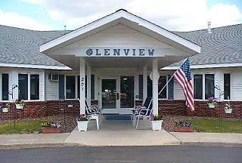
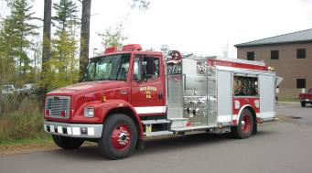
Community Facilities Programs
Quality of Life Improvements
Grantsburg Fire Association – Grantsburg, WI
Prairie du Chien Memorial Hospital – Prairie du Chien, WI
Sheboygan Senior Community – Sheboygan, WI
Sokaogon Chippewa Community – Crandon, WI

Slide 5
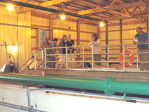
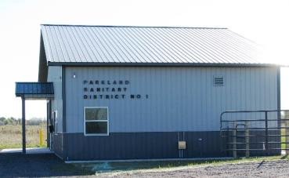
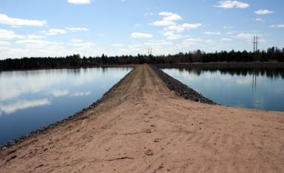
Water & Environmental Programs
Improve Waste, Wastewater, and Water Systems

Slide 6
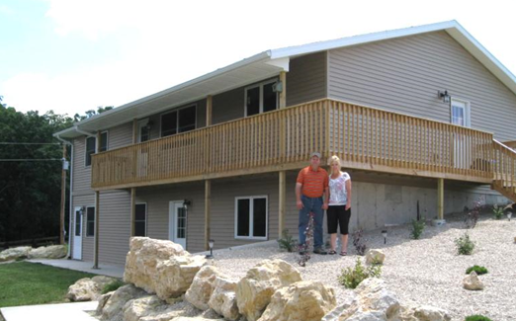
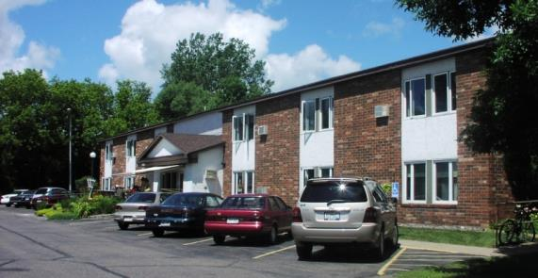
Housing Programs
Safe and Affordable Housing
Since 2010:
Financed 17,686 home loans.
Provided financing to 986 rural Wisconsin households for necessary repairs, accessibility updates, and to address safety issues.
Invested nearly $75 million in Rental Assistance to more than 22,000 rural residents.

Slide 7
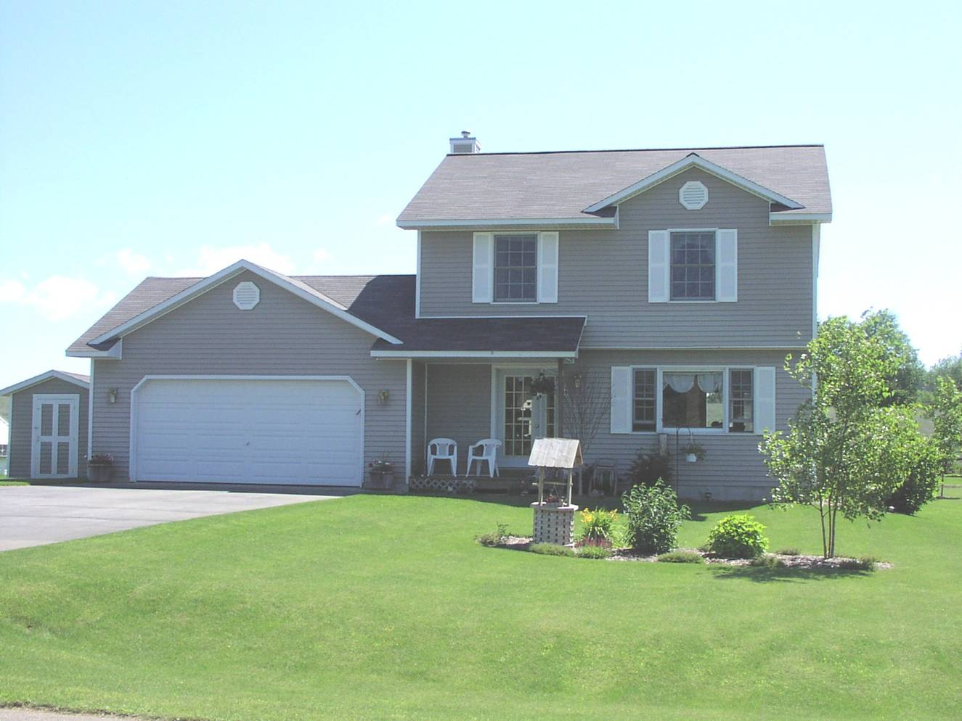
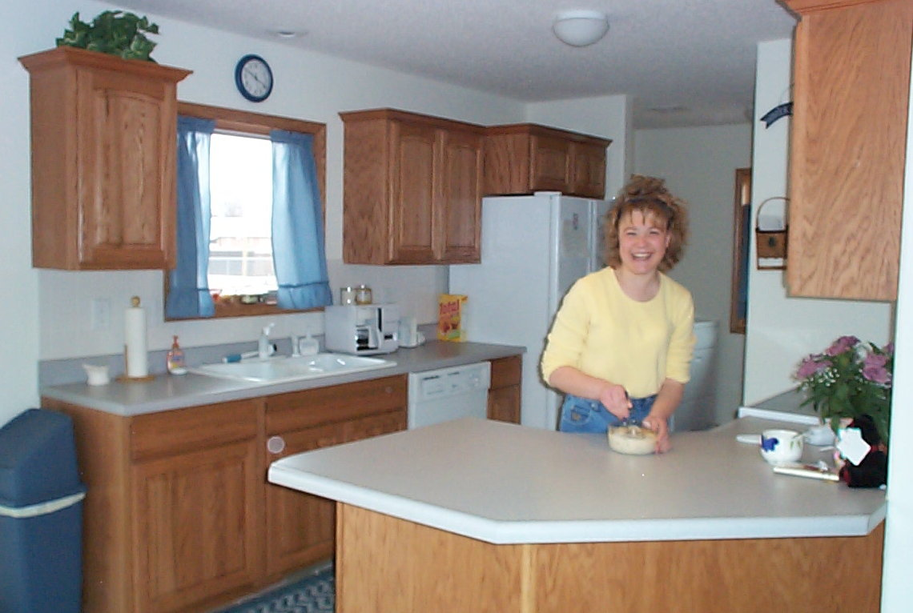
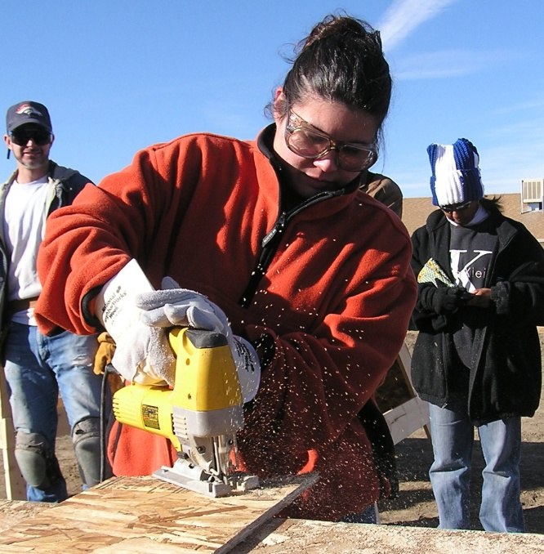
Rural Housing Ownership Opportunities
Guaranteed
Direct
Self-Help
Home Ownership

Slide 8
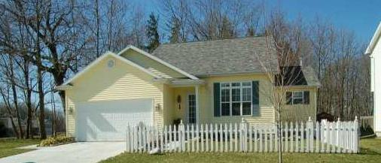
Rural Housing Programs
502 Direct Program
Loan Program

Slide 9
502 DIRECT LOAN PROGRAM
*Primary purpose – purchase/construct a home
*Can be used to make repairs to an existing home
*Refinancing (in case where customer may lose home)
*Applicant does not own adequate housing
*Fixed rate mortgage – current rate is 3.125%
*Term of loan – 33/38 years; 30 years for a manufactured home

Slide 10
*Loans may be made up to 100% of market value –
no down payment required – unless asset limitation is exceeded ($20,000 elderly; $15,000 non-elderly)
*Payment assistance subsidy reduces monthly payments
for eligible applicants.
*No PMI (private mortgage insurance) required.
*Low and very-low income limits apply

Slide 13
PROPERTY REQUIREMENTS – DIRECT
Site Size: Site must not be large enough to be subdivided under local subdivision regulations. (If no local zoning, one-acre site is minimum which cannot be subdivided.) AND, the value of the site must not exceed 30% of the “as improved” value. (30% limitation may be exceeded if site cannot be subdivided and is typical for the area).
Site Location: Property must be located in a rural area. Certain counties have ineligible areas. Can check website: www.rd.usda.gov/wi to determine if property is in an eligible area. Milwaukee County is ineligible.

Slide 14
Dwelling: Must meet definition of “modest”. Market value
must not exceed the applicable area loan limit. Depending upon the county in which the property is located, this amount varies. Effective June 15, 2015, Wisconsin is apart of Pilot program, utilizing 80% of FHA’s One-Family mortgage limits. In this state most limits will be set at $216,840.
Structures: Must not include farm service buildings, however, smaller outbuildings, such as storage sheds are allowed.
Income Producing Property: No
In-Ground Swimming Pools: Prohibited; not acceptable to remove pool
to meet this requirement.
Inspection Reports: Satisfactory inspection by State Certified Inspector (or qualified Tradesperson if SCI not available), including heating/cooling, structural soundness, water/sewer and electrical

Slide 15
Condominiums: OK – At least 70% of units must be sold, and not more than 15% of the owners more than 1 month delinquent.
Zero Lot-Line Property: OK-On case by case basis; approval by loan approval official.
New Manufactured Home: Must be purchased/completed/warranted by a RD approved dealer-contractor.
Finance Existing Manufactured Home: No
Lead Based Paint: Rural Development requirements.

Slide 16
PRIVATE WATER & WASTE DISPOSAL SYSTEMS – Direct
Private Well Inspection: Incorporated in (or part of) plumber’s
inspection.
Basement Well: Only with certification from the DNR that it meets current WI Code as well as satisfactory private well inspection & safe water tests.
Shared Well: Must have “Shared Well Water Agreement”
(based on HUD model). Cannot serve more than
4 properties.

Slide 17
504 Home Repair and Rehab
Loans and Grants

Slide 18
504 GRANTS
Remodel dwellings to make them accessible to household
members with disabilities
Applicant must be at least 62 yrs. of age for grant
Very low income limits apply
Maximum grant assistance is $7,500 (lifetime)
Applicant must own & occupy property
Asset limitations apply

Slide 19
Examples of Section 504
Grant Repairs
Funds can be used to:
Remove health & safety hazards
Unsanitary plumbing conditions
Hazardous electrical
Sewer lines or septic tank failure
Unsafe structural conditions
Code violations
Leaking roofs
Faulty heating
Installation of grab bars, railings and other accessibility devices
to assist the elderly or disabled

Slide 20
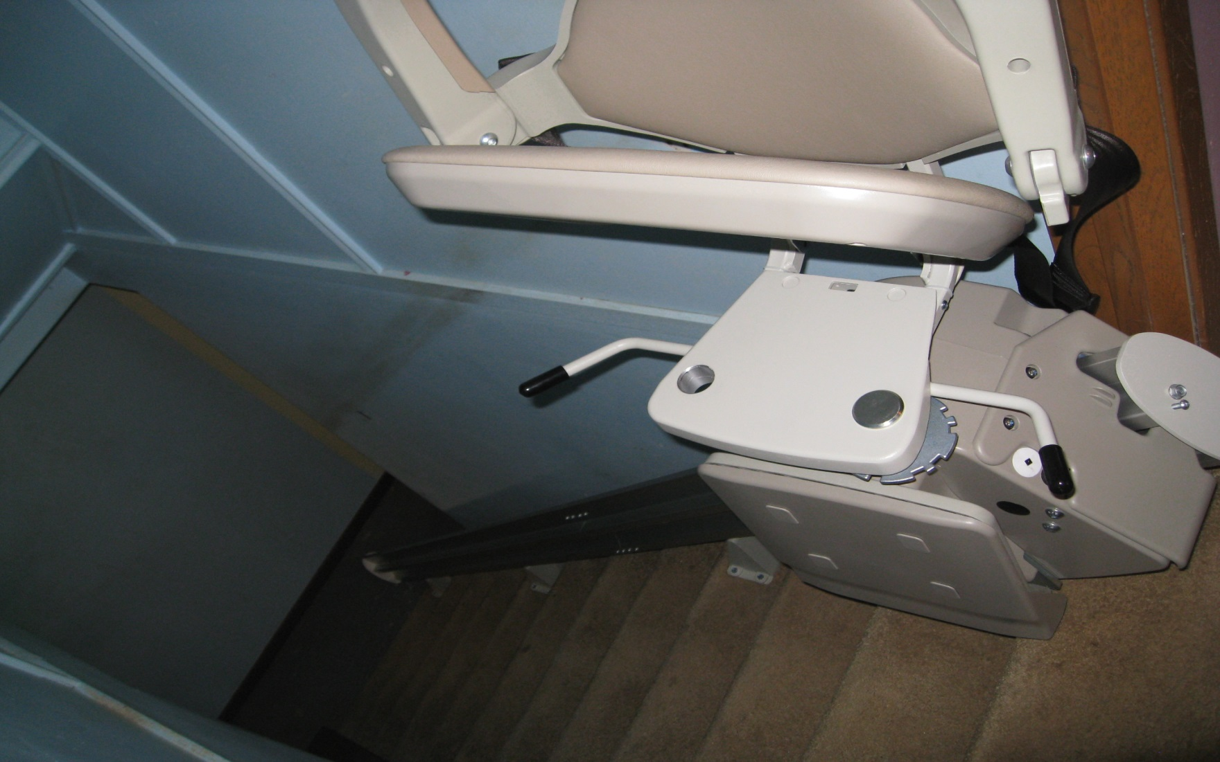

Slide 21
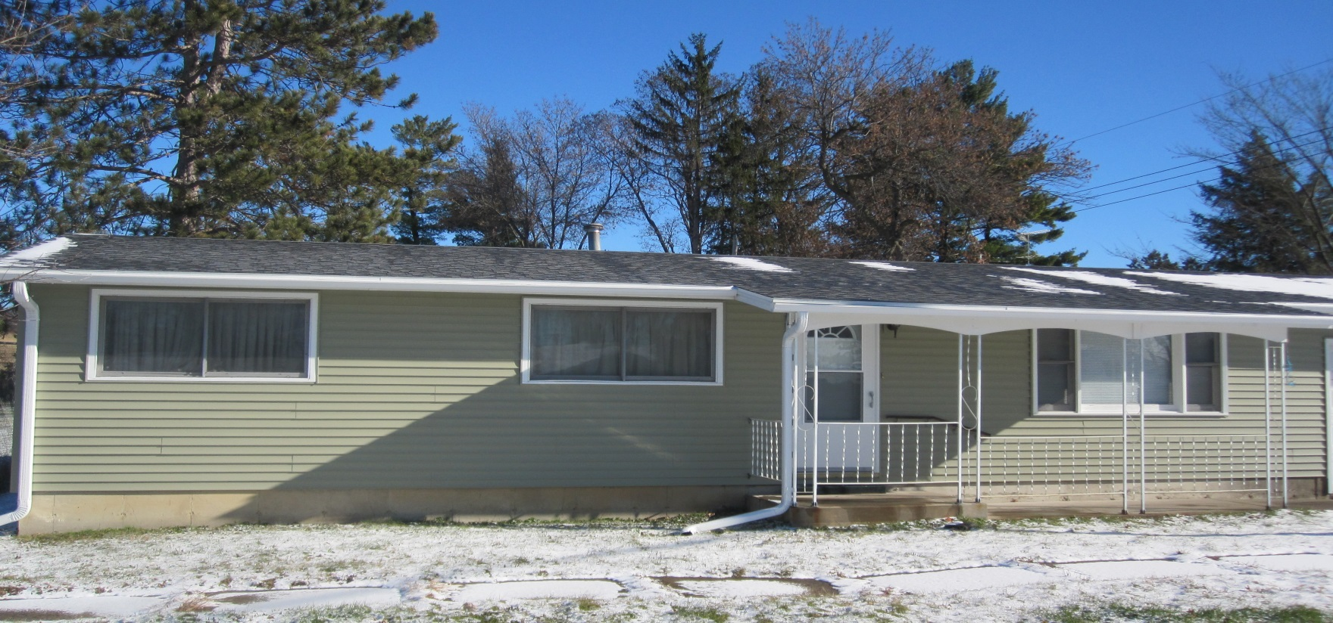

Slide 22
504 LOANS
Maximum of $20,000 under loan program
Loan can be amortized over a maximum of 20 years
Fixed 1% interest rate
Very low income limits apply
Applicant must own & occupy property
Asset limitations apply

Slide 23
504 LOANS
Repairs or Improvements
Funds can be used to:
Improve or modernize home in addition to those items found in the grant program
Exterior and interior painting
Storm windows/security doors
Insulation
Gutters/downspouts
Replacement of sinks and toilets
Replacement of flooring

Slide 24
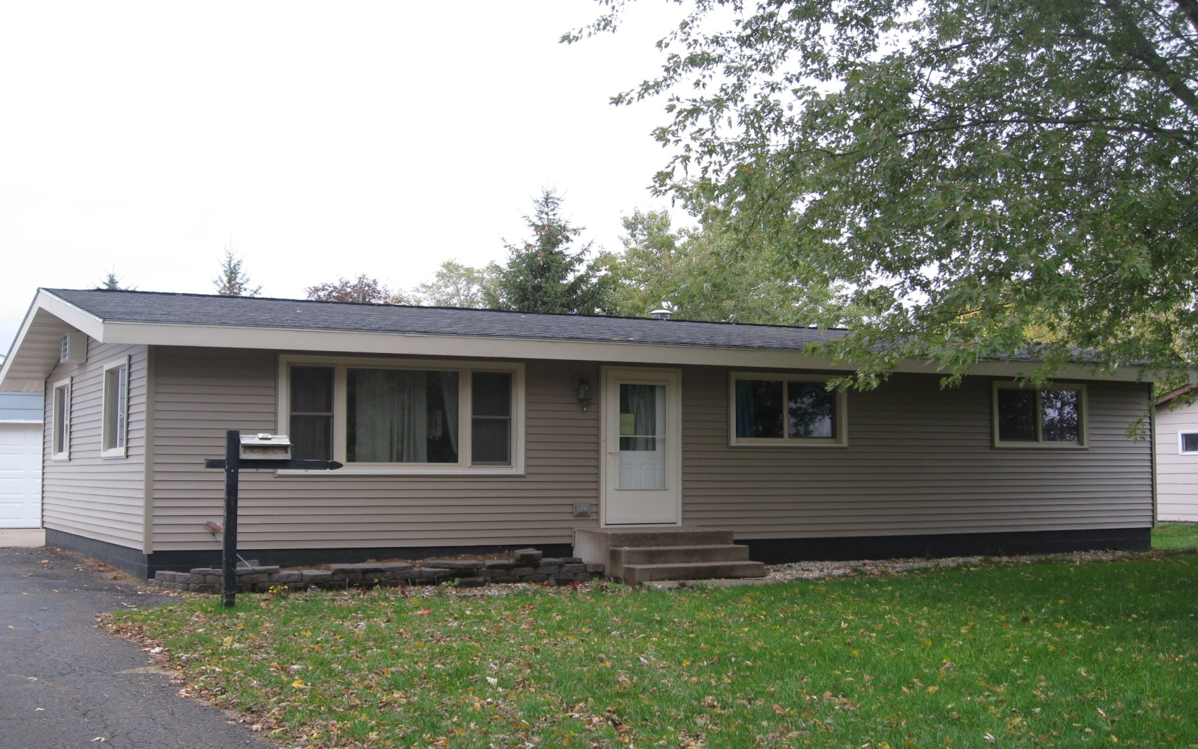

Slide 27
Guaranteed Rural Housing Program
Applicants who exceed the income limit for the direct 502
program, may be eligible for the GRH program.
Started in 1991
Has grown to annually a $414 million program
assisting some 3300 households becoming home owners.
Voice (715) 345-7623 • Email Wisconsin-GRH@wi.usda.gov

Slide 28
Outstanding RD Portfolio in Indian Country
Program 502 504 GRH
Number of Loans 96/2961 35/710 65/20572
to American Indians
Percent of Portfolio 3% 5% > 1%
Loans on Trust Lands 37 11 0

Slide 29
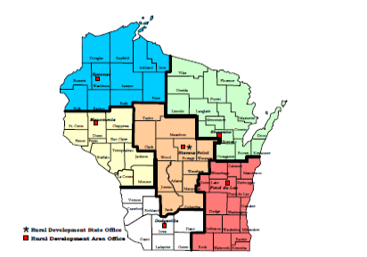

Slide 30
Rural Development Contact Information
1 (715) 345-7620
Ask to be transferred to the Rural Development Office that covers your area of interest.

Slide 31
Dodgeville Area Office Shawano Area Office
138 S Iowa Street, Ste 2 603B Lakeland Road
Dodgeville, WI 53533 Shawano, WI 54166
Phone : (608)935-2791 Phone: (715)524-8522
Fond du Lac Area Office Menomonie Area Office
W6529 Forest Ave., Ste. 200 390 Red Cedar St., Ste. G
Fond du Lac, WI 54937 Menomonie, WI 54751
Phone: (920)907-2976 Phone: (715)232-2614
Stevens Point Area Office Spooner Area Office
1462 Strongs Avenue 800 N. Front St., Rm. 102
Stevens Point, WI 54481 Spooner, WI 54801
Phone: (715)346-1313 Phone: (715)635-8228
Stevens Point State Office
5417 Clem’s Way
Stevens Point, WI 54482
Phone: (715)345-7615

