Slide 1
Economic Contribution of the Forest Industry in Michigan, Minnesota and Wisconsin
Dr Julie Ballweg
Forest Economist
Wisconsin Department of Natural Resources
June 23, 2015

Slide 2
Overview
Historical Trends
Current Status of Industry
Current Challenges
Future Opportunities

Slide 3
History of the Industry
Consolidation
2002-2102 lost 802 forest products establishments
2002-2012 lost 58,715 employees
Slow recovery in 2014-15

Slide 4
Change in Forest Industry Employment 2002-2012
State | 2002 Employment | 2012 Employment | Change in Employees | Percent Change
Michigan | 59,599 | 38,903 | -20,696 | -35%
Minnesota | 44,444 | 30,350 | -14,094 | -32%
Wisconsin | 84,853 | 60,928 | -23,925 | -28%
Total | 188,896 | 130,181 | -58,715 | -31%
Source: 2014 Annual Survey of Manufactures

Slide 5
Change in Number of Establishments 2002-2012
State | 2002 Establishments | 2012 Establishments | Change in Establishments | Percent Change
Michigan | 1,412 | 1,057 | -355 | -25%
Minnesota | 1,122 | 899 | -223 | -20%
Wisconsin | 1,496 | 1,272 | -224 | -15%
Total | 4,030 | 3,228 | -802 | -20%
Source: 2014 Annual Survey of Manufactures

Slide 6
Other Changes
Value added decreased 20% from 2002-2012
Value of shipments decreased15% from 2002-2012
Total payroll decreased 31% from 2002-2012

Slide 7
Where have the jobs gone?
Employment 2002-2012
Wood Products -34%
Pulp and Paper -26%
Wood Furniture -33%

Slide 8
Current Status of the Forest Products Industry
Forest products
Employment
Output
Value Added
Other Services

Slide 9
Forest Products
3,228 forest products companies
Wood furniture industry is fastest growing
$45 billion in industry shipments
12% of the value of all shipments in Wisconsin
Source: 2014 Annual Survey of Manufactures

Slide 10
Forest Products
Percent of Wisconsin Forest Industry

Slide 11
Employment (in 2014)
128,402 employees
Payroll of $6.2 billion
Every job in forestry supports 3.8 additional jobs
Notes:
California is number 1 (71,895) and North Carolina is number 2 (65,054)

Slide 12
Employment (in 2014)
State | Ranking | Employment
California | 1 | 71,895
North Carolina | 2 | 65,054
Wisconsin | 3 | 61,226
Indiana | 5 | 42,437
Ohio | 7 | 40,899
Michigan | 8 | 39,259
Minnesota | 16 | 27,917

Slide 13
Wages
Industry | Average Annual Wage
Converted Paper Products Mfg | $57,750
Wood Furniture Mfg | $41,757
Other Wood Product Mfg | $30,976
Pulp, Paper and Paperboard Mills | $70,213
Veneer and Engineered Wood Products | $35,675
Sawmills and Wood Preservation | $32, 196
Logging | $32,212
Support Activities for Forestry | $41,203
Foresters | $57,150
Source: WORKnet, Wisconsin’s Workforce and Labor Market Information System

Slide 14
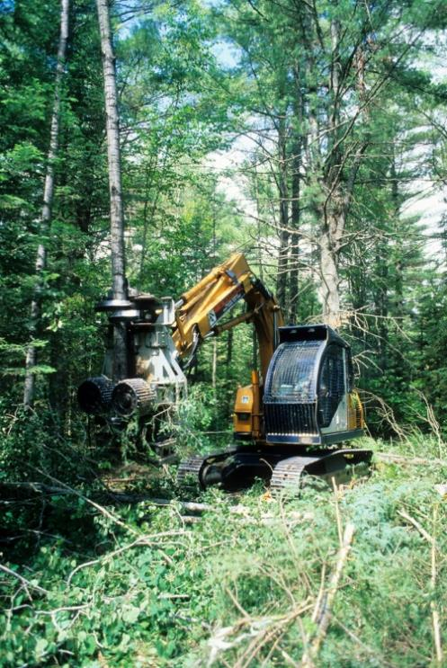
Value of Shipments
$45 billion in output
Output of $354,000 per worker (above national average of 324,000)
Every million dollars of output in forestry creates $1.3 million in other sectors
One of the top ten industries in Wisconsin by output

Slide 15
Value of Shipments
State | Ranking | Value of Shipments
Wisconsin | 1 | $22 billion
Michigan | 6 | $14.6 billion
Ohio | 8 | $12.3 billion
Indiana | 11 | $10.8 billion
Minnesota | 16 | $9.2 billion

Slide 16
Value Added
State | Ranking | Value Added
Wisconsin | 1 | $10 billion
Michigan | 5 | $7.4 billion
Ohio | 11 | $5.2 billion
Minnesota | 13 | $4.8 billion
Indiana | 14 | $4.8 billion

Slide 17
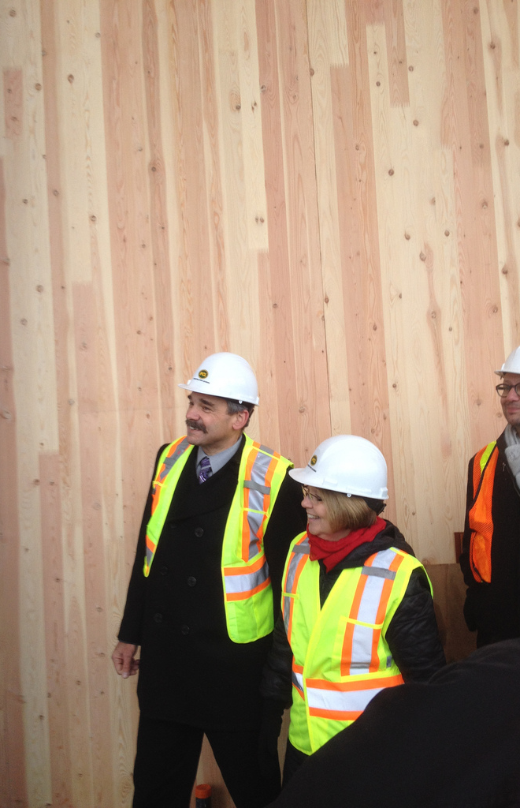
Adding Value
Improve log grade
Use more of the tree
New timber products
New uses for wood
Improvements in cost efficiencies
Payment for ecosystem services

Slide 18
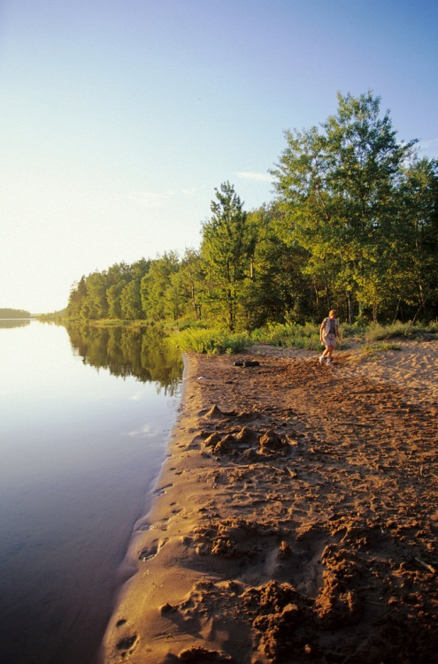
Ecosystem Service Values
Forest health
Clean water
Erosion control
Endangered species habitat
Cultural values
Biological diversity
Climate regulation

Slide 19
Valuing Ecosystem Services
Direct Use Value
Timber, Non-timber forest products, recreation
Indirect Use Value
Erosion control, water quality, animal habitat
Option and Existence Value
Existence of trees, existence of wildlife, cultural uses

Slide 20
Challenges
Forest supply
Forest certification
Workforce
Invasive species
US Farm Bill

Slide 21
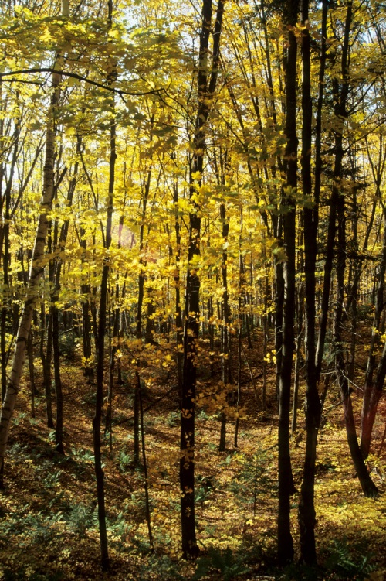
Forest Supply
Supply of sawtimber
Landowners harvesting without professional assistance
Forest fragmentation
Cost of entry
Notes:
Growing more trees than harvesting
Supply of sawtimber is increasing but companies are struggling to get enough logs to meet demand
Forest parcelisation is increasing, more landowners and smaller parcels
Changing landowner demographics
Incentives for managing private forests

Slide 22
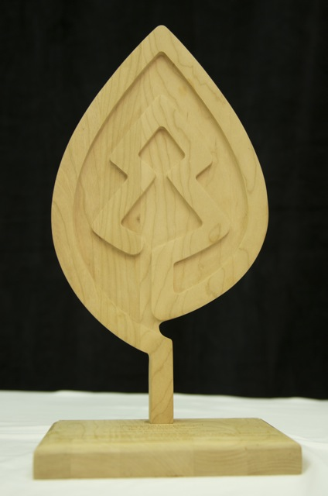
Forest Certification
44% of Wisconsin forests are certified,
10% of worlds forests certified
Process for improvement versus economic benefits
Notes:
Forest cooperatives to acquire group certification and bring additional funding to priorities
Concern that certification systems represent a process for improvement instead of better management and economic benefits
SFI and FSC msut find ways to collaborate to expand cost-effective and appropriately designed forest certifcation to landowners, especially family forest owners
44 percent of Wisc
http://dnr.wi.gov/topic/TimberSales/documents/WICertifiedAcres.pdfonsin’s private and public forest lands, have been certified by the American Tree Farm System (ATFS), Forest Stewardship Council (FSC) and the Sustainable Forestry Initiative (SFI)

Slide 23
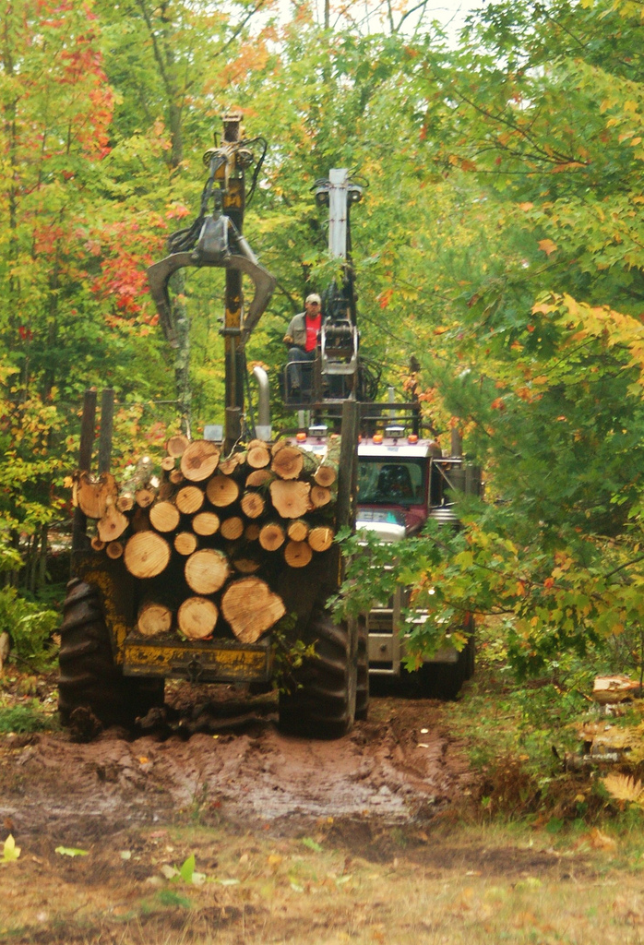
Workforce
100% small, independent logging contractors
Manufacturing workforce provides lower compensation than other industries
Training capacity within industry
Notes:
Logging-Family owned, rising age.
Manufacturing, despite high unemployment, hard to find good workers due to lack of skills
Skill standards have been established
List of trades taught through job corps should include timber harvesting
Tech schools expand programs, especially in Northern Wisconsin
Possible career program for high school

Slide 24
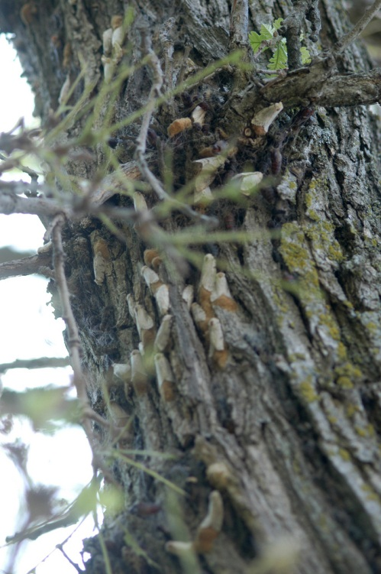
Invasive Species
Costs $138 Billion/year
Citizen science and crowd sourcing using mobile technologies for detection and communication
Notes:
Invasive species programs need to work to provide protection but also minimise disruption to markets

Slide 25
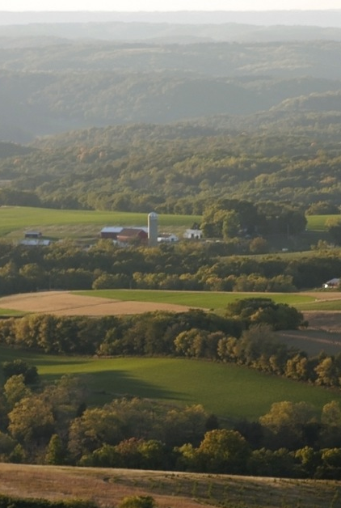
Farm Bill
2.2 Million family farms in US
11 million family forest landowners
Farm Bill largely goes to farms
Use forest certification to leverage conservation funding
Notes:
Forest cooperatives to acquire group certification and bring additional funding to priorities
Farm Bill-Family farms account for 96% of the farms in the US.

Slide 26
Opportunities
Green building
Growth of export market
Carbon programs
Renewable energy
Nanocellulose
Notes:
Green building rating systems are a growing phenomenon in the building sector. Rating systems provide a rating based on a buildings environmental impact. tools currently do NOT give a preference to wood materials. Programs discriminate against forestry. LEED system should better recognize forest products in its rating system
Growth of export market-Demand for wood in China is high. DO NOT UNDERESTIMATE THE IMPORTANCE OF HIGH VALUE TREES
Aim for value added
$7/acre/year for carbon at $20/tonne. Doesn’t seem large but makes returns to land competitive with agricultural and leads to less land conversion. Especially when ecosystem values are included. And landowners that don’t want to sell timber may appreciate the carbon payment.
All logging residue would meet 2% of energy needs. Biomass to biodiesel.
Nanocellulose-Greener building material Stronger light weight wood composites Stronger than steel and more durable

Slide 27
Green Building
Cross Laminated Timber
Whole Trees
Research being done at Forest Products Lab in Madison, Wisconsin
World’s tallest wood building in Melbourne, Australia
Notes:
CLT is a multi-layer wood panel made from lumber. Layers of board (also known as plies) are placed cross-wise to adjacent layers and glued over their entire surface, creating a product with exceptional strength and dimensional stability.

Slide 28
Source: Wholetrees.com
Notes:
Whole Trees building in Madison, Wisconsin

Slide 29
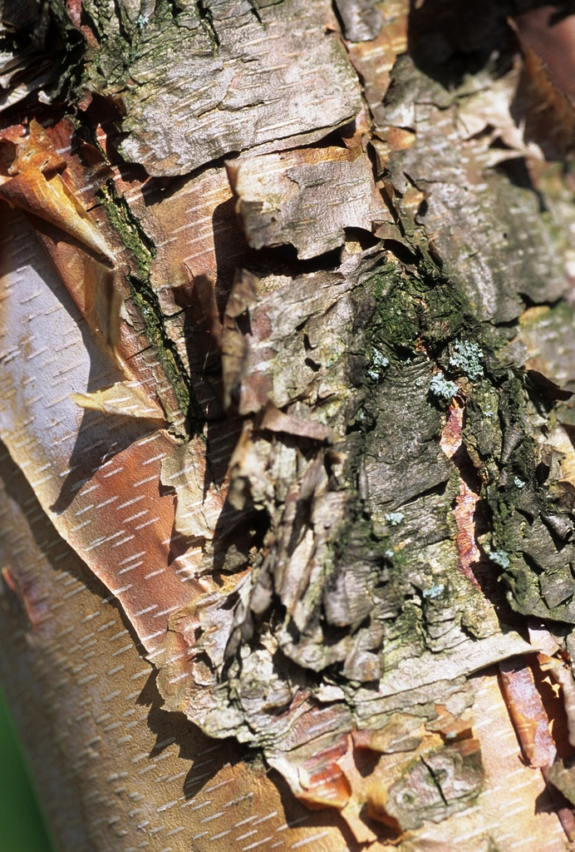
Emissions Trading
Carbon Tax
Cap and Trade
Voluntary Programs
Small annual payments but makes forestry competitive with agriculture
Notes:
$7/acre/year for carbon at $20/tonne
Doesn’t seem large but makes returns to land competitive with agricultural and leads to less land conversion
$3600/acre for agricultural land
$2006/acre for forest land

Slide 30
Renewable Energy
Converting forest biomass to biodiesel
First generation-sugar, corn crops
Second generation-woody crops, agricultural residue
Notes:
All logging residue would meet 2% of energy needs

Slide 31
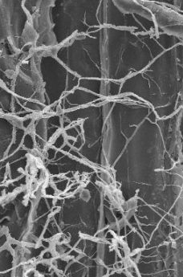
Wood-Based Nanotechnology
Smart paper/packaging
Electronic paper with magnetic properties
Security/anti-counterfeiting
Lightweight printing paper and paperboard, enhanced recycling properties
Active defences against bacteria/fungal infiltration
Wood composites
Greener building material
Stronger light weight wood composites
Stronger than steel and more durable
Notes:
Raw materials production
New applications for composite wood and paper products
New generations of functional wood-based (lignocellulosic) materials at the nanoscale

Slide 32
Nanotechnology
Year | Direct Jobs |  | GDP (Final Product)
 | US | World | US | World
2000 | 25,000 | 60,000 | $13 billion | $30 billion
2008 | 150,000 | 400,000 | $80 billion | $200 billion
2015 | 800,000 | 2,000,000 | $400 billion | $1 trillion
2020 | 2,000,000 | 6,000,000 | $1 trillion | $3 trillion
Source: National Science Foundation
Notes:
Nanotechnology is the development of cellulose nanocrystals that are added to other materials. Products can be made strong, lighter and cheaper from renewable resources. Need work on manufacturing facilities to put products into new markets. Incredible potential but much work needs to be done.
Engineering matter at the atomic and molecular scales
The nanoscale ranges from 1 to 100 nanometers in at least one dimension
A nanometer is a billionth of a meter, or about 80,000 times thinner than a typical human hair.

Slide 33
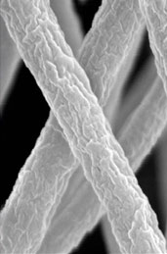
Wood-Based Nanotechnology
Potential for 20,000-74,000 direct jobs
75,000-200,000 manufacturing jobs
GDP $10-100 billion
Notes:
Lower numbers at demonstration scale, higher numbers with economies of scale

Slide 34
Thank you
Julie Ballweg
Forest Economist
Wisconsin DNR
Julie.ballweg@wisconsin.gov
608-228-3256

