Slide 1
Property – PL 93-638
Self-Determination Staff – Midwest Region:
Michelle R. McCormick-Corbine, Regional Office
Desiree Red Day, Regional Office
Susan Fedorko, Regional Office
Chelsea Meierotto, Great Lakes Agency
Jody Zordan, Great Lakes Agency
Pauline Cardinal-Mitchell, Michigan Agency

Slide 2
Property – PL 93-638
Objectives:
How to obtain an Activity Address Code (AAC)
How to apply for screener card
How to obtain BIA Midwest Region excess property
Provide demonstration of “screening” for excess federal property
Discuss the various GSA programs available
Notes:
Intro –Amie, Brett (MITW), Richard (GSA)

Slide 3
Property – PL 93-638
Public Law 93-638 provides authority:
105 (f) – Donation to an Indian Tribe/TO personal or real property excess to BIA, IHS or GSA
105 (k) Tribe/TO access to federal supply sources in carrying out a contract/grant/cooperative agreement.

Slide 4
Tribal Access to Property under BIA
Presenter:
Ryan Burrows
Regional Property Officer
BIA – Midwest Regional Office
ryan.burrows@bia.gov
612-725-4535
612-713-4401 (Fax)

Slide 5
TOPICS: AAC and Screener Programs
Activity Address Code (AAC)
Unique code for each Tribe/Tribal Organization
Only one (1) code per Tribe
Application to apply
Required to use GSA as a source of supply
SCREENER
Access granted to individual
Could be one or more individuals per Tribe
Application to apply
User Code
Notes:
Discuss the two programs are different and provide information on each.

Slide 6
Activity Address Code (AAC)
What is an Activity Address Code?
Six (6) character code assigned to Tribe/Organization
Identifies the sponsoring agency (Bureau of Indian Affairs)
All begin with 14XXXX – which designates the Department of Interior, BIA
Provide GSA information, such as:
Where to ship ordered materials
Status of the order
Billing information
Confirms authorization to GSA

Slide 7
Activity Address Code (AAC)
Who is authorized to obtain an AAC?
Tribes/organizations performing under PL 93-638 contracts, grants, cooperative agreements and Self-Governance compacts

Slide 8
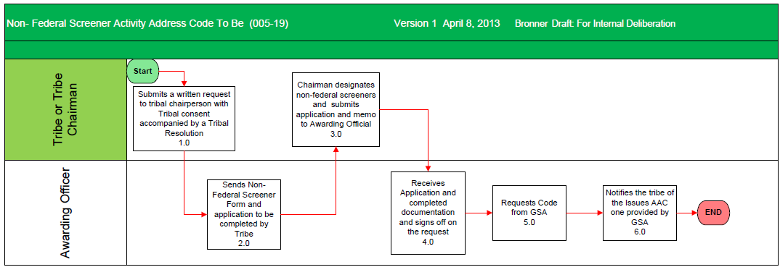
Obtaining an Activity Address Code

Slide 9
Acquiring an Activity Address Code
HOW TO APPLY FOR AN AAC?
Submit written request to appropriate to BIA Awarding Official or OSG Director
Request must:
Be on tribal letterhead
Signed Tribal leader (Chairperson, Chief, President, Omega)
State contract, grant, co-operative agreement or self governance compact number
Effective dates and duration of each contract/agreement.

Slide 10
Acquiring an Activity Address Code
HOW TO APPLY FOR AN AAC?
BIA Awarding Official/OSG:
Reviews
Approves/Denies request
Prepares Findings & Determination (F&D) which authorizes Tribe to purchase from GSA supply sources
Submits F&D, written request and driver’s license to BIA Central Office for issuance of AAC
BIA Awarding Official/OSG is notified of the AAC assignment and will notifies Tribe that code is issued
* NOTE: AACs expire on date listed in the F&D, unless we are notified that the contract/agreement will be renewed or extended. If AAC expires, cannot order from GSA

Slide 11
Activity Address Code
ADDRESSES:
Three (3) types of addresses used under an AAC:
MAIL: Mailing address, where mail is received. Multi-purpose – Could be used for mail, freight (if not PO Box) and billing.
FREIGHT: Shipping address, if not same as mail address. Must be Street address for delivery. Cannot be a Post Office box number.
BILLING: Used for billing purposes when the address is not the same as the mail address.

Slide 12
Activity Address Code Address
ADDRESS:
First line – Bureau of Indian Affairs
Second line – Tribe/Organization name
Third line – Street address
Fourth line – City, State and Zip Code

Slide 13
Activity Address Codes
NOTE: Prior to submitting application for AAC code, check with your Tribe/Organization or Midwest Regional Office Awarding Official/Property staff since many Tribes already have been assigned an AAC

Slide 14
GSA Websites
After AAC assigned – GSA websites to obtain property:
GSA Global Supply
https://www.gsaglobalsupply.gsa.gov
GSA Advantage
https://www.gsaadvantage.gov

Slide 15
What is GSAXcess?
http://gsaxcess.gov
Operated by the General Services Administration (GSA)
Website used to screen for excess Federal property.
Two programs: Federal Excess Personal Property Utilization Program and the Federal Surplus Personal Property Donation Program Site to search for and obtain excess personal property that the government is no longer in need of.
Site is not for general public use
Notes:
Separate program

Slide 16
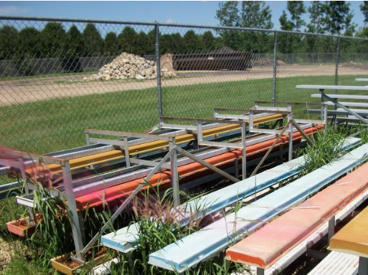
What type of Excess Property is Available?

Slide 17
GSAXcess
How to obtain access
Tribe/Tribal Organization
Submits letter of request from the Tribe authorizing him/her to screen excess property for the Tribe
Completes the BIA Excess Property Screener’s Application Package
Excess Property Screener’s Application
Application for GSAXcess
Approval Letter from the BIA/OSG Awarding Official authorizing Non-Federal Employee to screen excess personal property at Federal installations
Justification Statement of Use

Slide 18
GSAXcess
REQUIRED INFORMATION:
Application for Federal Excess Screening.
Complete the forms and return with the following information:
Contract or Grant Number that excess property can be utilized under.
Name of Contract or Grant Program (i.e. housing, forestry, etc.)
Name of person designated as a Screener for the Tribe
Request signed by Tribal Leader and on tribal letterhead

Slide 19
BUREAU OF INDIAN AFFAIRS MIDWEST REGIONAL OFFICE EXCESS PROPERTY SCREENER’S APPLICATION P.L. 93-638 INDIAN SELF DETERMINATION & EDUCATION ASSISTANCE ACT
Name & Title:
Date of Birth:
Tribal Organization & Address: | Telephone No.:
Contract Numbers & Expiration Dates:
List any Organization for which you have previously been issued a Screener’s Identification Card: _______________________________________________________________ _______________________________________________________________
“I certify that Mr./Ms. _________________________________ is an authorized representative.” ___________________________________________________ Signature of Chairman/Chairperson

Slide 20
EXCESS PROPERTY SCREENER’S APPLICATION CERTIFICATION In accordance with P.L. 93-638 Indian Self-Determination and Education Assistance Act, I understand that a Screener’s Identification Card may be used only for the purpose of screening Federal excess personal property for use by the ____________________________________, with that use subject to any limitations or restrictions imposed by the Federal agency sponsor. I understand that excess personal property approved for transfer by the General Services Administration is transferred for use by authorized recipients. I understand that transfer of excess property for the purpose of exchange or sale violates federal law, even if the proceeds are used in furtherance of the approved activity. I further understand that I cannot be paid for screening services with Federal excess property transferred by the General Services Administration and that acceptance of Federal excess property as payment for services violates federal law. I hereby certify that neither I nor any member of my immediate household will participate or act as an agent for other bidders in competitive or negotiated sales of personal property by the Federal Government or any agency thereof during the period of screening authorized by the U. S. Department of the Interior, Bureau of Indian Affairs. __________________________________ _______________ Signature of Applicant Date __________________________________ _______________ Signature of BIA-Regional Property Officer Date ___________________________________ _______________ Signature of BIA-Awarding Official Date:

Slide 21
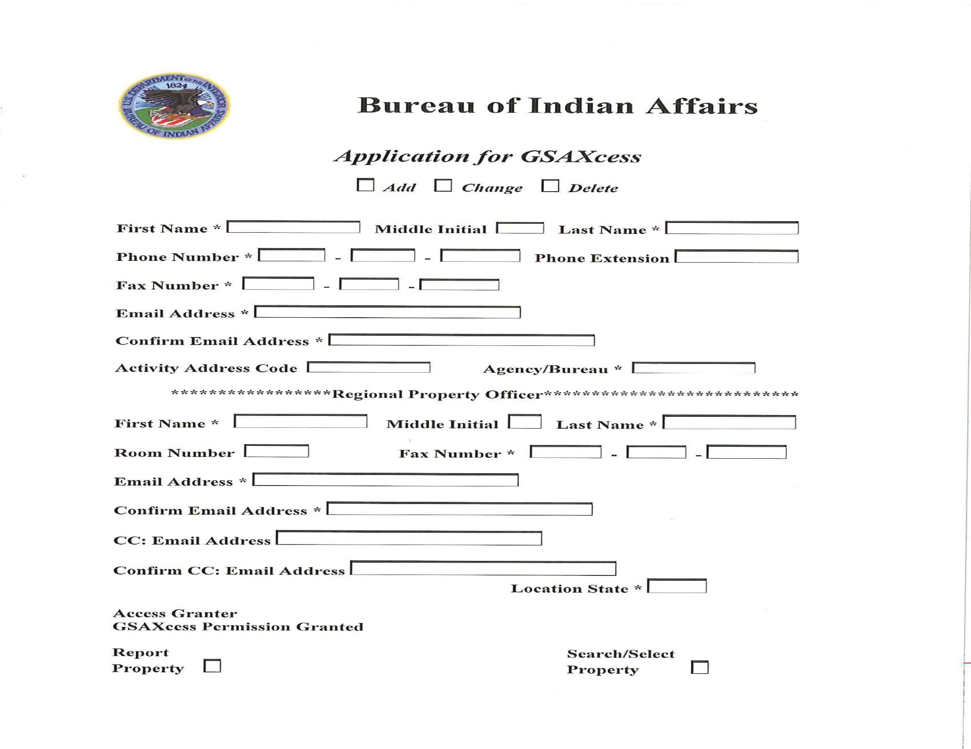

Slide 22
GSAXcess
PROCESS:
Requests submitted to Regional Property office for review and submission to appropriate office to generate a User Code
User Code – grants access to the system.
GSA will notify you via e-mail of your User Code

Slide 23
Use of GSA Sources
IMPORTANT:
All supplies, equipment or excess property can be obtained only for official use under a PL 93-638 contract/Self-Governance agreement.
Personal use not allowed
Tribe to include on property inventory

Slide 24
Requesting Excess BIA –Midwest Region property
PROCESS:
Submit letter to the Regional Director or Agency Superintendent – Attention Property staff
Letter must:
Be on tribal letterhead
Signed by Tribal Leader
PL 93-638 contract or Self-governance agreement number
Justification of use under the contract/agreement
Point of Contact (POC) – Designated person that can be reached for questions or pick up of items
Description of items requested and quantity. Be specific as possible

Slide 25
Requesting Excess BIA –Midwest Region property
PROCESS:
Property staff reviews request and determines if excess property available.
If available, provides letter and DI-105 form to Awarding Official for review and approval.
If approved, Property staff coordinate with POC pick-up

Slide 26
PROPERTY
AAC
Screener
Region’s Excess
QUESTIONS?

