Slide 1
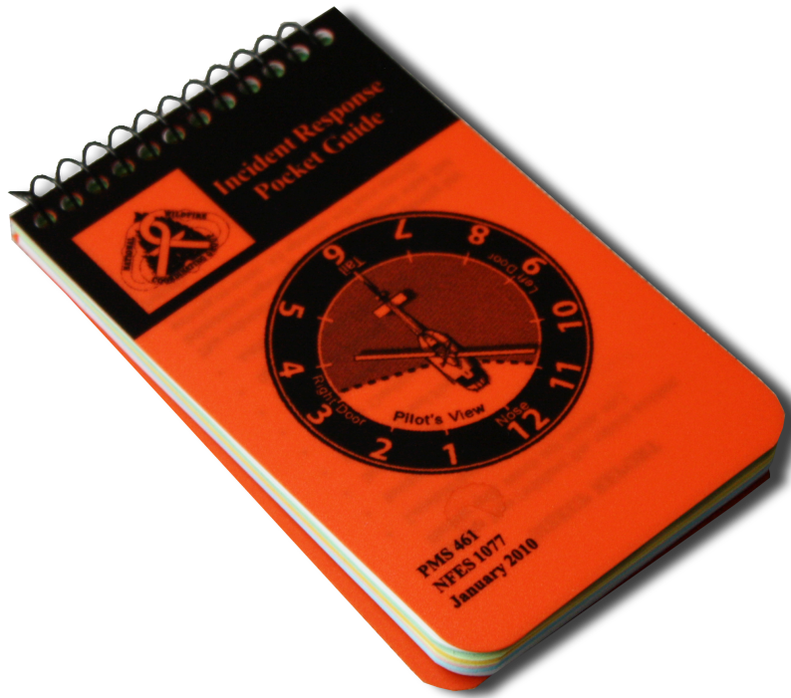
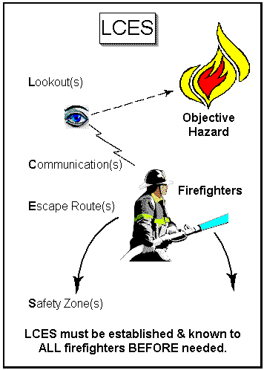
Operational Risk Management & Risk Assessment

Slide 2
Levels of Operational Risk Management
Planning Level
Operational Level
Time Critical Level

Slide 3
Risk Assessment Planning
Risk Management Process | Planning | Operational
Tools | 215A/Risk Mgmt Matrix | IAP
Situation Awareness Establishing situation awareness/gathering information | Planning Strategy Meeting Operations Safety Logistics Plans | Incident objectives (202) Incident organization (203) Weather forecast Fire behavior forecast Communications Plan (205)
Hazard Assessment Identifying hazards and assessing the risk | Risk Management Matrix JHA/RA | Safety Messages Pocket card Briefings
Hazard Control Controlling or eliminating hazards | Safety Planning - (215A) Engineering Administrative PPE Educational Avoidance | Safety Messages Medical Plans
Decision Point Making go/no-go decisions based on acceptability of remaining risk Residual risk | Operational Planning – (215) Contingency plans Incident Emergency Plans Safety Action Plan ICP/Remote Camp Safety Plans Incident within Incident Plan Re-evaluate and revise strategy and/or tactics | Work Assignments (204) Medical Plan (206) Turndown protocols (IRPG)
Evaluate Evaluating effectiveness of hazard controls and continuously re-evaluating situation | During Action Review Concurrence from Command & General Staff | Debrief

Slide 4
Operational Risk Management
Red Book
Chapters 1 & 7
Blue Book (BIA)
Chapters 2 & 9
Fireline Handbook
Local Unit SOP’s
IRPG

Slide 5
Operational Risk Management
IRPG - Green Pages
Risk Management Process
Look Up, Down, Around
LCES
Safety Zones
Urban Interface
Complexity Analysis
Refuse Risk
Notes:
Insert photo.

Slide 6
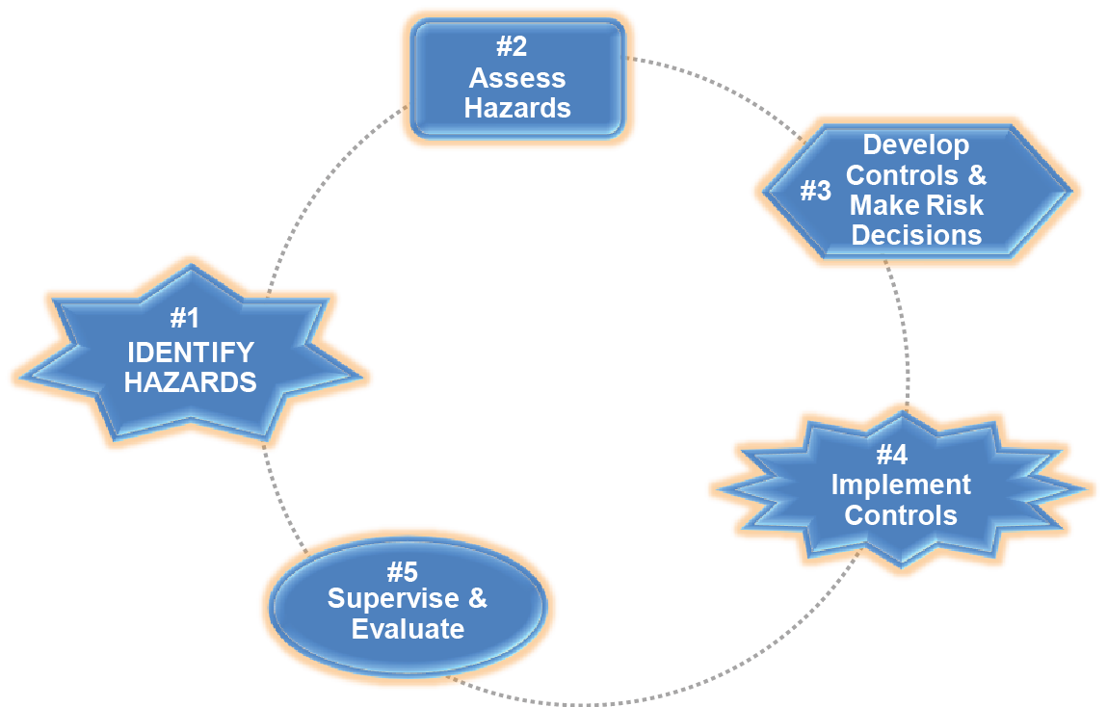
The Five Step Process

Slide 7
Principles of Operational Risk Management
Manage risk in the planning stage
Do not accept unnecessary risk
Make risk decisions at the appropriate level
Accept risk when benefits outweigh costs and/or potential consequences

Slide 8
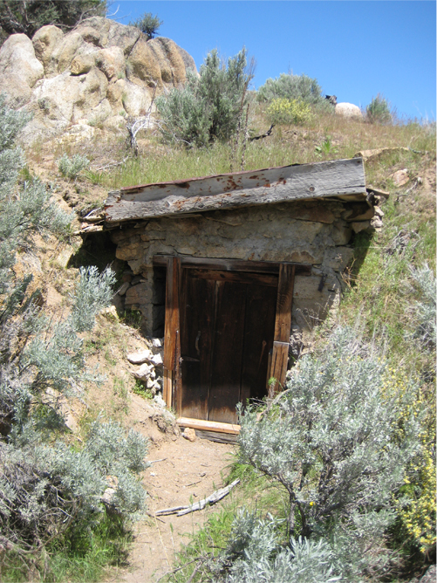
Operational Risk Management Process
Determine level of Risk and establish Mitigations

Slide 9
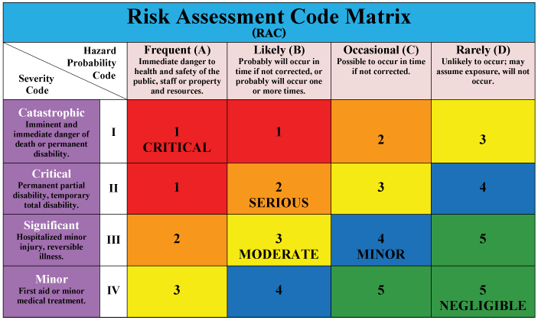
Risk Assessment Matrix

Slide 10
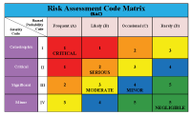
Risk Assessment Code Matrix
Definition
Probability – The likelihood that a hazard will result in a mishap or loss (Exposure in terms of time, proximity, and repetition)
Hazard Probability Codes
Frequent (A)
Likely (B)
Occasional (C)
Rarely (D)

Slide 11
Risk Assessment Code Matrix
Definition:
Severity – The worst credible consequence that can occur as a result of a hazard
Severity Codes
Catastrophic (I)
Critical (II)
Significant (III)
Minor (IV)

Slide 12
Risk Management Process
Risk
An expression of possible loss in terms of severity and probability
Hazard
Any real or potential condition that can cause injury, illness or death of personnel, or damage to, or loss of equipment or property.

Slide 15
INCIDENT SAFETY ANALYSIS (215a)
DIV | HAZARDS | MITIGATIONS
All | Driving | Use spotters when backing, and honk horn to alert personnel Follow 3 second rule when driving on all County/Forest roads Wear seatbelts and turn on headlights on all roads Observe all posted speed limits on Highways and forest roads Avoid parking in hazard tree concentrations Avoid travel on F.S. Road 42 to minimize risk of rolling debris & trees
MM, PP | Extreme Fire Behavior | Establish “Decision Points” to withdraw Use “Risk Management” approach prior to suppression actions, refer to page 1 in the IRPG Create decision criteria with spotting over fireline
All | High Winds | Eye protection along with all PPE is critical Plan for unexpected changes in wind direction Follow all hazard tree mitigations
MM | Firing Operations | Establish “Decision Points” and follow them Ensure communication between aerial and ground forces Watch out for fences, holes, and other hazards
All | Border Fire Operations Safety | Alert all personnel in area if illegal drugs are found GPS locations and alert DIVS to contact Communications Avoid dump sites, and camping areas, alert DIVS of location Disengage to drop point if illegal activity is discovered, follow protocol in International Border Watchouts
PP, TT, Rehab Monument, BAER Team | Hazard Trees | Avoid all heavily wooded areas, during wind event. Follow “Hazard Tree Safety” guidelines, IRPG pages 20 & 21 Avoid working in high hazard tree concentrations Only fell hazard trees if an emergency
MM, PP, BAER Team | Helicopter Operations | Don’t plan on air resources for medical transport or re-supply Directing Bucket Drops, refer to page 65, IRPG
All | Fatigue Management | Get adequate rest…….follow the 2:1 work/rest guidelines Get proper hydration & nourishment, take frequent breaks

Slide 16
Risk Management Process
Types of Hazards
Material
Environment
Organizational
Special Considerations

Slide 17
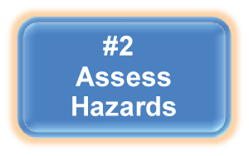
Risk Management Process
Assess hazards to determine
risks
Assess impact of each hazard
Potential loss (Risk vs Reward)
Cost
Mission degradation based on probability and severity.

Slide 18
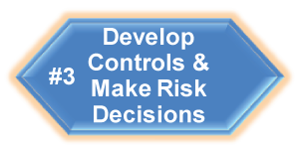
Develop Controls
Reduce risk by lowering the probability of occurrence and decreasing potential severity of a hazard, or both.
Types of Controls –
Engineering
Administrative
PPE
Educational
Avoidance
Most often described as “mitigations” within the wildland fire community.

Slide 19
Criteria for Controls
Suitability – The control must truly remove the hazard or mitigate (reduce) the risk to an acceptable level.
Feasible – The end user will have the capability to implement the control.
Acceptable – The end user will accept and implement the control.
Effectiveness – Benefit gained by implementing the control and justifying the cost in resources and time.
Notes:
Rhonda – Tawny added “Discussion Point” box; reposition if it would look better in a different location.

Slide 20
Residual Risk
The level of risk remaining after controls have been identified and selected.
Eliminating every risk is often not achievable
Residual risk after mitigation needs to be identified and determined if the risk is at an acceptable level.

Slide 21
Overall Residual Risk
Cumulative Risk
Should be determined based on the hazard having the greatest residual risk down to the hazard having the least risk.
Determining overall mission risk by averaging the risks of all hazards is not valid.

Slide 22
Risk Decision
The decision to accept or not accept the Risk(s) associated with an action.
Based on residual risk
Benefits outweigh the cost/potential consequence
Made at the appropriate level

Slide 23
Decision Options
Accept Risk
Modify Risk with control
measures
Requires more information
Reject Risk
Elevate to higher levels
Consider alternative action
Avoidance

Slide 24
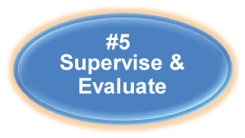
Risk Management Process
Evaluate hazard controls and continuously monitor the overall situation
Each operational period, leaders should evaluate how well the risk management process was executed.

Slide 25
Completed Risk Assessments
13 Generic R.A.’s Completed
Need to Complete R.A.
Codes
Add/Delete Mitigation
Measures
http://www.bia.gov/nifc/safety/risk/index.htm

Slide 27
Tony Beitia
BIA-NIFC
juan.beitia@bia.gov
1-208-387-5177

Slide 28
Risk Assessment Planning
Risk Management Process | Planning | Operational
Tools | 215A/Risk Mgmt Matrix | IAP
Situation Awareness Establishing situation awareness/gathering information | Planning Strategy Meeting Operations Safety Logistics Plans | Incident objectives (202) Incident organization (203) Weather forecast Fire behavior forecast Communications Plan (205)
Hazard Assessment Identifying hazards and assessing the risk | Risk Management Matrix JHA/RA | Safety Messages Pocket card Briefings
Hazard Control Controlling or eliminating hazards | Safety Planning - (215A) Engineering Administrative PPE Educational Avoidance | Safety Messages Medical Plans
Decision Point Making go/no-go decisions based on acceptability of remaining risk Residual risk | Operational Planning – (215) Contingency plans Incident Emergency Plans Safety Action Plan ICP/Remote Camp Safety Plans Incident within Incident Plan Re-evaluate and revise strategy and/or tactics | Work Assignments (204) Medical Plan (206) Turndown protocols (IRPG)
Evaluate Evaluating effectiveness of hazard controls and continuously re-evaluating situation | During Action Review Concurrence from Command & General Staff | Debrief

Slide 29
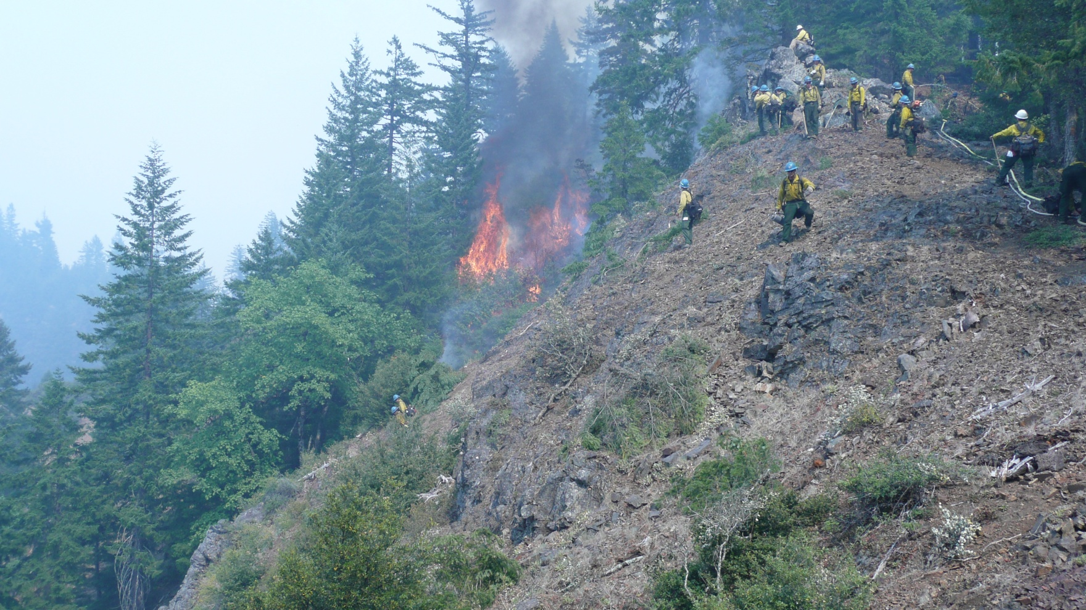
Hazards & Mitigations

