Slide 1
NIOGEMS
National Indian Oil and Gas Evaluation and Management System
(NIOGEMS)
Project sponsor:
Assistant Secretary-Indian Affairs
Office of Indian Energy and Economic Development
Division of Energy and Mineral Development (DEMD)
Division Chief: Stephen Manydeeds

Slide 2
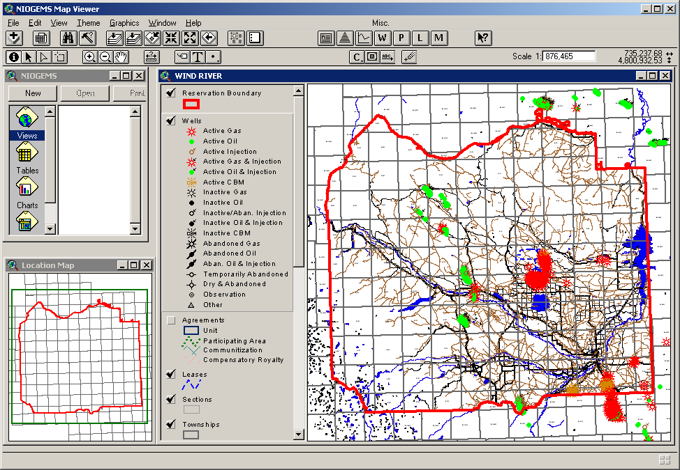
NIOGEMS
National Indian Oil and Gas Evaluation and Management System
Consolidates various natural resource, realty, and geo-technical data into a single management software application
Provides Tribal, BIA, BLM managers access to well, production, lease, agreement, and other natural resource data on Indian & non-Indian owned lands, both in and around their reservation to monitor oil & gas and other mineral exploration and development
Facilitates management decisions on energy & mineral leasing and development for optimal use of Tribal resources
Presents a user-friendly, “point & click” interface simplifying the execution of these complex data management operations
Data Sources include:
Tribal
BIA
ONRR
Commercial
BLM
USGS, Census, NRCS
Other Gov

Slide 3
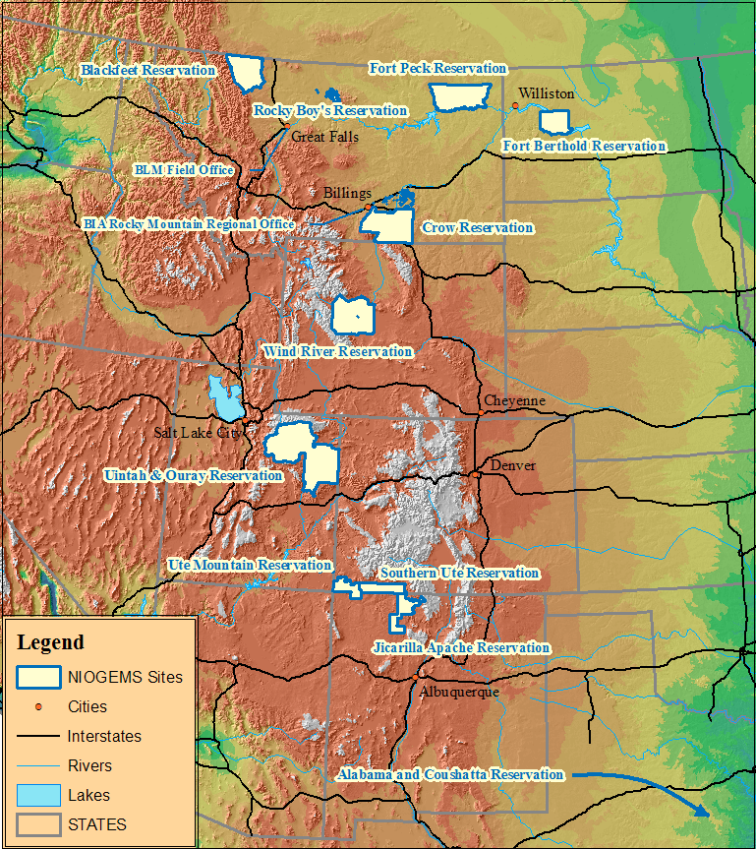
NIOGEMS
Installations:
Alabama and Coushatta
Blackfeet
Crow
Fort Berthold
Fort Peck
Jicarilla Apache
Rocky Boys
Southern Ute
Uintah and Ouray
Ute Mountain Ute
Wind River
Division of Energy and Mineral Development (DEMD)
BIA-Rocky Mountain Regional Office (RMRO)
BIA-Great Plains Regional Office (GPRO)
BLM-Great Falls Field Office (MT)
BLM-Billings, MT
OST-Albuquerque
ONRR - Denver
BIA Great Plains Regional Office
OST

Slide 4
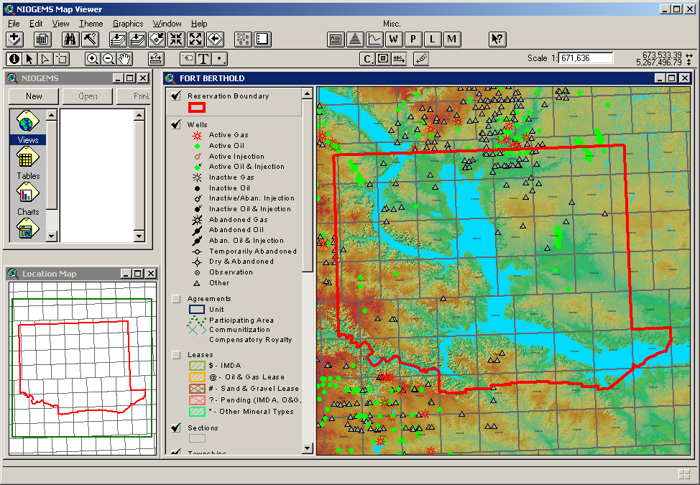
NIOGEMS
Two User Components
Map Viewer uses standard and customized GIS functionality linked to Oracle.

Slide 5
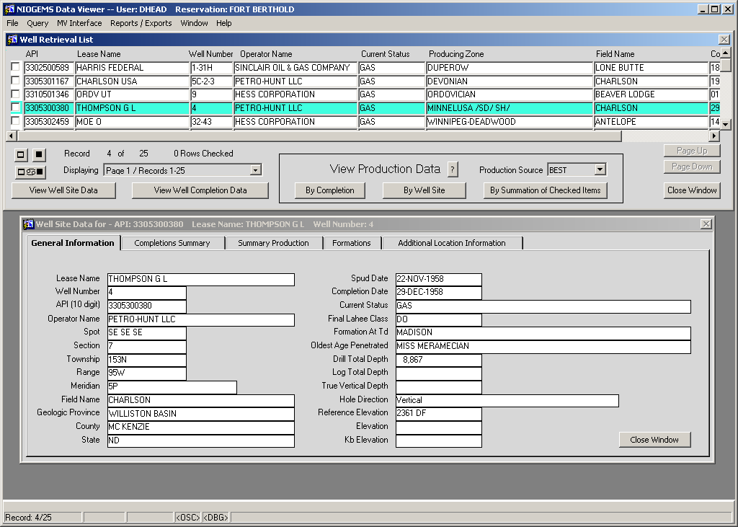
NIOGEMS
Data Viewer with data views, reports, and exports hosted by Oracle.

Slide 6
NIOGEMS
Live Demonstration
By Gary Deters – Program Specialist (DEMD)
Application used by:
Three Affiliated Tribe Offices
BIA Agency Offices
BLM, ONRR, and OST Offices
To support management of energy development at Fort Berthold Reservation

