Slide 1
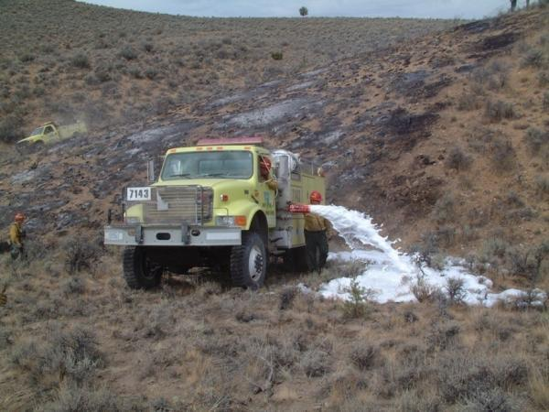
Water Handling Operations
Unit 4C - Foam and Foam Proportioning Equipment

Slide 2
Objectives
Discuss why foam is more effective than plain water when performing wildland fire suppression operations.
Discuss foam safety, including guidelines for handling foam products.
Identify and discuss the advantages and disadvantages of two manual foam proportioning methods used when performing wildland fire suppression operations.

Slide 3
Objectives
Identify various operational components of the FoamPro® 1600/1601 and Waterous Aquis 1.5.
Demonstrate the ability to set up, run, have foam solution pumped to a nozzle person, and shut down a foam proportioner.

Slide 4
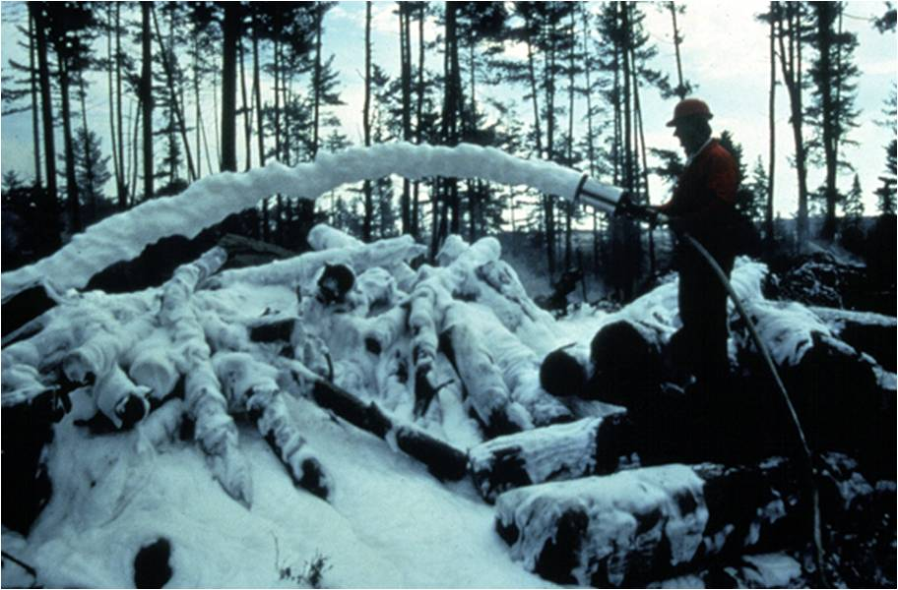

Slide 5
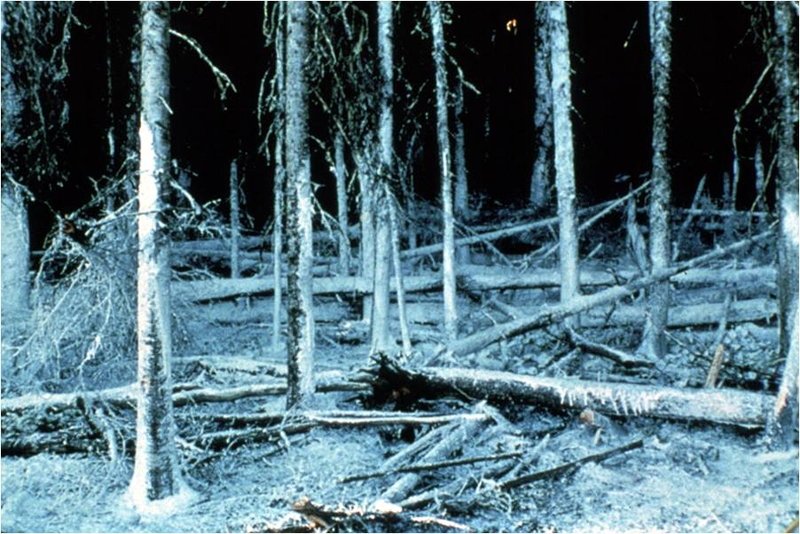

Slide 6
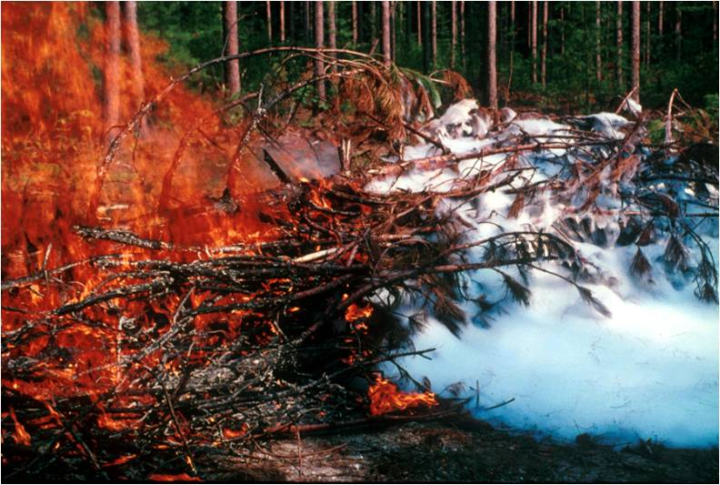

Slide 7
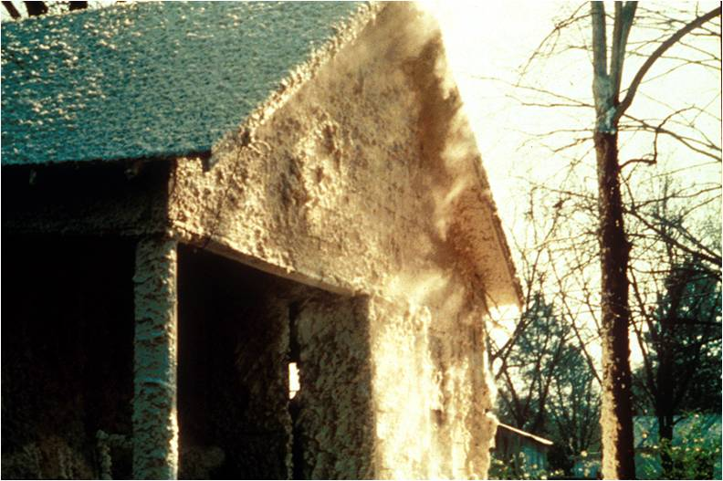

Slide 8
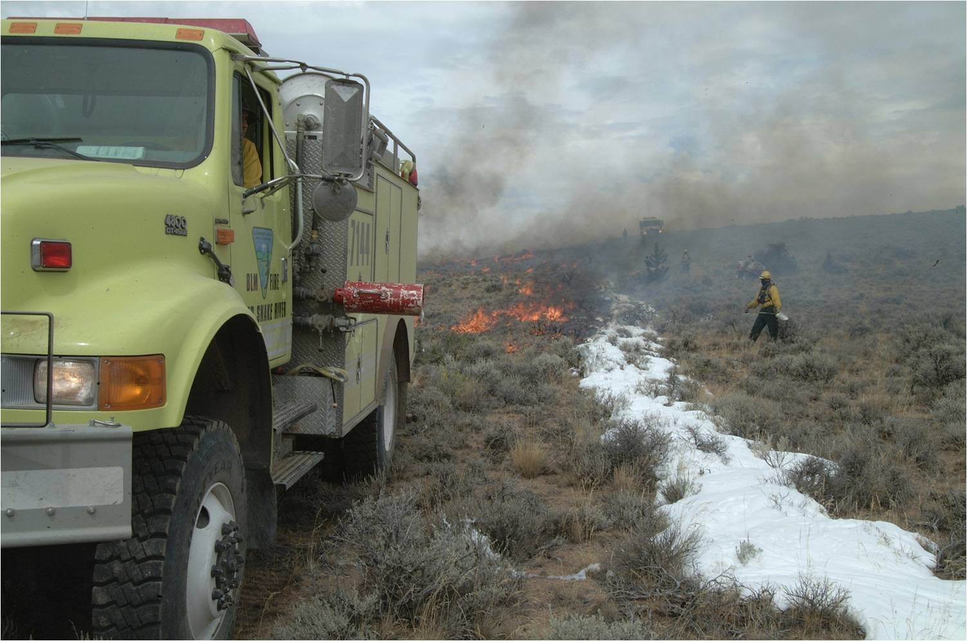

Slide 9
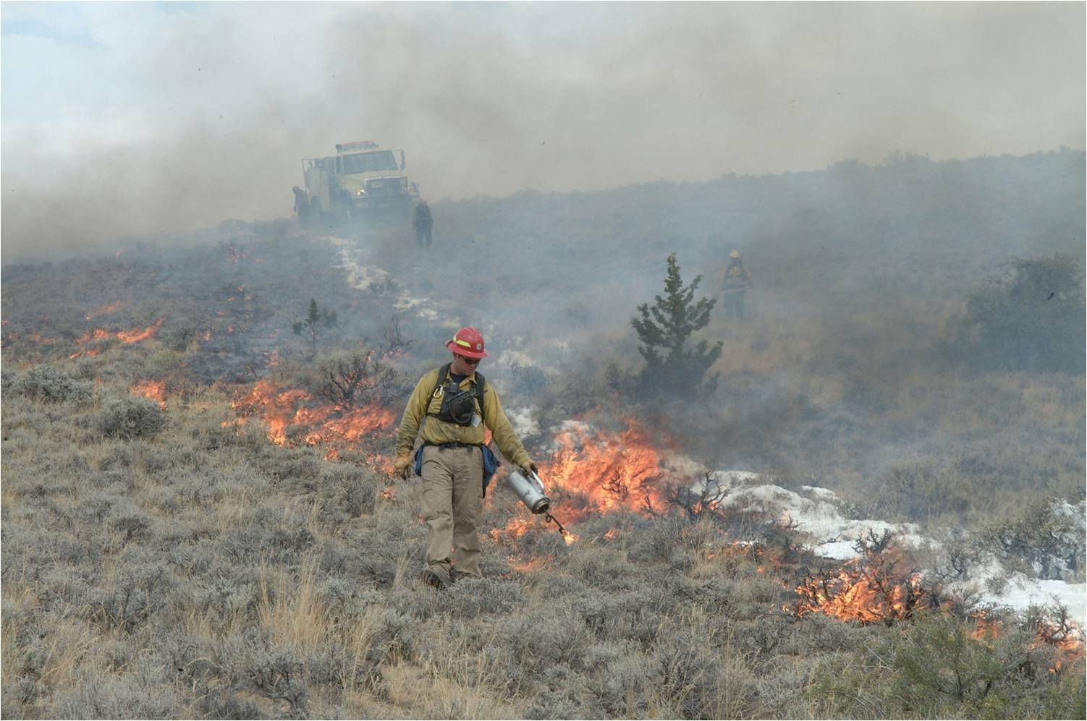

Slide 10
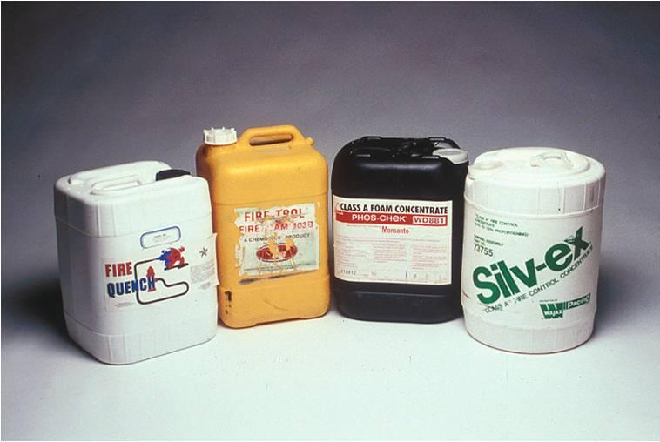

Slide 11
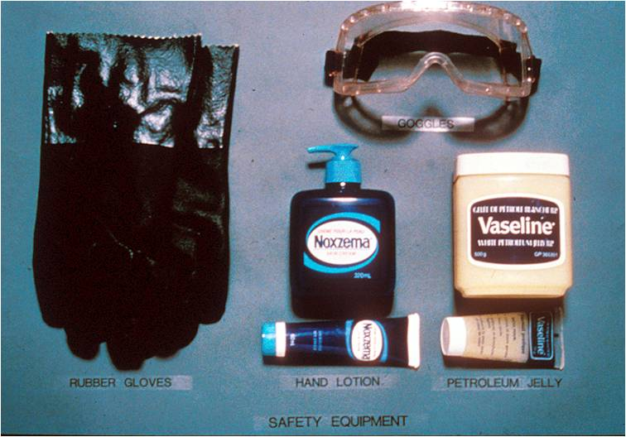
Safety equipment

Slide 12
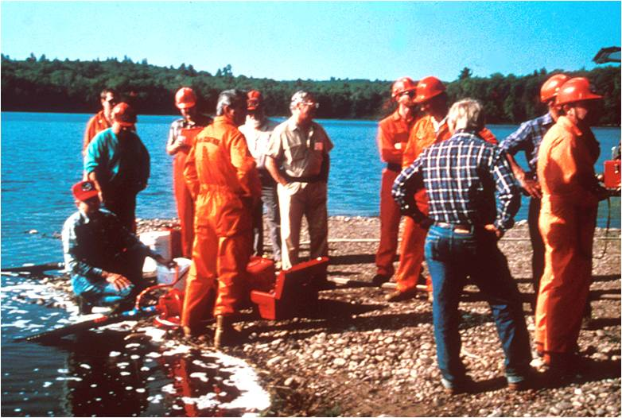

Slide 13
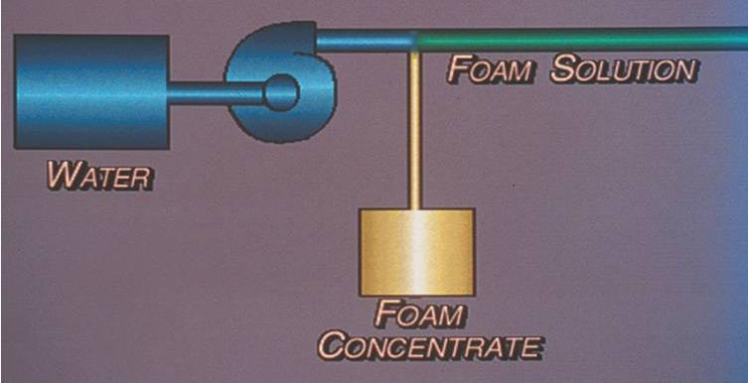
Foam Proportioners

Slide 14
Manual Foam Proportioners
Operators manually adjust the device to maintain a constant mix ratio when water flow and pressure changes.
Cannot maintain constant mix ratio over various flow and pressure rates

Slide 15
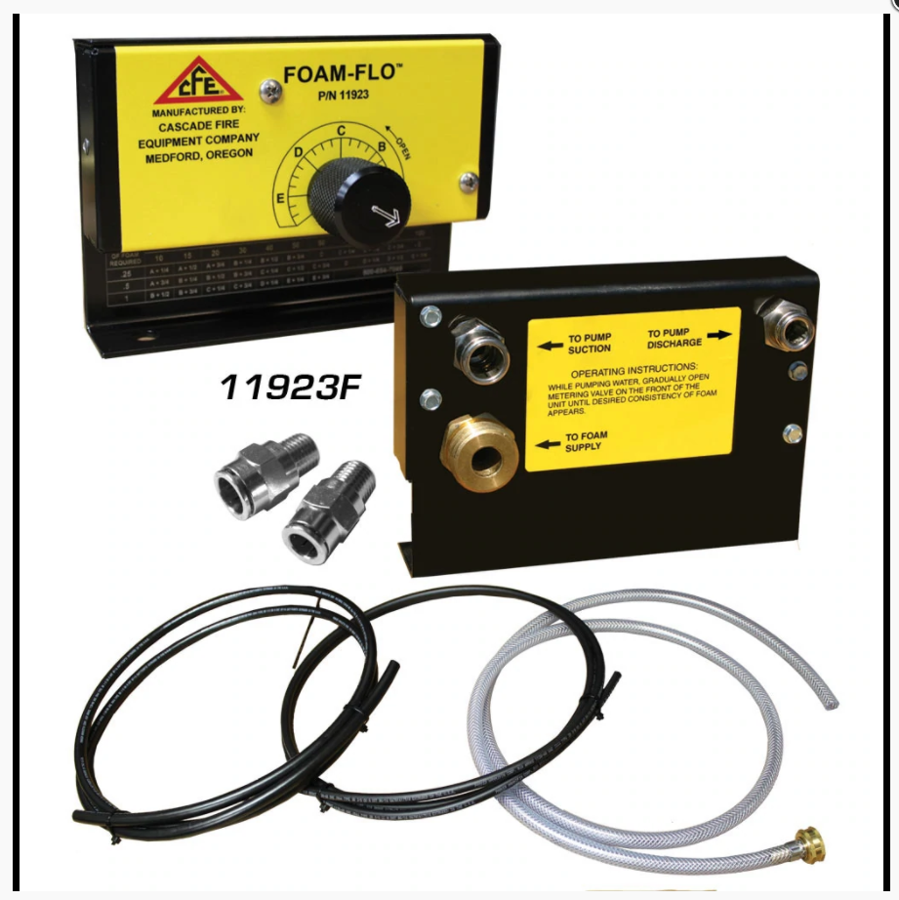
BIA M-52 Foam Flo
Simple and Effective.
Uses Standard Fittings and is Unpowered.
Can Get Foam Into Tank if Valving is Not Correctly Installed or if Internal Check Ball Malfunctions.

Slide 16
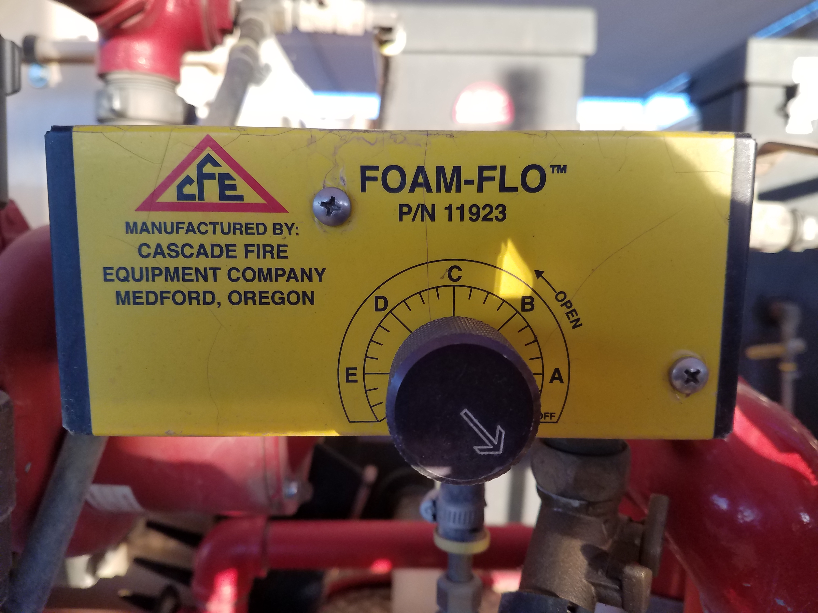
BIA M-52 Foam FLo Off Position
Notes:
Proportioner is graduated from Off to E. A is the lowest setting, E is the highest. Adjust to nozzle operators desired foam output. A Foam Flo will not automatically adjust for pressure or volume, the ENOP must do this manually.

Slide 17
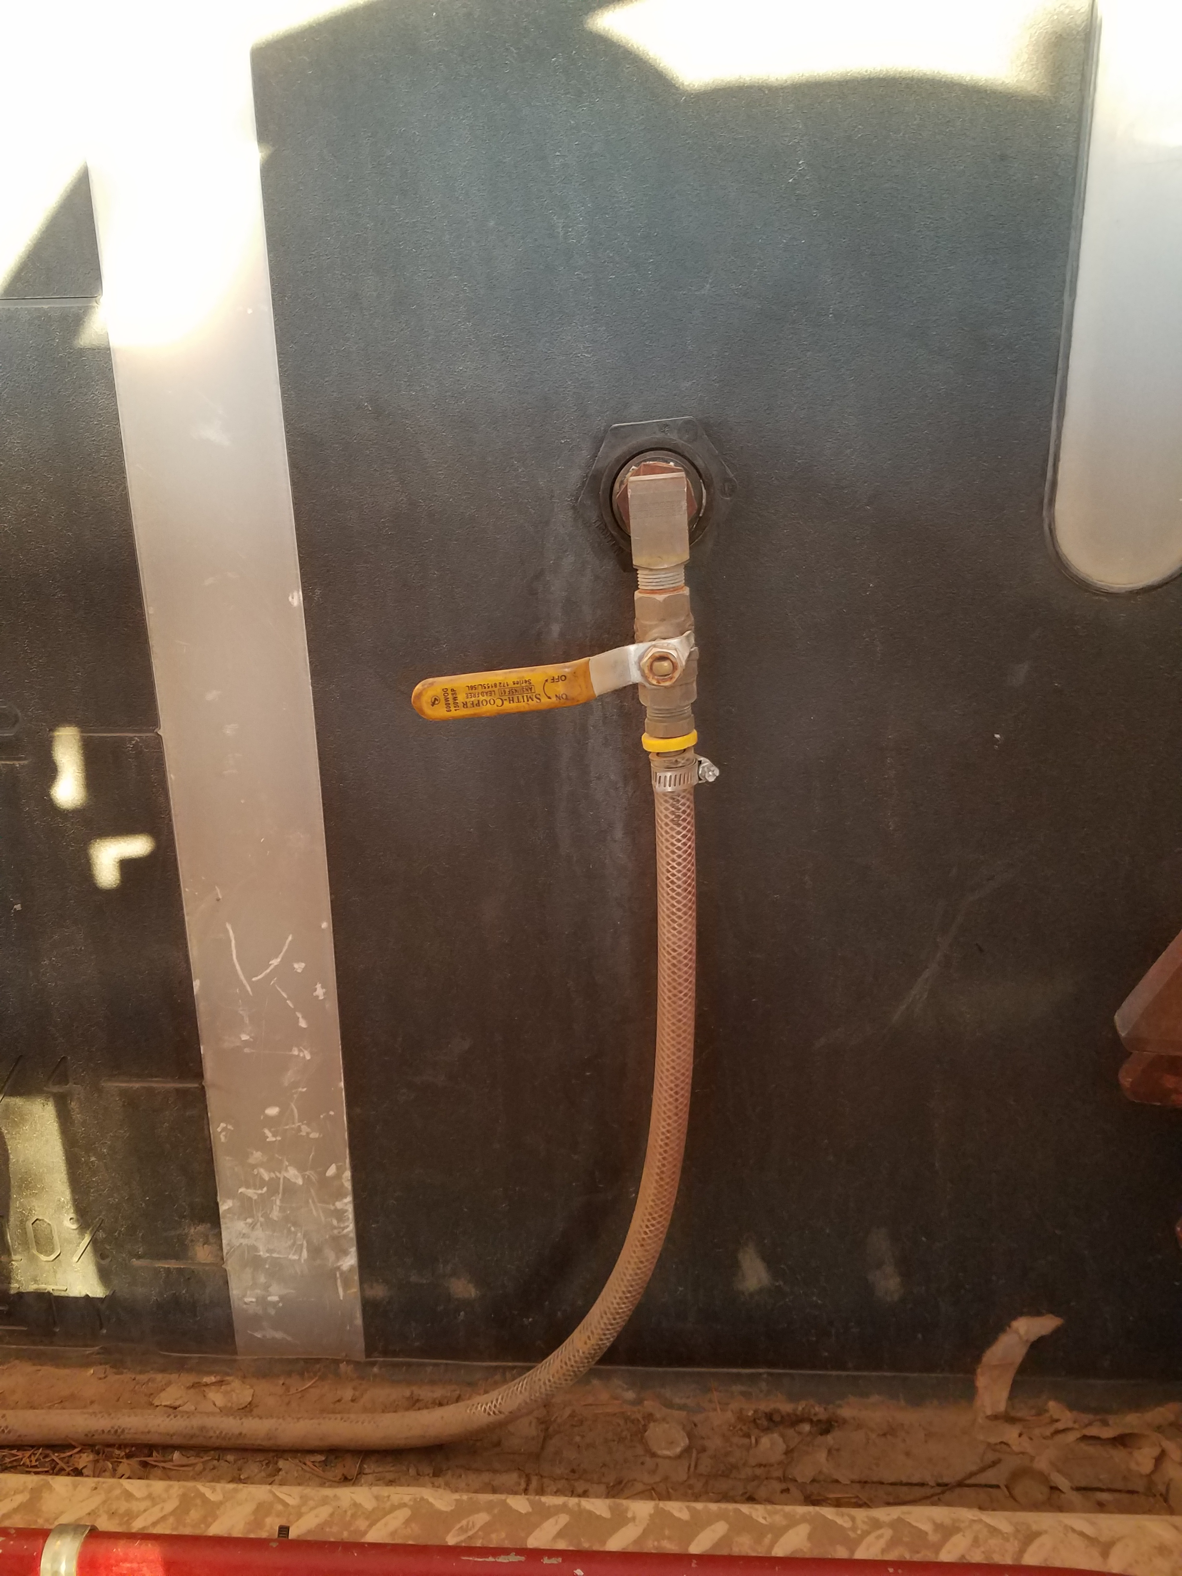
Foam On/off valve at tank
Notes:
On/ Off Valve to foam tank. Must be opened to flow foam.

Slide 18
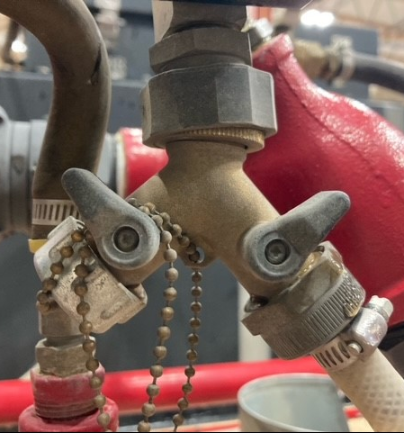
Foam Proportioner inlet Valve -Off Position
Notes:
This photo is input from the foam tank to foam proportioner. This valve must also be in the open position to flow foam.

Slide 19
Model 52 Foam-flo
Water is Pushed Into the Unit From the Pump Side (LEFT SIDE)
Flows Across the Proportioner Valve and Pulls Concentrate Into a Mixture of Water and Concentrate.
Exits in Solution Above the Overboard Discharge Valve #3 (Right Side).
Notes:
Most BIA M-52's discharge into a single Overboard Pipe. If this pipe is plumbed to part of the system that can uptake water into the pump head (common on BIA Model 52's) and the Recirculation Valve is open (#17), you will pump foam into the tank. This is a common issue and can lead to all sorts of problems. One of the discharge valves needs to be cracked open in order prevent foam from going the into the water tank. Review the foam valving on all BIA M-52's and correct as needed. View is top of Foam Pro.

Slide 20
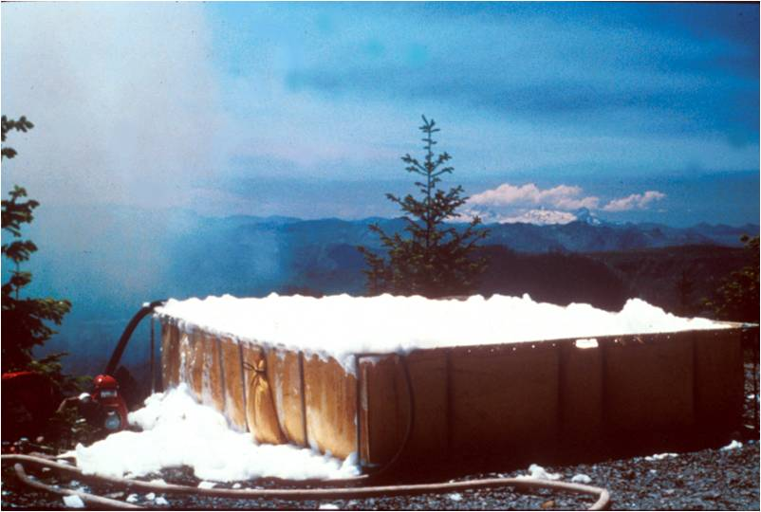
Batch Mixing

Slide 21
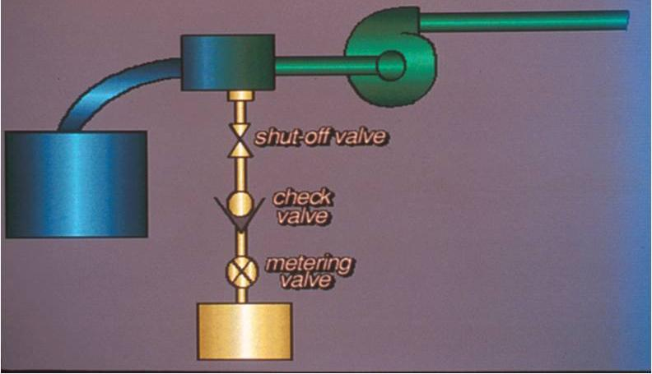
Suction-Side Proportioners

Slide 22
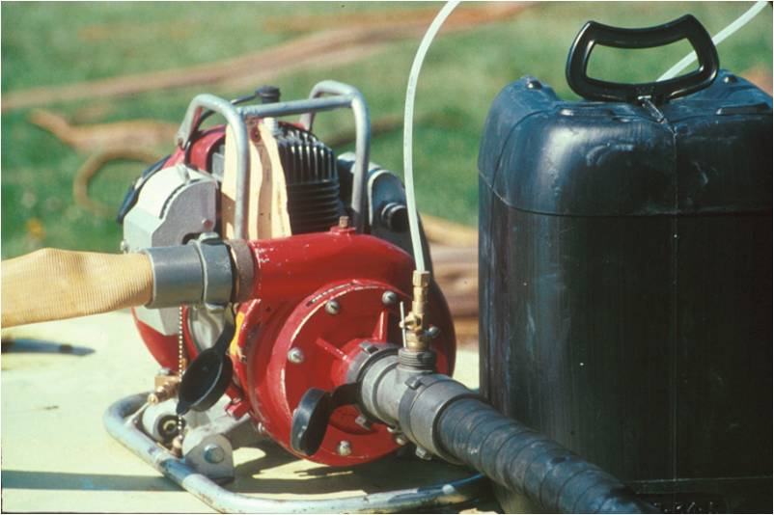

Slide 23
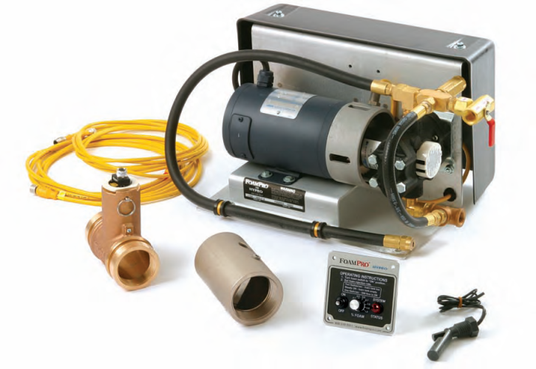
Automatic Foam Proportioner
The automatic foam proportioner makes an adjustment on its own to maintain a constant mix ratio when water flow and pressure changes.
FoamPro® 1601
Waterous Aquis™ 1.5

Slide 24
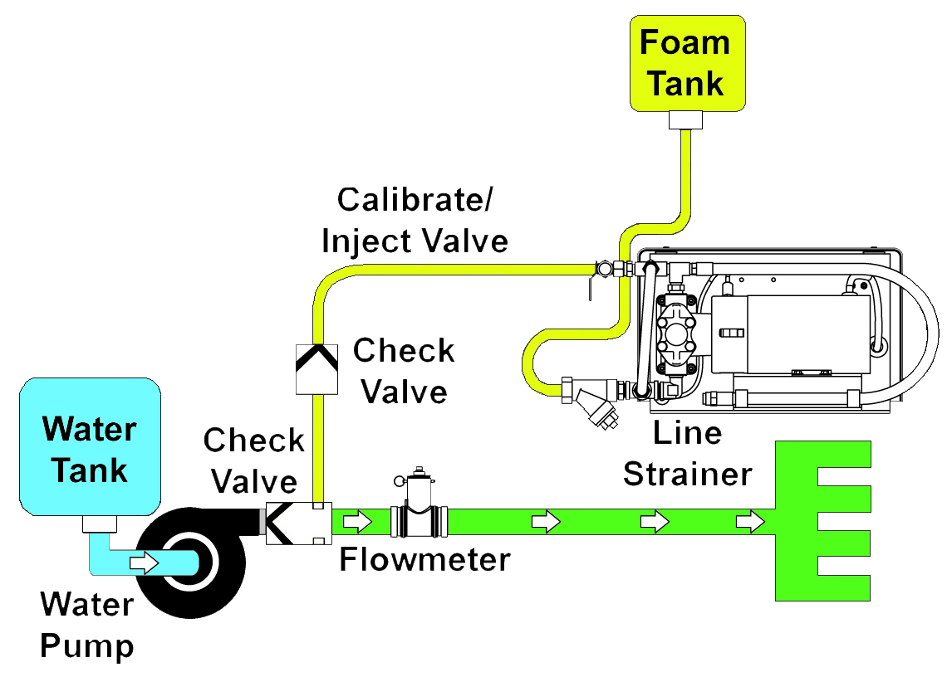
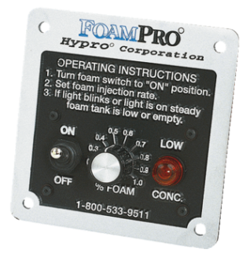
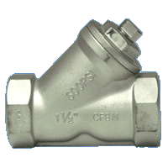
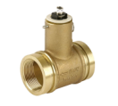
Foam Proportioner
s

Slide 25
Foam Proportioner
Proportional and automatic
Works on discharge side of pump
Class A foam only
Requires water flow and electrical current
No restrictions due to hose length or number of nozzles
No loss of pressure or flow
Accurate at all flow ranges
Resupply foam without interruption

Slide 26
Operating the Foam Proportioner Major Components
Operator control module
Motor driver box/module
Paddlewheel flowmeter
Foam pump and electric motor
Calibrate/Inject valve
Inline strainer

Slide 27
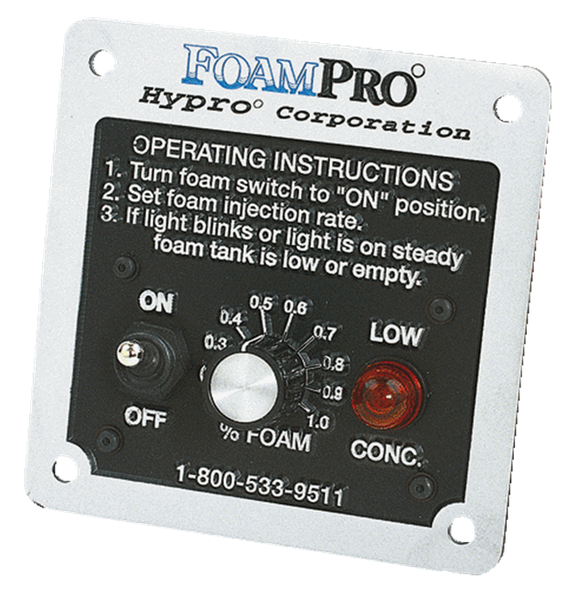
Operator Control Module Panel Mounted
Operating instructions
On/Off switch
Injection rate control
Adjustable from 0.1%-1.0%
Low concentrate (“LOW CONC.”) light

Slide 28
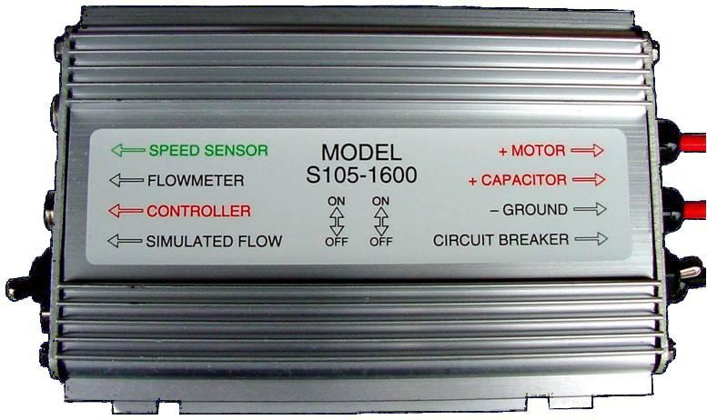
Motor Driver Box/Module Normal Operation
Simulated flow switch “Down” for normal operation
Circuit breaker switch “Up” for normal operation

Slide 29
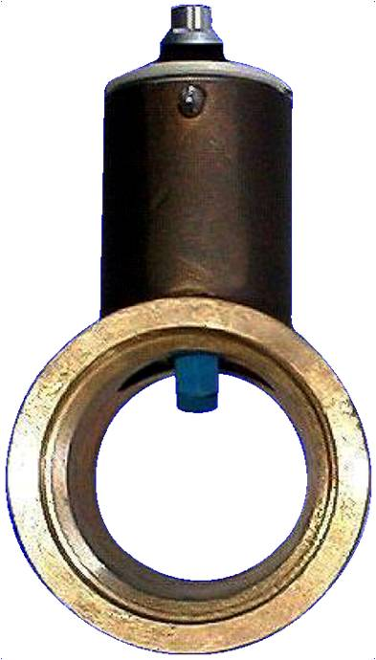
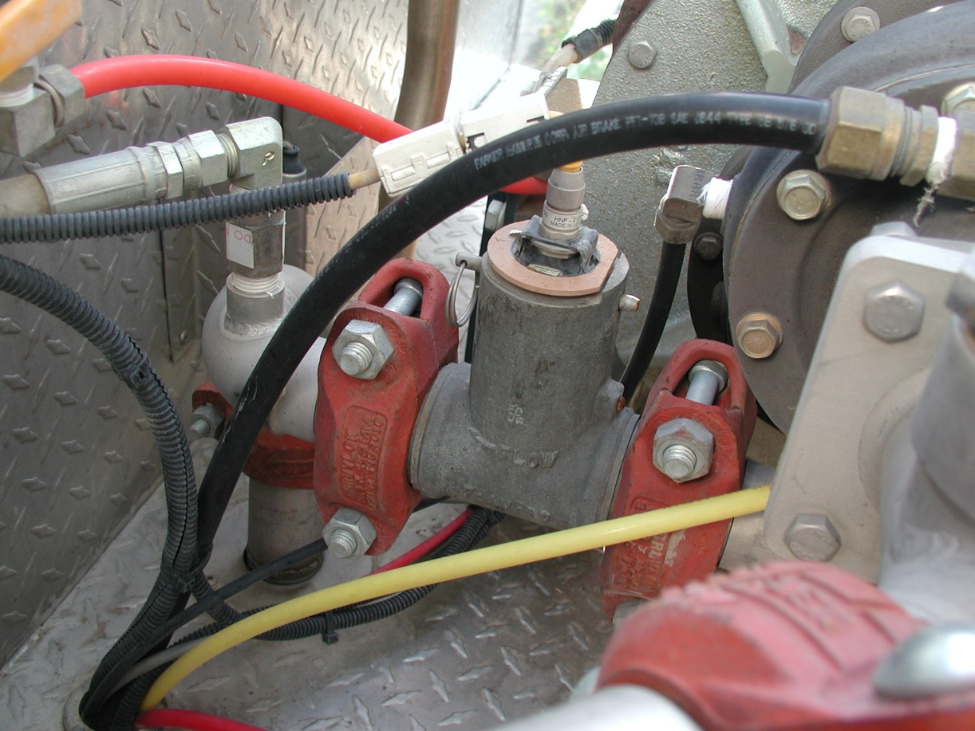
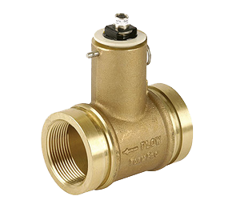
Paddlewheel Flowmeter

Slide 30
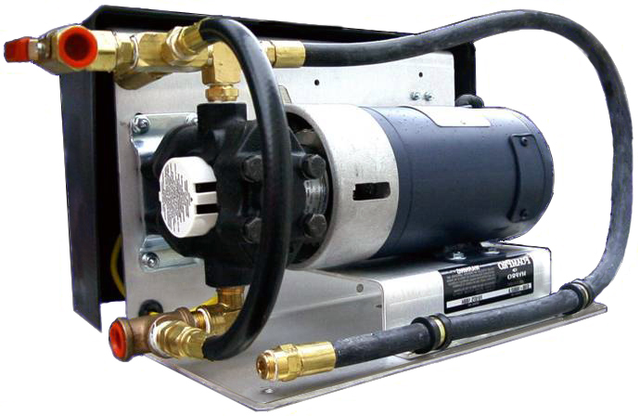
Foam Pump and Electric Motor

Slide 31
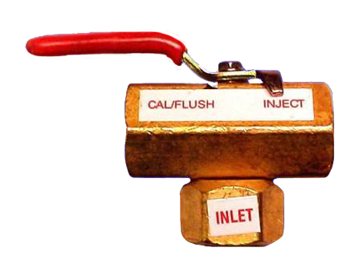
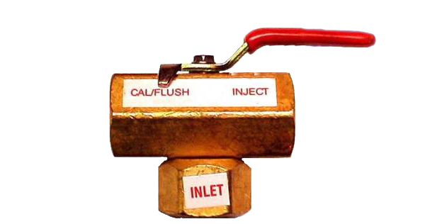
Calibrate/Inject Valve

Slide 32
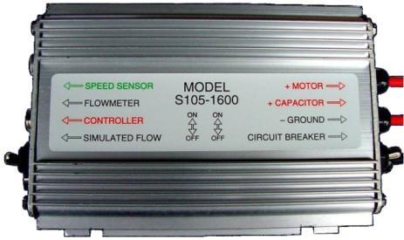
Purging Air
Enter “Simulated Flow”
Switch to “Up” position
Preprogrammed for 100 gpm
Valve to “Cal/Flush”
Turn panel switch “On”
Run pump until concentrate flows from dump line

Slide 33
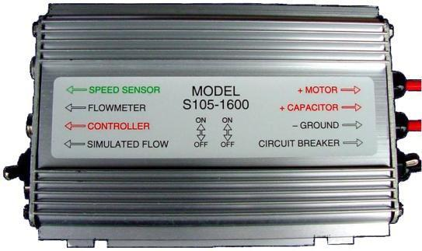
Purging Air Continued
Turn control panel to “Off” position
Return valve to “Inject”
Exit “Simulated Flow” by returning switch to “Down” position

Slide 34
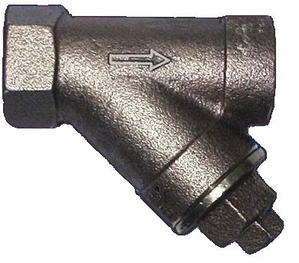
Inline Strainer

Slide 35
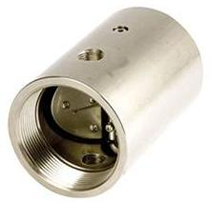
Foam Injection Check Valve and Injection Port

Slide 36
Objectives
Discuss why foam is more effective than plain water when performing wildland fire suppression operations.
Discuss foam safety, including guidelines for handling foam products.
Identify and discuss the advantages and disadvantages of two manual foam proportioning methods used when performing wildland fire suppression operations.

Slide 37
Objectives
Identify various operational components of the FoamPro® 1600/1601 and Waterous Aquis 1.5.
Demonstrate the ability to set up, run, have foam solution pumped to a nozzle person, and shut down a foam proportioner.

