Slide 1
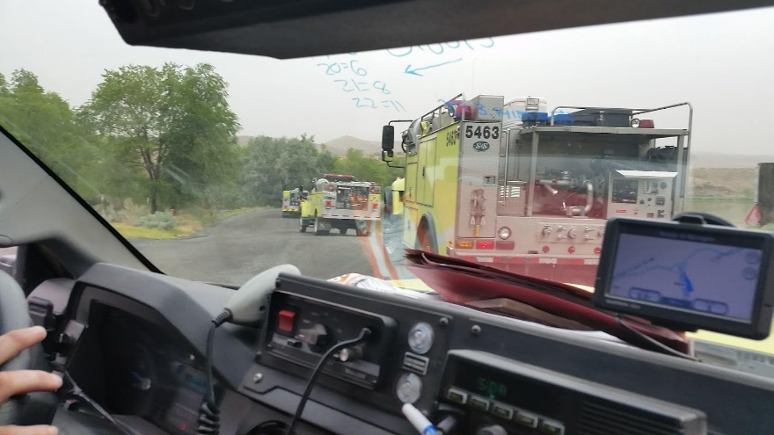
Fire Engine Driving Operations
Unit 3B - Basic Driving Skills

Slide 2
Objectives
Describe and demonstrate the driver walk-around before moving a fire engine.
Describe the STOP procedure and how it relates to the driver when operating a fire engine.
Identify danger zones around fire engines and describe actions that can be performed to reduce risk in these areas.

Slide 3
Objectives
Describe and demonstrate the start-up and shifting procedures an ENOP must perform when operating fire engines.
Identify hazardous driving situations and describe actions that can be performed to reduce risk.
Demonstrate on an established course fire engine handling and maneuvering capabilities.

Slide 4
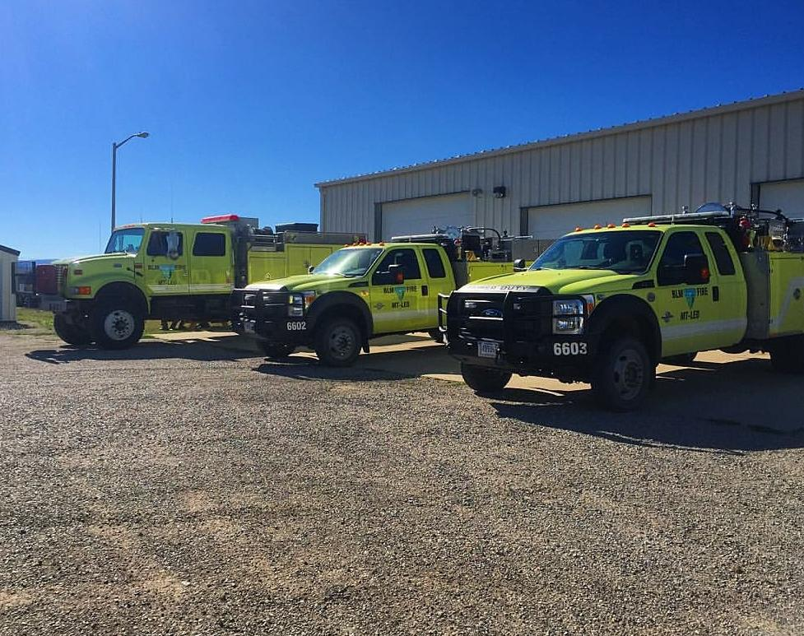
Preparing to Drive a Fire Engine

Slide 5
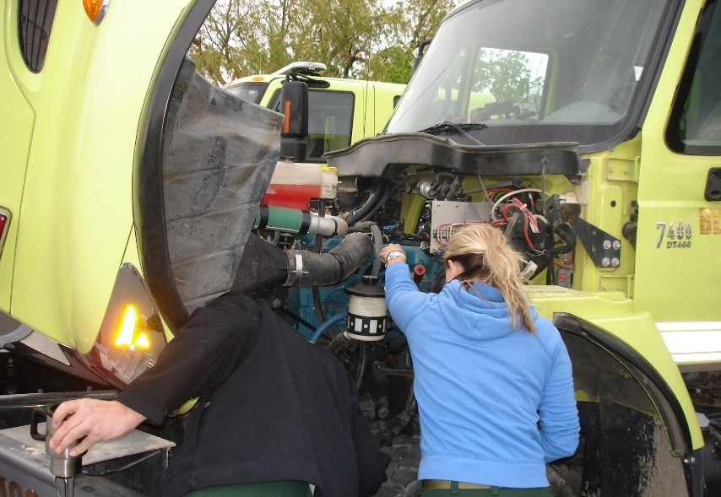
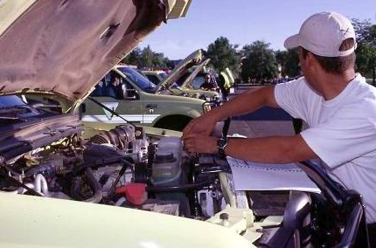
Pre-trip Inspection (Preventative Maintenance Check)
Performed daily during fire season
Documented in the FEMPR
Different from the driver walk-around

Slide 6
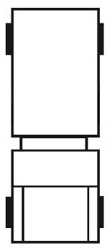
Driver Walk-Around
Passenger Side Rear
Driver Side Rear
Cab
Passenger Side Front
Driver Side Front

Slide 7
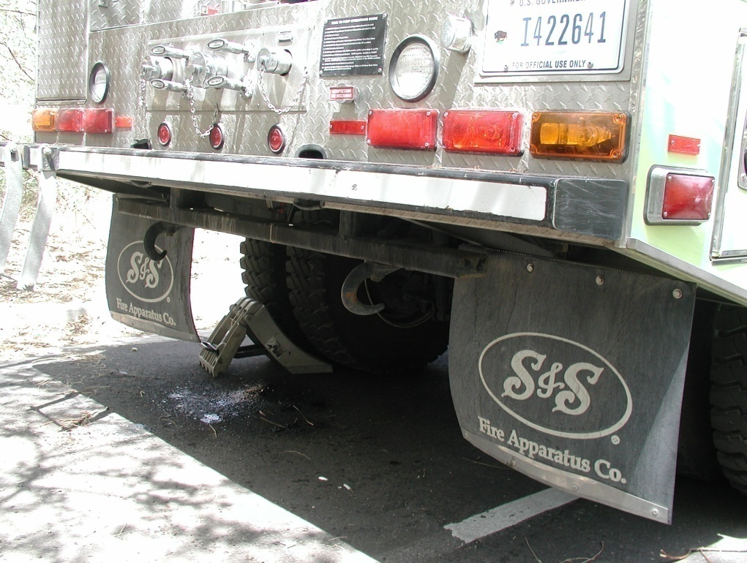
Walk-Around Watch Outs
Rocks in the way of tires
Holes, berms, ditches, etc.
Large stobbs or downed trees
Chock blocks secured and in place
Gear or equipment around or under vehicle

Slide 8
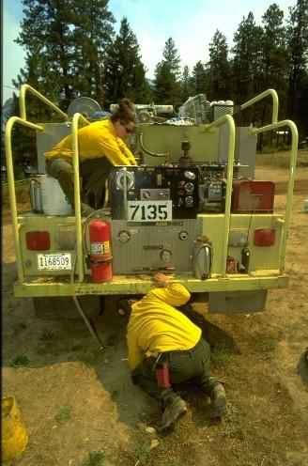
More Walk-Around Watch Outs
Vehicles parked behind the engine
Personnel relaxing or sleeping around engine
Body damage while away from the engine
Cabinets latched and equipment secured
Side and overhead clearance in and near the path your vehicle will travel

Slide 9
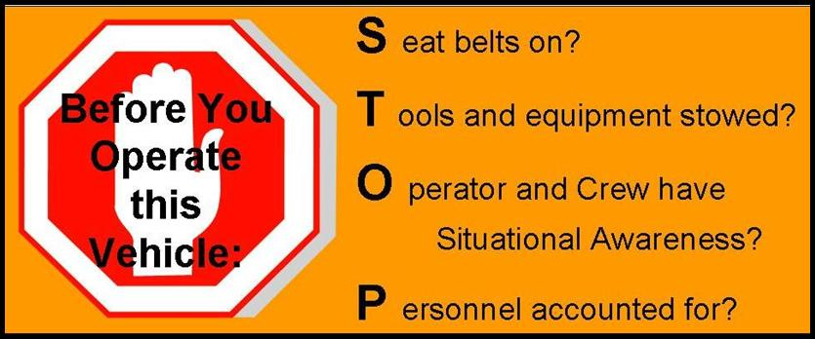
STOP Procedure

Slide 10
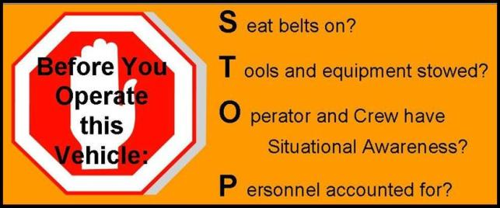
“S”
Seat belts on?
Seat belts must be available and used in Bureau motor vehicles.
The driver is responsible for asking passengers if they are wearing their seat belts and ensuring they are worn at all times.

Slide 11
“T”
Tools and equipment stowed?
Ensure all tools and equipment are secured in cabinets or approved storage areas before moving the engine.

Slide 12
“O”
Operator (driver) and crew has situational awareness.
Determine if the engine is clear of hazards.
Never back up an engine without checking behind the vehicle.
Utilize spotters whenever possible.

Slide 13
“P”
Personnel accounted for?
Ensure all personnel are account for and their locations are known.
Communicate your intentions to all personnel before moving the vehicle.

Slide 14
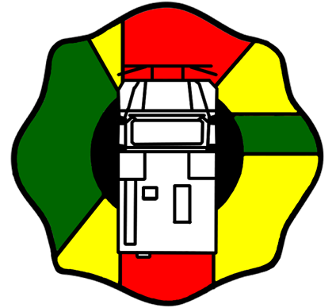
Engine Danger Zones

Slide 15
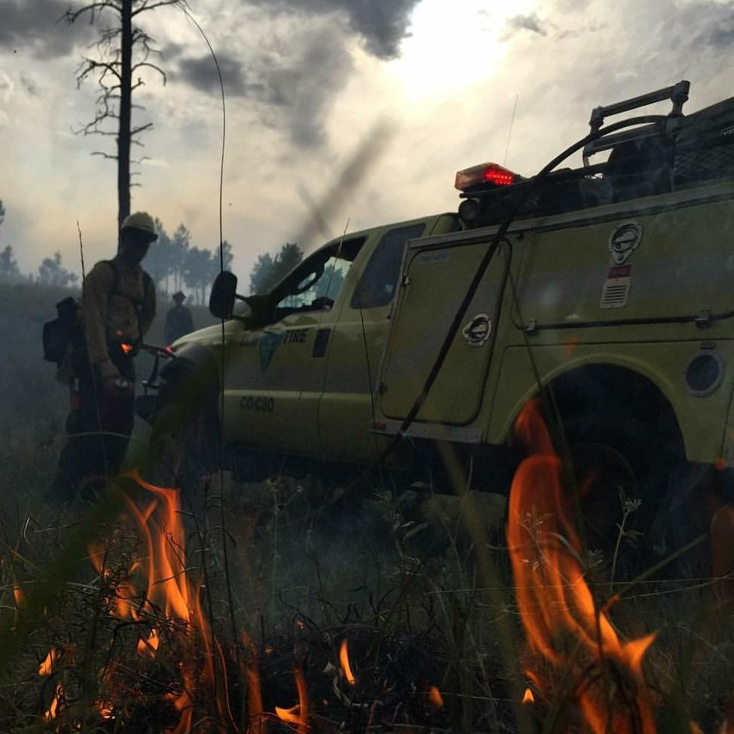
Engine Danger Zones
When working in close proximity of a moving engine, there is an increased risk for an accident to occur.
Given the size of our engines and the environment we work in, operator “blind spots” or danger zones exist.

Slide 16
Engine Danger Zones
Whenever possible, operate in the green zones.
Offer visual contact with the operator.
Yellow zones are areas of limited visibility and mirror-use areas.
Notify the driver when you are in these areas.

Slide 17
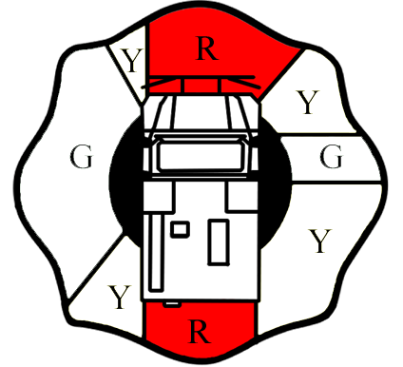
Engine Danger Zones
Never work in red zones when vehicle is moving.
Notify operator prior to entering red zones.
Stay out of red zone where the operator has no visual.

Slide 18
Engine Danger Zones
The red area in front of the engine extends 10 feet out from the front bumper.
You must have visual contact with the driver when working in front of the vehicle beyond the 10-foot range.

Slide 19
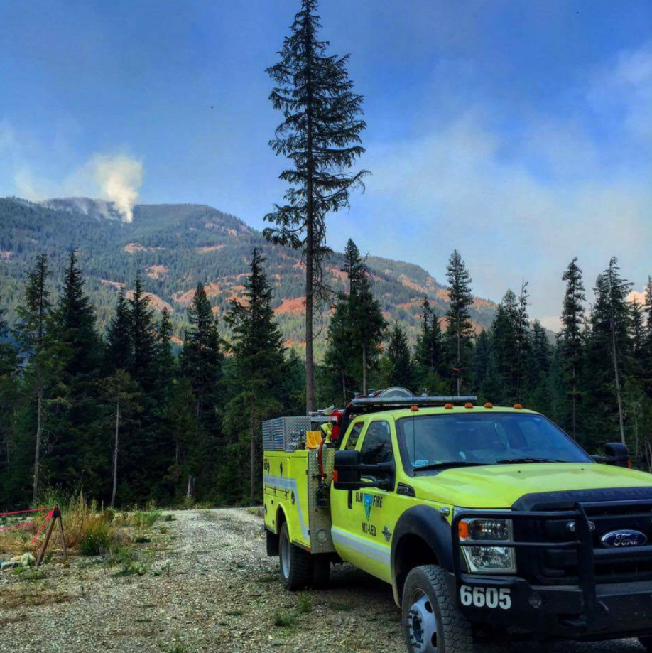
Engine Spotter Usage
There are always blind spots around the engine.
Always use a spotter when another person is available.
If alone, get out and do a visual yourself.

Slide 20
When to Use a Spotter
Backing up
Off-road pioneering
Hazardous conditions exist
Low vehicle clearances exist
Narrow/confined driving spaces exist

Slide 21
Spotter Techniques
Spotters should have a clear line of sight to the driver. Spotter position should be:
Forward movement: Outside the forward red zone on the driver side windshield
Backing movement: Outside the rear red zone on the driver side mirror
Spotters and drivers should agree upon a common set of hand signals.

Slide 22
Spotter Techniques
Spotters and drivers need to communicate on the planned action.
Spotter distance from the engine will depend on various situations at the time of the maneuver; however, visual contact between the spotter and the driver shall not be compromised.
If the driver loses sight of the spotter, the driver should stop immediately and determine the spotter’s location.

Slide 23
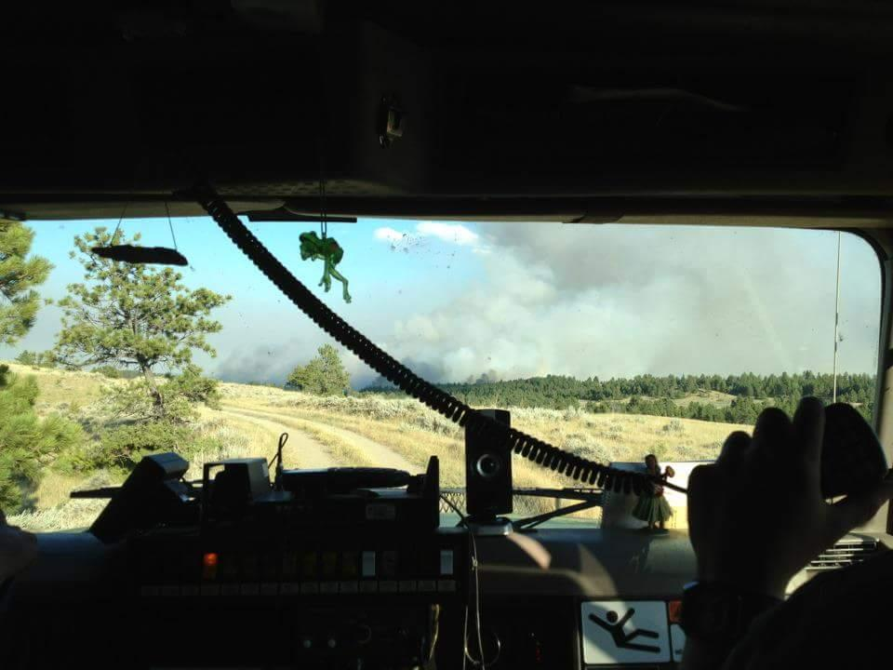
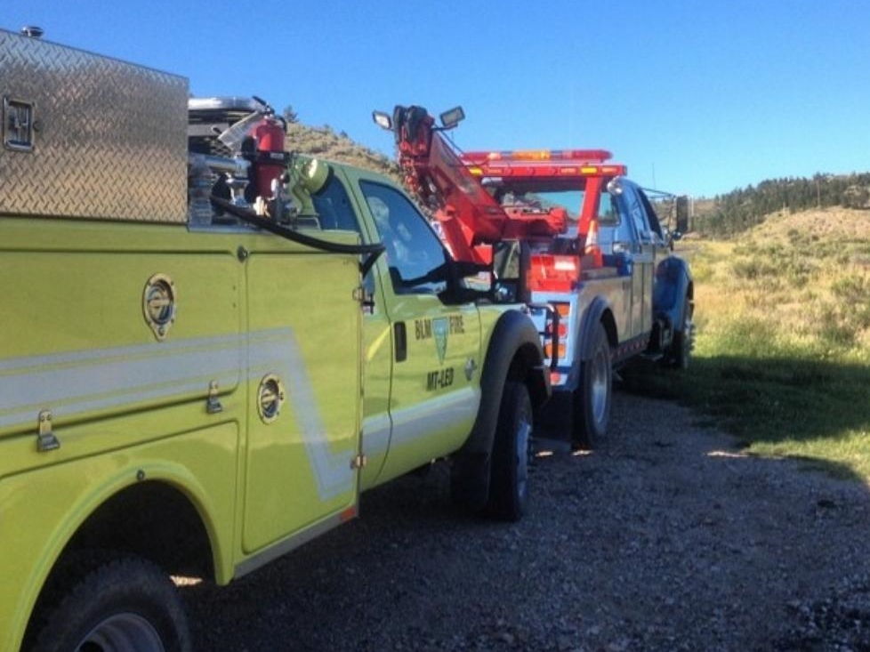
Vehicle Operations and Recovery

Slide 24
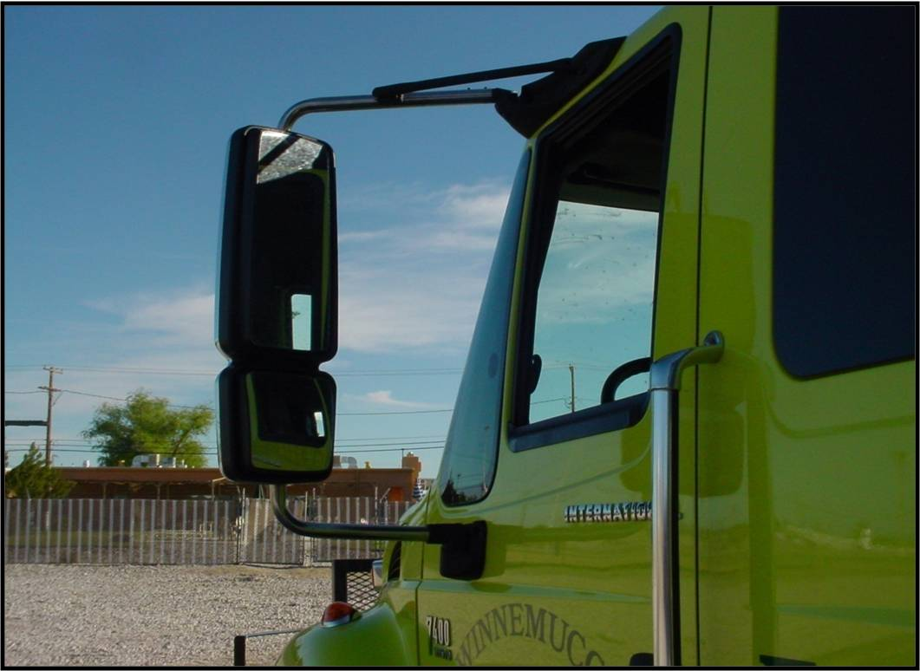
Mirror and Seat Adjustment

Slide 25
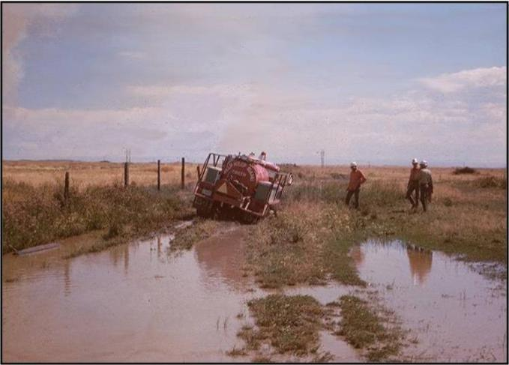
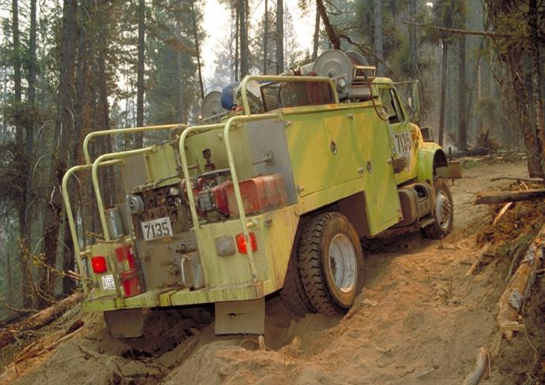
Mud and Sand Areas

Slide 26
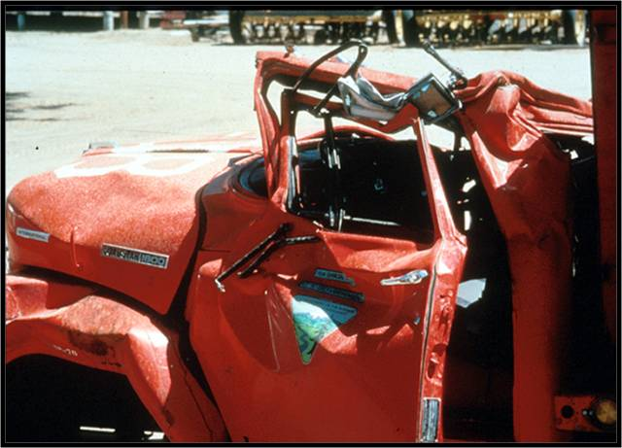
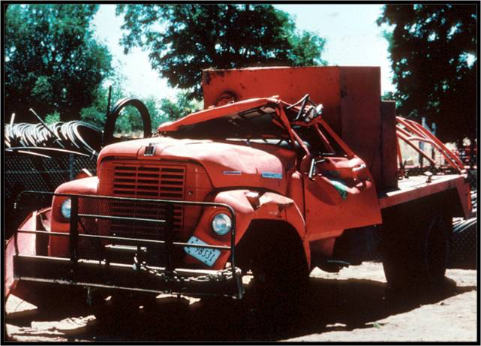
Side Hills

Slide 27
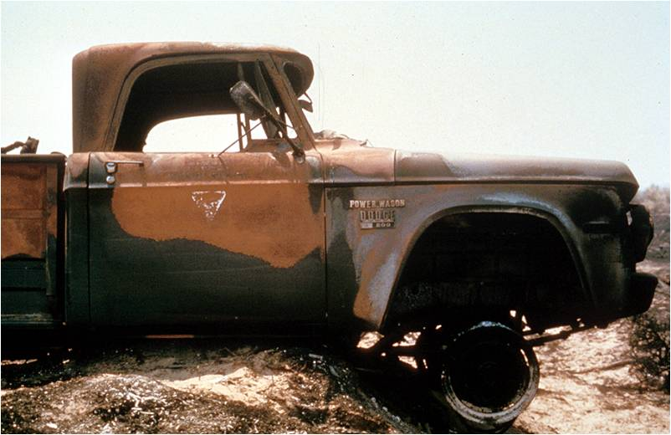
Gullies/Ditches

Slide 28
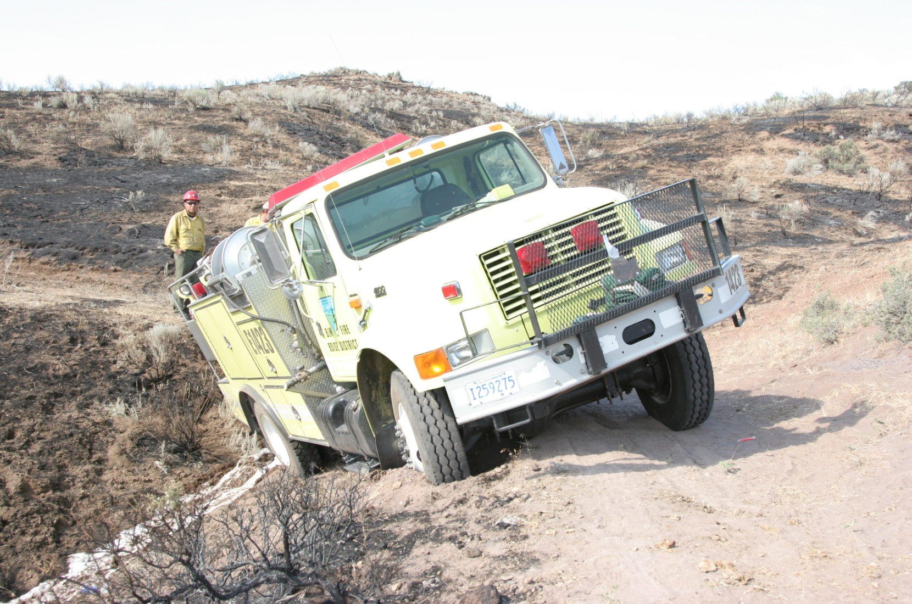
Vehicle Recovery

Slide 29
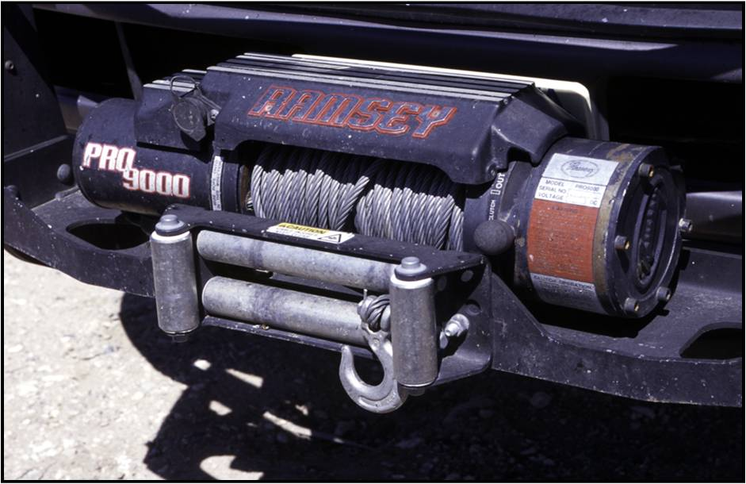
Winch Use

Slide 30
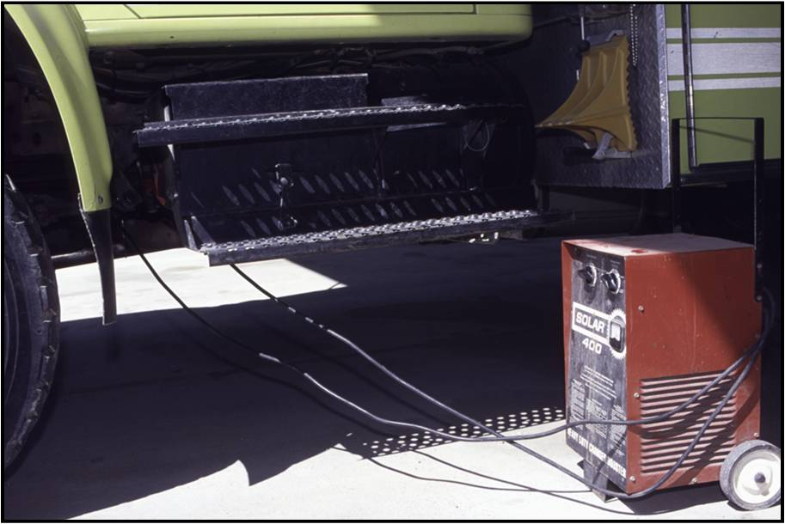
Jump Starting

Slide 31
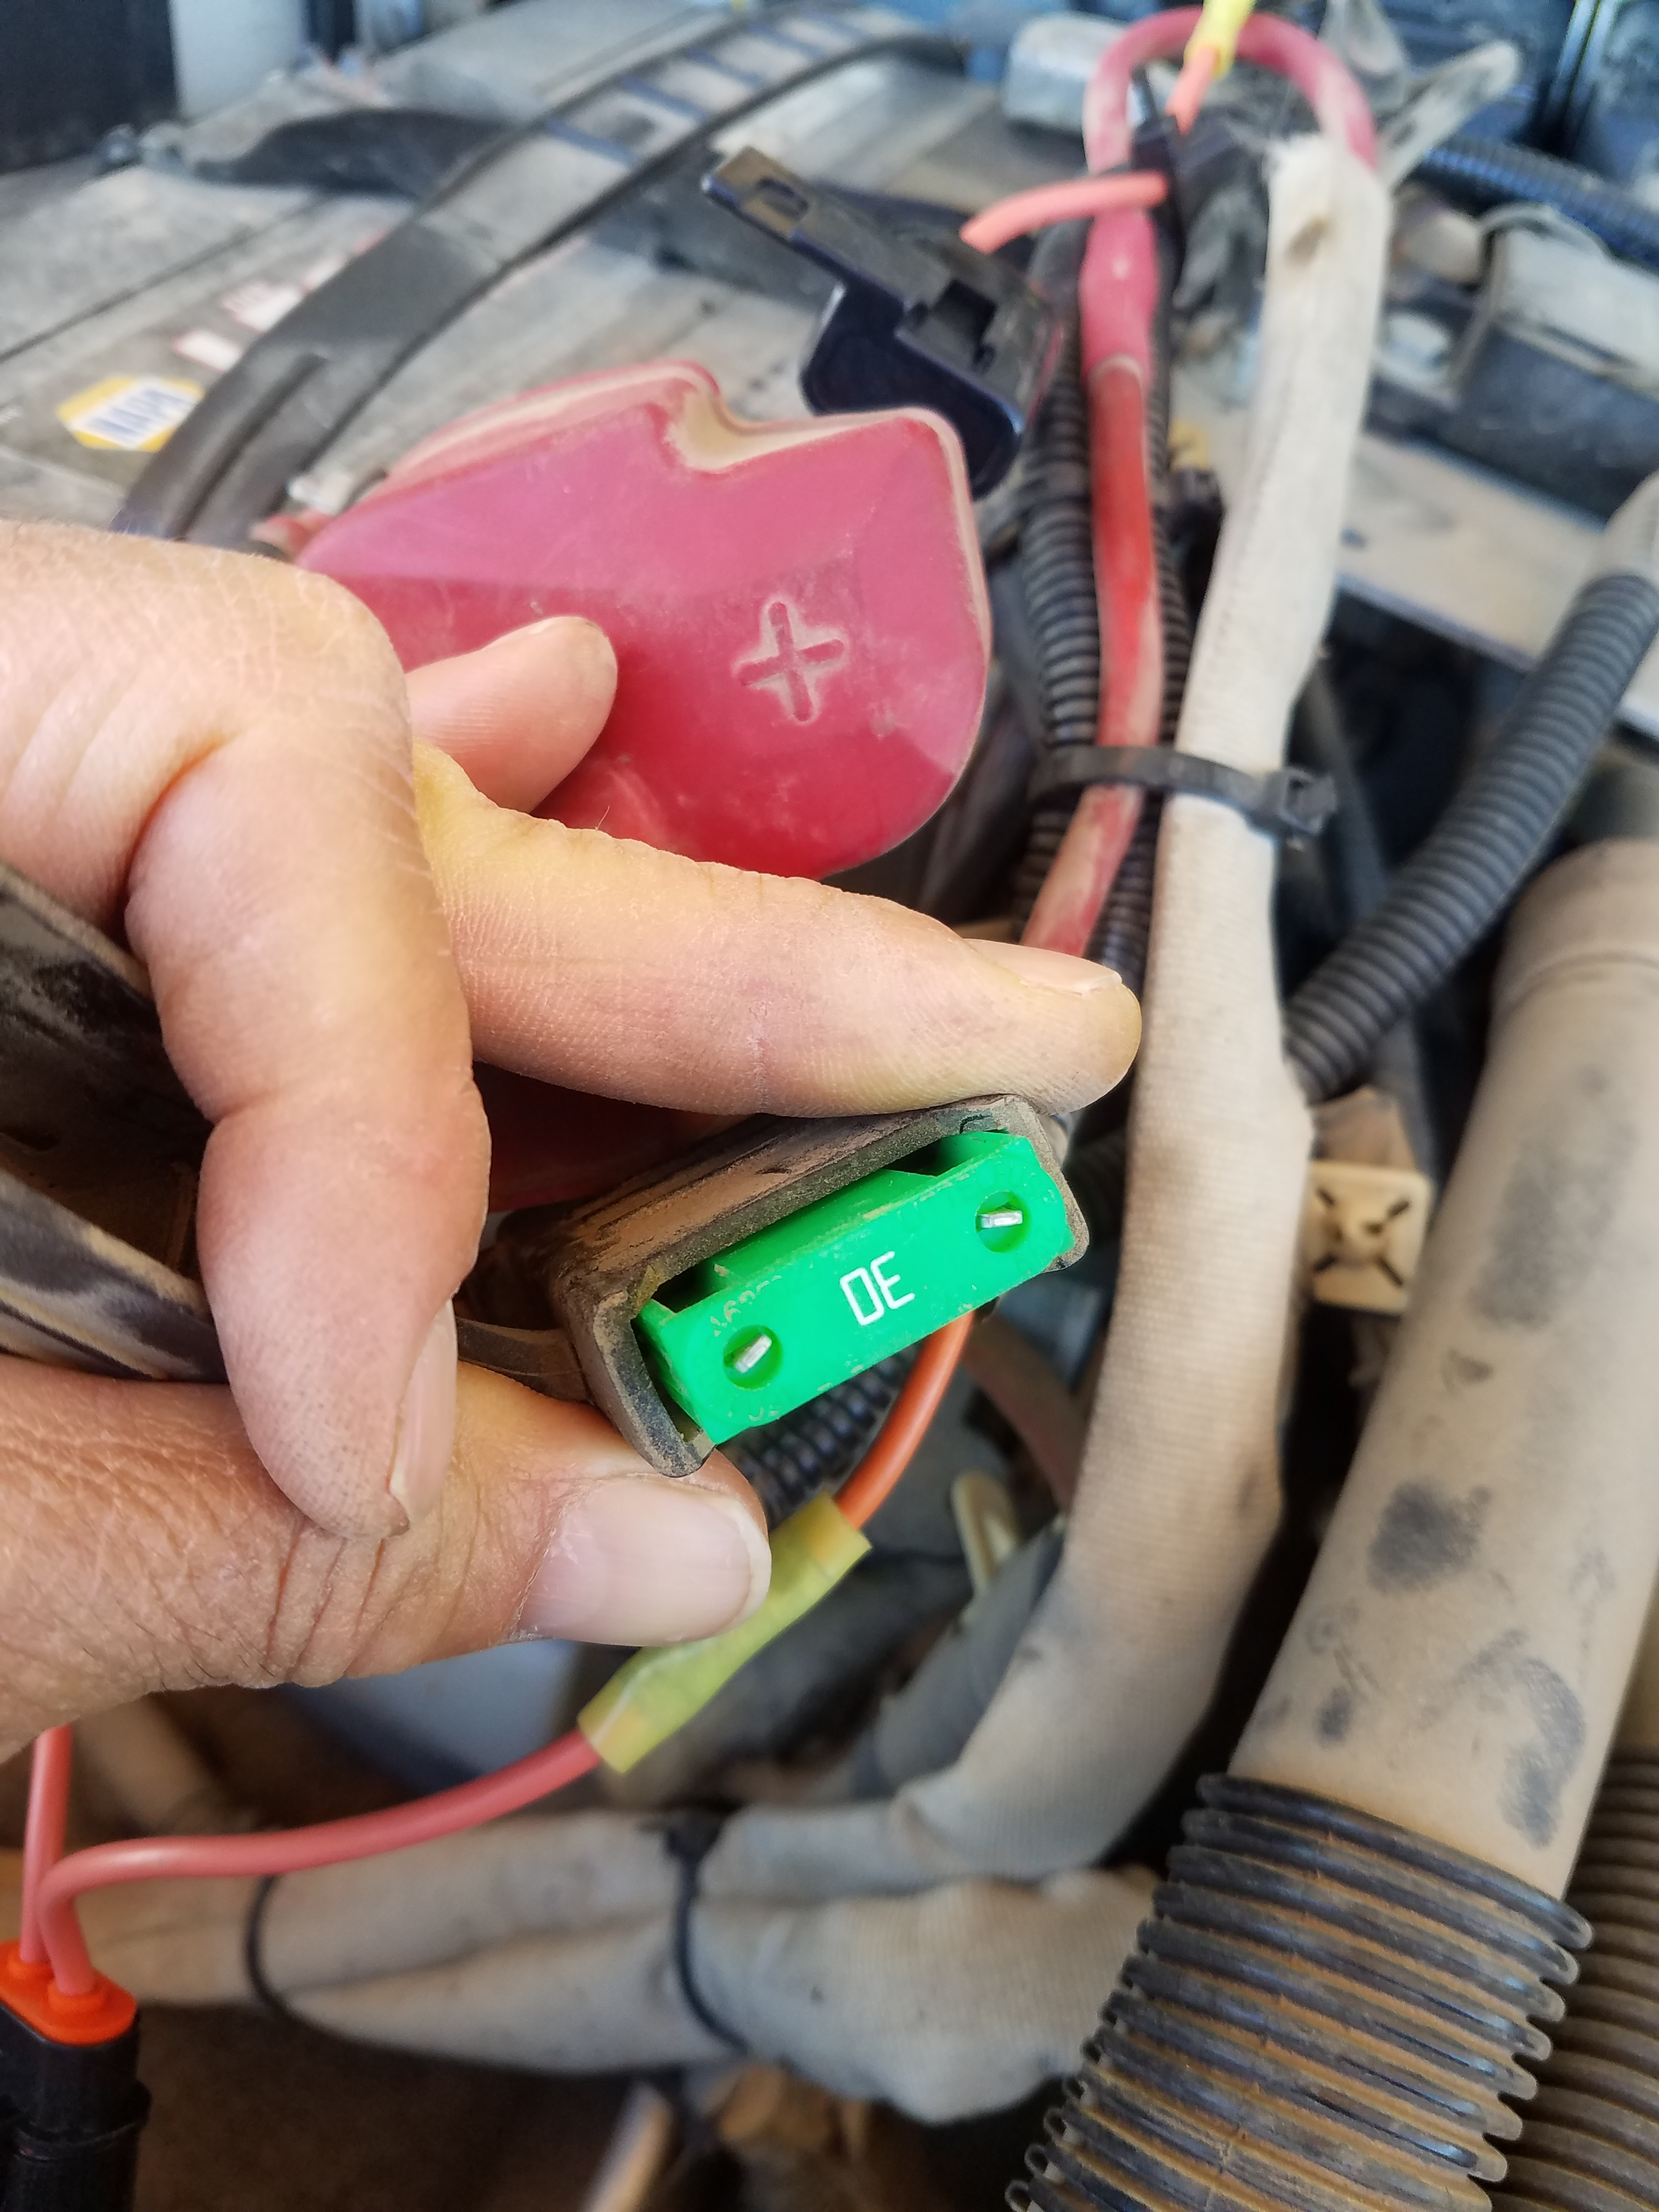
BIA M-52 Remove Radio Fuse
Most M-52 Radios are Fused at the Battery.
Remove Fuse Before Jump Starting.
Failure Will Lead to Serious Radio Damage for the KNG M-Series Radios.
B/K (Old Style) are Less Vulnerable But Can Still Become Damaged.

Slide 32
Portable Battery Jump Starter
Works on Model 52 engines
Inexpensive.
Easily Stored.
Does Not Need a Second (Jumper) Vehicle.

Slide 33
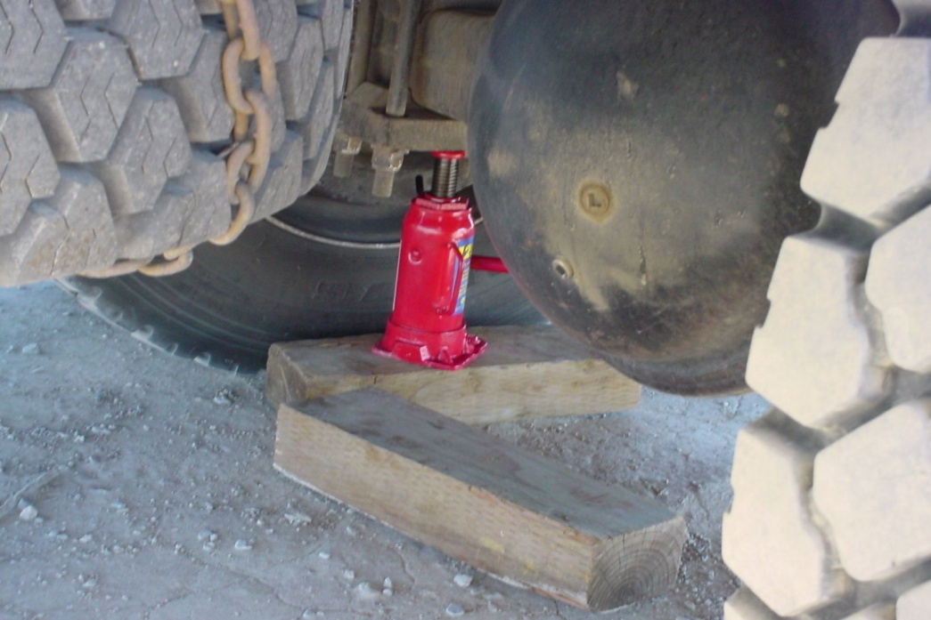
Tire Changing and Jacking

Slide 34
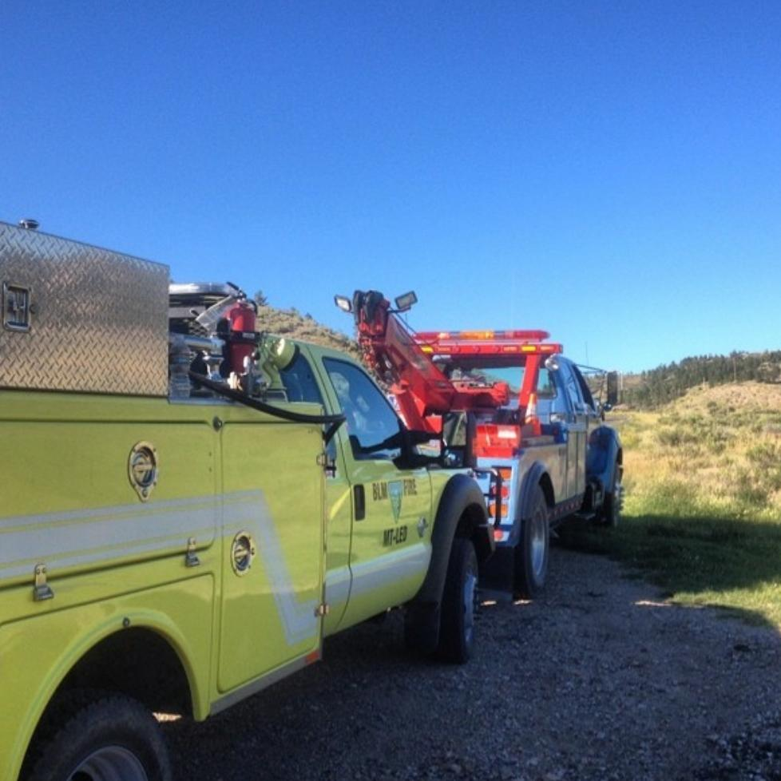
Towing and Being Towed

Slide 35
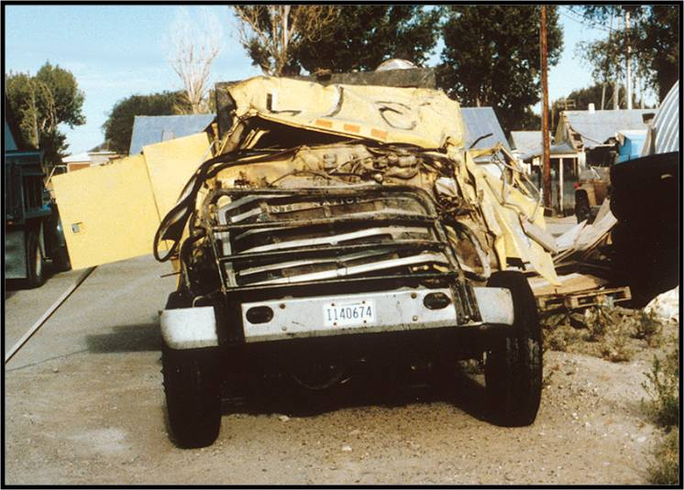
Driving Safety
The crew depends on you!

Slide 36
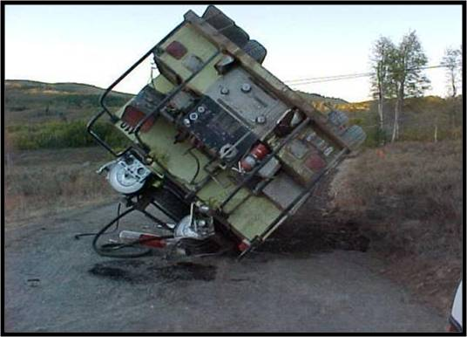
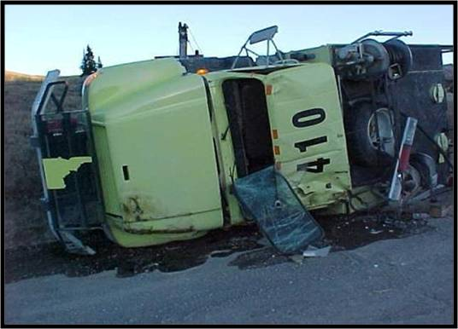
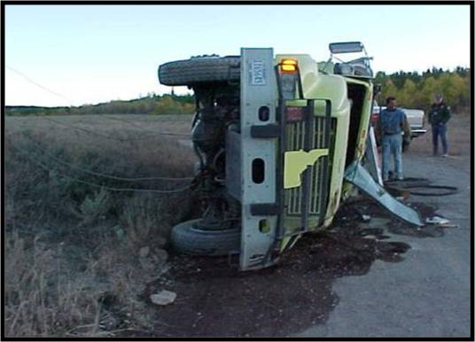
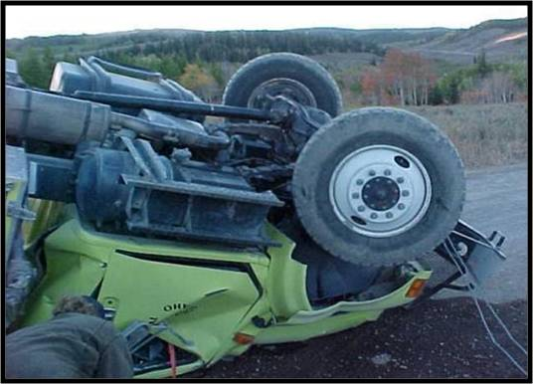
Follow Safe Driving Practices

Slide 37
Following Other Vehicles

Slide 38
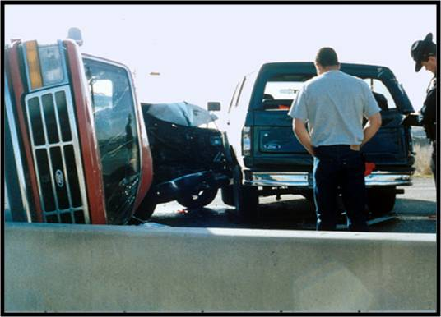
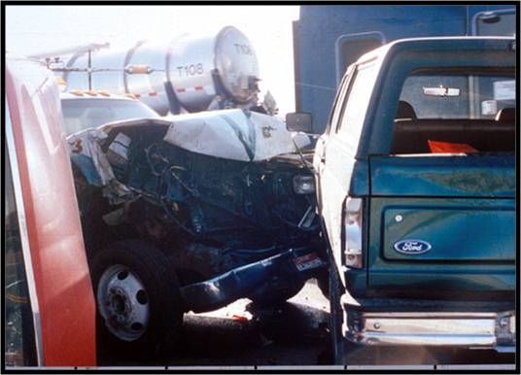
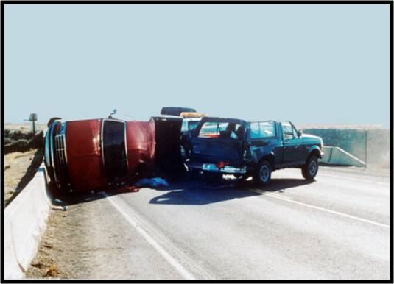
Braking/Stopping Distance

Slide 39
Blown Tire Technique
The goal in any rapid loss of tire pressure or “blowout” is to keep the vehicle balanced and controllable. Do not panic. Any over-reaction by the driver—including slamming on the brakes or abruptly removing your foot from the accelerator—can result in a loss of vehicle control.
What you should not do:
Do not step on the brake.
Do not abruptly release your foot from the brake pedal.
What you should do:
Accelerate slightly or keep steady pressure on the accelerator pedal.
Gently correct the steering as necessary to stabilize your vehicle and regain control. Look where you want the vehicle to go and steer in that direction.
Once your vehicle has stabilized, slowly remove your foot from the accelerator pedal allowing the vehicle to slow on its own.

Slide 40
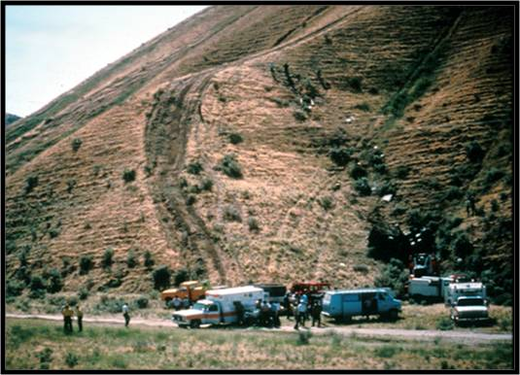
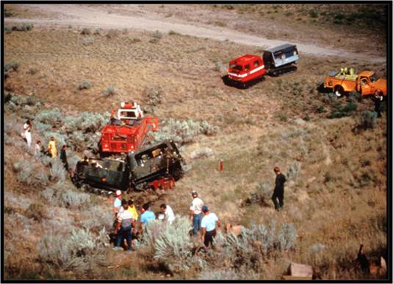
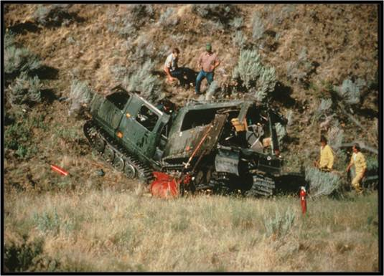
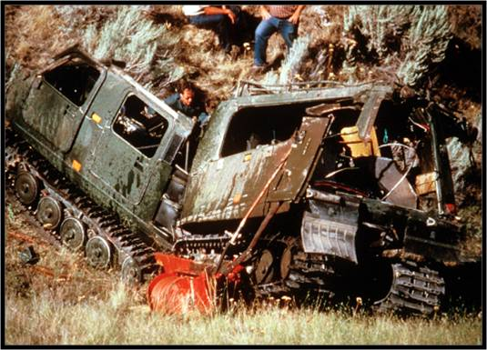
Off-Road Driving

Slide 41
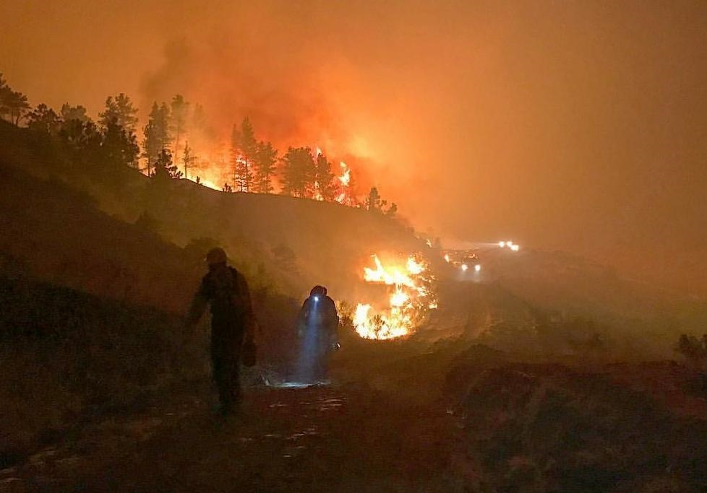
Night Driving

Slide 42
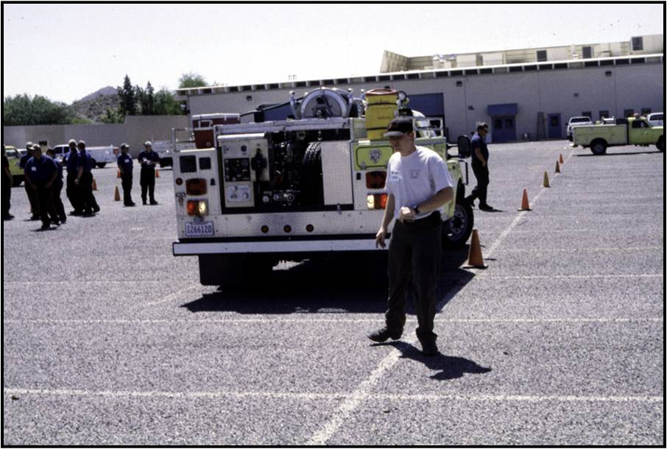
Backing

Slide 43
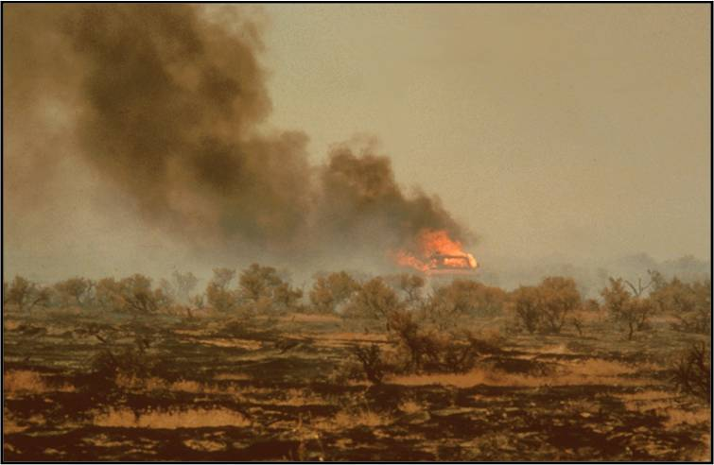
Engine Placement

Slide 44
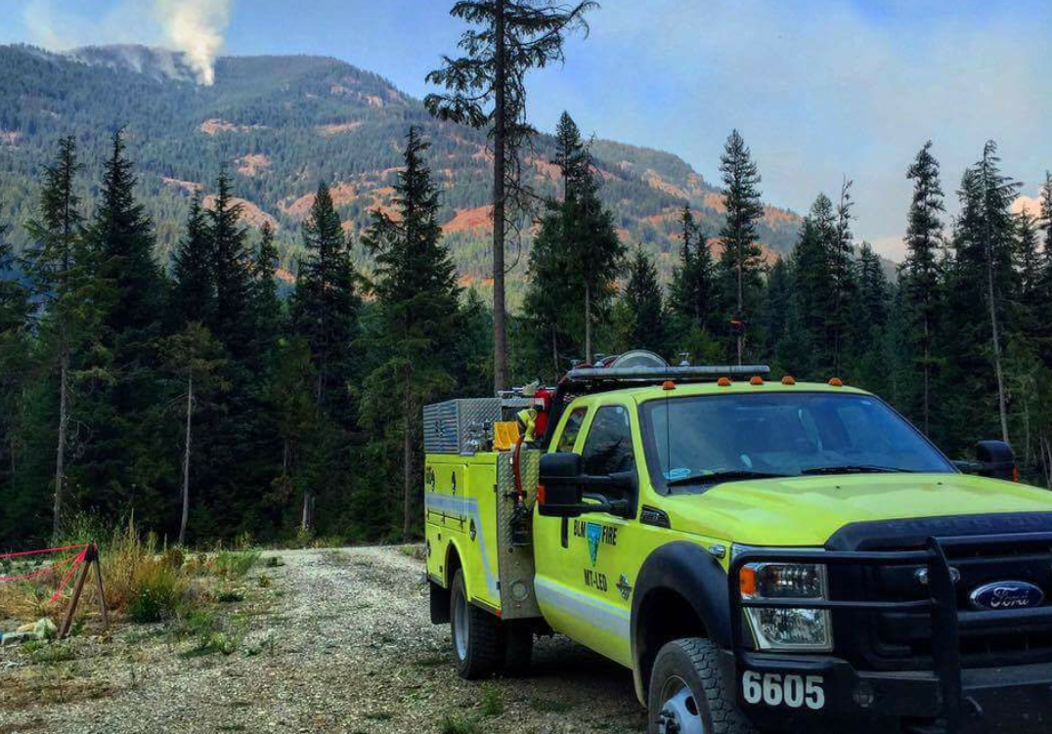
Ingress and Egress

Slide 45
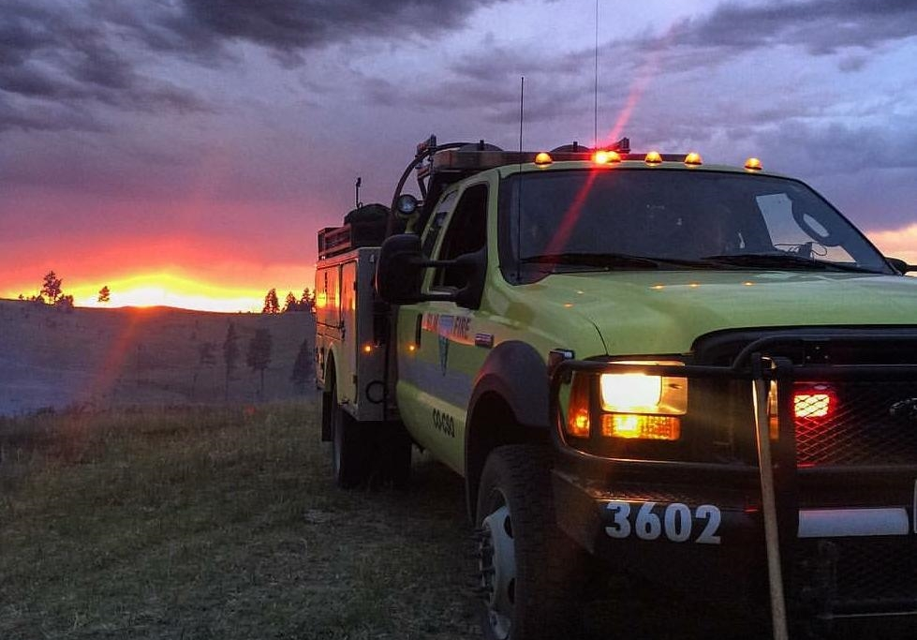
Parking

Slide 46
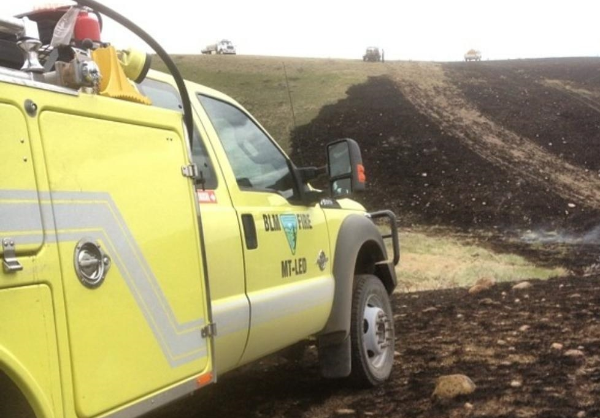
The Black

Slide 47
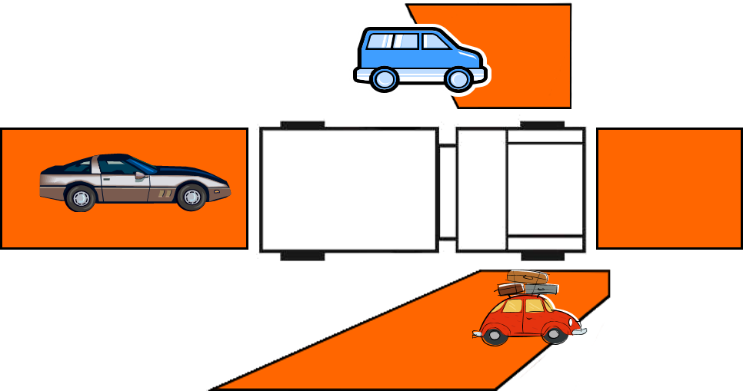
Blind Spots

Slide 48
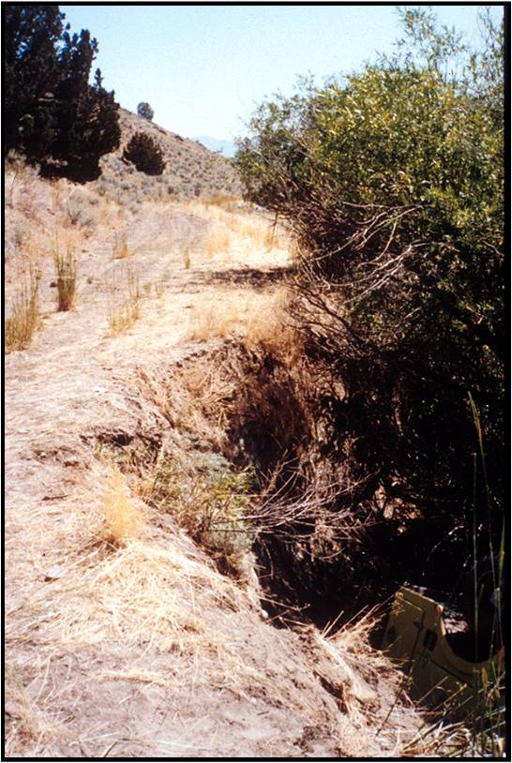
Hazards
Pay attention to your surroundings!
What hazards do you see in this picture?

Slide 49
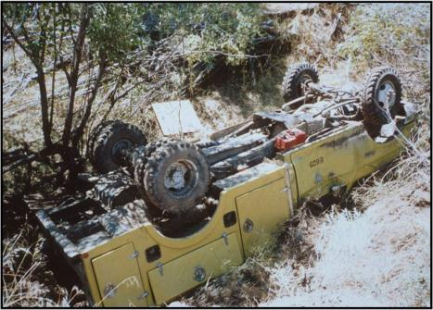
What was in the picture . . .
Creek undercut the road bank
Narrow passage way
Various terrain and fuel types
Rolled engine!

Slide 50
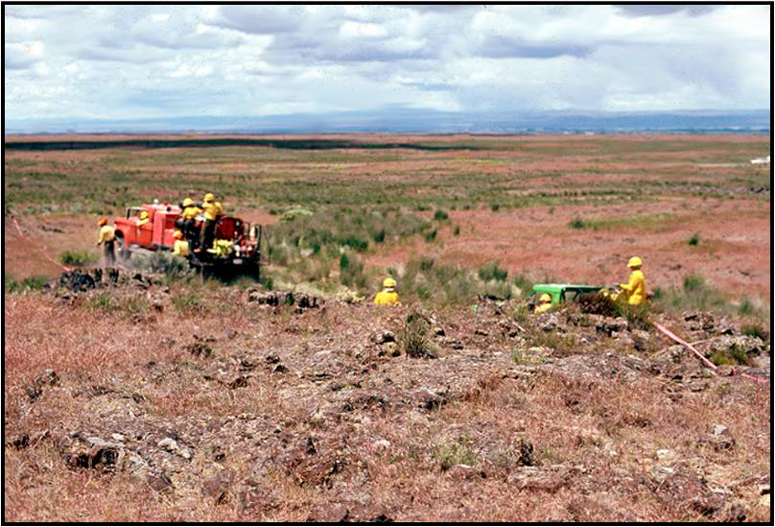
Rock Piles/Outcroppings

Slide 51
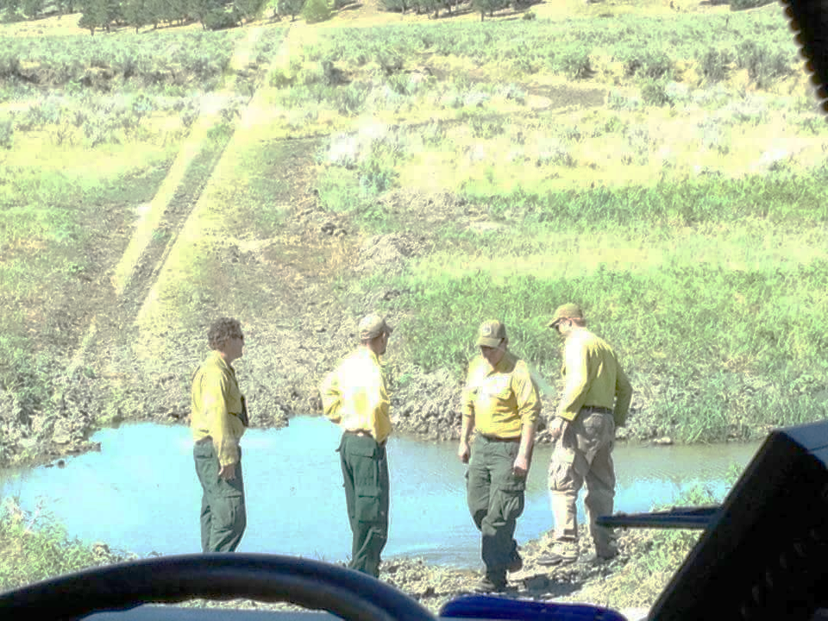
Various Terrain and Fuel Type Changes

Slide 52
Aircraft

Slide 53
Wild and Domesticated Animals

Slide 54
Poor Weather Conditions

Slide 55
Wildland-Urban Interface

Slide 56
Staying Alert

Slide 57
Post Off-Road Inspection

Slide 58
Driving Reminders

Slide 59
Driving Reminders
More time can be made up by getting out of the station quickly than by speeding en route.
Keep your vehicle in top condition. Inspect it regularly.

Slide 60
Driving Reminders
Never let distractions interfere with your driving.
Good drivers drive smoothly and with control, not recklessly or erratically.
A heavier piece of equipment will not stop as easily as a passenger car.

Slide 61
Accidents do not “just happen”

Slide 62
Cone Course Exercise

Slide 63
Objectives
Describe and demonstrate the driver walk-around before moving a fire engine.
Describe the STOP procedure and how it relates to the driver when operating a fire engine.
Identify danger zones around fire engines and describe actions that can be performed to reduce risk in these areas.

Slide 64
Objectives
Describe and demonstrate the start-up and shifting procedures an ENOP must perform when operating fire engines.
Identify hazardous driving situations and describe actions that can be performed to reduce risk.
Demonstrate on an established course fire engine handling and maneuvering capabilities.

