Slide 1
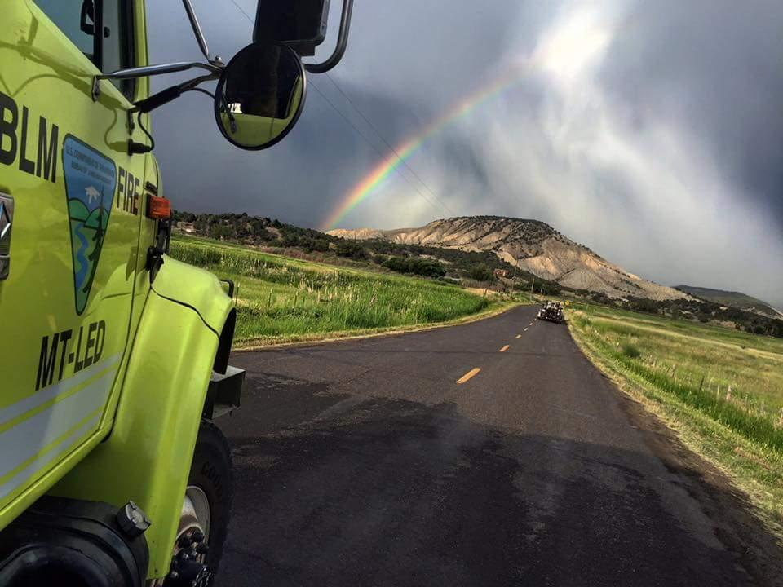
Fire Engine Driving Operations
Unit 3A – Driving Policy and Procedures

Slide 2
Objectives
Discuss agency policies and regulations related to driving fire engines.
Discuss and interpret duty-day limitations.
Identify the components of a risk assessment (RA).

Slide 3
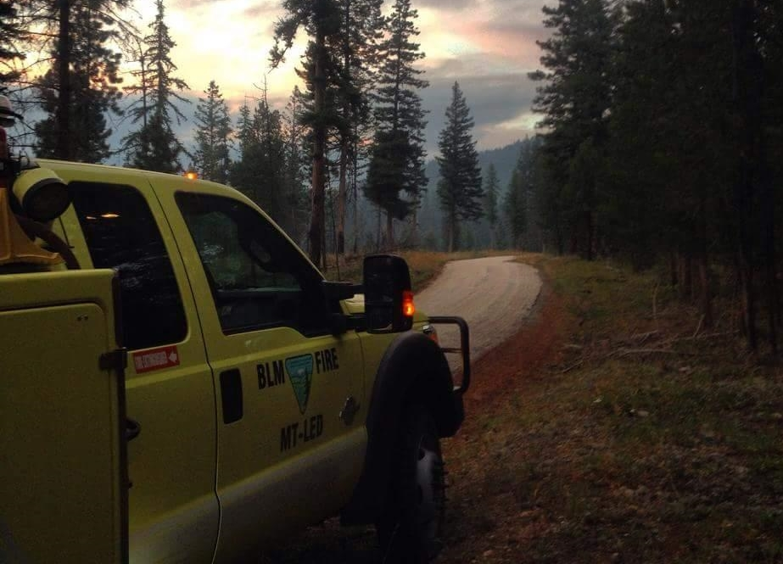
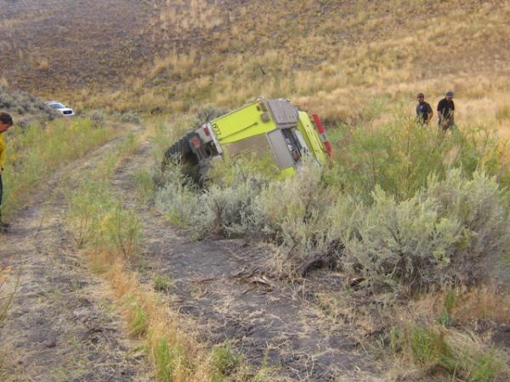
Agency Policies and Regulations

Slide 4
Drug-Free Work Place
Executive Order 12564
Interagency Standards for Fire and Fire Aviation Operations

Slide 5
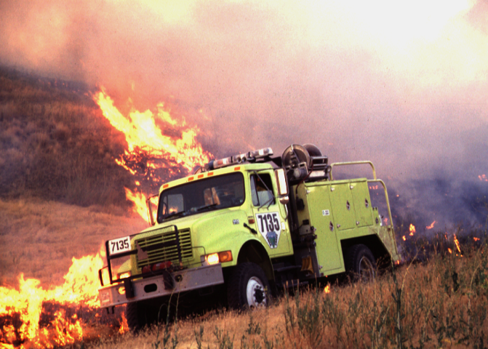
Fire Vehicle Operation Standards

Slide 6
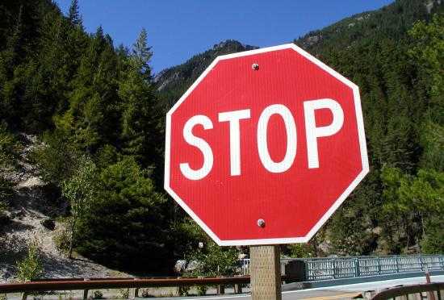
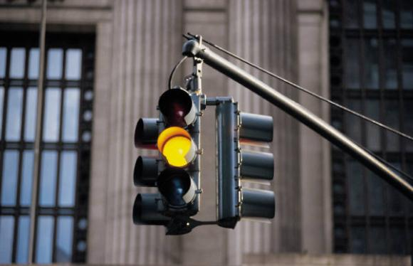
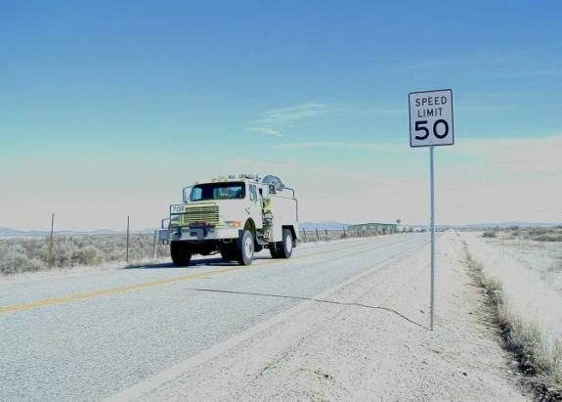
State Traffic Regulations

Slide 7
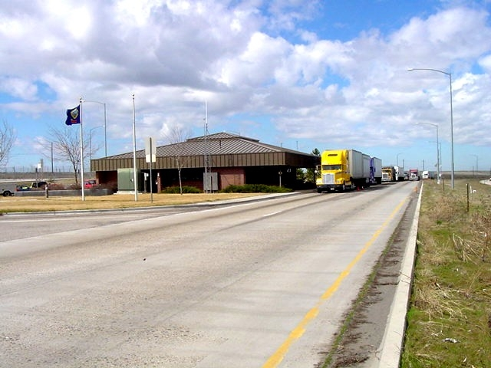
State Traffic Regulations

Slide 8
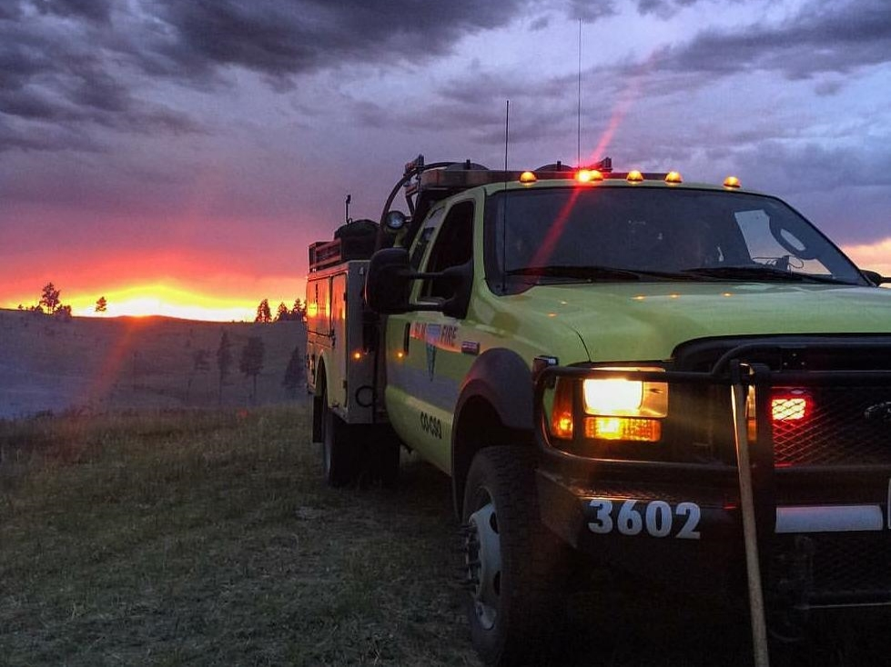
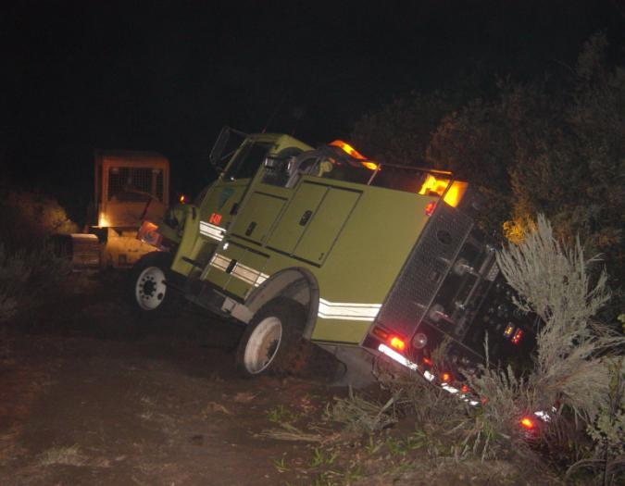
Lights

Slide 9
General Driving Policy
Valid state driver’s license
Defensive driver training
Seat belts
Government Motor Vehicle Operator’s Identification Card (BLM policy)
Government Motor Vehicle Operator’s Identification Card (BIA policy)
Physical Fitness Inquiry for Motor Vehicle Operators (BLM policy)

Slide 10
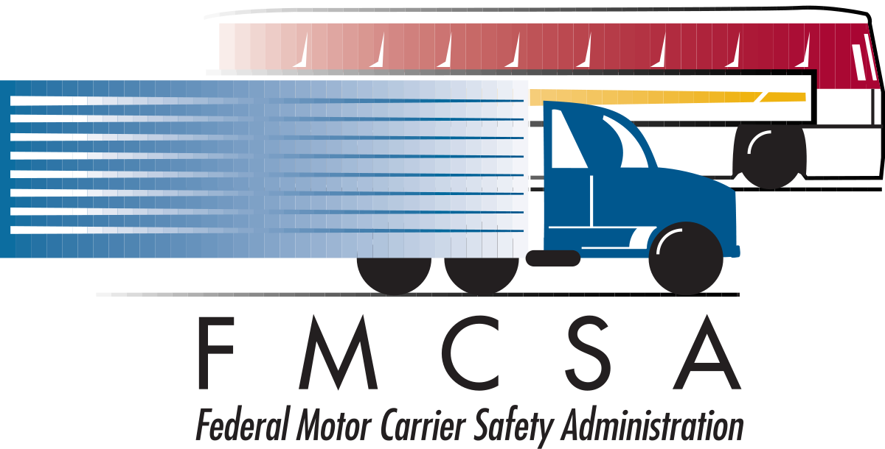
Driving Limitations
CDL for ENOPs operating vehicles in excess of 26,000 GVW
DOT exemptions for wildland fire

Slide 11
Incident Operations Driving
No driver will drive more than 10 hours (behind the wheel) within any duty day.
Multiple drivers in a single vehicle may drive up to the duty-day limitation provided no driver exceeds the individual driving (behind the wheel) time limitation of 10 hours.
Driving hours are from 0500-2200 hours.
To manage fatigue, every effort should be made to avoid off-unit (excluding IA response) mobilization and demobilization travel between 2200-0500 hours.
Notes:
25 IAM Chapter 4 is the official BIA driving policy, updated in April 2020. This sets the duty day limitations for one driver at 8 hours. This is also in the 2022 Red Book.

Slide 12
Incident Operations Driving
A driver shall drive only if he/she has had at least eight (8) consecutive hours off duty before beginning a shift. Exception to the minimum off-duty hour requirement is allowed when essential to:
Accomplish immediate and critical suppression objectives.
Address immediate and critical firefighter or public safety issues.

Slide 13
Work/Rest Guidelines
Documentation is required for shifts in excess of 16 hours.
Minimum 2:1 work-to-rest ratio (for every two hours of work or travel, provide one hour of sleep and/or rest)

Slide 14
Work/Rest Driving Scenarios

Slide 15
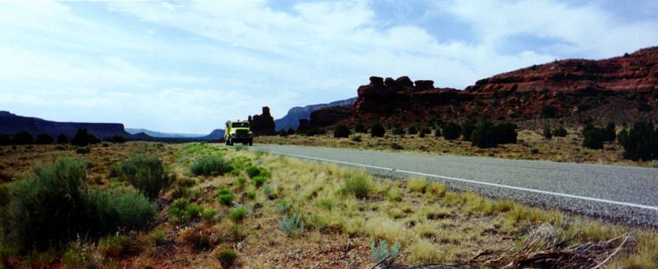
Scenario 1
You (the ENOP with a CDL) and a module member (non-CDL driver) are traveling to another state in a Type 4 engine. The trip length is estimated at 26 hours.
How many days will it take to reach your destination?

Slide 16
Scenario 1 - Answer
Three days
“No driver will drive more than 10 hours (behind the wheel) within any duty day.”
The non-CDL driver is not allowed to drive the engine.

Slide 17
Scenario 2
You (the ENOP with a CDL) and a module member (non-CDL driver) are traveling to another state in a Type 6 engine. The trip length is estimated at 26 hours.
How many days will it take to reach your destination?

Slide 18
Scenario 2 - Answer
Two days
“Multiple drivers in a single vehicle may drive up to the duty-day limitation provided no driver exceeds the individual driving (behind the wheel) time limitation of 10 hours.”
The non-CDL driver is allowed to drive the engine, but both drivers are subject to the 16-hour duty day.

Slide 19
Scenario 3
While on assignment on a 200,000-acre fire and working 12-hour shifts, the division group supervisor asks your crew to work an extra 8-hour shift to monitor the line.
Is this something your crew can do?

Slide 20
Scenario 3 - Answer
No. This will exceed the 2:1 work-to-rest ratio.
However, the Incident Commander could write a justification authorizing the action.

Slide 21
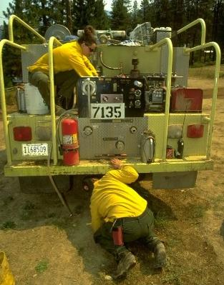
Driver Walk-around
A driver walk-around will be done every time the engine is moved.

Slide 22
BIA Has No set Policy, however-
"One Person"
"Buddy System"
To walk from your driver's side door all the way around the vehicle looking for damage, once you reach the driver's door get in.
Start at the side you approach from, walk around until you reach the starting point.
The Captain checks drivers' side, ENOP (or Engineer) checks passenger side. Both meet after inspecting their ½ of the vehicle and confirms the vehicle is ready to operate.
Notes:
Can do driver walk around using the one person or use the "buddy system" with two people.

Slide 23
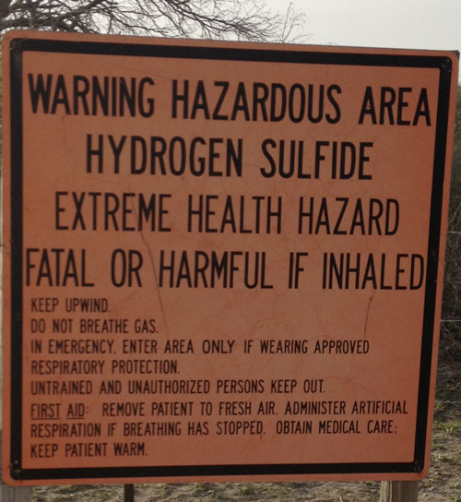
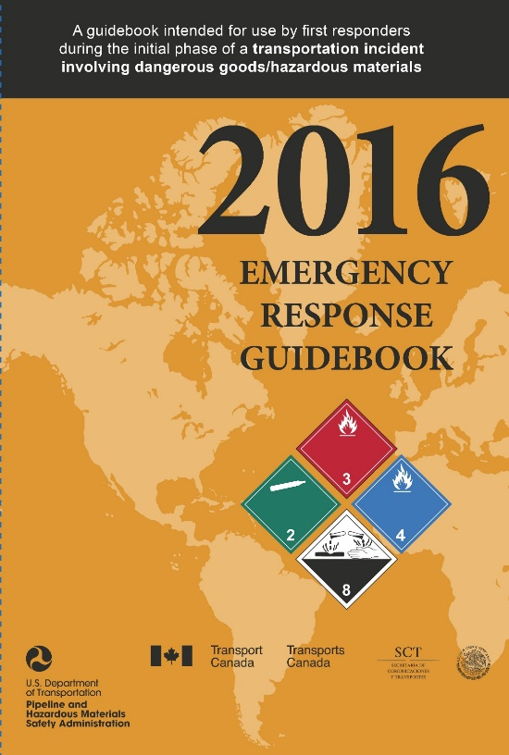
Hazardous Materials

Slide 24
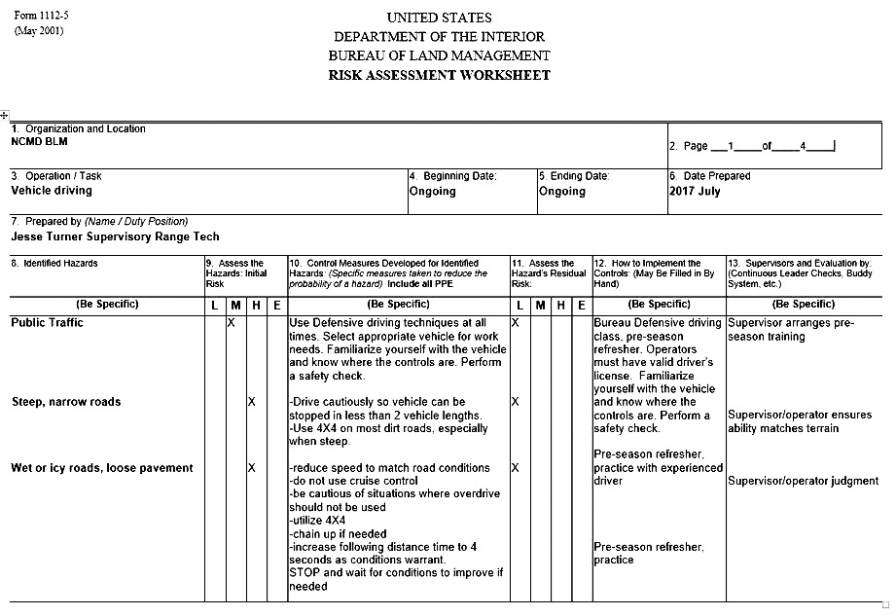
Safety and the RA

Slide 25
What is a Risk Assessment?
A risk assessment (RA) is a technique that focuses on job tasks as a way to identify hazards before they occur. It focuses on the relationship between the worker, the task, the tools, and the work environment. Ideally, after you identify uncontrolled hazards, you will take steps to eliminate or reduce them to an acceptable risk level.

Slide 26
Why Complete a Risk assessment?
A completed RA is required for:
Jobs or work practices that have potential hazards.
New, non-routine, or hazardous tasks to be performed where potential hazards exist.
Jobs that may require the employee to use non‑standard personal protective equipment (PPE).
Changes in equipment, work environment, conditions, policies, or materials.
Interagency Standards for Fire and Fire Aviation Operations

Slide 27
Why do a Risk Assessment? (Continued)
Supervisors and appropriate line managers must ensure that established JHAs are reviewed and signed prior to any non-routine task or at the beginning of the fire season.
BLM – A risk assessment (in lieu of JHA) must be completed for all non-suppression work practices/projects that have potential hazards.”
Interagency Standards for Fire and Fire Aviation Operations
FOR BIA
A completed JHA/RA is required for:
• Jobs or work practices that have potential hazards.
Interagency Standards for Fire and Fire Aviation Operations

Slide 28
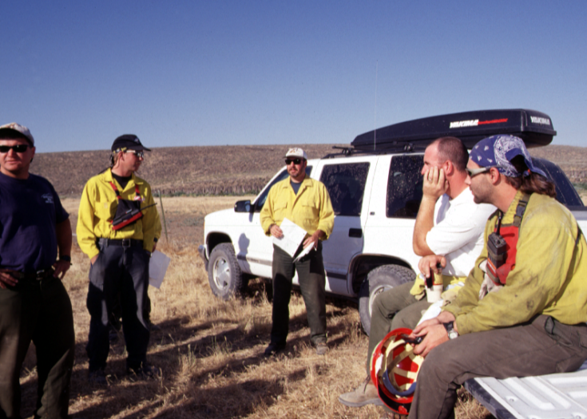
Tailgate Safety Session
Notes:
BIA utilizes tailgate safety sessions as a component of discussing the risk assessment and identifying mitigations for hazards.

Slide 29
Objectives
Discuss agency policies and regulations related to driving fire engines.
Discuss and interpret duty-day limitations.
Identify the components of a risk assessment (RA).

