Slide 1
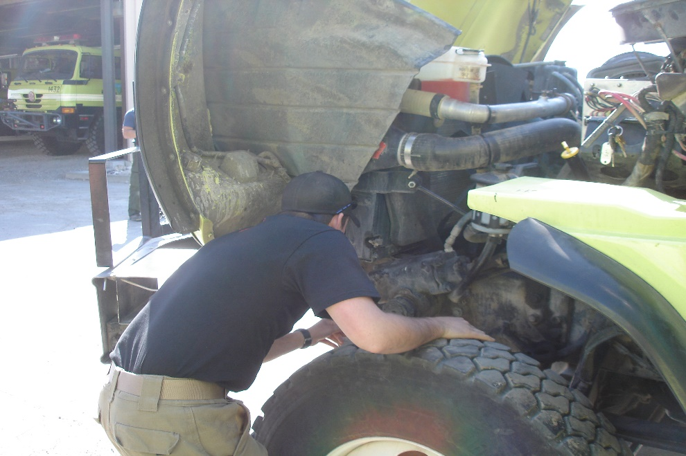
Fire Engine Maintenance
Unit 1A – Diesel Engine Operation and Maintenance

Slide 2
Objectives
Describe…
Differences between diesel fuel and gasoline
Major components of a diesel fuel system
Correct operating procedures/parameters of starting a diesel engine
Basic powertrain components of a fire apparatus and each component’s operating characteristics
Discuss…
Diesel particulate filter and its function in the regeneration process

Slide 3
Diesel Vs. Gasoline
Built stronger
More fuel efficient
Produce torque at a lower RPM
Use compression ignition
Weigh more

Slide 4
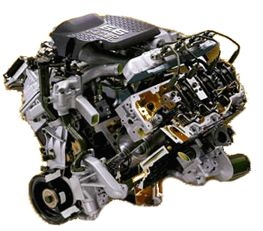
Torque and Horsepower
Torque
Horsepower
How much work can get done
Force x Distance
How fast work gets done
Torque ÷ Time

Slide 5
Diesel Fuel

Slide 6
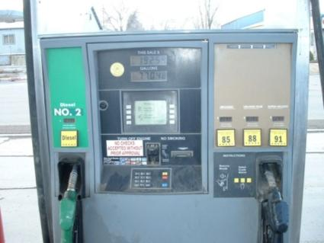
Diesel Fuel Vs. Gasoline
Diesel fuel:
Is heavier and oilier
Evaporates much more slowly
Burns for a longer duration
Has a higher energy content

Slide 7
Octane vs. Cetane Number
Octane Number (Fuel grade of the gasoline)
Cetane Number
Measurement of a fuel’s ability to resist self-ignition when subjected to heat and pressure
The higher the octane number, the more control there is over the fuel’s ignition point.
Fuel should not start burning before the spark plug fires.
Describes diesel fuel’s ignition characteristic
The higher the cetane number, the easier the fuel is to ignite.
A cetane number of 40 is common for most diesel engines.
Certain manufacturer warranties stipulate the use of 50 cetane-rated fuel.

Slide 8
Diesel Fuel Differences
On-Road Diesel
Off-Road Diesel
Used in vehicles that travel on federal, state, and local highways and roads
Road maintenance tax
Yellowish to clear in color
Strictly used by vehicles traveling off-road
Not subject to road taxes
Reddish in color (red fuel or dyed)

Slide 9
No. 2 and No. 1 Diesel Fuels
Number 2 Diesel (No. 2)
Number 1 Diesel (No. 1)
Most widely used grade of diesel fuel
Provides improved power and better mileage than No. 1 diesel (heat energy)
Most widely used fuel in very cold environments
Considered a non-gelling fuel
Winter Grade
In most areas where the weather can become cold, distributors will blend No. 1 and No. 2 diesel together for a winterized fuel.

Slide 10
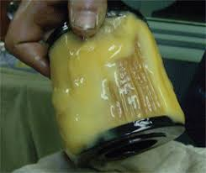
Cold Weather
Diesel fuel is a hydrocarbon made up of paraffin (wax).
Cold weather can result in:
Gelled fuel
Hard starting

Slide 11
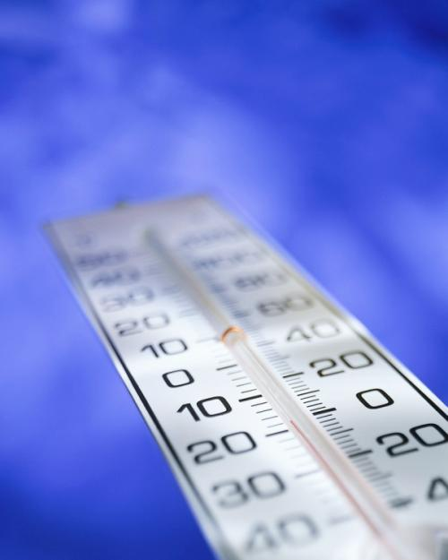
Preventing Gelling
Buy winter grade fuel.
Add a fuel conditioner.
Employ fuel heaters.
Keep your fuel tank full.

Slide 12
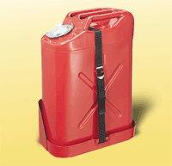
Fuel Handling Practices
Keep your fuel tank full of clean fuel.
Never store diesel fuel in galvanized containers.
Never pour the diesel fuel out of your old fuel filter into the new filter.
Keep water out of the fuel system.

Slide 13
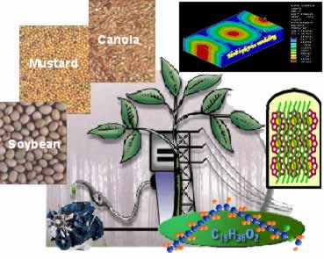
Biodiesel Fuel
Alternative or additive
Made from biological ingredients instead of petroleum (or crude oil)

Slide 14
Using Biodiesel Fuel
Biodiesel is a blended fuel.
B20 is 20% biodiesel and 80% diesel
B20 and B40 are the most common blends.
Use of blended fuel with a rating higher than B20 may void some manufacturer’s warranties.

Slide 15
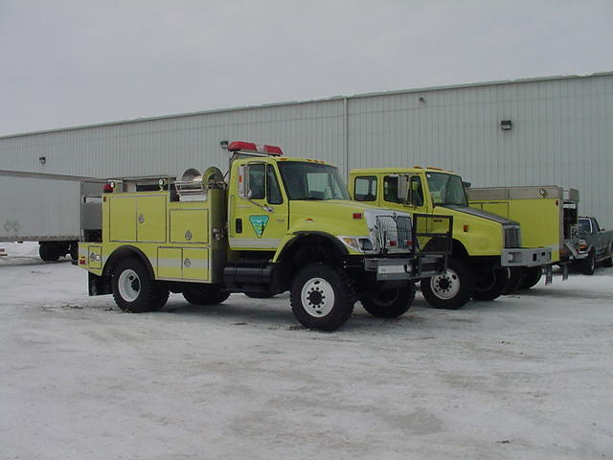
Biodiesel Fuel Concerns
Known to clog fuel filters of older diesel engines
Add fuel conditioners for winter storage.

Slide 16
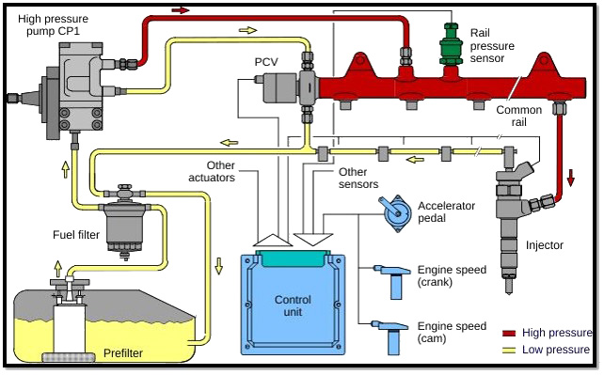
Diesel Fuel Systems

Slide 17
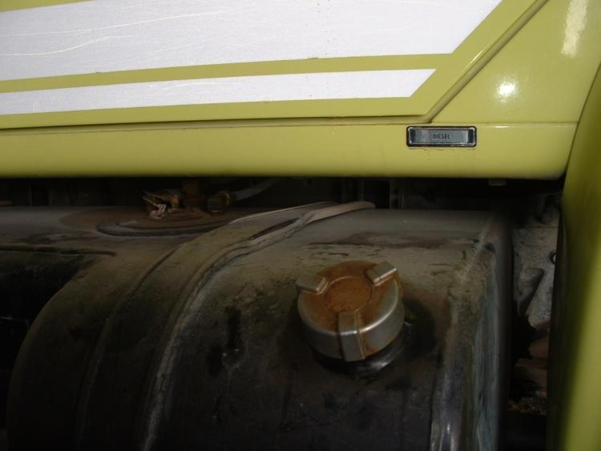
Fuel Tank
Use correct, clean fuel.
Keep tank full.
Keep fuel cap and surrounding area free of debris.
Check for restricted fuel tank vent line.

Slide 18
High- and Low-Pressure Lines
Low-Pressure Fuel System
High-Pressure Fuel System
Carries fuel from the tank to the filters and then to the fuel injection pump.
Carries back to the tank the fuel that is used for lubricating and cooling the injectors, the injector pump, and for bleeding the filters.
Carries fuel from the high pressure injection pump to the injectors and recirculation back to the injection pump or just stays in the rail until used in the motor.
60,000 to 90,000 PSI!

Slide 19
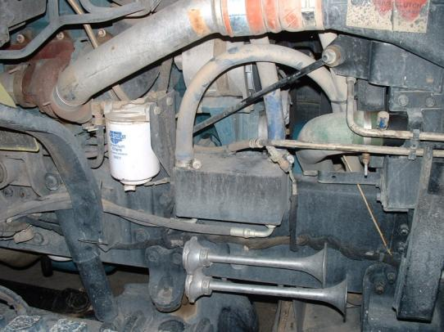
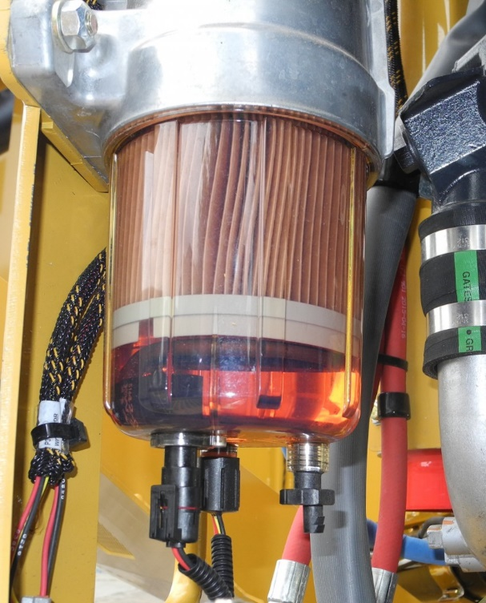
Primary Filter/Water Separator
Collect waters and dirt particles which cause the engine to run poorly or damage the injection equipment.

Slide 20
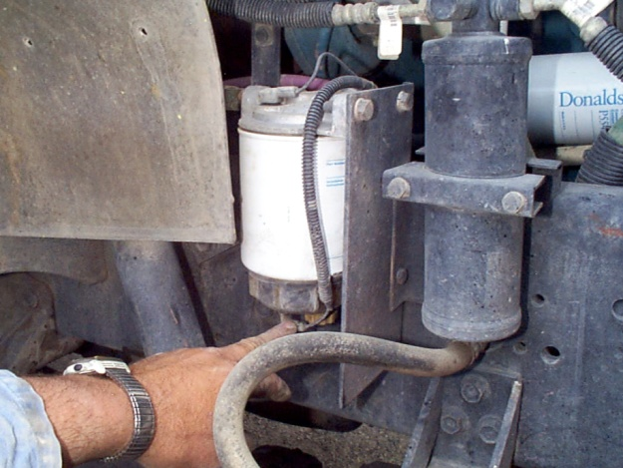
Water in Fuel (WIF) Light
A sensor detects the presence of water in the fuel.
If the WIF light comes on, stop and drain the primary filter immediately.

Slide 21
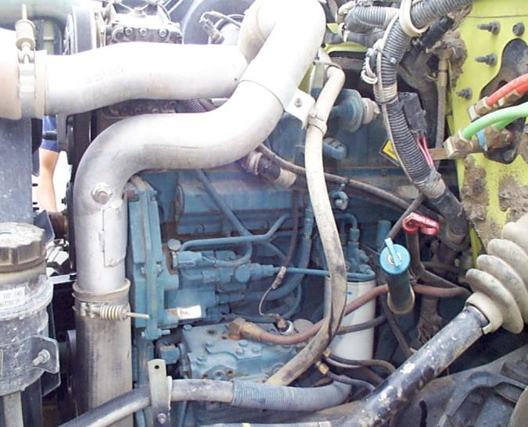
Secondary Fuel Filter
The secondary fuel filter removes smaller particles before fuel goes to the injectors.

Slide 22
Filter Maintenance
At a minimum, drain the water separator once a week.
Replace the primary and secondary filter when the engine oil is changed.

Slide 23
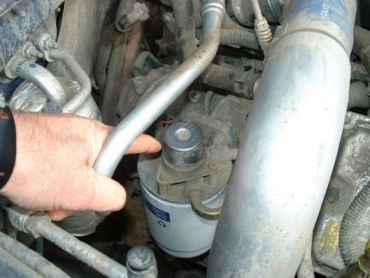
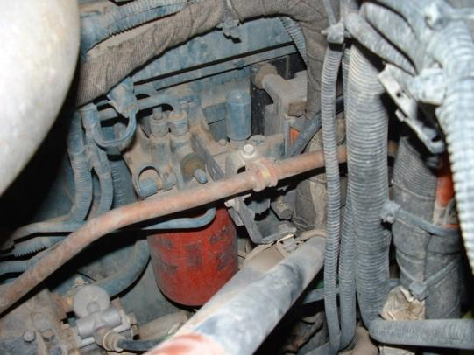
Hand Primer Pump
Used to bleed the fuel system.
Bleeder must be opened to allow air to escape.
Bleeders
Pump

Slide 24
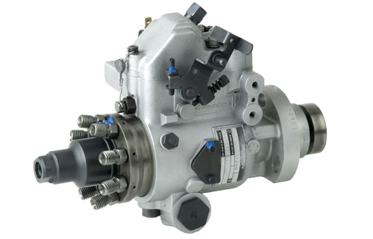
Injection Pump
Delivers high-pressure fuel to the injectors.

Slide 25
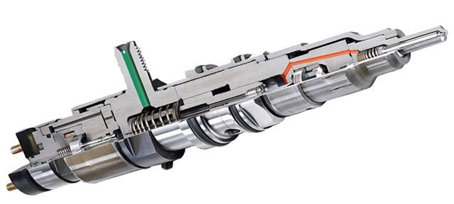
Injectors
Made up of the nozzle assembly, pressure spring and spindle, nozzle holder (injector body), and a cover.
Pressurizes fuel into an atomized spray that is injected into the combustion chamber.

Slide 26
High-Pressure Common Rail Fuel System
The high-pressure rail binds the pump and injectors together and supplies compressed fuel to the injector.
Allows for a smoother running engines, better fuel economy, and reduced emissions.
Water at this pressure can cause severe damage to the injection pump and injectors.
Drain the water/fuel separator weekly or as needed.
If you have compromised fuel, more service may be required.
60,000 to 90,000 PSI!

Slide 27
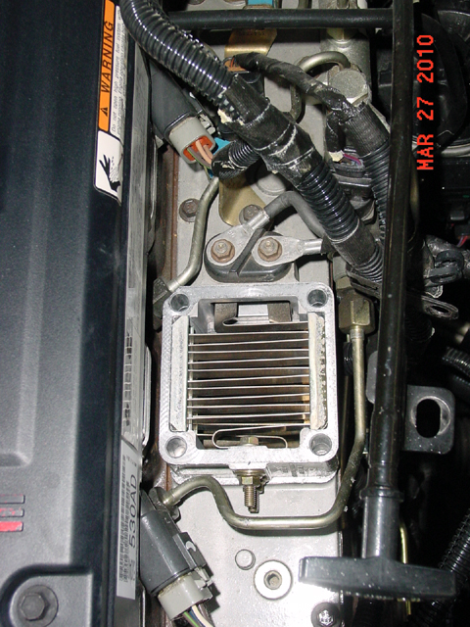
Glow Plugs and Heating Grids
Assist with heating the combustion chamber
1,500° F
May continue to operate after the engine has started
High electrical load

Slide 28
Electronic Control Module (ECM)
The ECM is the brain for all engine controls—the fuel injectors, turbocharger, transmission, and even some of the cab air conditioning components.

Slide 29
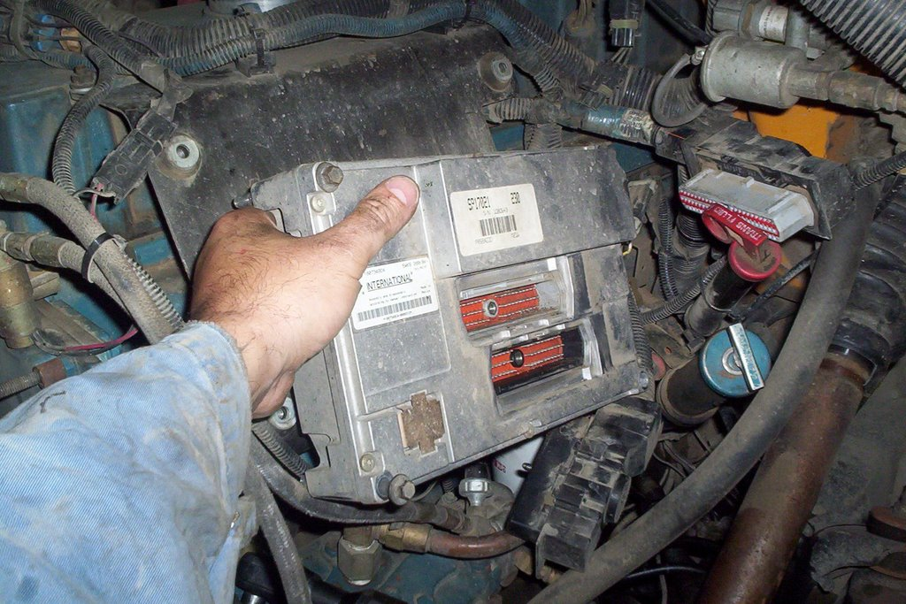
Electronic Control Module
May also control external options:
Cruise control
Power take-off (PTO) controls
Instrument panel engine indicators
Care is needed when cleaning the engine compartment to prevent water from getting to the electrical compartment and the ECM.

Slide 30
GASOLINE eNGINE

Slide 31
Gasoline FUEL Characteristics
GASOLINE fuel:
Is lighter and higher level of Carbon Monoxide
Evaporates much faster
Burns very quickly
More horsepower and torque generated at Higher RPM's

Slide 32
gasoline Fuel Types
Super Unleaded 89
Premium Unleaded 91-93
Higher Octane Level
Mid-Grade Octane Level
Regular Unleaded
87
Regular Grade Octane Level​

Slide 33
Octane vs. Cetane Number
Octane Number (Fuel grade of the gasoline)
Cetane Number
Measurement of a fuel’s ability to resist self-ignition when subjected to heat and pressure
The higher the octane number, the more control there is over the fuel’s ignition point.
Fuel should not start burning before the spark plug fires.
Describes diesel fuel’s ignition characteristic
The higher the cetane number, the easier the fuel is to ignite.
A cetane number of 40 is common for most diesel engines.
Certain manufacturer warranties stipulate the use of 50 cetane-rated fuel.

Slide 34
Gasoline Handling Practices
Keep your fuel tank full of clean fuel.
Use approved gasoline containers.
Never put fuel around heat sources
Store in well-ventilated areas.
Avoid breathing in fuel fumes and vapors

Slide 35
Cold Weather
Gasoline fuel is made up of crude oil. Organic compounds made up of Hydrogen and Carbon atoms
Cold weather can:​
Reduce fuel economy by 15% to 24%​
Cause hard starting​

Slide 36
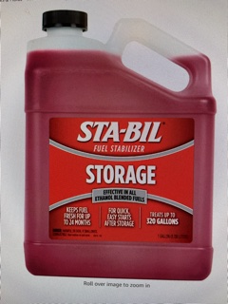
Gasoline Additives
Keep your fuel tank full of clean fuel.
Use approved recommended gasoline Additives.
If not using equipment for 30-90 days add STA-BIL
ADD HEET to vehicles during cold winter months.

Slide 37
ETHANOL FUEL vs gas PUMP fuel
The boiling point (vaporization) of gas pump fuel is highly variable, due to variances in ethanol additives. High ethanol fuel, or E-30/E-85 has a very low in boiling point. E-30/85 is also running an Octane Rating of 91+. This is what sawyers should be running in their saws, in order to maintain the piston heads on high revving 2-stroke's. These fuels are analogous to 91 Octane Pump Gas.

Slide 38
GAS FUEL SYTEMS

Slide 39
Ford company new engines

Slide 40
Model 52 Type-6 Engine
F-550 6.8L EFI V-10 ENGINE

Slide 41
Diesel Engine Components

Slide 42
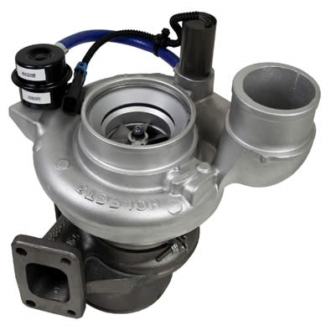
Turbocharger Basics
Devices that force more air into the engine to create more horsepower.
Basically a bolt-on horsepower increaser device with no mechanical connection to the engine.

Slide 43
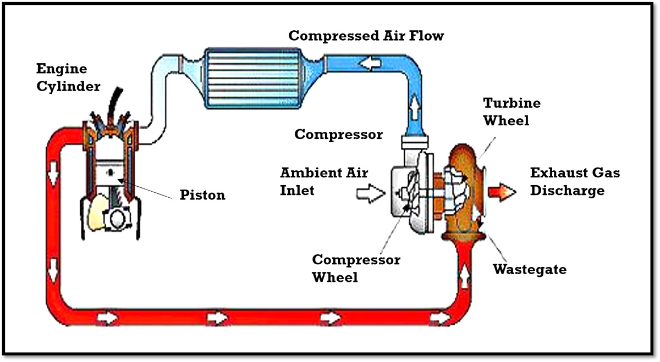
Turbocharger Basics

Slide 44
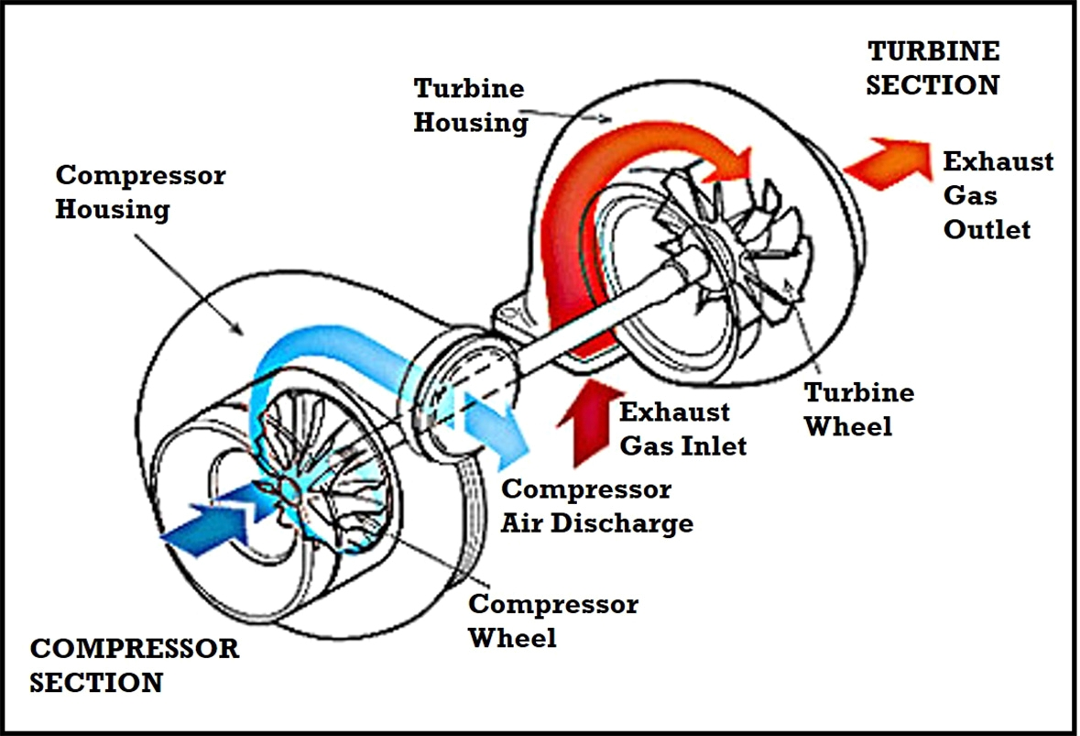
Turbocharger Basics

Slide 45
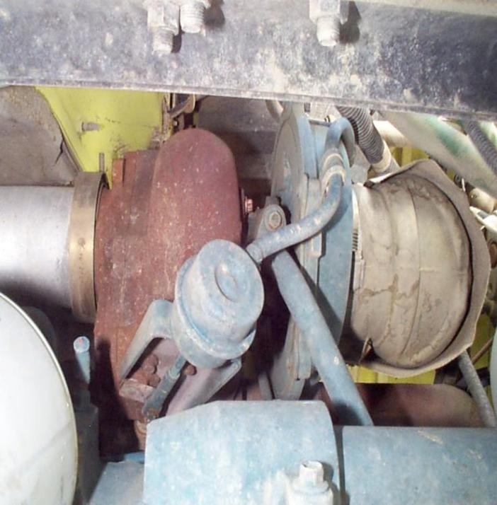
Turbocharger Considerations

Slide 46
Turbocharger Considerations
Lubricated and cooled by oil from the engine.
Operate under severe conditions:
Temperatures above 1,300° F
Turbine and compressor speeds > 90,000 RPM.
Never rev up the engine and then shut it off.
Always let the engine idle down for at least 3-5 minutes when it is hot or has been in heavy.

Slide 47
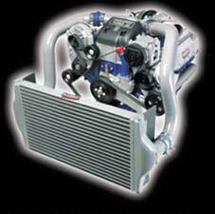
Aftercooler
Cools air generated by the turbocharger.
Helps reduce emissions.
Can plug up easily.
Periodically check aftercooler duct clamps.

Slide 48
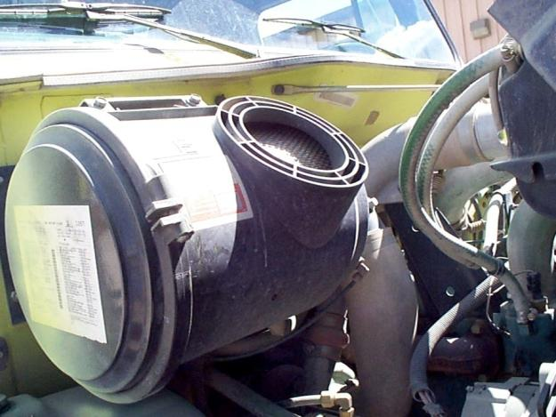
Air Cleaner/Filter
Physically inspect the filter daily.
Lightly tap out dirty filters.
Replace damaged air cleaner elements.
Do not drive an engine with a damaged air cleaner element.
Check intake piping for dirt/dusting.

Slide 49
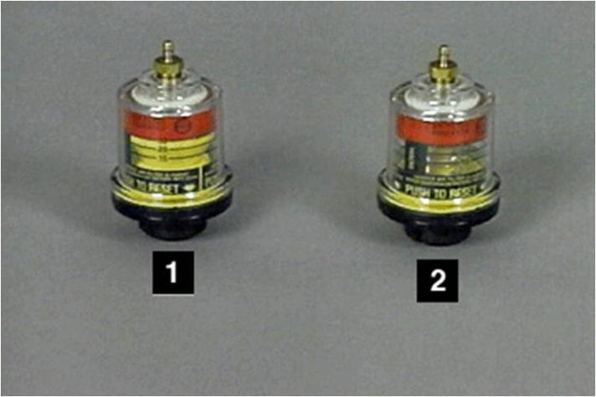
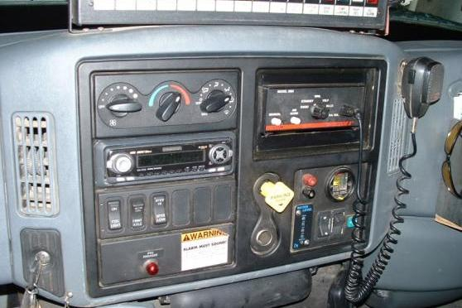
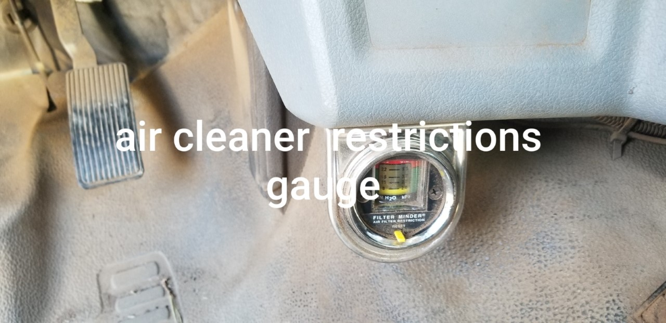
Air Cleaner Restriction Gauge
Tells the operator when your air cleaner is dirty.
Do not trust the gauge completely; you might have an intake leak.

Slide 50
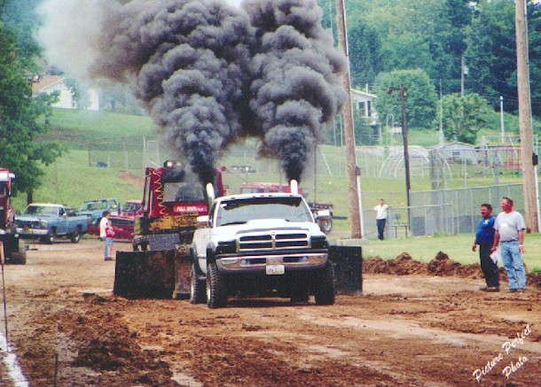
Reasons for Black Smoke
Going up a steep grade
Operating at higher altitudes
Pulling a heavy load
Heavy acceleration
Plugged air cleaner

Slide 51
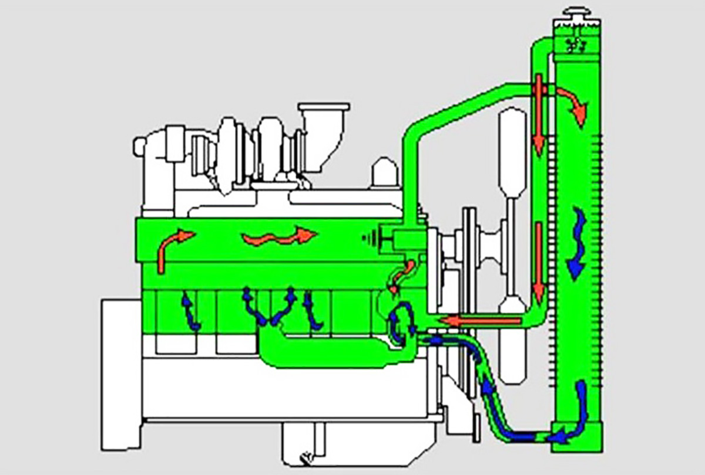
Cooling System

Slide 52
Radiator
Designed to transfer heat away from the engine keeping the engine cool.
Make sure the radiator is free of debris.

Slide 53
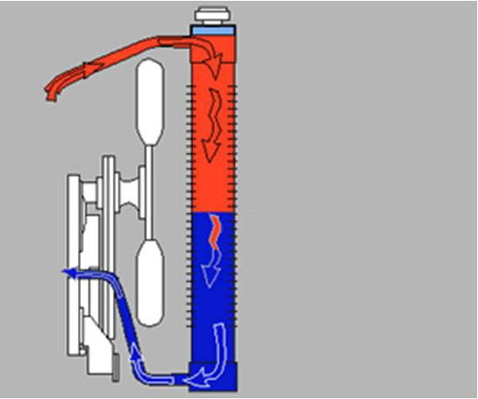
Fan
Pulls air through the radiator, intercooler, transmission cooler, and air conditioning condenser.
Make sure fan is operating correctly.
Outside air pulled in by fan

Slide 54
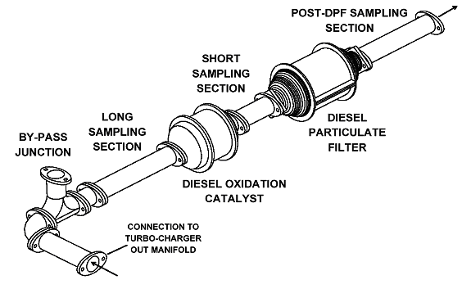
Exhaust System

Slide 55
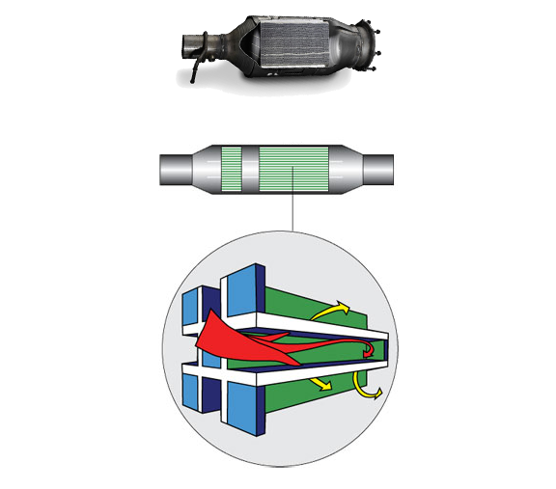
Diesel Particulate Filter (DPF)
Exhaust Gas Out
Exhaust Gas In
Filter
Non-filtered Exhaust Gas
Filtered Exhaust Gas
Trapped Particulates
Filter Sections
Wall Flow Filter

Slide 56
Regeneration
The process of cleaning the DPF.
Vehicle manufacturers have different regeneration processes.
Read and understand the information in the vehicle owner’s manual.
The following slides are general information and do not pertain to a specific manufacturer.

Slide 57
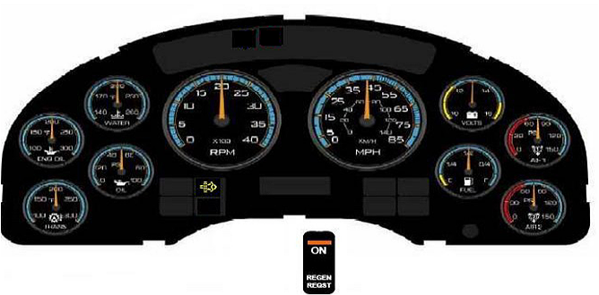
Regeneration
The yellow regeneration indicator light on the dash tells the operator that some process of regeneration needs to be done (passive, active, or manual).

Slide 58
Regeneration
Generally done automatically by passive and active systems without driver involvement.
Passive systems use only the exhaust gas stream to burn out the soot.
Active systems use a fuel burner that heats the filter to soot combustion temperatures.
Can also be done manually by the driver through a process known as “parked regeneration” or manual stationary regeneration.”

Slide 59
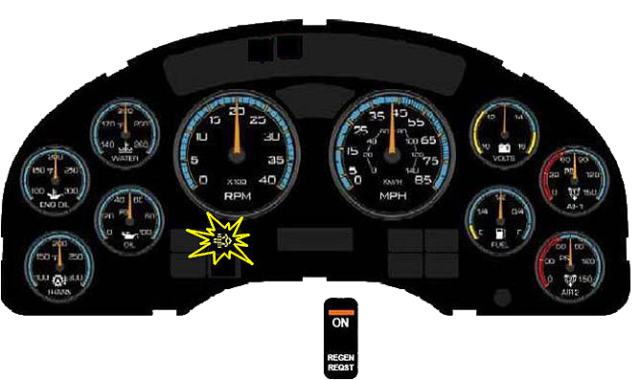
Regeneration
A flashing yellow regeneration indicator light on the dash console tells the driver that he/she should perform a parked regeneration.
Flashing

Slide 60
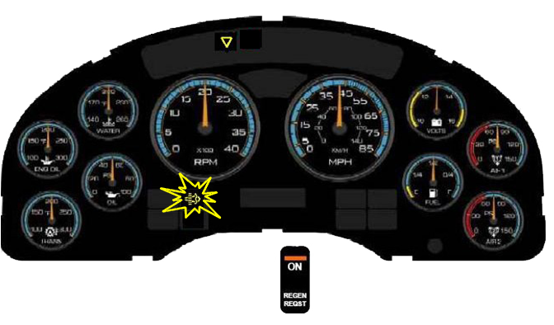
Regeneration
If the yellow regeneration indicator light is flashing and a yellow triangle light appears on the dash console, the driver must perform a parked regeneration.
Flashing

Slide 61
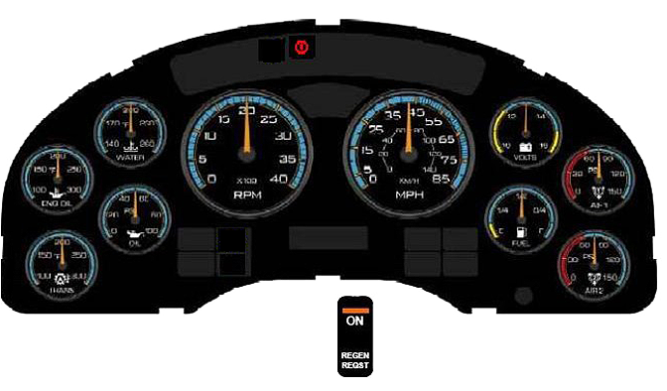
Regeneration
If the red regeneration indicator light comes on, stop the truck immediately in a safe area. To avoid severe engine damage, turn off the engine and call a mechanic.

Slide 62
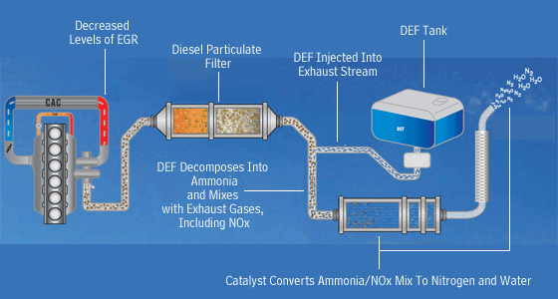
Diesel Exhaust Fluid
Has a shelf life, can freeze, or degrade.
Running out of DEF will derate power, produce limited speeds, and may shut down the motor.
Avoid system damage; use the correct DEF.

Slide 63
Diesel Engine Power Train Components

Slide 64
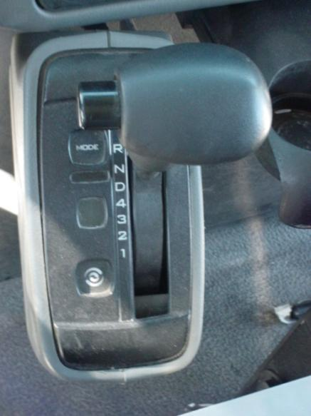
Automatic Transmission
Uses an internal clutch to shift between gears.
Employs a torque converter which allows the vehicle to stop without disengaging the transmission.

Slide 65
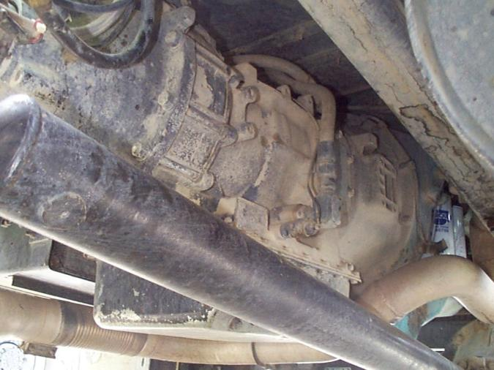
Precautions
Do not leave the transmission engaged when the vehicle is stopped for long periods of time.
Do not hold vehicle on hill with transmission.
Use the proper gear for the type of driving.
Come to complete stop when shifting directions.

Slide 66
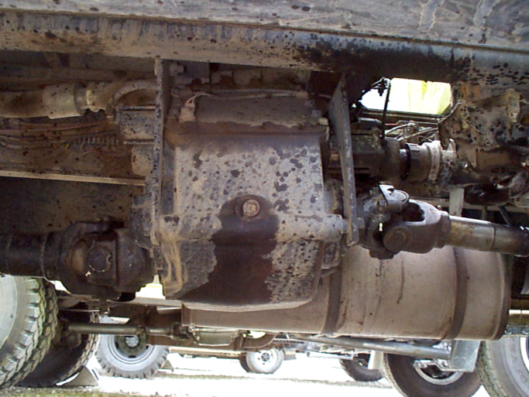
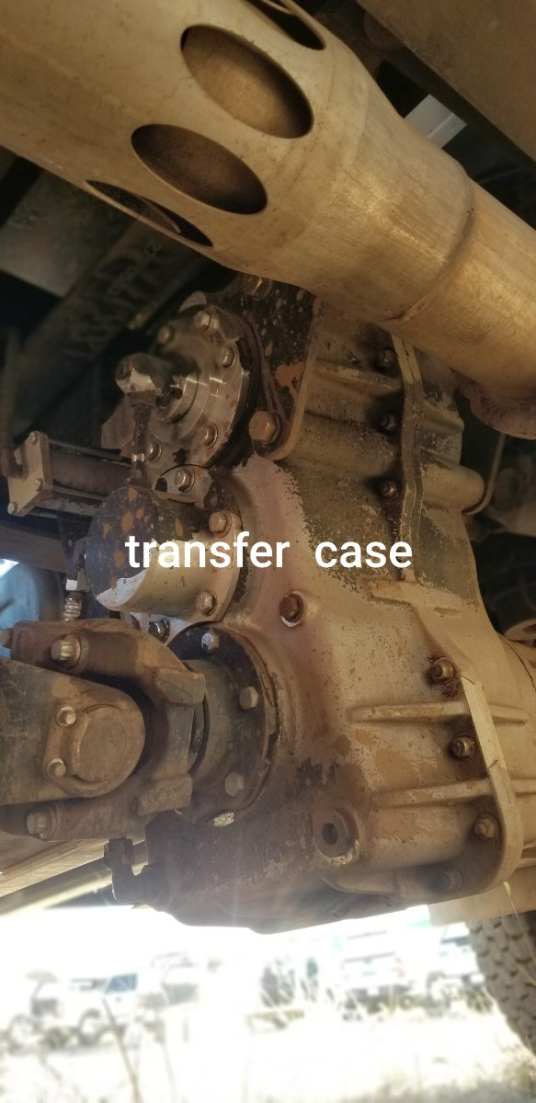
Transfer Case
Connects the front differential to the rear differential.
High range vs. low range
Transmission in neutral to switch between
Know your hubs.
Do not engage on dry pavement.

Slide 67
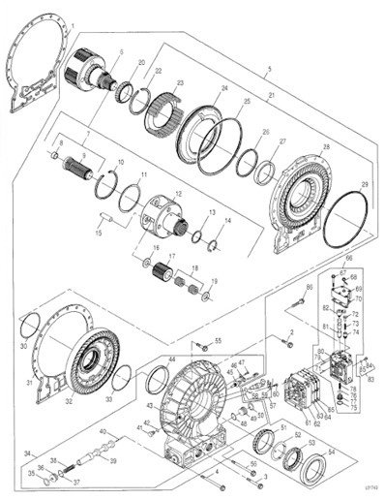
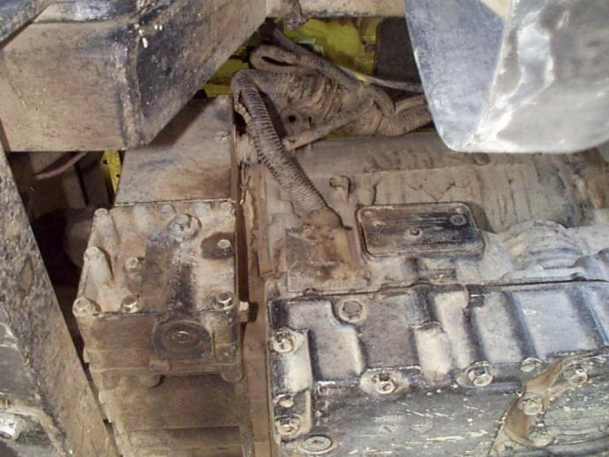
Retarder
Supplements the vehicle braking system through the transmission.

Slide 68
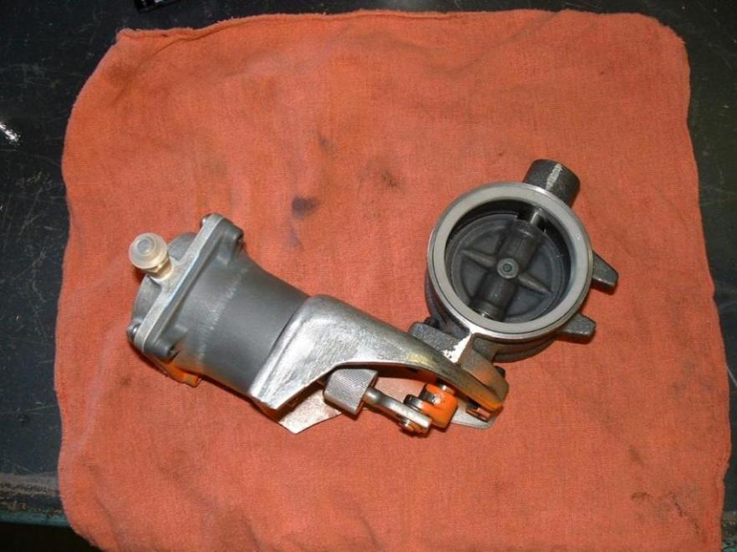
Dynamic Engine Brakes
Supplements the vehicle braking system through the engine.

Slide 69
Causes of Low Power

Slide 70
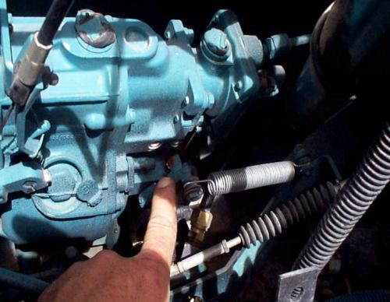
Throttle Linkage
Look for:
Dirt under the throttle pedal
A frayed throttle cable
A miss-adjusted throttle position sensor

Slide 71
Plugged Air Cleaner
Check and tap out the air cleaner.
Never blow out an air filter.
Replace as needed.

Slide 72
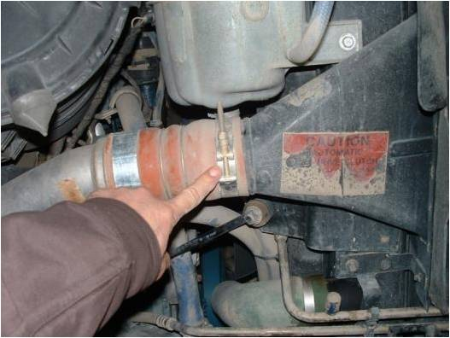
Turbo Outlet Clamps
Loose turbo outlet clamps will make a whistling sound.

Slide 73
Split air charge boot

Slide 74
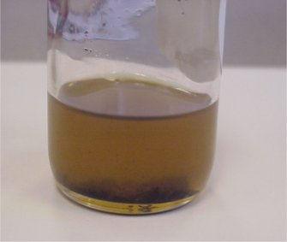
Poor Fuel Quality
Add diesel additives or drain the fuel tank and add a quality fuel.

Slide 75
Dirty Fuel Filter
Replace the fuel filter.

Slide 76
Plugged DPF
Clean DPF
Plugged DPF

Slide 77
Plugged DPF
Have your engine checked out by a qualified technician since the engine may need major repairs.

Slide 78
Anti-freeze and DPF

Slide 79
Engine Blow-By
Dust and dirt is the biggest cause of motor damage.
Will damage rings and cylinders and blow seals and gaskets.
Causes loss of power.
Dilutes engine oil.
Have a qualified technician check your engine; the engine may need major repairs or overhaul.

Slide 80
Engine Start Up and Shut Down

Slide 81
Basic Procedures
If possible, start your engine and let idle for 2 to 3 minutes before moving.
Slowly throttle the engine until the coolant is up to operating temperature.
Never idle your engine for more than 5 minutes (low idle).
Shut down after 5 minutes if engine has been run hard or when exhaust temperature is below 300° F.
If your engine must idle, set throttle between 1,000 and 1,200 RPMs (high idle).

Slide 82
Objectives
Describe…
Differences between diesel fuel and gasoline
Major components of a diesel fuel system
Correct operating procedures/parameters of starting a diesel engine
Basic powertrain components of a fire apparatus and each component’s operating characteristics
Discuss…
Diesel particulate filter and its function in the regeneration process

