Slide 1
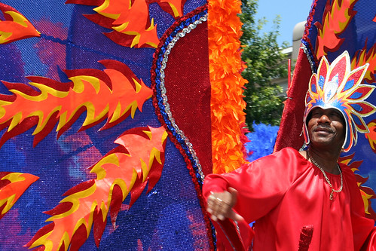
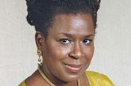
u.s. department of the interior National Caribbean American Heritage Month (NCAHM)
“Our Shared History, Our Shared Future”
“
Staking Claim
on America
Presentation by: Founder and President of the Institute of Caribbean Studies, Claire Nelson, Ph.D.
To Connect:
https://www.doi.gov/events
When: Wednesday, July 22nd
1:00 PM to 2:15 PM ET
This presentation will cover:
- Caribbean American History
- Dr. Claire Nelson’s Personal Reflection
- Contribution to the Proclamation of the National Caribbean American Heritage
All are encouraged to participate.
Closed captioning and sign language interpreting is provided, for additional reasonable accommodations, Kimberly Ly at kimberly_ly@ios.doi.gov

