Slide 1
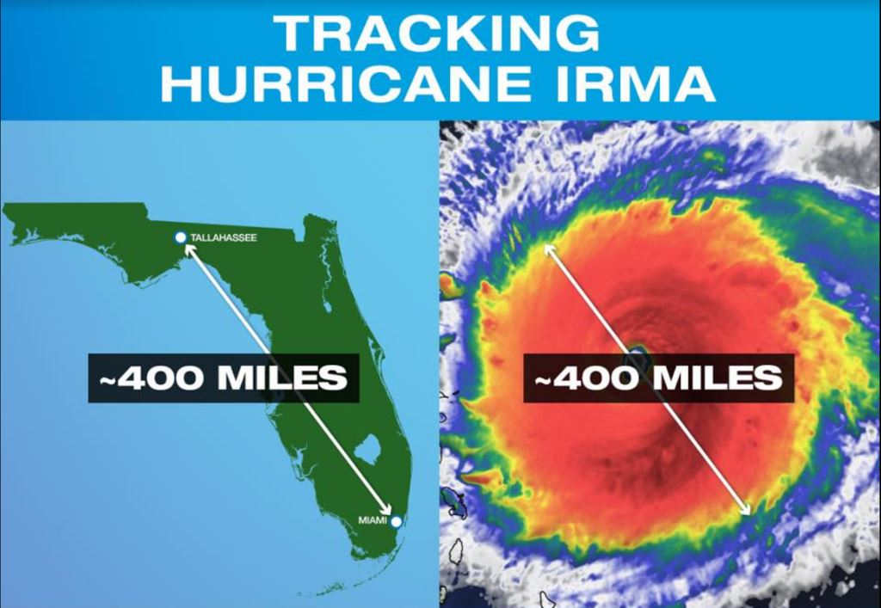
Hurricane Irma declared as Category 5
Last Update Time:
Sun, Sept 10 5:00 pm (MDT)
FOUO
Notes:
Tracking Hurricane Irma

Slide 2
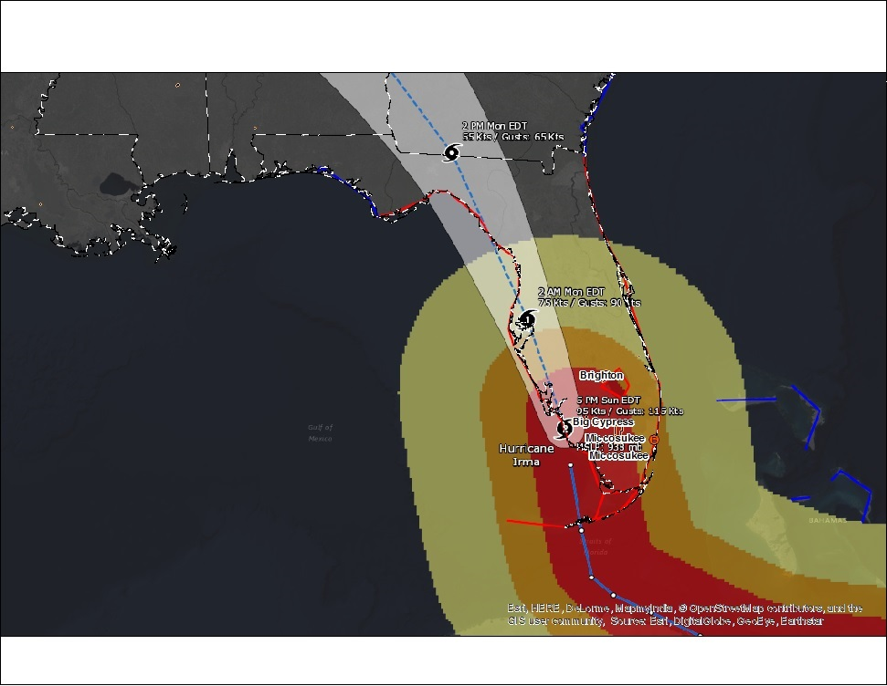
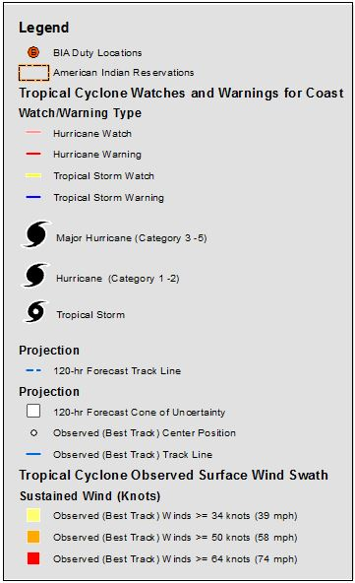
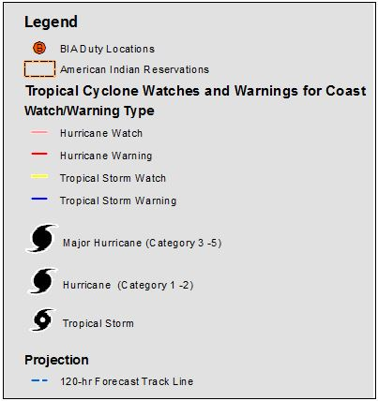
Hurricane Irma
Last Update Time:
Sun, Sept 10 5:00 pm (MDT)
FOUO
Notes:
Hurricane and Cyclone Public Information Map Source NOAA
This map describes the current & recent location of tropical storms, as well as forecast positions and probable track of tropical storms.
Estimated time of arrival of Tropical Store Force Winds:
Mid – Northern Florida Sun 8pm
Southern – Mid Georgia Monday 2am
Northern Georgia 8am
North Alabama 2pm
Northwest point of Alabama Monday 8 pm
Estimated Wind Speed: Between 34 Kts and 64 Kts
This map is provided by the Branch of Geospatial Support
Last Update Time:
Sun, Sept 10 5:00 pm (MDT)

Slide 3
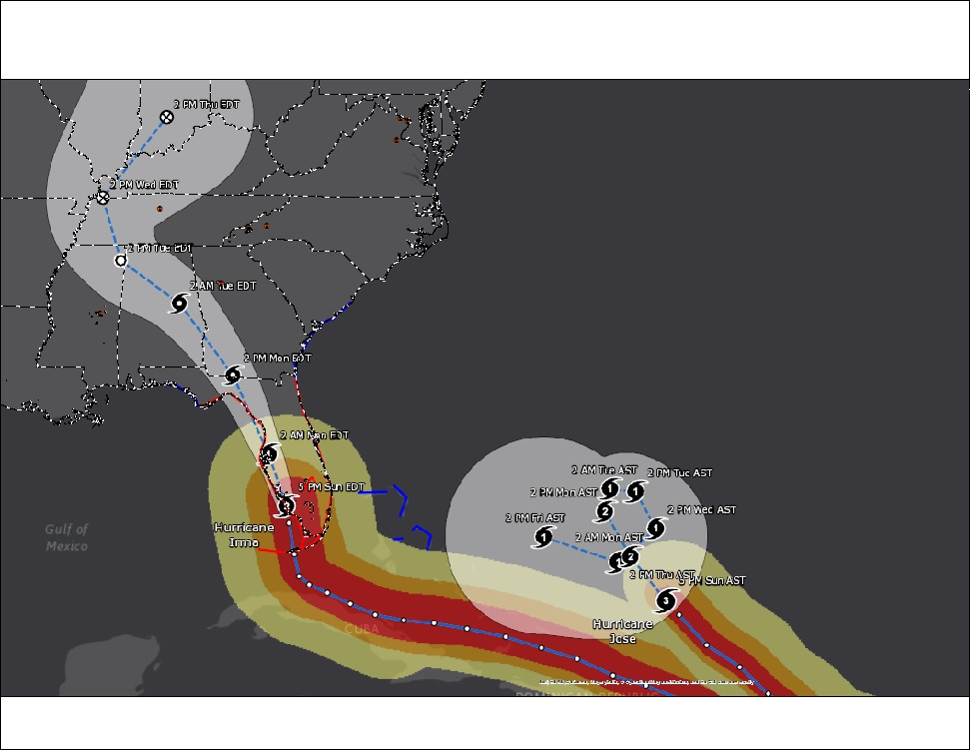
Hurricane Irma
Last Update Time:
Sun, Sept 10 5:00 pm (MDT)
FOUO
Notes:
Hurricane and Cyclone Public Information Map Source: NOAA
This map describes the current & recent location of tropical storms, as well as forecast positions and probable track of tropical storms.
The shaded area around the forecast track is called the "cone of uncertainty." The cone represents the probable track of the center of a tropical cyclone.
This map is provided by the Branch of Geospatial Support
Last Update Time:
Sun, Sept 10 5:00 pm (MDT)

Slide 4
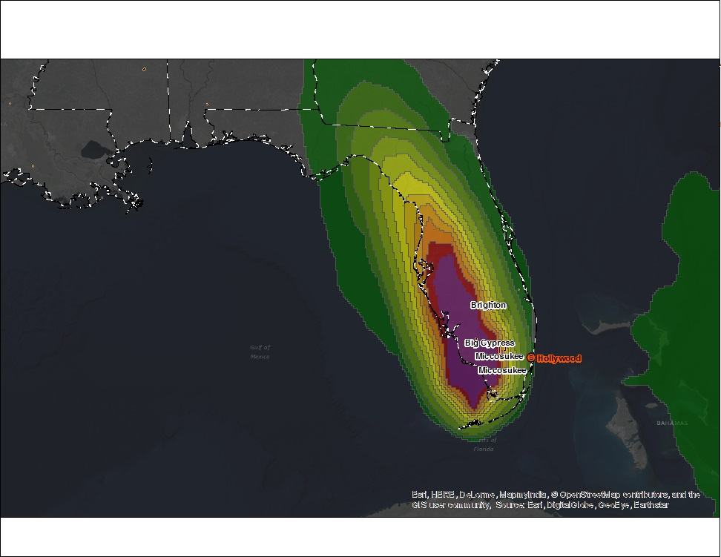
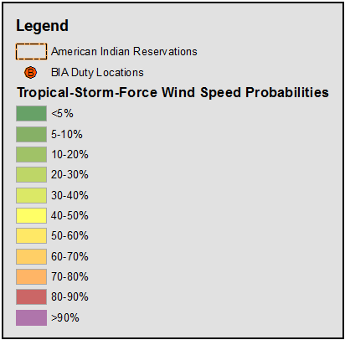
Hurricane Irma Tropical Storm Force Wind Speed Probabilities for 120 hours
Last Update Time:
Sun, Sept 10 5:00 pm (MDT)
FOUO
Notes:
The map shows tropical storm force wind speed probabilities (1-minute average >= 39 mph)
for the next 120 hours (2 AM AST Fri, Sept 08 – 2 AM AST Wed, Sept 13)
Source: NOAA
Miccosukee: 70-80%
Big Cypress: 80-90%
Brighton: 50-60%
Last Update Time:
Sun, Sept 10 5:00 pm (MDT)

Slide 5
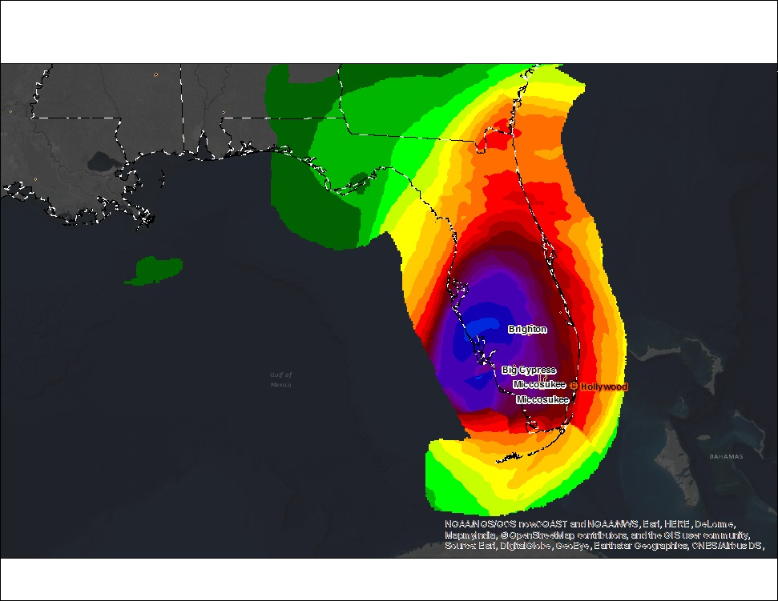
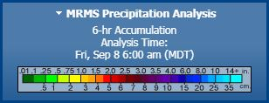
Hurricane Irma
6 hour Precipitation Amount
Last Update Time:
Sun, Sept 10 5:00 pm (MDT)
FOUO
Notes:
Source: NOAA/NOS/OCS nowCOAST and NOAA/NWS/NHC

Slide 6
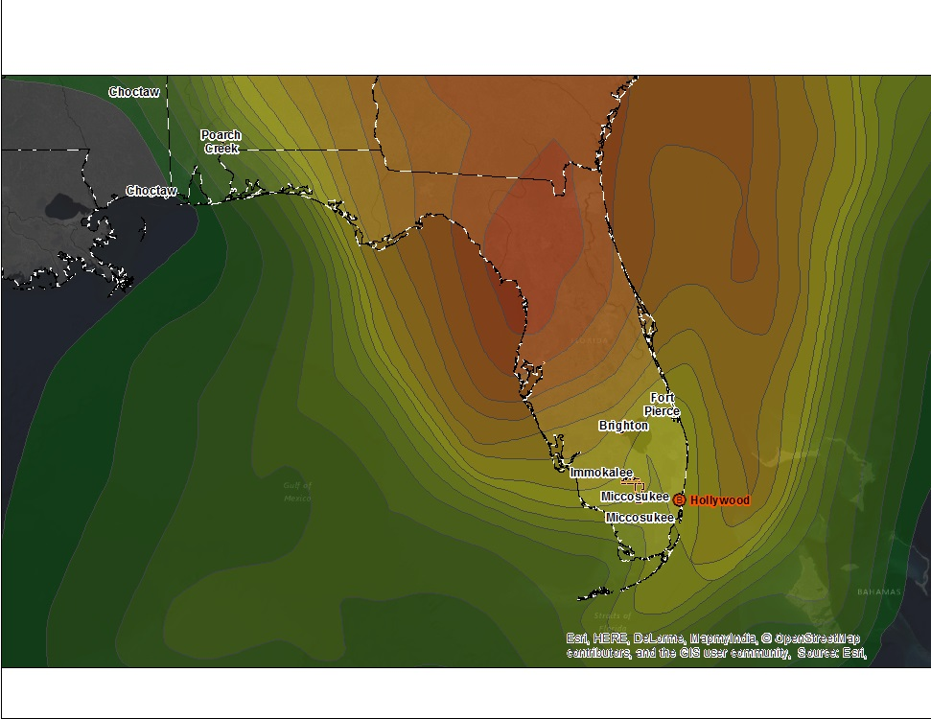
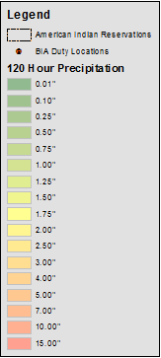
Hurricane Irma
120 hour Precipitation Amount
Last Update Time:
Sun, Sept 10 5:00 pm (MDT)
FOUO
Notes:
The map shows precipitation amounts for the next 120 hours
(Sun, Sept 11–Wed, Sept 16)
Miccosukee: 1.5 inches
Big Cypress: 1.75 inches
Brighton: 2.0 inches
Source: NOAA
Last Update Time:
Sun, Sept 10 5:00 pm (MDT)

Slide 7
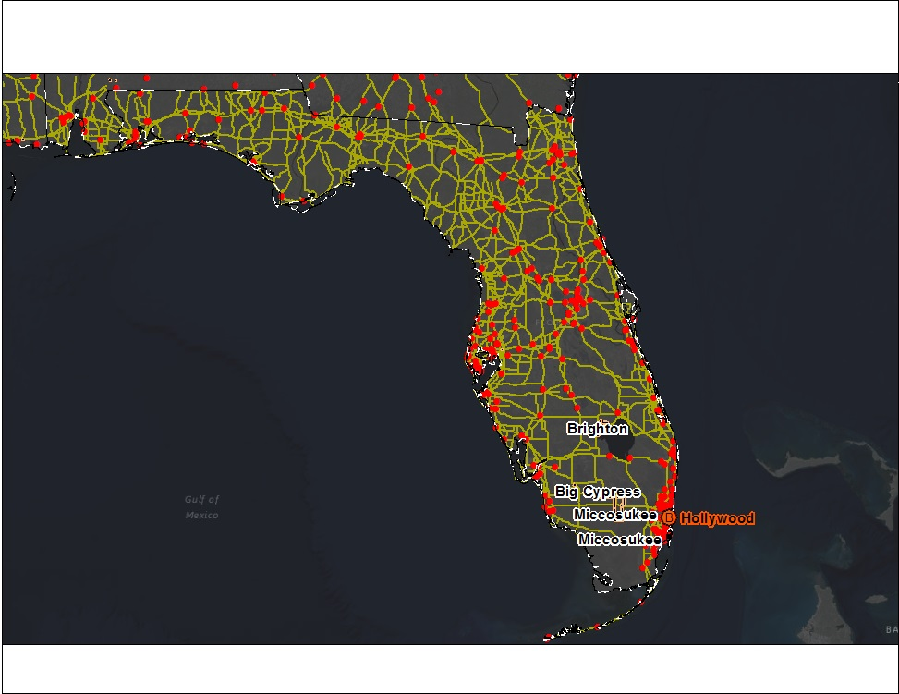
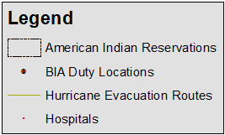
Hurricane Irma
Evacuation Routes
Last Update Time:
Sun, Sept 10 8:00 am (MDT)
FOUO
Notes:
The map shows evacuation routes and hospitals.
Source: Census
Last Update Time:
Sun, Sept 10 8:00 am (MDT)

