Slide 1
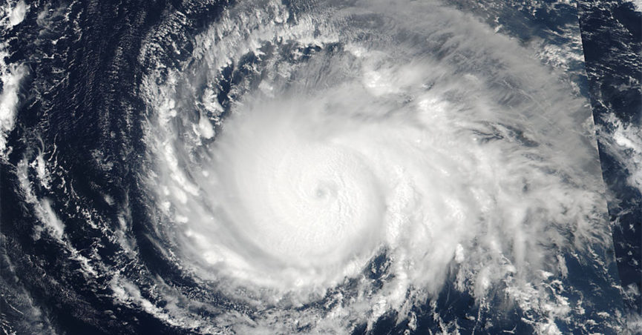
Hurricane Irma declared as Category 4
Last Update Time:
Sat, Sept 09 6:00 am (MDT)
FOUO
Notes:
Tracking Hurricane Irma
HURRICANE IRMA HITTING HARD THE NORTH COAST OF CUBA... ...TERRAIN OF CUBA WEAKEN THE HURRICANE BUT RESTRENGTHENING IS ANTICIPATED

Slide 2
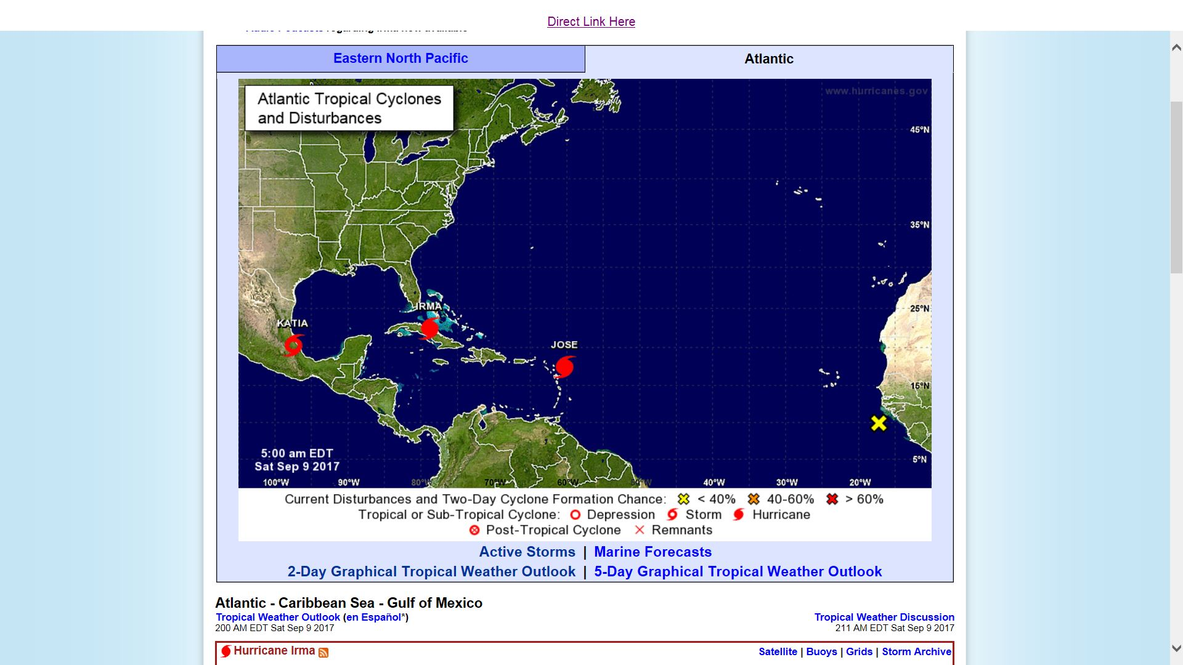
Hurricane Irma
Last Update Time:
Sat, Sept 09 5:00 am (EDT)
FOUO
Notes:
Hurricane and Cyclone Public Information Map Source NOAA
This map describes the current & recent location of tropical storms, as well as forecast positions and probable track of tropical storms.
This map is provided by the Branch of Geospatial Support
Last Update Time:
Fri, Sept 09 5:00 am (EDT)

Slide 3
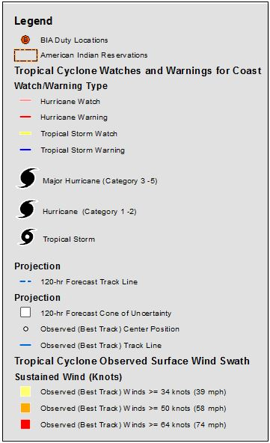
Hurricane Irma
Last Update Time:
Sat, Sept 09 5:00 am (MDT)
FOUO
Notes:
Hurricane and Cyclone Public Information Map Source: NOAA
This map describes the current & recent location of tropical storms, as well as forecast positions and probable track of tropical storms.
The shaded area around the forecast track is called the "cone of uncertainty." The cone represents the probable track of the center of a tropical cyclone.
This map is provided by the Branch of Geospatial Support
Last Update Time:
8:00 AM EDT Sat Sep 9
Location: 22.6°N 79.6°W
Moving: W at 12 mph
Min pressure: 937 mb
Max sustained: 130 mph

Slide 4
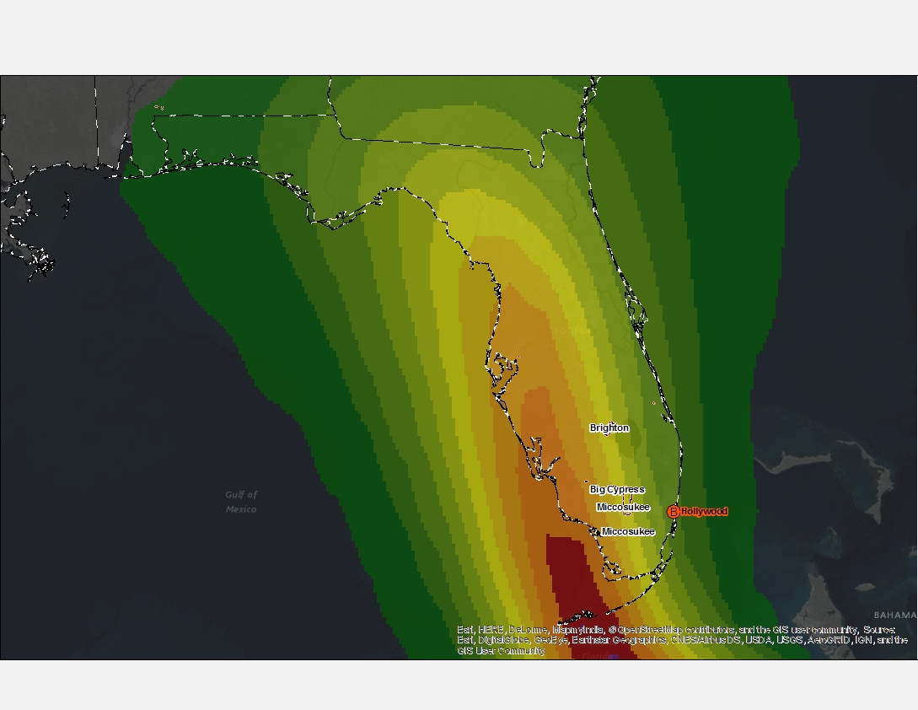
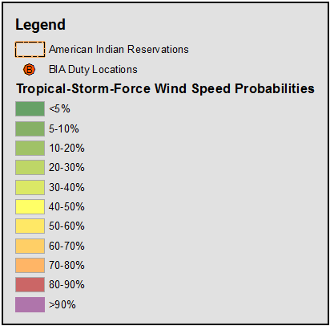
Hurricane Irma Most Likely Time of Tropical-Storm-Force Winds
Last Update Time:
Sat, Sept 09 6:00 am (MDT)
Sun 8 PM
Sun 8 AM
Sun 2 AM
Sat 8 PM
Sat 2 PM
Sat 8 AM
FOUO
Notes:
The times displayed show the most likely time of arrival of tropical-storm-force winds for Hurricane Irma as of Saturday, Sept. 9 2017 at 6 AM MDT.
The map shows tropical storm force wind speed probabilities for the next 120 hours (2 AM AST Sat, Sept 08 – 2 AM AST Wednesday, Sept 13)
Wind speeds range from 34-64 knots.
Source NOAA
Last Update Time:
Sat, Sept 09 6:00 am (MDT)

Slide 5
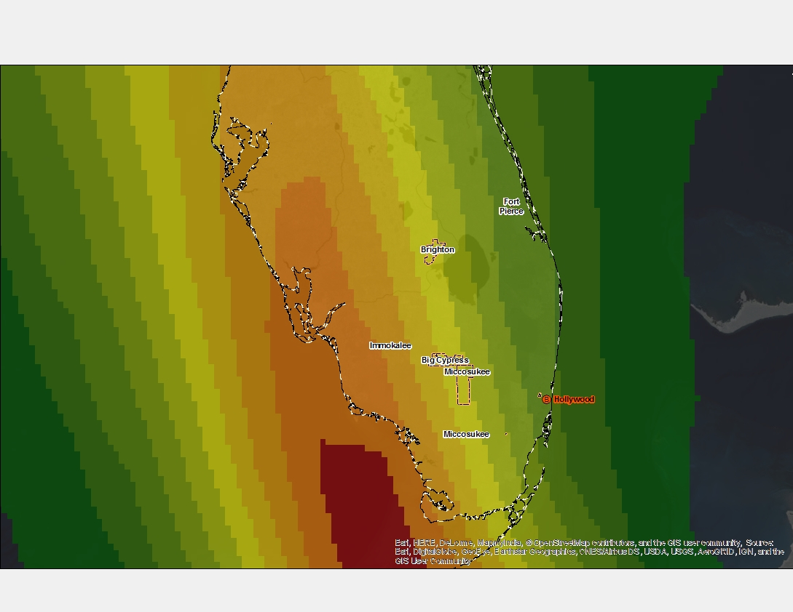
Hurricane Irma Tropical Storm Force Wind Speed Probabilities for 120 hours
Last Update Time:
Sat, Sept 09 6:00 am (MDT)
FOUO
Notes:
The map shows tropical storm force wind speed probabilities (1-minute average >= 39 mph)
for the next 120 hours (2 AM AST Sat, Sept 09– 2 AM AST Thur, Sept 14)
Source: NOAA
Miccosukee: 70-80%
Big Cypress: 60-70%
Brighton: 60-70%
Last Update Time:
Fri, Sept 08 7:36 am (MDT)

Slide 6
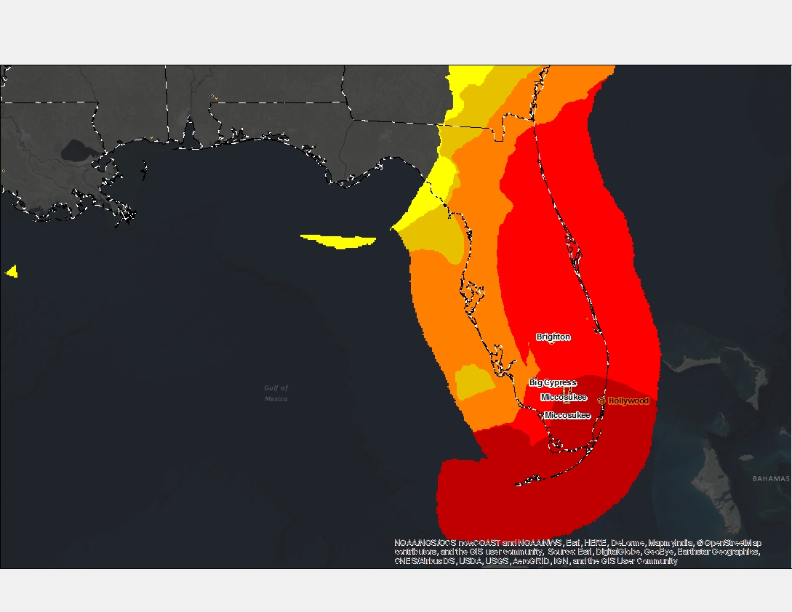
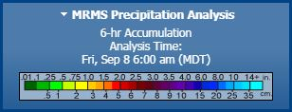
Hurricane Irma
12 hour Precipitation Amount
Last Update Time:
Sat, Sept 09 6:00 am (MDT)
FOUO
Notes:
Source: NOAA/NOS/OCS nowCOAST and NOAA/NWS/NHC

Slide 7
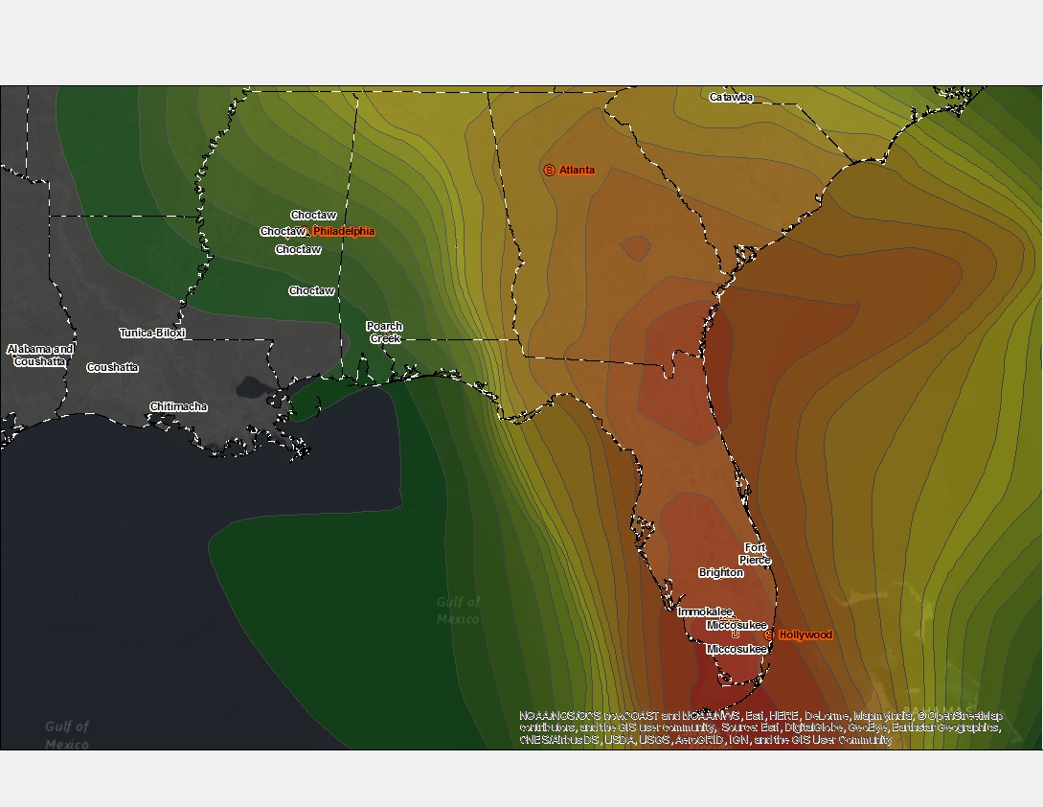
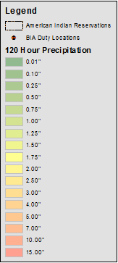
Hurricane Irma
120 hour Precipitation Amount
Last Update Time:
Sat, Sept 09 9:01 am (MDT)
15 00”
FOUO
Notes:
The map shows precipitation amounts for the next 120 hours
(2 AM AST Fri, Sept 08 – 2 AM AST Wed, Sept 13)
Miccosukee: 10 inches
Big Cypress: 10 inches
Brighton: 10 inches
Source: NOAA
Last Update Time:
Fri, Sept 08 8:22 am (MDT)

Slide 8
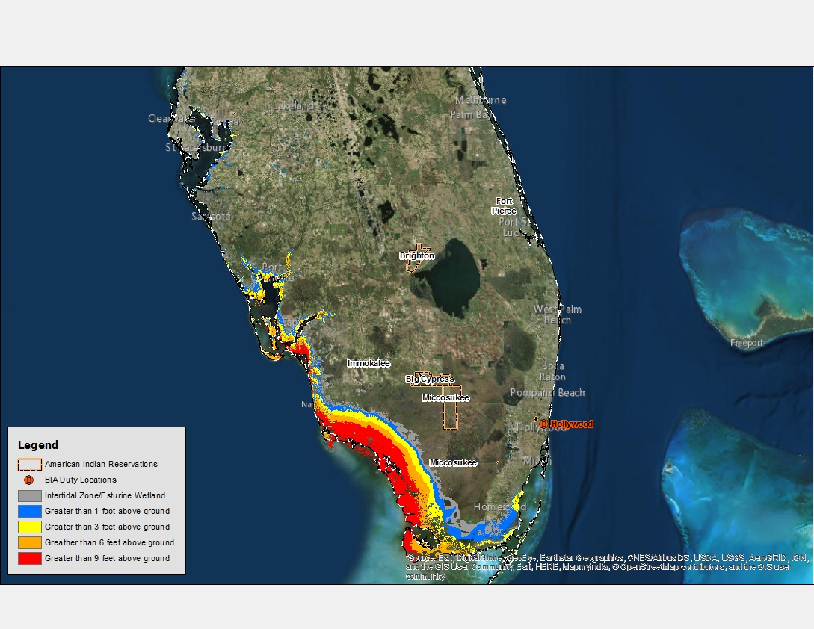
Hurricane Irma
Potential Storm Surge Flooding
Last Update Time:
Sat, Sept 09 6:00 am (MDT)
FOUO
Notes:
The map shows Potential Storm Surge Flooding
Source: NOAA
Last Update Time:
Fri, Sept 08 8:37 am (MDT)

Slide 9
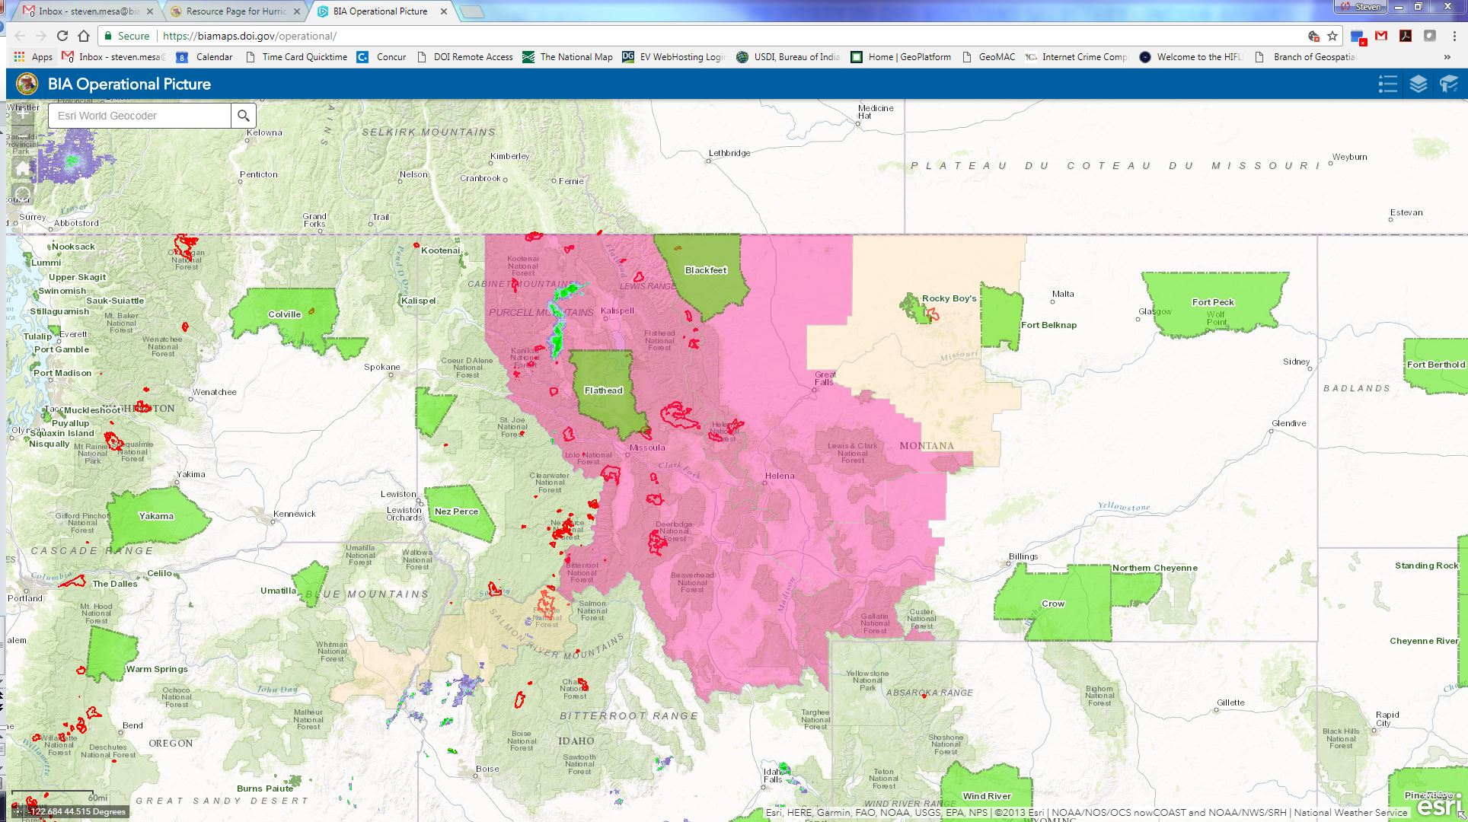
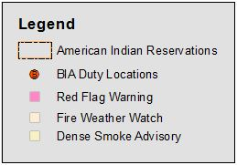
Hazardous Wildfire Conditions
Last Update Time:
Sat, Sept 09 9:01 am (MDT)
FOUO
Notes:
This map shows hazardous wildfire for the Western states. There are over 50 American Indian Reservations/Tribal Organizations within the
states of Washington, Oregon, Montana, Utah, South Dakota, and Idaho.
Source: NOAA
Last Update Time:
Fri, Sept 08 7:49 am (MDT)

