Slide 1
Alaska Region Presentation to the Tribal Budget Advisory Committee
May 12, 2009

Slide 2
Thank you for this opportunity to present the BIA Budget needs
of Alaska Tribes and Tribal Members.
First some background and common indicators on Alaska
Natives.

Slide 3
Alaska has 231 federally recognized tribes spread across the State of Alaska, which is approximately 663,000 square miles. Enrolled Tribal members number approximately 125,000 – 130,000;

Slide 4
Under the Alaska Native Claims Settlement Act, Alaska was divided up into twelve regions. ANCSA settled aboriginal title in the State of Alaska. ANCSA did not terminate the tribal governments in the State, many of which reorganized under the IRA back in the 1930’s -1950’s. ANCSA did abolish the reservations in the State of Alaska, except for Metlakatla.

Slide 5
Most Alaska Natives continue to rely on subsistence caught foods for much of their nutrition. Our cultures are based on hunting, fishing and gathering off the land – which is still practiced extensively in rural Alaska.
Subsistence hunting and fishing are important not only for cultural, but also for economic reasons.
Community | Fuel Price
Brevig Mission | $7.11
Diomede | $7.28
Elim | $8.33
Gambell | $7.88
Golovin | $5.32
Koyuk | $8.06
Saint Michael | $8.06
Savoonga | $7.65
Shaktoolik | $7.18
Shishmaref | $7.91
Stebbins | $7.98
Teller | $6.78
Unalakleet | $7.23
Wales | $7.98
White Mountain | $6.31
Nome | $5.80
Average | $7.30

Slide 6
Air freight – Anch to Nome - $.83/lb. Barge Truck – Seattle To Nome - $3,000 – $5,700 | Elim | Nome | Anchorage | Seattle |  | Nome/Vill/Nome - $314 RT Nome/Anch/Nome - $550 RT Nome/DC/Nome – 3 wk. advance -$1,200 Last minute - $1,800
Fuel Oil/Gallon Gasoline/Gallon Milk/Gallon | $8.09 $7.25 $15.80 | $5.29 $4.99 $7.49 | $3.42 $2.35 $2.99 | $2.31 $2.13 $1.99
Bread | $5.75 | $2.09 | $1.39 | $0.99
40 pk. Huggies | $29.77 | $20.99 | $15.99 | $14.99
Plywood 1/2 in smooth | $58.39 | $46.95 | $29.97 | $25.88
2×4 | $7.25 | $5.99 | $1.78 | $1.97
Prices from Fred Myer Safeway Outsiders Lowes and Native Store

Slide 7
Common Indicators:
Alaska Natives per capita income is 51% of the non-Native income;
Half of Native families have incomes below $30,000 a year – as compared with 25% of non-Native families. And since we know that Native families are on average larger, those lower incomes often support more people;
Incomes are especially low in remote areas – Alaska Natives in remote areas have, on average, incomes about 60% of Alaska Natives in other parts of Alaska;
Less than half of adult Natives have jobs, compared with 73% of non-Native men and 64 % of non-Native women. Native jobs are also more likely to be part-time or seasonal. Only 35% of jobs held by Native people are full-time year round compared to 60% of jobs held by non-Natives.
The remote areas where incomes are lowest are also the places where costs are highest.

Slide 8
Table 4. Total cost of gas, electricity, and heating fuel for those who pay at May 2008 prices.
Household Income |  | Anchorage |  | Kenai & Mat-Su |  | Mid-Sized & Roaded |  | Remote Rural |  | Total
$28,715 and below | avg. | 16.2% |  | 43.1% |  | 29.9% |  | 80.5% |  | 37.6%
$28,716-$52,021 | avg. | 4.4% |  | 9.7% |  | 7.9% |  | 18.2% |  | 8.2%
$52,022-$78,601 | avg. | 3.8% |  | 6.0% |  | 6.6% |  | 11.6% |  | 5.9%
$78,602-$119,777 | avg. | 3.0% |  | 4.1% |  | 5.7% |  | 8.1% |  | 4.5%
over $119,777 | avg. | 2.1% |  | 2.7% |  | 3.9% |  | 5.7% |  | 3.0%
Total |  | 5.4% |  | 14.2% |  | 10.6% |  | 31.6% |  | 11.9%
Source: Institute of Social & Economic Research (ISER)
University of Alaska, Anchorage

Slide 9
Our population is young: 44% of the Alaska Natives in the State of Alaska are 19 years of age and younger;

Slide 10
Carpentry Trainees – Nome.
Because of our young population and need for employment, our training needs are great. In 2008, Kawerak provided 84 scholarships to tribal members , 224 students participated in our Village Based Training classes and 64 students were funded to attend Adult Vocation training. 41 adults received their GED.

Slide 11
Education Attainment
The Bureau of Indian Affairs operated village schools in much of rural Alaska. In 1985, all the BIA schools were transferred to the State of Alaska and the State became responsible for the education of Native children. Alaska Natives are not eligible to receive BIA school funding except for Johnson O’Malley funds.
73% of Alaska Natives statewide have high school diplomas as opposed to 90% of non-Natives though this varies widely by region. In the Bering Straits region, 47% of our adults 20 years of age or older – do not have a high school diploma.
6% of Alaska Natives have a four year college degree as compared with 25% of other Alaskans;
Approximately 10% of Alaska Native high school students statewide drop out of high school.

Slide 12
Public Safety
Public safety in Rural Alaska is provided by : 1) the Alaska State Troopers who are located in the sub-regional centers; and 2) State funded Village Public Safety Officers – there are approximately 60 funded positions state wide.
Almost ¾’s of the villages in rural Alaska either have no law enforcement at all or they have Village Police Officers –hired by the 2nd class cities or the tribes - who have no training whatsoever.
Alaska Tribes are not eligible for BIA Law Enforcement funding, nor do they receive Tribal Court funding, though many tribes have active Tribal Courts.

Slide 13
Health Delivery System
In rural Alaska, Health services are provided at village clinics by Village Health Aides.
These are village residents who receive tiered training and provide services under the
direction of a doctor usually located in the sub regional centers (like Nome) around
the State. Serious situations, weather depending, are medivaced by small plane into
Nome and frequently on to Anchorage. Doctors, PHS dentists, and Mental Health Clinicians travel
out of the sub-regional centers to our villages perhaps twice a year.
While 2/3rds of the villages in rural Alaska have voted themselves “dry” (no alcohol allowed) or “damp” (alcohol may be shipped in but not sold), alcohol continues to fuel high rates of domestic violence, child abuse, and violent death.
The leading causes of death in the Bering Straits Region are:
1) Unintentional injuries (accidental death);
2) Malignant Neoplasms (cancer);
3) Intentional Self Harm - Suicide; and
4) Diseases of the Heart.
Fetal Alcohol Spectrum Disorder rates doubled in the 1990’s. The increase may be due
in part to increased access to alcohol and improved reporting. Alaska Natives have 5
cases/1,000 births as compared to .2 cases/1,000 live births for non-Natives.

Slide 14
Health Systems
Suicide rates in the Bering Strait region are staggering: they are three times higher than the Alaska rate and six times higher than the national rate. 41 people took their lives in 14 of our 16 communities between 2002 and 2006. 100% of them were Alaska Native, many of whom were teenagers and young adult men, and 93% were from our villages.
Alaska Natives make up 19% of the State population:
- 25% of the children in Alaska are Native children and 50% of the children in State protective custody are Native children. 100% of the children in State’s custody in the BSR are Alaska Native. Our ICWA provided services to 143 children during FY 08 in our region.
- 35% of the inmates in Alaska prisons are Alaska Native.

Slide 15
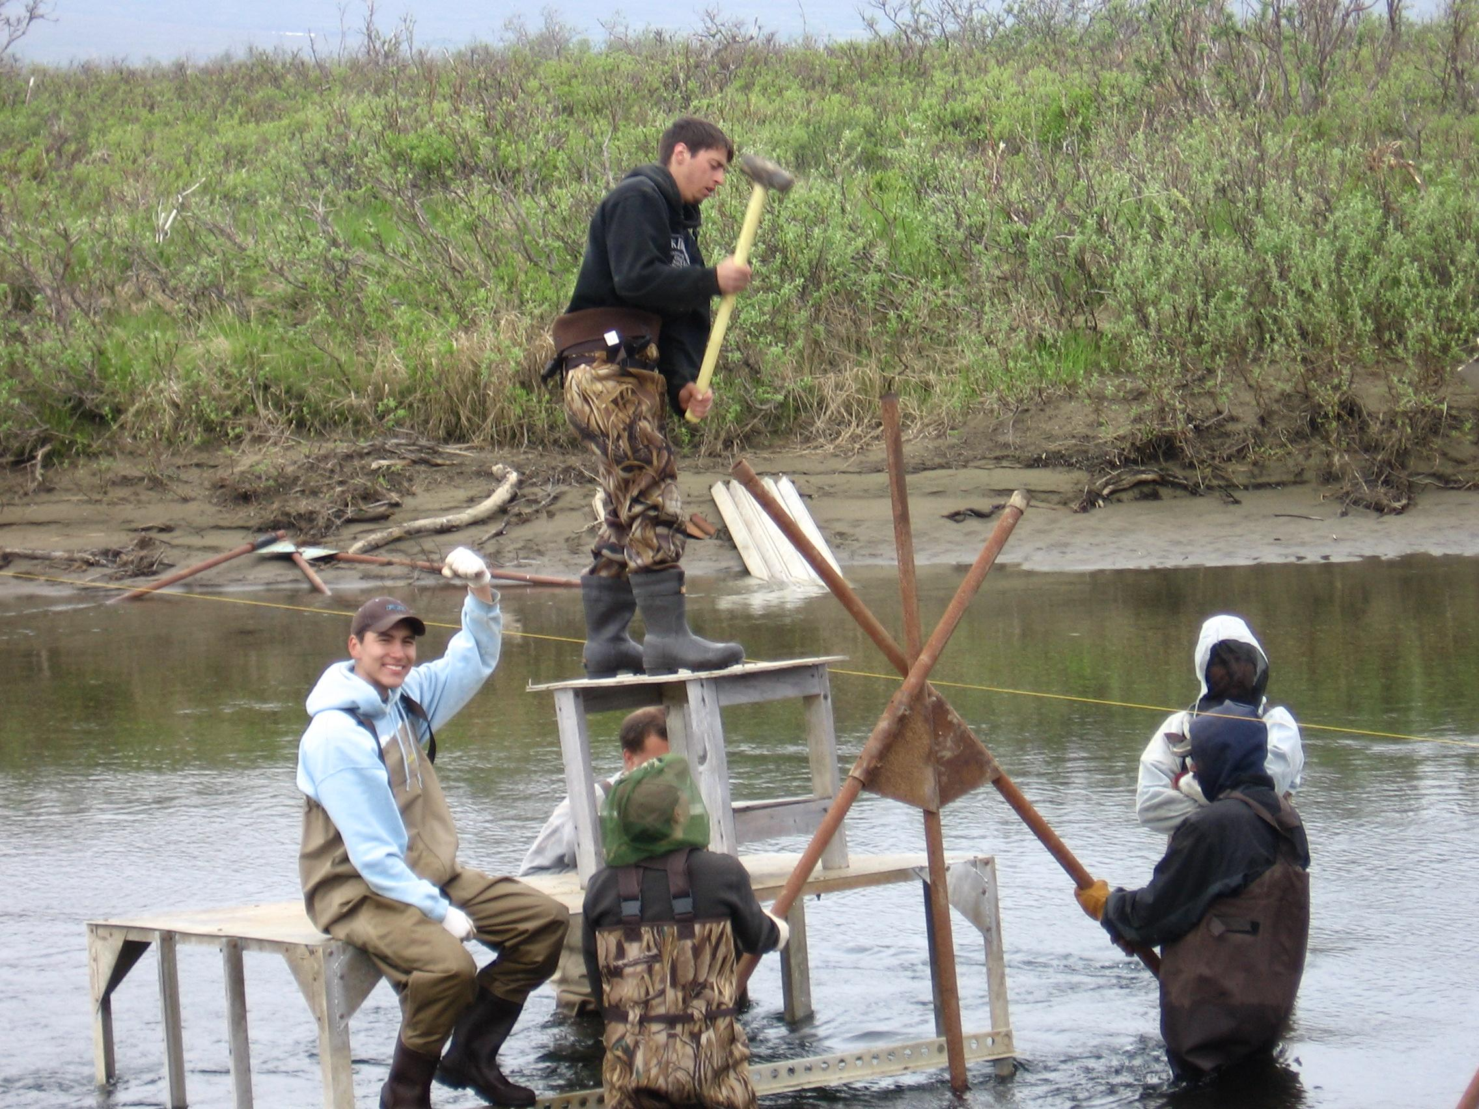
Natural Resources - Tribes and Tribal Consortiums are very committed to insuring our continued ability to live off the land. Here you see Kawerak staff installing a fishery weir, so that we are able to count returning salmon and collect samples. Alaska tribes/tribal consortium receive very limited funding for Natural Resources Management. Ie., Kawerak received a total of $218,987 in natural resources funds on behalf of the 18 tribes in our tribal consortium, out of the $147 million appropriated in FY 08.

Slide 16
Natural Resources Management
Of the $218, 987 received in FY 08, $161,773 was from Agriculture line item within the BIA Budget. These funds are dedicated in the Kawerak compact to providing support to the Reindeer Industry.
In 1937, Congress passed the Reindeer Act, which prohibited ownership of reindeer in Alaska to Alaska Natives. In the Act, Congress provided for up to $1.5 million to be appropriated annually in support of the Reindeer Industry. Funding has never been requested by BIA and appropriated specifically for this purpose.
We have approximately 15,000 head of semi- domesticated reindeer on the Seward Peninsula, in 21 herds owned by Native individuals and Tribes.

Slide 18
Marine Mammal Protection Act
Under the Marine Mammal Protection Act, Alaska Natives are the only group authorized to take marine mammals for subsistence purposes. We use the remainder of our very limited Natural Resource dollars to conduct studies and participate in forums to insure that our ability to hunt marine mammals and other game is not unduly restricted or eliminated.
Our communities routinely hunt bowhead, minke and beluga whales, seals, walrus, and polar bear and participate in the Int’l Whaling Commission , Eskimo Walrus Commission, the Nanuq Commission and Indig. Peoples Council on Marine Mammals, as well as the Fed. Subsistence RAC and State Fish and Game Forums.
Under Title 8 of ANILCA, rural Alaskans are provided a subsistence priority on federal lands, when resources are limited.

Slide 19
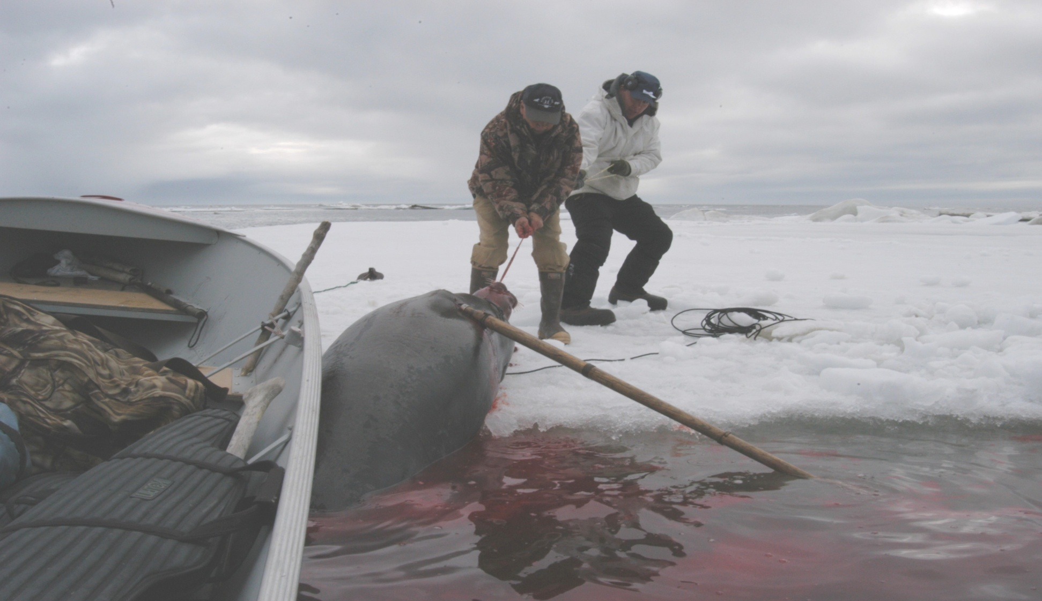
Pulling up an “oogruk” or bearded seal on the sea ice to butcher – these generally range from 300-600 pounds.

Slide 20
“Meat ball” – used to bring meat home and to keep it clean – folks on St. Lawrence Island age the meat balls in permafrost pits.

Slide 21
Because Alaska is so large and a relatively young state, there is a great need for infrastructure development, particularly in the remote, predominantly Native communities in the State. There are no roads to most of rural Alaska, so all food, consumer goods, building materials, comes in either by air freight or by barge during the summer months.

Slide 22
Infrastructure needs, continued
The following needs are representative of villages in rural Alaska.
Golovin (1/30/07):
Water and Sewer/Year ‘Round Water Source
Relocation of Generator Building/Alternative Energy
Rock Quarry/Heavy Equipment
Erosion Control
Roads, Including to Subsistence Areas
New Store Building
Small Boat Harbor
Own Zip Code/New Post Office
Recreational Building/Day Care
Crosswind Runway
Shaktoolik (6/4/07):
bulk fuel tank farm/power plant
evacuation route/gravel site development
erosion control
multi-use building
new housing development
environment/subsistence/wildlife conservation
water system upgrade
Shaktoolik boat harbor
community roads upgrade land expansion and site control

Slide 23
Alaska Tribes and Tribal Consortiums are increasingly able to access IRR’s funding. Funds are used to address the transportation infrastructure needs in our villages.
Shishmaref – in need of protection for roads and infrastructure
After a seawall was installed to help protect Shishmaref’s roads and buildings.

Slide 24
Board walk in Diomede – Before
. . . . And after.

Slide 25
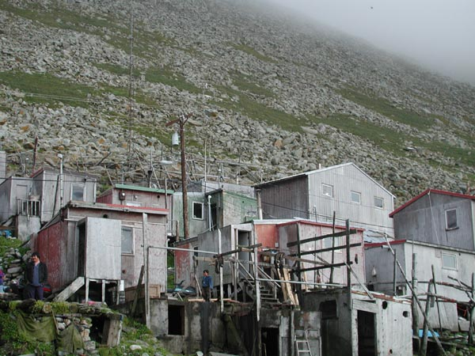
Housing
Housing is a huge need in rural Alaska. . . Houses are overcrowded – we have on average twice as many people per household as the national average. It is extremely expensive to construct homes in rural Alaska since all materials must be barged or flown in. In the 1980’s, Kawerak received enough money to construct 8 homes in Gambell. Now, the funding that is made available on a per unit basis is not enough to fully fund the construction of 1 home annually.

Slide 26
Typical village housing in Brevig.

Slide 27
Land Status
ANCSA lands – Alaska Native Corporations own in fee simple – 44 million acres. They are the largest private land owners in the United States. In the BSR, the village corporations own 1.725 million acres and BSNC owns 2.24 million acres. We receive no funding to help manage, protect or develop our lands.
Native Allotments/Vietnam Veteran Allotments - There are approximately ________ Native Allotments in the State of Alaska. In the BSR, we have 1,077 Native allotments and 237 Restricted Town site lots, for a total of 1,314 parcels encompassing 84,977.78 acres. We have seen increased directed funding for Realty Services over the past ten years, due to the Cobelle litigation.

Slide 28
Tribal Budget Priorities as approved/proposed by the TBAC
2007 2008 2009 2010 2011
Education Education Education Pub. Safety Pub. Safety
Law Enforce. Law Enforce Law Enforce Education Education
Contract Sup. Cont. Sup. Cont. Sup. Econ. Devel. Econ. Devel.
Natural Res. Nat. Res. Nat. Res. Natural Res. Natural Res. Contract Sup.

Slide 29
Enacted BIA Budget Adjustments (up/down) over time
2000 2007 2008 2009 % Increase
Operating 2000-2009
Trib. Govnm’t 352,849 384,932 392,363 394,531 11.8 % 2000- General Administration, Regional & Central Office
Hum. Svcs. 149,511 140,933 135,695 133,309 -10.8 % operations budgeted separate from programs. Had to move edu-
Nat. Res. 127,549 136,481 137,994 141,156 10.7 % cation expenses in line with 2007-2009.
Trust – Realty 61,877 118,924 133,015 134,925 +118.0 % 2007-2009 - regional & central office budgeted for within
Public Safety/Justice 142,549 217,611 243,656 270,785 + 90.0 % Program summaries . Had to back out regional & central office
Com. & Econ. Develop. 43,840 40,742 38,032 41,803 -4.6 % oversight, and General Admin for Construction in order to
Exec. Dir & Admin. Svcs 98,922 244,070 240,375 260,327 +263.2 % make numbers comparable to FY 2000.
Ind. Education 568,291 657,912 689,612 716,153 +26.0 %
Construction
Education 133,199 204,956 142,935 128,837
Public Safety 5,537 11,605 14,393 39,399 Between FY 2000 and 2009, the Anchorage Consumer
Resources Mnmt. 50,573 45,125 38,309 40,306 Price Index rose by 22.82 %. This reflect price increases in
General Admin. 8,095 10,137 8,117 9,146 Anchorage - not rural Alaska.
Construction 189,309 261,686 195,637 208,542 +10.0 %
Settlements/Misc. Payments 27,128 42,000 33,538 21,627 -20.3 % The only areas of the BIA budget which have kept current
Ind. Guar. Loan Program 4,985 6,258 6,178 8,186 +39.0 % with or exceeded the cost of inflation are: Trust, Public Safety, Executive Direction and Admin. Svcs., Indian Ed., Loan Program, and Central Office.
TOTAL – APPROP. FUNDS 1,878,034 2,308,304 2,291,279 2,376,131 +26.5 %
General Const. Admin. 8,096 10,137 8,117 9,146
Reg. Office Program 42,241 30,240 29,647 27,957 -33.8 %
Oversight/Operations
Central Office Oversight/ 52,037 210,436 261,958 286,777 +551.0 %
Operations
Exec. Dir & Admin. Svcs 98,922 244,070 240,375 260,327 +260.0 %
201,296 250,813 299,722 584,207 +290.2 %

Slide 30
ARRA $’s
In FY 09, significant amounts of new money was appropriated to the BIA for:
IRR Road Construction -$310 million
BIA Road Maintenance - $143
HIP - $20 million
BIA School Replacement - $132 million
BIA School Rehab - $136 Million
BIA Workforce Const. Trng. - $6 million

Slide 31
Budgetary Impacts on Contractors
In reviewing the budgetary impact to Kawerak
between 2000 and 2009, we found that:
Our total BIA funding had decreased 22.3%;
Our direct dollars (excluding 477 and one time money) had decreased 2.4%;
The consumer price index for Anchorage increased 22.82% between 2000 and 2009;
We estimate our Tribal member service population increased by 10%.
Our funding level has gone done while the
cost to provide services and our service
population has increased. We have lost buying
power because of inflation.

Slide 32
Recommendations
at the recommended minimum funding level of $200,000 has never
been implemented.
We respectfully request and recommend that:
the minimum TPA funding level for Alaska Small and Needy tribes be increased to $200,000 as recommended in the 1994 BIA Budget Task Force Report;
Tribal Priority Allocation funding nationwide be increased by 25% to bring it current with inflation;
further that TPA be adjusted annually, to keep it current with inflation;
BIA use the authority per the 1937 Reindeer Act to make funds available to support the reindeer industry;
$10,000,000 be appropriated annually to ARO to provide fuel assistance vouchers to Native Households in remote rural Alaska (similar to the CITGO initiative) until such time as fuel prices substantially decrease and/or alternative energy is developed.
BIA TPA dollars are continuing funds that can be directed to areas of
high need, unlike competitive grant dollars, that come and go. BIA
TPA dollars constitute core funding around which other services
revolve and we encourage continuing increases to this budget
category in the BIA budget, such that TPA is kept current with
inflation, population growth and the cost of providing services.
Quianna for your attention. Any questions?
In reviewing where increases have been made to the BIA Budget over the years, much of the increases have been in areas of the BIA Budget, which Alaska Native Tribes are not eligible to access: Public Safety, School Operations, Public Safety and School Construction and Central Office operations.
In 1994, the BIA Budget Task Force recommended that all Small and Needy Tribes in the lower 48 should receive a minimum TPA allocation of $160,000 and that Alaska Small and Needy Tribes should be allocated a TPA base of $200,000. In 1998, the recommendation to bring all S & N tribes nationwide to $160,000 was implemented. The recommendation to fund Alaska Small and Needy tribes

