Slide 1
Tribal Consultation
WALKING WITH TRIBES & NATIVE BUSINESSES -
Supporting the Economic Future of Indian Country
Division of Economic Development –
Grant Programs

Slide 2
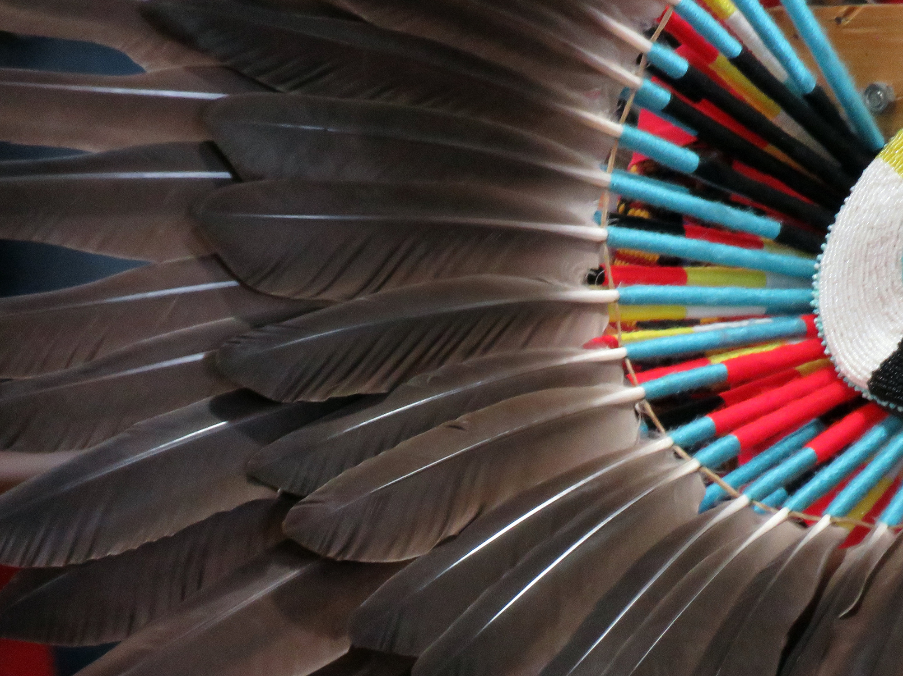
OIED Grants
Native American Business Development Institute (NABDI)
Tribal Tourism Grant Program (TTGP)
Living Languages Grant Program (LLGP)
National Tribal Broadband Grant (NTBG)
Indian Business Incubator Program (IBIP) Grant

Slide 3
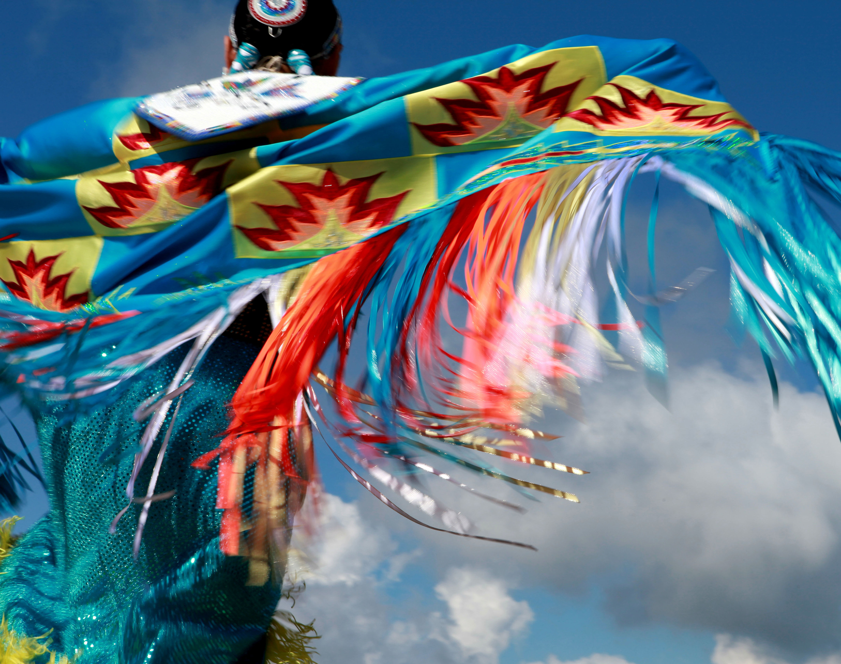
Native American Business Development Institute (NABDI)
NABDI funds Federally Recognized Tribes to hire consultants and conduct economic development feasibility studies.

Slide 4
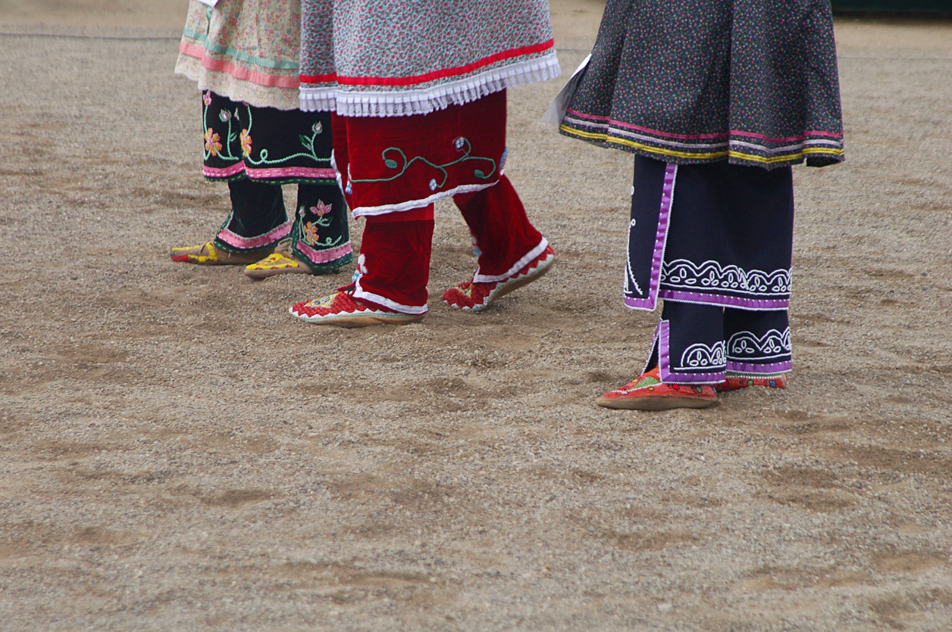
Native American Business Development Institute (NABDI) Cont.
Since 2017, OIED has received 218 proposals and awarded 66 NABDI grants totaling $2,707,575.
The FY 2021 NABDI closed July 2, 2021. Awards are expected to be announced by the end of July 2021.

Slide 5
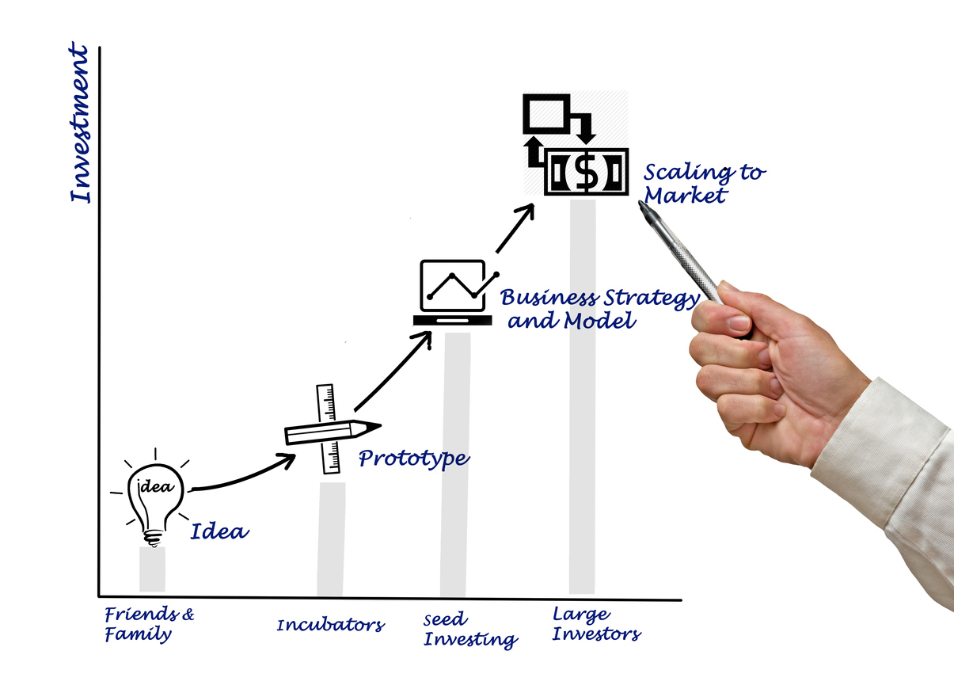
NABDI Feasibility Study Examples
Seneca Tribe – White Corn Distribution
Catawba Indian Nation - Industrial Park Development
Hualapai Tribe - Mini-Mart Truck Stop at Grand Canyon
St. Regis Mohawk Tribe - Property Development, repurpose of a Damn Facility
Angoon Community Association - Wood Products Development/Business
Kalispel Tribe of Indians - Pet Boarding and Daycare Business
Nez Perce Tribe - Manufacturing Facility Development

Slide 6
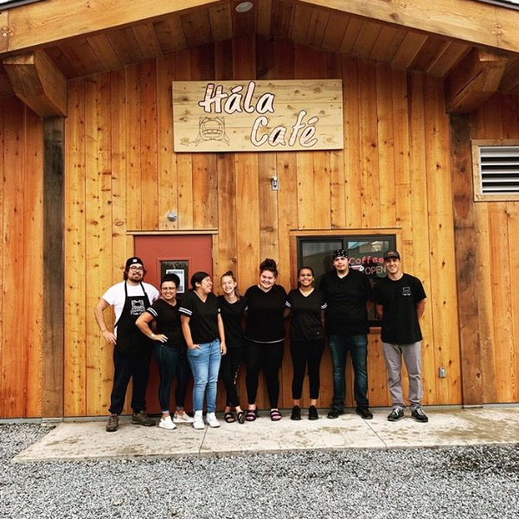
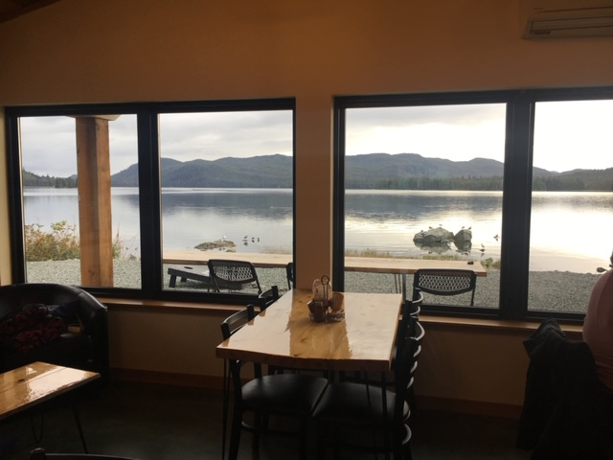
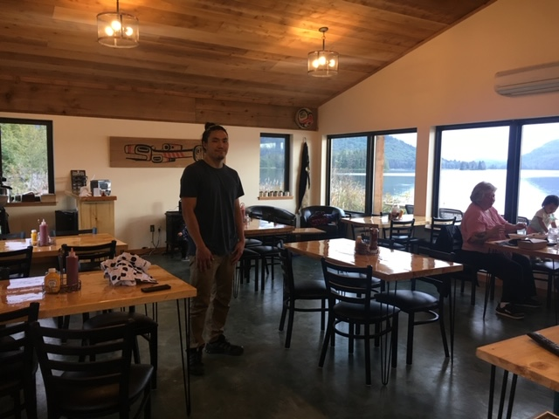
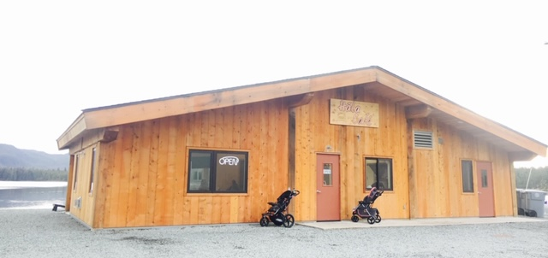
NABDI Grant Success Story
Hydaburg Cooperative Association (the tribe) was awarded $30,000 to conduct a feasibility study for a café/laundromat.
The completed study was then used, in part, to secure a $600,000 Housing and Urban Development Indian
Community Development Block Grant (HUD-ICDBG) to construct the café/laundromat.
Seneca Tribe – White Corn Distribution, Railroad Museum Conversion
Catawba Indian Nation - Industrial Park
Passamaquoddy Tribe at Pleasant Point– Convenience Store Gas Station Development
St. Regis Mohawk Tribe– Property Development
Aroostook Band of Micmacs – Fisheries Related Business, Tribal Campground
Seminole Tribe – Airport Expansion

Slide 7
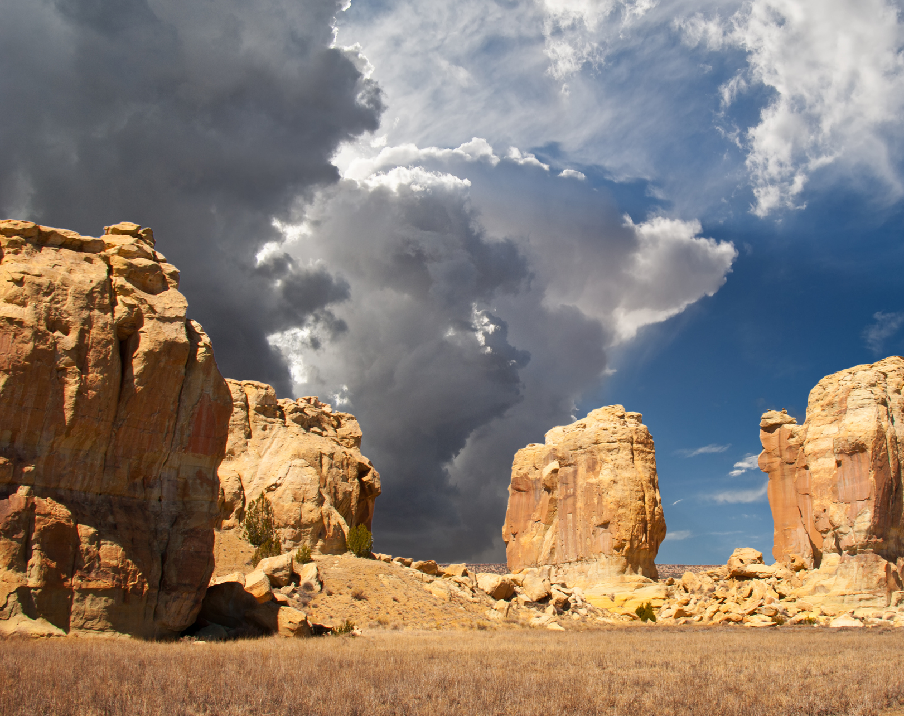
Tribal Tourism Grant Program (TTGP)
The TTGP funds support Federally Recognized Tribes and Tribal Organizations in hiring consultants to conduct tourism feasibility studies and develop tourism business plans.

Slide 8
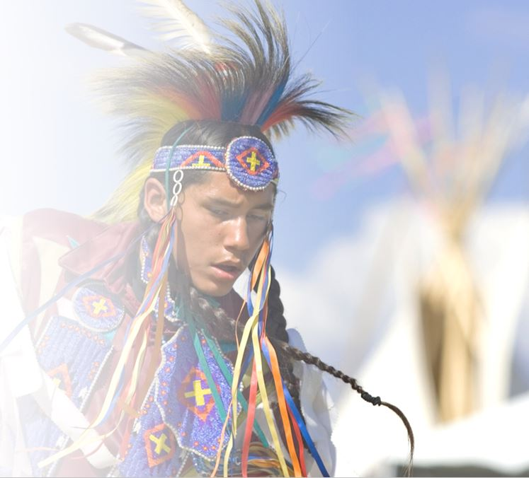
Tribal Tourism Grant Program (TTGP) cont.
The TTGP supports Federally Recognized Tribes and Tribal Organizations to plan, develop and manage tourism and related infrastructure in support of economic development and the NATIVE Act (Public Law No: 114-221 (09/23/2016))

Slide 9
Tribal Tourism Grant Program (TTGP) cont.
The TTGP is a new grant opportunity available for application submission June 22-August 13, 2021
OIED will award 20-30 grants ranging from
$25,000 to $150,000.

Slide 10
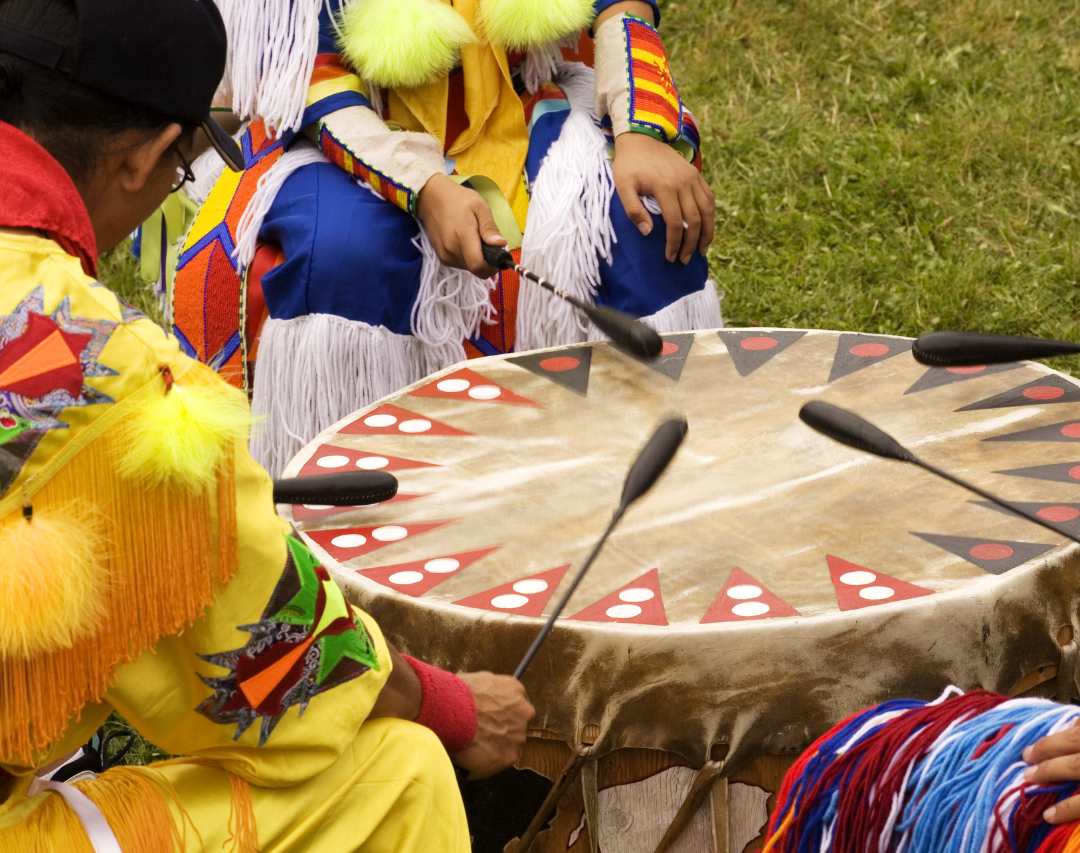
Living Languages Grant Program (LLGP)
Federally Recognized Tribes use awarded LLGP funds to provide Native language instruction, immersion programs, and build Tribal capacity to create or expand language preservation programs.

Slide 11
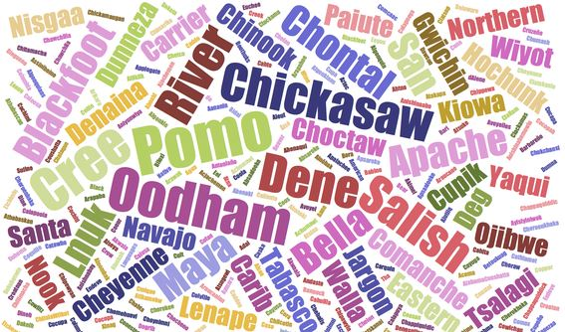
Living Languages Grant Program (LLGP) cont.
55 LLGP applications were received in 2020.
18 LLGP grants were awarded totaling $3,000,000.
LLGP grant awards range from $100,000 to $200,000.
Applications for the LLGP
grant will be accepted on Grants.gov in July 2021.

Slide 12
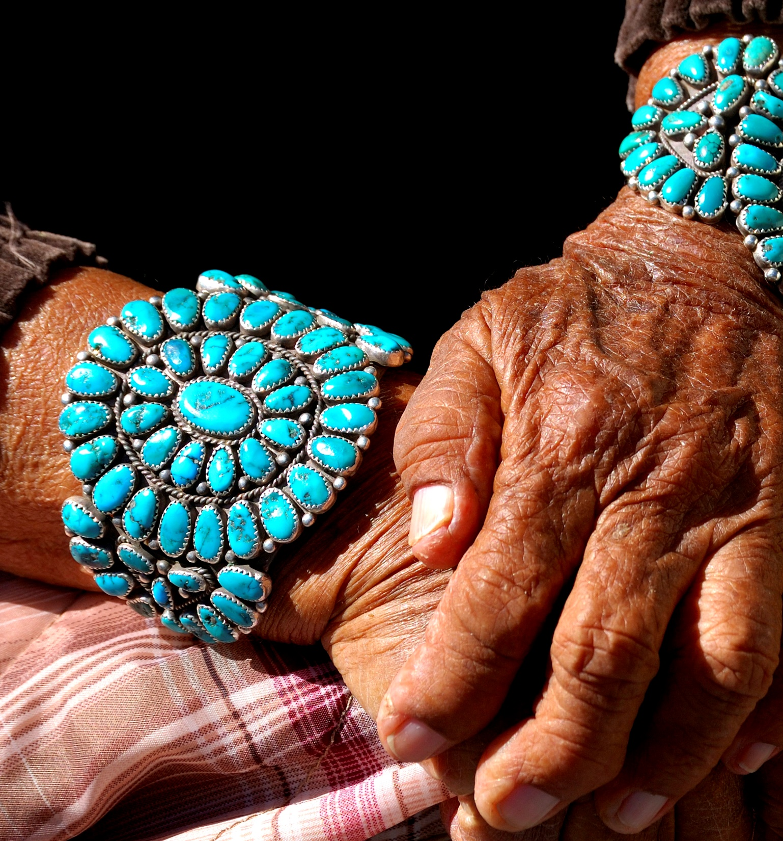
Coming Soon!
Indian Business Incubator Program (IBIP)

Slide 13
Indian Business Incubator Program (IBIP)
The Native American Business Incubator Act of 2020 (P.L. 116-174) was passed to establish and operate business incubators that serve entrepreneurs (start-up and early-stage businesses) who will provide products or services to tribal reservation communities.

Slide 14
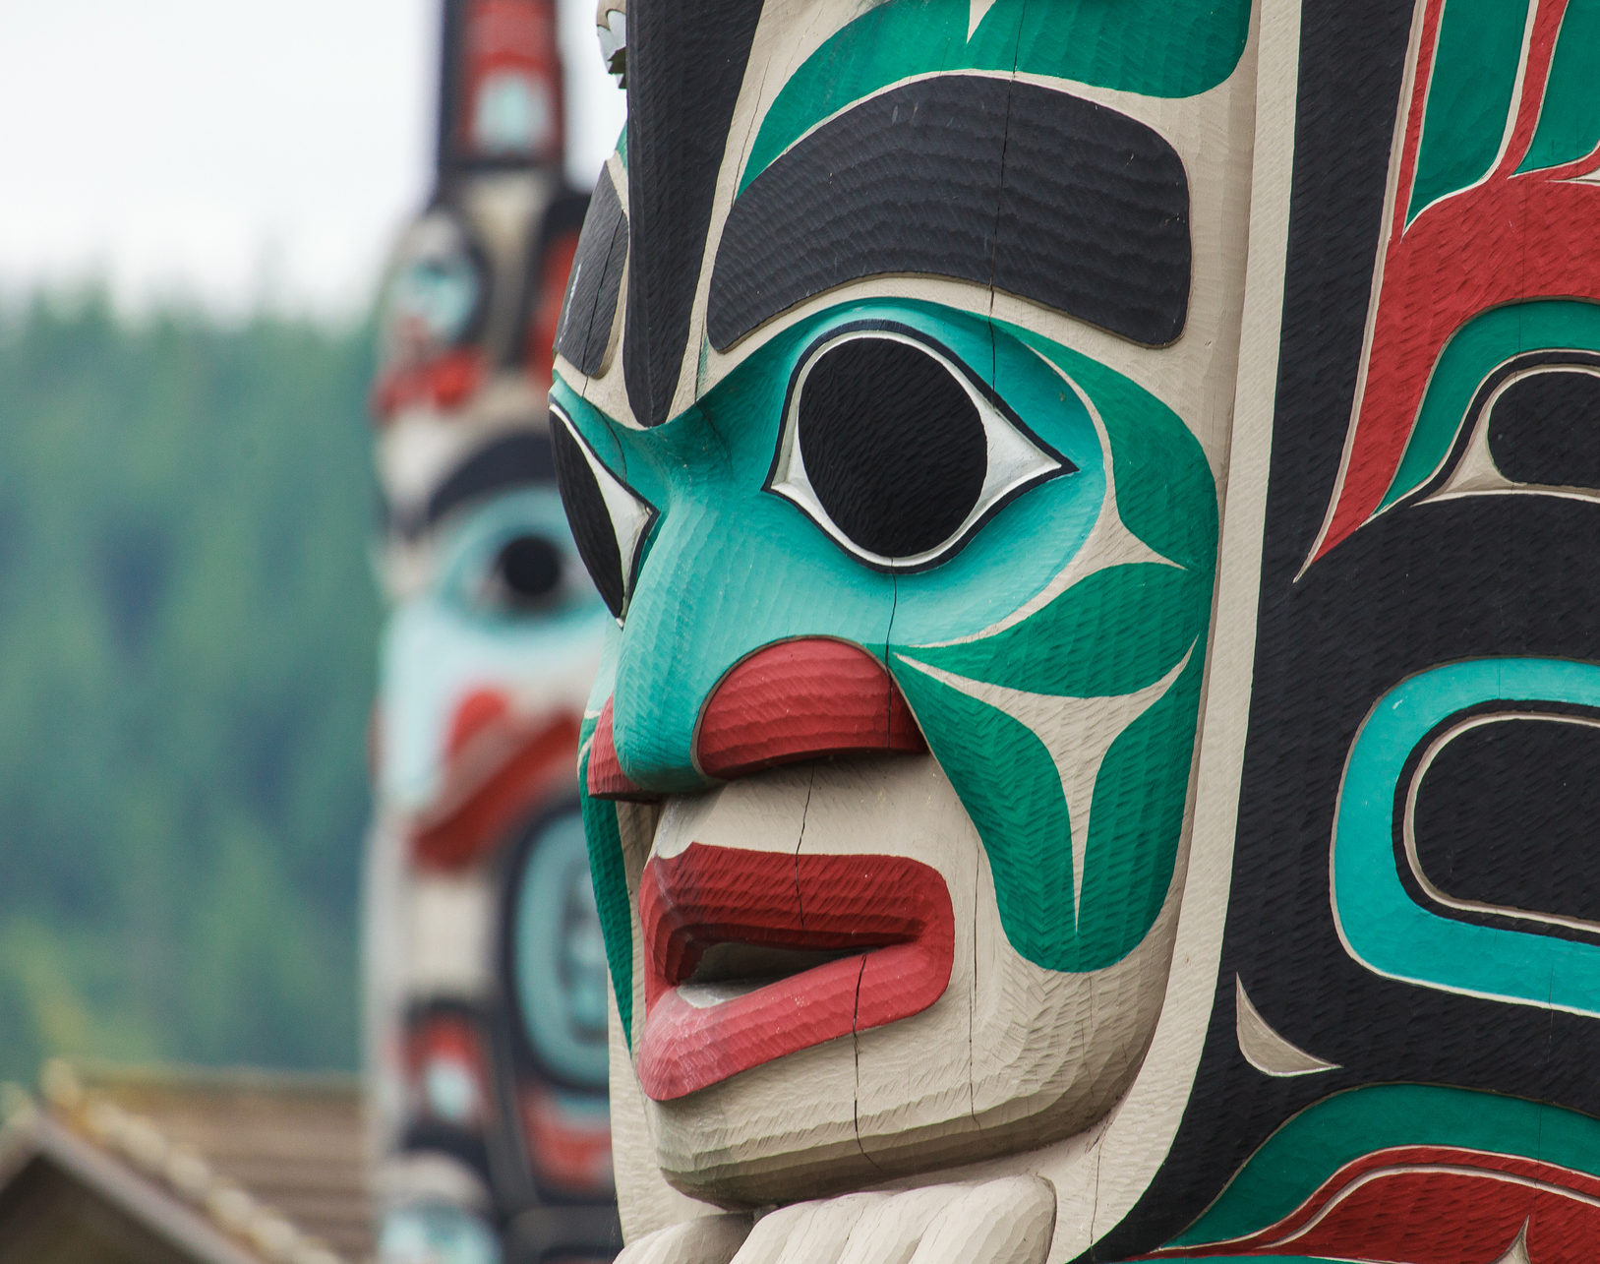
Indian Business Incubator Program (IBIP) cont.
A business incubator provides an organization opportunities to assist entrepreneurs in developing viable businesses.

Slide 15
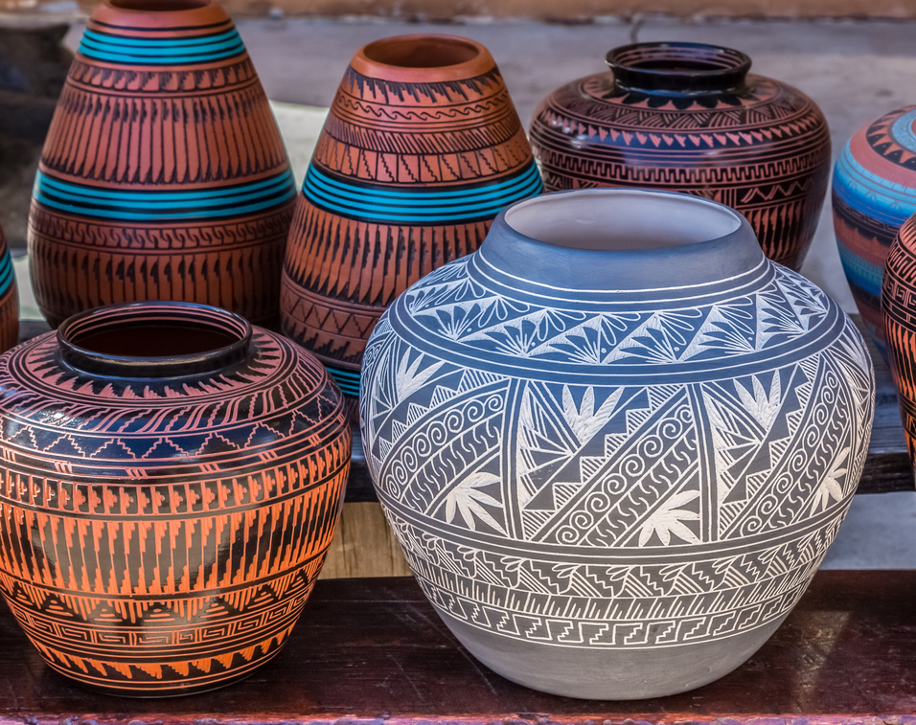
Indian Business Incubator Program (IBIP) Update
Consultations were held May 12 & 13, 2021
Comments closed for IBIP June 14, 2021
IBIP Regulations will be finalized summer 2021
IBIP grant process begins late FY 2021

Slide 16
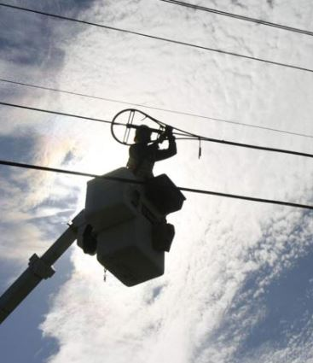
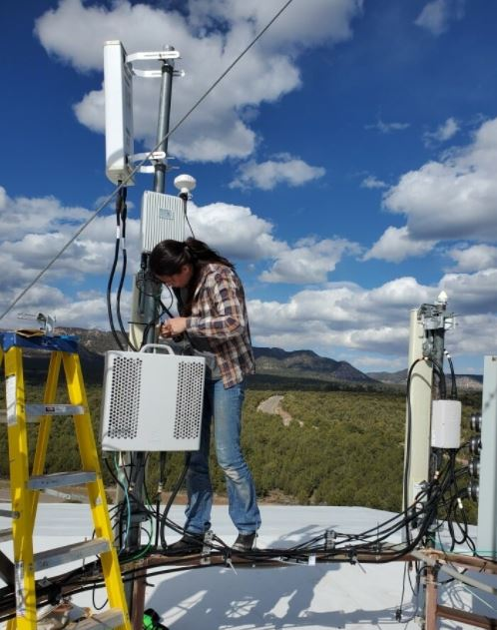
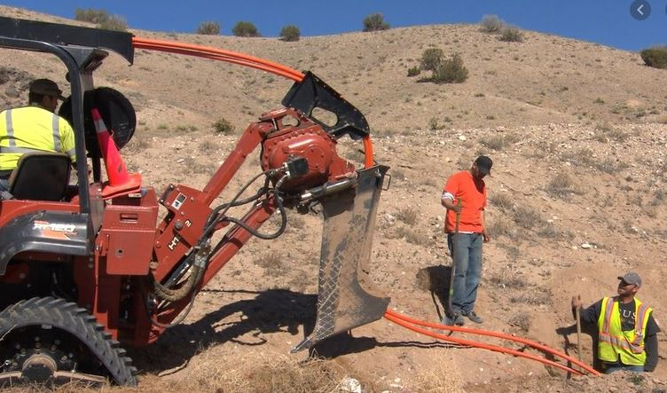
National Tribal Broadband Grant (NTBG)
OIED currently manages 31 FY2020 NTBG grants.
The OIED NTBG will not be available in FY2021.
The National Telecommunications and Information Administration (NTIA) will provide a tribal broadband grant. NTIA is currently accepting applications with a closing date of September 3, 2021.

Slide 17
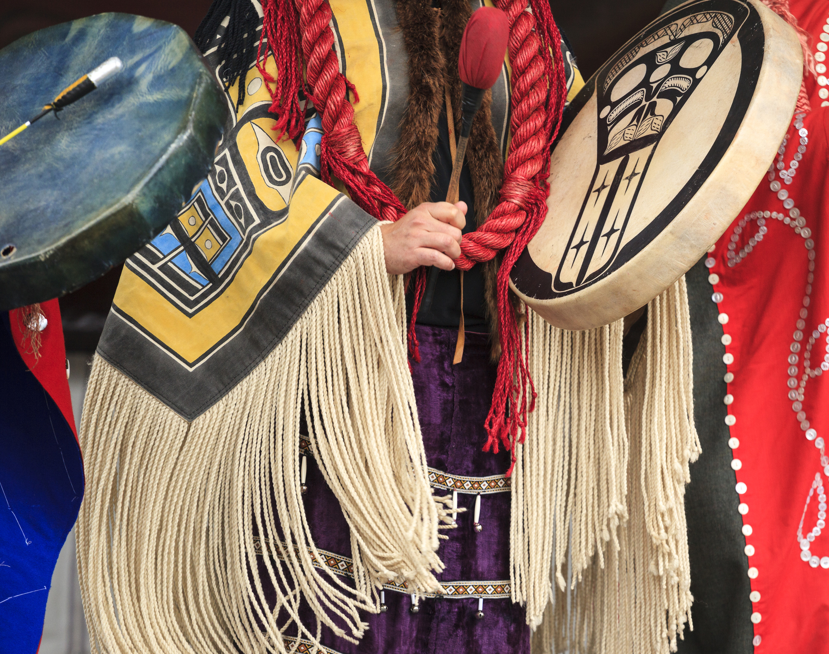
How to Apply for OIED Grants
All OIED grant applications are accepted via www.Grants.gov.
For information on how to apply for grants in Grants.gov, see the instructions available at https://www.grants.gov/help/html/help/Applicants/HowToApplyForGrants.htm
Tips: Read the NOFO listed in the grants.gov announcement thoroughly.
Be sure to submit all required forms and mandatory documents.

Slide 18
Important Dates Recap…
NABDI is closed. It will be awarded in FY2021
Tribal Tourism Grant Program is open. It will close on August 6, 2021, awarded FY2021.
Living Languages Grant Program will open in July 2021.
Indian Business Incubator Grant is coming soon!

Slide 19
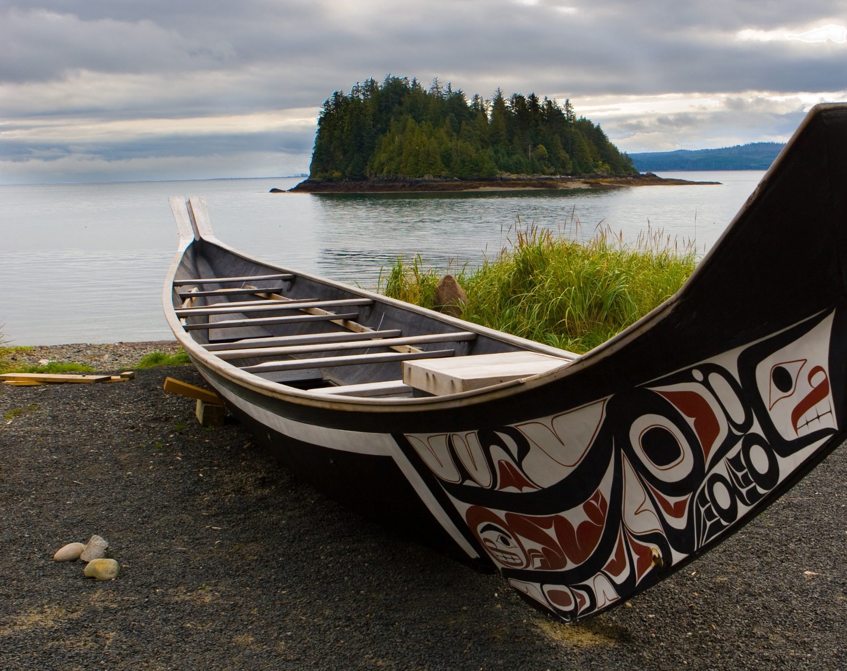
OIED Grants Contacts: James R. West, OIED, Program Analyst Jamesr.west@bia.gov 202-595-4766 or K. Denise Edwards, OIED, Director (acting) Katharine.Edwards@bia.gov 303-710-0661

Slide 20
Nyá:wę! Thank you.

Slide 21
Walking with Native Business “Helping Guarantee the Economic Future of Indian Country"
Indian Loan Guarantee and Insurance Program 25 U.S.C. §1481 et seq, 25 CFR Part 103
Division of Capital Investment
Office of Indian Economic Development
U.s. Department of the Interior

Slide 22
Who is DCI… I thought you were BIA?
The Program is no longer under the purview of the BIA. It is a standalone federal program under DCI/IA.
The Division of Capital Investment manages the Indian Loan Guarantee and Insurance Program (Program,) which breaks through the conventional financing barriers for tribes and individual Indians.
It is not a grant program. Rather, the Program helps borrowers obtain loan financing from private lenders when they would be unable to do so otherwise.
The Program helps reduce lender risk so that borrowers can secure funding at reasonable interest rates. We bring lenders and borrowers together so that all may prosper.

Slide 23
Common Features of Loan Guarantees and Insurance
Up to 90% of outstanding principal, unpaid interest and authorized fees on a loan
Federally-recognized Tribes and Alaska Native groups, their individual members, and organizations, whether for profit or nonprofit, are eligible to participate. Borrowers need to be at least 51% native-owned (or in the case of nonprofits, 51% native controlled) to be eligible.
Borrowers must have at least 20% equity in the project being financed and the project must benefit the economy of a reservation or tribal service area.
Loans can be used for operating capital, equipment purchases, construction, business acquisition, refinancing, lines of credit, and other needs
Individuals are limited to loans of $500,000 or less. No Program limit to loan amounts for Tribes and business entities consisting of at least two persons. There are limits based on Program funding, however.
Most lending organizations are eligible under the Program, including US-based banks, CDFIs, and some non-bank lenders.

Slide 24
Loan Guarantees vs Loan Insurance
Loan Guarantees
Loan Insurance
Authorized guaranteed lenders can apply. All Loan requests are submitted to DCI’s credit committee
Loan Guarantee premium of 2%
Pre-authorized insured lenders are given a level of coverage for the fiscal year. For loans of $250,000 or less, DCI credit committee is not required.
Loan Insurance premium of 1%

Slide 25
In the Event of Default
Loan Guarantees
Loan Insurance
Lender has the option to liquidate all collateral before submitting a claim for loss on any remaining debt or submit a claim for loss and immediately receive a payment on the loss
Payment based on percentage of Guarantee (up to 90%)
Lender must liquidate all collateral, first, before submitting a claim for loss on any remining debt
Insured losses are limited to the lesser of 90% of the lender’s loss on the insured loan or 15% of the value of that lender’s entire portfolio of Program-insured loans

Slide 26
Getting Started
Borrowers apply for a loan to the lender of their choice. As long as that lender is regularly engaged in making loans, it is probably eligible to use the Program (if not already authorized). Becoming authorized is a fairly quick and easy process.
Lenders should only apply for a loan guarantee or obtain loan insurance when it would not otherwise approve the borrower’s loan application
To apply, here are some of the necessary steps:
The borrower must develop a business plan and submit it to the lender, together with a completed loan application.
The lender must submit Indian Affairs Form RGI10 to the DCI Zone Manager where the business is to be located.
The lender’s application must include the proposed loan terms, all materials the borrower supplied in its loan application, the lender’s analysis of the borrower’s prospects and collateral, and a recent credit report. If the loan is for refinancing or construction, there are additional requirements.

Slide 27
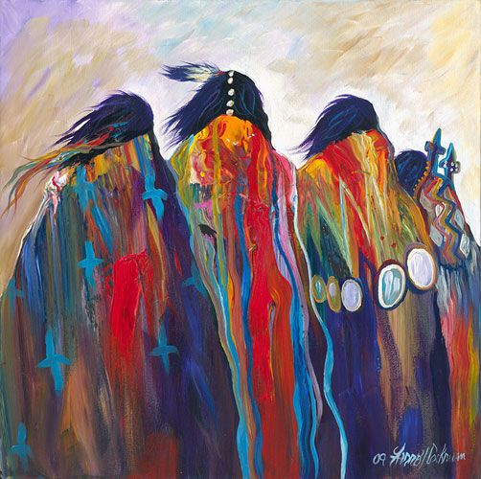
If the loan is for $250,000 or less, the process can be even easier. If an approved lender with loan insurance authority cannot offer its best terms without Program insurance, it can simply use a portion of its authority and close the loan, without prior review by DCI’s credit committee. The lender simply sends in the required premium and paperwork afterwards to comply with Program requirements, and the loan is insured.
There is no reason a lender cannot have in place both a Loan Guarantee Agreement and a Loan Insurance Agreement with DCI, so that it can choose which product to use as circumstances warrant.

Slide 28
Frequently Asked Questions
How do I obtain a guarantee?
Loan guarantee applications are made by the lender to DCI if, after doing its own underwriting, the lender determines that it cannot make the loan without a guarantee. DCI will guarantee up to 90% of eligible loans. The loan guarantee application consists of a one-page form making the request, as well as a series of documents that most prudent lenders will have already collected from the borrower. Those items are listed in 25 CFR 103.12 and 103.26.
Where and when do I apply?
Complete applications can be sent to our Zone Offices. The Lender must state why it is unable to make the loan without a guarantee through the Program. Once a complete application has been received, a written explanation of DCI’s decision will be delivered within 30 days.
Native CDFIs may close on the loan of $250K or less and send the 1% premium into DC, the loan will be automatically insured if the CDFI has followed regulations under 25CFR 103
What happens after the loan has been approved?
DCI will sign a loan guarantee certificate with attached, mutually agreed-upon conditions of approval. The certificate is not valid until the loan closes and the premium payment has been received. DCI staff can work with the lender to make sure that the loan closes in a timely manner.

Slide 29
Frequently Asked Questions
What types of loans are eligible for the Program?
The borrower must be at least 51% native-owned and its project must benefit the economy of a reservation or tribal service area. Loans cannot be made for re-lending or gaming purposes, smoke shops, liquor stores, or cannabis operations.
Do all financial institutions qualify?
Most CDFIs, including Native CDFIs, and almost all US-based commercial banks qualify for participation in the Program. Non-bank lenders can also be eligible, but they must meet the requirements of 25 CFR 103.10. All lenders must sign a Loan Guarantee Agreement or Loan Insurance Agreement or both, before participating. Credit Unions do not qualify unless they have CDFI status.
Is any equity required by the borrower?
The borrower must be projected to have at least 20 percent equity in the business being financed, immediately after the loan is funded. If a substantial portion of the loan is for construction or renovation, the borrower's equity may be calculated based upon the reasonable estimated value of the borrower's assets after completion of the construction or renovation.

Slide 30
.
Children’s bookstore in Tulsa Oklahoma
Offers tutoring for literacy including specialization in dyslexia and special education
Event space for theme specific parties and events
*Cherokee Nation Economic Development Trust Authority*

Slide 31
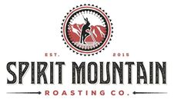
.
Coffee roasting company based in Winterhaven, CA
All Native staff
Coffee is roasted to order and shipped anywhere in the US
*Native Capital Access*

Slide 32
.
Family entertainment center specializing in virtual reality and social gaming
Located in Mishawaka, IN
*Chi Ishobak*

Slide 33
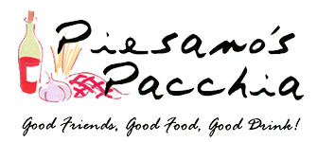
.
Italian Eatery locates in Rapid City, SD
Owner, Stacey Livermont worked at the restaurant for 20 years before working with Lakota Funds to buy out the owner
*Lakota Funds*

Slide 34
Little Traverse Bay Band of Odawa Indians GNI Phase 1 LLC – Marriott Courtyard, Petoskey, MI
Loan $21,000,000 in Fiscal Years 2018 /2019
Build out 144-unit Marriott Courtyard and 6,000 sq. ft retail strip mall

Slide 35
Victories Square in Petoskey, MI
6,000 sq. ft. retail strip mall anchored by 2,000 sq. ft. Starbucks

Slide 36
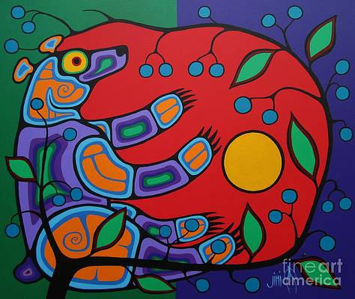
Compass by Margaritaville Coquille Indian Tribe Medford, Oregon

Slide 37
