Slide 1
Tribal Consultation
TRIBAL CONSULTATION
on the proposed rule for the
Indian Business Incubator Program (IBIP)

Slide 2
Agenda
Welcome & Invocation
1. The Purpose of Tribal Consultation
2. Consultation Expectations
3. Native American Business Incubator Program Act
4. Congressional Findings on Tribal Business Development
5. What is a Business Incubator?
6. What Services Will Business Incubators Provide?
7. Overview of IBIP Grant Basics
Logistics & Written Responses
Government-to-Government Dialogue
Closing

Slide 3
The Purpose of Tribal Consultation
Tribal consultation is used to facilitate dialogue with Tribal leaders and their communities to foster communication and collaboration with Tribal Nations.

Slide 4
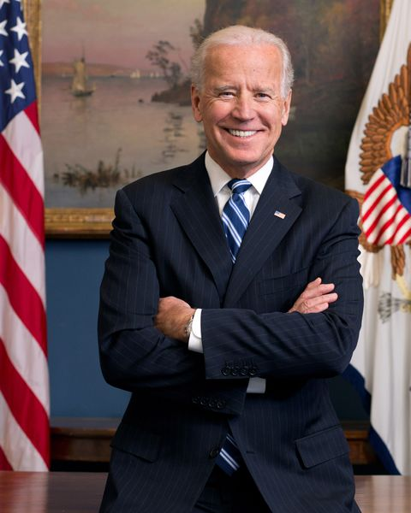
The Purpose for Tribal Consultation (cont.)
“It is a priority of my Administration to make…regular, meaningful, robust consultation with Tribal Nations cornerstones of Federal Indian policy.”
President Joe Biden

Slide 5
The Purpose of Tribal Consultation (cont.)
Honor our nation-to-nation relationship;
Hear directly from Tribal leaders as we address the health, economic, racial justice, and climate crises — all of which disproportionately impact American Indians and Alaska Natives; and
Commit ourselves to a process that addresses Tribal needs and ensures we respect and take input to heart.

Slide 6
Indian Business Incubator Program Consultation Expectations
Provide an overview of the Indian Business Incubator Program (IBIP) proposed rule
Listen to participants' questions about the proposed IBIP rule (regulations)
Record comments and questions from participants
Respond to questions and provide answers to the best of our ability

Slide 7
Overview of the Native American Business Incubator Act of 2020 (P.L. 116-174)
The Native American Business Incubator Act of 2020 (P.L. 116-174) was passed to establish and operate business incubators that serve entrepreneurs (start-up and early-stage businesses) who will provide products or services to tribal reservation communities.

Slide 8
Congressional Findings:
All entrepreneurs face challenges when transforming ideas into profitable business enterprises.
Entrepreneurs that want to provide products and services to tribal reservation communities face an additional set of challenges that require special knowledge.
The business incubator model is suited to:
Accelerating entrepreneurship in reservation communities,
Promoting collaboration to address challenges,
Providing individually tailored services to overcome obstacles that are unique to each participating business,
Stimulating economic development in reservation communities.

Slide 9
What is a Business Incubator?
A business incubator is an organization that assists entrepreneurs in developing viable businesses.

Slide 10
A Business Incubator provides:
Specialized resources tailored towards business growth
Training, mentoring, and hands-on business development
Designated training workshops
Access to a community of entrepreneurs and business owners

Slide 11
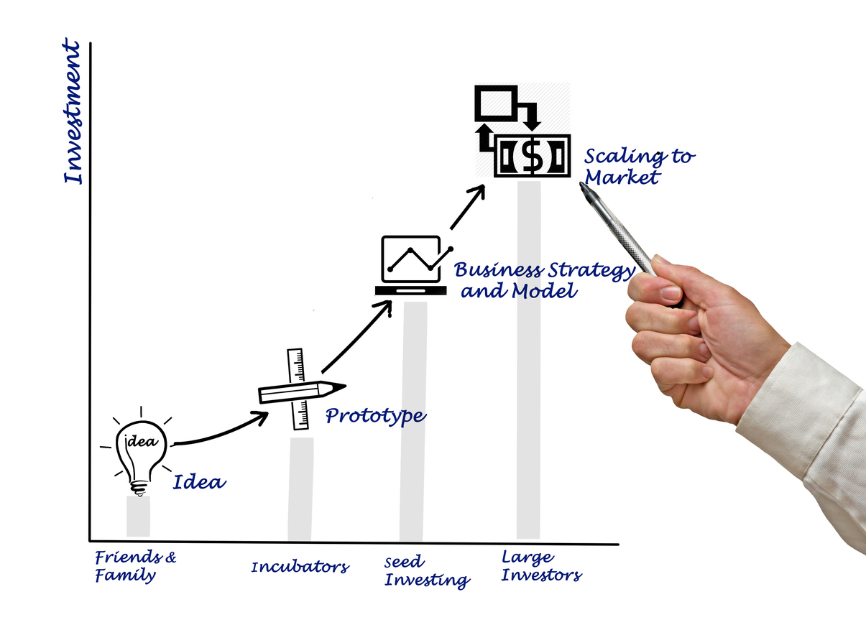
A successful Indian Business Incubator will:
Accelerate entrepreneurship in reservation communities
Promote collaboration
Address specific challenges to business start-ups in Indian Country.
Stimulate economic development
Provide tools necessary for Native entrepreneurs to develop successful businesses

Slide 12
What other services will the business incubators provide?
Advice and counseling to entrepreneurs to navigate obstacles in transforming their innovative ideas into operational businesses
Workspace and facilities
Advice on how to access capital
Business education
Networking and mentorship opportunities

Slide 13
Who is eligible to apply for the IBIP grant?
To be eligible to receive an IBIP grant, the applicant must:
(a) Be able to provide the physical workspace, equipment, and connectivity necessary for Native businesses and Native entrepreneurs to collaborate and conduct business on a local, regional, national, and international level; and
(See proposed § 1187.3 of the proposed rule)

Slide 14
Who is eligible to apply for the IBIP grant? (continued) (b) Be one of the following entities:
(1) An Indian Tribe;
(2) A Tribal college or university that will have been operational for not less than one year before receiving a grant under the IBIP;
(3) An institution of higher education that will have been operational for not less than one year before receiving a grant under the IBIP; or
(4) A Tribal or private nonprofit organization that provides business and financial technical assistance and:
(i) Will have been operational for not less than one year before receiving a grant under the IBIP; and
(ii) Commits to serving one or more reservation communities.
(See proposed § 1187.3 of the proposed rule)

Slide 15
How to Apply
The IBIP grant will be available for application at www.Grants.gov.
For information on how to apply for grants in Grants.gov, see the instructions available at https://www.grants.gov/help/html/help/Applicants/HowToApplyForGrants.htm
(See proposed § 1187.10 of the proposed rule)

Slide 16
Overview of the IBIP Grant Basics
Grant Proposal Requirements
Evaluation Criteria for IBIP Grant Proposals
Minimum Awardee Requirements
Grant Administration

Slide 17
Grant Proposal Requirements
Certification of eligibility
Description of tribal communities to be served
3-year plan for providing services to entrepreneurs
Detailed budget
Information demonstrating applicant's experience
Description of non-Federal contribution of at least 25% of grant amount requested
IEED may waive this requirement under 1187.43
Site description of place where applicant will provide physical workspace
(See proposed §§ 1187.11-12 of the proposed rule)
This Photo by Unknown Author is licensed under CC BY-SA

Slide 18
Evaluation Criteria for IBIP Grant Proposals
OIED will use the following to develop IBIP proposal evaluation criteria:
This Photo by Unknown Author is licensed under CC BY-NC-ND

Slide 19
Evaluation Criteria for IBIP Grant Proposals
Ability of eligible applicant to operate a business incubator (as demonstrated by experience/qualifications), begin providing services within 3 months, and provide quality incubation services to significant number of Native businesses/entrepreneurs or in geographically remote locations
(See proposed § 1187.20(a))
This Photo by Unknown Author is licensed under CC BY-NC-ND

Slide 20
Evaluation Criteria for IBIP Grant Proposals (cont.)
Experience of eligible applicant in providing services in Native American communities, including one or more of the reservation communities described in the application
(See proposed § 1187.20(b))

Slide 21
Evaluation Criteria for IBIP Grant Proposals (cont.)
Extent to which grant award will enable an entity that is already providing business incubation services to appreciably enhance those services
(See proposed § 1187.20(d))

Slide 22
Evaluation Criteria for IBIP Grant Proposals (cont.)
For the Proposed Location OIED will:
Consider goal of achieving broad geographic distribution of incubators; and
Give priority to eligible applicants that will provide services on or near the reservation unless:
Incubator location will not prevent the eligible applicant from providing quality business incubation services to Native businesses/entrepreneurs from one or more reservation communities to be served; and
The location will serve the interests of one or more reservation communities
(See proposed § 1187.20(c) & § 1187.21)

Slide 23
Evaluation Criteria for IBIP Grant Proposals (cont.)
Proposed Location/Site Evaluation
Before awarding a grant, OIED will evaluate the proposed site.
If in possession: OIED conducts site visit or video submission
If not yet in possession: OIED reviews written site proposal and conducts on-site or video visit one year later
(See proposed § 1187.20(c) & § 1187.21)

Slide 24
Minimum Awardee Requirements
Each awardee must:
Offer culturally tailored incubation services to Native businesses/entrepreneurs
Use competitive process to select participants
Provide physical workspace
Provide entrepreneurship and business skills training
Provide direct mentorship or assistance finding mentors in the industry in which the Native business/entrepreneur operates or intends to operate
Provide access to networks of potential investors, etc.
Leverage technology
(See proposed § 1187.44)

Slide 25
Grant Administration
IBIP Grant Term: 3 years
May be renewed for a term up to three additional years based on evaluation, performance, continued eligibility
Awardees receiving renewals must provide non-Federal contribution of at least 33% of total grant amount, unless OIED waives
(See proposed § 1187.41)
This Photo by Unknown Author is licensed under CC BY-SA

Slide 26
Grant Administration (cont.)
Awardees will be required to provide a narrative and financial report annually
OIED will evaluate awardee's performance based on awardee’s demonstrated accomplishments
Funding will be disbursed annually
(See proposed §§ 1187.41-1187.50)
This Photo by Unknown Author is licensed under CC BY-SA

Slide 27
Partnerships
OIED will facilitate relationships between awardees and education institutions serving Native American communities (e.g., TCUs)
OIED will coordinate with other agencies to ensure awardees have information needed to provide Native businesses/entrepreneurs for assistance in applying for agency programs
(See proposed § 1187.52)
This Photo by Unknown Author is licensed under CC BY-SA-NC

Slide 28
IBIP Grant Award
An IBIP grant award, and the services it provides, may not duplicate existing Federal funding from another source.
This means that an IBIP award may not provide services that are already being provided by other Federal funding
Same activities from other Federal funding sources are not allowed
(See proposed § 1187.31)

Slide 29
Comments
The proposed rule for the Indian Business Incubator Program was published in the Federal Register (FR) on April 13, 2021. Google search “Indian Business Incubator Program” to read the FR publication.
Please submit comments by June 14, 2021 to either:
www.regulations.gov or
consultation@bia.gov
FOR FURTHER INFORMATION CONTACT:
Elizabeth Appel, Office of Regulatory Affairs & Collaborative Action, telephone (202) 273-4680, elizabeth.appel@bia.gov.

Slide 30
Government to Government Dialogue

