Slide 1
Weather Forecasting and Hazardous Weather in the Field
John Wetenkamp
National Weather Service La Crosse Wisconsin

Slide 2
Overview
Red Flag Warnings
  Weather Factors
  Common Weather Patterns for Red Flag Warnings in the western Great Lakes Region
Hazardous Weather in the Field
  Lightning
  Damaging Thunderstorm Winds
  Tornadoes
  Hail
  Flash Flooding
New NWS Webpage
New NWS Spot Forecast Page (Coming Soon)

Slide 3
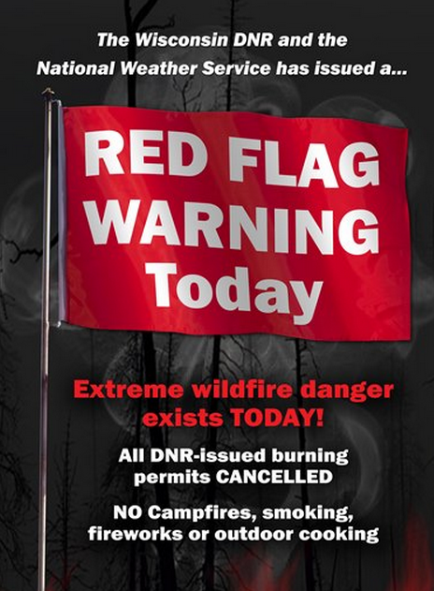
Red Flag Warnings
Issued when weather and “fuel” conditions are conducive for explosive fire growth potential
  Extreme Fire Danger
NWS works closely with land managers to determine the need for a Red Flag Warning

Slide 4
Weather Factors
Key weather factors:
  Relative Humidity (≤25% WI, MN, IA)
  Wind
    WI: 15 mph RAWS (Sensor at 20 ft) , 17 mph ASOS (Sensor at 33 ft)
    MN and IA: 20 mph
    Frequent winds gusts also factored into determining the need for the Red Flag Warning
  Temperatures considered
  Amount of time since last rainfall (Dryness)
    Fuels status determined by land managers.
      Canadian Forest Fire Danger Rating System (CFFDRS)
      National Fire Danger Rating System (NFDRS)

Slide 5
Red Flag Warning Climatology in the Western Great Lakes/Upper Mississippi River Valley
Climatology:
  1) Spring before Green-up (April and early May)
    Warm and dry air masses fairly common
    Weather systems can produce strong winds
  2) Fall after a killing frost
    Again, strong winds possible with weather systems
  After a period of prolonged drought (below normal precipitation for 3-8 months)

Slide 6
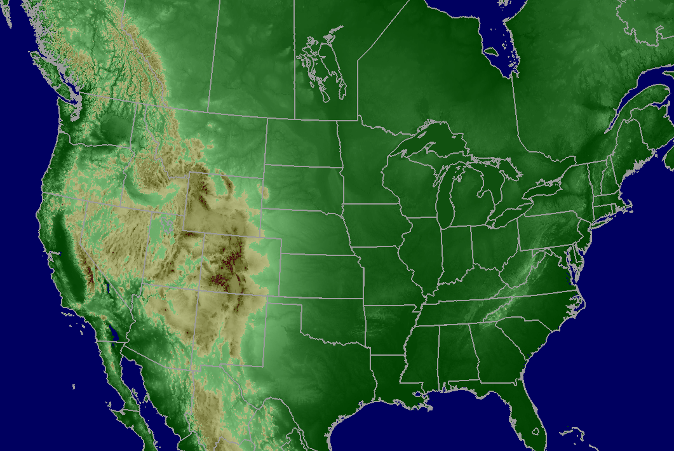

Examples of Weather Patterns That Could Lead To Red Flag Conditions (Spring Fire Season, Pre green-up)
(Dry Canadian High Pressure)

Slide 7
Examples of Weather Patterns That Could Lead To Red Flag Conditions (Spring Fire Season, Pre green-up)
The high may sit over the region
for a few days drying the wildland fuels.

Slide 8


Examples of Weather Patterns That Could Lead To Red Flag Conditions (Spring Fire Season, Pre green-up)
Warm & Dry Air

Slide 9
Examples of Weather Patterns That Could Lead To Red Flag Conditions (Spring Fire Season, Pre green-up)
Warm & Dry Air

Slide 10

Examples of Weather Patterns That Could Lead To Red Flag Conditions (Spring Fire Season, Pre green-up)
As the front draws closer winds increase and combine with the dry conditions to potentially create dangerous wildfire conditions.

Slide 11
Examples of Weather Patterns That Could Lead To Red Flag Conditions (Spring Fire Season, Pre green-up)
Strong northwest winds can develop on the back side of the front . These strong winds can also create dangerous wildfire conditions.

Slide 12
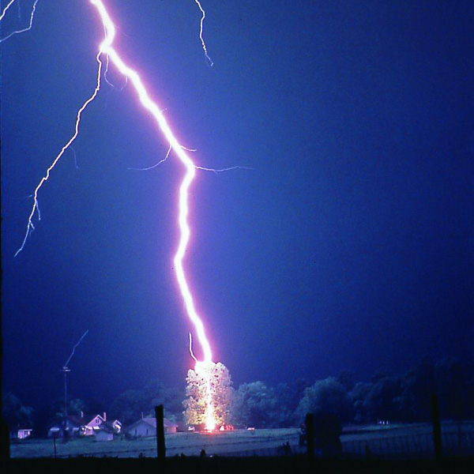
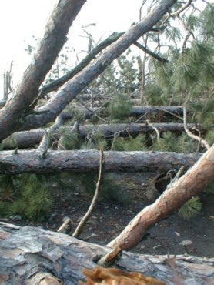
Hazardous Weather in the Field
Thunderstorm Hazards
  Lightning
  Severe Thunderstorm Winds
  Tornadoes
  Hail
  Flash Flooding

Slide 13
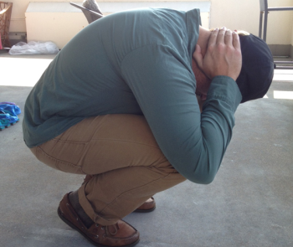
Lightning
Kills an average of 49 people in the United States each year with hundreds severely injured
If you can hear thunder you are close enough to be struck by lightning
  If outdoors
    Go to your vehicle
    If you don’t have a vehicle nearby
      Avoid tall objects such as trees and assume the lightning position

Slide 14
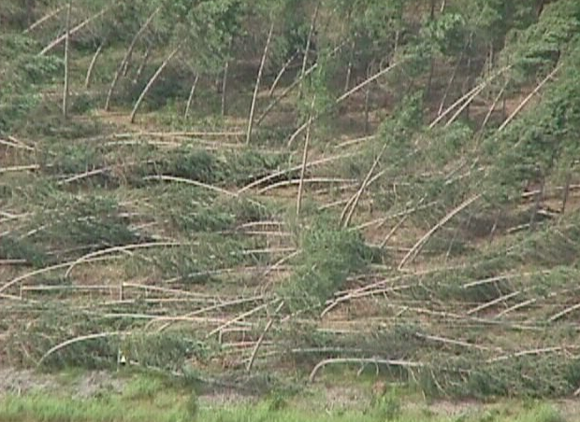
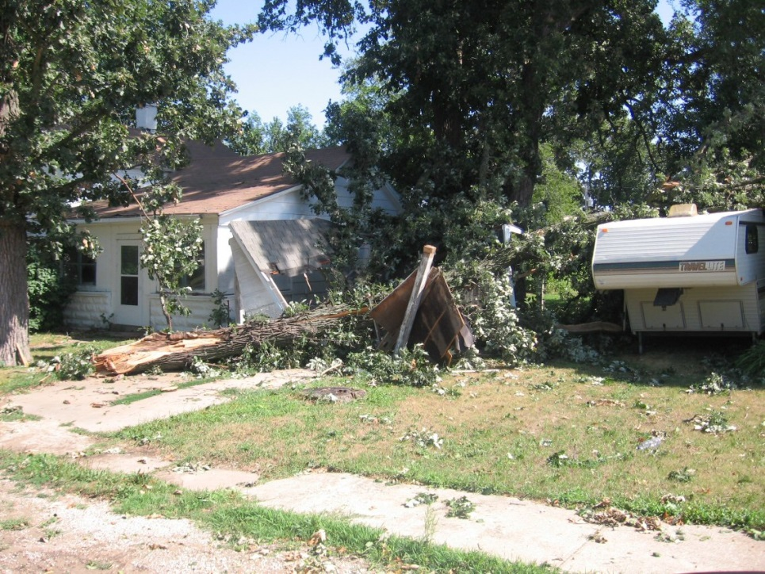
Severe Thunderstorm Winds
Winds ≥ 58 mph
Can cause extensive tree and property damage

Slide 15
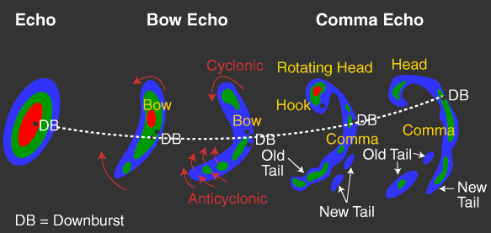
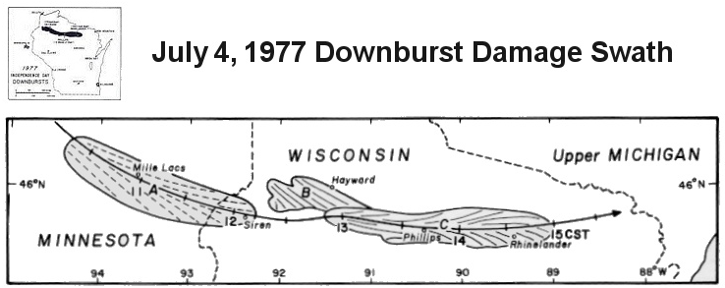
Cases of Extreme Winds
July 4th 1977 across northern Wisconsin
  Winds estimated at 113 to 157 mph
  A damage path of 17 miles wide and 166 miles long
Radar Representation of a Bow Echo

Slide 16
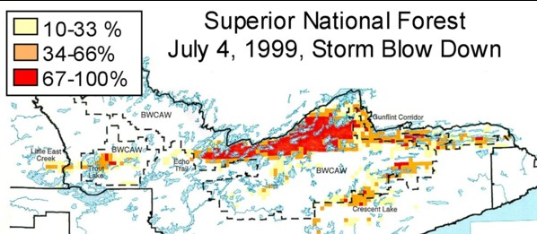
Cases of Extreme Winds
July 4th 1999 Boundary Waters Canoe Area
  Winds estimated at 80 to 100 mph
  Tens of millions of trees blown down
  60 people injured by falling trees, some serious
Percentage of trees blown down in northeast Minnesota (USDA Forest Service)

Slide 17
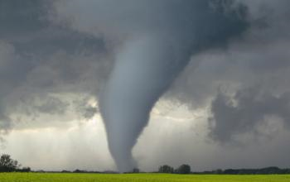
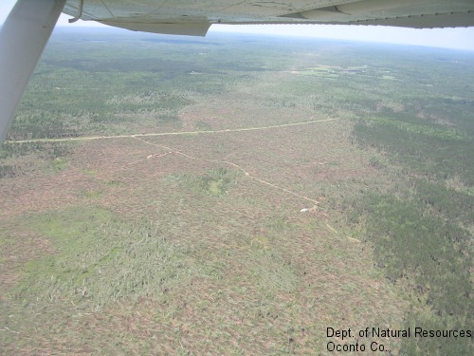
Tornadoes
Tornadoes can occur anytime but are most common in the afternoon and evenings
Can last for a few seconds or hours
Winds speeds of 65 to over 200 mph.
  Longest tornado track: 212 miles/ 3.5 hours

Slide 18
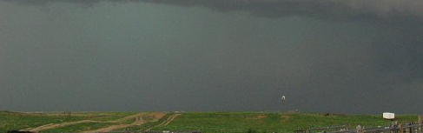
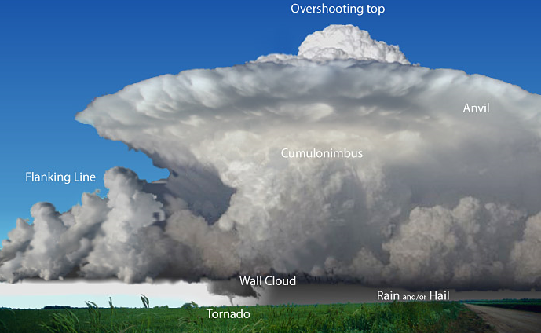
Tornadoes
Tornadoes aren’t always visible
  Can be obscured by rain, hail, trees, hills
What would you see if you were here?
Storm Movement

Slide 19
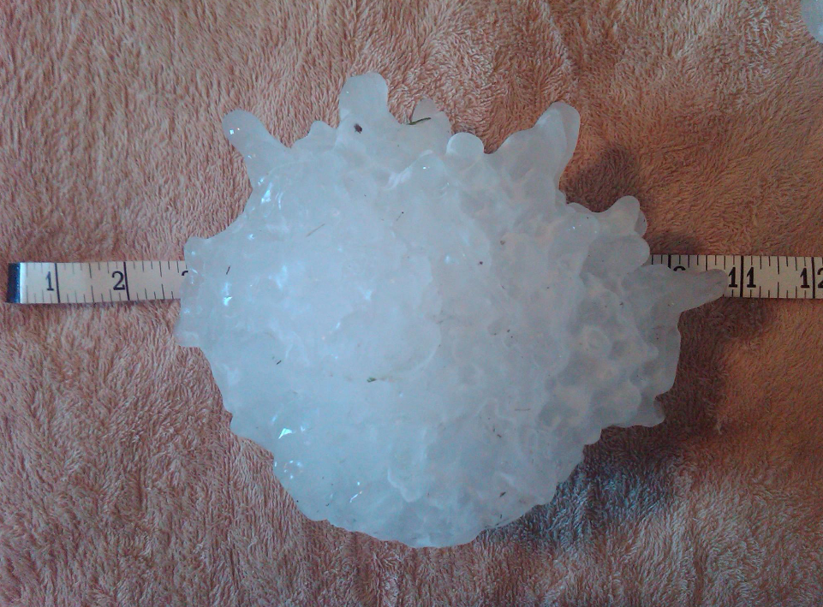
Large Hail
Severe hail
  Hail ≥ 1” in diameter (Quarter Size)
  Can grow to the size of softballs or larger!
  Vivian, SD record hail stone was 8” in diameter
  Weight was nearly 2 pounds
Record Hail Stone From Vivian, SD July 23, 2010

Slide 20
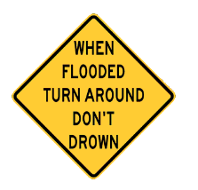

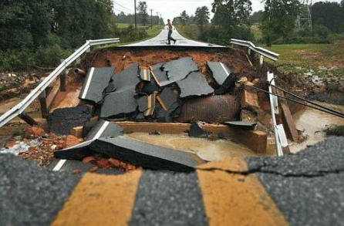
Flash Flooding
Causes more deaths than any other thunderstorm related hazard!
Don’t drive or walk into flood waters
It only takes 12 inches of flowing water to wash away a small car
6 inches of fast flowing flood water can knock you off your feet

Slide 21
Severe Weather Preparedness in the Field
Ensure you and your staff are weather aware
Have a means of receiving weather alerts
  Have a NOAA Weather Radio with you and make sure it is properly programmed
If you are caught outdoors during a storm
  Stay away from trees during lightning and high winds
    Your vehicle (with windows up) is a safe place to shelter from lightning
  If no shelter is available during a tornado, lie flat in a low spot or ditch and cover your head with your hands
  Be alert for flash flooding during and after heavy rainfall. Never cross water of unknown depth and watch out for roads that may have been washed out.
    Road/bridge washouts can be narrow and difficult to see, especially when approaching these areas with your vehicle. People have been killed driving into narrow washouts on paved and unpaved roads.

Slide 22
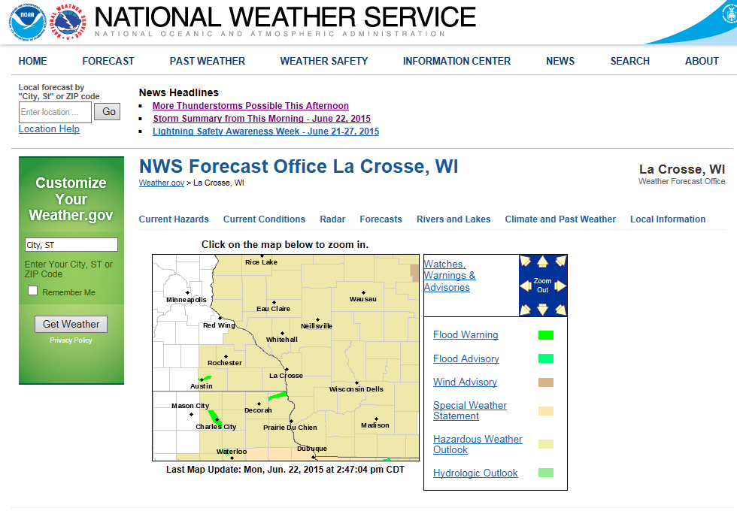
NWS Webpage
weather.gov (National View) You can click on your location
weather.gov/lacrosse (weather.gov/”enter you local office here”

Slide 23


Slide 24
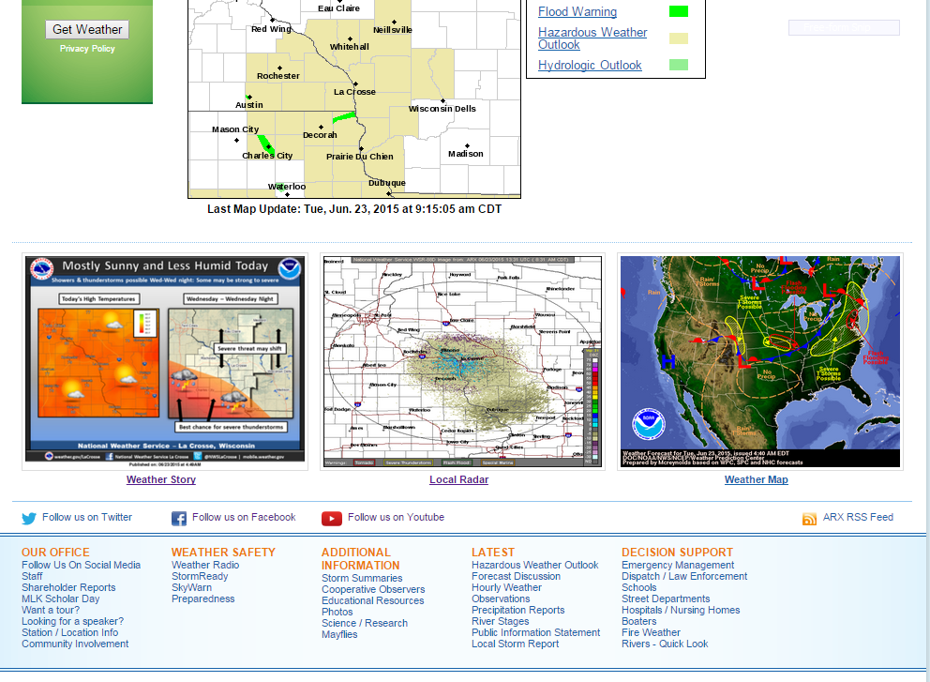

Slide 25
(Local NWS Information)

Slide 26
(National Information)

Slide 27
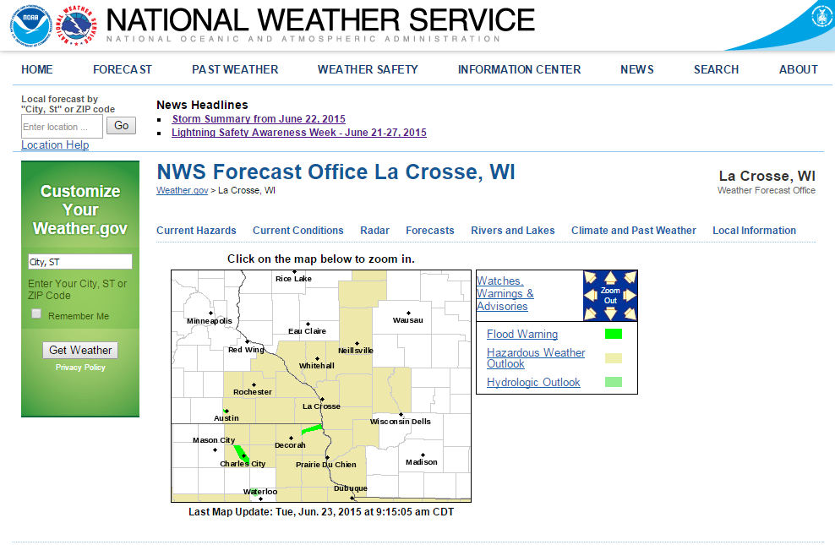
Accessing Fire Weather Information

Slide 28
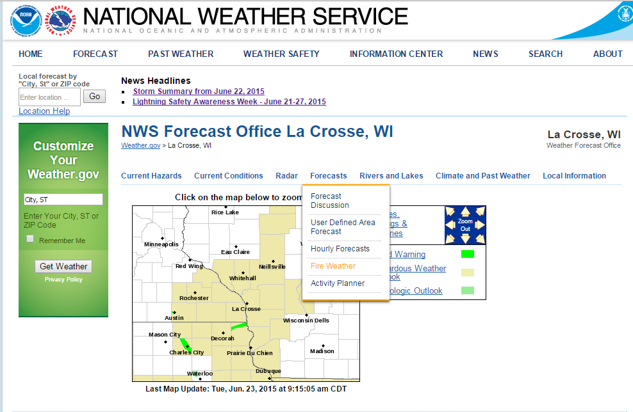
Accessing Fire Weather Information
Takes you to your local NWS Offices Fire Weather Page.

Slide 29
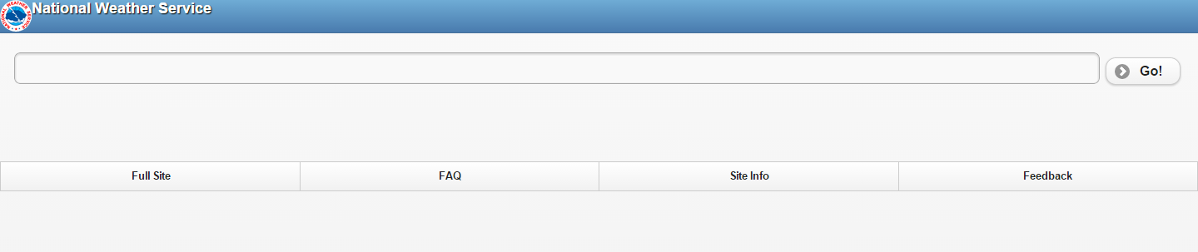
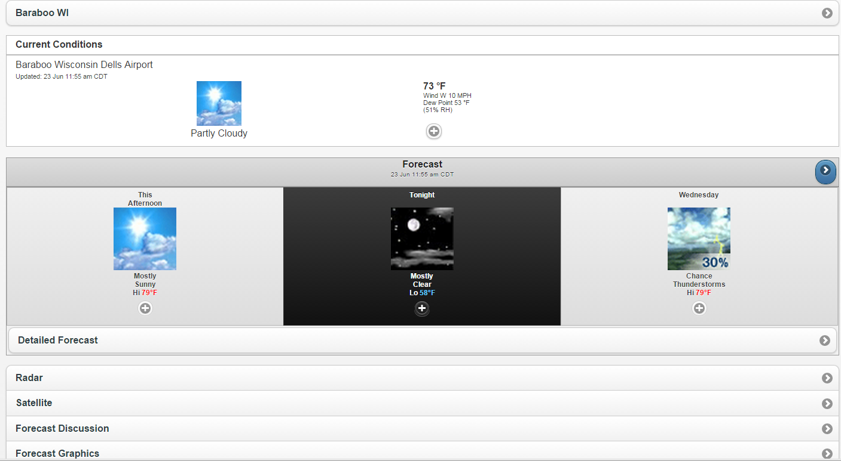
Mobile Phone Friendly Page
mobile.weather.gov
Zip, City or Place

Slide 30
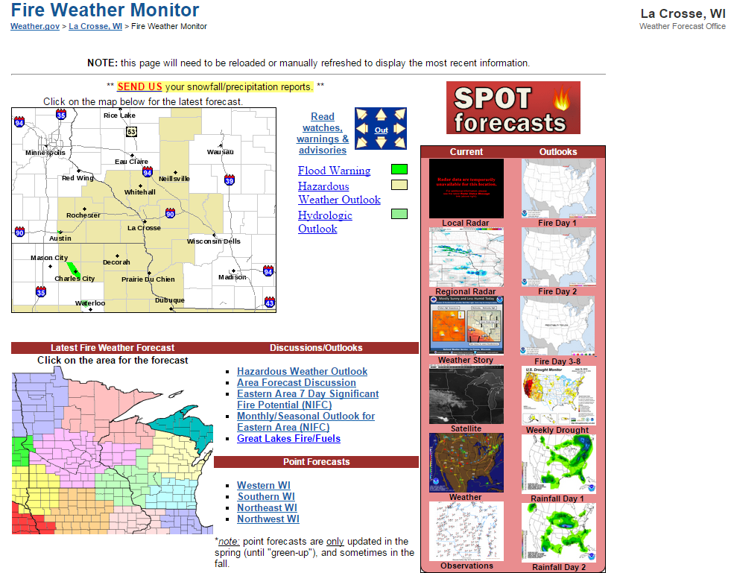
NWS La Crosse Fire Weather Page
(Standardized Local Pages in the near future)

Slide 31
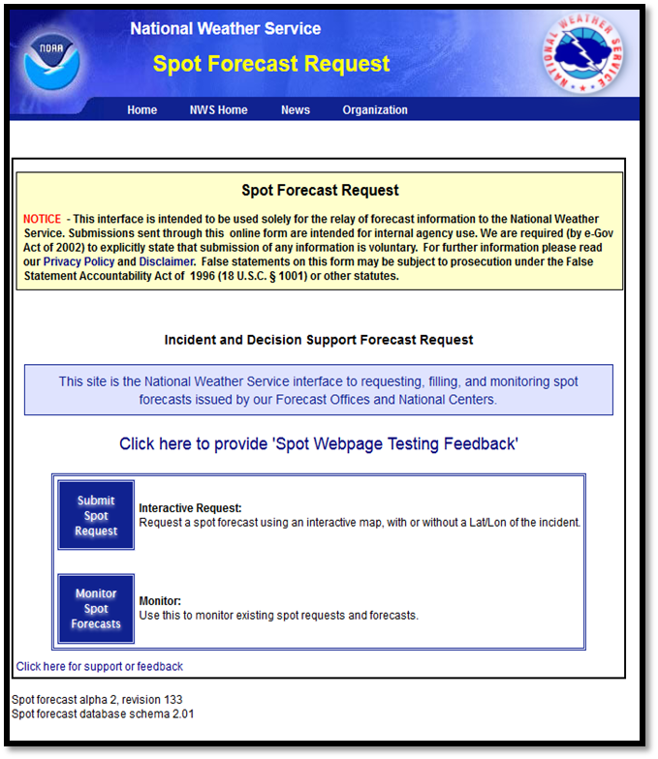
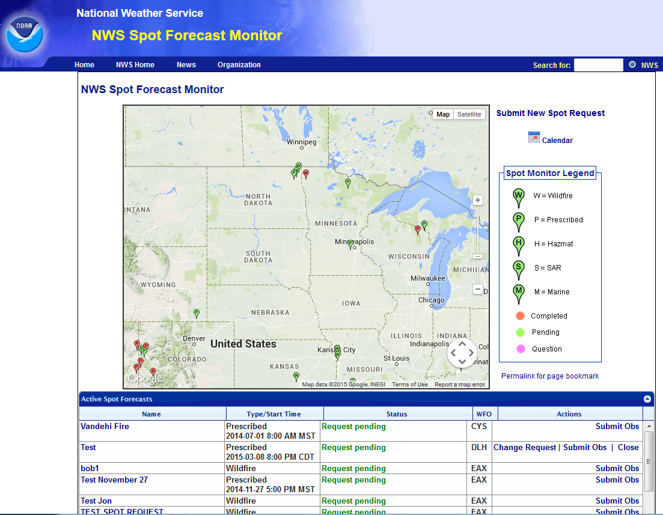
New Spot Page (Coming Soon)
http://www.weather.gov/spotnws/

Slide 32
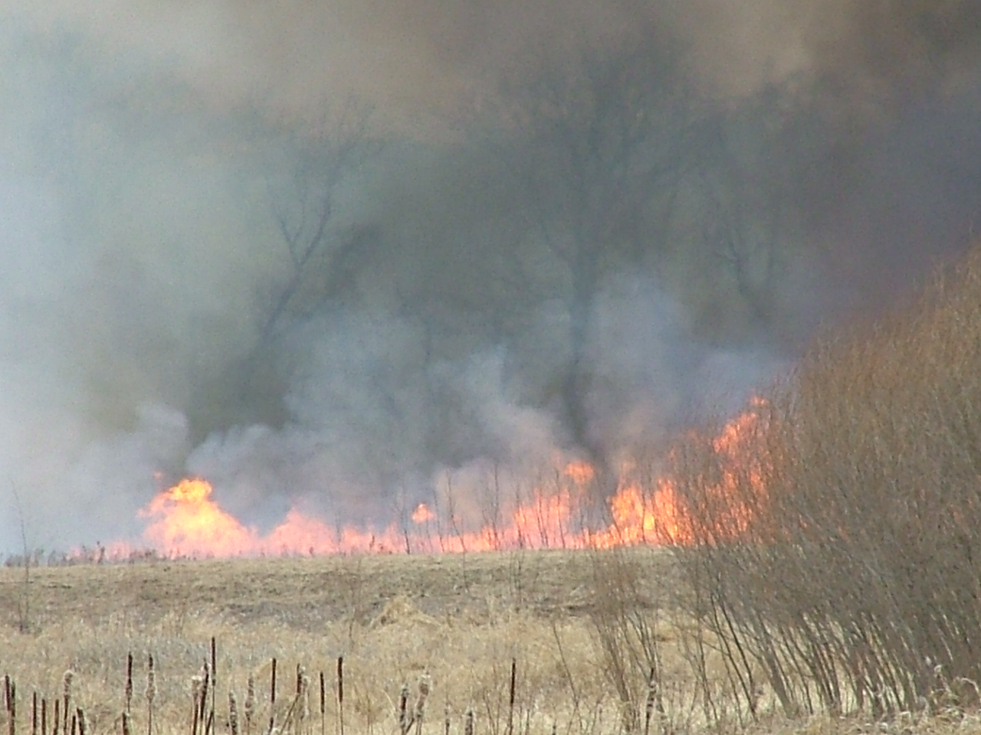

New Spot Page (Coming Soon)
Training Video
Available (8 min)
Lots of great new features with the new SPOT site!
YouTube Channel
https://www.youtube.com/user/NWSDuluth

Slide 33
Thank You
Questions?
Contact information: john.wetenkamp@noaa.gov

